Slide 1
High Gradient Laser Plasma Accelerating Structure WP3: LPI discussion
B. Cros, 19th June 2017

Slide 2
Questions for discussion
Is there anything missing from this review? Are there experimental results we should be aware of?
General suggestions or comments?
What are the ways we should explore to improve parameters?
Final proposal for injector design, define necessary contributions

Slide 3
Main conclusions of report MS3.1
Gas cells as stable media for LPI
Waveguides for LPAS: channel-GICT can be used
Laser quality and stability essential for reliable operation
Efforts on plasma (density) stabilisation required: more experimental data necessary
LPI: combination of schemes (III and density gradient) for control of electron bunch
Acceleration of externally injected electrons: more experimental data necessary

Slide 4
Laser Plasma injector session
Tomorrow Tuesday 20th, 10:30-11:15
These preliminary conclusions will be discussed, as well as future actions before the final proposal for LP injector design

Slide 5
Next steps for WP3
In the 2 next tasks of WP3 (MS reports in October 2017):
  pre-selected schemes will be analyzed in detail for experimental implementation in the beamline
  diagnostics (plasma, accel field, electrons, laser)
Topics to discuss with other WP at the collaboration week:
  Simulations for selected schemes (WP2)
  Laser parameters, quality and stability (WP4, WP2)
  Electron coupling and diagnostics (WP5, WP2)
  Plasma development and compatibility (WP4,WP9, WP14

Slide 6
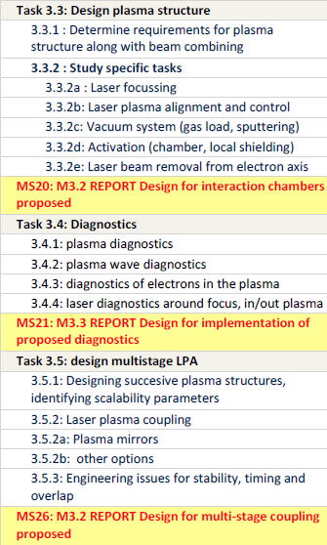

Next WP3 tasks
MS20: end October 2017
MS21: end October 2017
MS26: end July 2018
End October 2018

Slide 7
Active contributions are needed for these tasks
In Pisa we have identified a list of contributors
For the first report, only a few of them have effectively contributed
Active participation and contributions are needed urgently to prepare next October reports (otherwise light, incomplete or delayed reports are foreseen)

Slide 8
Agenda WP3 meetings 1/2
Wednesday 21st June 14:00 -15:30 : WP3 meeting
Discussion on the constraints defining the general implementation
  Type and length of plasma for each stage
  Laser beam focusing and coupling (input/output) for each stage
  Electron beam focusing and coupling for each stage
  Plasma chamber characteristics
Discussion with WP9 on plasma source development for PWFA (M Ferrario, J Osteroff)
Wednesday 21st June 16:00-18:00 : WP3-WP5 joint meeting
Electron diagnostics
  1600 (20mn) Diagnostics conceptual design of EuPRAXIA-like machine (A. Cianchi, Roma2)
  1620 (20mn) 6D characterization of witness beam before injection (B. Marchetti, DESY)
  1640 (20mn) Beam Diagnostics for Plasma Accelerators (J. Wolfenden , CI)
  Discussion on plasma-based devices for e-beam diagnostics
  1700 (15mn) WP14: Challenges in diagnostics of ultrahigh 6d-brightness and laser insertion/removal (B. Hidding, U. Strathclyde)
Compatibility with plasma implementation
Plasma source (LWFA or PWFA) and diagnostics
Radiation diagnostics

Slide 9
Agenda WP3 meetings 2/2
Thursday 22nd June 9:00-10:30 : WP2-WP3-WP4 joint meeting: specs tolerance
Discussion on laser requirements and specifications :
pulse duration, need of pulse trains option in the laser
laser beam quality at focus and coupling to plasma
energy requirements for injector/accelerator
Thursday 22nd June 11:00-12:30 :WP3-WP4 joint meeting : Implementation
Diagnostics implementation
Laser focusing and diagnostics before interaction
Laser plasma alignment and control
Vacuum system (gas load, sputtering)
Activation (chamber, local shielding)
Laser beam removal from electron axis and diagnostics after interaction
Thursday 22nd June 16:30-18:00 : WP3 meeting conclusions
  Summary of discussions: preparation of Friday report/output
  Organization of contributions for future reports

