Slide 1
6th Steering Meeting
R. Assmann, R. Mundt, 20. June 2017

Slide 2
Agenda
Session: Welcome and Approval of Agenda
Time and Place: Building 1, SR 1 / Convener: Ralph Wolfgang Assmann
Session: Approval of minutes from 5th Steering Meeting
Time and Place: Building 1, SR 1 / Convener: Ralph Wolfgang Assmann
Session: Action Items of 5th Steering Meeting
Time and Place: Building 1, SR 1 / WebEx(16:25-16:35) Convener: Ralph Wolfgang Assmann
Session: Reporting Milestones and Deliverables
Time and Place: Building 1, SR 1 / WebEx(16:35-17:00)
Session: Discussion Calendar Management 2017
Time and Place: Building 1, SR 1 / WebEx(17:00-17:05) Convener: Ruth Mundt
Session: Liverpool Symposium in 2018
Time and Place: Building 1, SR 1/ WebEx (17:05-17:15) Convener: Ricardo Torres
Session: Update on LEAPS
Time and Place: Building 1, SR 1/ WebEx (17:15-17:25) Convener: Ralph Wolfgang Assmann
Session: AOB
Time and Place: Building 1, SR 1 / Convener: Ralph Wolfgang Assmann
Adjourn

Slide 3
Agenda
Session: Welcome and Approval of Agenda
Time and Place: Building 1, SR 1 / Convener: Ralph Wolfgang Assmann
Session: Approval of minutes from 5th Steering Meeting
Time and Place: Building 1, SR 1 / Convener: Ralph Wolfgang Assmann
Session: Action Items of 5th Steering Meeting
Time and Place: Building 1, SR 1 / WebEx(16:25-16:35) Convener: Ralph Wolfgang Assmann
Session: Reporting Milestones and Deliverables
Time and Place: Building 1, SR 1 / WebEx(16:35-17:00)
Session: Discussion Calendar Management 2017
Time and Place: Building 1, SR 1 / WebEx(17:00-17:05) Convener: Ruth Mundt
Session: Liverpool Symposium in 2018
Time and Place: Building 1, SR 1/ WebEx (17:05-17:15) Convener: Ricardo Torres
Session: Update on LEAPS
Time and Place: Building 1, SR 1/ WebEx (17:15-17:25) Convener: Ralph Wolfgang Assmann
Session: AOB
Time and Place: Building 1, SR 1 / Convener: Ralph Wolfgang Assmann
Adjourn

Slide 4
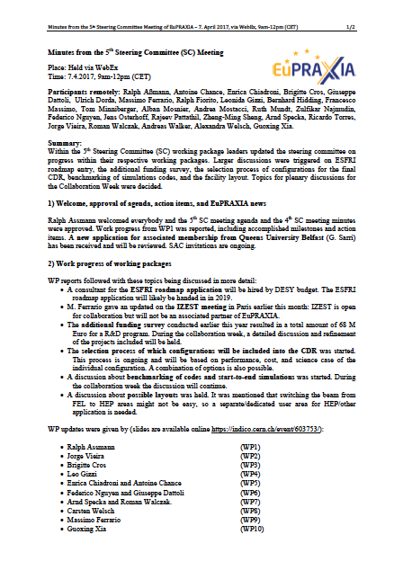
Minutes

Slide 5
Agenda
Session: Welcome and Approval of Agenda
Time and Place: Building 1, SR 1 / Convener: Ralph Wolfgang Assmann
Session: Approval of minutes from 5th Steering Meeting
Time and Place: Building 1, SR 1 / Convener: Ralph Wolfgang Assmann
Session: Action Items of 5th Steering Meeting
Time and Place: Building 1, SR 1 / WebEx(16:25-16:35) Convener: Ralph Wolfgang Assmann
Session: Reporting Milestones and Deliverables
Time and Place: Building 1, SR 1 / WebEx(16:35-17:00)
Session: Discussion Calendar Management 2017
Time and Place: Building 1, SR 1 / WebEx(17:00-17:05) Convener: Ruth Mundt
Session: Liverpool Symposium in 2018
Time and Place: Building 1, SR 1/ WebEx (17:05-17:15) Convener: Ricardo Torres
Session: Update on LEAPS
Time and Place: Building 1, SR 1/ WebEx (17:15-17:25) Convener: Ralph Wolfgang Assmann
Session: AOB
Time and Place: Building 1, SR 1 / Convener: Ralph Wolfgang Assmann
Adjourn

Slide 6
Action Items
The following action items on general issues were agreed:
Prepare discussion about start-to-end simulations/benchmarking of codes for collaboration week (action J. Vieira & A. Mosnier).
Distribute summary information about possible facility access parameters to all SC members for comments in early June. This document will be used for Collaboration Week discussion (action R. Pattathil).
All WP leaders can send request for experiments and facility access to R. Pattathil (action all).
Please let us know if your institution would like to host the 2nd EuPRAXIA week in November 2017 (action all).
Sent around summary document with all Deliverable and Milestone reports to members before collaboration week. (action R. Mundt).
Follow up with Crockcroft Institute and check if they want to continue participanting within WP5 (action A. Walker).
Define procedure for new associated partner (action DESY).

Slide 7
Agenda
Session: Welcome and Approval of Agenda
Time and Place: Building 1, SR 1 / Convener: Ralph Wolfgang Assmann
Session: Approval of minutes from 5th Steering Meeting
Time and Place: Building 1, SR 1 / Convener: Ralph Wolfgang Assmann
Session: Action Items of 5th Steering Meeting
Time and Place: Building 1, SR 1 / WebEx(16:25-16:35) Convener: Ralph Wolfgang Assmann
Session: Reporting Milestones and Deliverables
Time and Place: Building 1, SR 1 / WebEx(16:35-17:00)
Session: Discussion Calendar Management 2017
Time and Place: Building 1, SR 1 / WebEx(17:00-17:05) Convener: Ruth Mundt
Session: Liverpool Symposium in 2018
Time and Place: Building 1, SR 1/ WebEx (17:05-17:15) Convener: Ricardo Torres
Session: Update on LEAPS
Time and Place: Building 1, SR 1/ WebEx (17:15-17:25) Convener: Ralph Wolfgang Assmann
Session: AOB
Time and Place: Building 1, SR 1 / Convener: Ralph Wolfgang Assmann
Adjourn

Slide 8
18 month report
Due essentially now.
Finalizing it.
Input to Tom... All there?

Slide 9
Milestone-Reports 2017
12 | M2.2 Report defining tolerance | CEA | 18 | 30.04.2017 | x | x
13 | M2.3 Simulation tools and theory set up | CEA | 18 | 30.04.2017 | x | x
14 | M3.1 Design for an electron injector and a laser plasma stage proposed | CNRS | 18 | 30.04.2017 | x | x
15 | M4.2 Preliminary laser requirements table and tech survey | CNR | 18 | 30.04.2017 | x | x
16 | M7.2 Users workshop | CNRS | 18 | 30.04.2017 | x | x
17 | M6.3 Models and scaling laws for Plasma FEL dynamics | SOLEIL | 20 | 30.06.2017 | x | x
18 | M2.4 Preliminary simulations set up | CEA | 24 | 31.10.2017
19 | M5.3 Specification of the transfer line from the RF-injector to the plasma | INFN | 24 | 31.10.2017
20 | M3.2 Design for interaction chambers proposed | CNRS | 24 | 31.10.2017
21 | M3.3 Design for implementation of diagnostics proposed | CNRS | 24 | 31.10.2017
22 | M8.2 Decision for top 3 science / outreach stories | ULIV | 24 | 31.10.2017

Slide 10
Deliverable-Reports 2017
WP No | Del No | EU No | Title | Lead Benef. | Month | Est. Del. Date | requested | received
WP8 | D8.3 | 8 | Project initial brochure | ULIV | 15 | 31.01.2017 | x | x
WP10 | D10.1 |  | Tests are performed to extract an ultra-cold electron bunch from an alternating current magneto-optical trap | DESY | 17 | 31.03.2017 | x | x
WP2 | D2.1 | 9 | Report defining baseline design | CEA | 18 | 30.04.2017 | x | x
WP7 | D7.2 | 10 | Application survey assessment | CNRS | 18 | 30.04.2017 | x | x
WP14 | D14.1 |  | Design of an optimized plasma ionization module | USTRATH | 18 | 30.04.2017 | x | x
WP4 | D4.2 | 11 | Preliminary laser design | CNR | 24 | 31.10.2017
WP4 | D4.3 | 12 | Preliminary design of transverse functions | CNR | 24 | 31.10.2017
WP6 | D6.2 | 13 | Models, scaling laws Plasma FEL dynamics | SOLEIL | 24 | 31.10.2017
WP6 | D6.3 | 14 | Diagnostic requirements and technical approaches | SOLEIL | 24 | 31.10.2017
WP12 | D12.2 |  | Programm for tests including schedules and teams | STFC | 24 | 31.10.2017

Slide 11
Half Term Review
Will take place in Brussels in October 2017.
Reviewer is Rasmus Ischebeck.
Small group only can go there.
Proposal:
  R. Assmann (coordinator)
  T. Minniberger or Ute Krell (coordinator admin)
  R. Mundt (coordinator admin)
  A. Specka (deputy coordinator)
  M. Ferrario (chair collaboration board)
  C. Welsch (WP leader – coordination)
  B. Cros (WP leader)
  E. Chiadroni (WP leader)

Slide 12
Agenda
Session: Welcome and Approval of Agenda
Time and Place: Building 1, SR 1 / Convener: Ralph Wolfgang Assmann
Session: Approval of minutes from 5th Steering Meeting
Time and Place: Building 1, SR 1 / Convener: Ralph Wolfgang Assmann
Session: Action Items of 5th Steering Meeting
Time and Place: Building 1, SR 1 / WebEx(16:25-16:35) Convener: Ralph Wolfgang Assmann
Session: Reporting Milestones and Deliverables
Time and Place: Building 1, SR 1 / WebEx(16:35-17:00)
Session: Discussion Calendar Management 2017
Time and Place: Building 1, SR 1 / WebEx(17:00-17:05) Convener: Ruth Mundt
Session: Liverpool Symposium in 2018
Time and Place: Building 1, SR 1/ WebEx (17:05-17:15) Convener: Ricardo Torres
Session: Update on LEAPS
Time and Place: Building 1, SR 1/ WebEx (17:15-17:25) Convener: Ralph Wolfgang Assmann
Session: AOB
Time and Place: Building 1, SR 1 / Convener: Ralph Wolfgang Assmann
Adjourn

Slide 13
Events 2017

Slide 14
Events 2018

Slide 15
Events 2019

Slide 16
Agenda
Session: Welcome and Approval of Agenda
Time and Place: Building 1, SR 1 / Convener: Ralph Wolfgang Assmann
Session: Approval of minutes from 5th Steering Meeting
Time and Place: Building 1, SR 1 / Convener: Ralph Wolfgang Assmann
Session: Action Items of 5th Steering Meeting
Time and Place: Building 1, SR 1 / WebEx(16:25-16:35) Convener: Ralph Wolfgang Assmann
Session: Reporting Milestones and Deliverables
Time and Place: Building 1, SR 1 / WebEx(16:35-17:00)
Session: Discussion Calendar Management 2017
Time and Place: Building 1, SR 1 / WebEx(17:00-17:05) Convener: Ruth Mundt
Session: Liverpool Symposium in 2018
Time and Place: Building 1, SR 1/ WebEx (17:05-17:15) Convener: Ricardo Torres
Session: Update on LEAPS
Time and Place: Building 1, SR 1/ WebEx (17:15-17:25) Convener: Ralph Wolfgang Assmann
Session: AOB
Time and Place: Building 1, SR 1 / Convener: Ralph Wolfgang Assmann
Adjourn

Slide 17
Agenda
Session: Welcome and Approval of Agenda
Time and Place: Building 1, SR 1 / Convener: Ralph Wolfgang Assmann
Session: Approval of minutes from 5th Steering Meeting
Time and Place: Building 1, SR 1 / Convener: Ralph Wolfgang Assmann
Session: Action Items of 5th Steering Meeting
Time and Place: Building 1, SR 1 / WebEx(16:25-16:35) Convener: Ralph Wolfgang Assmann
Session: Reporting Milestones and Deliverables
Time and Place: Building 1, SR 1 / WebEx(16:35-17:00)
Session: Discussion Calendar Management 2017
Time and Place: Building 1, SR 1 / WebEx(17:00-17:05) Convener: Ruth Mundt
Session: Liverpool Symposium in 2018
Time and Place: Building 1, SR 1/ WebEx (17:05-17:15) Convener: Ricardo Torres
Session: Update on LEAPS
Time and Place: Building 1, SR 1/ WebEx (17:15-17:25) Convener: Ralph Wolfgang Assmann
Session: AOB
Time and Place: Building 1, SR 1 / Convener: Ralph Wolfgang Assmann
Adjourn

Slide 18
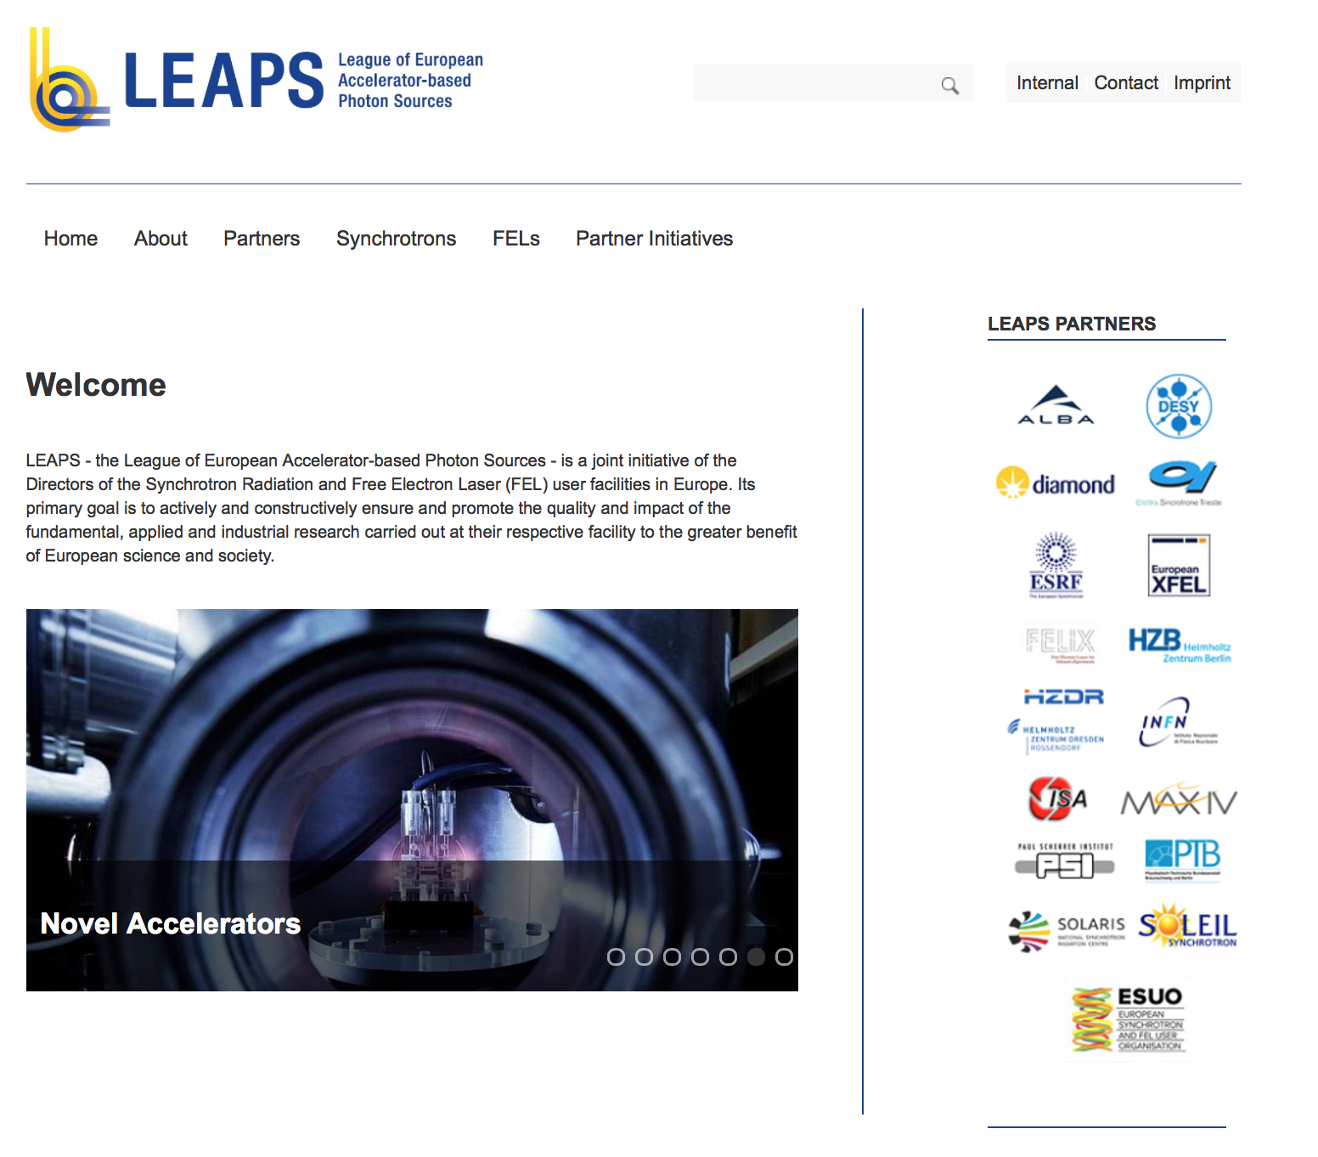
LEAPS Web Site
https://www.leaps-initiative.eu

Slide 19
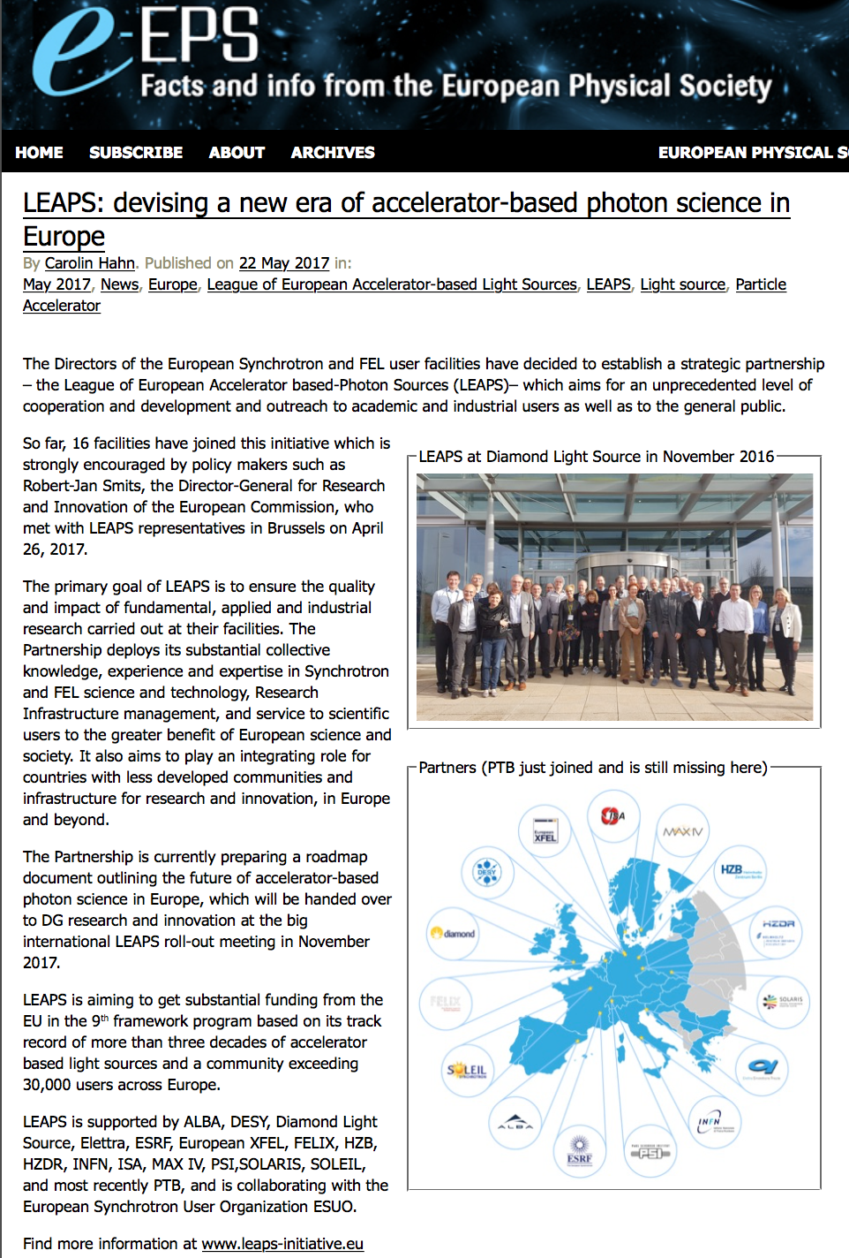
LEAPS
http://www.epsnews.eu/2017/05/leaps-devising-a-new-era-of-accelerator-based-photon-science-in-europe/
LEAPS: devising a new era of accelerator-based photon science in Europe
The Directors of the European Synchrotron and FEL user facilities have decided to establish a strategic partnership – the League of European Accelerator based-Photon Sources (LEAPS)– which aims for an unprecedented level of cooperation and development and outreach to academic and industrial users as well as to the general public.

Slide 20
LEAPS Labs
ALBA
DESY
Diamond Light Source
Elettra
ESRF
European XFEL
FELIX
HZB
HZDR
INFN
ISA
MAX IV
PSI
SOLARIS
SOLEIL
PTB
collaborating with the European Synchrotron User Organization ESUO.

Slide 21
LEAPS and Accelerators
The accelerator domain in WP5 is coordinated by Hans Braun (PSI). Three topics have been defined with topic leaders:
Future compact sources / Ralph Assmann
FEL developments / Thomas Tschentscher and Simone Di Mitri
Storage rings / Andreas Jankowiak
But: most R&D topics discussed are of interest for several topics  ?no easy sorting but combined table

Slide 22
TO DO for LEAPS
Define our proposals in more detail
Will be an appendix in the request for Brussels

Slide 23
Agenda
Session: Welcome and Approval of Agenda
Time and Place: Building 1, SR 1 / Convener: Ralph Wolfgang Assmann
Session: Approval of minutes from 5th Steering Meeting
Time and Place: Building 1, SR 1 / Convener: Ralph Wolfgang Assmann
Session: Action Items of 5th Steering Meeting
Time and Place: Building 1, SR 1 / WebEx(16:25-16:35) Convener: Ralph Wolfgang Assmann
Session: Reporting Milestones and Deliverables
Time and Place: Building 1, SR 1 / WebEx(16:35-17:00)
Session: Discussion Calendar Management 2017
Time and Place: Building 1, SR 1 / WebEx(17:00-17:05) Convener: Ruth Mundt
Session: Liverpool Symposium in 2018
Time and Place: Building 1, SR 1/ WebEx (17:05-17:15) Convener: Ricardo Torres
Session: Update on LEAPS
Time and Place: Building 1, SR 1/ WebEx (17:15-17:25) Convener: Ralph Wolfgang Assmann
Session: AOB
Time and Place: Building 1, SR 1 / Convener: Ralph Wolfgang Assmann
Adjourn

Slide 24
Agenda
Session: Welcome and Approval of Agenda
Time and Place: Building 1, SR 1 / Convener: Ralph Wolfgang Assmann
Session: Approval of minutes from 5th Steering Meeting
Time and Place: Building 1, SR 1 / Convener: Ralph Wolfgang Assmann
Session: Action Items of 5th Steering Meeting
Time and Place: Building 1, SR 1 / WebEx(16:25-16:35) Convener: Ralph Wolfgang Assmann
Session: Reporting Milestones and Deliverables
Time and Place: Building 1, SR 1 / WebEx(16:35-17:00)
Session: Discussion Calendar Management 2017
Time and Place: Building 1, SR 1 / WebEx(17:00-17:05) Convener: Ruth Mundt
Session: Liverpool Symposium in 2018
Time and Place: Building 1, SR 1/ WebEx (17:05-17:15) Convener: Ricardo Torres
Session: Update on LEAPS
Time and Place: Building 1, SR 1/ WebEx (17:15-17:25) Convener: Ralph Wolfgang Assmann
Session: AOB
Time and Place: Building 1, SR 1 / Convener: Ralph Wolfgang Assmann
Adjourn

