Slide 1
6D Characterization of Witness Beam before Injection in LWFA
B. Marchetti
1st EuPRAXIA Collaboration Week
DESY, 19-23 June 2017

Slide 2
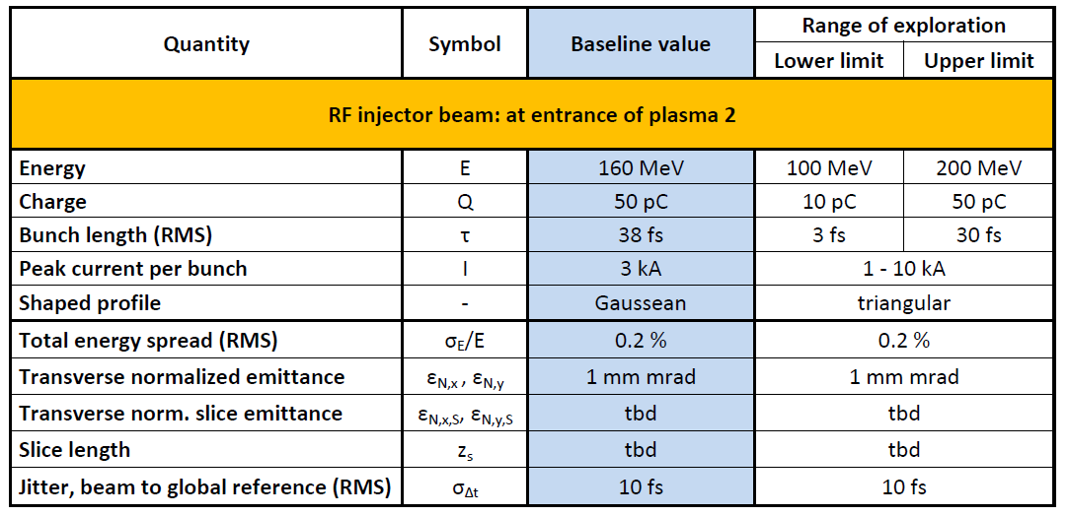
Characteristics of Witness Beams
From EuPRAXIA parameter table LWFA with external injection:
At SINBAD we are investigating the range Q=0.5pC-30pC, especially the limit in the characterization of very low charge and ultra-short e-bunches.

Slide 3
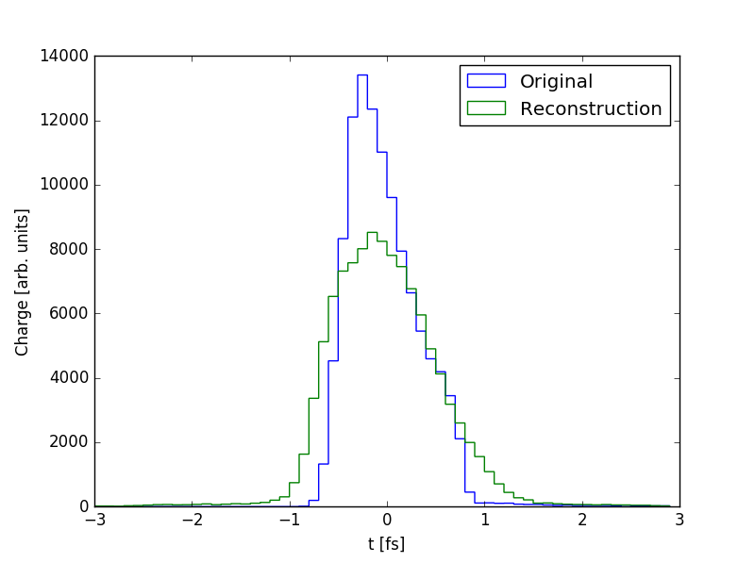
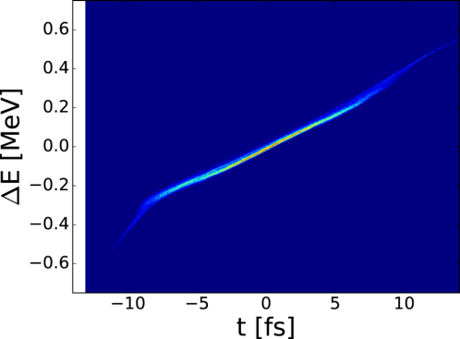
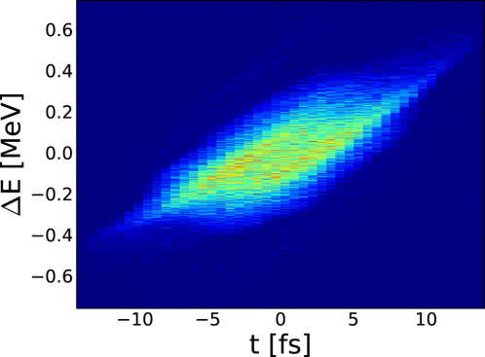
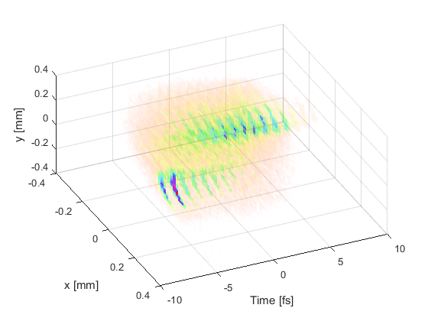
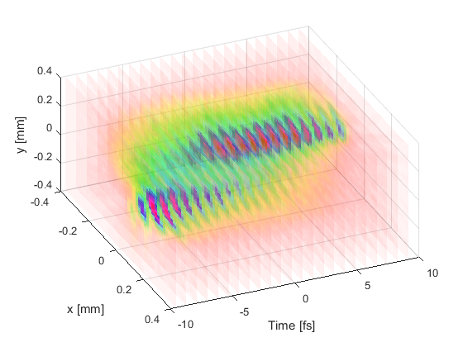
6D e-Beam Characterization includes
Bunch Length and Longitudinal Charge Profile
Longitudinal Phase Space
Slice emittance on different transverse planes
3D Reconstruction of e-Bunch Charge (new technique, relies on novel design of TDS not yet experimentally tested)
original
measured
original
Simulations by D. Marx,
More details in joint WP3-WP5
Meeting Wednesday 16.00-18.00
measured

Slide 4
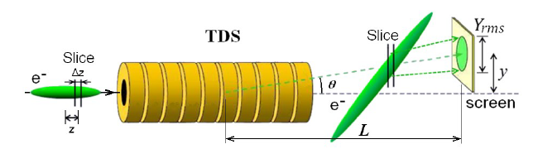

General idea of Lattice Design
RF cavity:
Frequency f = ω/(2π)
Peak deflection voltage V_{y}
Linac
Longitudinal Resolution:
Fig. Credits: D. Malyutin PhD thesis
e-bunch:
Energy E
Vertical emittance ε_{y}
High frequency ~12 GHz (X-band) allows 3-4 times higher resolution than S-band
RF cavity:
Frequency f = ω/(2π)
Peak deflection voltage V_{y}

Slide 5
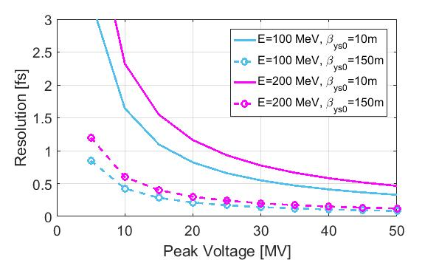
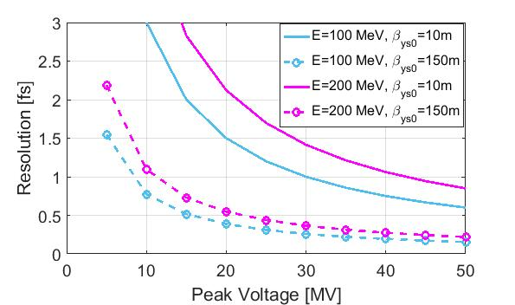
Resolution Range EuPRAXIA case
ε_{n}=0.3mm*mrad
Δφ = π/2
f=12GHz
ε_{n}=1mm*mrad
Δφ = π/2
f=12GHz
Typical β function after bunch compression <30m.
At low energies (100 MeV) the e-beam evolves relatively quickly (the e-bunch properties change along a few m drift or matching lattice).

Slide 6
Technical Issues to be addressed in the WP5 discussion
Resolution & lattice design:
At which energy is/are the diagnostics line/s?
High β - low V option vs low β - high V option
Integration of diagnostics line with focusing to plasma
Limits high voltage TDS operation:
RF Phase jitter
Arrival time beam jitter
Temperature stability of the cavity
Limits high resolution measurement at low charge
Signal to noise ratio on the measurement screen

