Slide 1
Facility Access
Plenary discussion
Coordinators
Rajeev Pattathil - STFC Rutherford Appleton Laboratory
Andrea Mostacci - Sapienza Univ. within SPARC_LAB
1st Collaboration Week, 19-23 June, 2017

Slide 2
Plan for this session
WP12 updates
Inputs required from WP’s- discussion points
Forward plans - Access

Slide 3
WP12 progress in brief
Objectives
Facilitate tests for concepts and prototypes developed in other work packages in various facilities
Survey of the experimental results of the proof-of-principle tests and accelerator prototyping studies
Key Tasks
Gather information regarding potential experimental facilities where tests can be conducted (nearly done)
Describe capabilities of these facilities and access mechanisms (nearly done)
Gather information regarding concepts that need testing/prototyping in consultation with other WP’s (discussion today/tomorrow)
Approaching facilities on behalf of EuPRAXIA regarding the best method for access (discussion today/tomorrow)

Slide 4
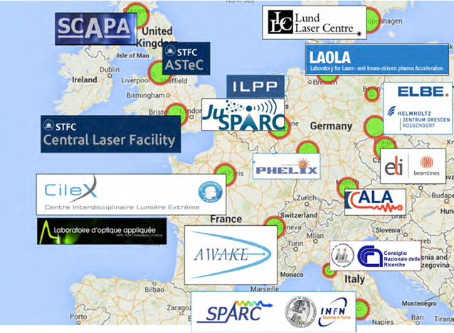
Facilities involved in Eupraxia

Slide 5
Relevant capabilities for prototype testing: LASERS
Germany
50 TW, 200 TW (LUX)
Hybrid Laser-beam-driven PWFA,
Electron bunch injection into LWFA
Plasma target design, Laser-driven light sources
Access: collaboration?
DESY/Hamburg Uni
ATLAS-3000 3PW, PFS few-cycle PW
CALA centre – main focus is on medical applications
Access: collaboration?
MPQ/LMU
POLARIS 17J, 100fs (diode-pumped)
JETI 40 1.5J, 25fs, 10Hz, JETI 200 4J, 17fs Commercial systems
Electron acceleration with few-fs probing
Access: collaboration?
Helmholtz Institute Jena
Helmholtz-Zentrum Dresden-Rossendorf
DRACO Commercial PW system
Main focus is on medical applications
Access: collaboration?

Slide 6
Relevant capabilities for prototype testing: LASERS
France
Cilex, Centre Interdisciplinaire Lumière Extrême
LOA: Access – collaboration? Laserlab
Salle Jaune (3J, 10Hz): gas targets of various kinds
LUIRE PW?
LIDyL-Saclay: Access-collaboration?, Laserlab?
UHI100 - 100TW, 25 fs, 10 Hz
Apollon, LULI (ELFIE): Access – Calls? Collaboration? Laserlab?
ELFIE-20J, 350fs, 1 shot in 20 mins
10PW, 150 J in 15fs at 1 shot per minute (later this year?)
CELIA
Italy
ILIL LAB@CNR-INO, Pisa: 100TW @2Hz, 10TW @ 10Hz, F/3 & F/10 focusing, Access – collaboration
INFN, Frascati (FLAME): 280TW, 10Hz electron acceleration configurations

Slide 7
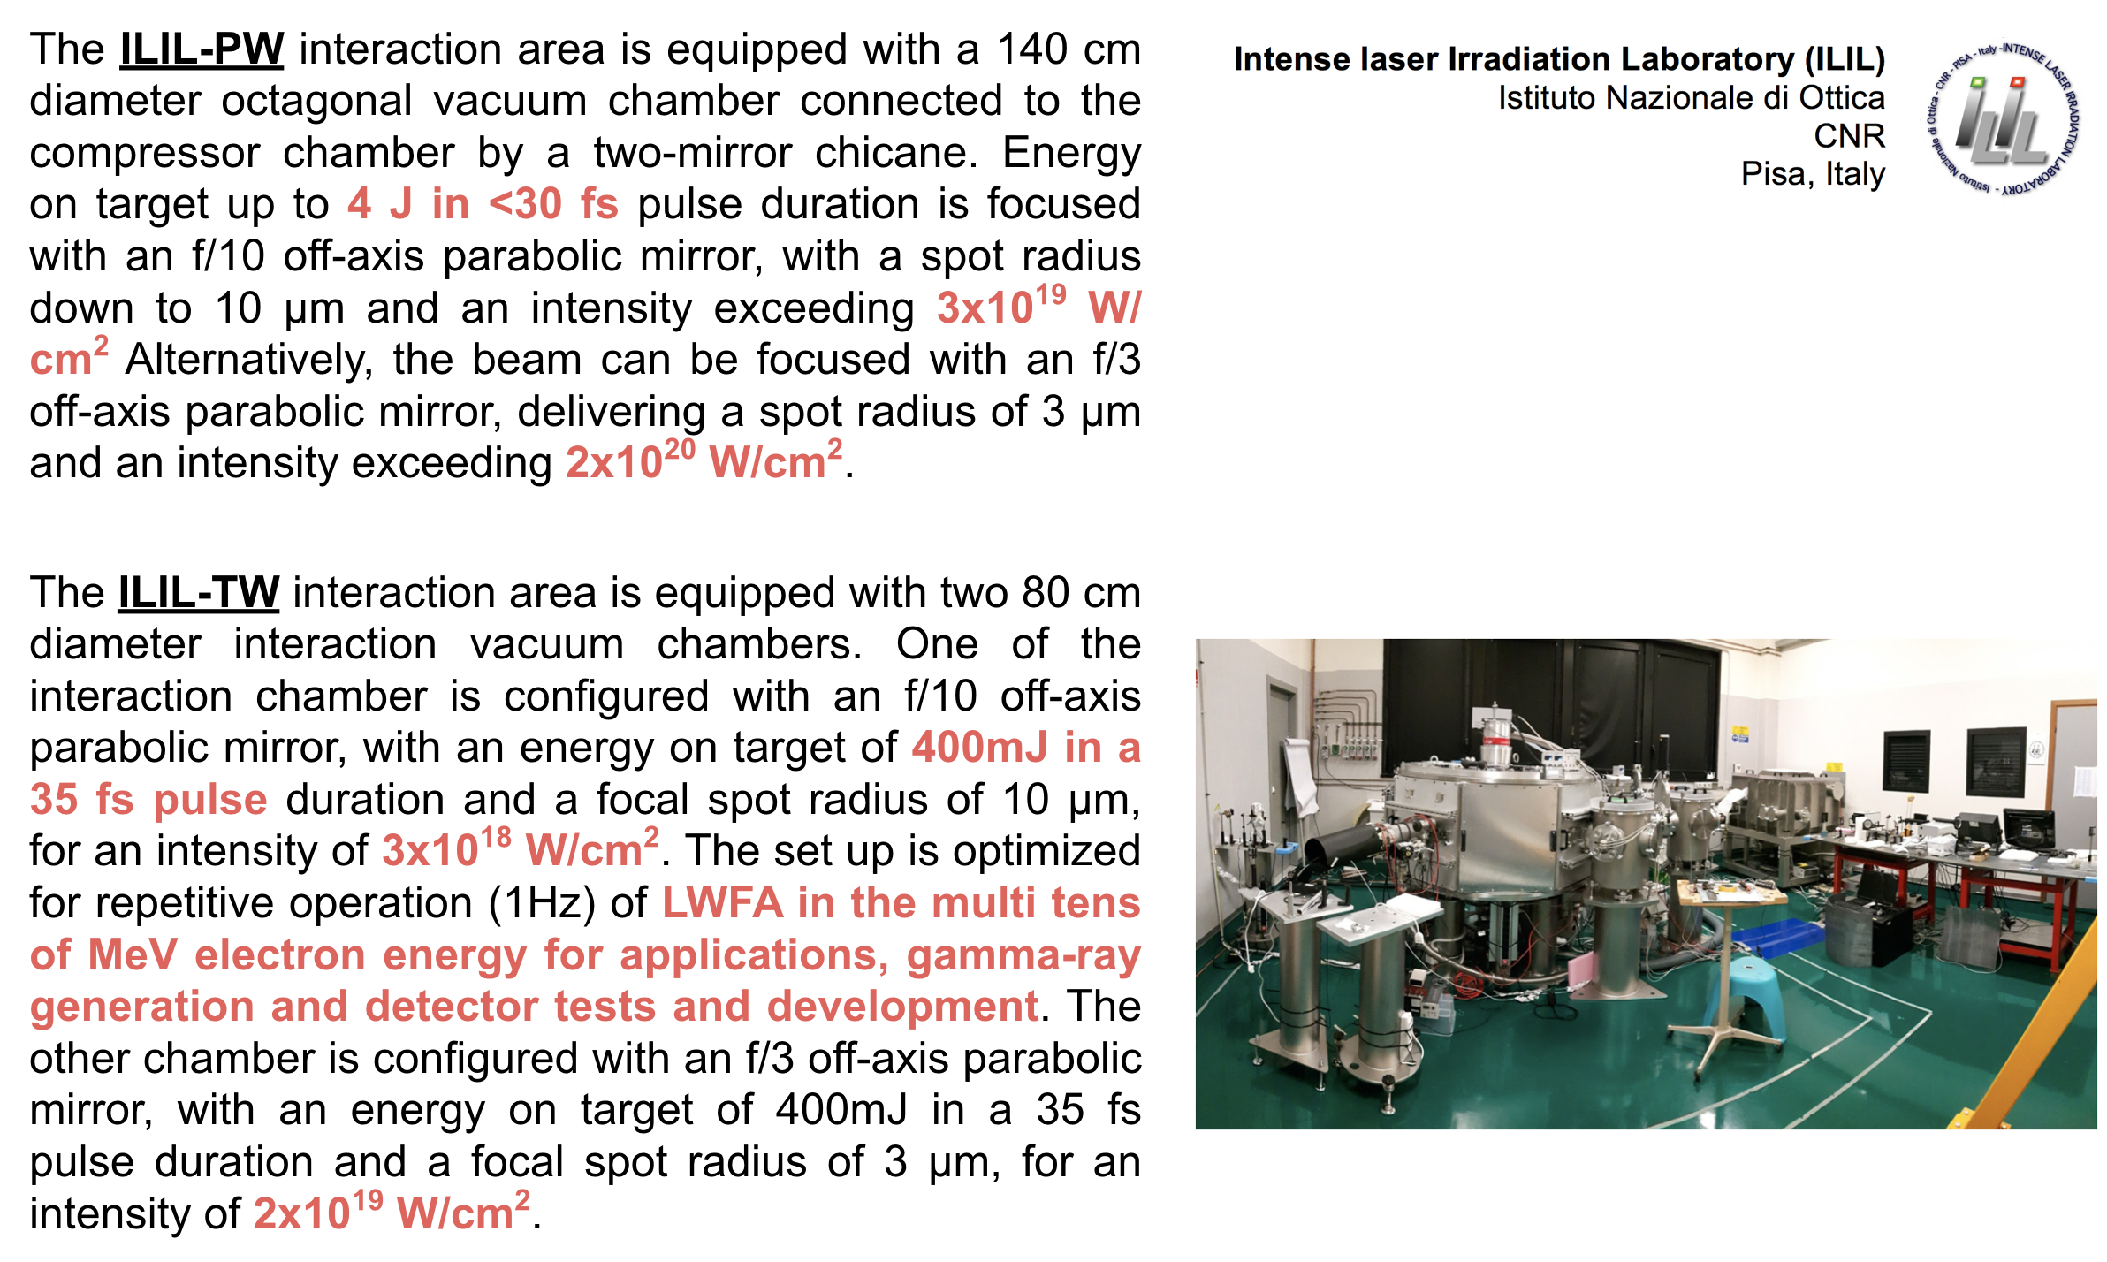
ILIL

Slide 8
Relevant capabilities for prototype testing: LASERS
UK
STFC-RAL: Access - Calls & FAP, Laserlab, programmatic slots to be defined
Gemini: 2 x 0.5 PW beams at 1 pulse in 20 seconds, gas targets of various kinds, F/40 focusing, capability of staging, betatron imaging,
Astra: 20 TW, 5Hz, 10fs probe, off-harmonic probe, tested feedback control at 5Hz,
gas targets of various kinds, f/15 focusing
SCAPA: Access – collaboration, Laserlab -TBD
350TW (8.75 J, 25 fs, 5Hz) laser commissioned, experimental areas under commissioning, 40 TW (1.4 J, 35 fs, 10 Hz
Electron beam transport, imaging, …
Smaller-scale, TW-class systems: Imperial, Oxford, Daresbury...
Sweden
Lund Laser Centre: Access – collaboration?, Laserlab,
10 Hz 35 fs, 40 TW laser

Slide 9
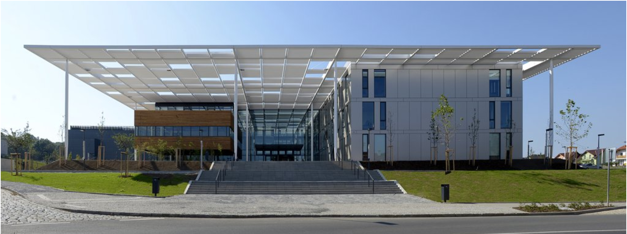
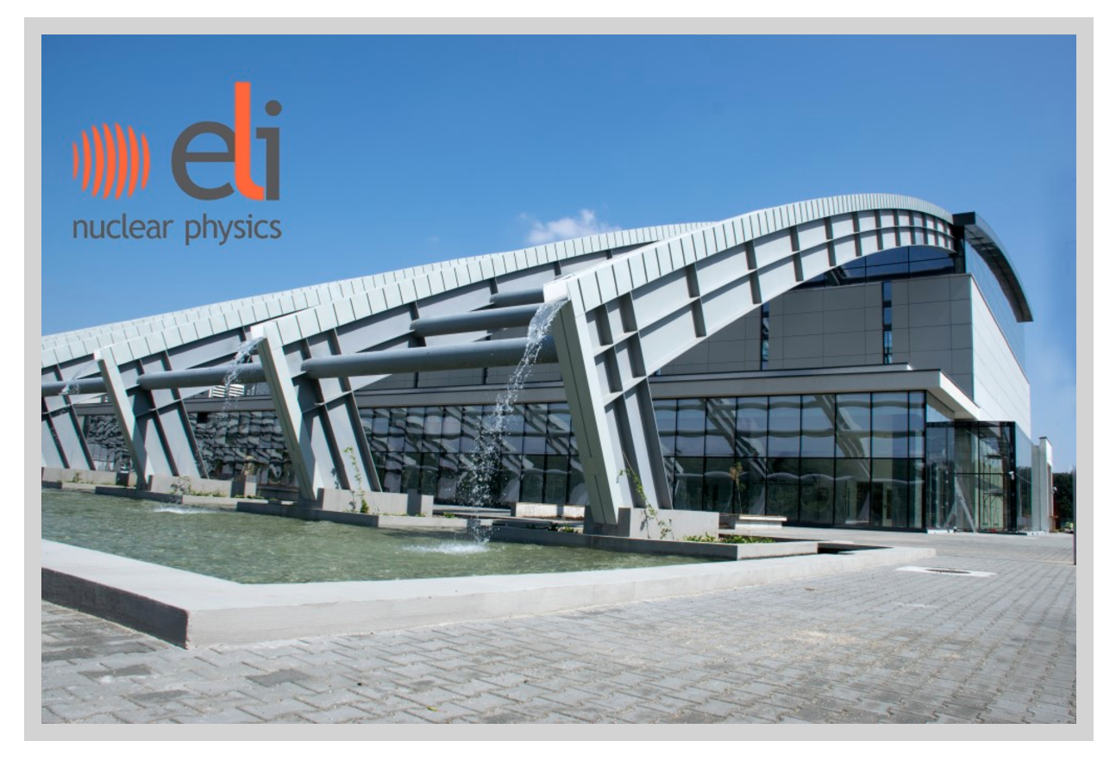

Future laser facilities for testing?
ELI-Beamlines (Prague)
1PW, 10Hz beamlines
10 PW beamline
ELI – Romania
10PW beamlines
CILEX
Will they be online in time?

Slide 10
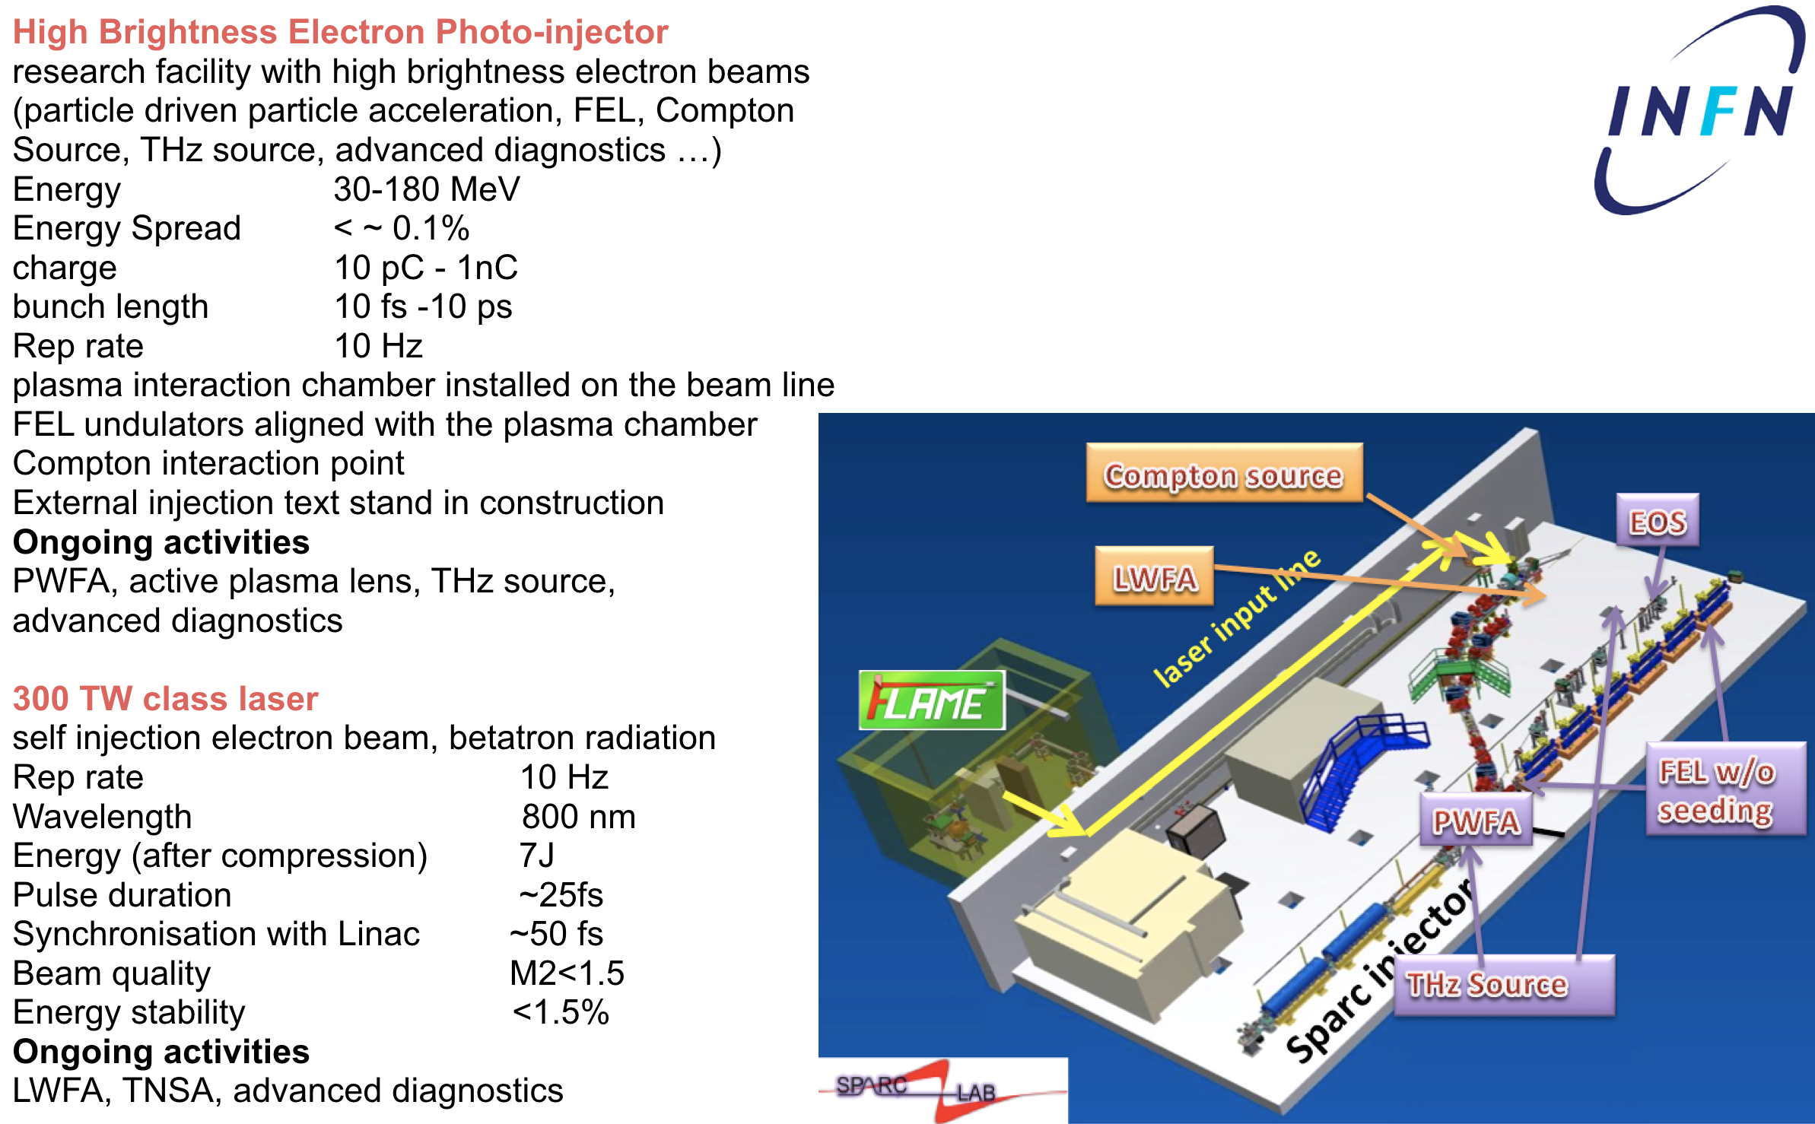
Laser + Accelerator facilities
Access: collaboration

Slide 11
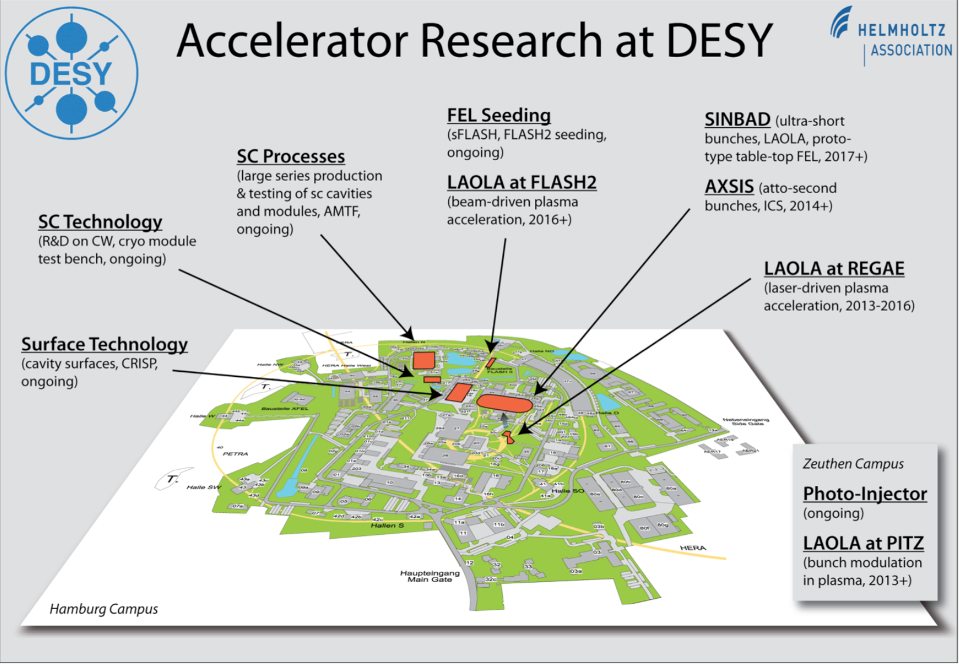
Laser + Accelerator facilities
LAOLA, the Laboratory for Laser- and beam-driven plasma Acceleration is a collaboration between groups from Desy and University of Hamburg
SINBAD (Short INnovative Bunches and Accelerators at DESY)
2019 first beam available for future experiments
design parameters
Energy 100 MeV
Charge 0.5 - 20 pC
Bunch length sub-fs to few fs
Electron Time arrival jitter < 10fs rms
Rep rate 10-50 Hz
Flash-Forward
Goal parameters
Energy 1.25 GeV
Energy Spread ~0.1%
Emittance 2 μm
Bunch length 10-500fs
Rep rate 10 Hz
Laser-to-beam synchronisation ~30 fs rms

Slide 12
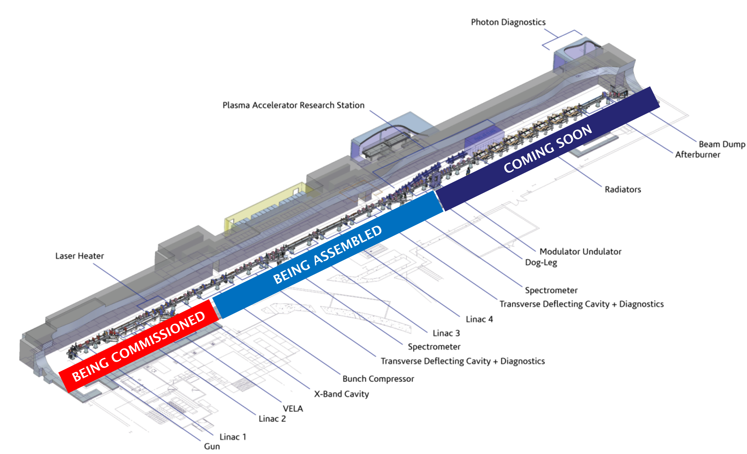
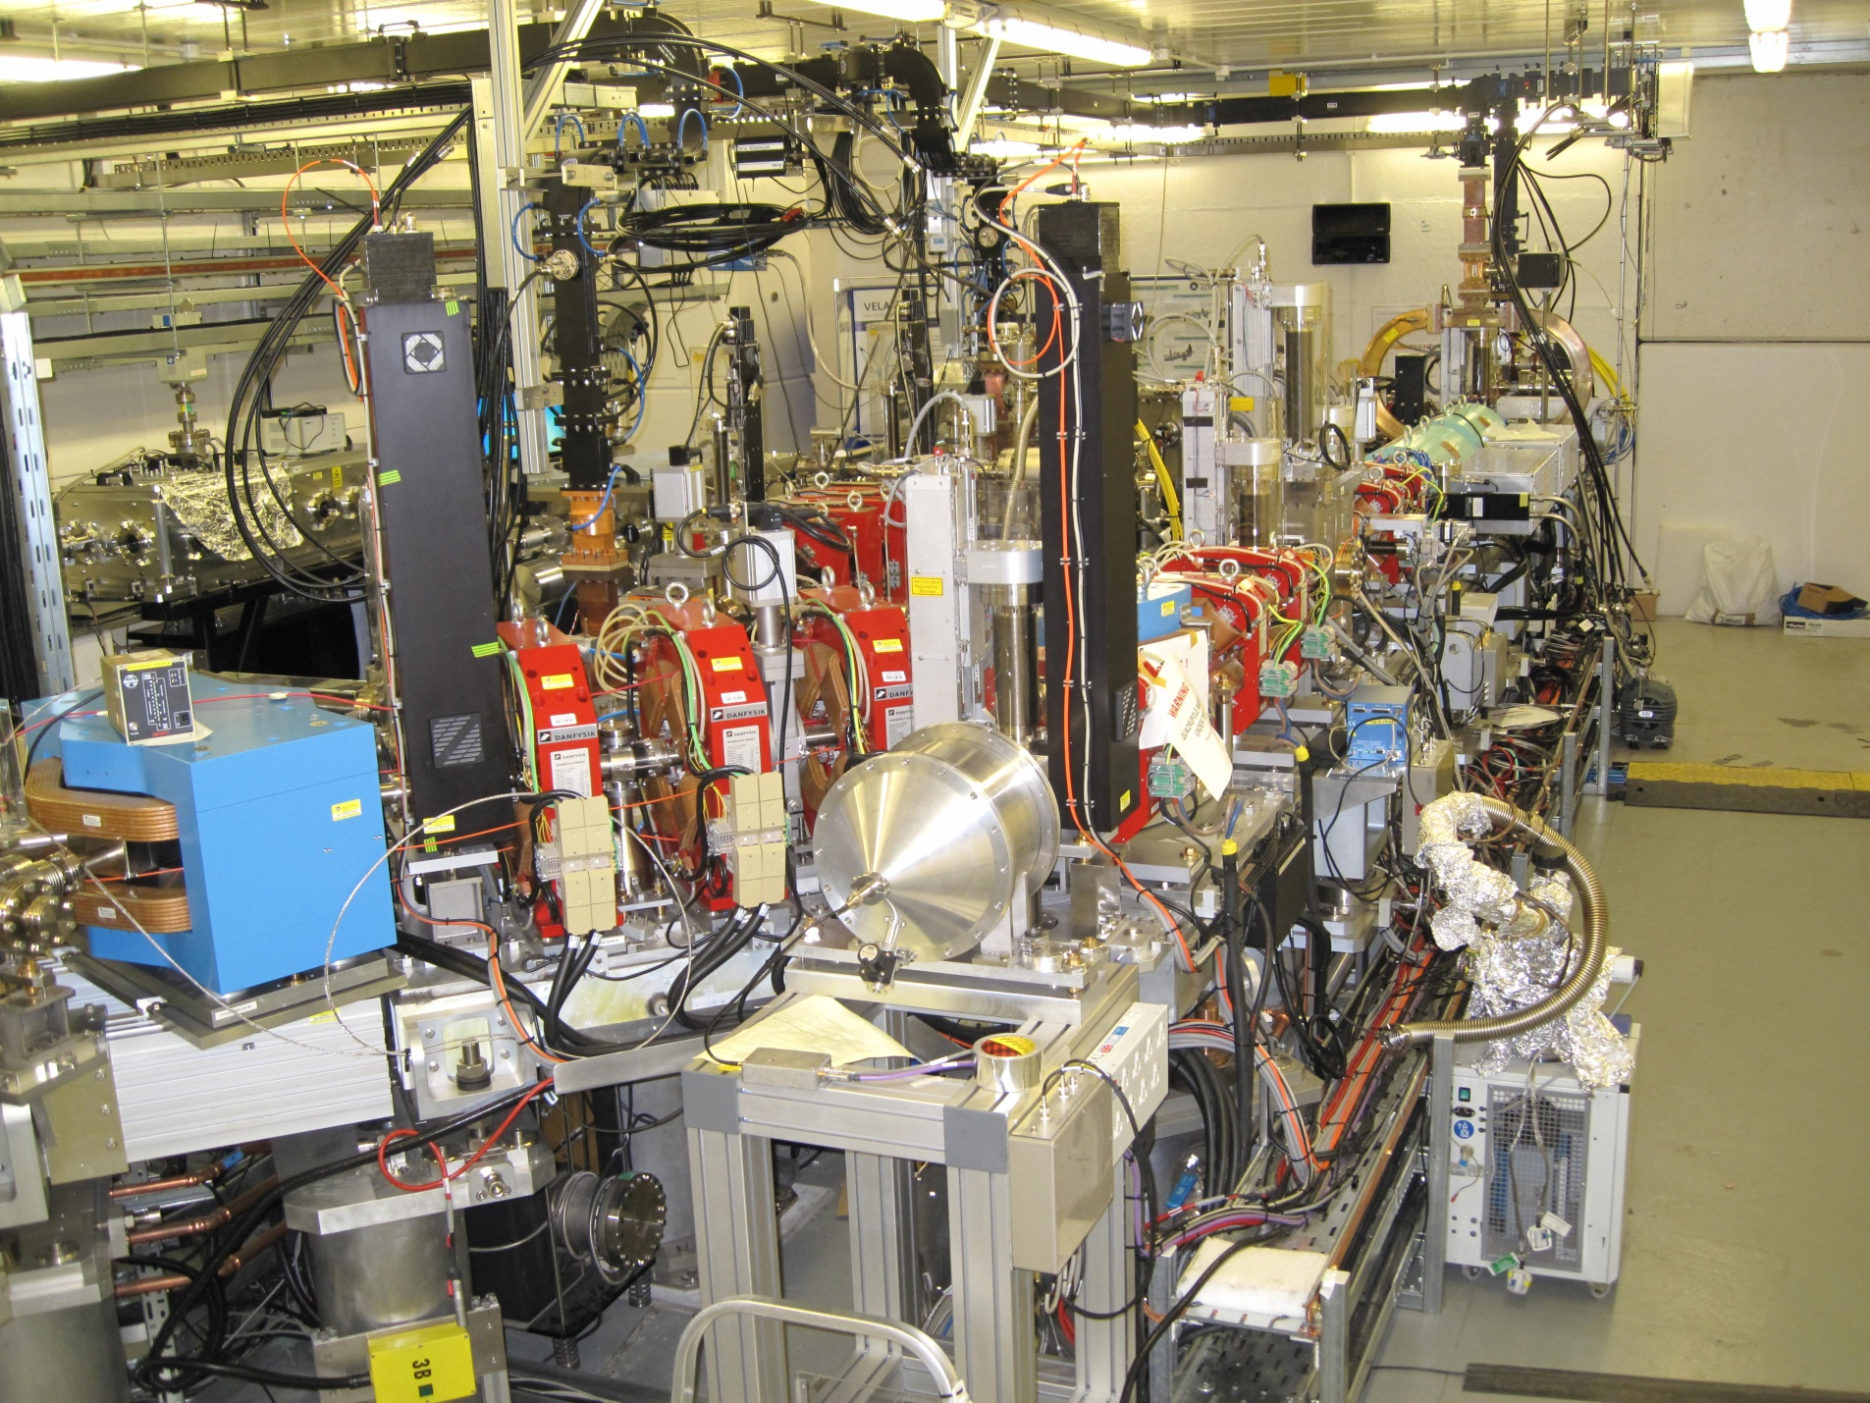

Accelerator facilities
CLARA is a purpose built dedicated flexible FEL Test Facility
A scaled down version of an X-ray FEL containing all of the key technical components, where all lessons learnt can be directly applied to any future UK XFEL.

Slide 13
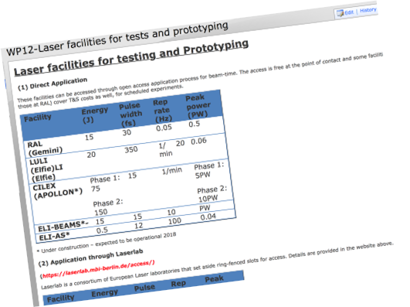
Facility information on vocal
vocal-external.liv.ac.uk/sites/eupraxia

Slide 14
List of the available facilities
Facility | Contact name | Contact email
STFC-RAL (Gemini)) | Dan Symes | dan.symes@stfc.ac.uk
LULI (Elfie)LI (Elfie) | Arnd Specka | specka@llr.in2p3.fr
HI-JENA (JETI) | Matt Zepf | m.zepf@uni-jena.de
LLC-LUND | Claes-Göran Wahlström | claes-goran.wahlstrom@fysik.lth.se
LOA | Victor Malka | victor.Malka@ensta.fr
SLIC | Pascal d'Oliveira | pascal.doliveira@cea.fr
CELIA | Stéphane Petit | stephane.petit@celia.u-bordeaux.fr
SCAPA | Mark Wiggins | mark.wiggins@strath.ac.uk
Oxford University | Simon Hooker | Simon.Hooker@physics.ox.ac.uk
Imperial College London | Zulfikar Najmudin | z.najmudin@imperial.ac.uk
ILIL Pisa | Leo Gizzi | la.gizzi@ino.it
LMU/MPQ | Stefan Karsch | stefan.karsch@mpq.mpg.de
HZDR Dresden | Ulrich Schramm | u.schramm@hzdr.de
LUX | Andreas Maier | andreas.maier@desy.de
SPARC_LAB | Massimo Ferrario | massimo.Ferrario@lnf.infn.it
Clara - Vela | Jim Clarke | jim.clarke@stfc.ac.uk
vocal-external.liv.ac.uk/sites/eupraxia

Slide 15
Test requirements
Please send us requirements
      Slice energy spread of plasma accelerated beam (~3fs slice for 1nm radiation)
      Schemes for selected issues (e.g. driver removal, resonant multiple laser pulses)
      Plasma based beam dump
  Switching options for driver and witness at low energy, preserving beam qualities.
  Compact advanced diagnostics
  Stability of different schemes for plasma injectors (pointing stability of laser, plasma oscillations)
  High charge (higher than few tens of pC) in Plasma Injectors
  Synchronization for external injections
  Advanced devices (e.g. de-chirper)
  Feedback control (pointing, temporal, phase..)

Slide 16



Access to facilities
STFC-RAL
LULI
STFC-DL
HI-JENA
LLC-LUND
LOA
SLIC
CELIA
SCAPA
ICL
OXF
QUB
CNR-PISA
SPARC_LAB (INFN)
LUX
MPQ
HZDR-DRESDEN
Problem
The experiments useful for Eupraxia may not be eligible

Slide 17
Access-discussion
Brainstorming on concepts need testing
How to approach facilities?
Proposals – will they get through panel?
How to have ring-fenced slots?
Access fee? Consumables? T&S?

