Slide 1
WP12 Accelerator Prototyping and Experiments at Test Facilities
R. Pattathil - STFC Rutherford Appleton Laboratory
Mostacci - Sapienza Univ. within SPARC_LAB
D. Symes - STFC Rutherford Appleton Laboratory
1st Collaboration Week, 19-23 June, 2017

Slide 2
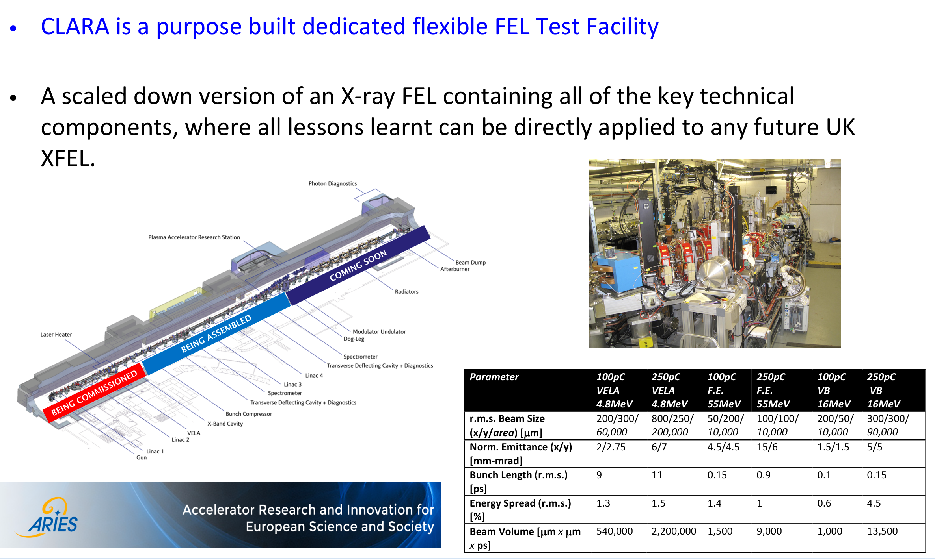
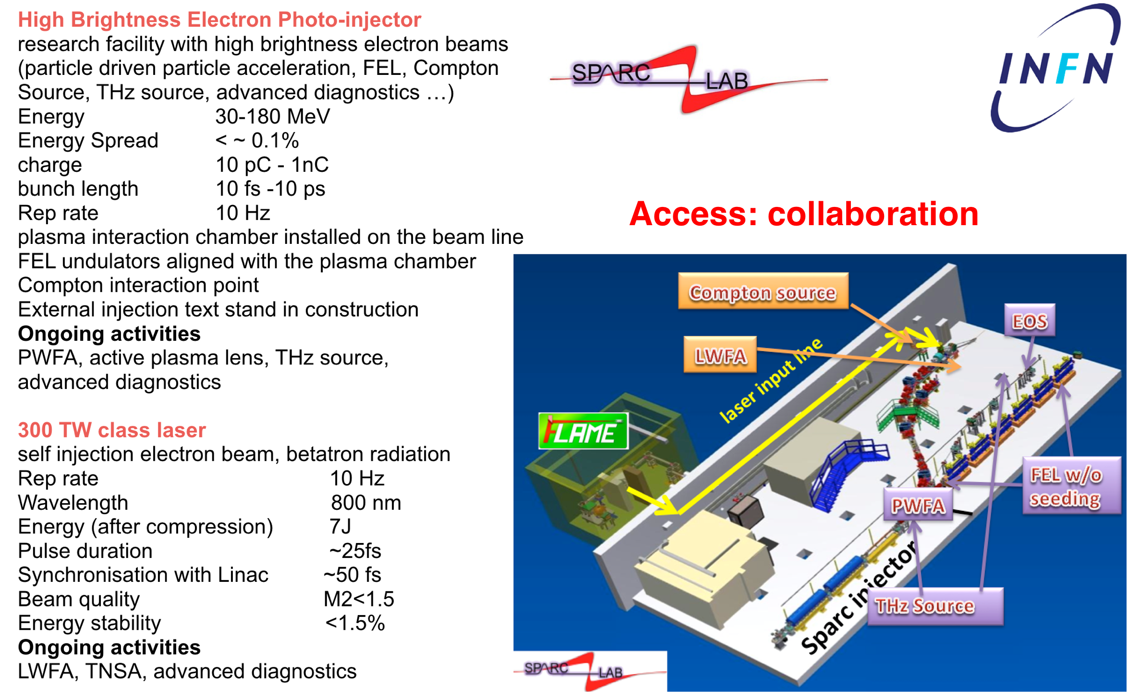
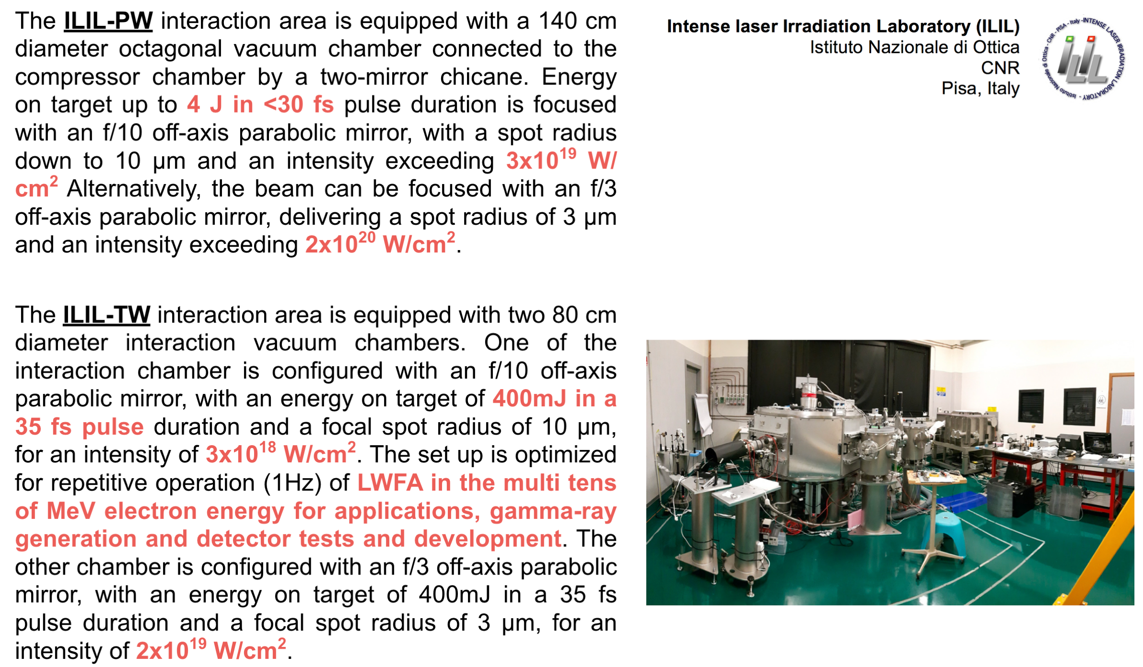

Facilities on web site
vocal-external.liv.ac.uk/sites/eupraxia
Please review or
send information in the website

Slide 3
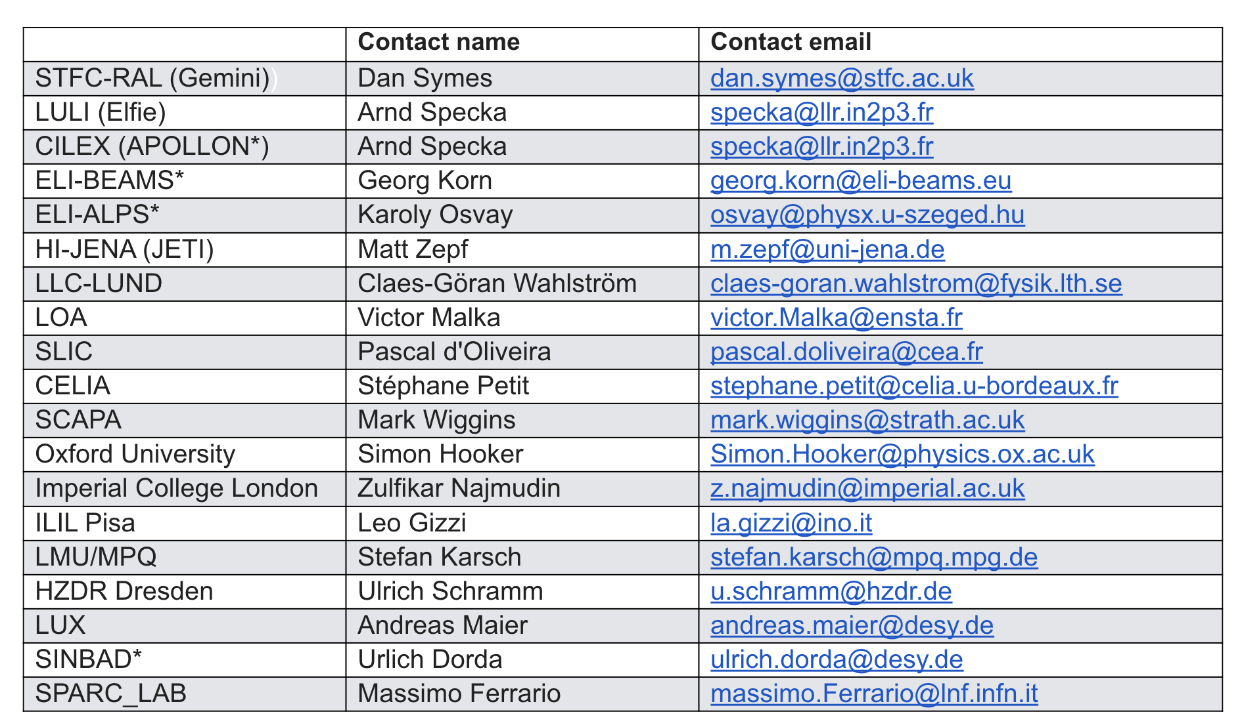
List of the available facilities
vocal-external.liv.ac.uk/sites/eupraxia

Slide 4
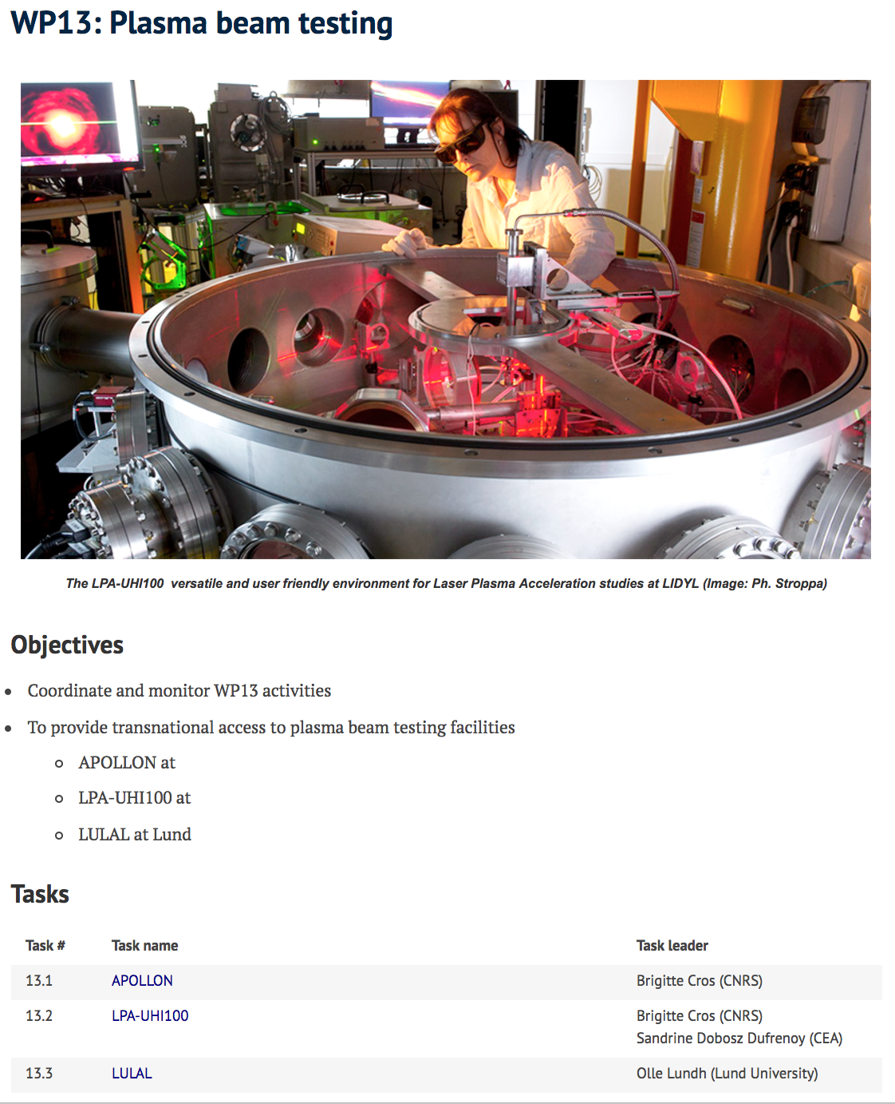
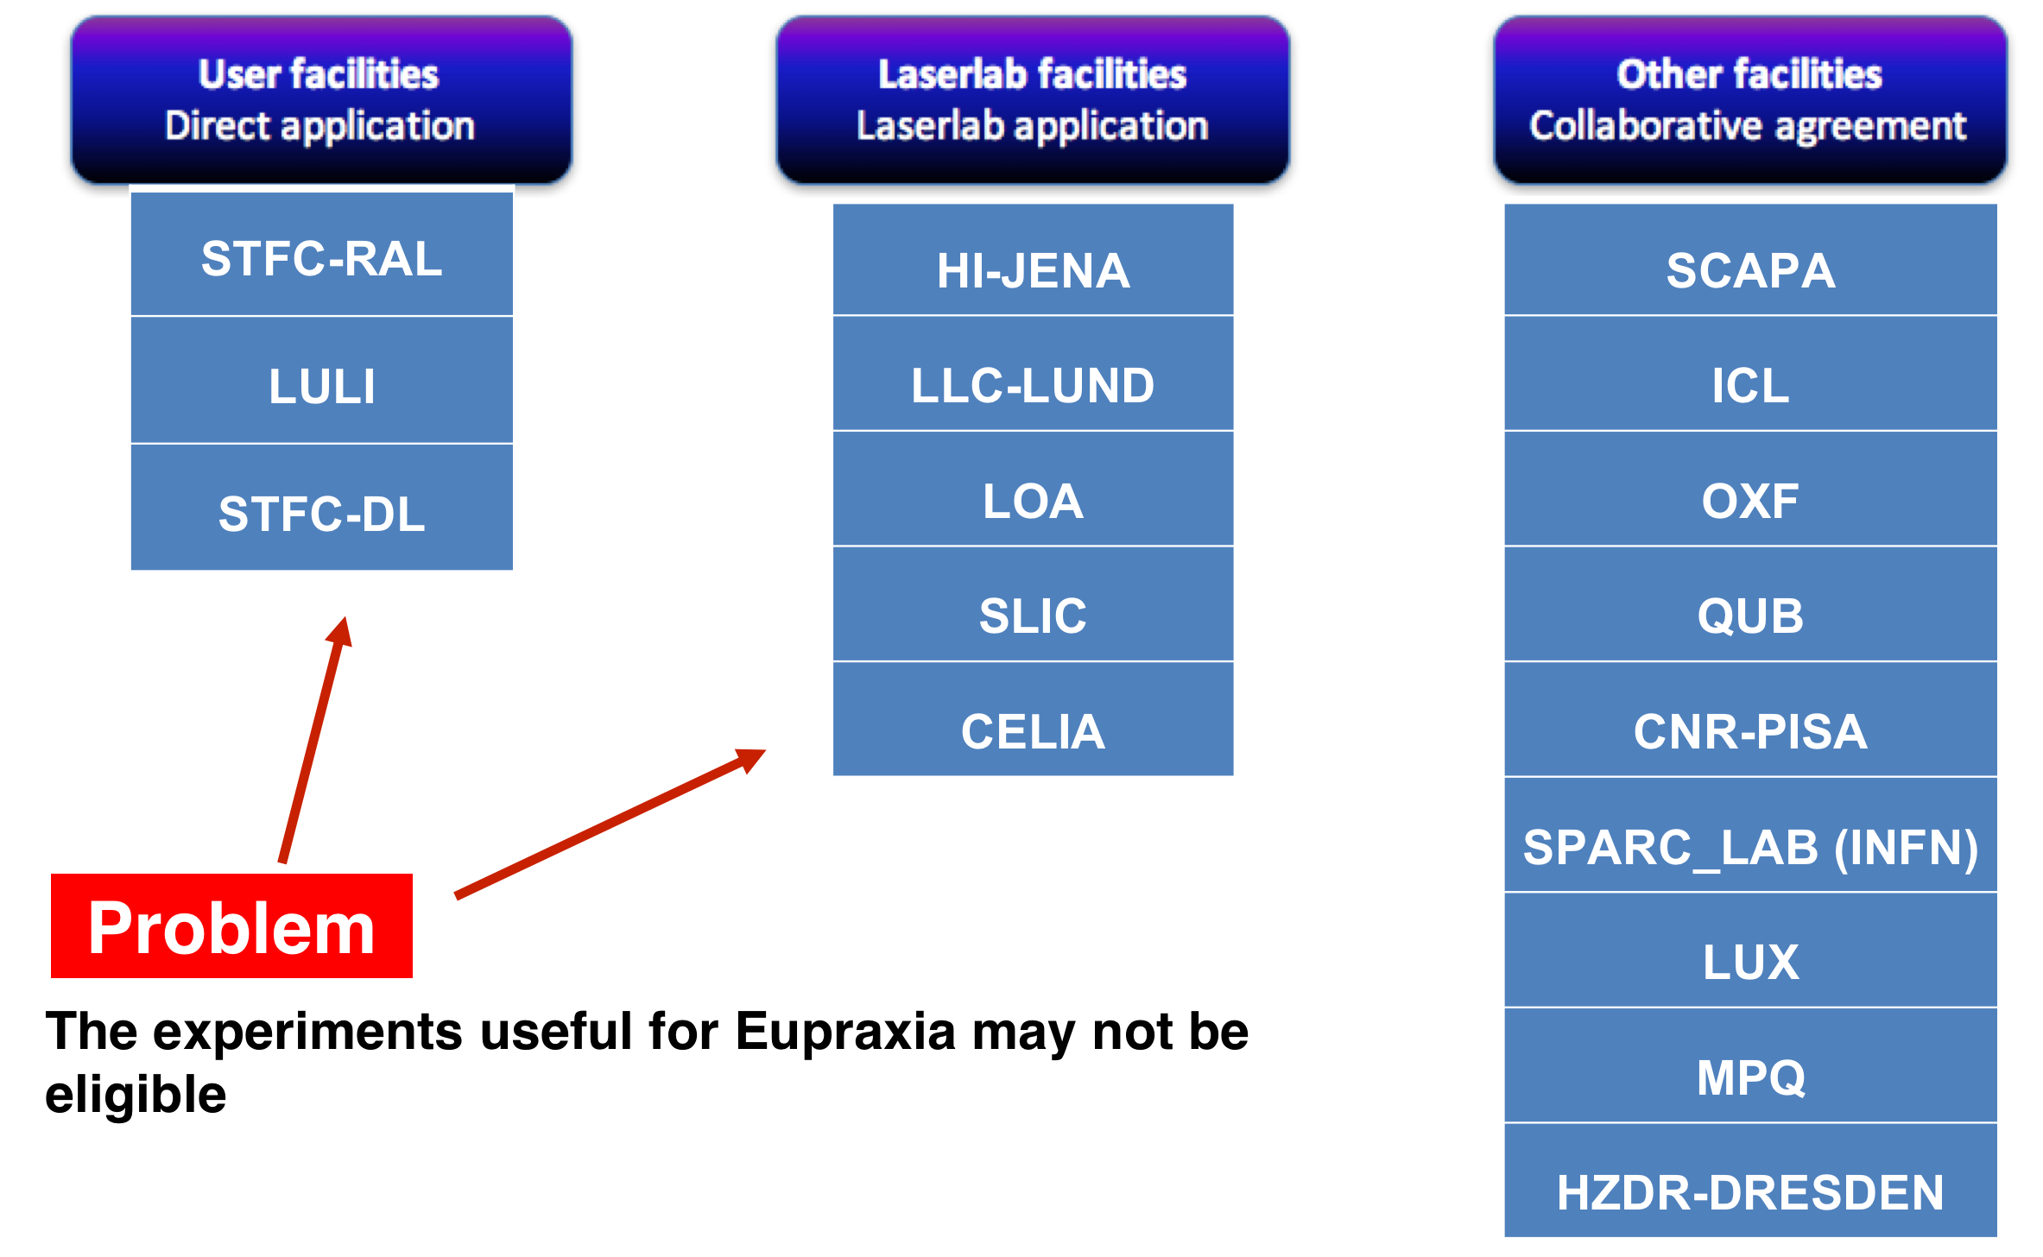


Access to facility

Slide 5
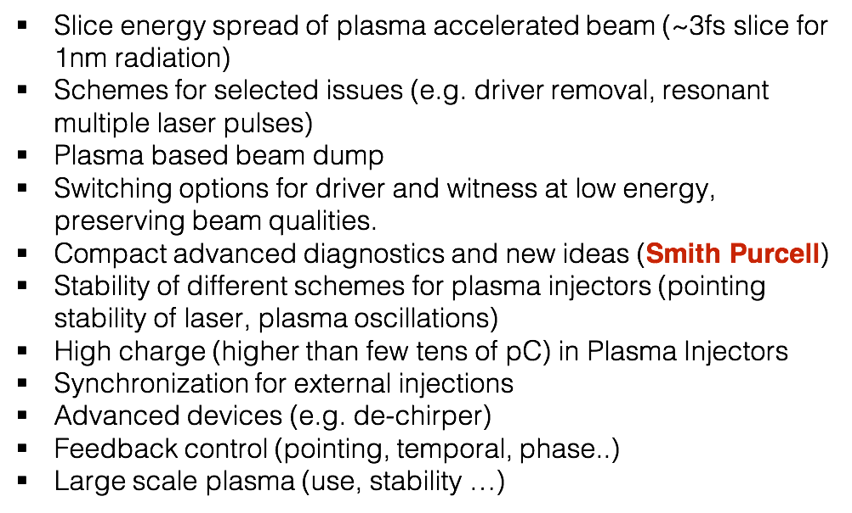
Needed experiments
Give a priority
Relevance for Eupraxia
Which experiment can not be done elsewhere?

Slide 6
Goal of WP12
Keep an updated status of the facilities
Sharing the information on needed experiments
Help in matching the facility and the experiments
Thank you for you attention

