Slide 1



Automated high-throughput analysis of metal atoms in biological macromolecules using ion beam analysis
Charlie Bury, Elspeth Garman
University of Oxford, Department of Biochemistry
and
Geoff W. Grime (and Chris Jeynes)
University of Surrey, Ion Beam Centre
Ion Beam Centre

Slide 2
Outline
Ion Beam Centre
PIXE (particle-induced X-ray emission) analysis of proteins
High throughput methods in biochemistry
High throughput Ion Beam Analysis
    Sample presentation
    Analysis protocols
    Data processing
Examples

Slide 3
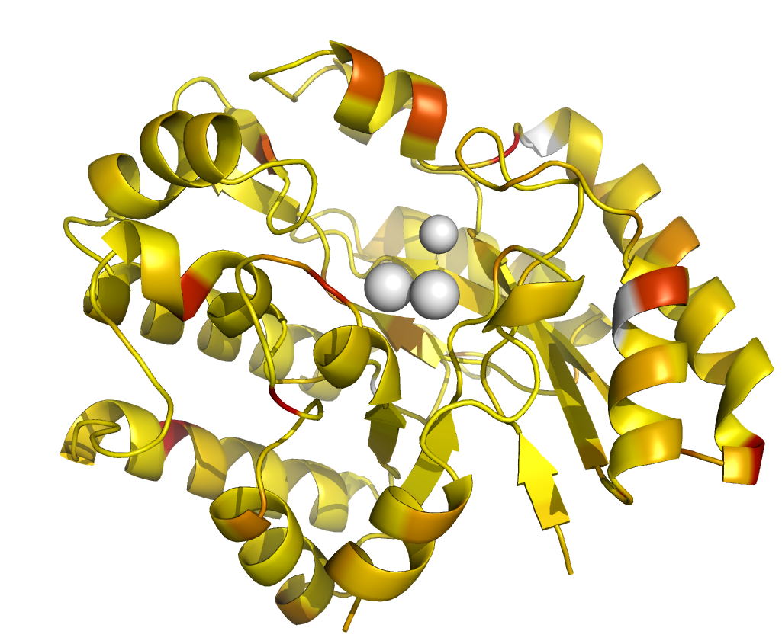
Metals in proteins
Many proteins contain small numbers of metal atoms
  Binding and transport of metals
  A single metal atom helps to determine the folded shape of the molecule
X-ray crystallography measures electron density
  Cannot determine Z of metal atoms
  Z is often inferred indirectly from molecular modelling
Ion Beam Centre
Unknown metal atoms

Slide 4
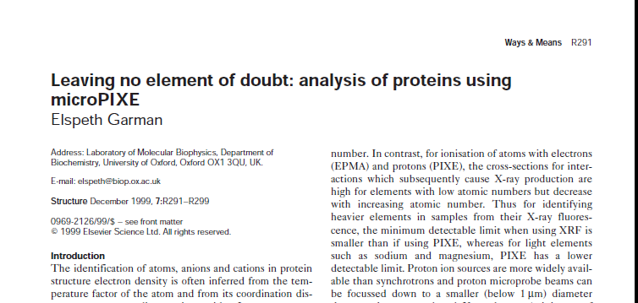
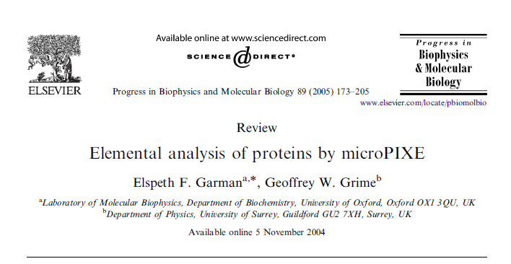
PIXE (particle-induced X-ray emission) analysis of proteins
Structure 1999
Concentrations are typically 1 atom per molecule of 10 – 100 kDa (10s to 100s ppm)
Available sample size is small (microlitres of solution)
MicroPIXE may be the only way to identify and quantify unknown metal atoms in proteins
PIXE conference 2004
Progress in Biophysics & Molecular Biology 2005

Slide 5
Quantification
Absolute PIXE concentrations have a large error
But: most (95%) proteins contain known numbers of molecules of the amino acids methionine and cysteine
These contain sulfur which provides an internal standard:
The expected results are small integers (or ratios of small integers) so high accuracy may not be essential
N_{Z} = number of unknown metal atoms
N_{S} = KNOWN number of sulfur per molecule
C = Concentration determined by PIXE (wt/wt)
M = atomic mass
Sulfur atom

Slide 6
Dependence on sample thickness
Results MUST be corrected for sample thickness
Simultaneous RBS provides matrix composition and thickness and allows correction
Zn:S
Mg:S
Elemental mass ratios calculated for peaks of equal area assuming different thicknesses of matrix C₅O (and 3MeV protons)

Slide 7
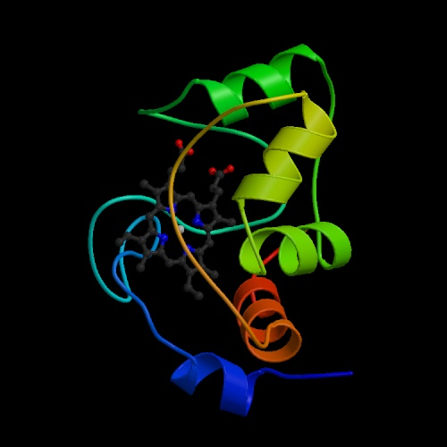
An example
Cytochrome C₅₅₀ from Paracoccus denitrificans
15kDa, 135 amino acids
1 Fe atom and 6 S atoms from methioneine and cysteine residues.
Sample: 0.3μl drop of protein in buffer solution at 1.35mg/ml.
Total mass of protein = 0.41μg
Thickness-corrected concentrations from PIXE
  S: 1520 ppm
  Fe: 430 ppm
Number of Fe atoms: 430 x 32 x 6 / 1520 x 56
= 0.98 (±0.18)
The Fe is an essential component of the molecule so the result is always 1 Fe/mol. Cytochrome C can be used as a QA material

Slide 8
Non-integer results?
Many measurements yield non-integer results: x atoms per molecule
This is not necessarily poor technique …
Metal binding proteins
Many proteins have a metal binding or transport function. In addition to the ‘structural’ atoms (S) they contain one or more (N) metal atom binding sites which may or may not be occupied:
Polymers
Many proteins function by forming polymers where two or more (M) identical monomer molecules come together to create, for example, a metal binding site.
The measured metal content relates to the monomer molecule so:

Slide 9
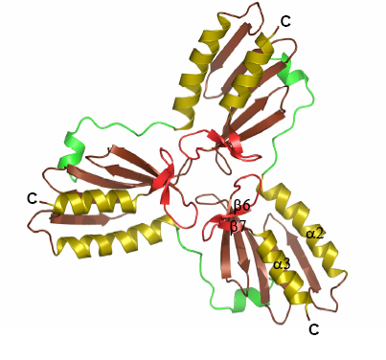
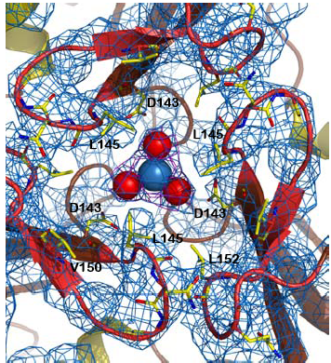
A typical problem
Frataxin:
a novel synthesised protein for the delivery or detoxification of iron.
A trimer of identical monomer molecules forming a ‘cage’ for the Fe atom.
… is the Fe atom present?
When the site is occupied x = 1/3
Smaller values indicate partial occupancy

Slide 10
What precision do we need?
M is rarely greater than 4.
Accuracy of ±0.1 in x is sufficient to quantify fully occupied sites.
The precision of the ratio of peak areas is given by
where σ_{M} and σ_{S} are the Gaussian counting errors of the metal and sulfur peaks in the spectrum.
In the case where the peak areas are similar, this implies that both the S and metal peaks should have >200 counts (7% precision).

Slide 11
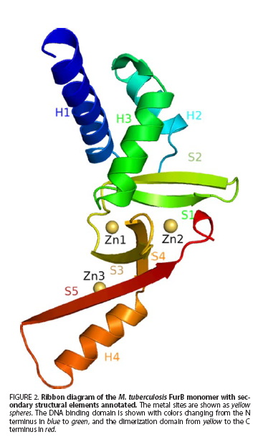
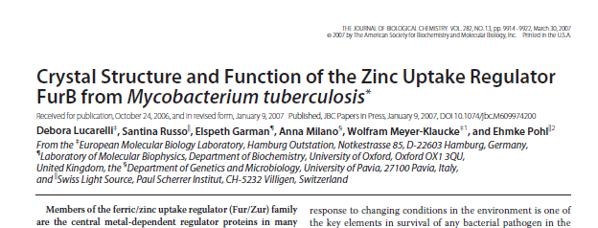
Another example:
The FurB monomer of M. Tuberculosis.
Iron binding protein identified (Ferric Uptake Regulator): with three metal sites how many of these are occupied?
One, but the metal is ZINC!
The paper was quickly rewritten… (J.Biol.Chem, 282, 2007)

Slide 12
This method has been used successfully for over 20 years:
Sample | Elements of interest | Result atoms/molecule | Reference
Reverse transcriptase + DNA oligodeoxynucleotide 22:9mer | P | 1.2 (± 0.5) oligonucleotide per dimmer | * (Jones et al., 1993)
Viral neuraminidase (subtype N8) | Ca | Present | * (Taylor et al., 1993)
Bacterial neuraminidase (VC) | Ca | Present | (Crennell et al., 1994)
Glucose dehydrogenase | Zn | Present | (John et al., 1994)
Epidermal growth factor like domain of factor IX | Ca | 1.7 (± 0.2) | * (Rao et al., 1995)
p13(suc1) cell-cycle control protein | Zn | 1.3 (± 0.2) | (Endicott et al., 1995)
Protein phosphatase 1 (native) | Mn Fe | 0.93 (± 0.08) 0.46 (± 0.05) | *(Egloff et al., 1995)
Protein phosphatase 1 (with bound tungstate) | Mn Fe | 0.92 (± 0.08) 0.45 (± 0.05) | *(Egloff et al., 1995)
Reduced desulphoferrodoxin | Fe Ca | 1.1 (± 0.1) 0.5 (± 0.05) | A Coelho, unpublished data
Oxidised desulphoferrodoxin | Fe Ca | 2.3 (± 0.15) 1.35 (± 0.15) | A Coelho, unpublished data
Class I ribonucleotide reductase R2 subunit mutant D84A | Fe Zn Hg | bdl † 0.23 (± 0.03) 1.5 (± 0.12) | (Nordlund et al., 1990)

Slide 13
This method has been used successfully for over 20 years
Class III anaerobic ribonucleotide reductase | Fe Zn Cu | bdl † 1.5 (± 0.3) 3.0 (± 0.5) | (Logan et al., 1999)
Blue tongue virus (BTV) core | Counter ions | Ca, Zn at low concentration | *(Gouet et al., 1999)
VP7 capsid protein from BTV | Zn | Present | (Basak et al., 1997)
CD80 (B7) | Se | S:Se = 1.8 (± 0.2) | *(Davis et al., 2001)
Nitrous Oxide Reductase (liquid sample) | Cu | 1.3 | Arif Jafferji, D.Phil thesis U. of Oxford, 2000
Nitrous Oxide Reductase (crystal) | Cu | 4.4 (± 0.3) | Arif Jafferji, D.Phil thesis U. of Oxford, 2000
RhoA.GDP.AlF₄⁻/RhoGAP RhoA.GDP/RhoGAP | Al:P Mg:P Mg:Al Mg:P Al | 0.39 (± 0.05) 0.34 (± 0.04) 0.9 (± 0.16) 0.86 (± 0.1) † bdl | *(Graham et al., 2002)
DAF34 (Au soaked crystal) | Au | Present | *(Garman and Murray, 2003) (Williams et al., 2003)
DAF34 (Hg soaked crystal) | Hg | Present | (Williams et al., 2003)
DAF34 (HgI crystal) | I Hg | 1 bdl † | *(Garman and Murray, 2003) (Williams et al., 2003)
cd1 Nitrate Reductase | Fe | 1 (± 0.3) | (Fulop et al., 1995)
Pseudoazurin 2000 | Cu | 0.95 (± 0.1) | (Williams et al., 1995)

Slide 14
This method has been used successfully for over 20 years:
Tau-D (crystal) | Fe | 0.003 | (Elkins et al., 2002)
Wild type tyrosinase Variant 1 tyrosinase Variant 2 tyrosinase | Cu Cu Cu | 1.62 (± 0.1) 1.55 (± 0.1) bdl † | *(Branza-Nichita et al., 2000)
RsbW | Se | Present | R. Lewis, personal communication
SpOA | P | bdl † | R. Lewis, personal communication
Ferric Uptake Regulator (preparation 1) | Fe | Present (near mdl) | *(Pohl et al., 2003)
Ferric Uptake Regulator (preparation 2) | Co | ~2 | *(Pohl et al., 2003)
GCM | Zn | 1.70 (± 0.15) | *(Cohen et al., 2002)
ssDNA + binding protein complex (washed crystal) | P | 4.4 (± 0.3) | *(Backe et al., 2004)
ssDNA binding protein complex without ssDNA (crystal) | P | 1.1 (± 0.4) x10⁻² | *(Backe et al., 2004)
Ferric Uptake Regulator | Fe Zn Co | 2.6 (± 0.3) 1.9 (± 0.2) ~2 | *(Pohl et al., 2003)
BslI Restriction Endonuclease | Zn | 7.3 (std. dev. 1.0) | *(Vanamee et al., 2003)
FIH, an Fe(II) dependent enzyme | Fe | bdl † | (Elkins et al., 2003)
Anastellin | S Fe | Present Present | (Briknarova et al., 2003)
NapC | Fe | 0.8 (std. dev. 0.5) | (Cartron et al., 2002)

Slide 15
This method has been used successfully for over 20 years:
EMR2 (Ba soaked crystal) | Ba | 2.4 (std. dev. 0.05) | *(Garman and Murray, 2003) (Abbott et al., 2004)
Cytochrome c₅₅₀ from P.denitrificans | Fe | 0.97 (std. dev. 0.18) | (Tinmkovich and Dickerson, 1976)
NAG6P Diacetylase (crystal) | Mn Fe Cu Zn K | 0.59 (std. dev. 0.03) 1.4 (std. dev. 0.2) 0.05 (std. dev. 0.02) 0.2 (std. dev. 0.06) 0.1 (std. dev. 0.04) | *(Vincent et al., 2004)
DAF 1,2,3,4 (Hg soaked crystal with Se substitution) | Se Hg | 2.4 (std. dev. 0.2) 0.02 (std. dev. 0.004) | *(Garman and Murray, 2003) (Lukacik et al., 2004)
DAF 1,2,3,4 (Au soaked crystal) | Au | 12 (std. dev. 1.7) | *(Garman and Murray, 2003) (Lukacik et al., 2004)
Germin Type IV (pH 5.0) Type II (pH 8.0) | Mn Mn | 1 1 | *(Woo et al., 2000)
ThiND | Se | 10.1 (±0.9) | E. Rudiňo Piňera, private communication

Slide 16
This method has been used successfully for over 20 years:
More recently:
The effect of X-ray absorbed dose and pH over a fungal laccase: insights into redox potential determination and conformational changes.
De la Mora et al., Acta Cryst. (2012) D68, 564-577.
VARP Is recruited onto endosomes by direct interaction with retromer, where together they function in export to the cell surface. Hesketh et al..
Developmental Cell (2014), 29, 591-606
A complex iron-calcium cofactor catalyzing phosphotransfer chemistry
Shee Chien Yong et al. Science (2014), 345, 1170-1173
Plant cysteine oxidases are dioxygenases that directly enable arginyl transferase-catalysed arginylation of N-end rule targets.
White, M. D. et al. Nature Communications (2017) 8, 14690 doi: 10.1038/ncomms14690.
Over 60 papers with references to microPIXE in mainstream biological journals
Surrey is now making this available as a service.

Slide 17
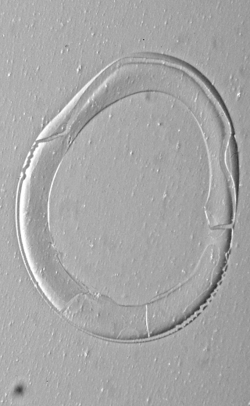
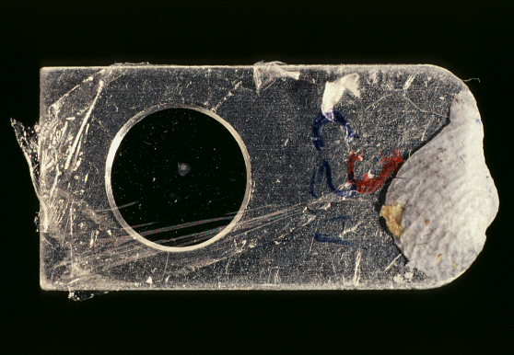
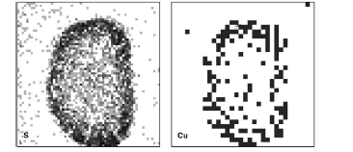
There are still issues
Samples are prepared by manual pipetting onto foils
Samples are analysed by manual positioning on the PIXE maps to locate the precipitated protein. Differential precipitation of buffer may require accurate positioning using elemental maps of sulfur.
Spectra are processed manually
It is difficult to analyse more than 10 samples in a run day

Slide 18
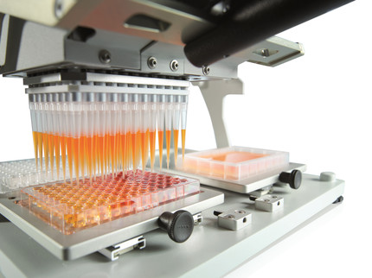
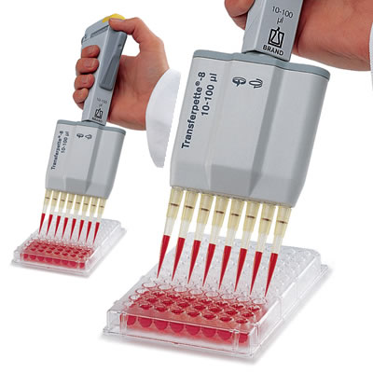
High throughput
Many experiments in biochemistry are now carried out using high-throughput (HT) models
Several parameters are varied simultaneously giving an array of samples to be analysed. E.g.:
  Robotic ICP-MS
  Array printing with fluorescence imaging
Can we develop an automated IBA method to engage with this type of experiment?
Bring down cost per sample and permit a wider range of applications?

Slide 19
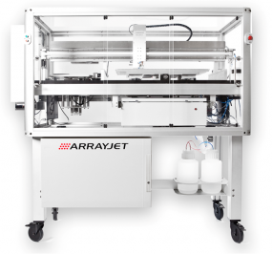
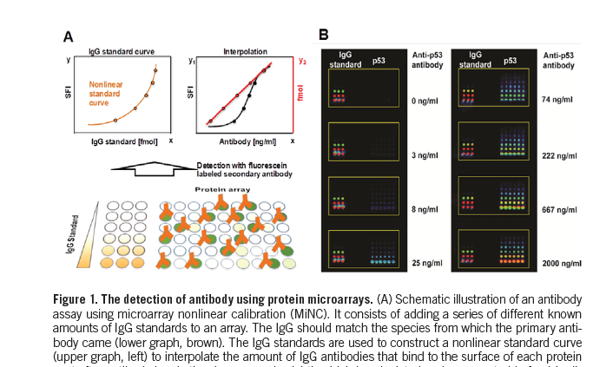
Sample preparation
Microarray printing
Inkjet deposition of arrays of spots of different solutions
Typical volume of spot 10 nL
Size and separation controllable in the 10 to 100 µm range
Example of fluorescence readout of antibody binding (from Biotechniques 54, 2013, 257)

Slide 20
Printed arrays for microPIXE?
Special requirements for IBA
Thin film substrate (4 μm polypropylene)
  Spot adhesion?
  Film damage during printing?
  Surface wetting issues?
  Crosstalk between spots
Reproducible positioning (to simplify sample localisation)
  Film must remain flat during printing
Several arrays per sample holder (to optimise beam time)

Slide 21

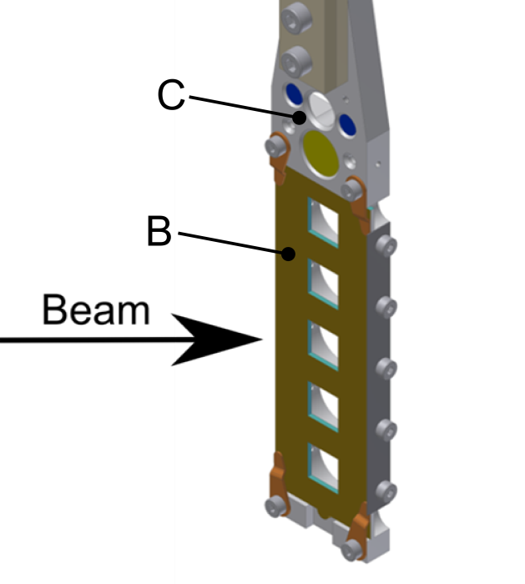
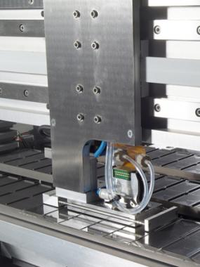
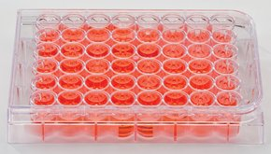
Sample preparation: support film and printing
Sample holders have the same dimensions as a standard microcope slide and are adapted for compatibility with both printer and sample stage
Five 8 × 8 mm sample windows per slide covered in polypropylene film using a specially developed coating machine and non-instant contact adhesive
Samples supplied as solutions in well plates
Printed by a non-contact ArrayJet microarrayer
Up to 144 samples per 12 × 12 array, 5 arrays per slide
Notes:
21

Slide 22
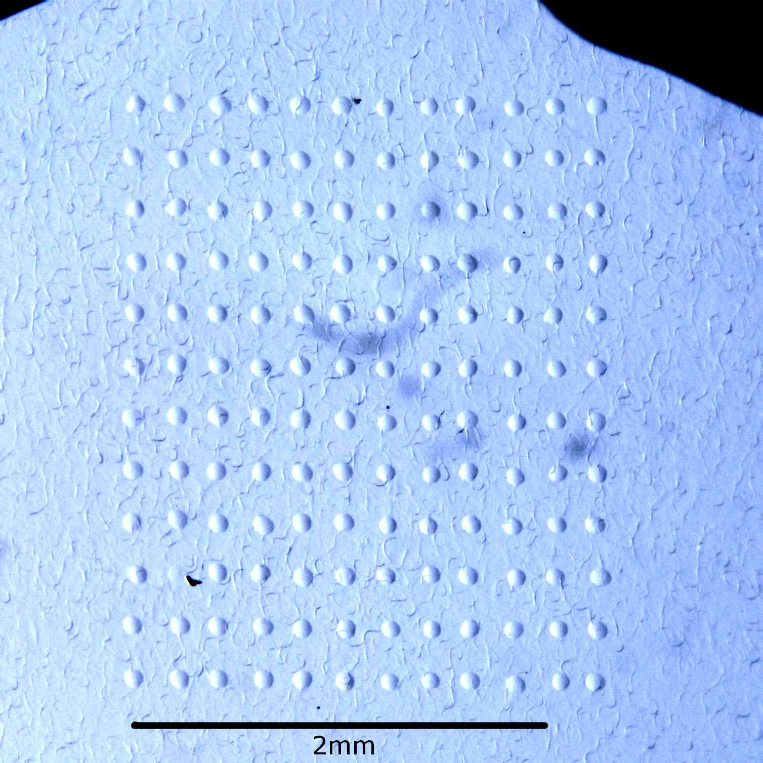
Printed arrays
Buffer array
Protein array
60 µm diameter drops, 200 µm apart
Note the positioning errors and the shape variation

Slide 23
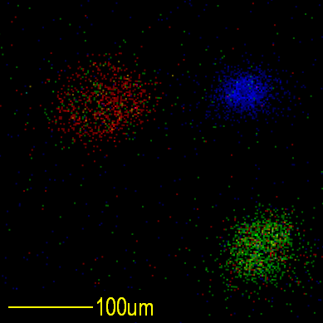
Cross-talk?
Array of standard salt compounds.
Verify that there is no cross talk between adjacent spots.
CaCl₂ CsI
Notes:
23

Slide 24
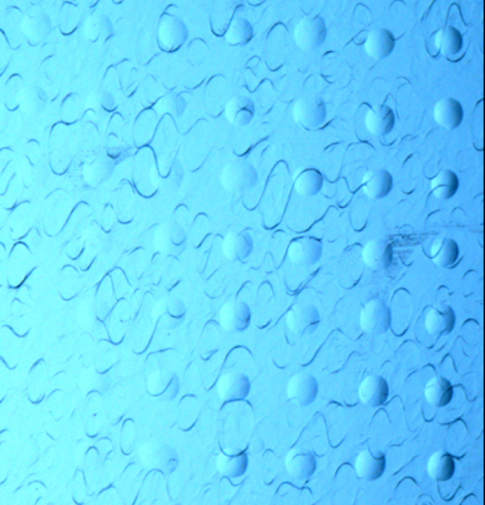
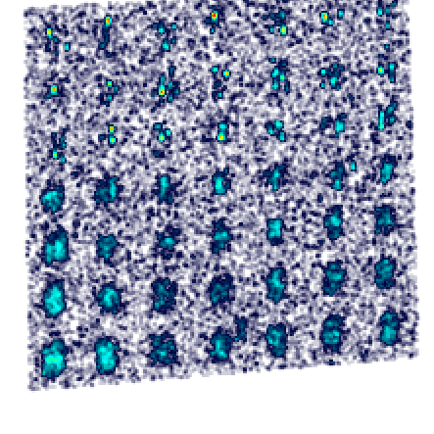
Locating and analysing the spots
Spots are difficult to see under light microscopy
Elemental maps have poor statistics so cannot be used easily for automatic location
Spot position errors:
  Random errors in printing
    Errors in the printer head position.
    Variation in shape due to wetting
  Geometric distortion of the array image:
    Scanning coil misalignment (common in quadrupole systems)
    Misalignment of axes (scanning, sample stage motion, array printer motion)
We require a system which allows for these errors
An array of KBr buffered protein spots and the K Kα X-ray map (2 x 2 mm)

Slide 25
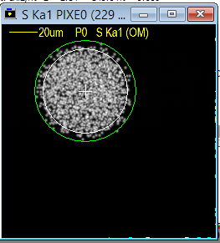
Finding the spots
Print ‘Landing Lights’ at the corners of the array. Spots of metal salt (e.g. KBr) which are easy to find with PIXE.
Move the stage to each corner (operator control) and use a least-squares fitting routine to find the centre of the spot from the PIXE map. (This is the only manual operation for each array)
Store the stage coordinates of the corners
Interpolate the stage coordinates of each cell in the array. This corrects for linear geometric distortions,

Slide 26
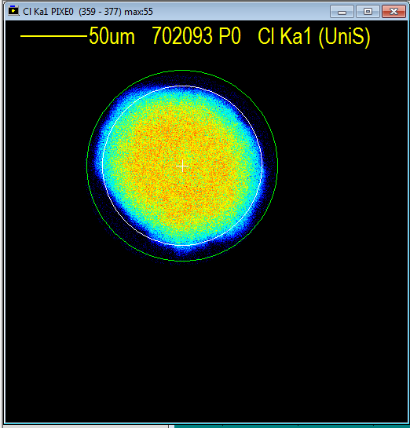
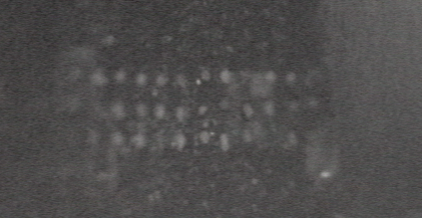
Analysis procedure
Once the corners have been located, the remainder of the procedure is automated.
For each spot in the stored list:
Move the stage to the interpolated coordinates of the centre of the cell.
Start a mapping run of the full cell area until a circular region can be fitted around the spot with good statistics.
Change the scan pattern to the fitted circular pattern (to avoid scanning a lot of blank foil...)
Run until the spectrum end conditions are reached.
View through the chamber microscope near the end of a HT run. Analysed areas can be seen as faint squares around the spots

Slide 27
Spectrum endpoint determination
A problem with automated analysis is determining when to stop.
Use a real-time Gaussian peak fitting routine to monitor the statistics of the major lines of the elements of interest.
  These are defined by the end-user in the sample information file.
Stop the run when:
  All of the peaks of interest have counting error less than a specified value
  AND
  The total count in the RBS spectrum exceeds a minimum value
  OR
  A maximum run time is reached (to allow for missing samples - in both senses...)
Elements of interest | Gaussian counts | Peak error
S | 6600 | 3.40%
Zn | 220 | 6.70%
Se | 104 | 9.80%
Run stopped when all peaks < 10% (7.5 min)

Slide 28
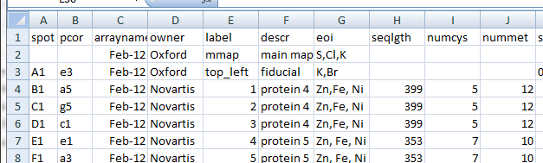
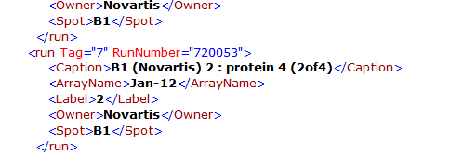
Data handling – spectrum processing
Data from the end-user and the ArrayJet spot mapping information are combined into a CSV file
CSV file used as input to set up the data acquisition
OMDAQ
(data collection)
Sample data and run statistics written to XML
XML file used to set up batch processing of RBS and PIXE (with human supervision at present!)
OMDAQ + GUPIX
(spectrum processing)
Element concentrations for each run written back to XML
XML file used to generate atoms/molecule results for end-user

Slide 29

Summary of the first run
36 ‘blind’ protein samples
Total run time 7.5 hours (2.5 MeV protons, ~0.5 nA). This would have required 4 days using the manual method.
All proteins analysed have an entry in the Protein Data Bank (PDB) and are believed to be metal binding proteins

Slide 30
Table of results
 | PDB ID | Gene | Residues | Metal in PDB | Metals in PIXE (>3xLOD) | Potential metals in PIXE (1-3xLOD)
PIXE data consistent with PDB
1 | 3NNG | BfR258E | 168 | Ca | Ca (1.7) | Fe
2 | 2KPN | BcR147A | 103 | Ca | Ca (0.8)
3 | 3LRQ | HR4604D | 100 | Zn | Zn (2.5), Fe (0..3) | Ca, Co, Cu
4 | 3NNQ | OR3 | 114 | Zn | Ca, Zn* | Fe, Ni*
5 | N/A | LkR105 | 290 | - | Fe (0.04) | Ca, Cu
6 | 2K52 | MjR117B | 80 | - | Ca (0.2) | Fe
7 | 3ESI | EwR179 | 129 | - | - | Ca, Fe
8 | 3DM3 | MjR118E | 105 | Na^{u} | - | -
9 | 3I24 | VfR176 | 149 | Na^{u} | - | Co
10 | 3L8M | SyR86 | 212 | Na^{u} | - | Fe
11 | 3FOJ | SyR101A | 100 | Na^{u} | - | Ca, Fe, Cu
12 | 4EVW | VcR193 | 255 | Mg^{u} | - | -
13 | 2KW4 | DhR1A | 147 | Mg^{u} | - | Ca, Fe*
14 | 3DJB | BuR114 | 223 | Mg^{u} | - | Fe, Ni
Sample too dilute for PIXE (no S signal)
1 | 3D3N | LpR108 | 284 | Ca | - | K, Mn
2 | 3DC7 | LpR109 | 232 | Mg/Na^{u} | - | -
*S signal was below 3 times the limit of detection, so accurate stoichiometries could not be established. ^{u}Presence of sodium and magnesium could not be confirmed at the proton energies used in these experiments.
Thanks to Eddie Snell of the Hauptman-Woodward Medical Research Institute, Buffalo for permission to present these data.

Slide 31
Table of results
 | PDB ID | Gene | Residues | Metal in PDB | Metals in PIXE (>3xLOD) | Potential metals in PIXE (1-3xLOD)
PDB inconsistent with PIXE
1 | 3LV4 | BiR14 | 456 | Ca | - | Ca, Mn
2 | 3HIX | NsR437I | 106 | Mn | - | -
3 | 3HLY | SnR135D | 161 | Ca | - | Ca
4 | 3DCP | LmR141 | 283 | Fe/Zn | Ca (3.3), Mn (0.5), Fe (1.2), Co (1.2) | Zn
5 | 3JSR | NsR236 | 119 | K | - | Ca
6 | 3ILM | NsR437H | 141 | Mn | - | Fe, Co
7 | 3I24 | SoR237 | 137 | Na | Co (0.7), Zn (0.7) | Fe, Ni
8 | 3GGL | BtR324A | 169 | Zn | - | Ca, Mn, Fe*
9 | 3KB1 | GR157 | 262 | Zn | - | Co
 | PDB ID | Gene | Residues | Metal in PDB | Metals in PIXE (>3xLOD) | Potential metals in PIXE (1-3xLOD)
Extra metals present in PIXE
1 | 3LMC | MuR16 | 210 | Fe/Zn | Fe (0.6), Co (0.9), Ni (0.4), Zn (0.7) | -
2 | 3K2Q | MqR88 | 420 | Na^{u} | Ca (7.1) | Fe
3 | 3LM8 | SR677 | 222 | Mg^{u} | Ca (0.7), Fe (0.05) | K/Br
4 | 3E5Z | DrR130 | 296 | Mg^{u} | Ca* | -
5 | 3HNM | BtR319D | 172 | Mg^{u} | Ca (1.74) | -
6 | 3DEV | ShR87 | 320 | Mg^{u} | Mn (0.8), Fe (0.7) | -
7 | 3IHK | SmR83 | 218 | Mg^{u} | Ca (0.5), Fe (0.1) | Ti, Co, Cu
8 | 3KB4 | NsR141 | 225 | Mg^{u} | Mn (0.2), Fe (0.4), Ni (0.4) | Co
9 | 3E48 | ZR319 | 289 | Mg^{u} | - | Ca, Fe, Cu
More than half of the proteins analysed were inconsistent with their entry in the PDB!
This highlights a deep problem in identifying metal constituents of proteins.

Slide 32
Conclusion
High throughput PIXE/RBS analysis of proteins (and other biological macromolecules) offers precise determination of the identity and quantity of metal atoms with a protocol compatible with standard biochemical methods and reduced cost per sample.
Further development is planned to increase further the throughput (detector solid angle, higher count rates).
30% of all known proteins are metallo-proteins and knowing the correct metal reliably will be a major step in understanding human health and disease and in drug discovery.

Slide 33
Thanks to …
Oliver Zeldin who developed much of the high throughput protocols as part of his Oxford D.Phil work.
Vladimir Palitsin of Surrey IBC for his help in developing the sample holders for printed arrays.
Eddie Snell of the Hauptman-Woodward Medical Research Institute, Buffalo, NY for selecting and providing the protein samples for the demonstration experiment.

