Slide 1
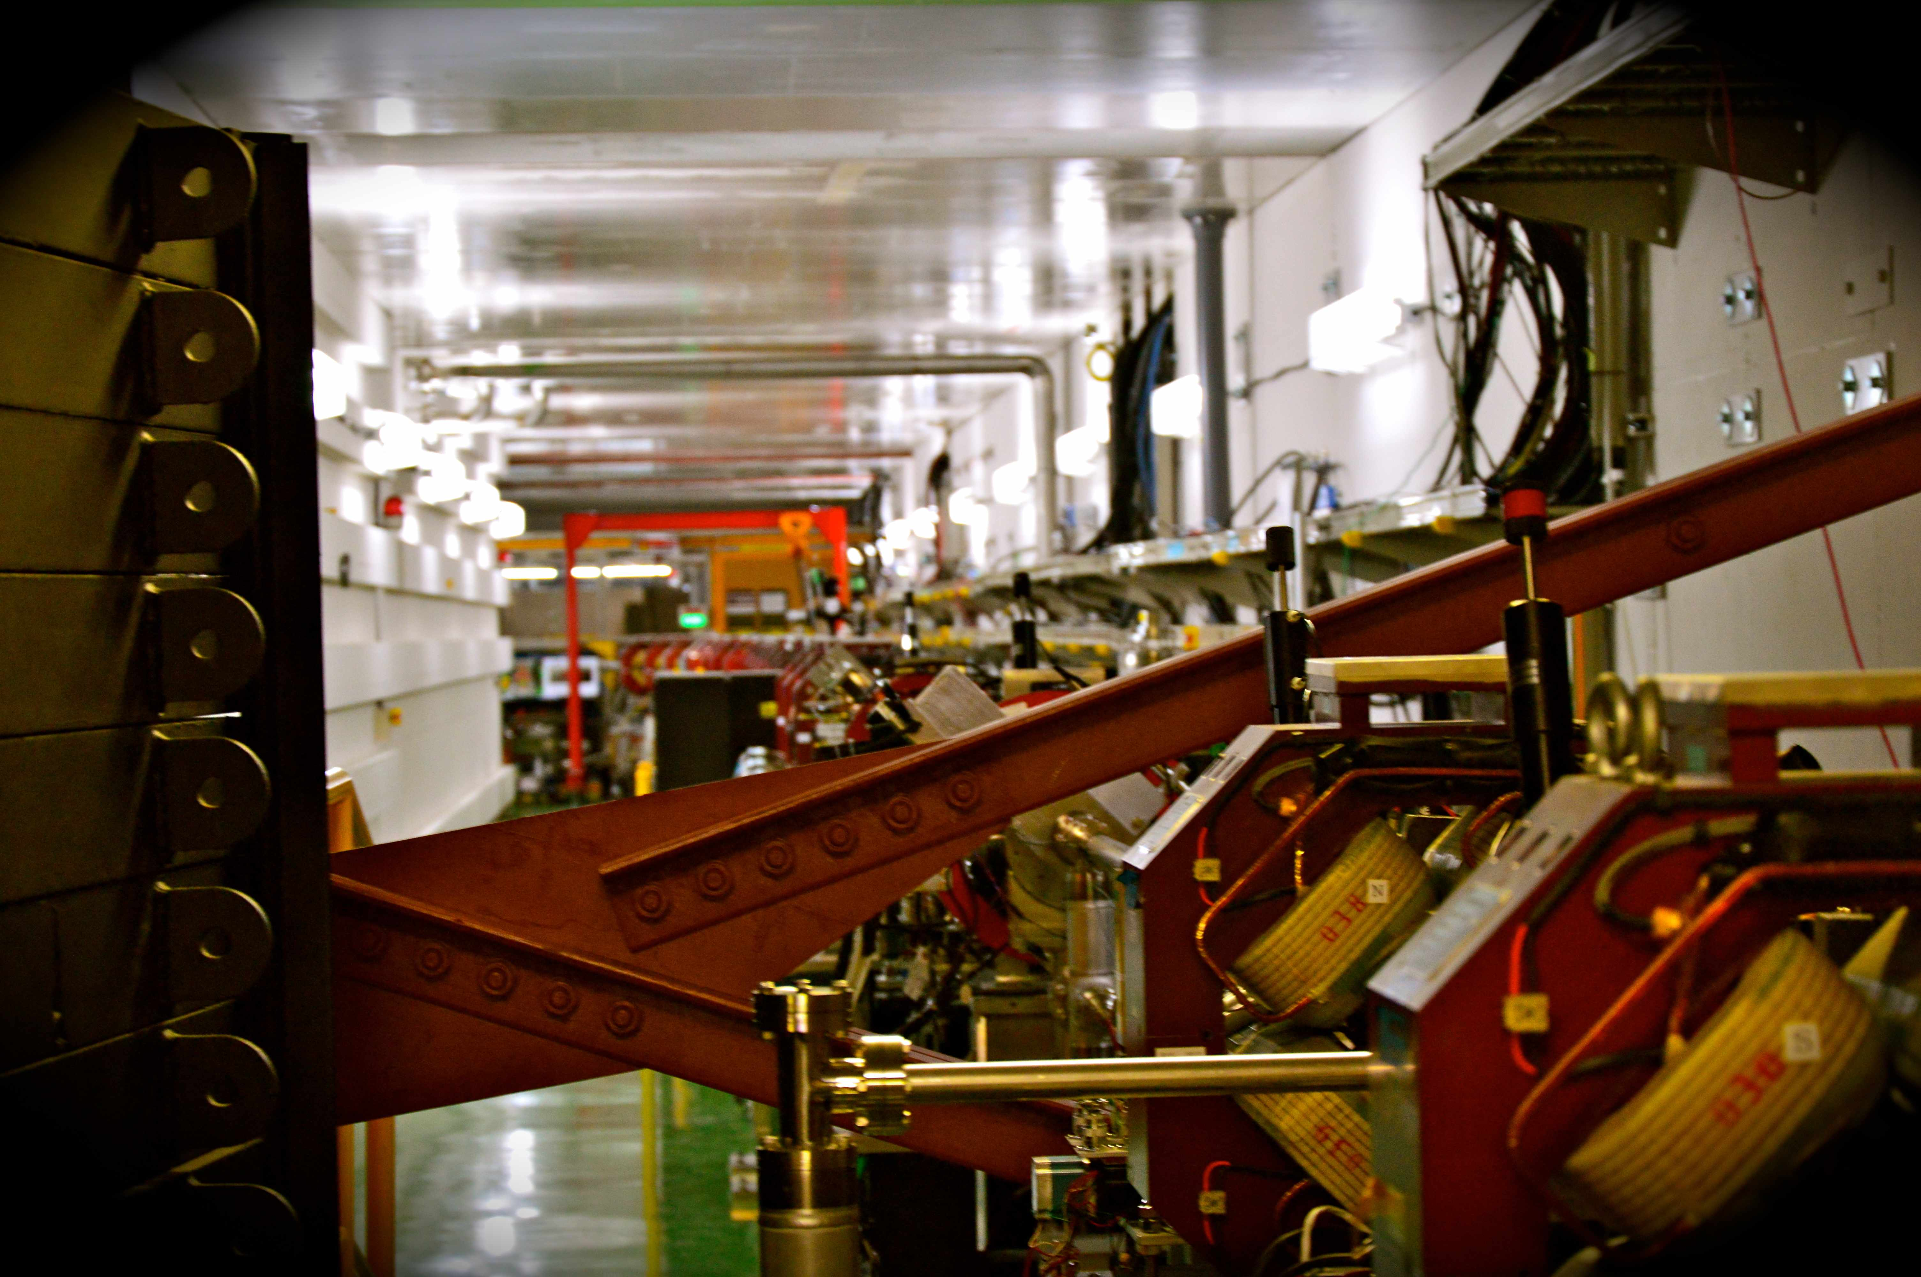



Analysis of the beam halo collimation system measurements
N. Fuster-Martínez (IFIC), A. Faus-Golfe, P. Bambade, R. Yang, S. Wallon (LAL), A. Schuetz (DESY)
In collaboration with KEK team and other ATF2 collaborators: A. Latina, E. Marin (CERN), G. White (SLAC)
J. Snuverink, L. Nevay, S. Boogert (RHUL)
14/03/2017
Notes:
Hello, can you hear me? I will share my slides and if it’s okay I will start. Okay, so I am going to talk about transverse beam halo collimation and collimator wakefield studies. All this work is been done in collaboration between ific, lal and kek and some of the studies are being done with the help of people/experts from CERN, SLAC and RHUL

Slide 2
Outline
  Introduction
  Summary shifts 2016
  Collimator WK impact measurements 2016
    Motivation
    Introduction
    Results
  Realistic collimation efficiency and related measurements 2016
    Motivation
    Results
  Summary

Slide 3
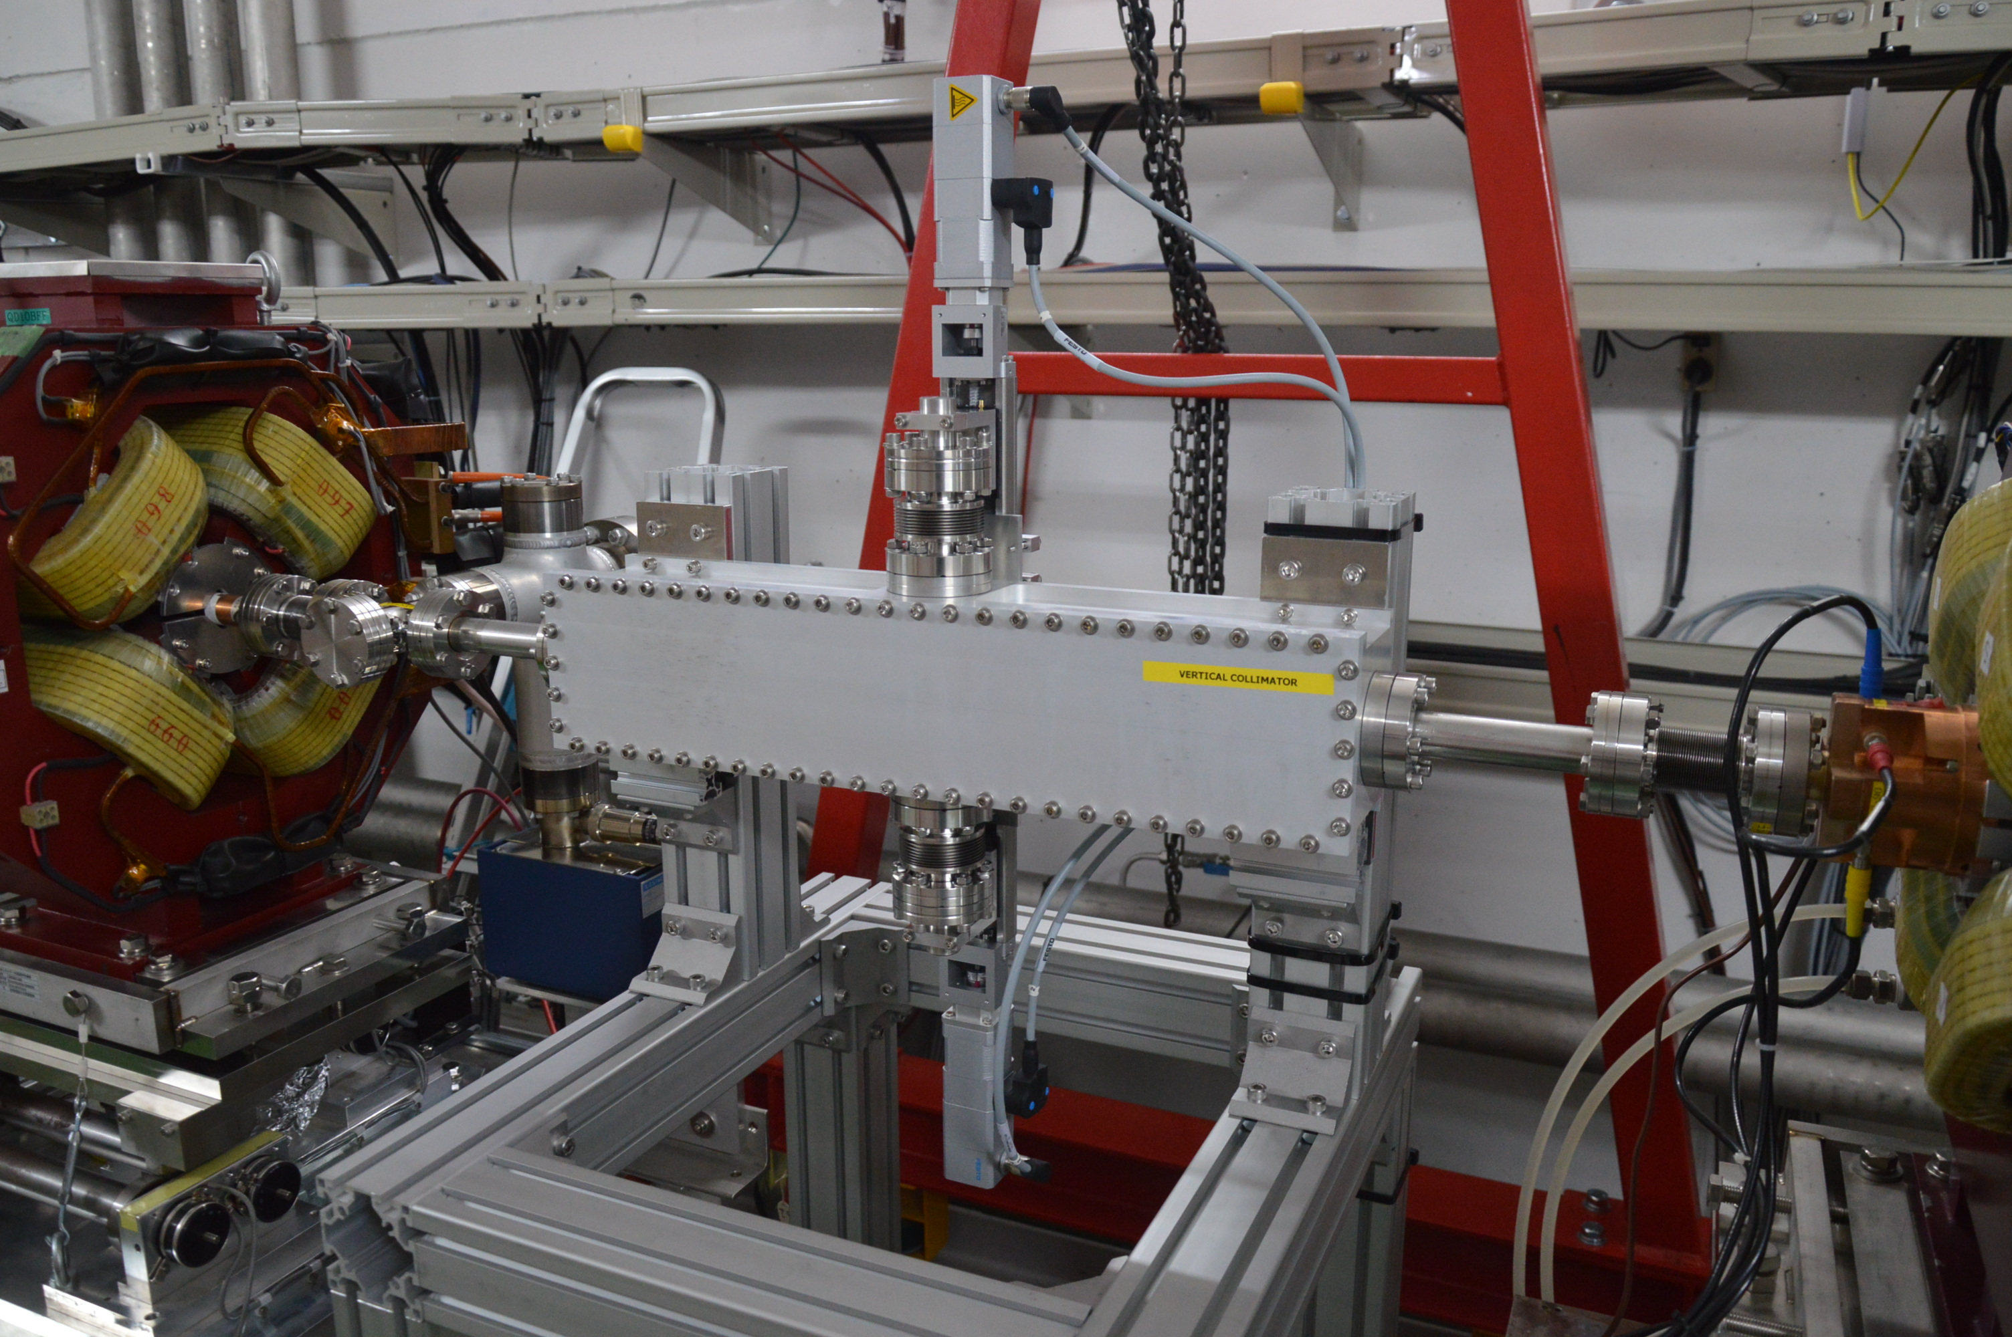
Introduction
A vertical collimation system was installed in the ATF2 FFS in March 2016
ATF2 beam line
1.3 GeV e-
ATF DR
  β^{c}_{y}=7126.51 m
  ΔΦ_{y} ^{BDUMP-C}=3π and ΔΦ_{y} ^{DS-C}=3π

Slide 4
  Summary shifts 2016
May: 6 shifts (over 2 weeks)
  Background measurements with different beam and machine conditions
    Different beam intensities
    Different vacuum pressure
    Different optics (10β_{x}x1β_{y,} 10β_{x}x0.5β_{y})
  Collimator wakefield impact measurements for 4 mm half aperture
October: 2 shifts (over 2 weeks)
  Repeat the background measurements for consistency
  Collimator wakefield impact measurements for 4 mm half aperture
    Increase scan range (maximum offset of 2 mm)
    Evaluate the bunch length intensity dependence and Streak Camera
November/December: 1 shift (over 2 weeks)
  Study the impact of the collimator on the beam size measurements
  Collimator wakefield impact measurements for 3 mm half aperture
  Participate on the intensity dependence studies

Slide 5
  Collimator WK impact measurements 2016: Motivation
Collimation is tradeoff between efficiency and the WF impact induced
The collimator WF increases with small apertures and high intensity and could limit the achievable luminosity in FLC
α
L_{F}
a
z
  Benchmarking of analytic models, numeric simulations and measurements is essential for the design and optimization of the FLC collimation system
    Different analytic models regimes (inductive, intermediate, diffractive)
      Only describe the jaws of the collimation system
      Accuracy not good when the parameters sit close to the limits
      Disagreements between published implemented in programs formulas...
    Discrepancies about a factor 2 between analytical calculations, EM simulations and measurements performed at ESA (SLAC) (2001-2007) for some geometries

Slide 6
  Collimator WK impact measurements 2016: Introduction
    Experiment
    Retractable vertical collimation system half aperture from 3-12 (with mechanical stop) and 2-12 (without mechanical stop)
    45 Cavity BPMs in the EXT and FFS with resolution about ~200 nm
      32 downstream the collimator
      17 upstream the collimator
    Measure the wakefield kick by changing the collimator-center-beam offset and measuring the impact on the upstream BPMs orbit
Downstream BPMs
κ_{y}
Δy^{BPM}
e- Beam
Upstream BPMs
Δy^{c}
a
Vertical Collimation system
      a = 4 mm (maximum offset of 2 mm)
      a = 3 mm (maximum offset of 1 mm)

Slide 7
  Collimator WK impact measurements 2016: Introduction
    Experiment beam requirements and BPMs sensibility
  Expected Δy^{BPM} it is of the order to 150-400 nm for 1 mm offset and high beam intensity
σ _{z} = 9 mm
Δy^{c} = 1 mm
a= 4 mm
κ_{y} calculated with CST PS
R34: Design values lattice version v5.2
10βx × 1βy
High intensity is required to induce an impact above the BPMs resolution (higher than 0.8x10¹⁰)
Sensitive BPMs
At highest R₃₄

Slide 8
  Collimator WK impact measurements 2016: Introduction
    Orbit data analysis and wakefield kick reconstruction
      1. Remove noise pulses: zeros and pulses with position and charge > than “mean+5σ”
      2. Orbit jitter subtraction is needed since wake kick is at the level of orbit jitter
a) Calculation of the correlation matrix, X, between upstream and downstream BPMs
b) Calculating the residual calculation (R) for each collimator offset as
a)
A: downstream BPMs
X
B: upstream
BPMs
b)
Collimator
  J. Snuverink et all,, `Measurements and simulations of wakefields at the Accelerator Test Facility 2, PRST-AB 19, 091002 (2016).
R [μm]
3. Plot R vs Δy^{C} and fit the data
4. Wakefield kick reconstruction
κ_{y} is the value to be compared with analytic and numeric simulations

Slide 9
  Collimator WK impact measurements 2016: Introduction
    Summary of the shifts and related measurements
  The precision the wakefield kick reconstruction:
    Beam intensity and stability
    BPMs resolution
    The optics
With the help of T. Naito
  The benchmarking accuracy will depends on:
    Collimator aperture
    Bunch length measurements
An 10% uncertainty is estimated due to space charge effect
Shift | a [mm] | BPMs calibration | σ_{z} [mm] | N
20/05/2016 | 4.0±0.2 | No calibration | 8.6±0.7 | 0.90±0.05
24/05/2016 | 4.0±0.2 | Only FFS BPMs | 9.1±0.7 | 0.90±0.6
27/05/2016 | 4.0±0.2 | Complete | 8.9±0.7 | 0.90±0.05
27/10/2016 | 4.0±0.2 | Complete | 8.9±0.7 | 0.80±0.06
1/12/2016 | 3.0±0.2 | Complete | 8.6±0.6 | 0.75±0.05

Slide 10
  Collimator WK impact measurements 2016: Results
    May 2016 run
  a= 4 mm
  Orbit data
    3 different shifts: 20-24-27/05
    I=0.9-0.95x10¹⁰
    10βx × 1βy
  Results
  κ_{y}^{average} = 0. 040±0.003 V/pC/mm
  Δ(κ_{y}^{an. (σz= 9 mm)} -κ_{y}^{me.} ) = 21 %
  Δ(κ_{y}^{CST (σz= 9 mm)} -κ_{y}^{me.} ) = 8 %
    27/05
CSTPS wakefield kick depicted in green for values of the bunch length between the measured error (8.9-0.7>σ_{z}>8.9+0.7)

Slide 11
  Collimator WK impact studies 2016: Results
    October 2016 run
  a=4 mm
  Orbit data
    1 shift: 27/10
    Intensity 0.8x10¹⁰
    10βx × 1βy
    Remove the mechanical stop
    Linear and third polynomial fit
  Results
  κ_{y}^{average} = 0. 038±0.003 V/pC/mm
  Δ(κ_{T,y}^{an. (σz= 9 mm)} -κ_{T,y}^{me.} ) = 15 %
  Δ(κ_{T,y}^{CST (σz= 9 mm)} -κ_{T,y}^{me.} ) = 3 %
CSTPS wakefield kick depicted in green for values of the bunch length between the measured error (8.9-0.7>σ_{z}>8.9+0.7)

Slide 12
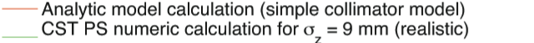
  Collimator WK impact studies 2016: Results
    November/December 2016 run
  a= 3 mm
  Orbit data
    1 shift: 1/12
    Intensity 0.75x10¹⁰
      Only a=3 mm impact could be measured
      Only at 3 BPMs (other removed)
  Results
  κ_{y}^{average} = 0. 070±0.003 V/pC/mm
  Δ(κ_{T,y}^{an. (σz= 9 mm)} -κ_{T,y}^{me.} ) = 15%
  Δ(κ_{T,y}^{CST (σz= 9 mm)} -κ_{T,y}^{me.} ) = 4 %
QD2AFF
CSTPS wakefield kick depicted in green for values of the bunch length between the measured error (8.6-0.6>σ_{z}>8.6+0.6)

Slide 13
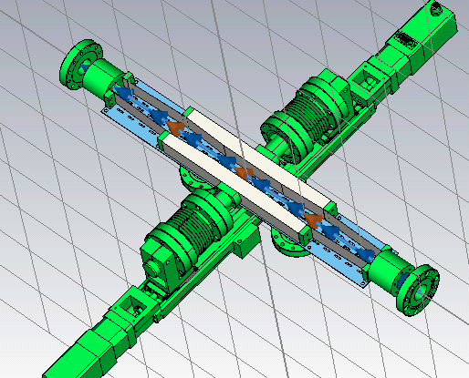
  Collimator WK impact studies 2016: Results
[mm] | [mm] | κ_{T,y} [V/pC/mm]
a | σ_{z} | Analytic | CST PS (jaws) | CST PS (realistic) | Measured
4 | 9.0±0.7 | 0.033 | 0.033 | 0.037 | 0.038±0.003
realistic
20thMay
24thMay
27thMay
27thOctober
Measurements are in agreement with the associated error with numeric simulations
About 15% difference within measurements and analytic calculation of the jaws
11% difference in the CST PS calculation of the jaws and realistic model

Slide 14
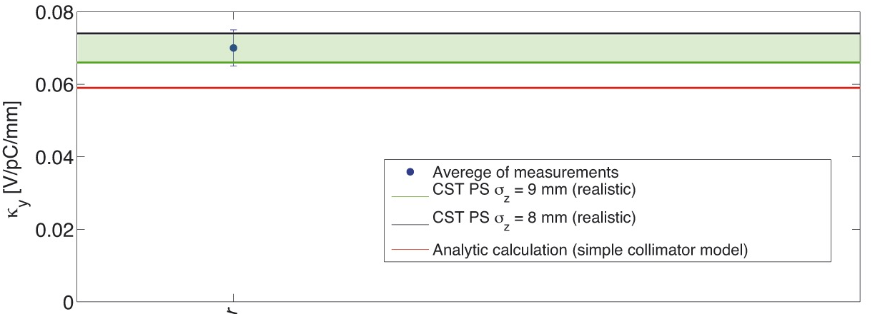
  Collimator WK impact studies 2016: Results
[mm] | [mm] | κ_{T,y} [V/pC/mm]
a | σ_{z} | Analytic | CST PS (jaws) | CST PS (realistic) | Measured
3 | 8.6±0.6 | 0.059 | 0.059 | 0.066 | 0.070±0.005
realistic
realistic
November/December
Measurements are in agreement with the associated error with numeric simulation
About 15% difference within measurements and analytic calculation of the jaws
Measurement values for a=4 and 3 mm agree with the analytic expected scaling 1 /a²

Slide 15
  Realistic collimation efficiency and related measurements 2016: Introduction
  Motivation
  To measure the vertical collimation system efficiency in reducing the background photons in the Post-IP
    To confirm our understanding of the background sources
  The vertical collimation system was installed in the context of beam halo investigation to provide a tool to confirm the DS measurements
DUMP

Slide 16
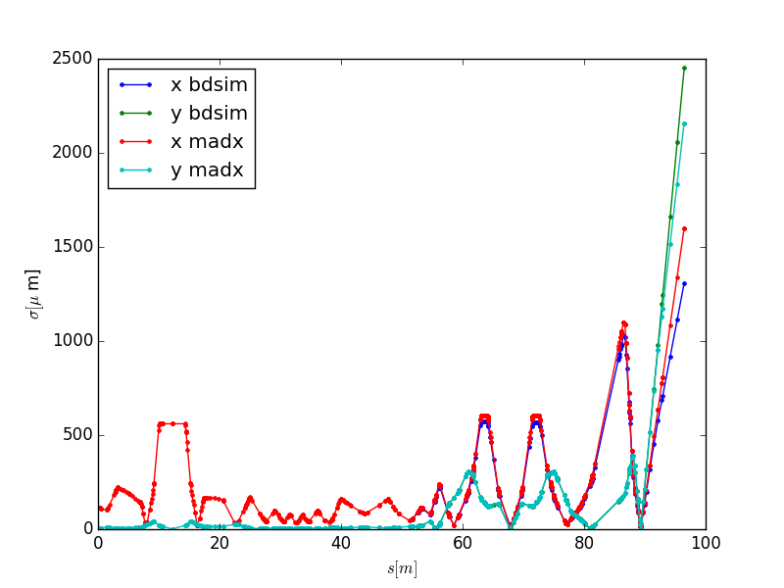

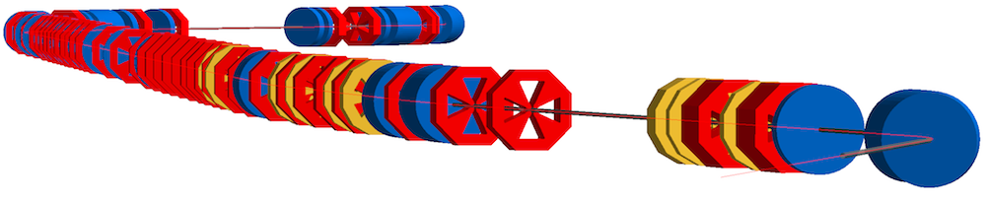
  Realistic collimation efficiency and related measurements 2016: Introduction
  Motivation
  Benchmark the realistic collimation system efficiency studies performed with the tracking code BDSIM
BDSIM is a Geant4 extension toolkit for in-vacuum thick-lens tracking as well as the full physics processes of Geant4 when the particles propagate in material machines
Significant recent development of BDSIM has been performed and need to be validate against a real machine
ATF2 model has been update in 2016 by RHUL team and reproduces the nominal optics from particle tracking
Some geometry upgrades are been performed for better agreement with measurements (more by A. Schuetz)
Notes:
So the vertical prototype is now under construction at LAL, we already received most of the components, still the chamber and the jaws as to be manufactured but we plan to installed it in the second week of February when there is one week with no operation. Then we will work on the software design and implementation of the controllers in the ATF2 control room and we will proceed to perform control tests and calibration by using the BPMs and the DS. Then, we want to perform some experimental studies: the first one consist in background studies by using some of the detectrs that are currentlly installed at ATF2 and correlate the increase of background with the collimator position. This measurements can later be compared with BDSIM. And the second one consist in measuring the wakefield impact by measuring the orbit variation for different positions of the collimator, measurements that will be compared with simulations.

Slide 17
  Realistic collimation efficiency and related measurements 2016: Results
  Measurements were taken in March 11th 2016 with the DSs
  To confirm the beam halo DS measurements by measuring the beam halo cut expected due to the collimation system
  These measurements were benchmarked with the WS and the observed cuts are in agreement with MADX-PTC simulation within 1 σ_{y}

Slide 18
  Realistic collimation efficiency and related measurements: Results
  Realistic collimation system efficiency studies
  The relative background is reduced when the collimator is closed more than 6 mm
ΔγCE [%]
Background monitor
  The reduction of photons generated in the BDUMP was modeled using BDSIM (Geant4) as a function of the vertical collimation system half aperture showing good consistency with measurements
Entrance of the BDUMP
BDUMP Window for γ

Slide 19
  Realistic collimation efficiency and related measurements: Results
Background monitor measurements for different vacuum and optics
(May 2016, I=0.9x10¹⁰)
(March 2016, I=0.7x10¹⁰)
with the help of M. Patecki
The background level increases for high intensity, high vacuum pressure and low β
To achieve the same level of background :
No change in the collimation depth is observed with different vacuum pressure
For low β optics the collimation depth has to be reduced about 3 σ_{y}
Measurements were taken in December 2016 with the IPBSM for the (10βx × 1βy)
optics and nominal machine conditions and no collimator aperture correlated effect was observed

Slide 20
Summary
A retractable vertical collimation system was installed in ATF2 in March 2016 and the functionality and efficiency in reducing the background photons in the Post-IP has been measured successfully.
The reduction of photons generated in the BDUMP was modeled using BDSIM (Genat4) as a function of the vertical collimation system half aperture showing good consistency with measurements.
The collimator WF impact has been completely studied by means of analytic models, numeric simulations and measurements. A 10% agreement on the benchmarking between CST PS simulations and measurements has been measured which gives us the possibility to understand the impact of such a system improving the accuracy of past measurements. This is crucial for FLCs since the ATF2 vertical collimation system was inspired on a first mechanical design of the ILC spoilers.
    These WF measurements give confidence on the CST PS simulations, the wake potential calculated can be introduced in tracking codes. The scaling to the ILC bunch length of the CST PS simulations for ATF2 has to be made.

Slide 21
Thank you very much to the whole ATF2 collaboration for the help, beam time and knowledge shared! It has been a very nice experience!

Slide 22
Back up…

Slide 23
Halo collimation betatron depth
Beam dynamics simulation and realistic tracking studies
Aperture (mm) | Vertical (σ_{y}=0.3265) | Horizontal (σ_{x}=0.5592)
5 | 15σ_{y} | 9σ_{x}
6 | 18σ_{y} | 11σ_{x}
7 | 21σ_{y} | 13σ_{x}
8 | 24σ_{y} | 15σ_{x}
10 | 30σ_{y} | 18σ_{x}
12 | 37σ_{y} | 21σ_{x}
15 | 46σ_{y} | 27σ_{x}

Slide 24
  Optics considerations studies and location optimization
The choice of the best location for a collimation system is a tradeoff between the the optics, the collimation depth required and the wakefield impact induced
For a given collimator aperture, a_{x,y} , the betatron collimation depth, N_{x,y} , is defined:
The wakefield beam impact of a rectangular collimation system:
Amplification factor
Where κ_{T} depends on the geometry and material of the collimator
    (Collimator Wakefield Calculations for ILC-TDR Report, P. Tenenbaum, LCC-0101, August 2002)
Optics considerations for a single rectangular betatron collimation jaw:
  High β_{x,y} for a given N with bigger a
  Δμ_{x,y}=nπ in phase with the collimation point (BDUMP and DS)
  D_{x,y} ≅ 0 for a pure betatron collimation
Notes:
So, the first thing when designing a collimation system is to find the more appropriate location. The choice of the beta location is a treadoff between the collimation depth required and the wakefield produced. Also in our case the system was not planned when the beamline was built and the available space may be limited. The collimation depth is defined as the half aperture of the collimator divided by the beam size. So, in order to have a high efficient system from the optics point of view considering only one block of matter we need a location with high beta allowing us for the same collimation depth to open more the collimator. We need the system to be in phase with the locations where we want to collimate. In our case the BDUMP and the DS. And also we look for a location with dispersion close to 0 in order to control the kind of collimation we are performing. Then if we look at the wakefield impact of a rectangular jaw we can see that the amplification factor which characterize the impact of the wakefields induced is proportional to the beat function but inversely proportional to the half aperture squared. I repeat this is for a rectangula jaw.

Slide 25
  Collimation efficiency and related measurements: Results
Measurements were taken in May 2016 to investigate the collimation and TBP efficiency
The TBP works as a collimation system but limited to a maximum symmetric cut of 18 σ_{y}
for a centered beam in the BDUMP a 25-35% reduction of background is measured (orbit dependence)In order to achieve the same impact the vertical collimation system has to be closed between 5- 6 mm corresponding to 15-18 σ_{y}

Slide 26
Wakefield design considerations and impact study
Vertical wake potential
y
Beam
_{Wy}
z
Beam: σ_{z}=7 mm , N=10⁶ , 1mm vertical offset
Jaws made of Cu and rest made of SS
Jaws parameters : Lf: 100 mm, α: 3°
1mm vertical offset
aV=5 mm
κ_{T} = 0.028 V/pC/mm
aV=8 mm
κ_{T} = 0.008 V/pC/mm
κ_{T}
Reference cavity:
κ_{T} = 0.079 V/pC/mm
Round tapered structure:
κ_{T} = 0.006 V/pC/mm
Notes:
So, then, we performed simulations with CST PS of the real mechanical design. In the top of this slide we can see first the prototype, then the resulting wake potential for different half apertures of the collimator. And then by integrating the wake potential convoluted with the gaussian beam distribution we find the transverse kick factor in the bottom plot as a function of the half aperture. This kick can be compared with the resulting kick of some other components of ATF2 like the reference cavity and the round tapered structure which correspond to high and low level of wakefield respectevily. Our estructure opened at 8 mm has a level of wakefields as the round tapered while at 5 mm is 4.5 times bigger but still much smaller than the reference cavity

Slide 27
Wakefield collimation studies and implications for ILC
 | α | a | L_{F}
ILC SP1 | 0.02 | 0.3/0.75 | 8.6
ILC SP2 | 0.02 | 0.3/0.75 | 8.6
ILC AB1 | 0.02 | 4/4 | 429
ATF2 vertical | 0.05 | 3-12 | 100
α
L_{F}
a
z
    (ILC lattice repository: https://bitbucket.org/whitegr/ilc-lattices, M. Woodley 15-Apr-2015)
 | ILC | ATF2
E [GeV] | 500 | 1.3
N_{b} | 20 x10⁹ | 10 x10⁹
σ_{z} [mm] | 0.3 | 7
ε*_{x,y} (geometric) | 11 mm/0.07 pm | 4-40mm/12pm
β*_{x,y} [mm] | 15/0.4 | 40/0.1

