Slide 1
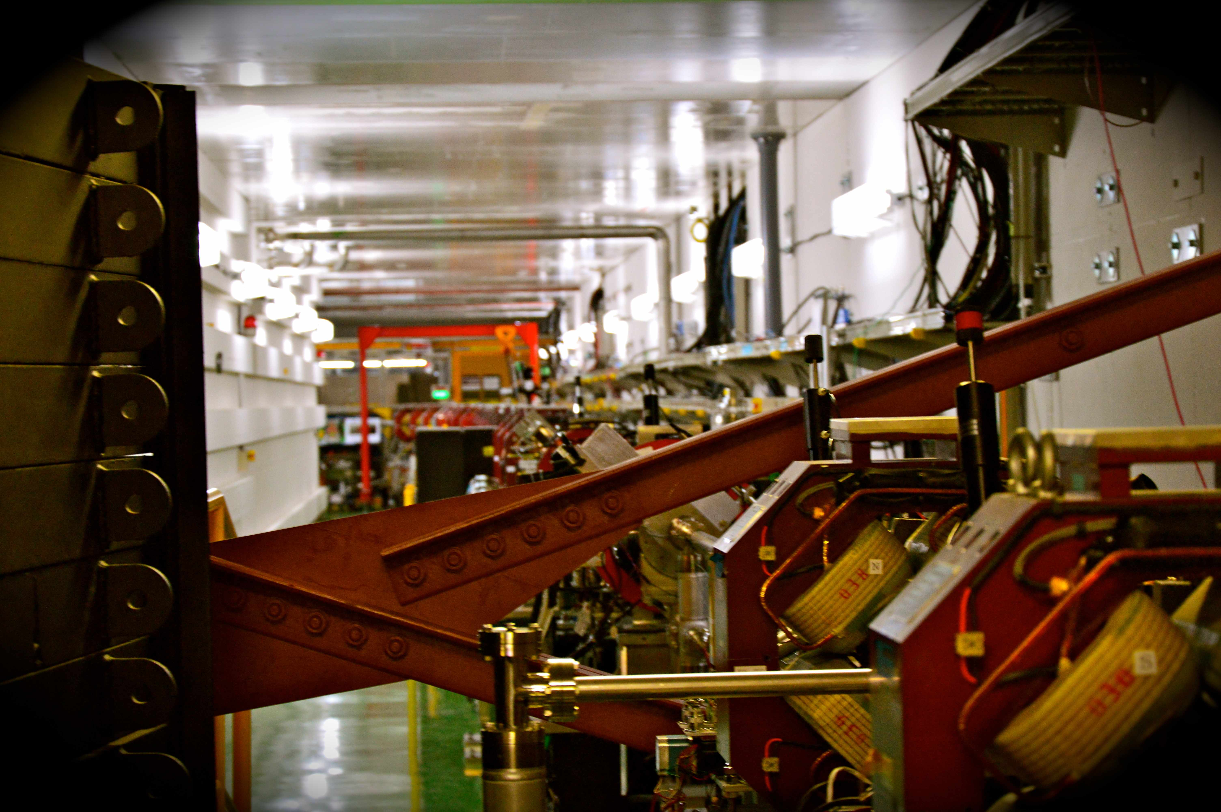
TB 20th ATF2 Collaboration meeting
A. Faus-Golfe (LAL)
15/03/2017
20th ATF2 project meeting

Slide 2
Outline
  ATF2 Studies
    Procurement, measurement and installation of 2 octupoles for ATF2
    Experience with half β_{y}* in ATF2
    Analysis of the beam halo collimation system measurements
    Simulation and measurement of beam halo at ATF (YAG/OTR)
    BDSIM simulation studies of the background measured at ATF2 in dependence on the vertical beam halo collimator
  Goal 2
    Status of IPBPM performance and resolution studies
    Beam stabilization at the IP using the upstream FONT system
    IP BPM movers calibration
    Proposed Changes to IP-BPMs
    Stray field measurements
    PLACET Simulations of Intensity-dependent effects at ATF2
  Goal 1
    Motivation
    Results
20th ATF2 project meeting

Slide 3
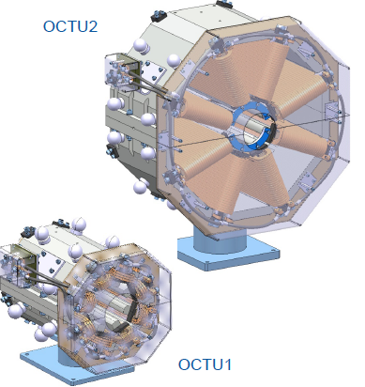
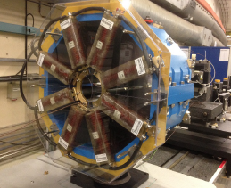
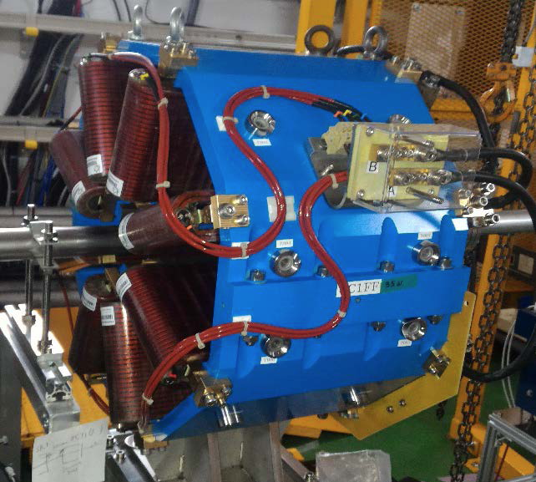
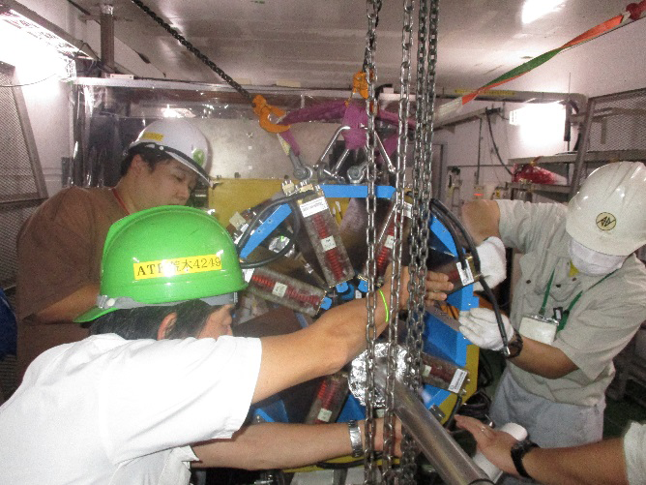
Procurement, measurement and installation of 2 octupoles for ATF2
The CERN procurement of 2 Octupoles for further exploration of nanometre beam size beam dynamic was agreed in 2014 after a proposal presented at the CERN Midterm Collaboration meeting. This would have been part of the hardware CERN contributions for the prosecution of the ATF program.
The designs converged to the following detailed 3D views and parameter set. The final required integrated gradient were: 212 and 2046 T/m²
The 2 magnets were assembled in June-July 2016 and tested at CERN in August.
Installation is now completed. Both magnets are mounted on micrometric tables.
First electrical checks at installation were done with a temporary power supply all tests were positive.
The magnets were sent to ATF in August. The magnets were finally installed in ATF on the 9-11 Nov. 2016.
20th ATF2 project meeting

Slide 4

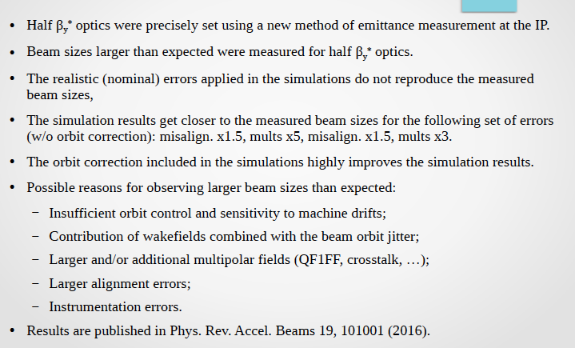
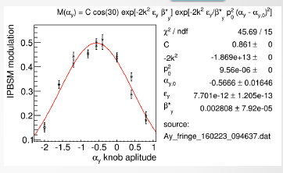
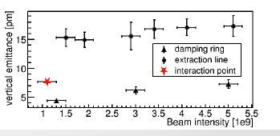
20th ATF2 project meeting

Slide 5
Analysis of the beam halo collimation system measurements
A retractable vertical collimation system was installed in ATF2 in March 2016 and the functionality and efficiency in reducing the background photons in the Post-IP has been measured successfully.
The reduction of photons generated in the BDUMP was modeled using BDSIM (Genat4) as a function of the vertical collimation system half aperture showing good consistency with measurements.
The collimator WF impact has been completely studied by means of analytic models, numeric simulations and measurements. A 10% agreement on the benchmarking between CST PS simulations and measurements has been measured which gives us the possibility to understand the impact of such a system improving the accuracy of past measurements. This is crucial for FLCs since the ATF2 vertical collimation system was inspired on a first mechanical design of the ILC spoilers.
    These WF measurements give confidence on the CST PS simulations, the wake potential calculated can be introduced in tracking codes. The scaling to the ILC bunch length of the CST PS simulations for ATF2 has to be made.
TBP has been removed before 2017 February run and now the collimator is the only way to reduce background in the IPBSM. It is working efficiently!!!!
20th ATF2 project meeting

Slide 6

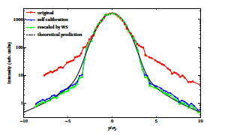
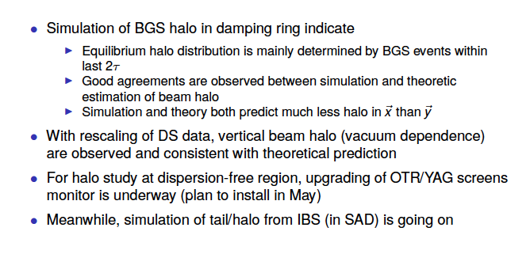

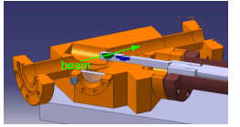
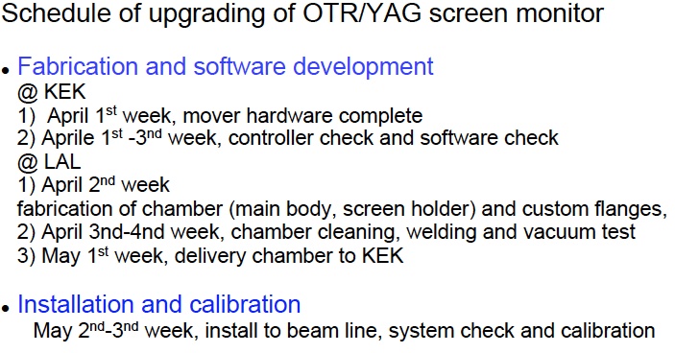
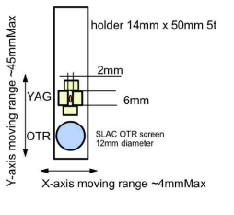
BGS: Beam Gas Scattering
20th ATF2 project meeting

Slide 7
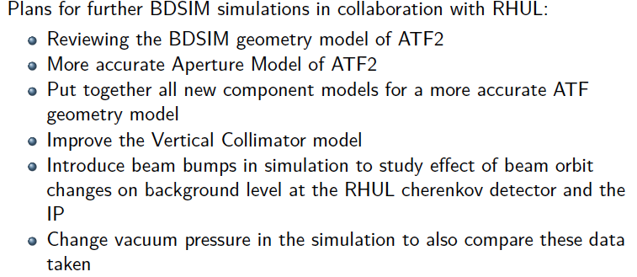
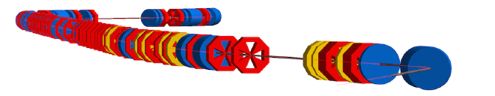
BDSIM simulation model of ATF2 & Background Studies for the Vertical Collimator System
20th ATF2 project meeting

Slide 8
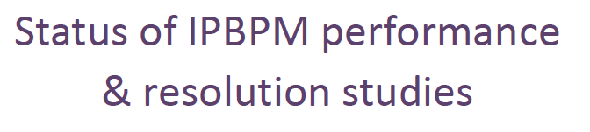
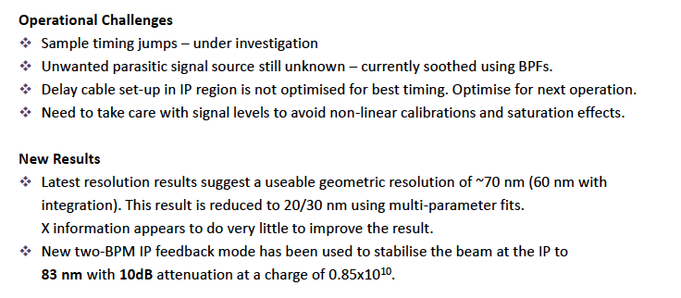
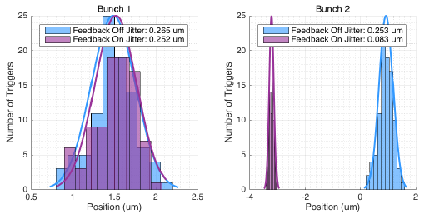

Slide 9
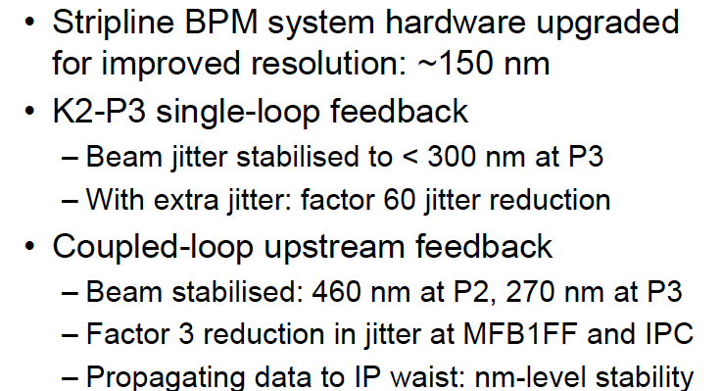
Beam stabilisation at the IP
using the upstream FONT system
20th ATF2 project meeting

Slide 10
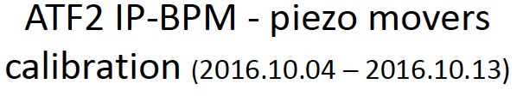
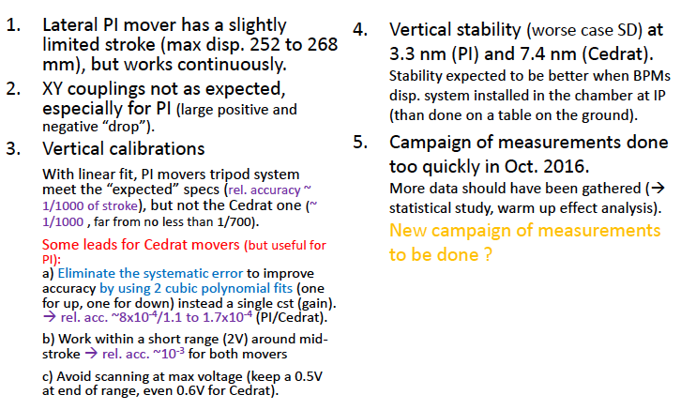

Slide 11

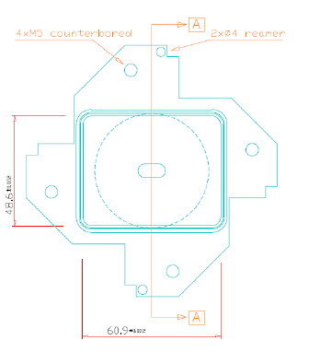
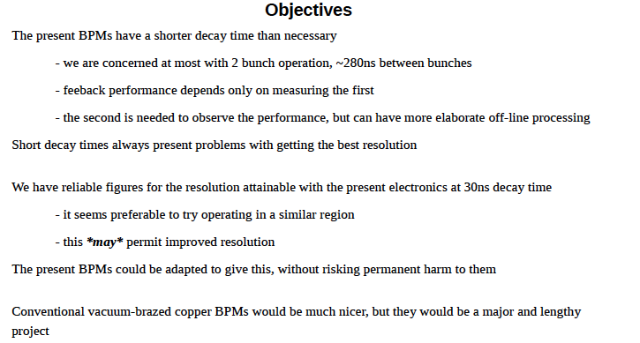
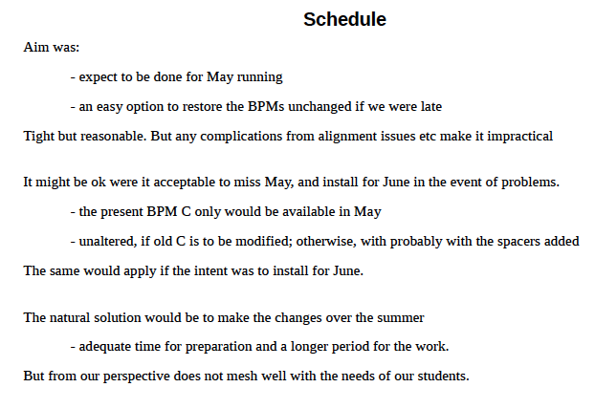
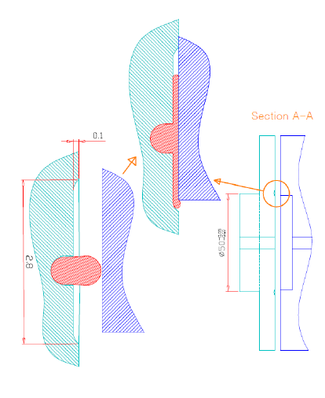

Slide 12

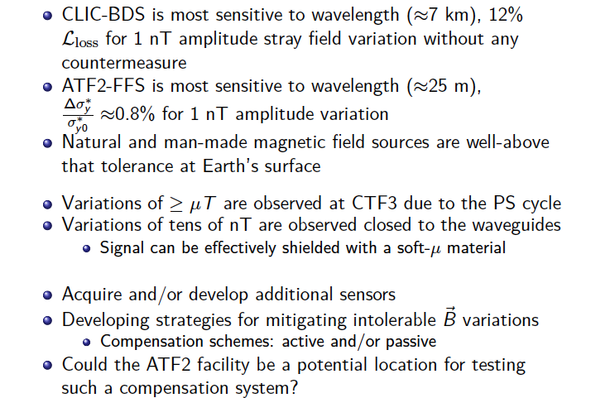

Slide 13

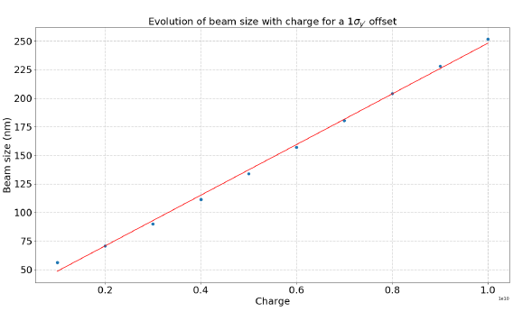
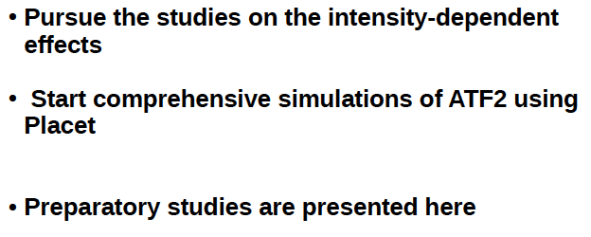
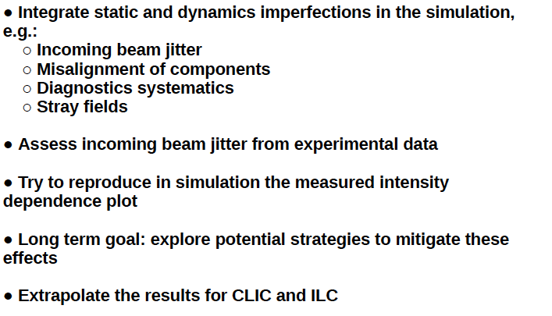
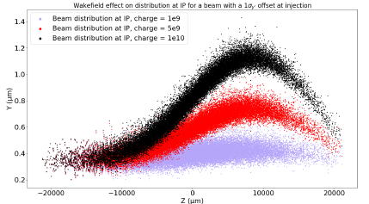

Slide 14
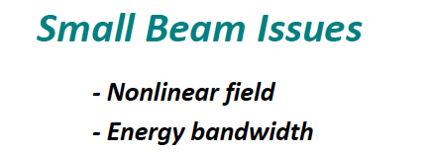

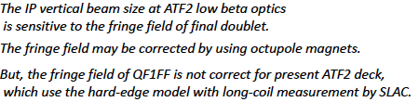
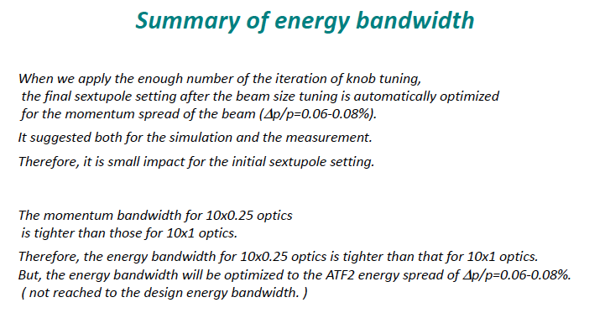

Slide 15
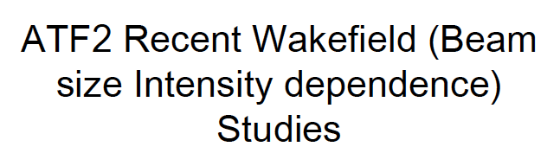
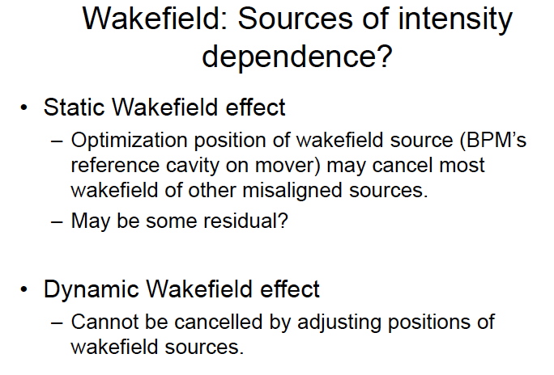
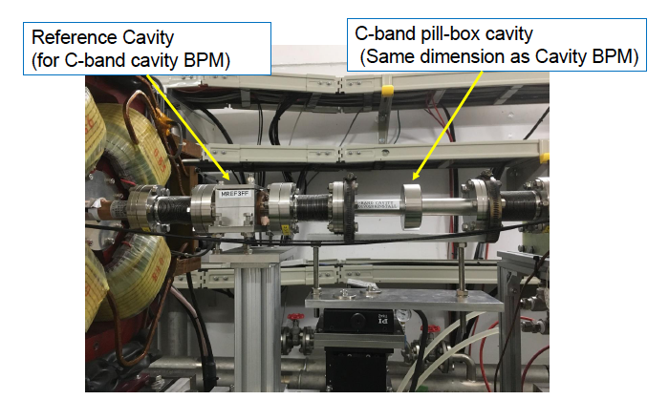
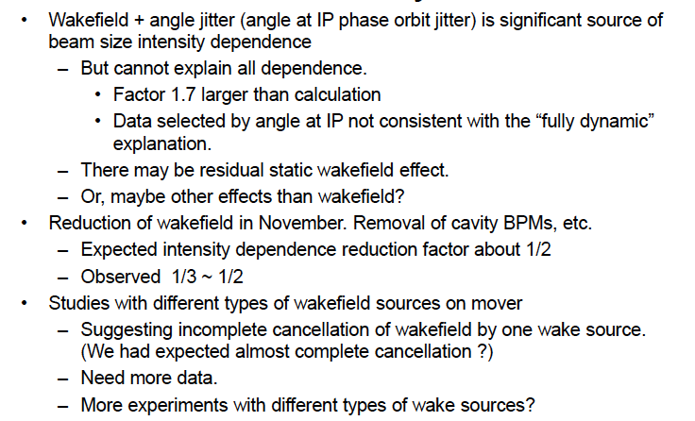
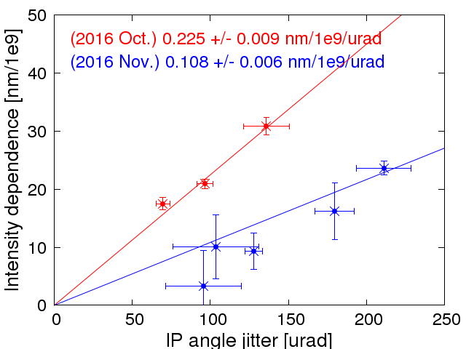

Slide 16

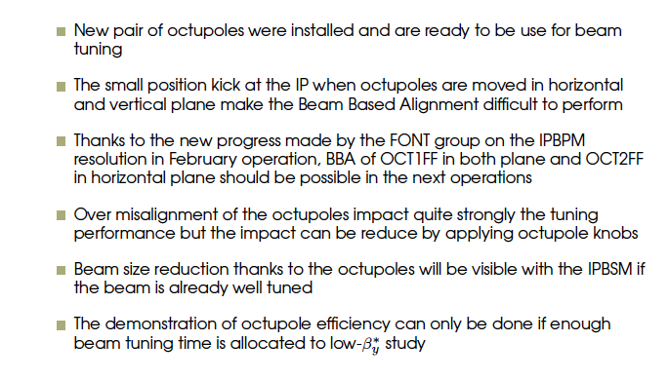
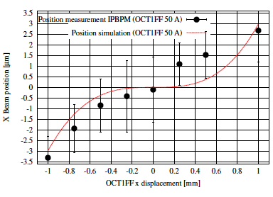
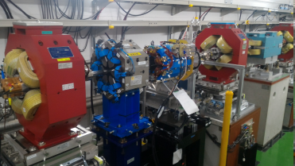
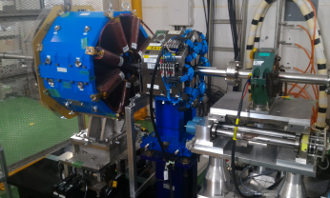

Slide 17

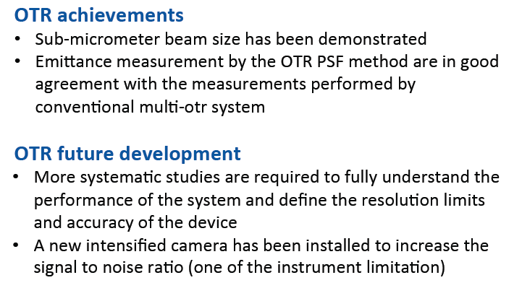
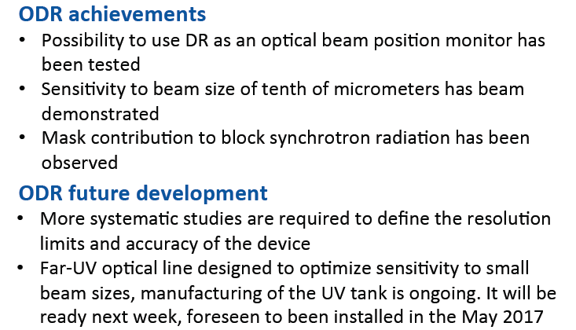
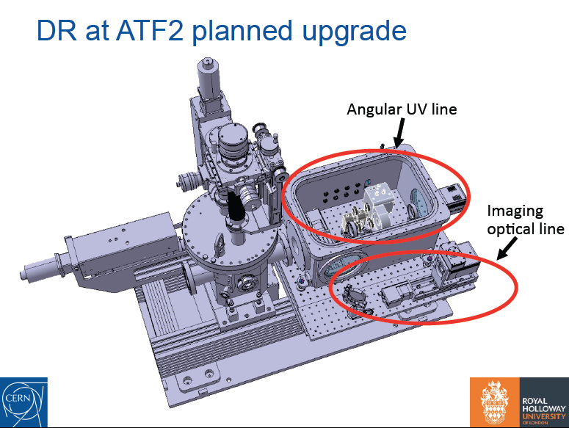
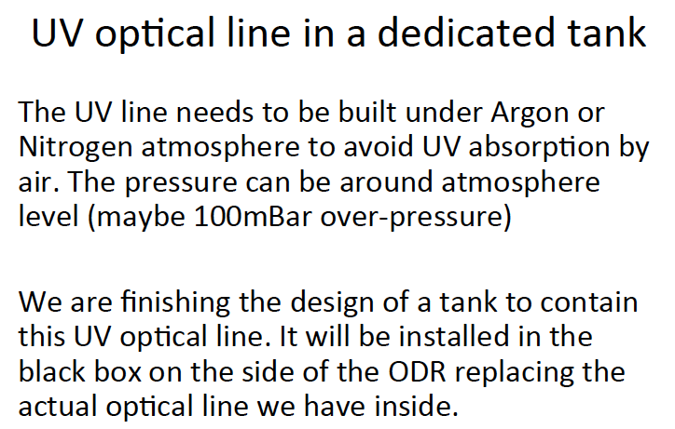

Slide 18
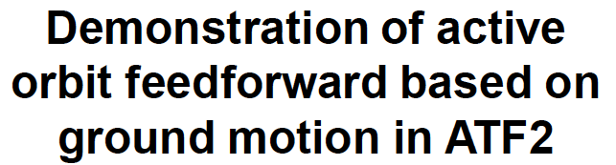
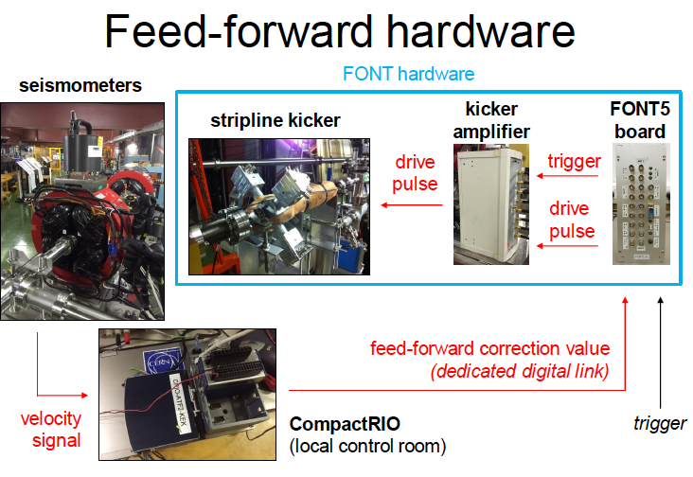
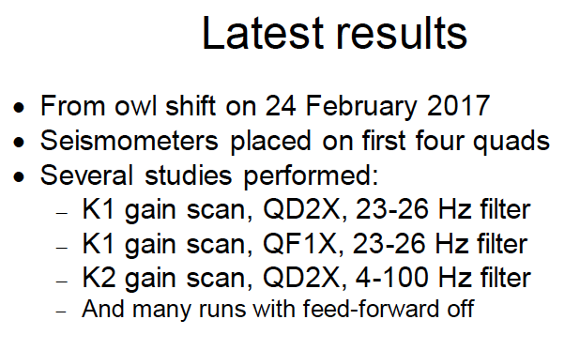
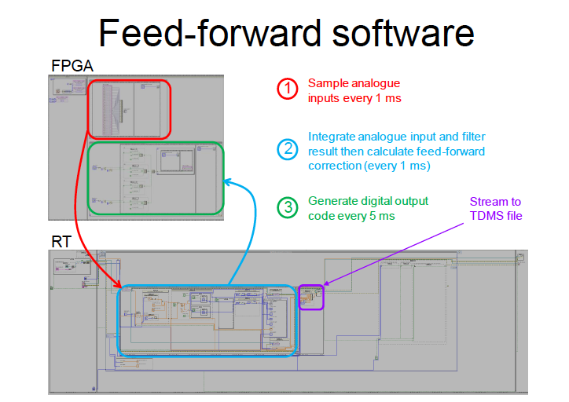


Slide 19





Slide 20
Ongoing PhDs
 | Instiutution | Expected Final year | Subject
M Patecki | CERN-U. Warsaw | Mai 2017 | ultra lowb*
N. Fuster Martinez | IFIC | June 2017 | collimation
M. Bergamaschi | CERN-RHUL | October 2017 | OTR-ODR
F. Plassard | CERN-UpSud | January 2018 | octupoles / long l*
T. Bromwich | JAI | March 2018 | FONT5 IPBPMs
A. Schuetz | DESY | March 2018 | backgrounds
R. Yang | UpSud | September 2018 | Halo formation
P. Korysko | JAI | October 2019 | wakefields

Slide 21
Thank you for participating in the 20th ATF2 Project meeting and make possible this fruitful collaboration
20th ATF2 project meeting

