Slide 1

International Review of the Cooling and Ventilation Systems Design for HL-LHC
Introduction to the HL-LHC project
Laurent Tavian, CERN, ATS-DO
14 March 2017- CERN

Slide 2
Table of contents
Main goals and upgrades of the LHC machine
The HL-LHC project structure and the integration of the cooling and ventilation package
The master schedule of the HL-LHC project

Slide 3
Large project timeline
1980
1985
1995
2000
2005
2010
2015
2020
2025
2030
2035
1990
2040
Construction
Physics
Upgr
LEP
Design
Proto
Construction
Physics
LHC
Design
Construct
Physics
HL-LHC
~25 years
the High-Luminosity LHC project
or
the Hi-Lumi LHC project
Increase by a factor 10 of the integrated luminosity delivered to the experiments

Slide 4
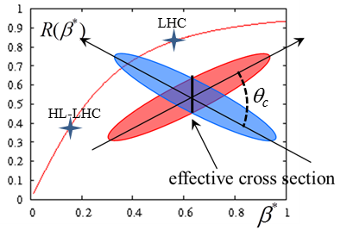
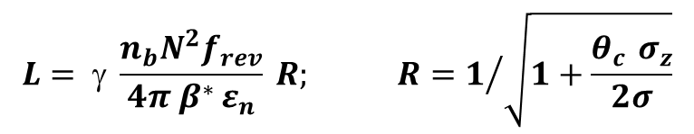
Paths to high luminosity
Increase bunch population
(number of protons)
Increase R = reduce crossing angle?
$$L= γ \frac{n_{b}N^{2}f_{rev}}{4π β^{∗ }ε_{n}} R; R=1/{\sqrt{1+\frac{θ_{c }σ_{z}}{2σ}}}$$
Reduce beta at collision
(bunch size)
Reduce emittance
(spread of particles in position and momentum)
Beam-beam effect precludes too low crossing angle

Slide 5
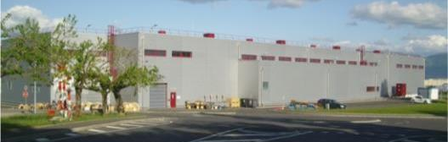
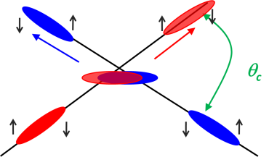

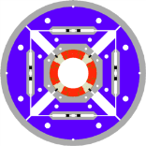
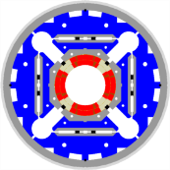
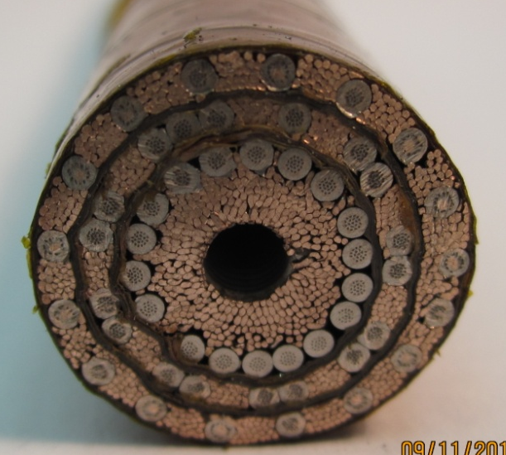
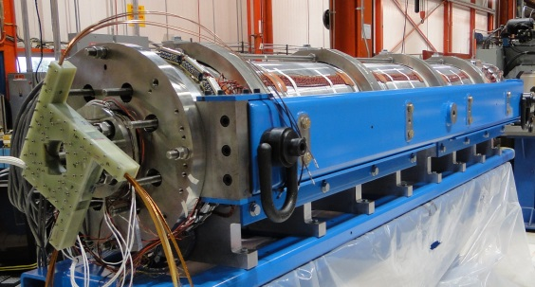
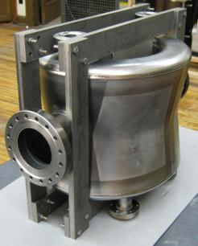
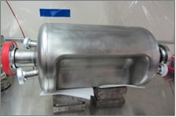
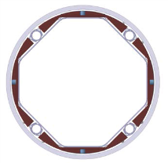
The HL-LHC project
From accelerator physics to technology
Reduce emittance
Increase bunch population
Reduce beta at collision
Reduce crossing angle
Accelerator physics
Increase intensity & brightness of injectors: the LIU project
Limit beam-beam effect
More powerful cryogenics
Improved collimation
Improved machine protection
Stronger Radiation to Electronics → relocation in new caverns and galleries
New low-beta quadrupoles
“Crab” cavities
Accelerator technology
Ph. Lebrun

Slide 6
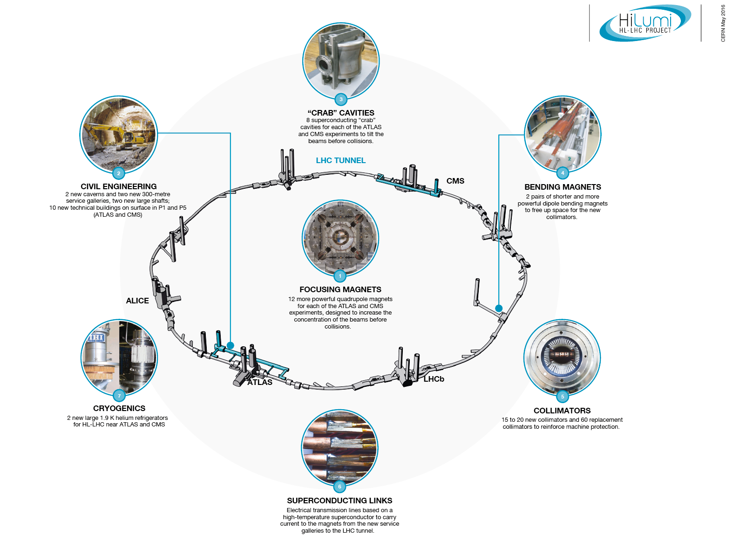
HiLumi LHC landmarks

Slide 7





The Inner Triplet region with in-kinds
Connection to LHC (UL)
Service gallery (UR)
SC Links
Q2a
Q1
TAXS
Q2b
CP
Q3
DFX
D1
DFM

Slide 8


The MS region with in-kinds
UA gallery
Service cavern
(BBLR)
Q4
Crab cavities
D2
Collimators
TAXN
Staging of crab cavities:
Start with 2/4 units per side
Keep the option of installing 4/4 units per side

Slide 9
HL-LHC Project structure and WP17

Slide 10
Technical infrastructure inventory
The main
cost drivers of the technical infrastructure!
WP17.1: Civil engineering
WP17.2: Electrical distribution
WP17.3: Cooling and ventilation
WP17.4: Access & alarm system
WP17.5: Technical monitoring system
WP17.6: N/A (Survey → WP15.4)
WP17.7: Transport
WP17.8: Contribution to SM18 upgrade
WP17.9: Logistics and storage
WP17.10: Operational safety

Slide 11
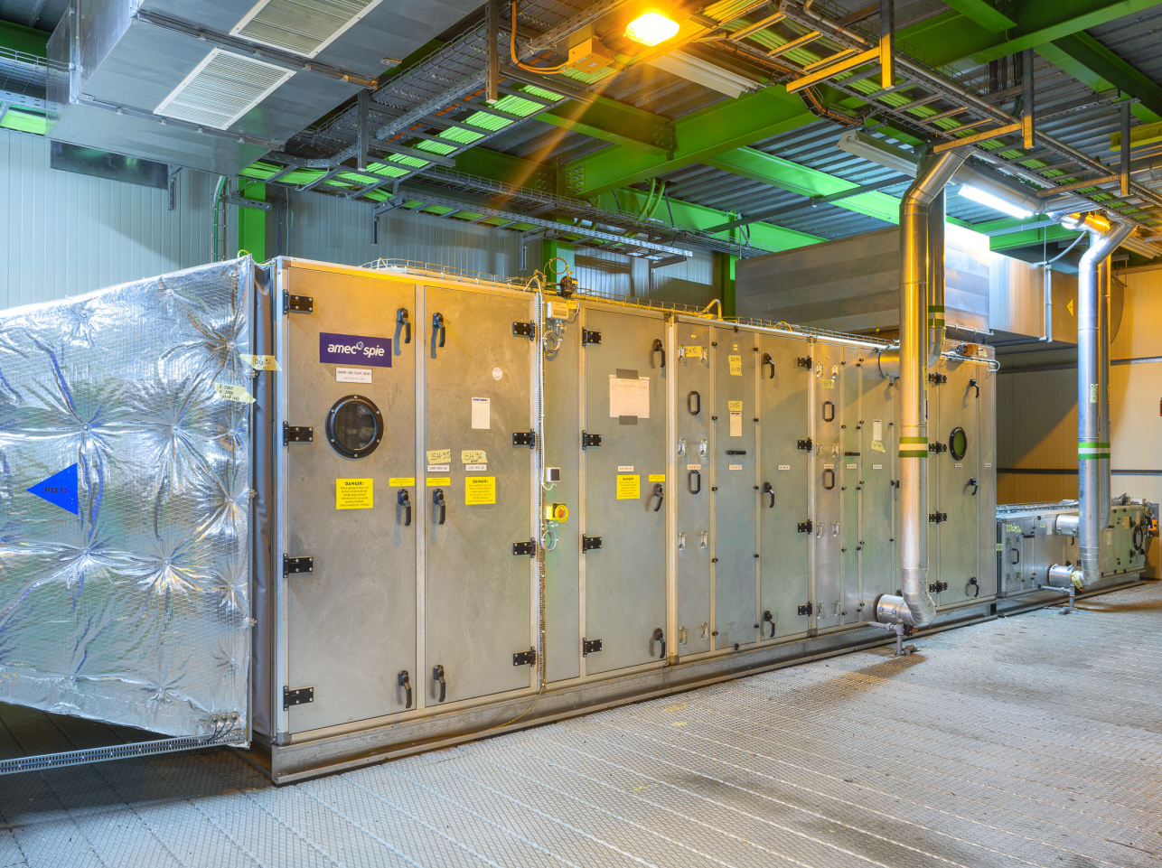
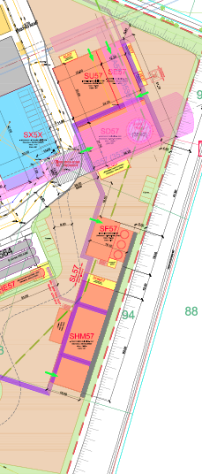
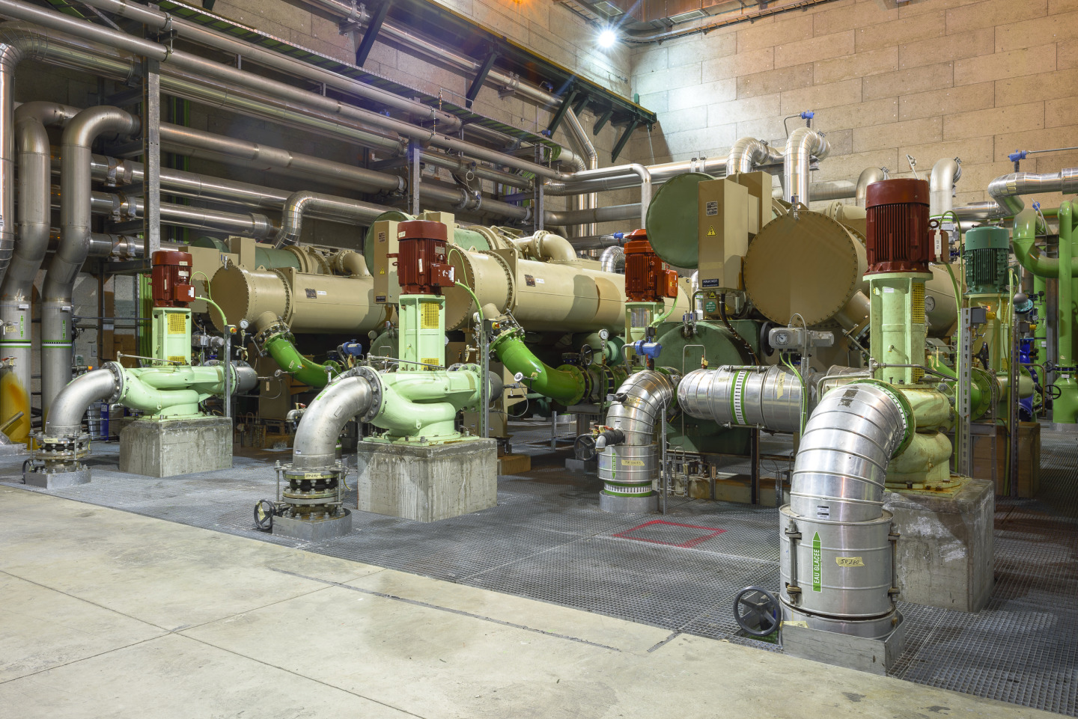
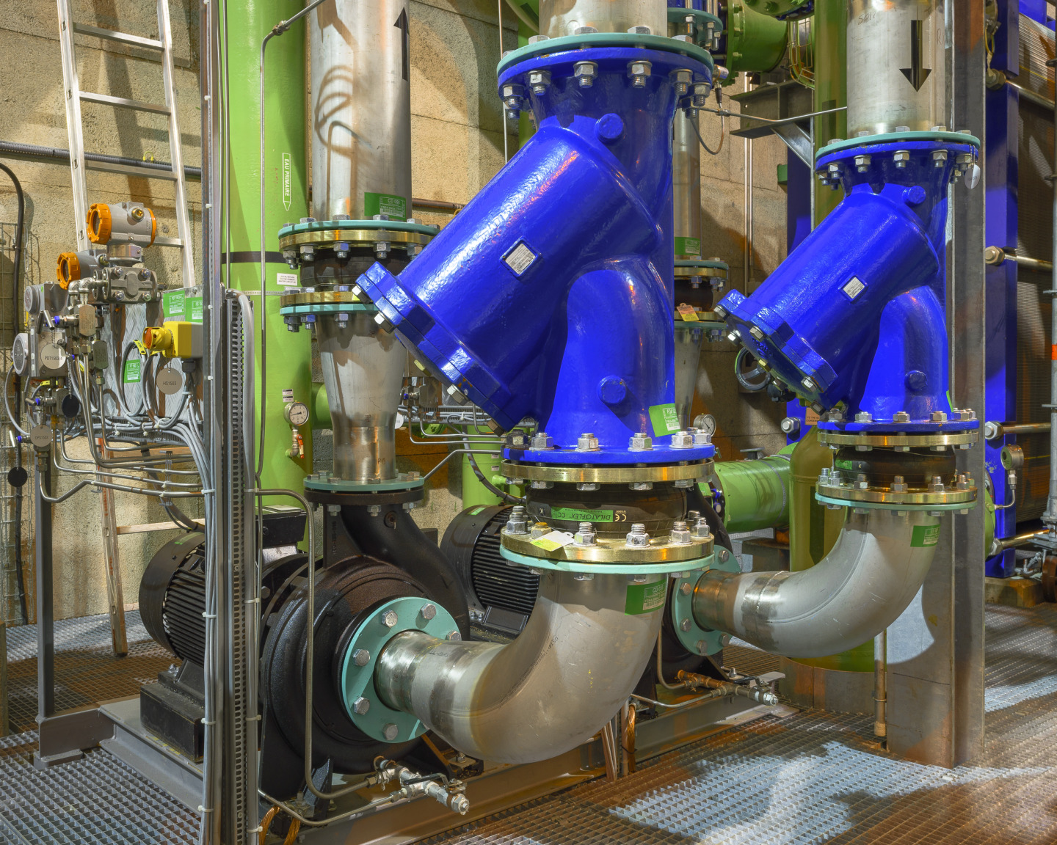
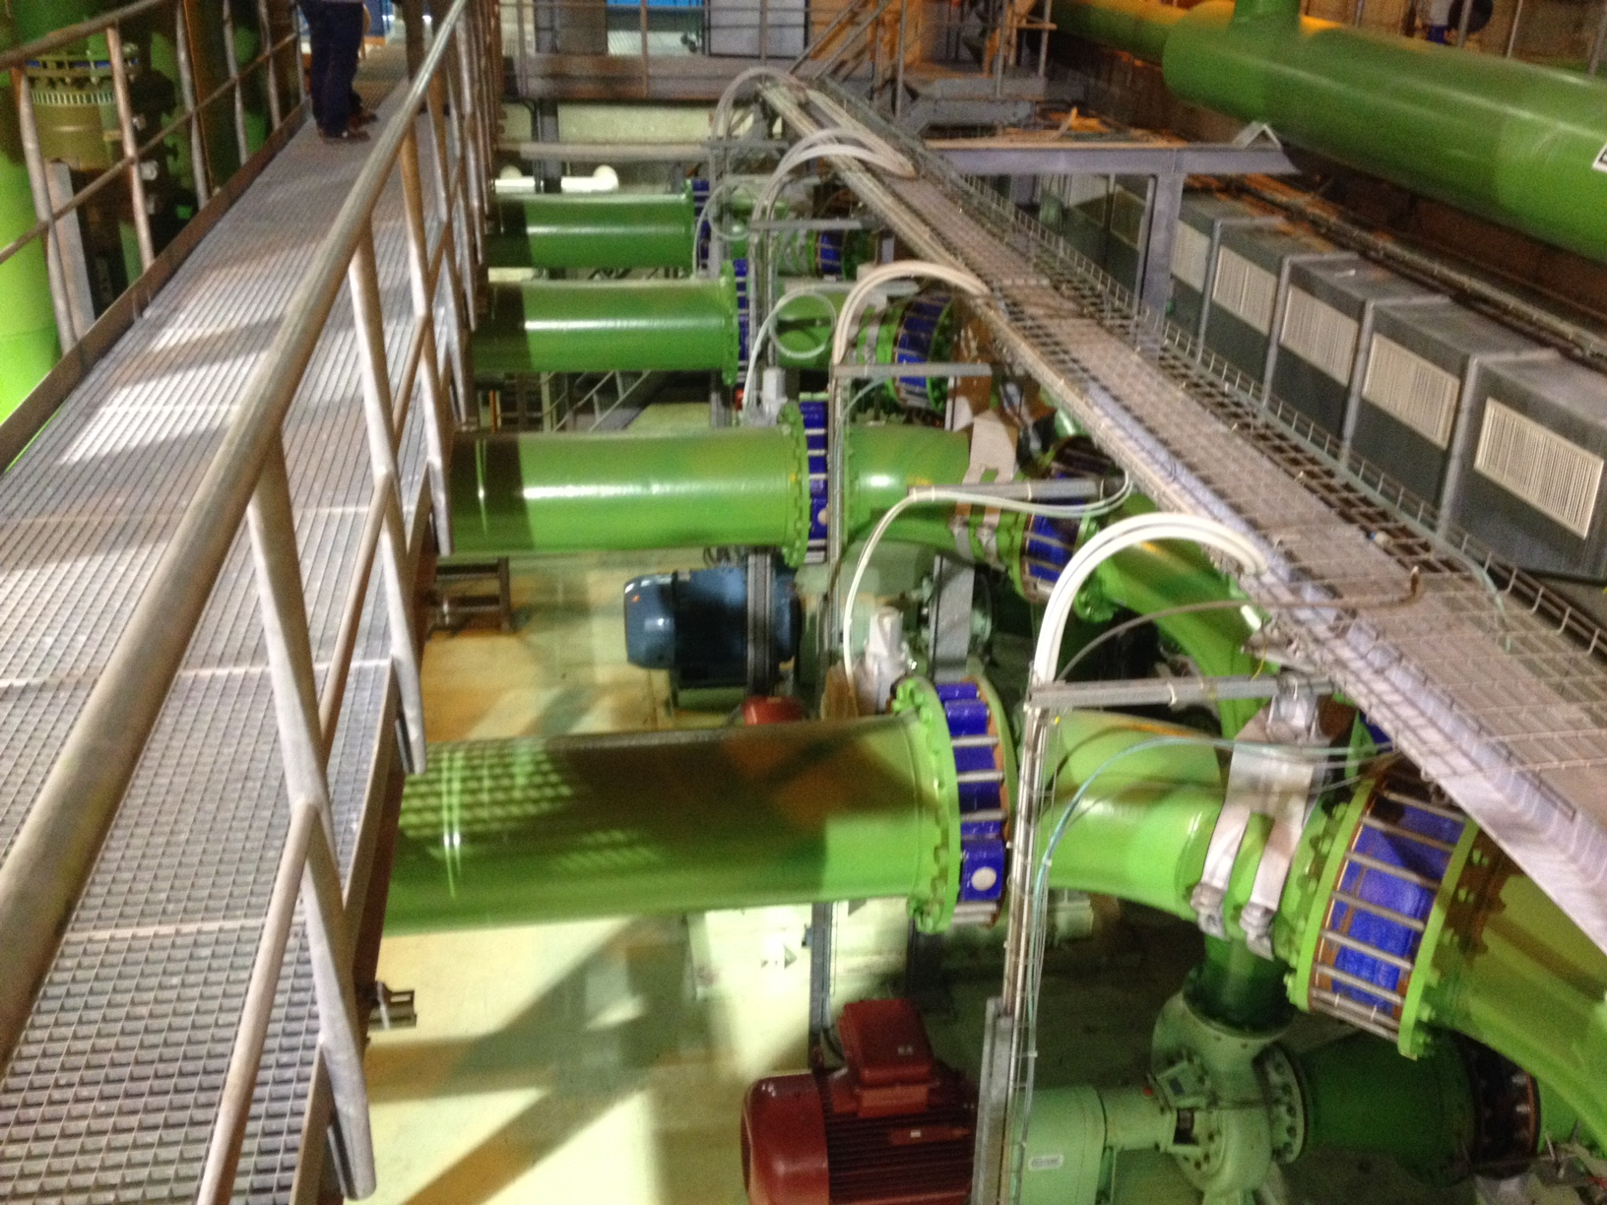
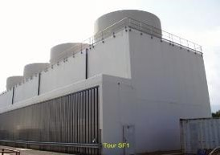
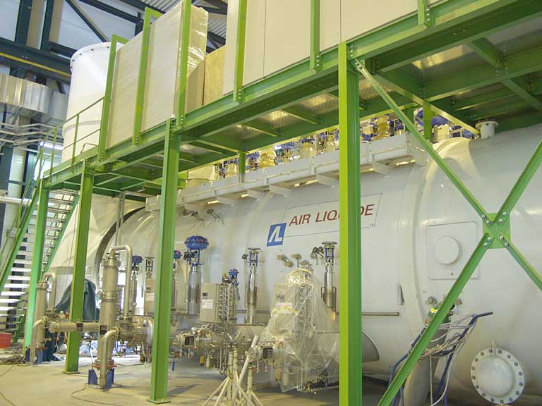
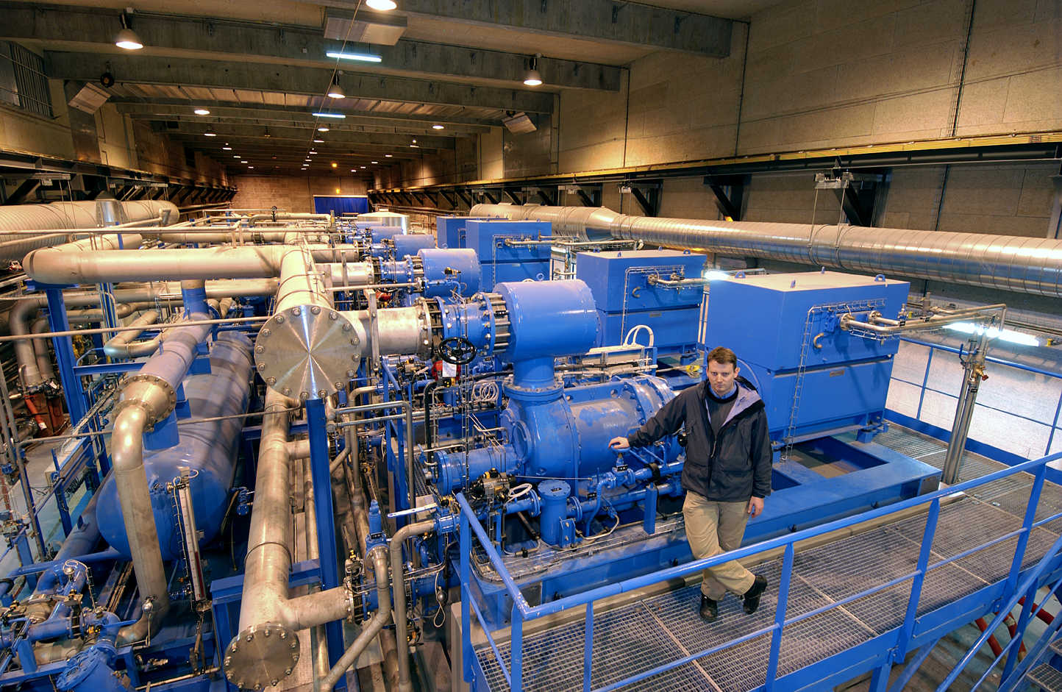
Technical infrastructures at Point 5
SU Ventilation units
SU chillers & pumping stations
SF cooling towers
SD He refrigerator
SHM Helium compressor station

Slide 12
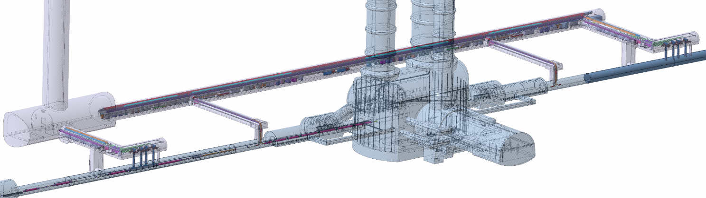
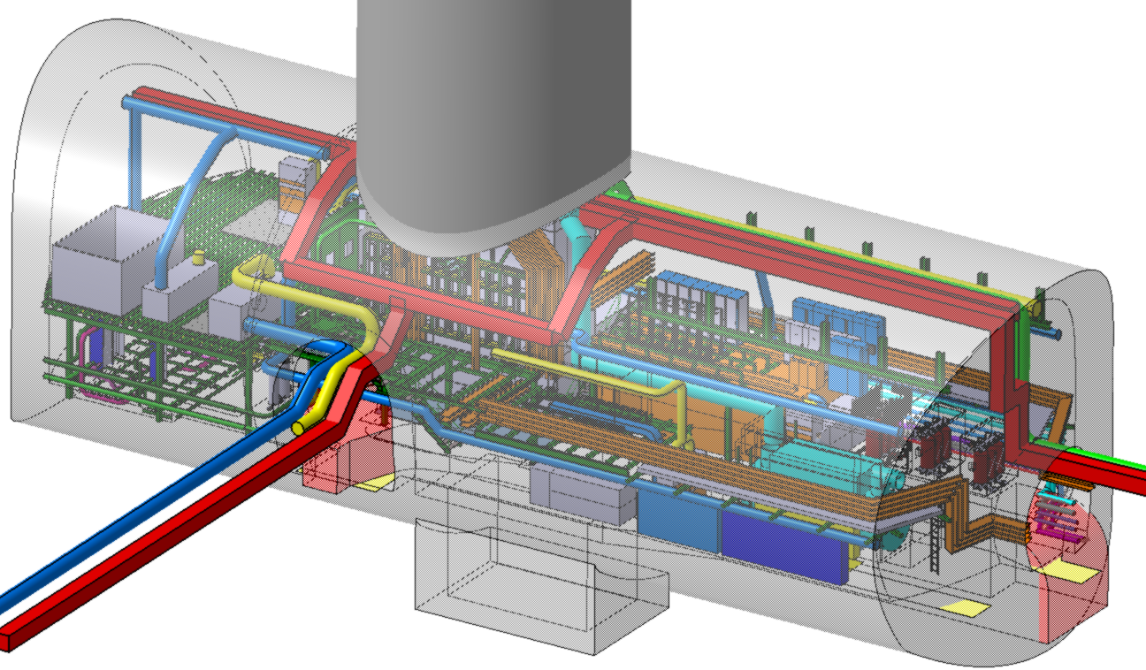
Underground structure (e.g. US/UW cavern)
Cooling & ventilation
Safe room
Transformers
Ventilation & smoke-extraction ducts
Cold box

Slide 13
Master schedule
Courtesy of Planning team

Slide 14
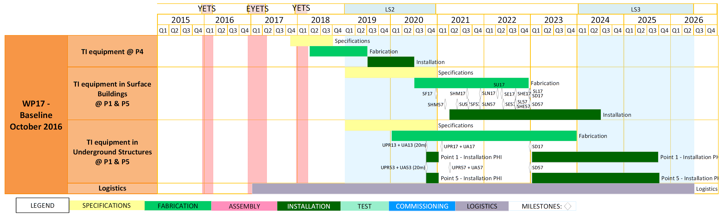
WP17 schedule (w/o civil-engineering)
Courtesy of Planning team

Slide 15
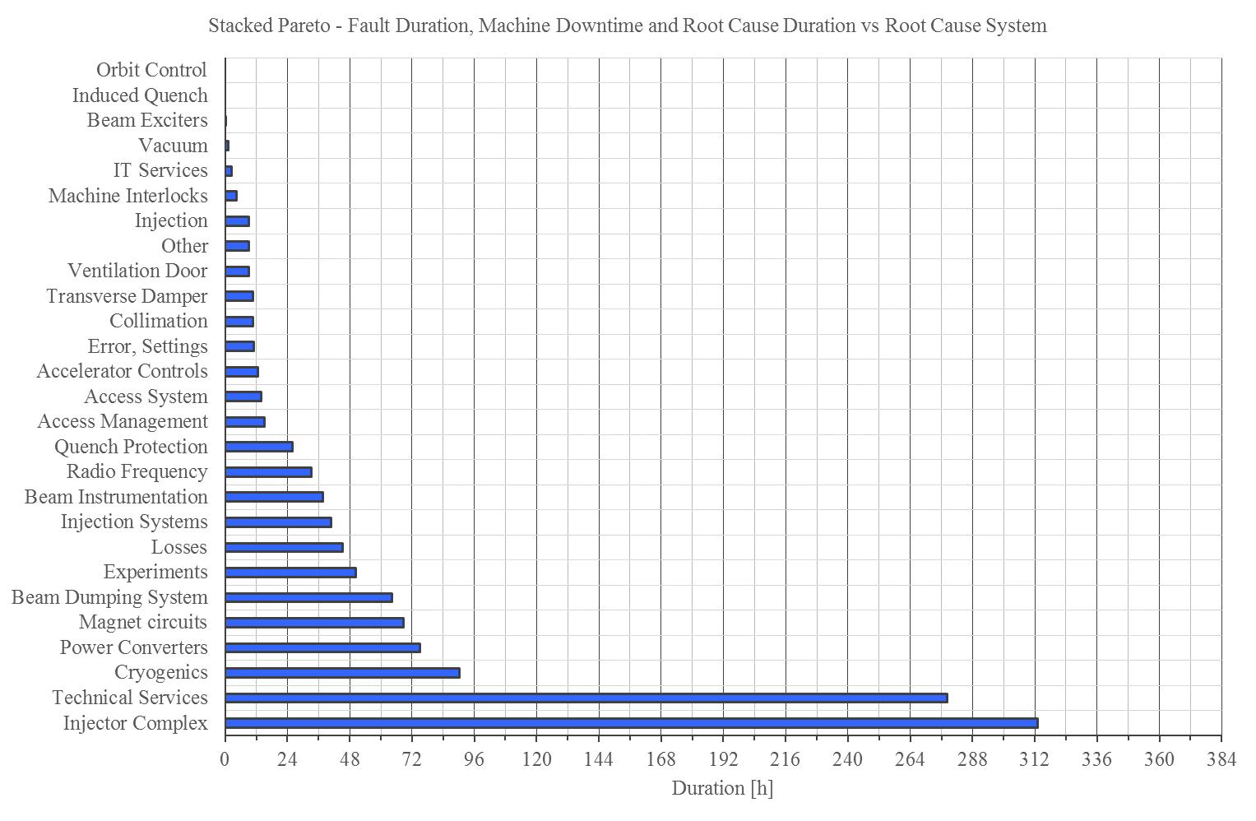
2016 downtime per system of LHC machine
Technical infrastructure faults have a large impact on overall availability
→ Good reliability mandatory

Slide 16
Introduction to the review
Recommendations of the last C&S Review (Oct’16)

Slide 17
Thank you!

