Slide 1

Cooling and Ventilation for HL-LHC
(WP17.3)
INTRODUCTION
Michele Battistin, Frederic Borralho, Alexandre Broche, Alejandro Mejica, Paul Pepinster
CERN
Engineering Department
Cooling and Ventilation Group
Cooling and Ventilation Technical Review – 14th March 2017

Slide 2
Content
  Scope of the HL-LHC CV Review
  New HL Infrastructure
  Cooling Requirements
  General Planning of the Project
  Main Design Assumptions & Criteria
  Introduction to Cool & Vent Presentations

Slide 3
Content
  Scope of the HL-LHC CV Review
  New HL Infrastructure
  Cooling Requirements
  General Planning of the Project
  Main Design Assumptions & Criteria
  Introduction to Cool & Vent Presentations

Slide 4
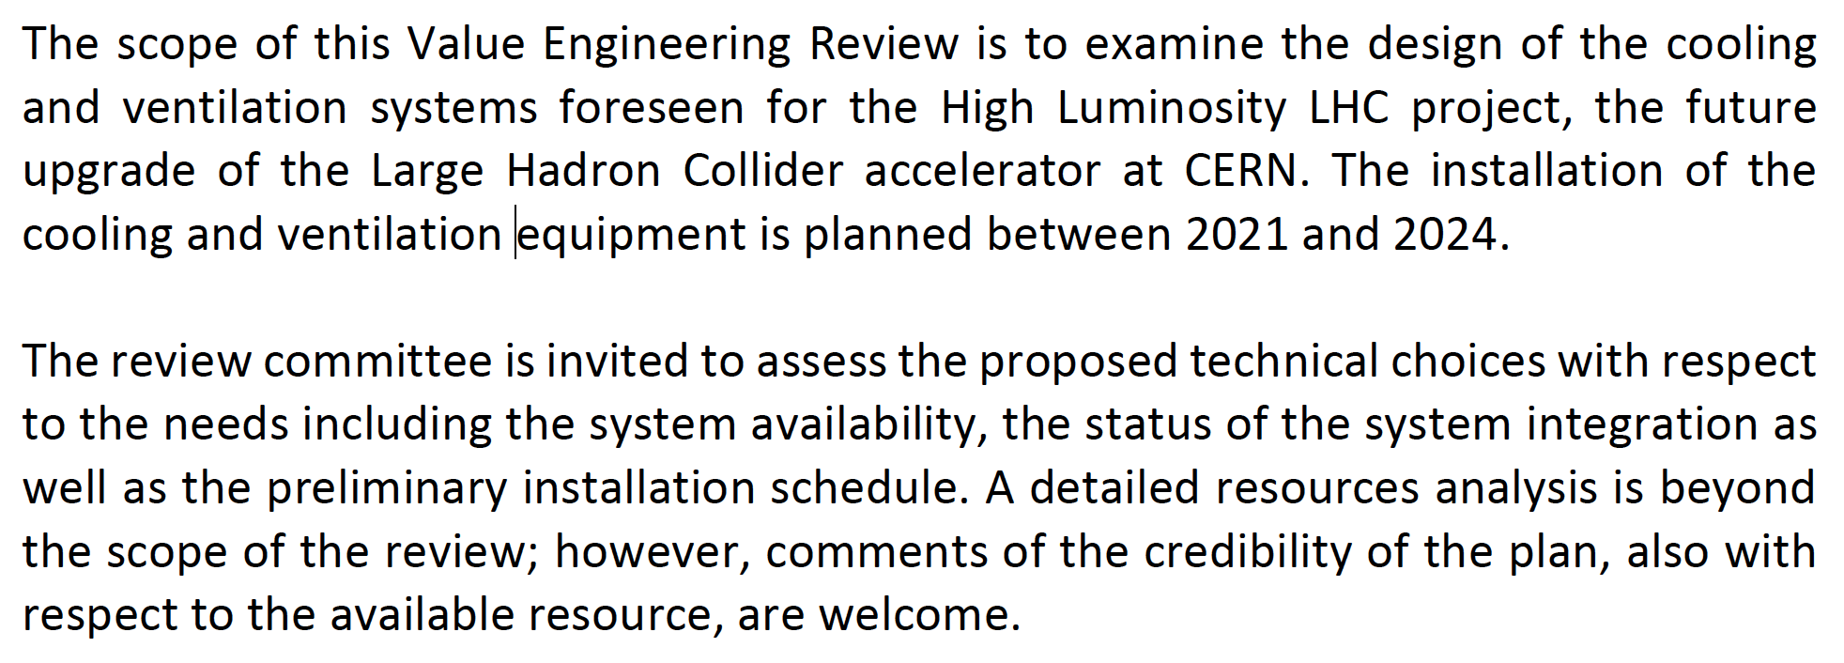
Scope of the HL-LHC CV Technical Review
Examine the design of the cooling and ventilation systems;
Assess the proposed technical choices with respect to the needs including the system availability;
Assess the advancement status of the system “integration” (incorporation of CV equipment in the 3D model of the buildings);
Assess the preliminary installation schedule;
Comment the credibility of the plan, and the adequacy of available resources for the project.
What is the review “perimeter”?

Slide 5
Scope of WP 17.3 – Cooling and Ventilation
Object of the review
  Cooling systems in point 1 and 5
  Ventilation systems in point 1 and 5
  General services (compressed air, fire-fighting water, demineralised make-up water, drinking water,…) in point 1&5
  Cryogenic equipment cooling in point 4
  Crab cavities bench test in SPS
Not object of the review
Who prepared and presents this review?
Notes:
The second part is “less demanding”

Slide 6
CERN - EN/CV
Engineering Department
Cooling and Ventilation Group
CV Group
M. Nonis
Operation Section
S. Deleval
DOW Section
Y. Body
MA Section
G. Peon
DC Section
O. Crespo
PJ
Section
M. Battistin
CL
Section
R. Barillère
Installation Maintenance and Operation
Design Office and Works Supervision
Maintenance Procedures, Installation Inventory and CMMS
Cooling Systems for Experiments Particle Detectors
Project Management and CFD studies
Control Systems
HW & SW
F. Borralho
A. Mejica
M. Battistin
P. Pepinster
A. Broche

Slide 7
Content
  Scope of the HL-LHC CV Review
  New HL Infrastructure
  Cooling Requirements
  General Planning of the Project
  Main Design Assumptions & Criteria
  Introduction to Cool & Vent Presentations

Slide 8

The Large Hadron Collider (LHC)
Point 5
CMS
France
Point 1
ATLAS
Switzerland
Globe & Reception
You are here
CERN Hostel
Notes:
8

Slide 9
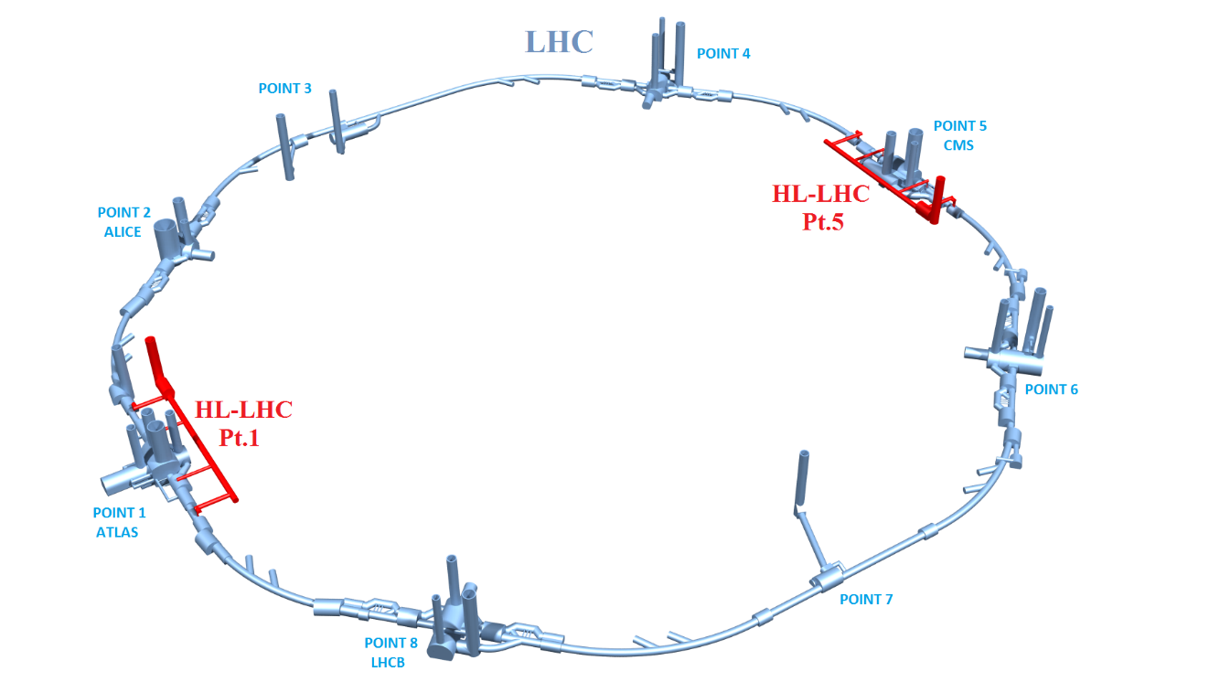
HL-LHC Underground Works

Slide 10
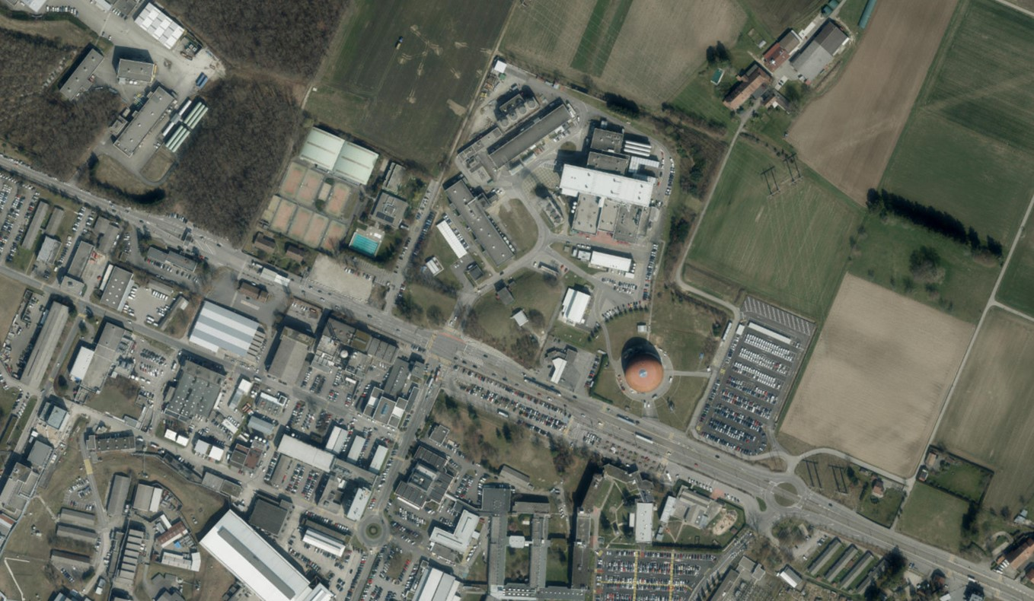

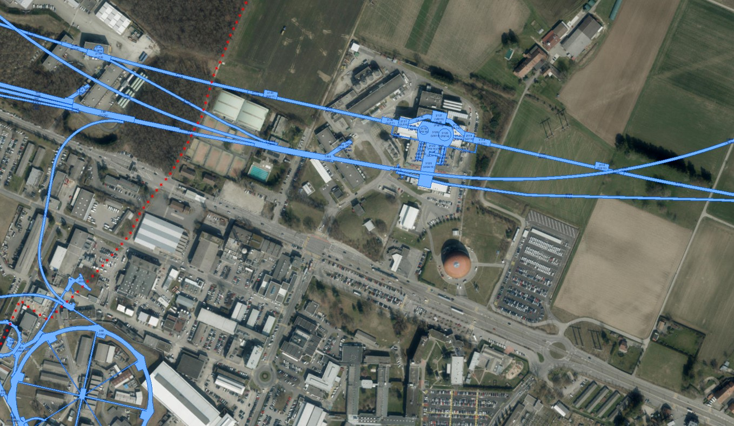
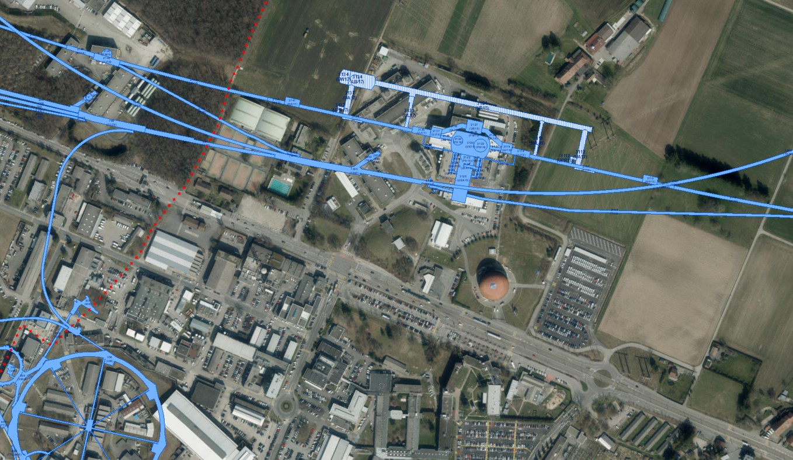
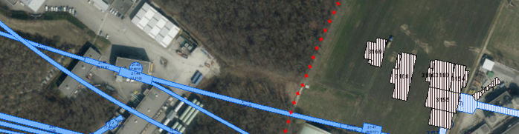


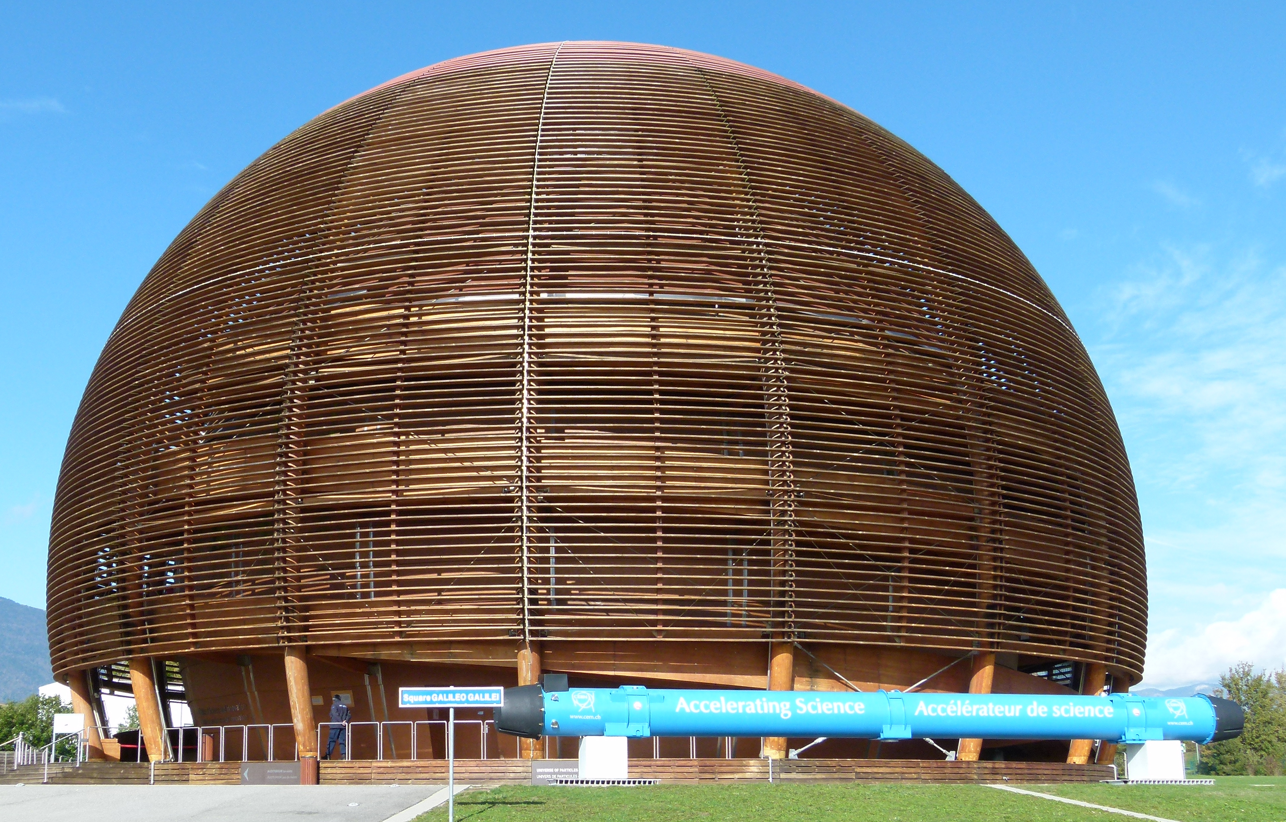
HL-LHC Works at Point 1 (ATLAS)
Reception building

Slide 11
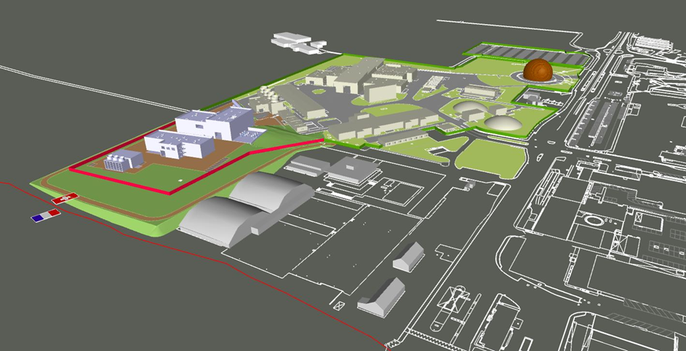
HL-LHC Surface Buildings at Point 1
What these buildings will be used for?

Slide 12
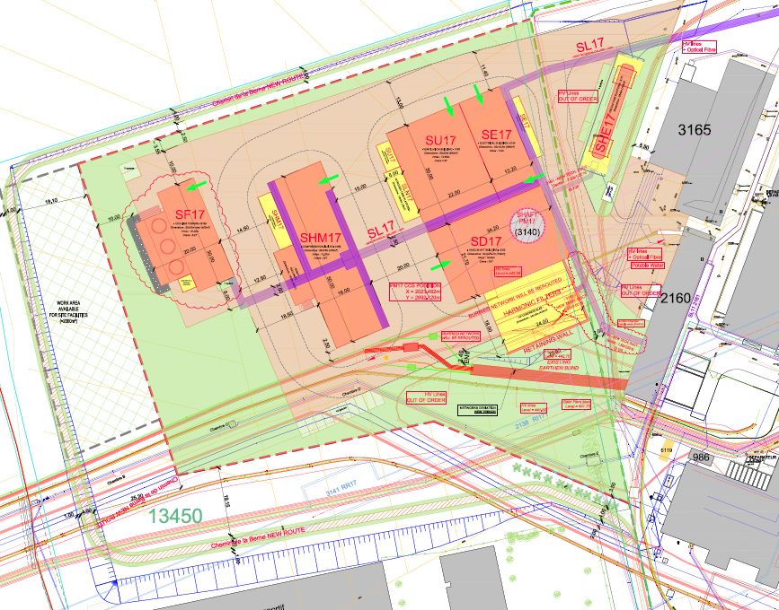
HL-LHC Surface Buildings at Point 1
Ventilation Building
Chilled Water Production
Helium Tanks
Cryogenic Compressor Building
Electrical Building
Cooling Towers
And Pumping Station
Head Shaft Building

Slide 13
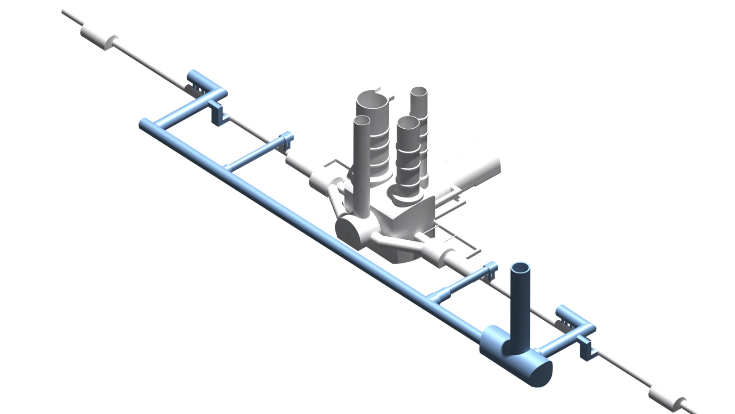
Underground Structures at Point 1
ATLAS
300 m
70 m
60 m
Let’s see Point 5 now:

Slide 14
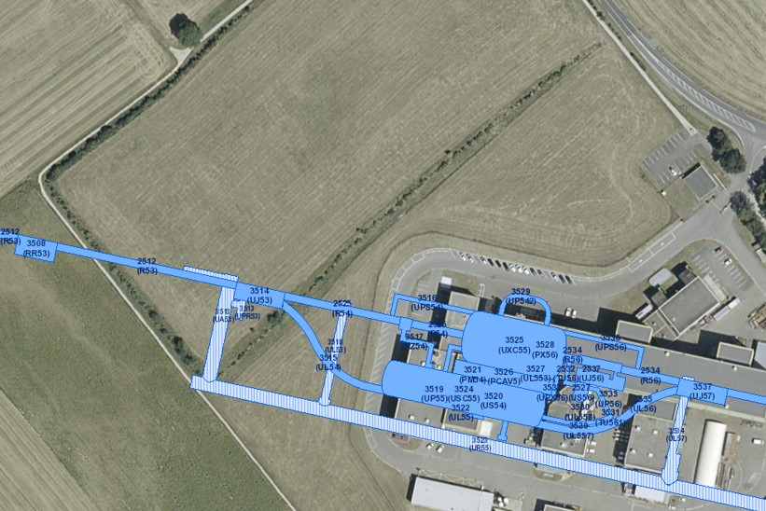
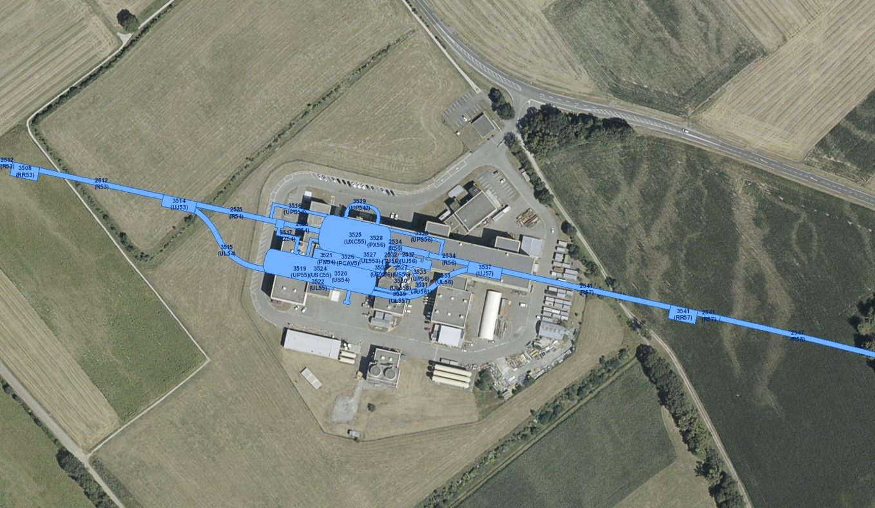
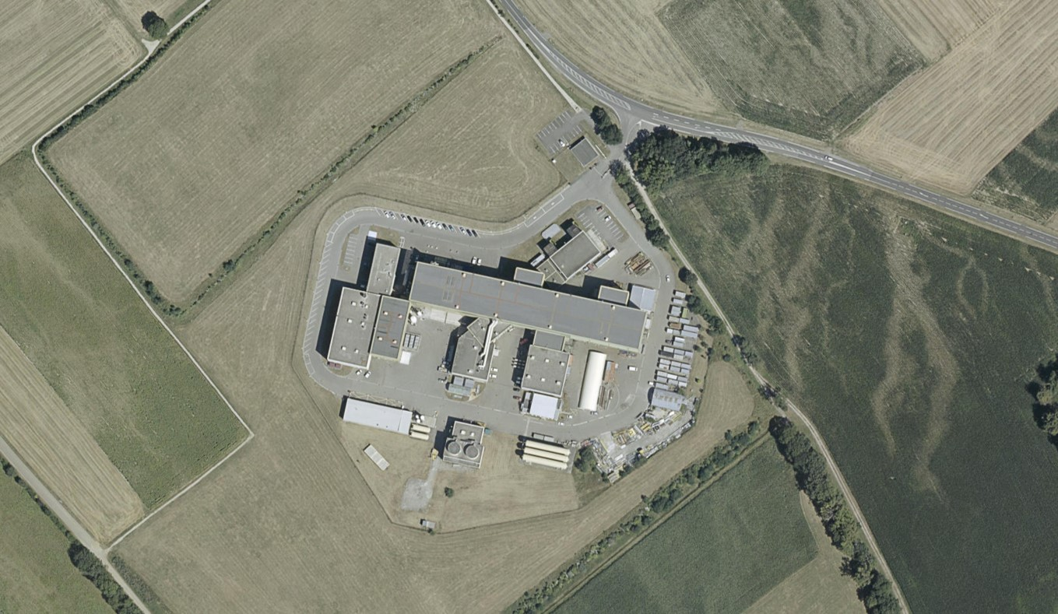
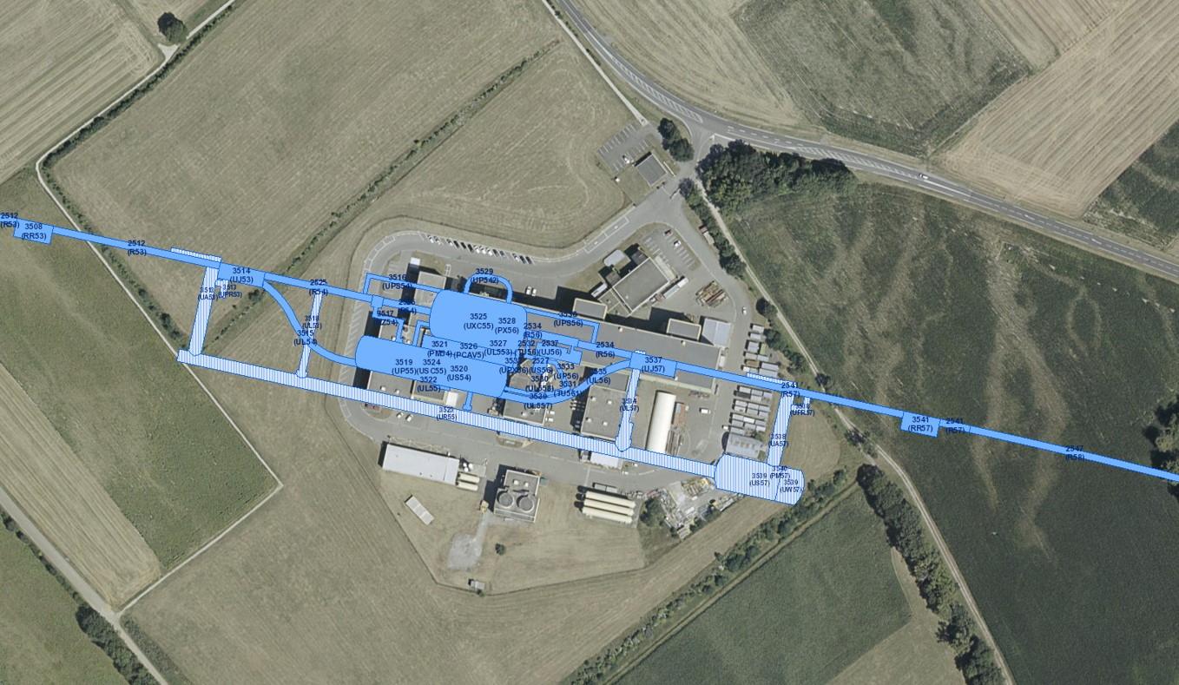
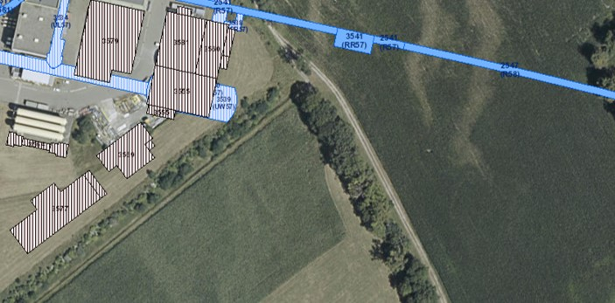
HL-LHC Works at Point 5 (CMS)

Slide 15
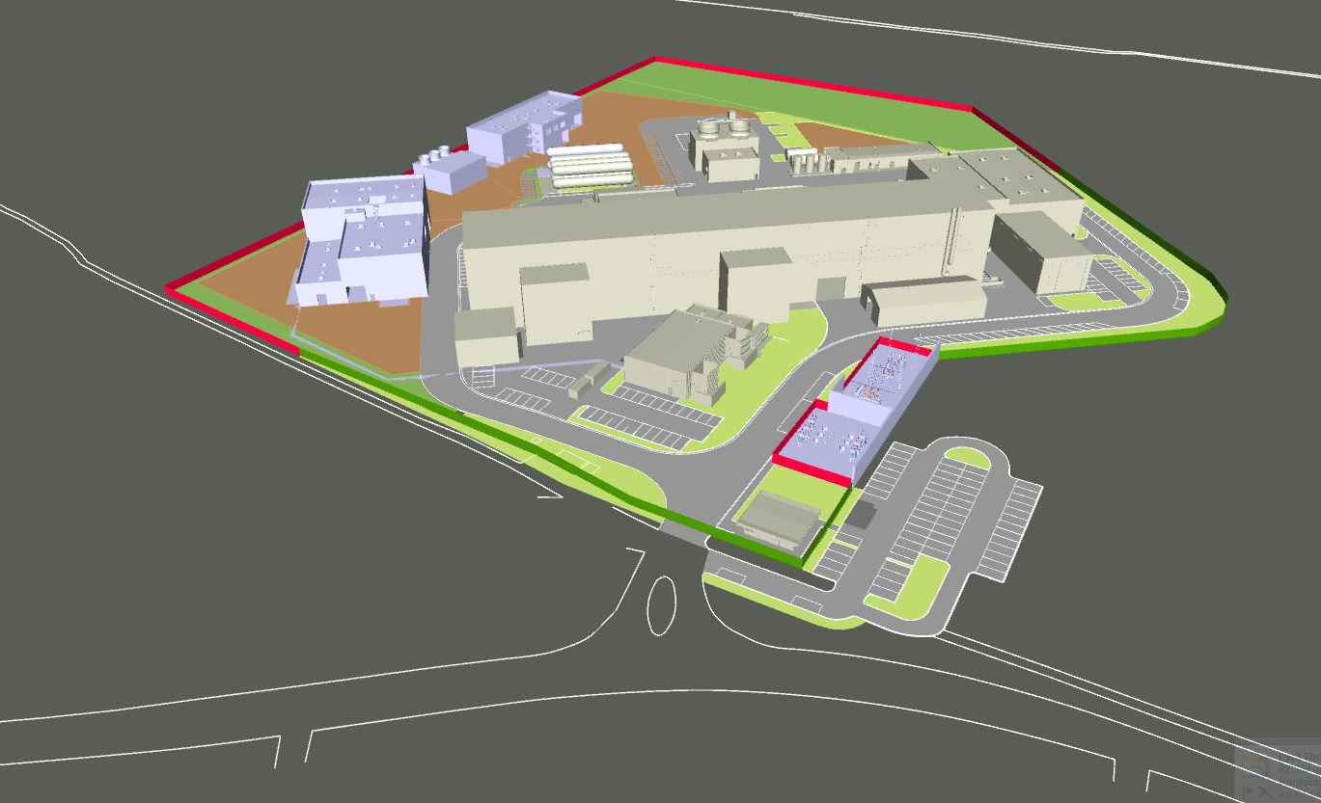
HL-LHC Surface Buildings at Point 5

Slide 16
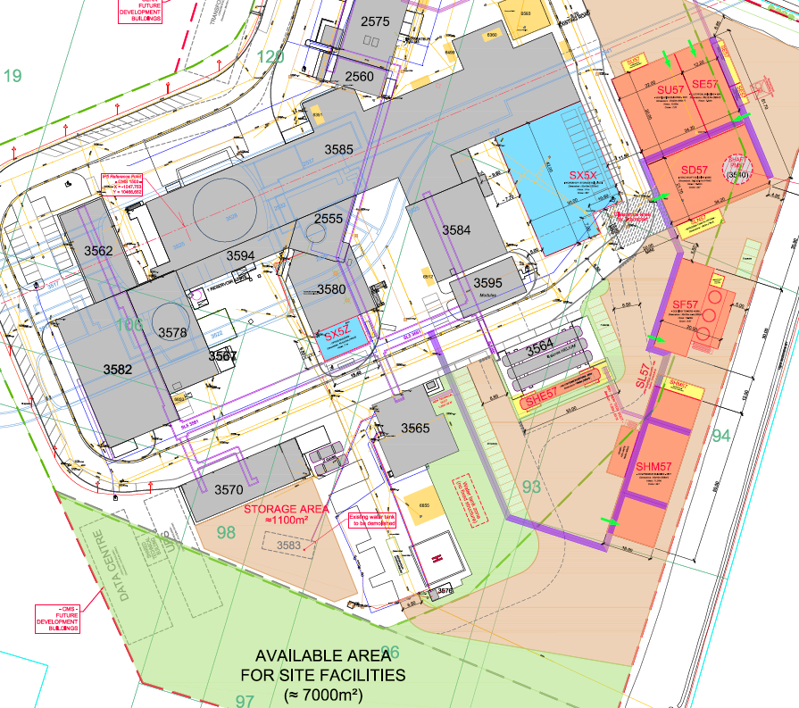
HL-LHC Surface Buildings at Point 5
Ventilation Building
Chilled Water Production
Electrical Building
Head Shaft Building
Cooling Towers
Primary Water Circuit
Helium tanks
Cryogenic Compressors Building

Slide 17
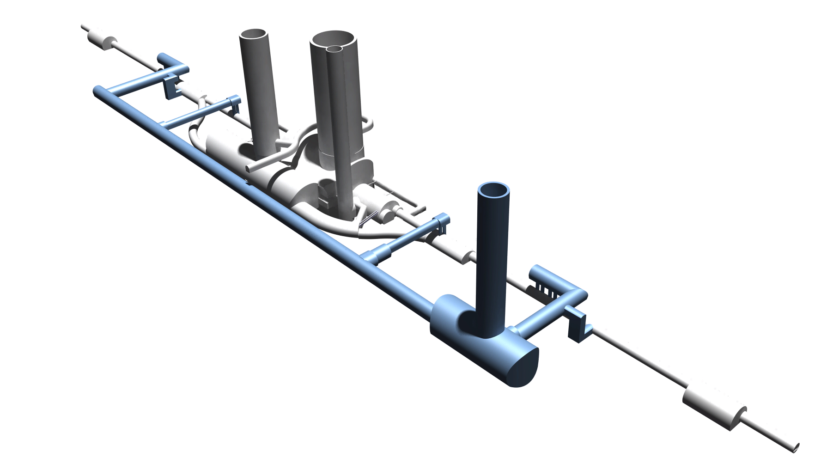
Underground Structures at Point 5
CMS
300 m
70 m
60 m
We review the cooling requirements now…

Slide 18
Content
  Scope of the HL-LHC CV Review
  New HL Infrastructure
  Cooling Requirements
  General Planning of the Project
  Main Design Assumptions & Criteria
  Introduction to Cool & Vent Presentations

Slide 19
Heat Load from Main Equipment
Equipment | Heat Power [kW] | Water | Air
Cryogenic compressors | 5000 | 96% | 4%
Radio Frequency equipment | 712 | 93% | 7%
DC power cables | 450 | 93% | 7%
Power converters | 317 | 86% | 14%
Cryogenic cold boxes | 300 | 78% | 22%
HV power supply | 256 | 72% | 28%
Machine protection system | 79 | 99% | 1%
Electronic racks | 68 |  | 100%
AC cables, transformers, etc. | 63 |  | 100%
Faraday cages | 15 |  | 100%
General services | 200 |  | 100%
Primary ventilation + pressurisation | 330 | 100%
Total | 7790
The project will be done in two phases:

Slide 20
From ½ Crab Cavities to Full Crab Cavities
Equipment | ½ CC [kW] | Full CC [kW]
Cryogenic compressors | 5000 | 5000
Radio Frequency equipment | 712 | (1424)
DC power cables | 450 | 450
Power converters | 317 | 317
Cryogenic cold boxes | 300 | 300
HV power supply | 256 | (512)
Machine protection system | 79 | 79
Electronic racks | 68 | 68
AC cables, transformers, etc. | 63 | 63
Faraday cages | 15 | (30)
General services | 200 | 200
Primary ventil + pressurisation | 330 | 330
Total | 7790 | (8773)
How will we manage this staging?

Slide 21
1/2 CC to Full CC Upgrade Strategy
Upgrade from ½ to full Crab Cavities configuration is possible with:
No new excavation works
No CV ventilation ducts and cooling pipes replacement
No EL main cabling replacement
Cooling pipes, ventilation ducts and main components sized for full CC
Equipment (pumps, AHUs, etc.) sized for ½ CC
When we will be asked to install our equipment?

Slide 22
Content
  Scope of the HL-LHC CV Review
  New HL Infrastructure
  Cooling Requirements
  General Planning of the Project
  Main Design Assumptions & Criteria
  Introduction to Cool & Vent Presentations

Slide 23
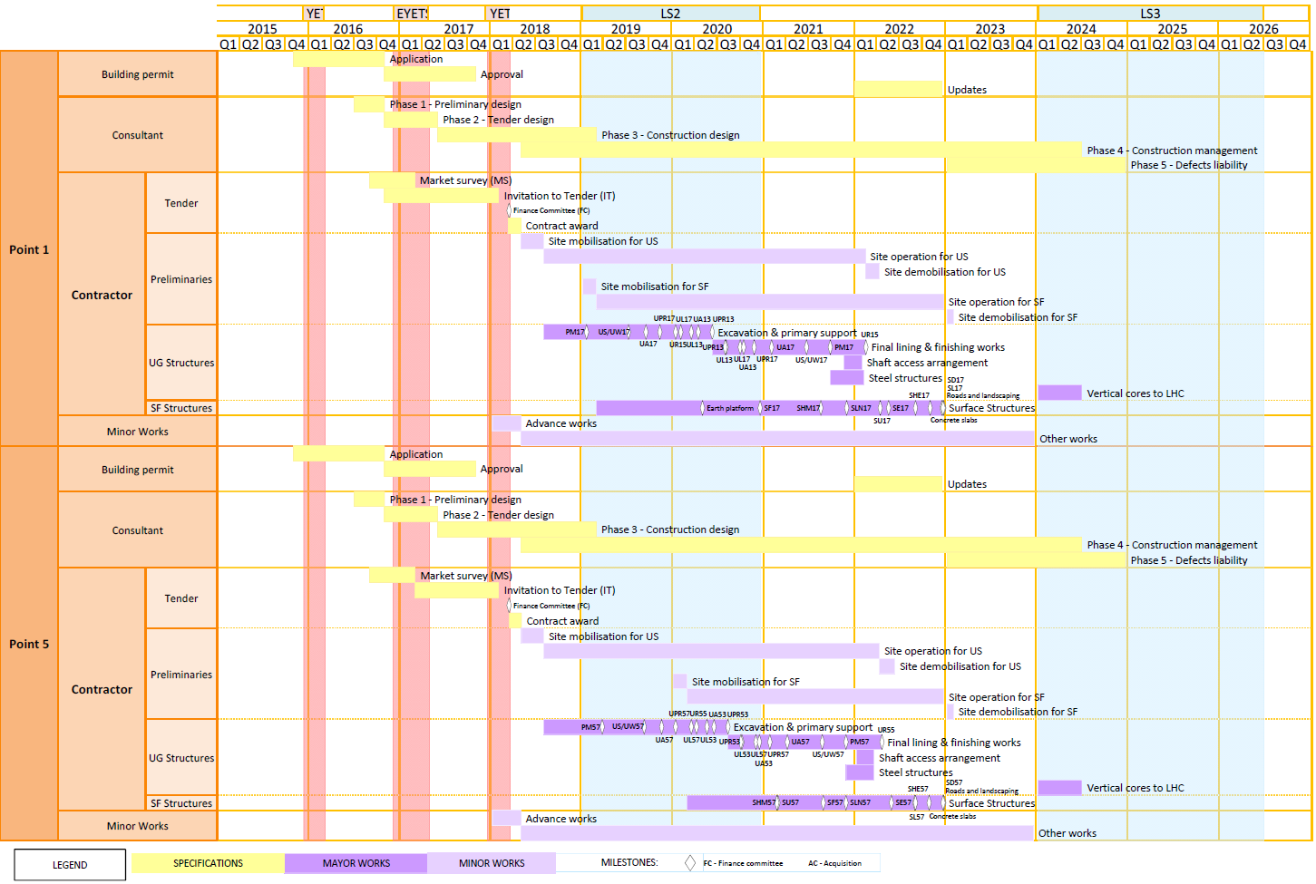
Civil Engineering Outline Schedule
2017
Tender design
Construction tender
2018
Site mobilisation
Shaft excavation
2019-2020 (LS2)
Underground
Excavation Works
Start Concreting
2021
Underground
Finish Concreting
(2020-) 2021-2022
Surface Works
When technical infrastructure will be installed?
Courtesy of Pieter Mattelaer

Slide 24
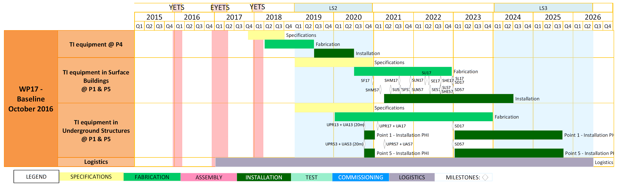
Technical Infrastructure Schedule
(Without Civil Engineering)
Connection of the HL-LHC buildings with LHC tunnel (UPR): ventilation of the safety SAS un UA
Time window for CV installation in surface buildings and underground areas
How CV is organising to get this result?

Slide 25
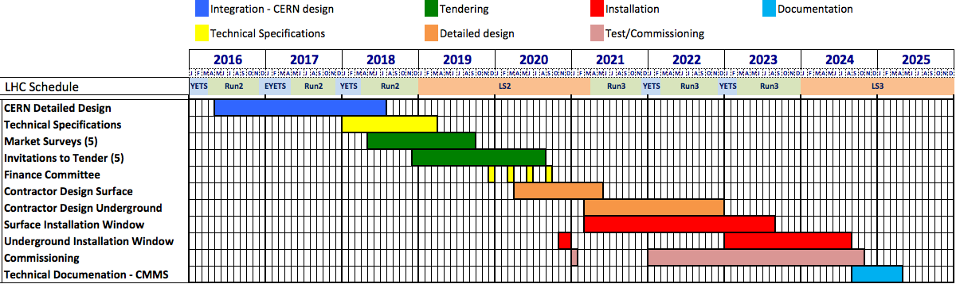
Cooling and Ventilation General Schedule
Tendering process @ CERN
  8-12 months for Market Survey phase
  8-12 months for Invitation to Tender phase (for each contract - 5)
  Finance Committee for contract authorisation
  Contractor preparatory phase
    12 months for construction design and purchase phase
  Installation phase details at the end of the day…

Slide 26
Content
  Scope of the HL-LHC CV Review
  New HL Infrastructure
  Cooling Requirements
  General Planning of the Project
  Main Design Assumptions & Criteria
  Introduction to Cool & Vent Presentations

Slide 27
Project Guidelines
Main Design Assumptions
HL equipment separated from LHC and Experiments ones; HL tech. infrastructure installation during LHC run phase;
Interconnection of HL new systems with existing LHC installation when reasonable (redundancy, operation…)
Solution Pt1 = Pt5 (except heating network).
Main Design Criteria
Energy savings:
  Energy savings required by law;
  Energy recovery if economically justified (ROI < 10 years);
  Enlarged acceptable temperatures ranges in buildings (S&U);
  Redundancy on safety systems and critical systems;
  Access to underground areas during machine run.

Slide 28
Content
  Scope of the HL-LHC CV Review
  New HL Infrastructure
  Cooling Requirements
  General Planning of the Project
  Main Design Assumptions & Criteria
  Introduction to Cool & Vent Presentations
Naming convention at first

Slide 29
CV Circuits Naming Conventions @ CERN
Primary Water Circuit
Demineralised make-up water
Tap make-up water
Secondary Water Circuits
Equipment with
conductivity requirements
Thermal load
with no special conductivity
requirement
Demineralised
-water
Raw-water

Slide 30
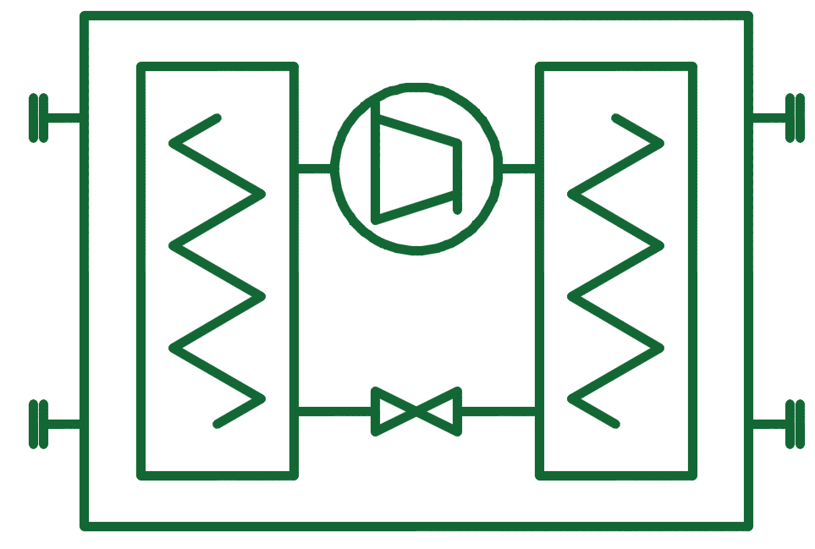

CV Circuits Naming Conventions @ CERN
Ventilation
Humidity Control
Chilled water
5/6 ➡ 10/12 °C
Ventilation
Air Cooling
Mixed water
14 ➡ 20 °C
25°C
Chiller condenser
Water circuit
Primary water
circuit

Slide 31
HL-LHC Underground Building Names (Pt1)
UA13
UPR13
ATLAS
UL13
UR15
PM17
UL17
UA17
US17
UPR17
UW17

Slide 32
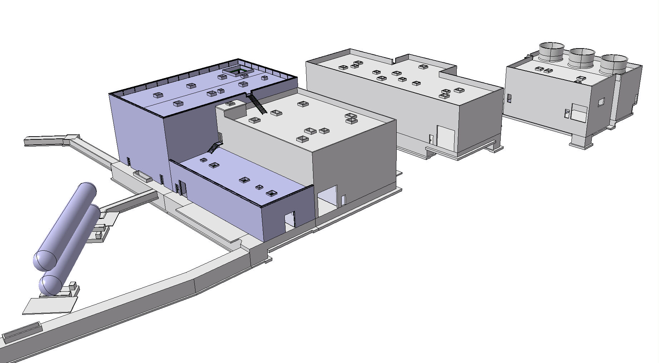
HL-LHC Surface Building Names (Pt1)
SHM17
SD17
SF17
SU17
SE17
We enter now in the technical details of the CV design

Slide 33
Ventilation
Paul Pepinster

Slide 34
Cooling
Alexandre Broche

Slide 35
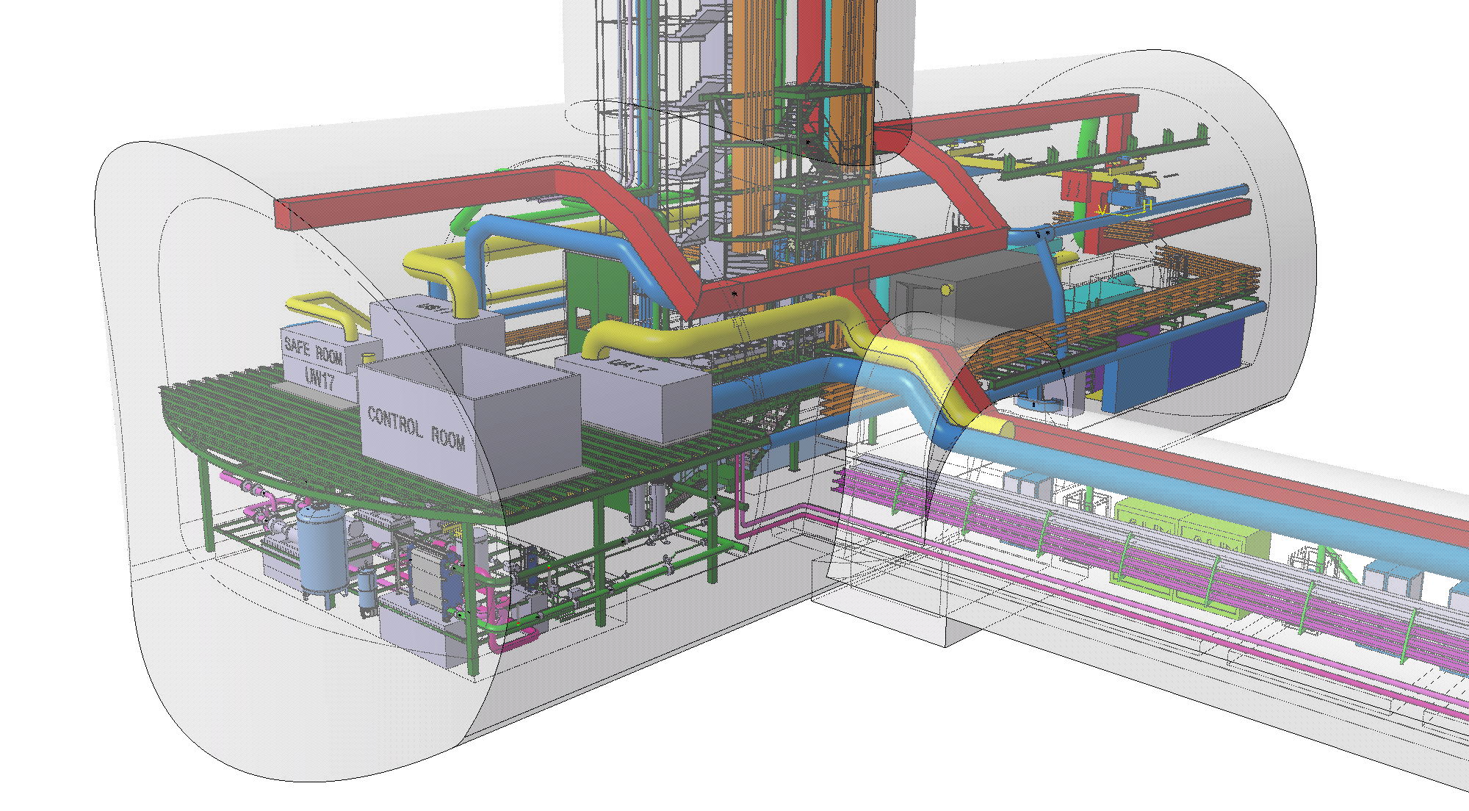
Integration
Frederic Borralho

Slide 36
…any question?
Thanks to:
Y. Body, F. Borralho, A. Broche, A. Mejica, P. Pepinster.

Slide 37
BACK-UP SLIDES
Thanks to:
Y. Body, F. Borralho, A. Broche, A. Mejica, P. Pepinster.

Slide 38
LHC Building Naming Convention
3
SU17
5
7
Location
S= Surface
U = Underground
P = Shaft (pit)
Position number
5 = interaction point
Growing clockwise
Use
F = Fluid
U = Ventilation
W = Water
H = Helium (Cryo)
E = Electricity
S = Service
L = Link
A = Power Supply
…
LHC reference
1 = Point 1 (ATLAS)
5 = Point 5 (CMS)

Slide 39
LHC Buildings Naming List
Building name | Description
SF | Cooling towers + primary water circuit pumping station
SE | Electrical distribution
SHM | Cryogenic compressor building
SD | Head of the shaft
SU | Chillers for chilled and mixed water production + Ventilation
PM | Shaft for the material passage
US | Service cavern
UW | Cavern dedicated to secondary water circuits and U ventilation
UR | Connection tunnel
UA | Radio frequency and power supply
UL | Cryogenic and power supply services passage
… | …

