Slide 1

Underground Drawings & Layout
for HL-LHC
(WP17.3)
Frédéric Borralho
CERN
Engineering Department
Cooling and Ventilation Group
Cooling and Ventilation Review – 14th March 2017

Slide 2
Agenda
  Underground Overview
  Status of Underground Layout & Drawings
  HL-LHC
  Integration US17
  Integration UA17
  Integration UW17

Slide 3
  Underground Overview
PMx7
UAx7
ULx7
ULx3
USx7 / UWx7
UAx3
URx5

Slide 4
Status of Cooling / Ventilation 3D Models HL-LHC
Buildings | Civil Engineering Drawings / 3D Models | Cooling / Ventilation 3D models
UW17/57 |  | 
US17/57 |  | 
PM17/57 |  | 50%
UR15/55 |  | 50%
UA13/53 |  | 50%
UA17/57 |  | 50%
UL13/53 |  | 
UL17/57 |  | 

Slide 5
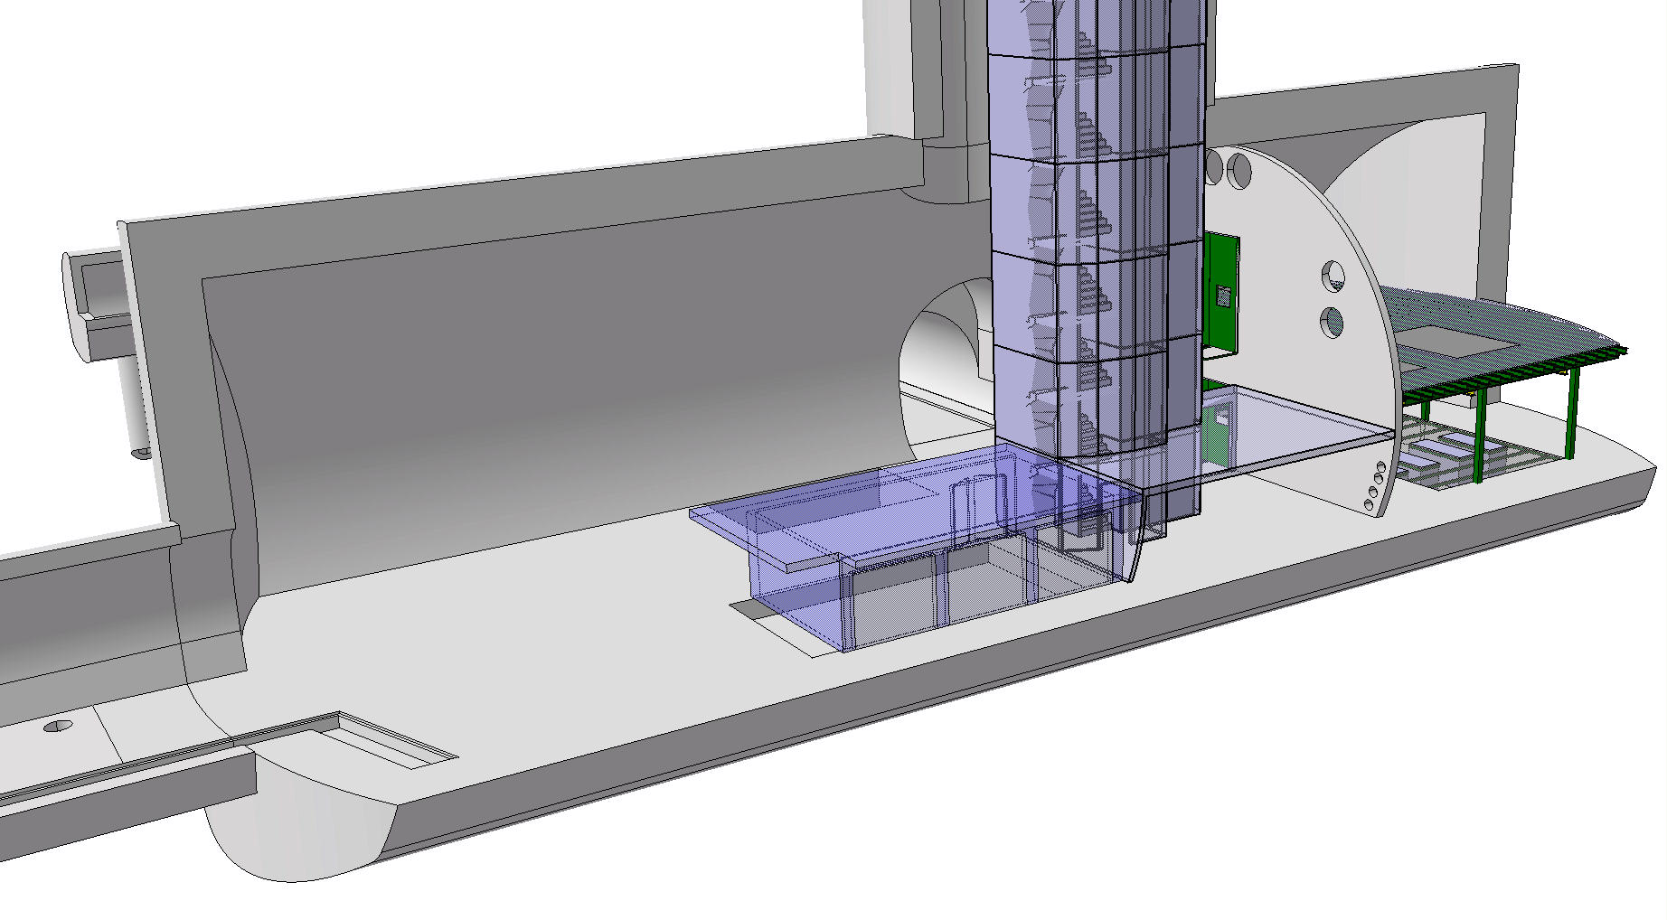
  Overview Cavern USx7 / UWx7
UWx7
USx7

Slide 6
  3D Model Ventilation USx7

Slide 7
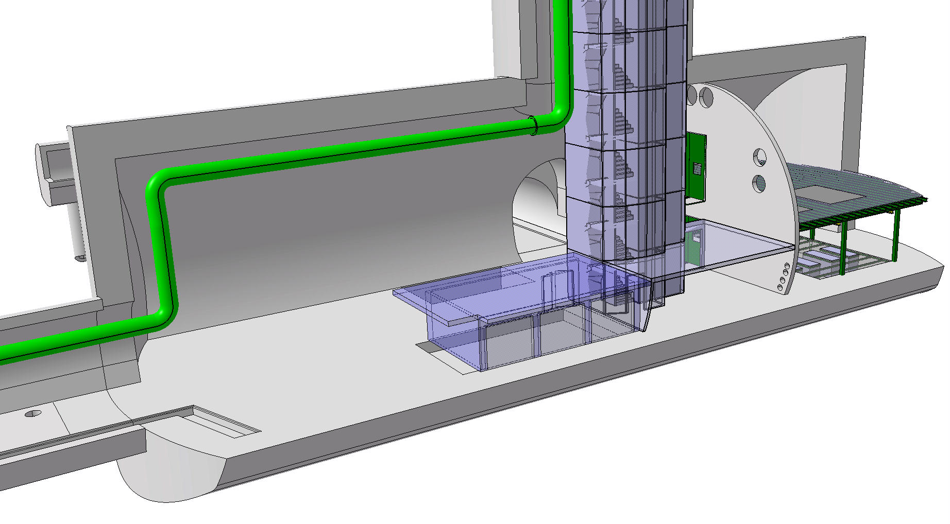
  Primary Air Underground
Primary Air

Slide 8
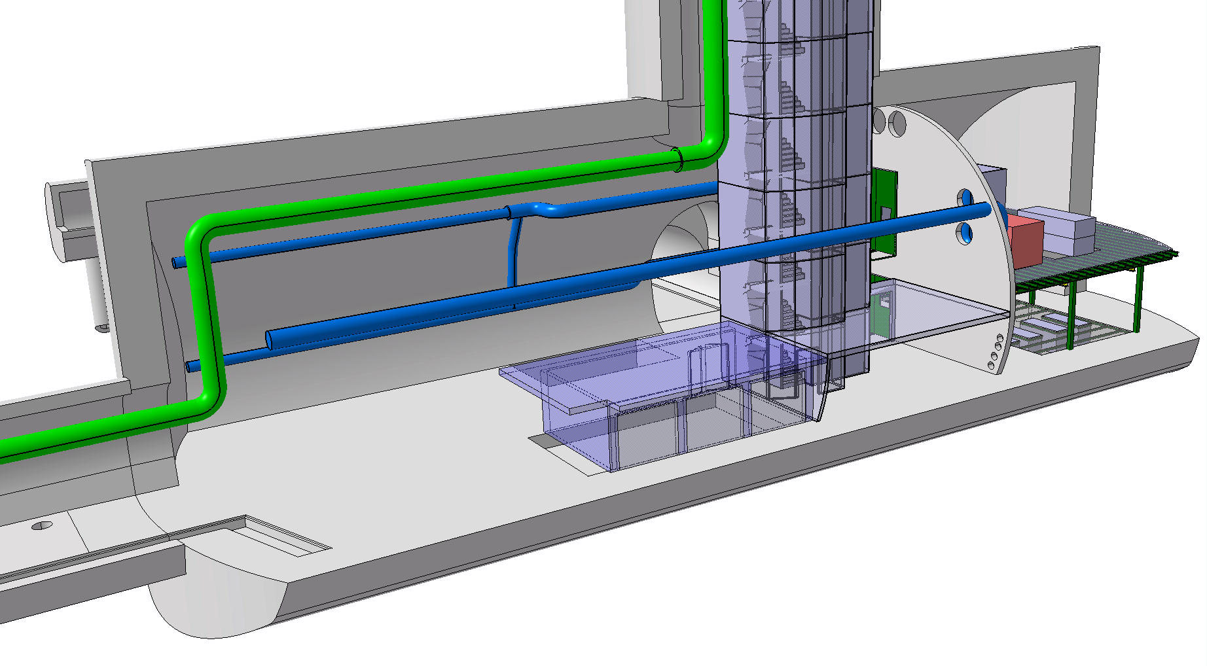
  Air Supply USx7
Primary Air
Air Supply

Slide 9
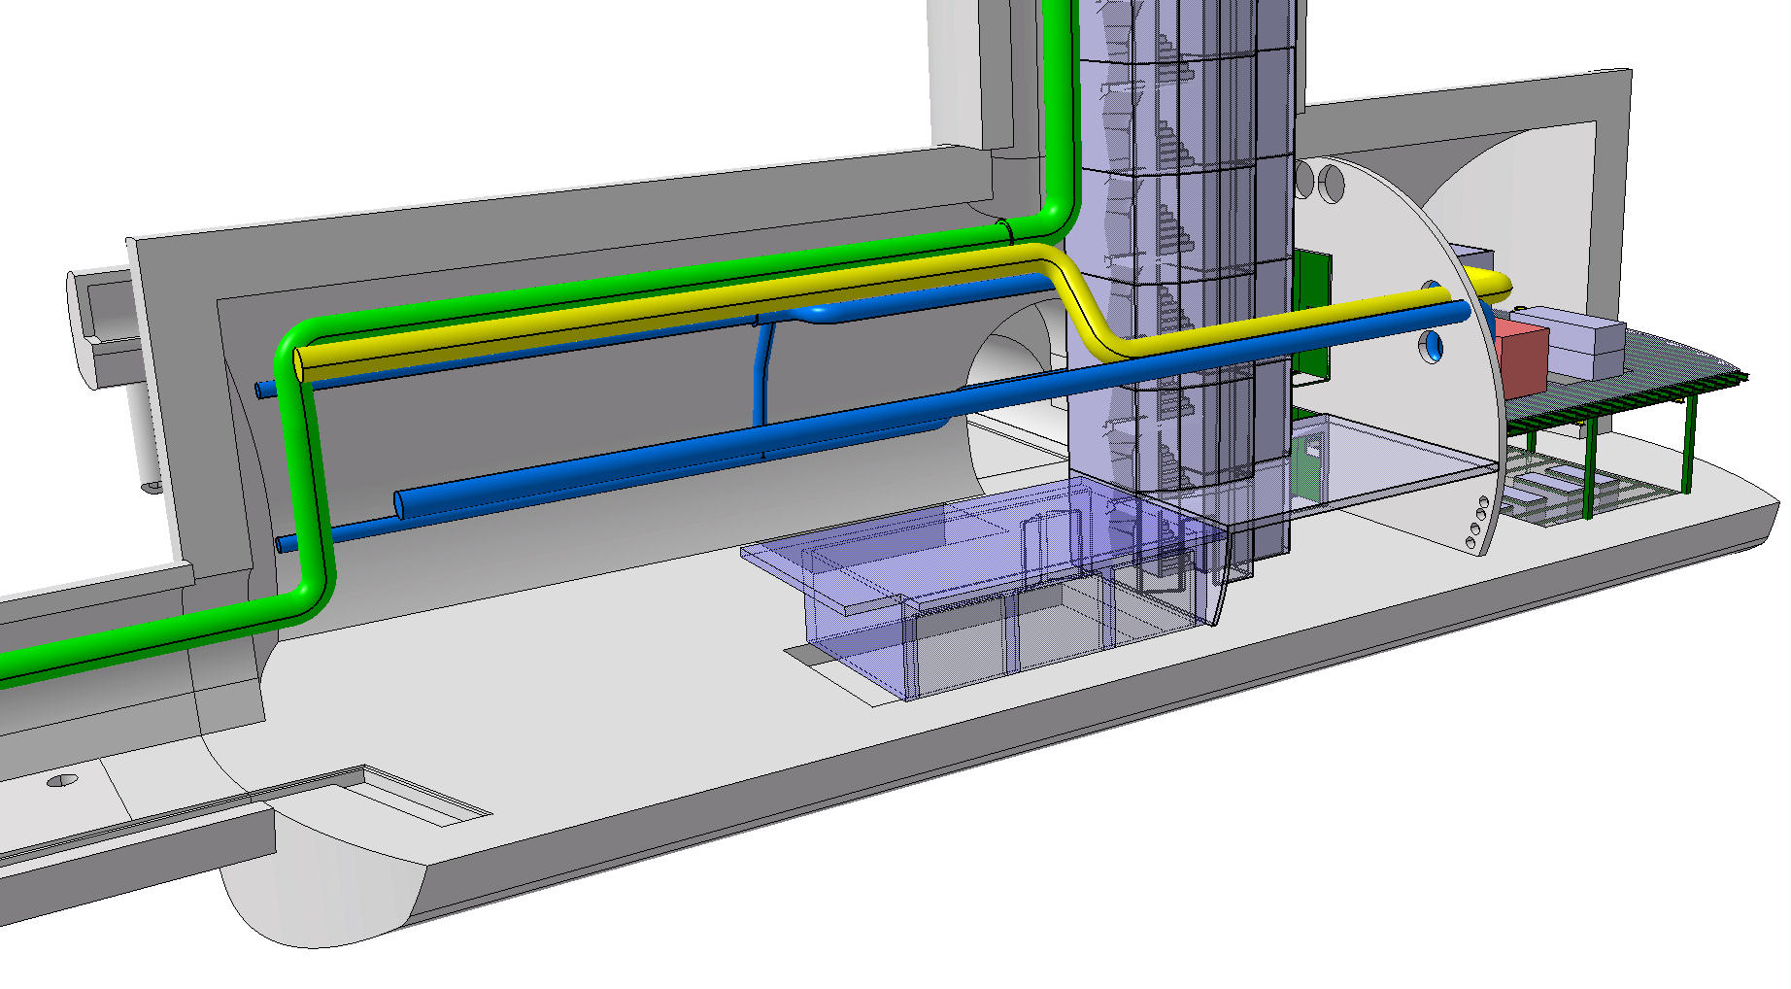
  Air Return USx7
Primary Air
Air Supply
Air Return

Slide 10
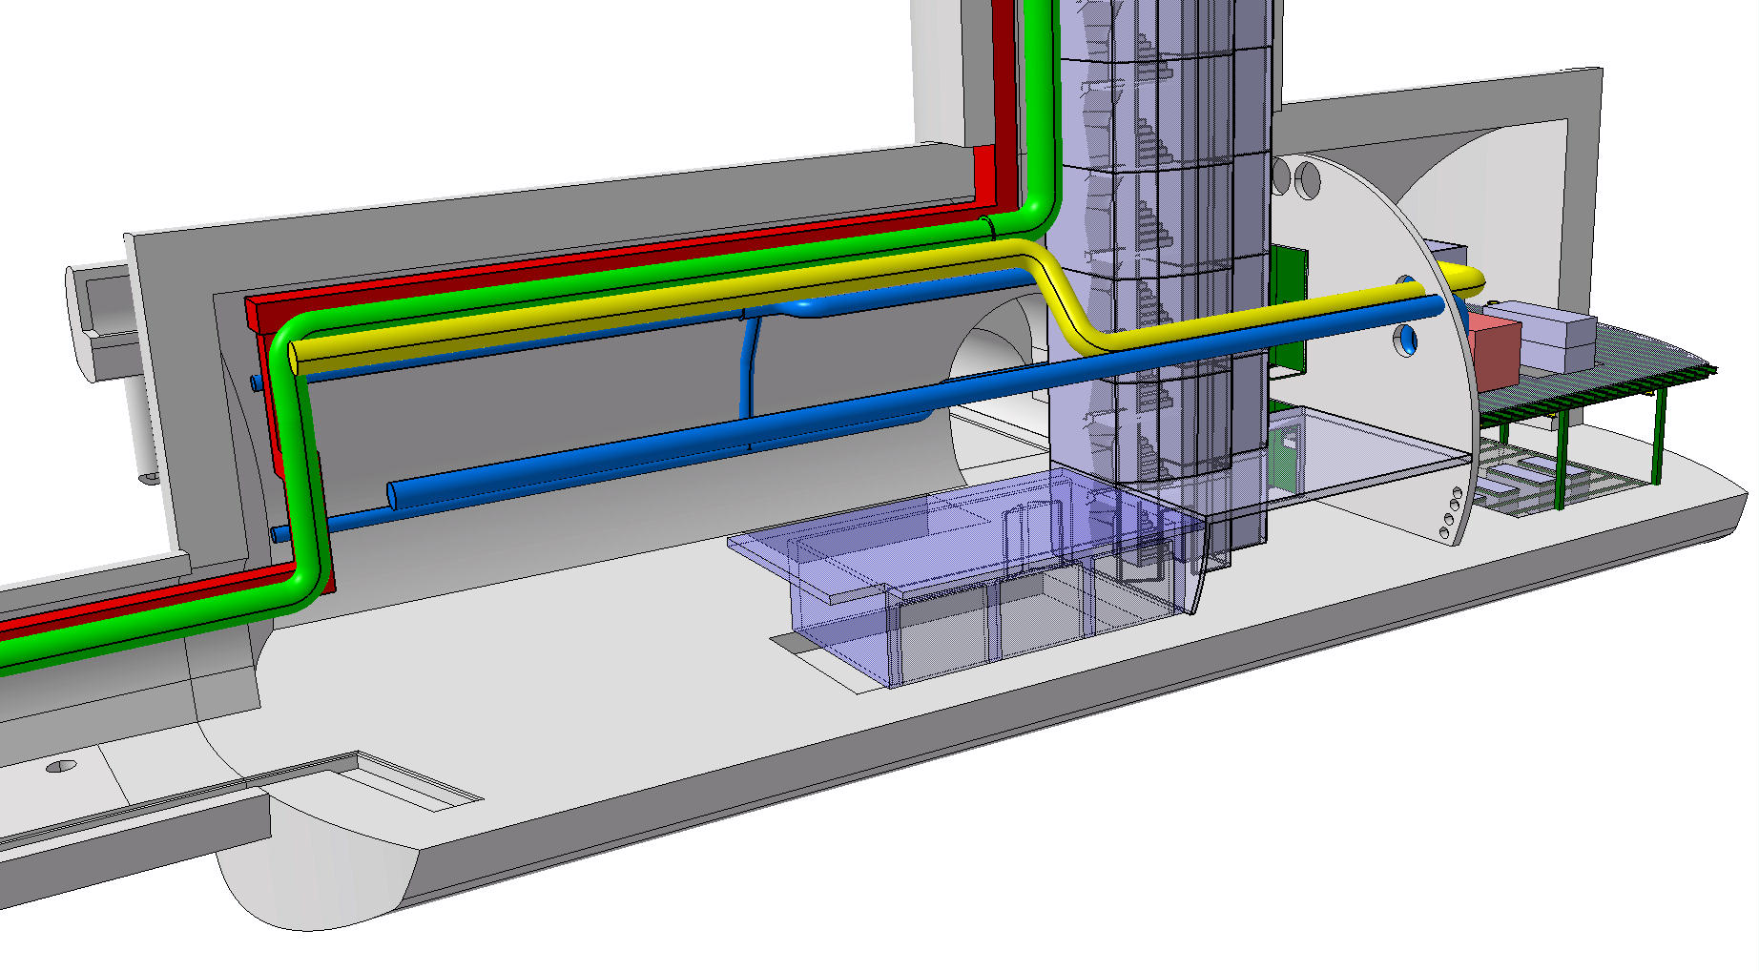
  Smoke Extraction USx7
Primary Air
Air Supply
Air Return
Smoke Extraction

Slide 11
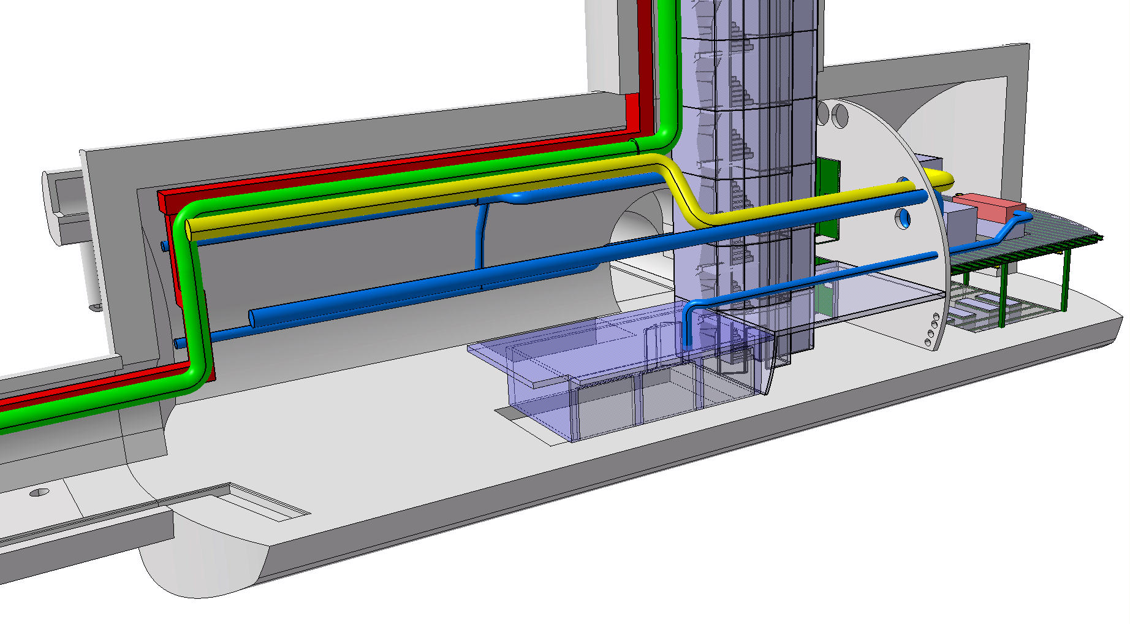
  Air Supply Safe-room USx7
Primary Air
Air Supply
Air Return
Smoke Extraction

Slide 12

  Air Return Safe-room USx7
Primary Air
Air Supply
Air Return
Smoke Extraction

Slide 13
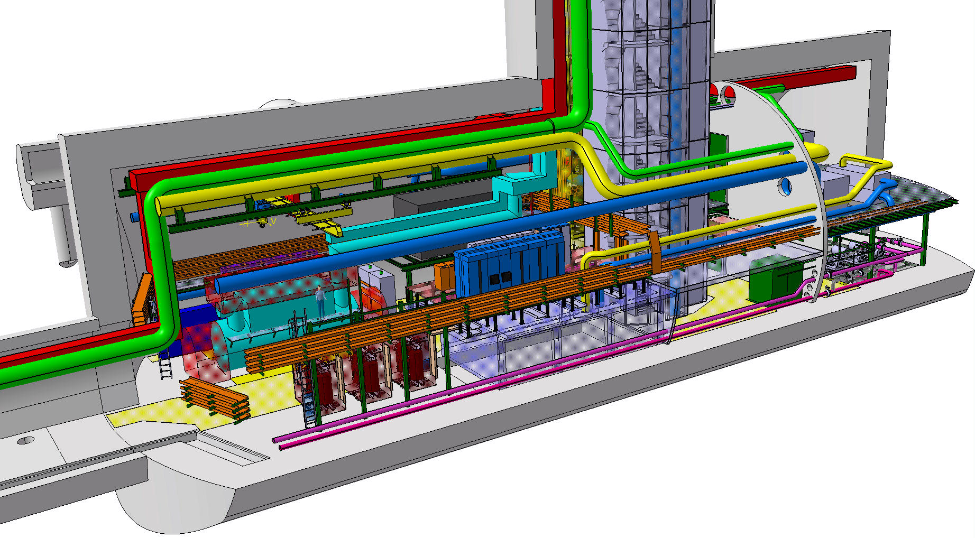
  View Complete 3D model cavern USx7

Slide 14
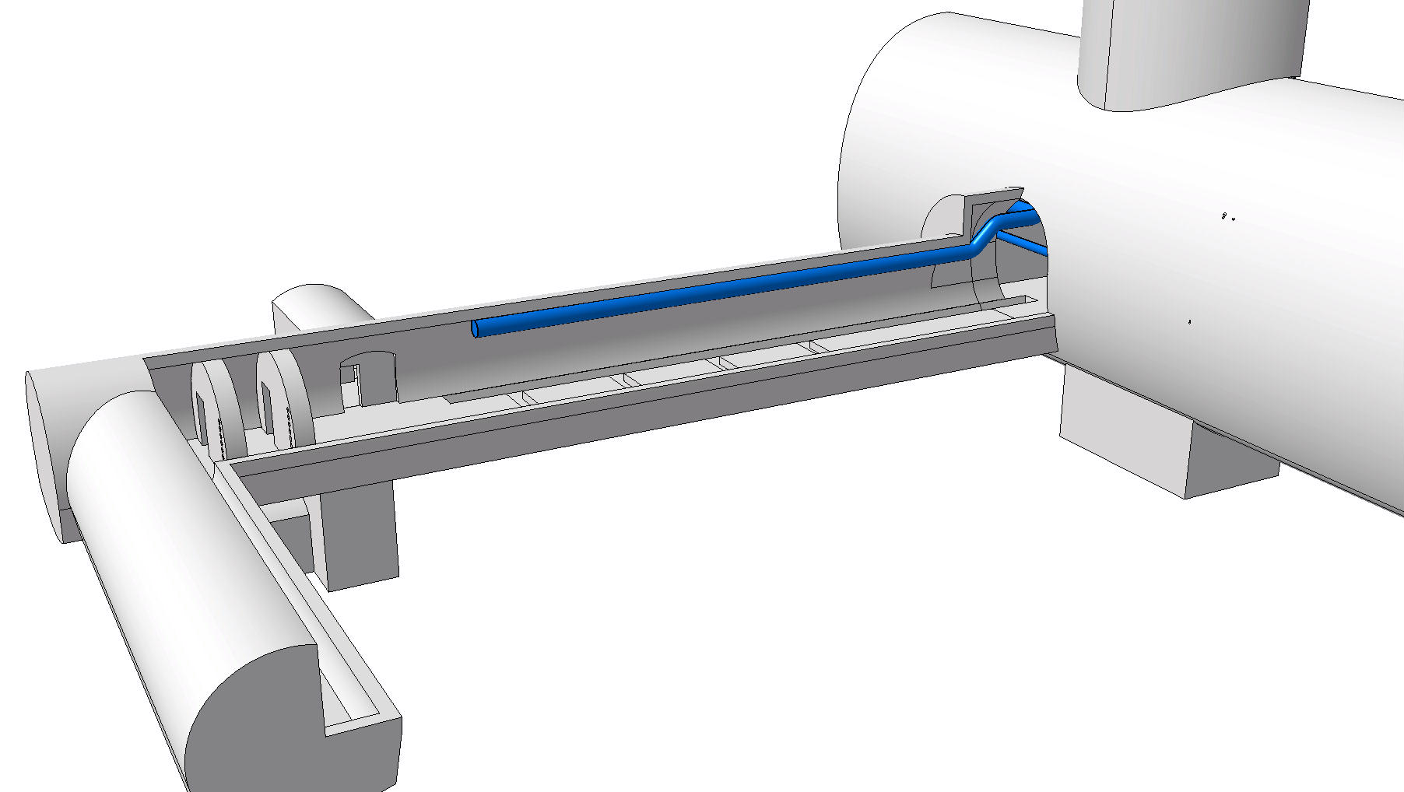
  Air Supply Gallery UAx7
AHU installed in UW
Air Supply

Slide 15
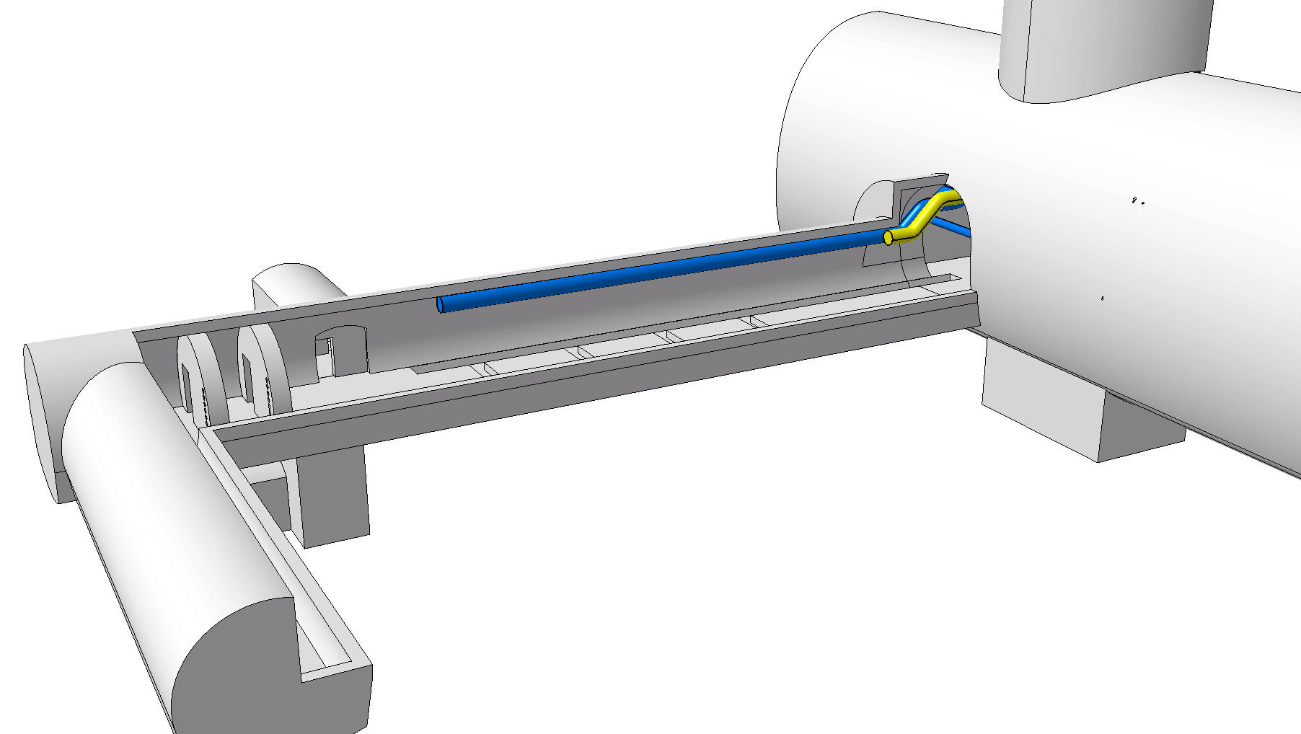
  Air Return Gallery UAx7
AHU installed in UW
Air Supply
Air Return

Slide 16
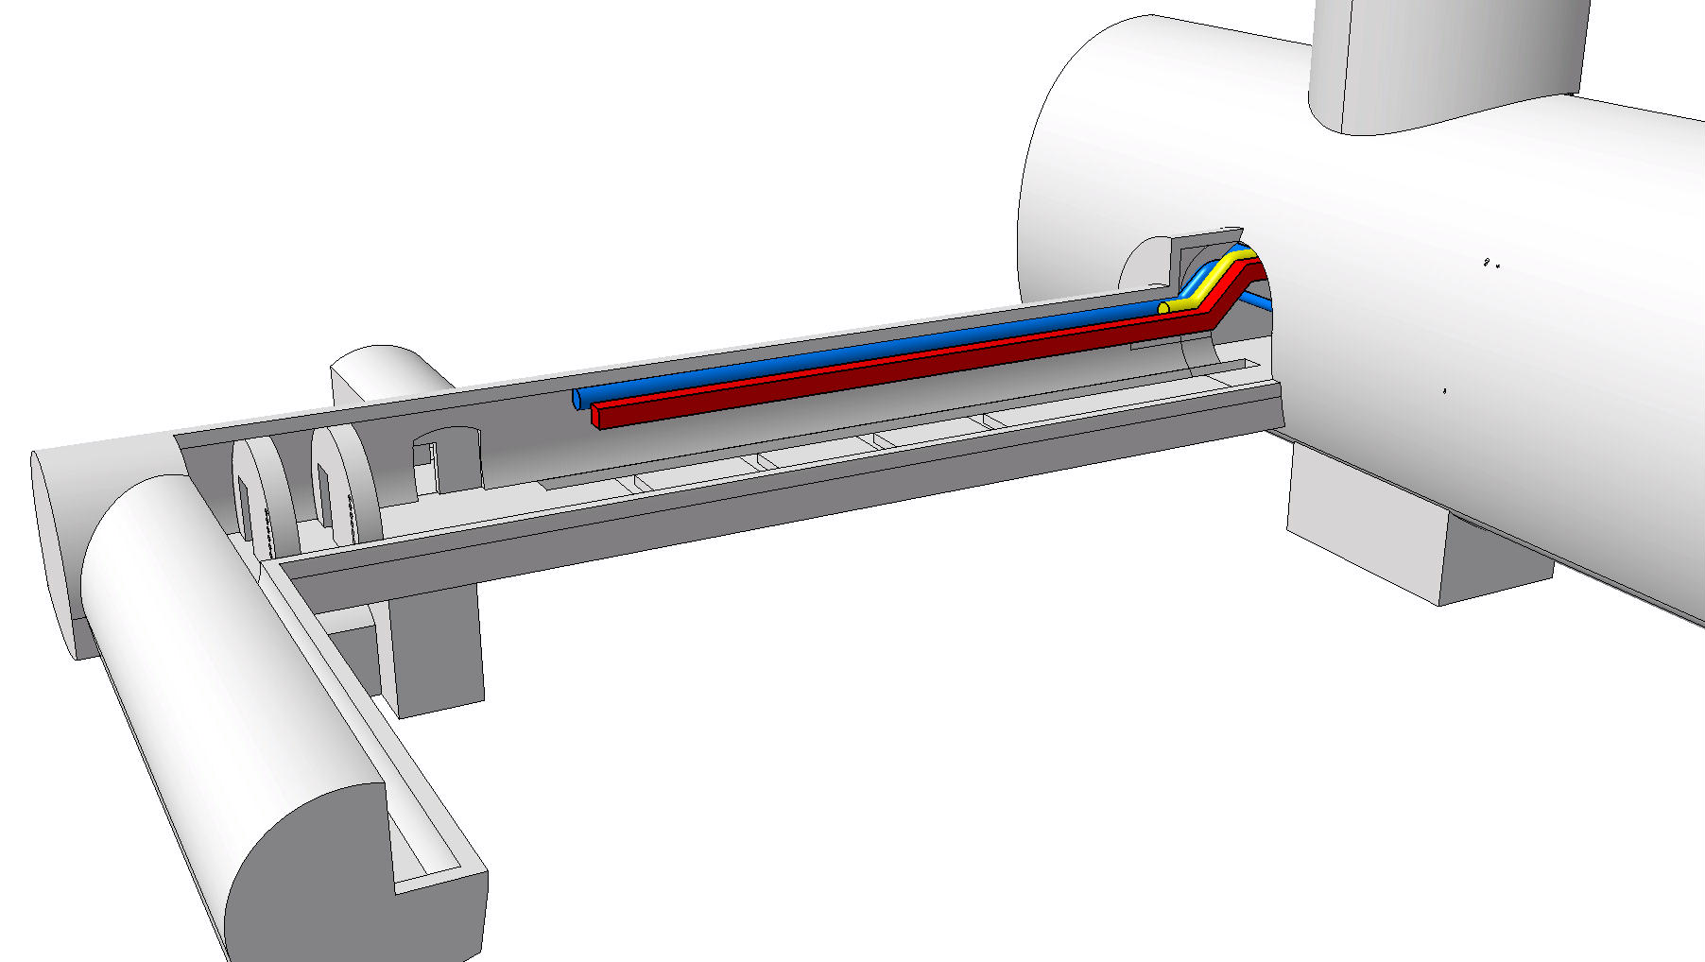
  Smoke Extraction Gallery UAx7
AHU installed in UW
Air Supply
Air Return
Smoke Extraction

Slide 17
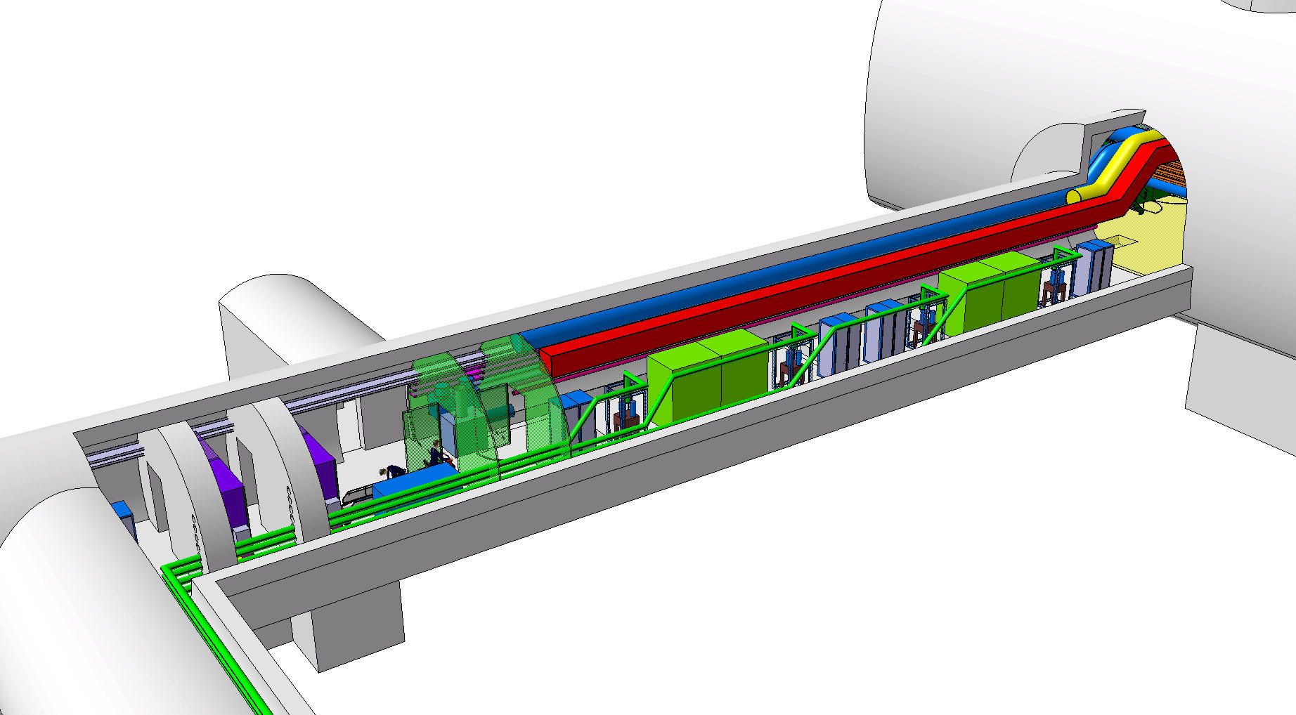
  Complete Integration gallery UAx7

Slide 18
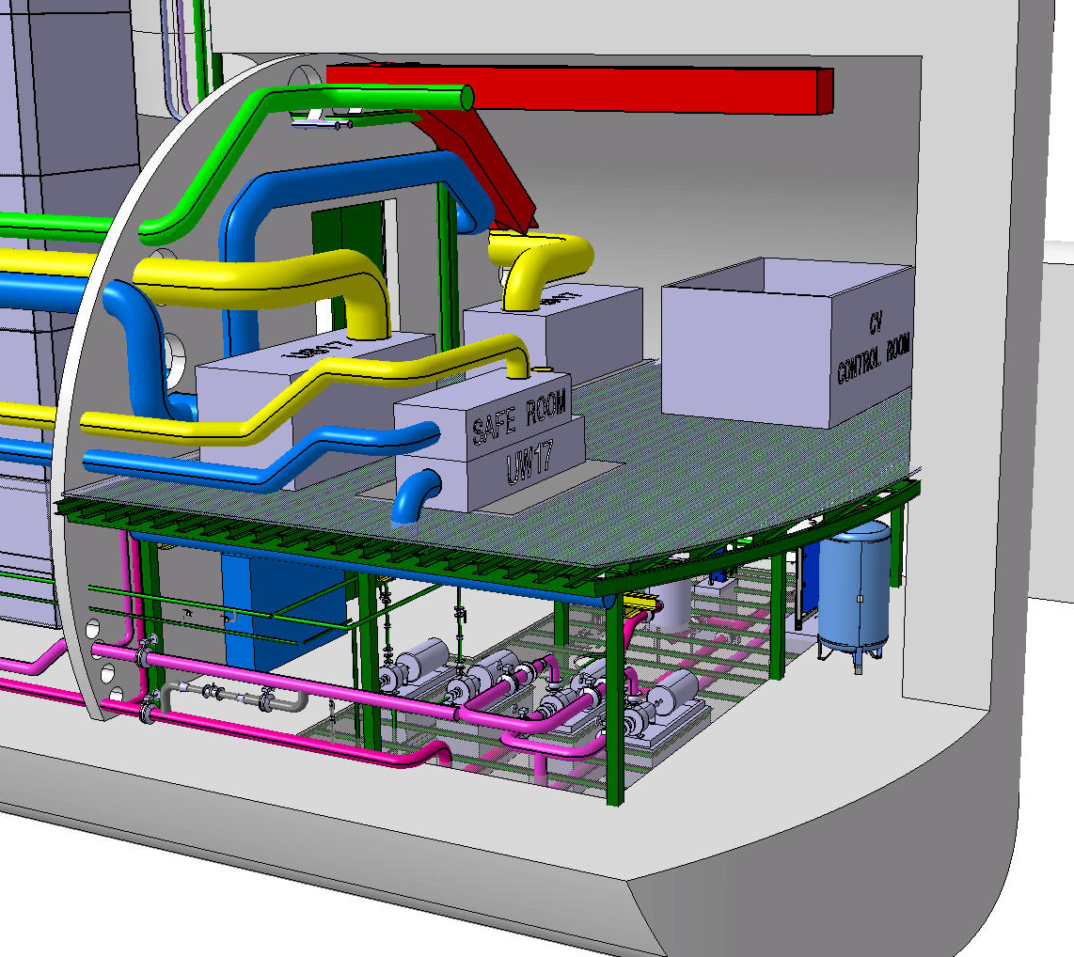
  Overview UWx7
Ventilation system
Cooling system

Slide 19
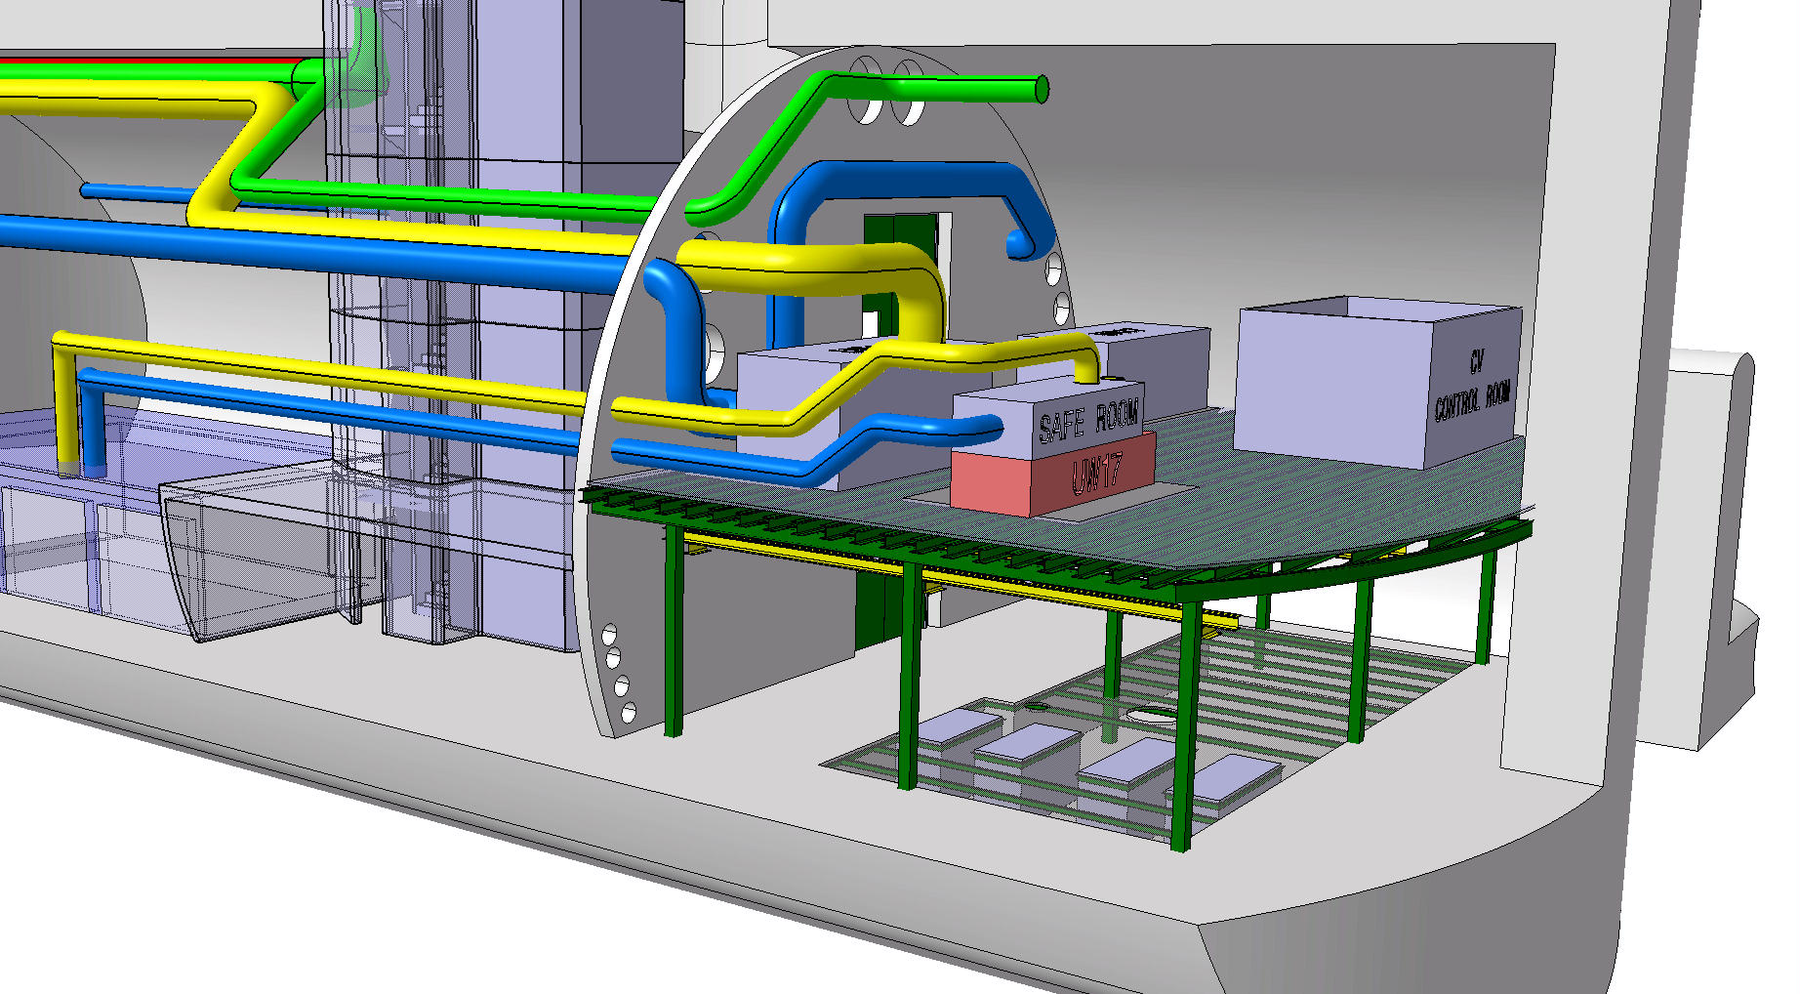
  Primary Air UWx7
Primary Air
Air Supply
Air Return

Slide 20
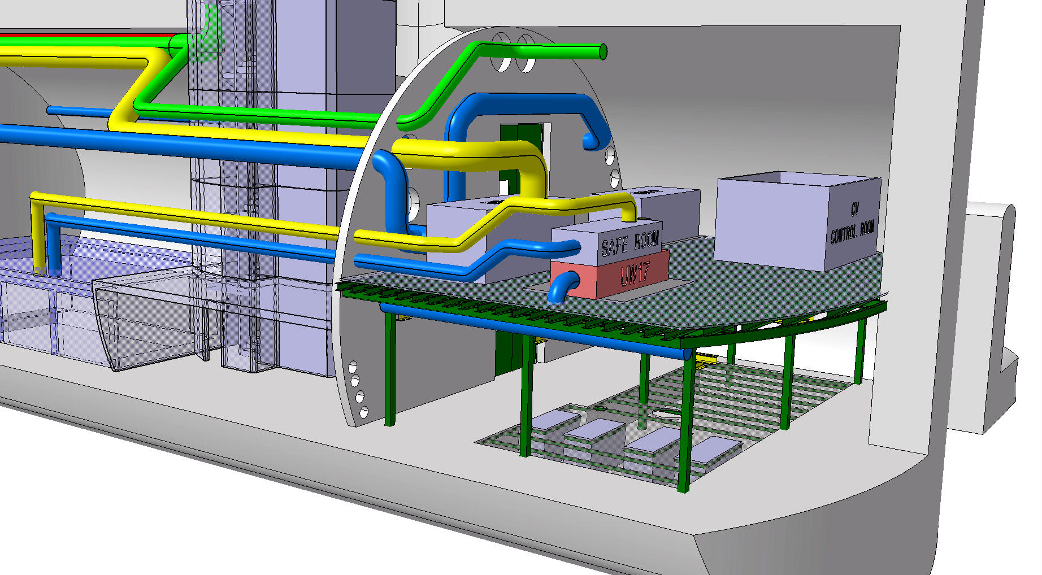
  Air Supply UWx7
Primary Air
Air Supply
Air Return

Slide 21
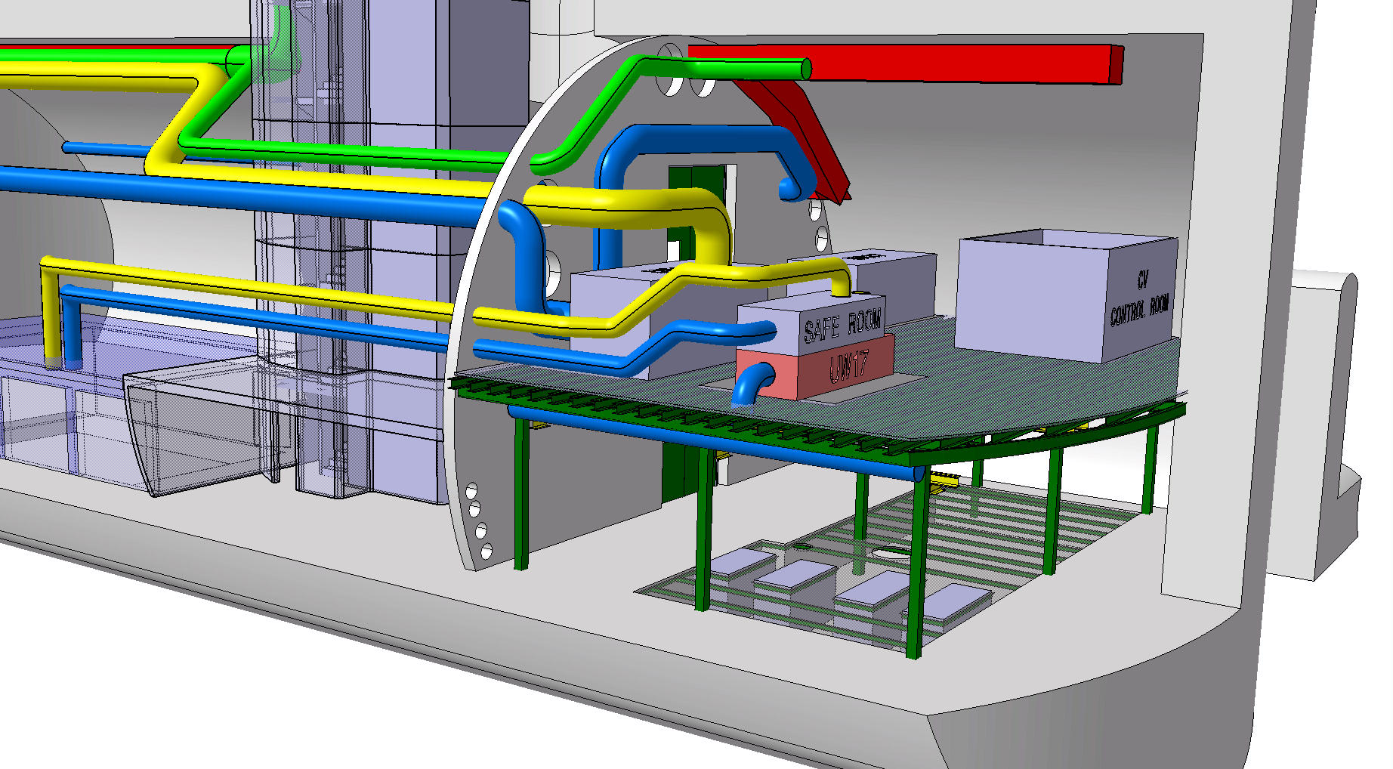
  Smoke Extraction UWx7
Primary Air
Air Supply
Air Return
Smoke Extraction

Slide 22
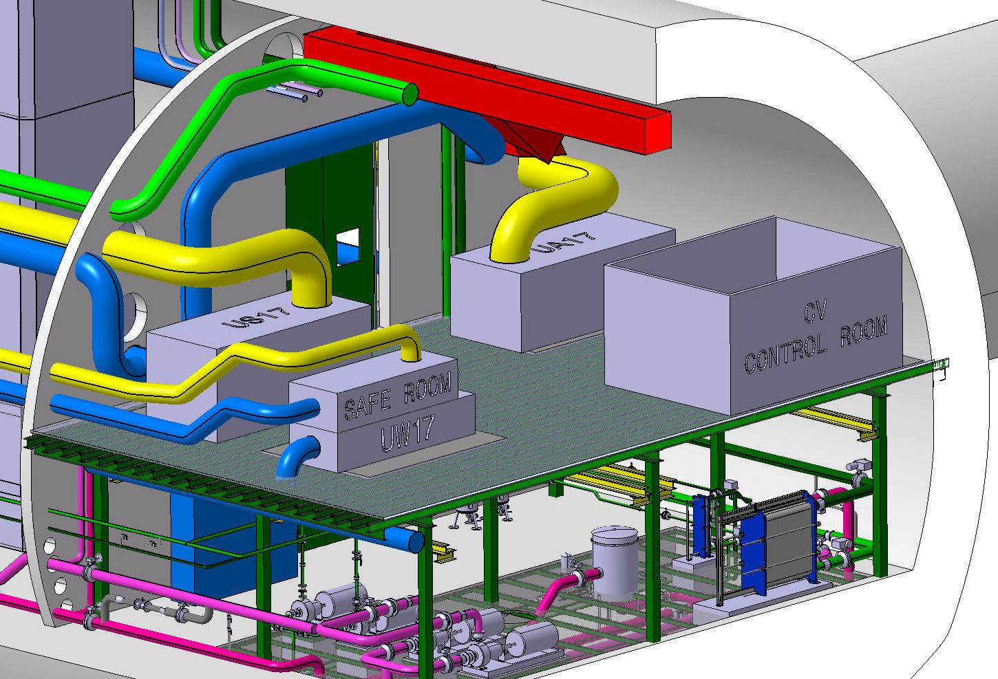
  3D Model Ventilation System UWx7

Slide 23
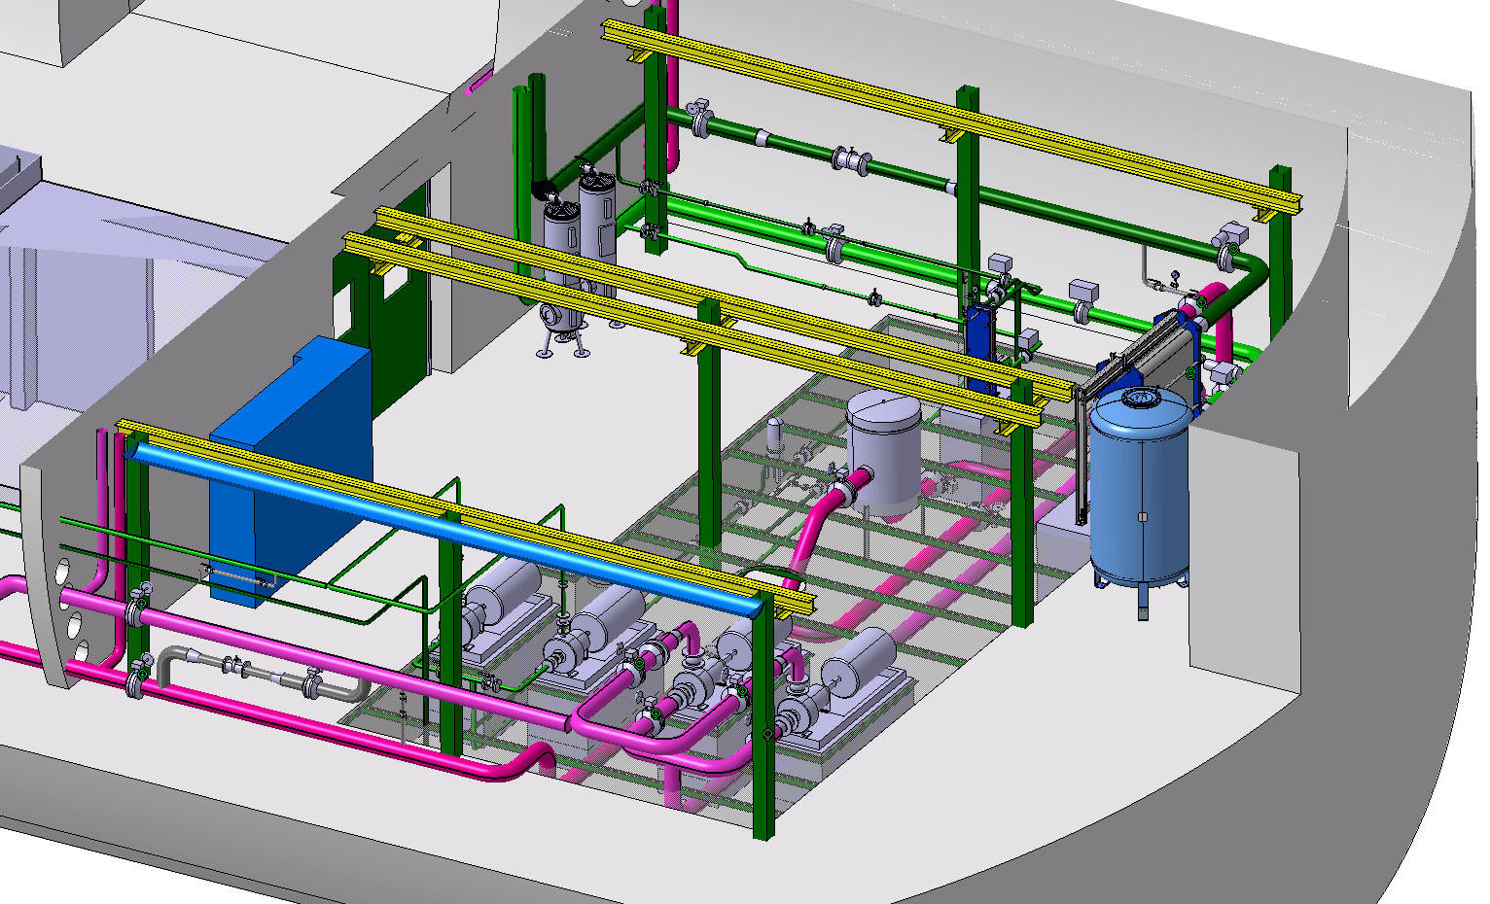
  3D Model Cooling System UWx7

Slide 24
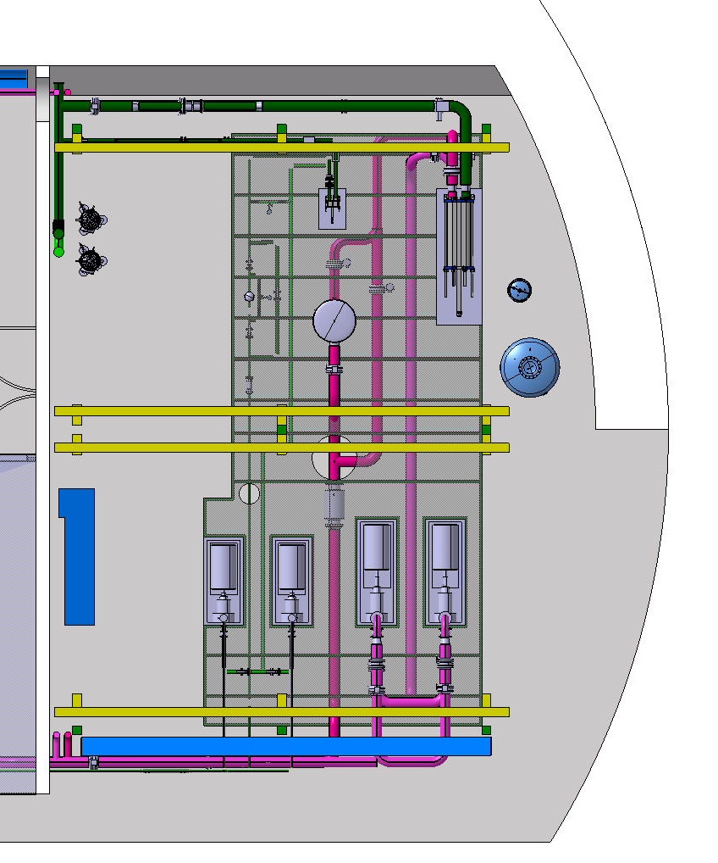
  Cooling System UWx7
Primary water circuit

Slide 25
  Cooling System UWx7
Primary water circuit
Secondary water
circuit

Slide 26
THANK YOU

