Slide 1

International Review of the Cooling and Ventilation Systems Design for HL-LHC
Giovanni Dell Orco (ITER, Chair), Peter Röllig (ILK Dresden), Ugo Rotundo (INFN), Maurice Ball (FNAL), Jiri Nožička (Technical Uni. Prague)
Cooling and Ventilation Technical Review – 14th March 2017

Slide 2
Acknowledgments
The members of the Panel thank the CERN management and HL-LHC team for the preparation and the presentations shown during the design review.
We wish to thank especially Mauro Nonis and Michele Battistin for their support.
We also wish to thank Celine Le Bon for her support and excellent management of logistics.

Slide 3
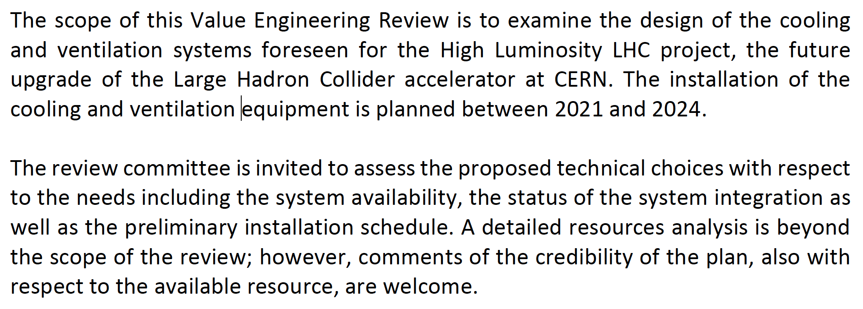
Scope of the HL-LHC CV Technical Review
Examine the design of the cooling and ventilation systems;
Assess the proposed technical choices with respect to the needs including the system availability;
Assess the advancement status of the system “integration” (incorporation of CV equipment in the 3D model of the buildings);
Assess the preliminary installation schedule;
Comment the credibility of the plan, and the adequacy of available resources for the project.

Slide 4
Examine the design of the CV systems
The panel agrees on the main design criteria according to the standard practice (e.g. equipment redundancy to maximize CV availability, assumed design margin of 15% etc.);
The panel also acknowledges the validity of the modular design between PT1 and PT5 limiting the differences only to national specific guidance;
The maturity of the design is well reported in the accurate list of 3D models and P&IDs drawings;
The two stages of ½ and full crab cavities are well assessed with good design assumption to only upgrade the pumps according to best value for money analysis between options.

Slide 5
Assess the proposed technical choices with respect to the needs including the system availability
The panel acknowledges that the accumulated experience in the management of LHC CV systems impose a specific attention to improve the relevant availability (ref. is the Pareto diagrams shown in the L. Tavian’s presentation).
So far the redundancy (N +1) is a correct answer but a quantitative estimation needs to be defined (e.g. MTTR and MTBF) for the concerned equipment (namely for rotating machines) with a final target of CV availabilities.

Slide 6
Assess the advancement status of the system “integration” (incorporation of CV equipment in the 3D model of the buildings
The panel acknowledges the progress to develop 3D CATIA models on CV plants integrated in the CE structures;
Nevertheless the panel recommends to prepare a clear list of impacts and loads on the CE namely for the piping/ducts supports, pumps, pressurizers, AHUs, piping penetrations and supporting steel structures;
Proper preliminary evaluation of the gravity loads of piping on supports, penetrations and for main equipment (e.g. weight > 10 kN) shall be ASAP determined not to delay the CE schedule; Distributed loads on steel structures shall be also evaluated considering maintenance requirements of large equipment;
Preliminary pumps and large equipment foundation drawings shall be prepared with details of plinths and foundation bolts;
Installation sequences shall be evaluated to avoid possible interference during first installation and later extraordinary maintenance and equipment upgraded phases (e.g. pumps replacement).

Slide 7
Assess the preliminary installation schedule;
The panel agrees on the preliminary time schedule prepared for the installation of the CV systems in PT1 and PT5;
The panel suggests to evaluate (if not yet done) some interlink milestones also at design level between the CE and CV to define the mutual requirements and interfaces (e.g. by when CV shall confirm the gravity loads etc.);
The panel suggests to evaluate the opportunity to group the contracts by three disciplines namely for CTs, Cooling Systems and Ventilation Systems;
The panel also suggests to prepare three frameworks contracts ready to be split in lots/packages according to appropriate capacity of contractors/consortiums and time schedule for each PTs and buildings.

Slide 8
Comment the credibility of the plan, and the adequacy of available resources for the project.
The panel agrees to consider adequate the resources estimated for the entire CV project;
Attention to be paid not to underestimate the effort required for in-house activities (e.g. I&C plant controls);
The panel suggests to also consider additional resources needed for the O&M of the CV new systems.

Slide 9
Final recommendations and risk mitigation
The panel highlights the need for the HL-LHC WP 1 management to tight control the general schedule and specifically the civil construction WP 17.1 not to jeopardize the WP 17.3 activities needed for the installation of subsequent systems.
The final selection of chillers shall consider the up-to-date F-gas European regulation.
The upgrade of the pumps for the full CC phase shall be performed following the best value for money analysis between these options :
  Replacement of the previous pumps;
  Installation of VFDs on initial pumps.

