Slide 1
Status of full simulation
Estel Perez
27th April 2017

Slide 2
Full Sim Status
Updating geometry to current baseline -> done
Scan over jet energies (same tracking strategies) -> on hold, validating performance
obtain preliminary parameterization
Variations
layout
resolution
tracking strategies

Slide 3
Summary
LAST MEETING
TODAY
Generation: MG5 central dijets, fixed quark pT.
Hadronization: Pythia6. MI off, ISR&FSR on.
Detector Model: CLIC_SiD with FCC vertex and squeezed FCC tracker. Barrel only.
Simulation: FCC material budget (services incl. in sensor)
Digitization: FCC pixel sizes. Gaussian smearing by √12.
Tracking: Nhits>=6, chi2<10, dca<20
Vertexing: LCFIPlus. PFOs in 2 kT jets R=0.5. Default parameters
Flavour Tagging: no cut on jet pT
Found issue with LF samples: contain mostly g-jets that can produce cc/bb pairs
Need to skip events containing HF hadrons
→ Optimized tracking strategies for displaced tracks. Tracking cuts to be tuned using b-jet samples
*should be revised
Observed an exaggeratedly bad flavor tagging performance. Checked:
Statistics of training sample
B filed consistency
Single point resolution
Tracking strategies

Slide 4
Evolution of flavor tagging performance

Slide 5
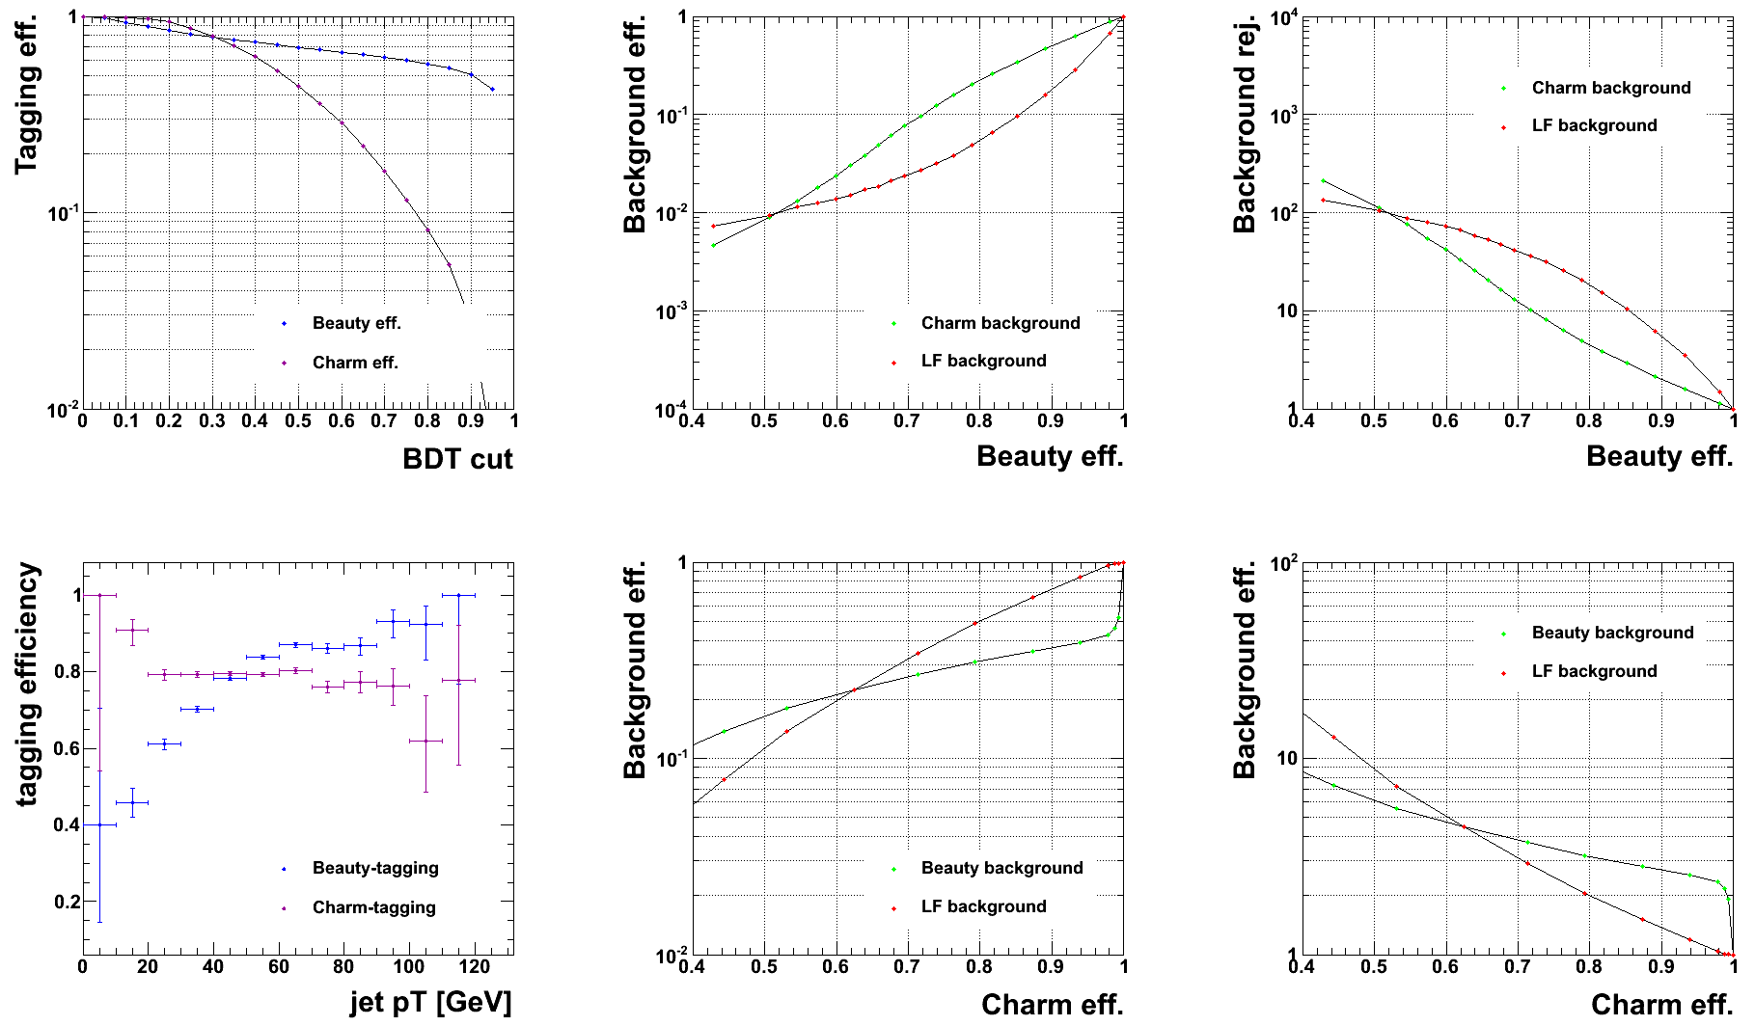
50GeV
20k per sample
inverted values in Y axis, for comparison with LHC
for BDT cut = 0.3
rej.
tagging efficiency depends more strongly in pT for b’s than for c’s

Slide 6
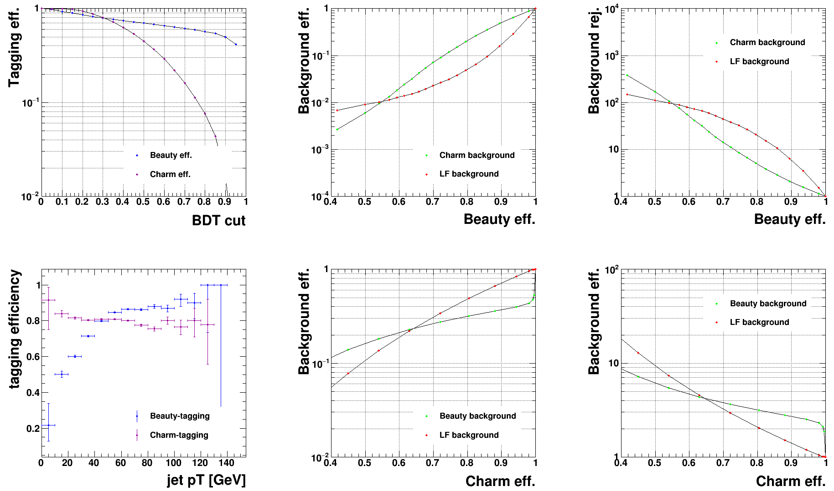
50GeV
100k per sample
inverted values in Y axis, for comparison with LHC
for BDT cut = 0.3
tagging efficiency depends more strongly in pT for b’s than for c’s

Slide 7
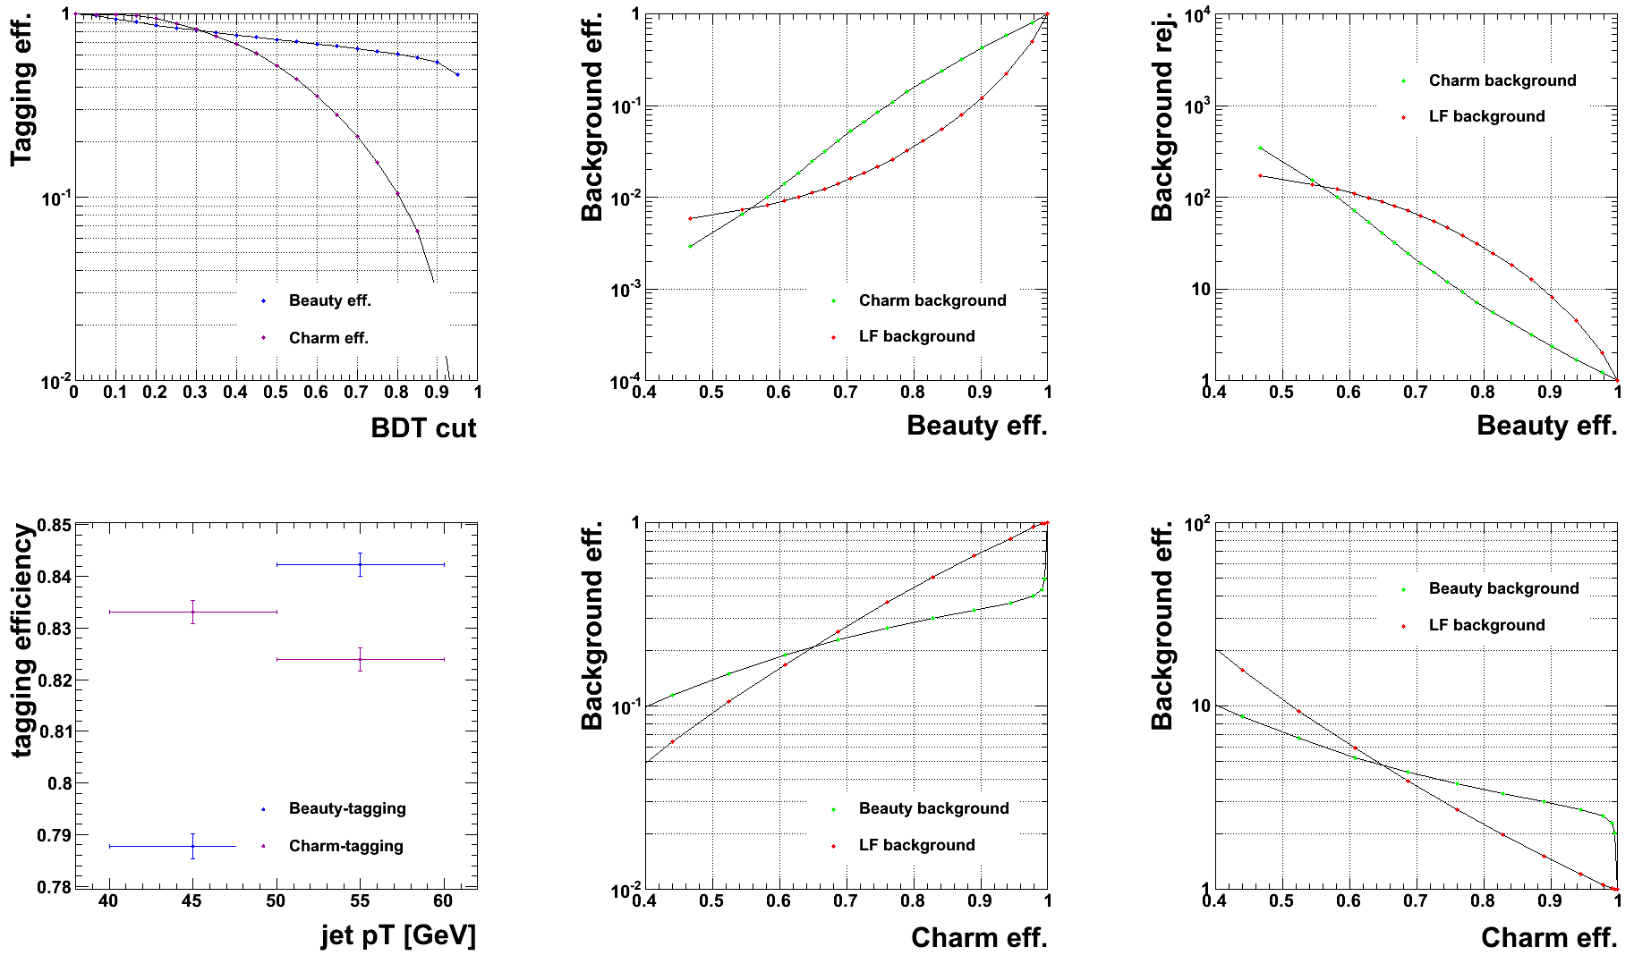
50GeV
100k per sample, 40<pt<60 GeV
inverted values in Y axis, for comparison with LHC
for BDT cut = 0.3
tagging efficiency depends more strongly in pT for b’s than for c’s

Slide 8
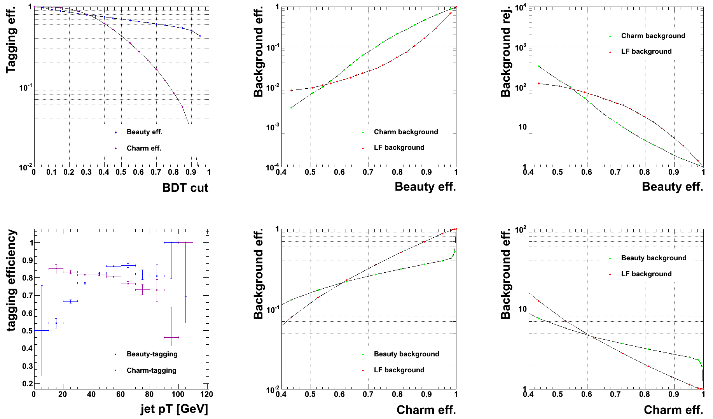
50GeV
20k per sample, 4T Bfield
inverted values in Y axis, for comparison with LHC
for BDT cut = 0.3
tagging efficiency depends more strongly in pT for b’s than for c’s

Slide 9
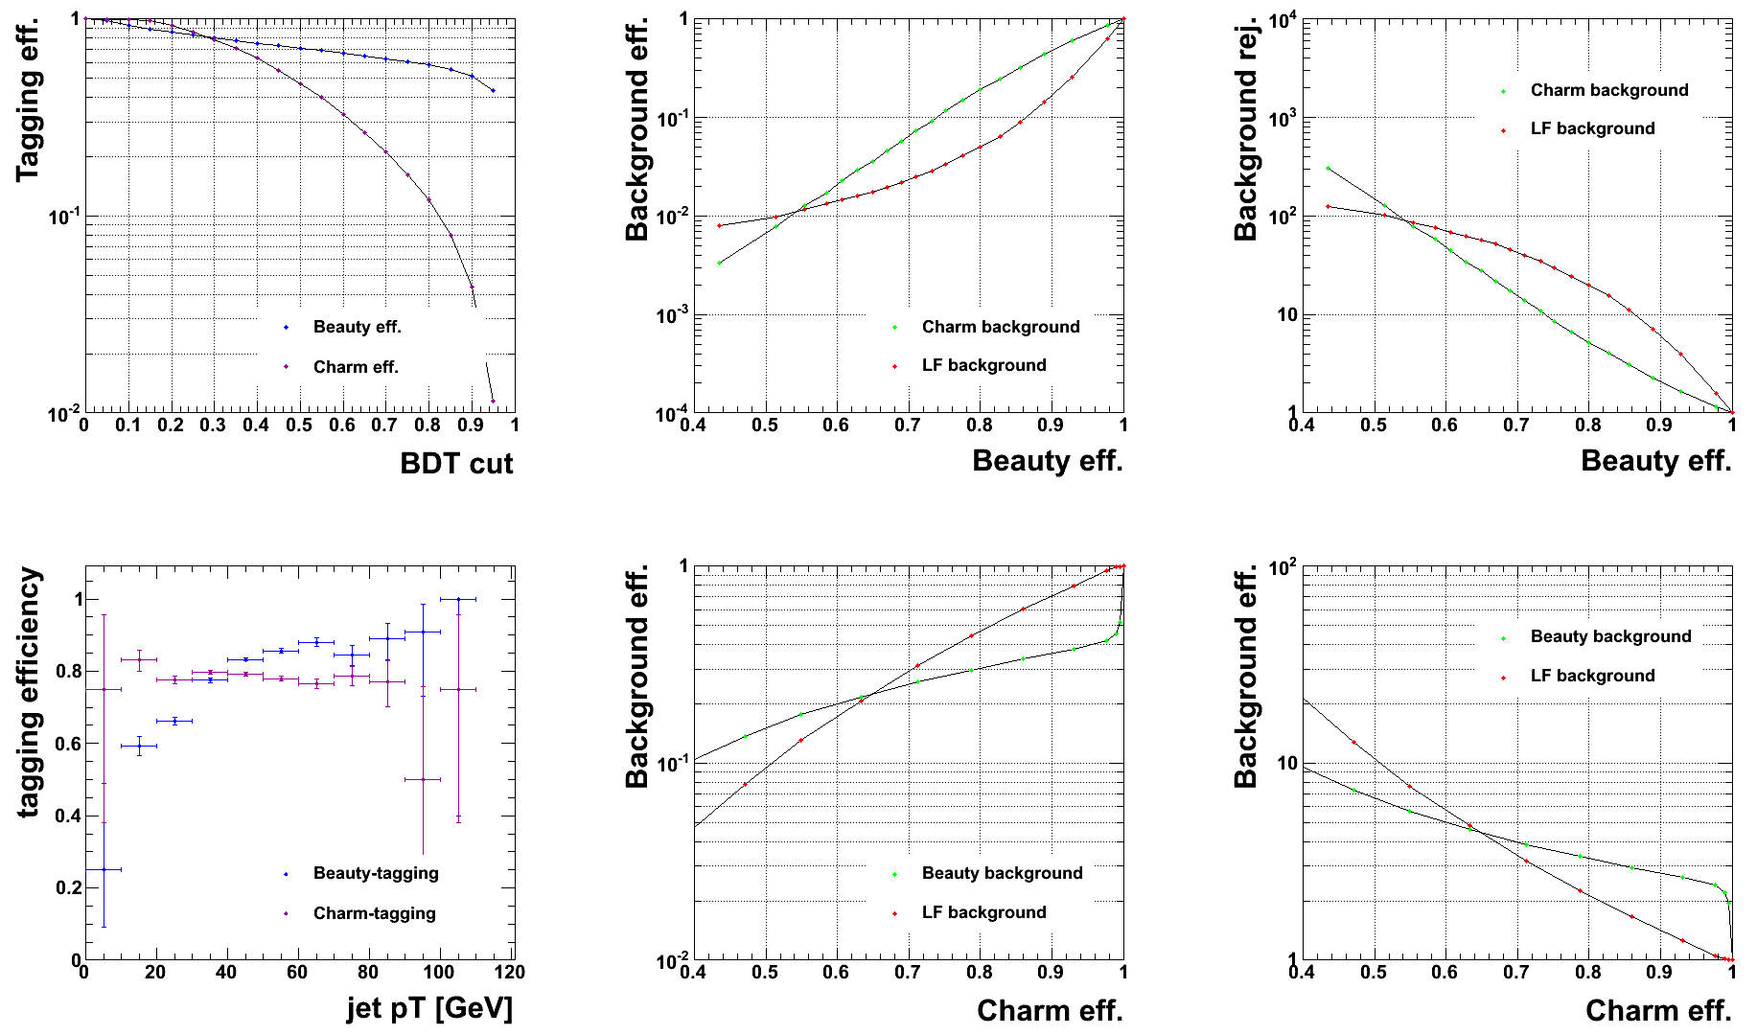
50GeV
20k per sample, 4T Bfield, 0.020 pitch
inverted values in Y axis, for comparison with LHC
for BDT cut = 0.3
tagging efficiency depends more strongly in pT for b’s than for c’s

Slide 10
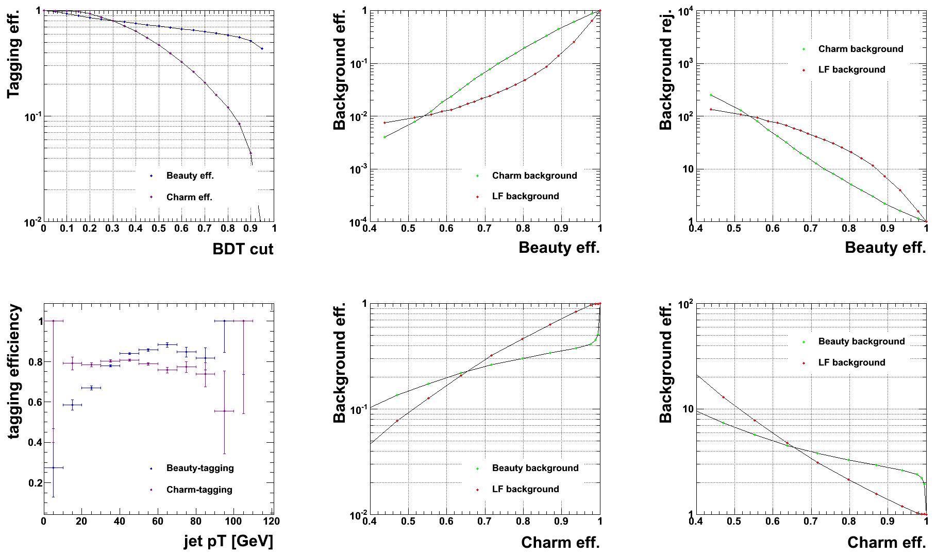
50GeV
20k per sample, 4T Bfield, 0.020 pitch
min 7 hits
inverted values in Y axis, for comparison with LHC
for BDT cut = 0.3
tagging efficiency depends more strongly in pT for b’s than for c’s

Slide 11
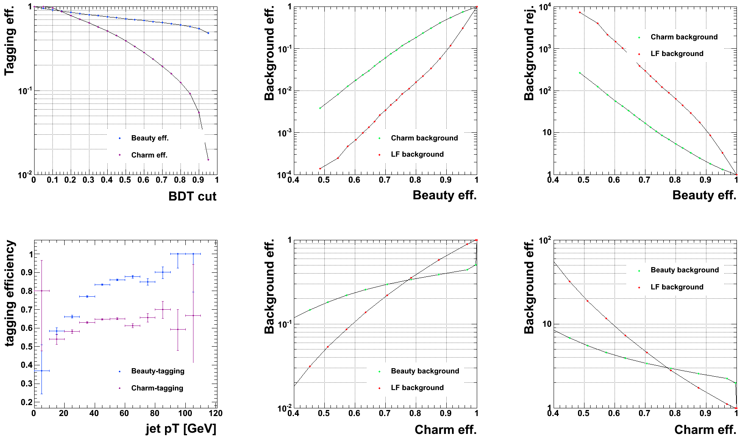
50GeV
20k per sample, 4T Bfield, 0.020 pitch
min 7 hits, removedHF
inverted values in Y axis, for comparison with LHC
for BDT cut = 0.3
tagging efficiency depends more strongly in pT for b’s than for c’s

Slide 12
50GeV
20k per sample, 4T Bfield, 0.020 pitch
min 7 hits, removedHF, material*0.5
inverted values in Y axis, for comparison with LHC
Not available yet due to grid issues, not enough stats to train flavour tagging
tagging efficiency depends more strongly in pT for b’s than for c’s

Slide 13
Look at some of the key variables that we feed to the flavour tagging training
Compare to CLIC CDR

Slide 14
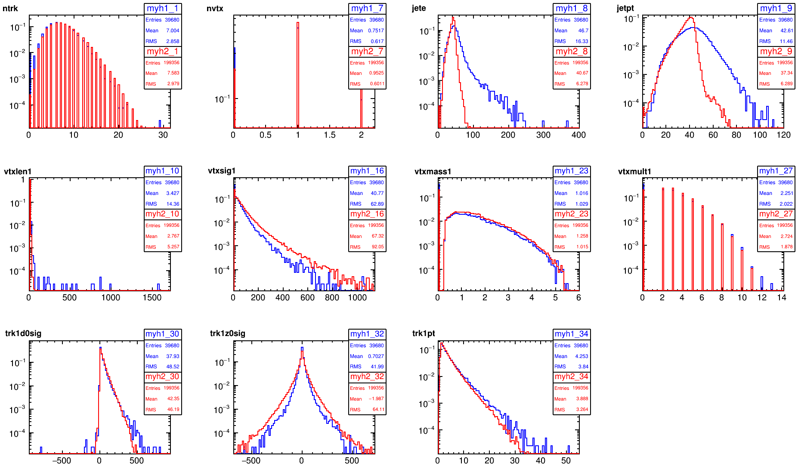
CDR->Opt3v02(4T)
bb

Slide 15
test
Is the difference due to geometry (# and position of the layers) or to their resolution?
→ Set the pitch of the 3 innermost layers to:
xpitch = 0.020 mm
ypitch = 0.020 mm
(as in the CDR)

Slide 16
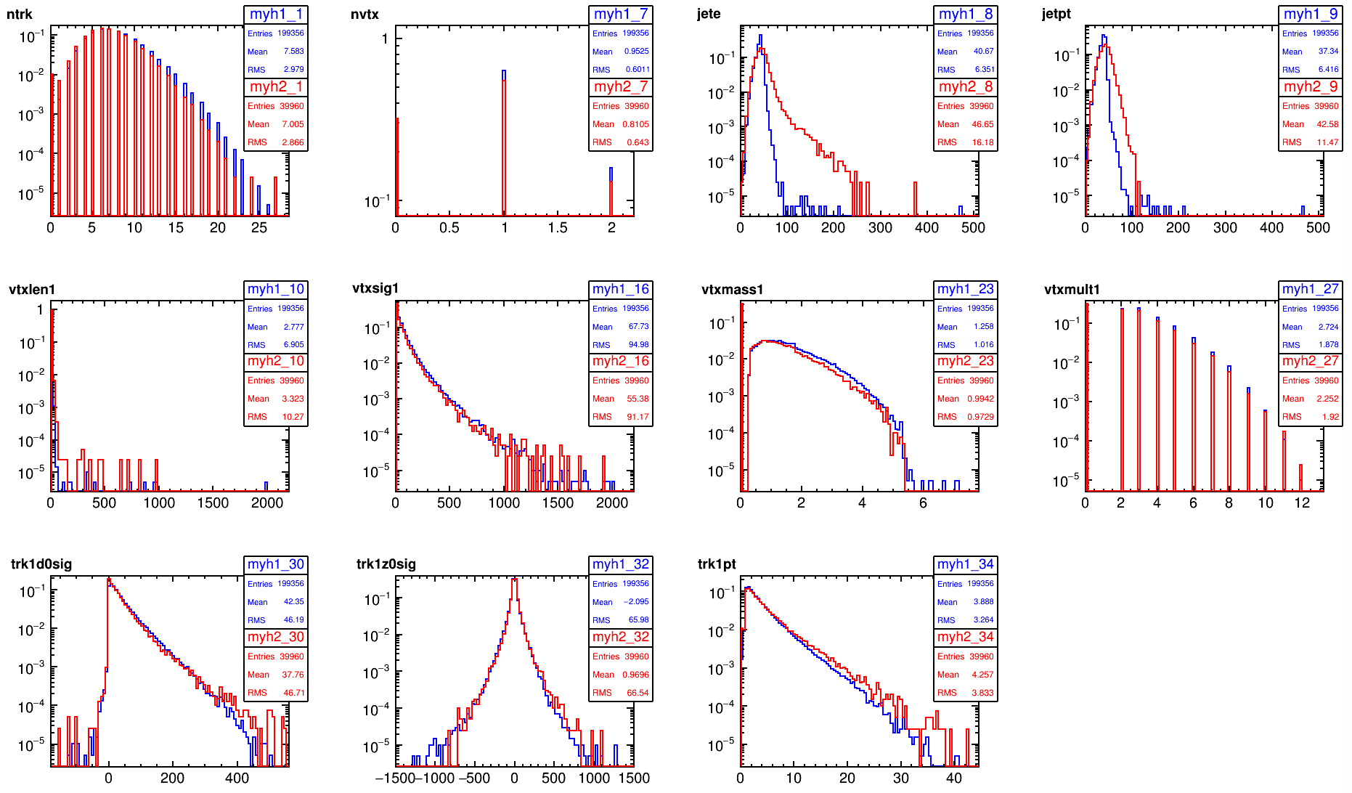
002InnerPitch->CDR
bb
fine for bb sample

Slide 17
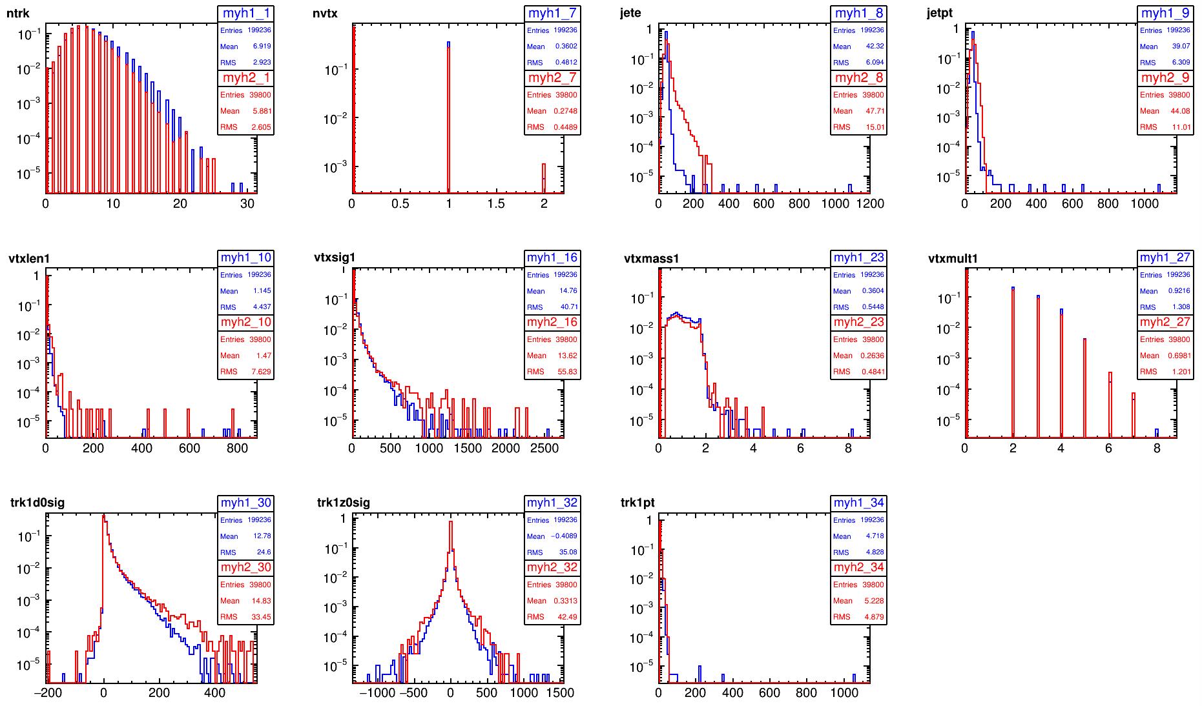
002InnerPitch->CDR
cc
~ fine for cc
sample

Slide 18
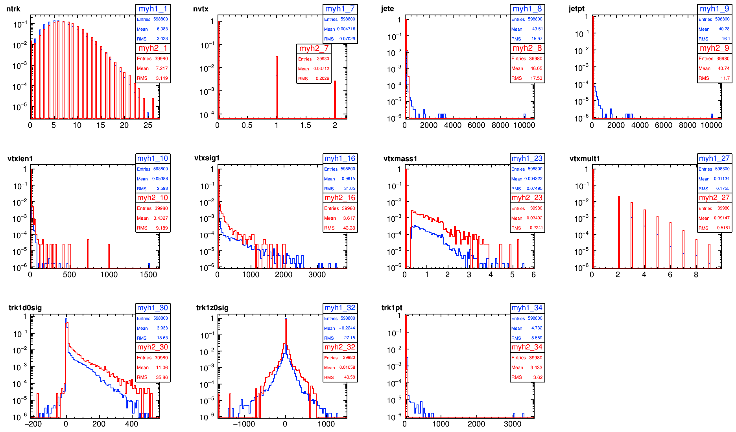
002InnerPitch->CDR
ll
weird for ll
sample

Slide 19
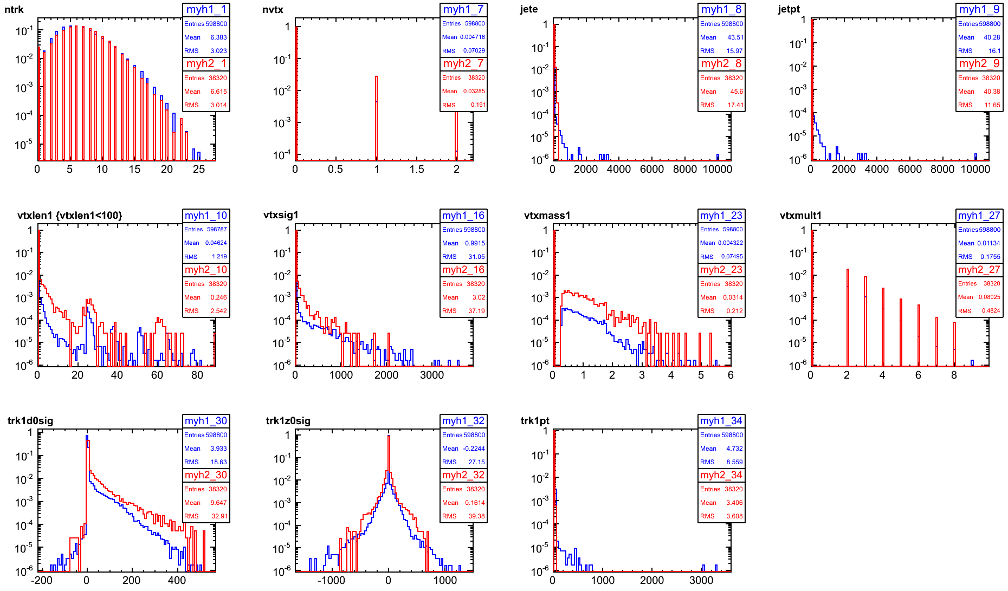
002InnerPitch->CDR
8hits
ll

Slide 20
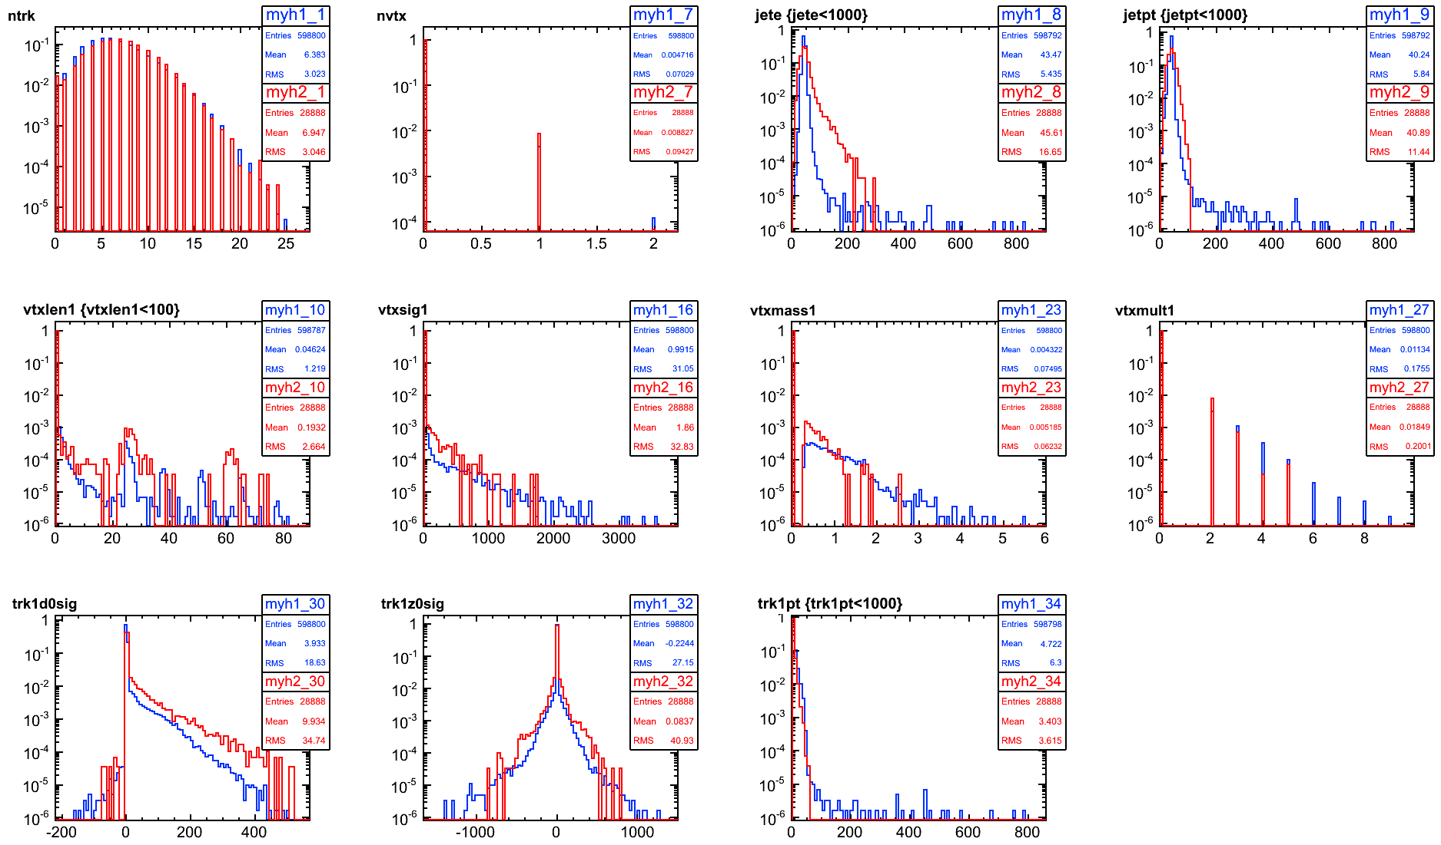
002InnerPitch->CDR
7hits
remove HF hadrons
ll
way less SV (they were from real Bs!)

Slide 21
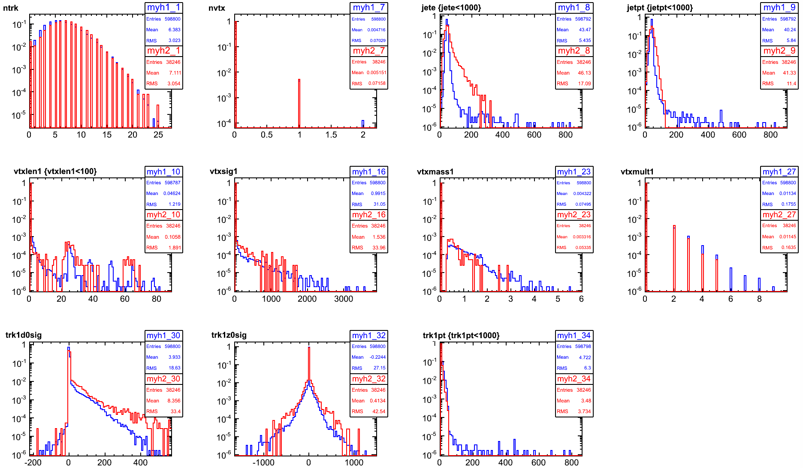
002InnerPitch mat*0.5->CDR
7hits
remove HF hadrons
ll
less SV from interaction with material

Slide 22
Tracking strategies
Generated displaced muons to train tracking strategies
0.1-1000 GeV
vtx R = 0-500 mm
theta 80-100
phi 80-100
10k events

Slide 23
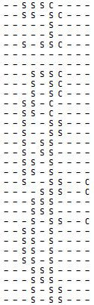
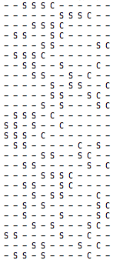
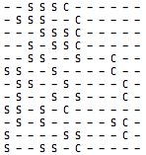
Visualize tracking strategies:
To optimize/debug them (layer weights, efficiency, etc…)
strategies for barrel-only tracks: S=seed ; C=confirm ; -=extend
CLIC CDR
never uses 1st 2nd layer as seed
FCC displaced tracks min 6 hits
FCC displaced tracks min 9 hits

Slide 24
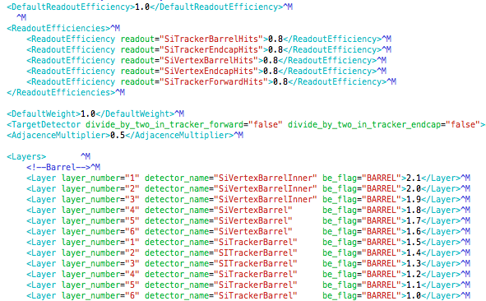
layerWeights

Slide 25
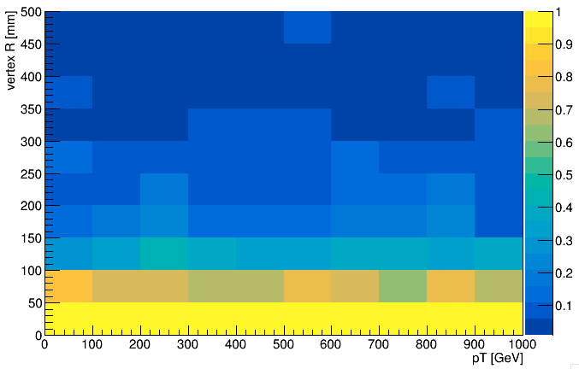
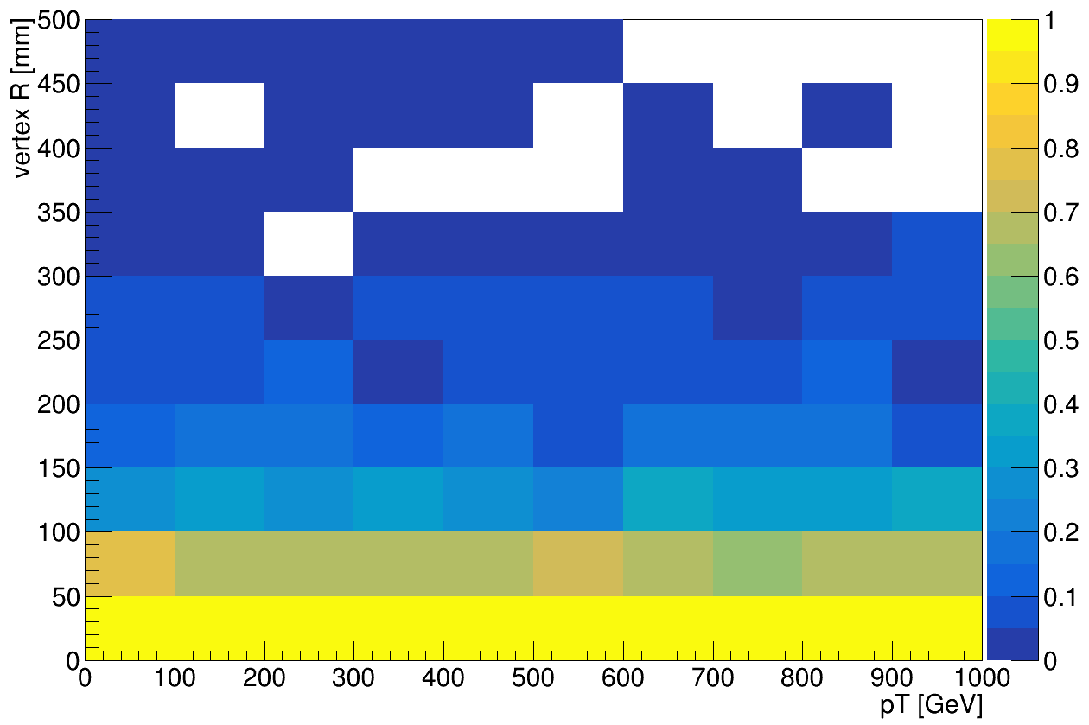
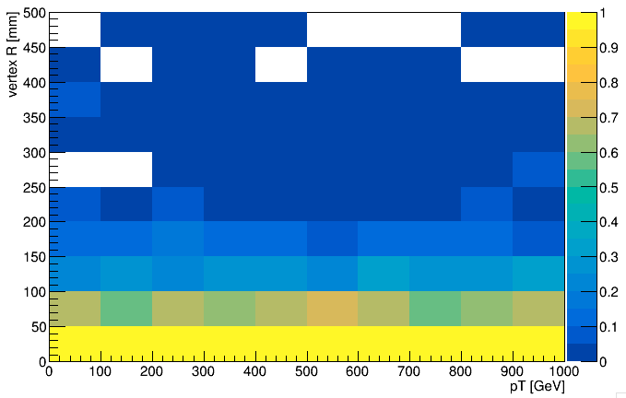
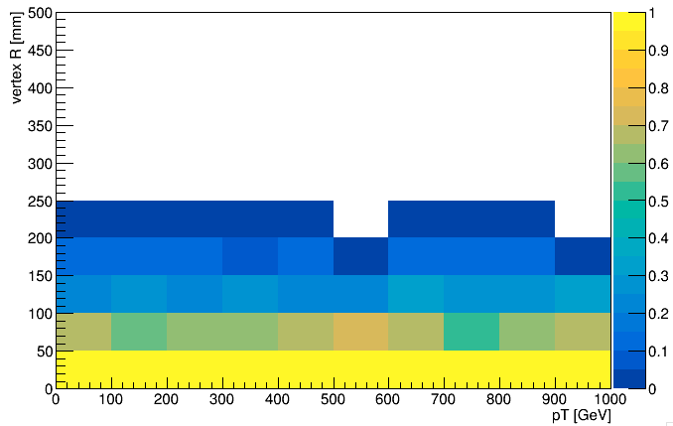
single muon tracking Efficiency vs pT and vertexR
minNL = 6
minNL = 7
minNL = 8
minNL = 9

Slide 26
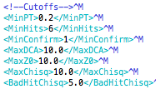
Next on tracking
Tracking performance plots:
efficiency
fake rate
(Using jet samples)
Converge on best startegies for HF jets of variuos energies?
chi2
d0 cut

Slide 27
Next steps
Finalize
material comparison
single point resolution comparison

Slide 28
Backup

Slide 29
The ll samples include: uu dd ss gg
most of the events are gg->gg
only 2% are not gg
in up to 25% of the ll events there is at least one C-hadron or B-hadron
Is this the cause of our bad performance?
→ look into the MCParticles anr skip the events that contain any of the HF hadrons
by now, skip all, do not check if they are log lived (TO DO)

Slide 30
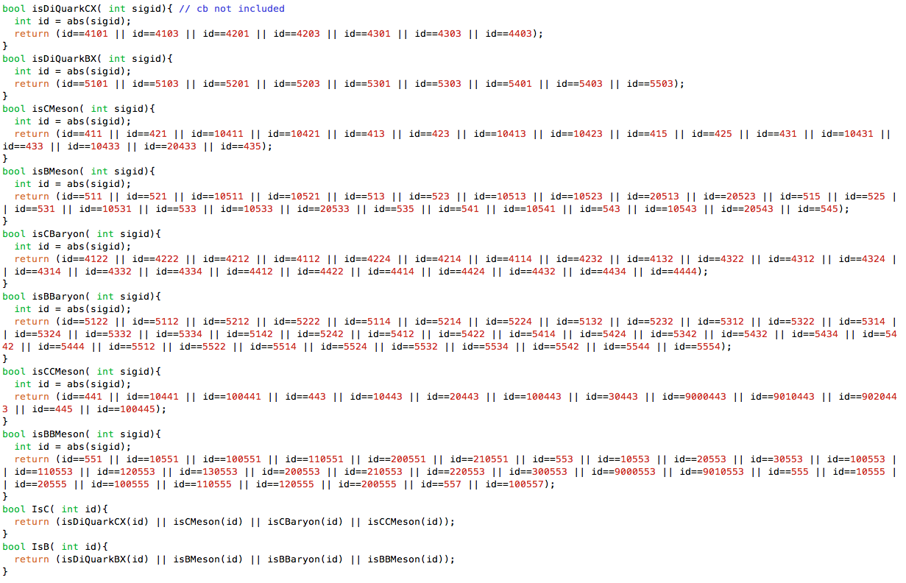
HF hadrons considered:

Slide 31
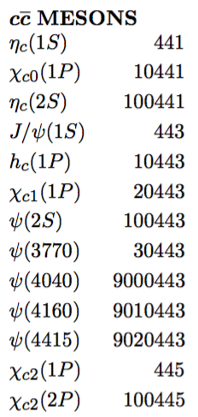
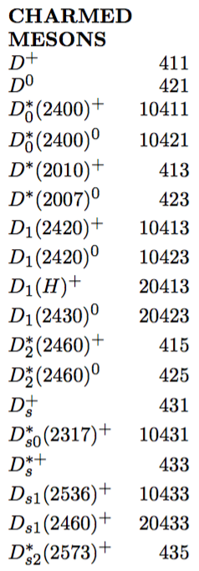
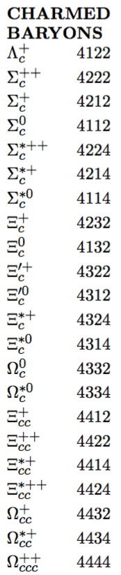
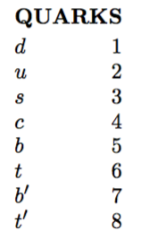
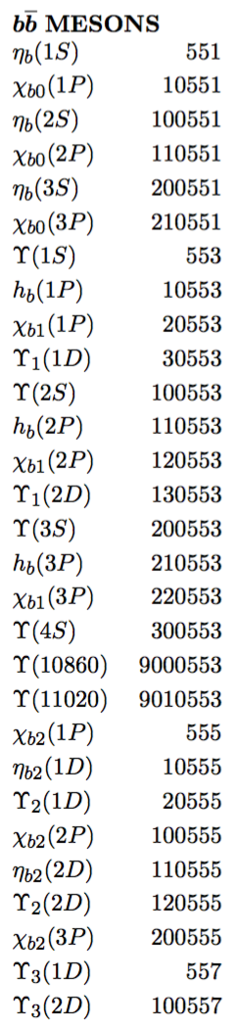
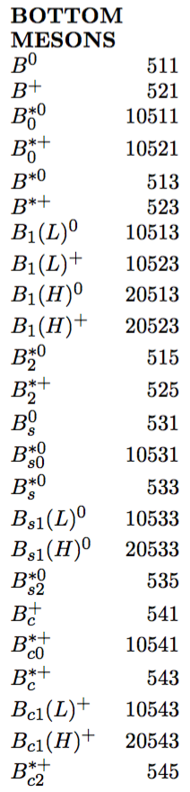
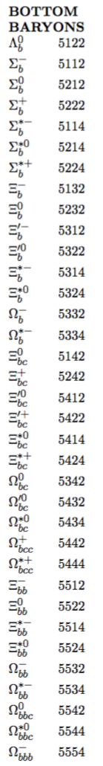
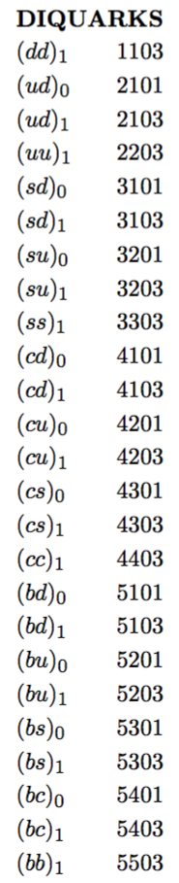
Considered HF hadrons:

Slide 32
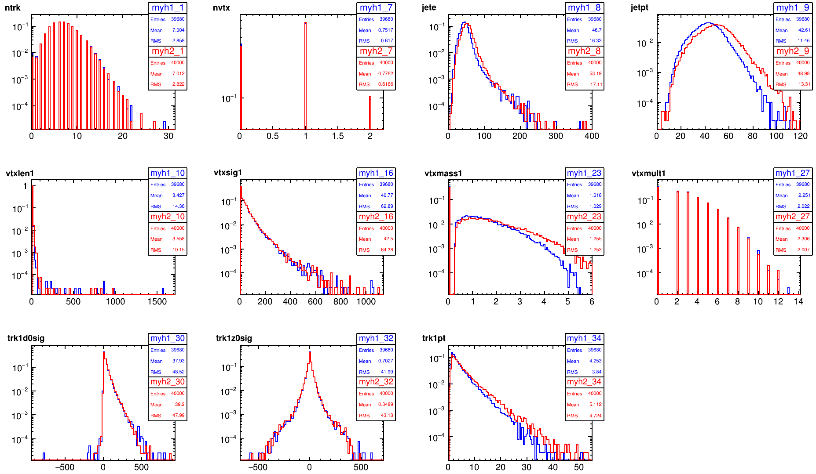
5T(wrong)->4T
bb

Slide 33
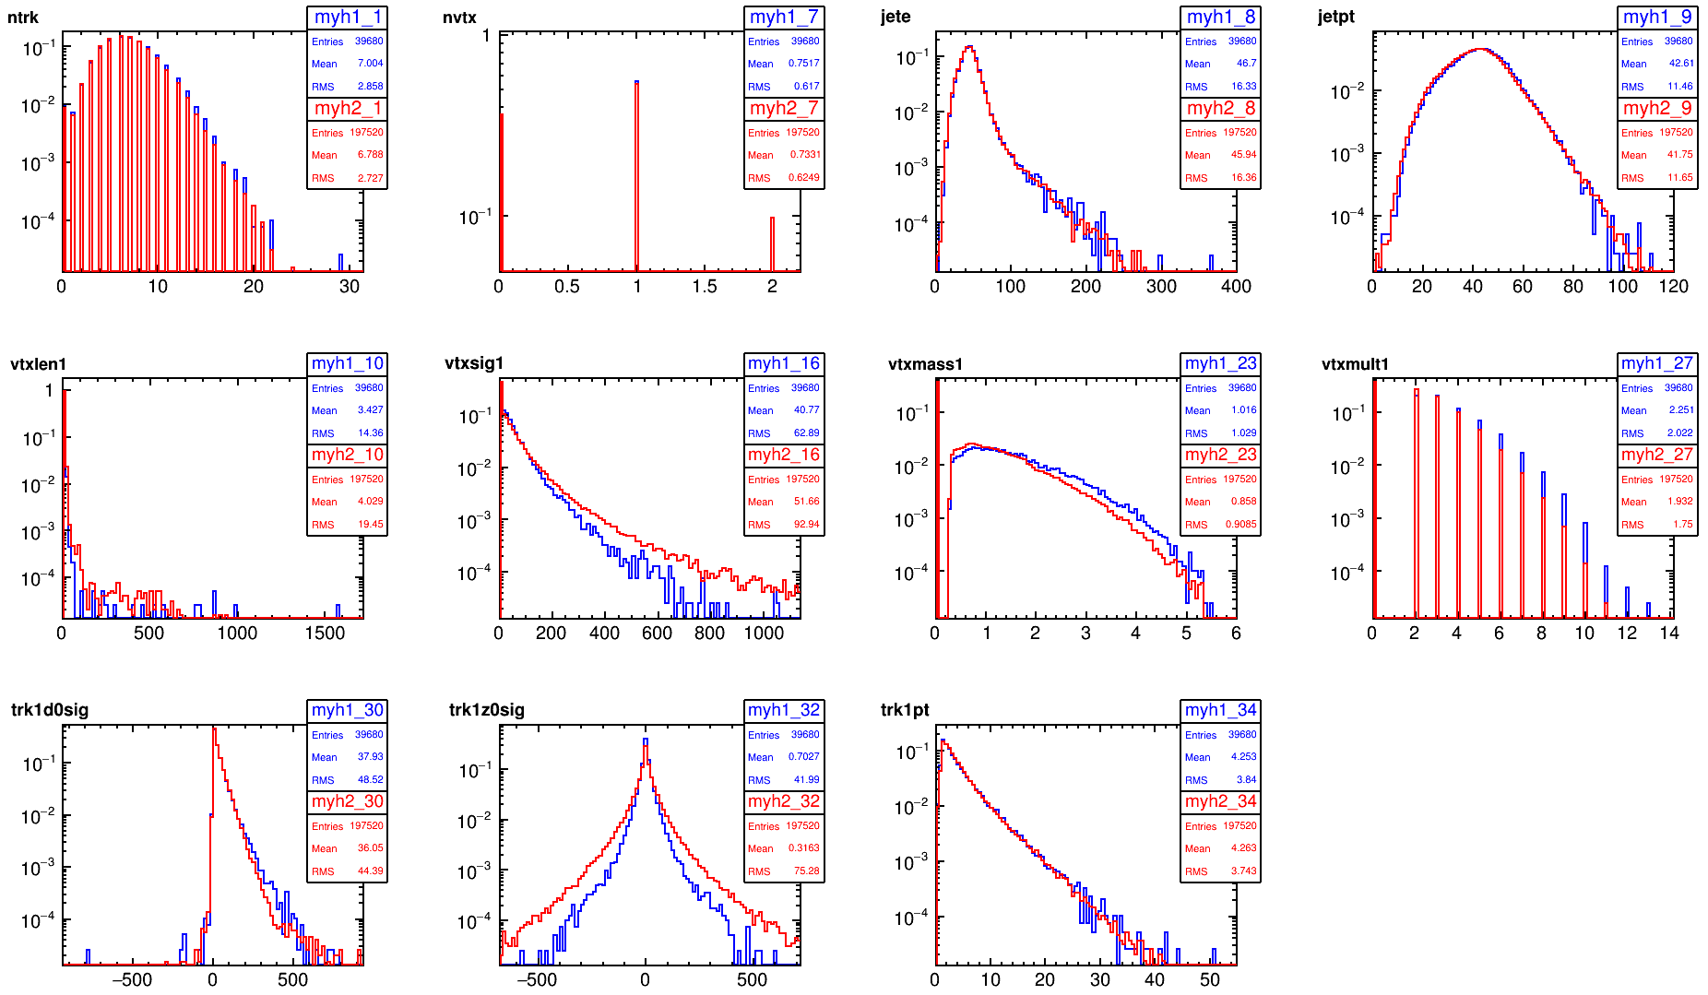
vRome->Opt3v02(4T)
bb

Slide 34
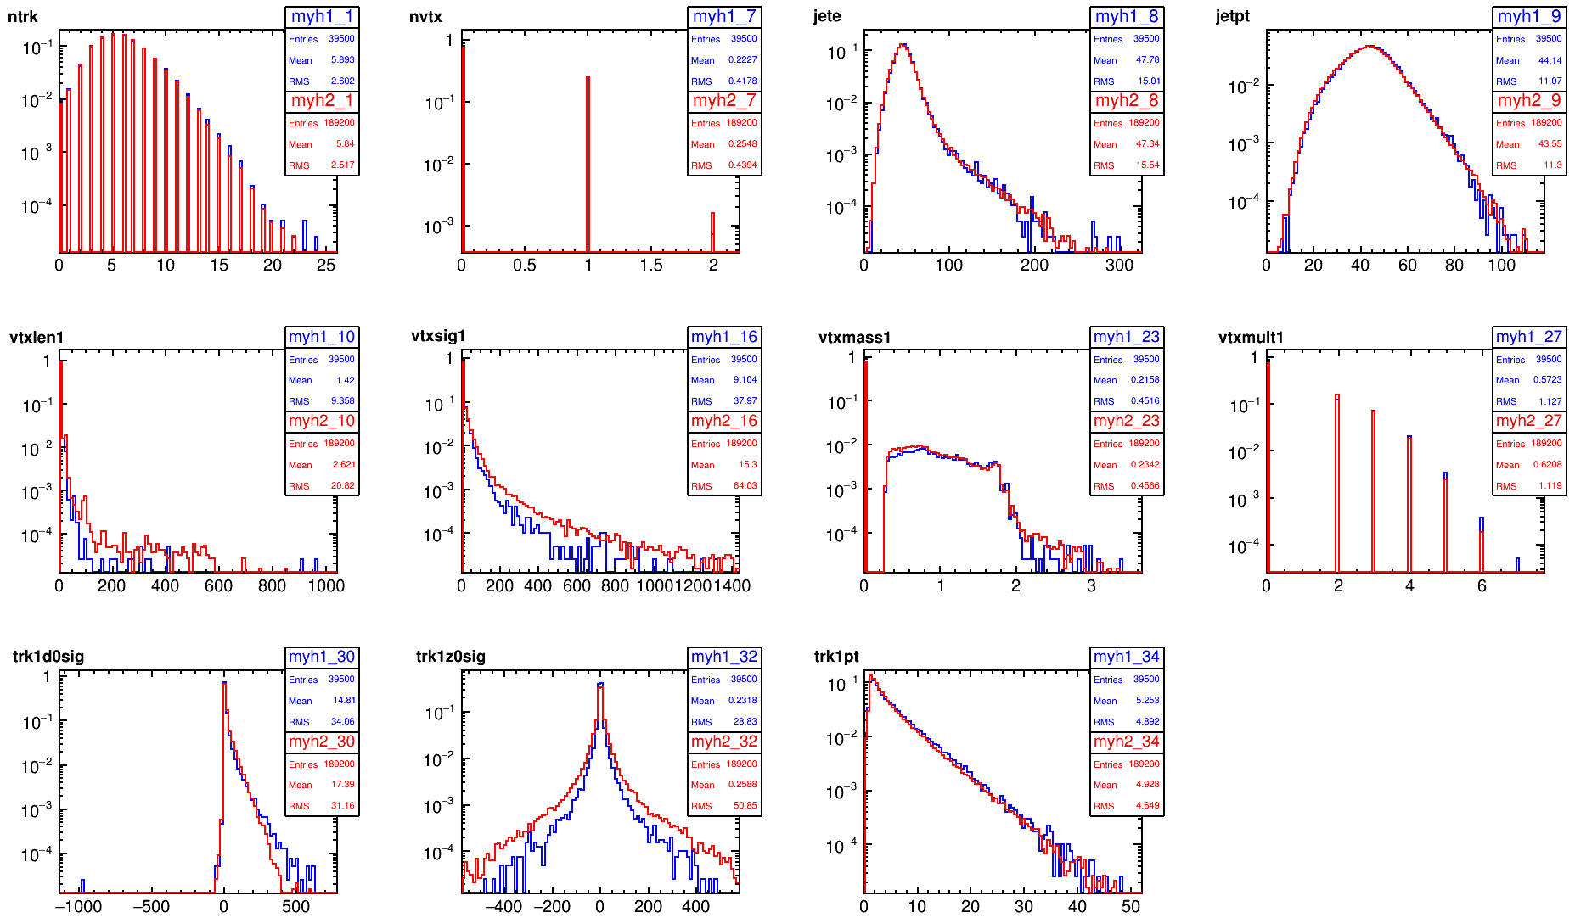
vRome->Opt3v02(4T)
cc

Slide 35
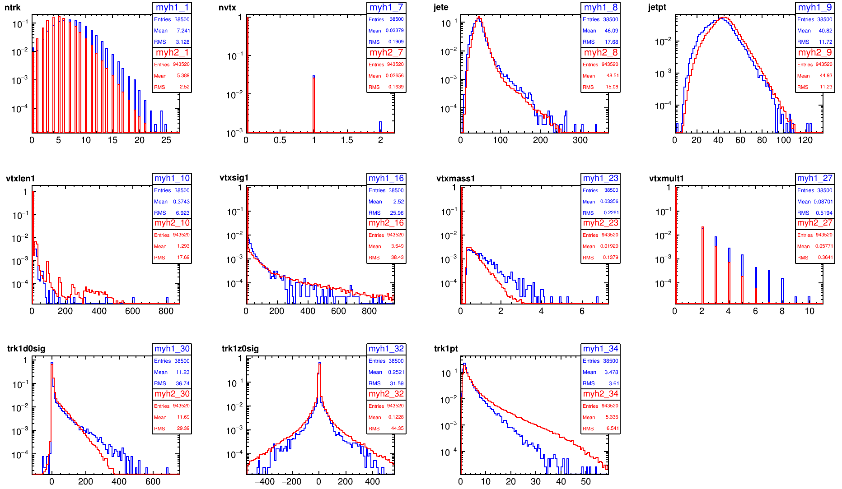
vRome->Opt3v02(4T)
ll/uu

Slide 36
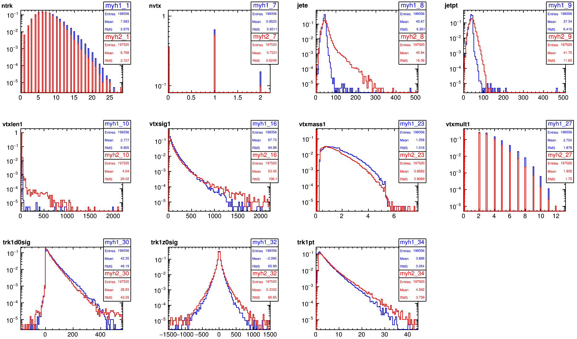
vRome->CDR
bb

Slide 37
CDR->Opt3v02(4T)
bb

Slide 38
test
Is the difference due to geometry (# and position of the layers) or to their resolution?
→ Set the pitch of the 3 innermost layers to:
xpitch = 0.020 mm
ypitch = 0.020 mm
(as in the CDR)

Slide 39
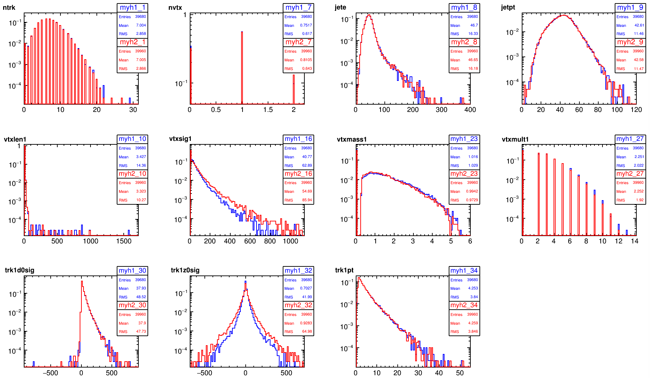
002InnerPitch->Opt3v02(4T)
bb

Slide 40
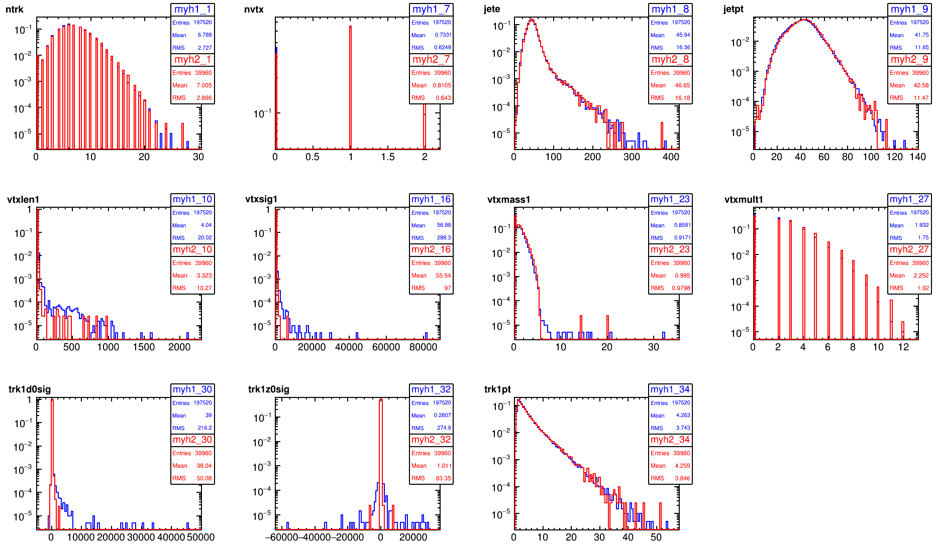
002InnerPitch->Roma
bb

Slide 41
002InnerPitch->CDR
bb

Slide 42
002InnerPitch->CDR
cc

Slide 43
002InnerPitch->CDR
ll

Slide 45
50GeV
20k per sample, 4T Bfield
inverted values in Y axis, for comparison with LHC
for BDT cut = 0.3
tagging efficiency depends more strongly in pT for b’s than for c’s

Slide 46
50GeV
20k per sample, 4T Bfield, 0.020 pitch
inverted values in Y axis, for comparison with LHC
for BDT cut = 0.3
tagging efficiency depends more strongly in pT for b’s than for c’s

Slide 47
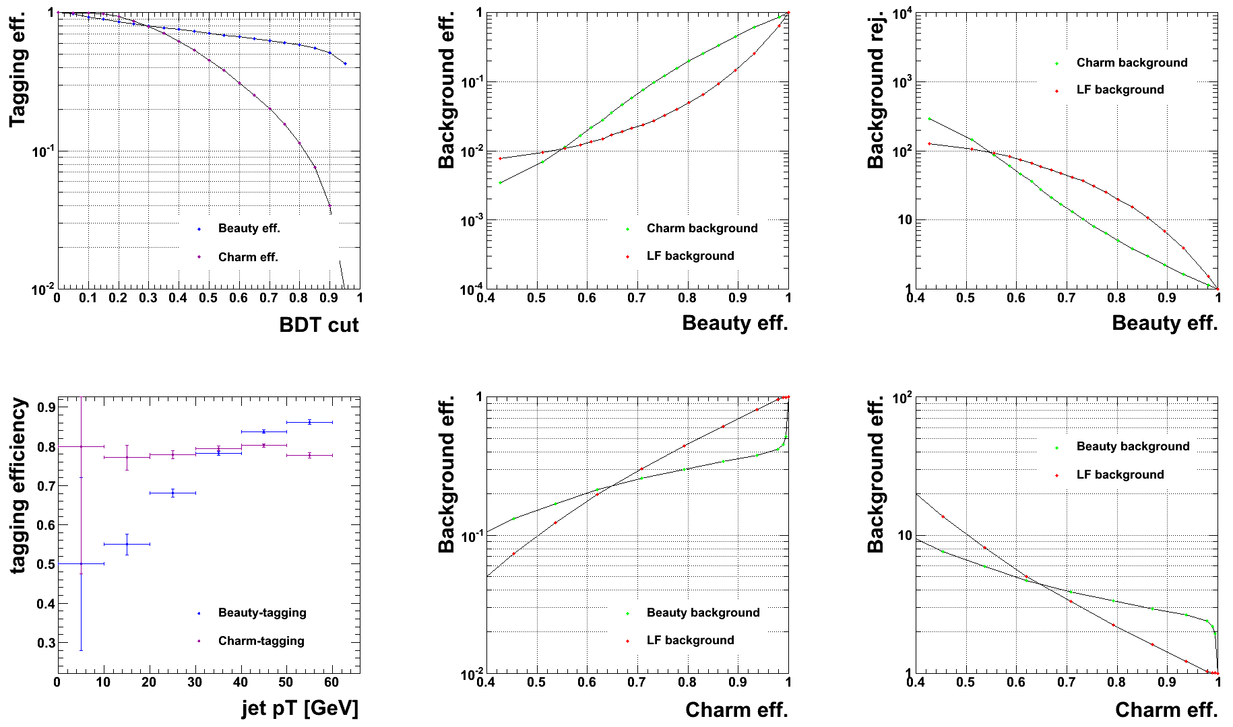
50GeV
20k per sample, 4T Bfield, 0.020 pitch
0<jet pt<60
inverted values in Y axis, for comparison with LHC
for BDT cut = 0.3
tagging efficiency depends more strongly in pT for b’s than for c’s

Slide 48
Why so many fake SV? is this the cause of the bad performance?
try increasing min Nhits per track
(missing plot number of hits per track)
try changing d0 cut
try chi2

Slide 49
50GeV
20k per sample, 4T Bfield, 0.020 pitch
min 7 hits, bugfix
inverted values in Y axis, for comparison with LHC
for BDT cut = 0.3
tagging efficiency depends more strongly in pT for b’s than for c’s

Slide 50
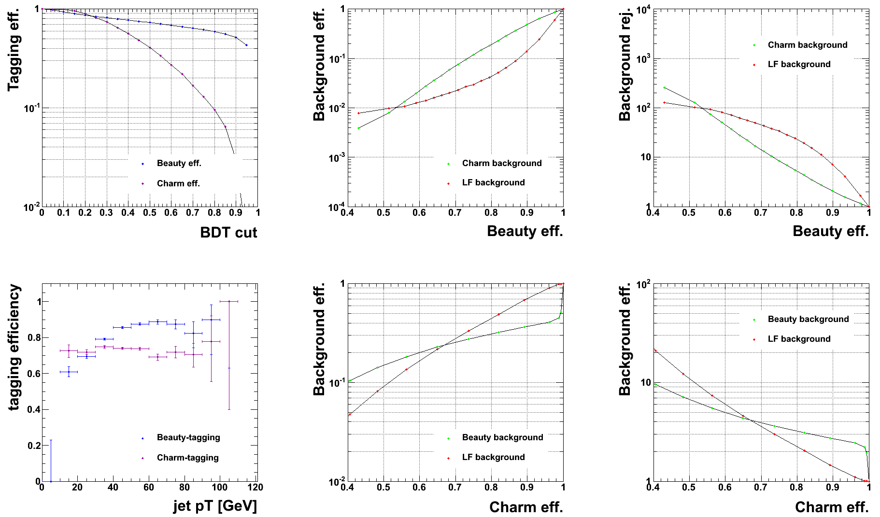
50GeV
20k per sample, 4T Bfield, 0.020 pitch
min 8 hits, bugfix
inverted values in Y axis, for comparison with LHC
for BDT cut = 0.3
tagging efficiency depends more strongly in pT for b’s than for c’s

Slide 52
002InnerPitch->CDR
6hits
ll

Slide 53
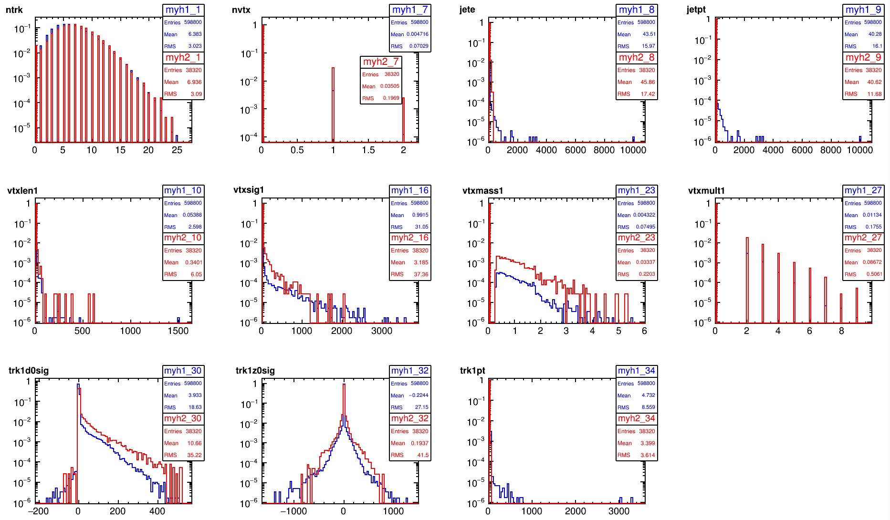
002InnerPitch->CDR
7hits
ll

Slide 54
002InnerPitch->CDR
8hits
ll

Slide 55
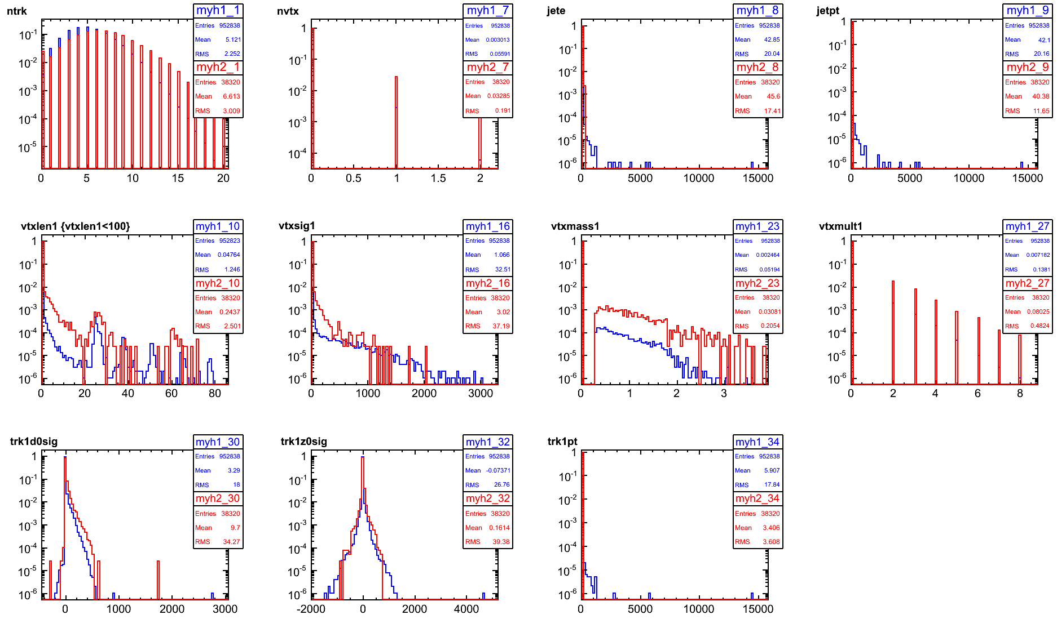
002InnerPitch->CDR pp coll
8hits
ll

Slide 56
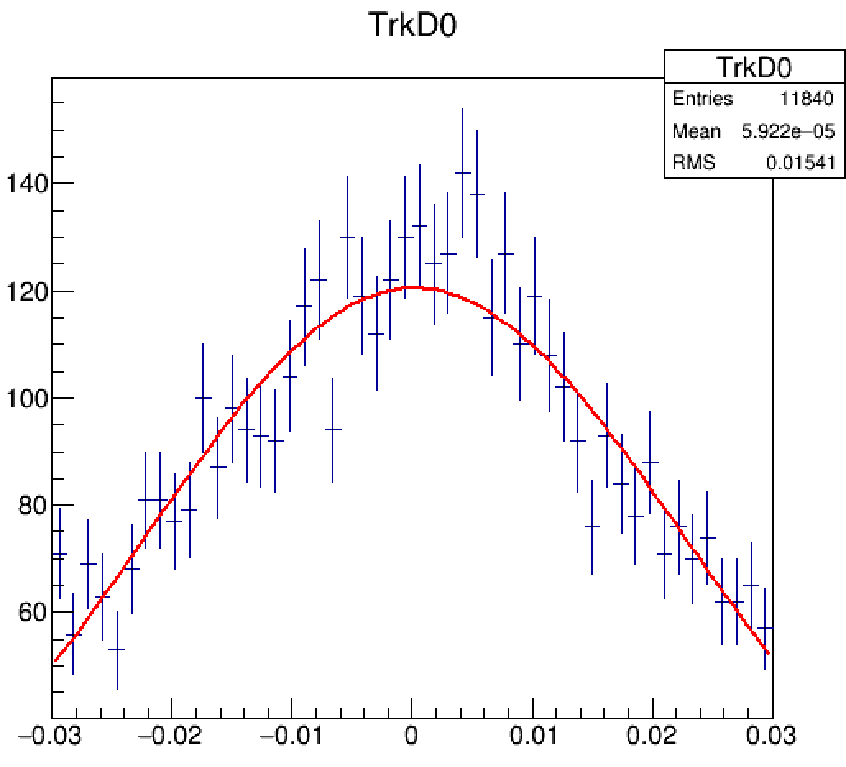

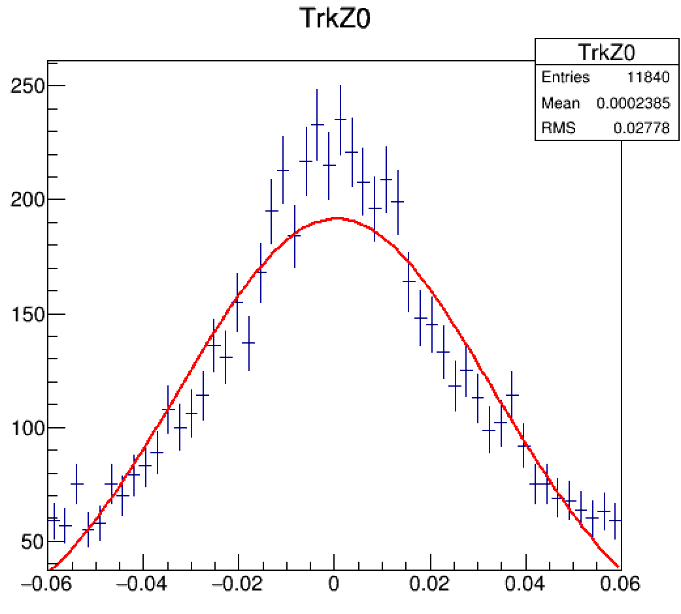
min 7 hits track

Slide 57
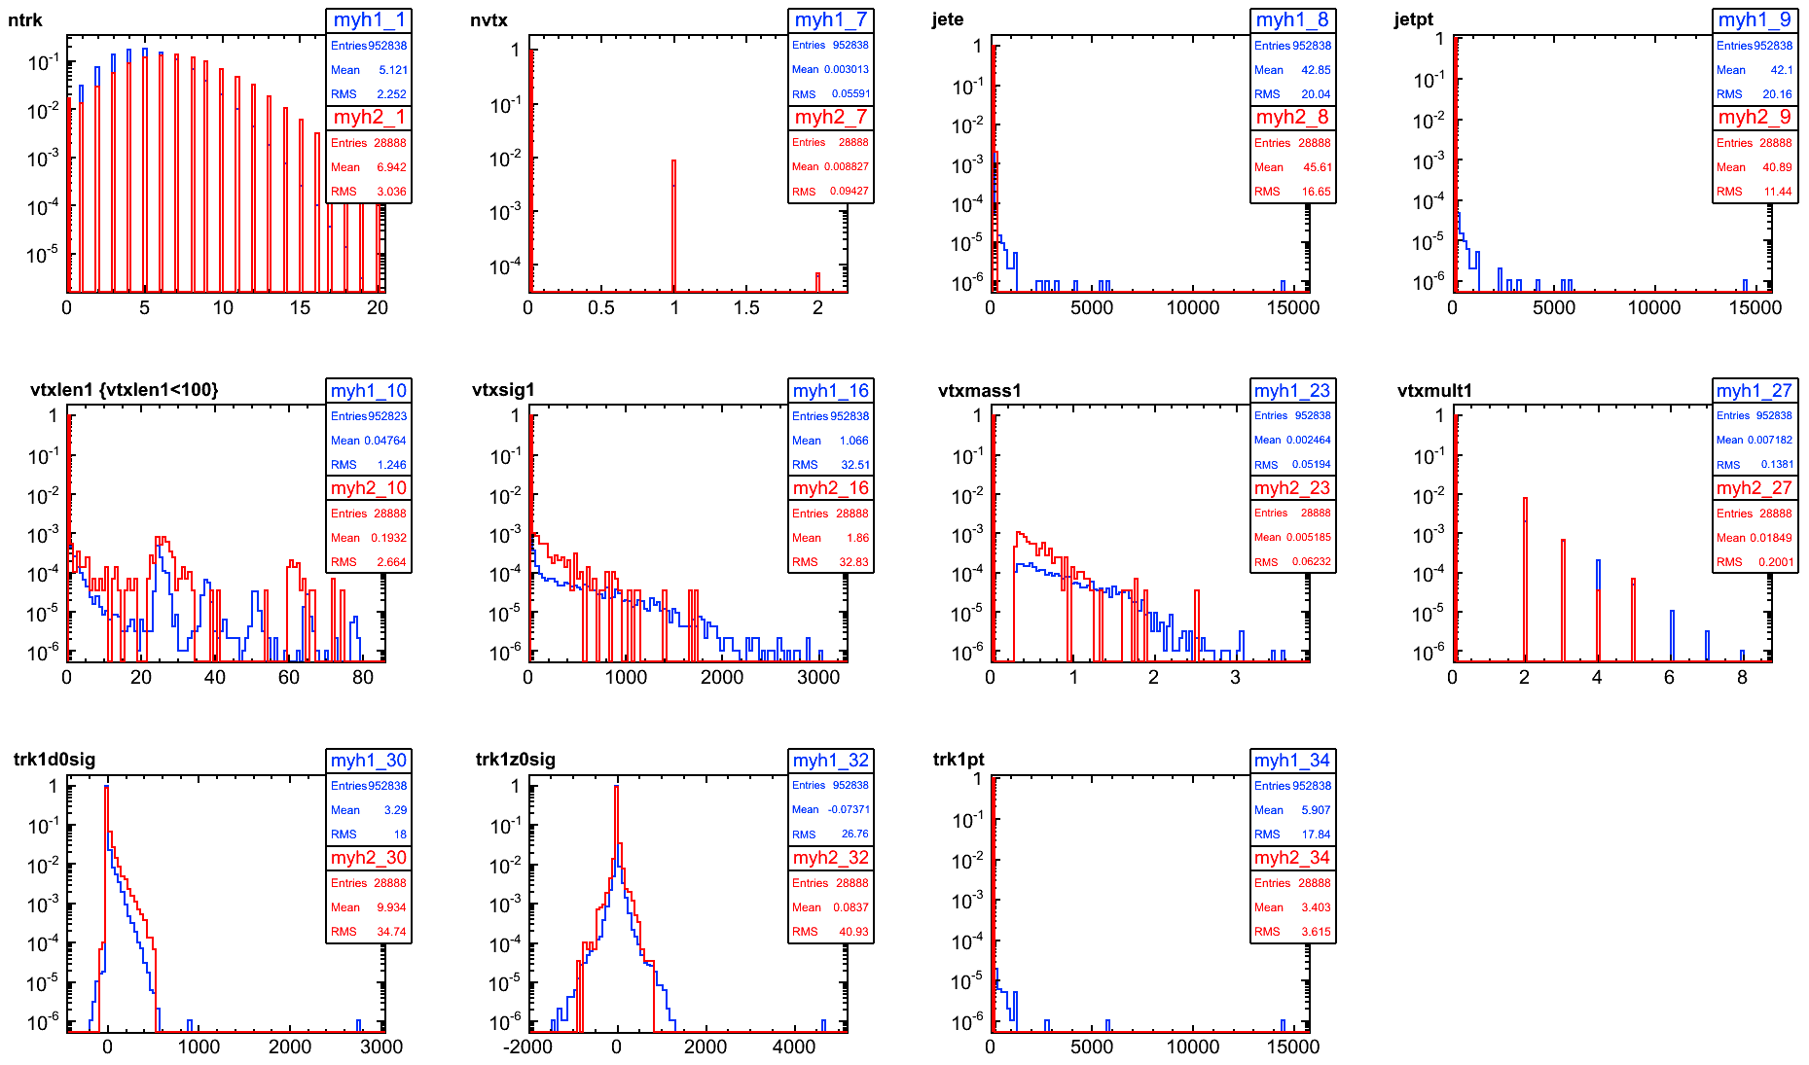
002InnerPitch->CDR pp coll
7hits
remove HF hadrons
ll

Slide 58
002InnerPitch->CDR
7hits
remove HF hadrons
ll

Slide 59
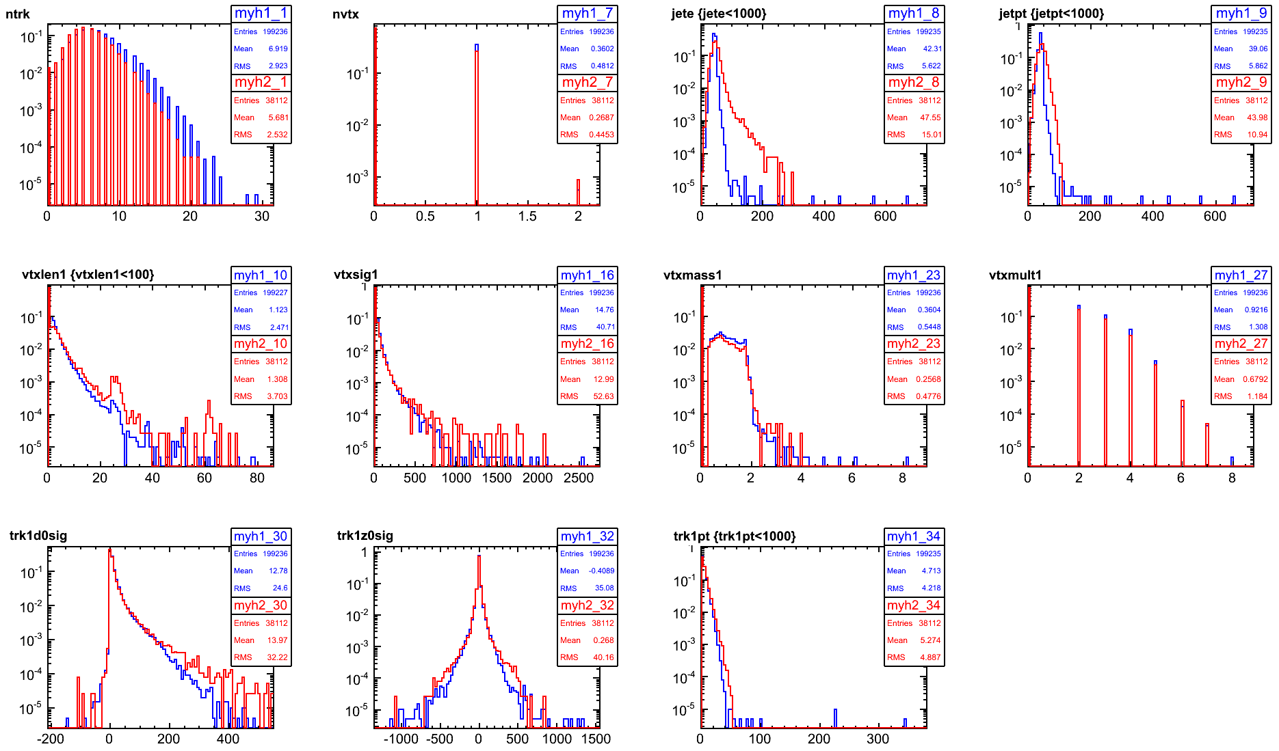
002InnerPitch->CDR
7hits
remove B hadrons
cc

Slide 60
50GeV
20k per sample, 4T Bfield, 0.020 pitch
min 7 hits,
inverted values in Y axis, for comparison with LHC
for BDT cut = 0.3
tagging efficiency depends more strongly in pT for b’s than for c’s

Slide 61
50GeV
20k per sample, 4T Bfield, 0.020 pitch
min 7 hits, removedHF
inverted values in Y axis, for comparison with LHC
for BDT cut = 0.3
tagging efficiency depends more strongly in pT for b’s than for c’s

Slide 62
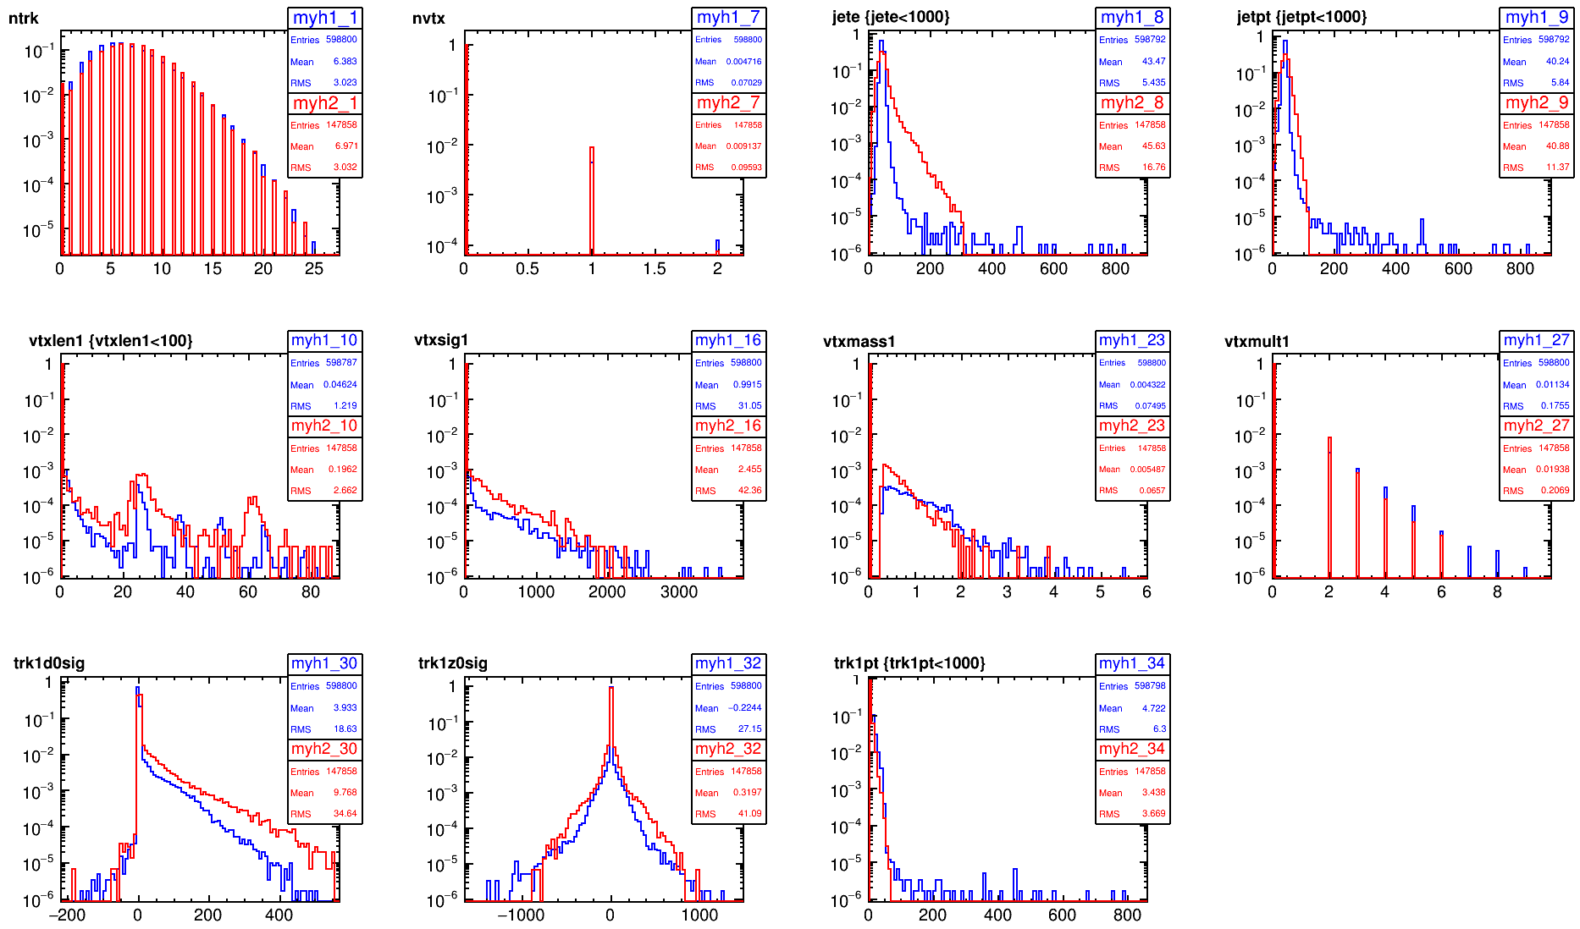
002InnerPitch->CDR
7hits
remove HF hadrons
ll

Slide 63
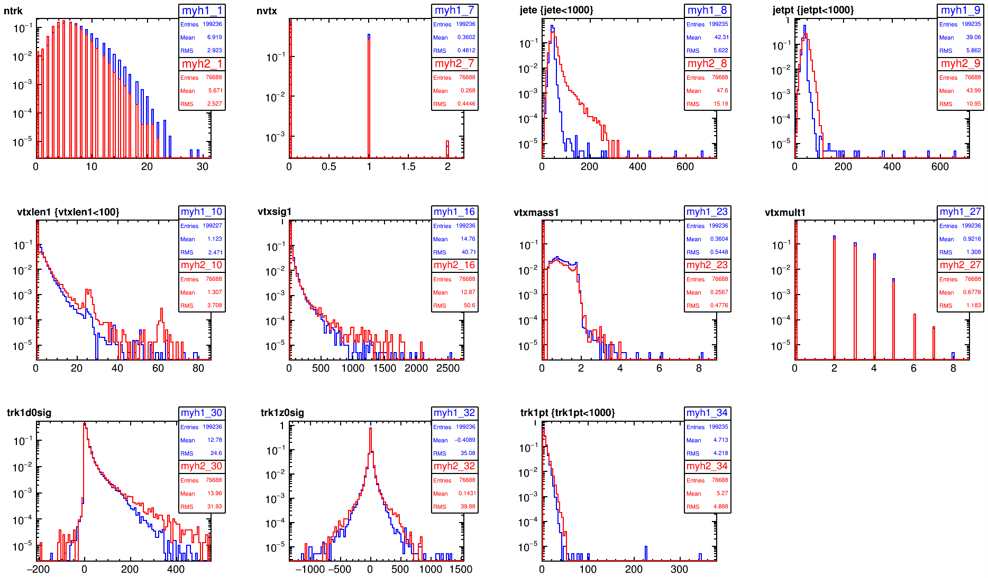
002InnerPitch->CDR
7hits
remove B hadrons
cc

Slide 64
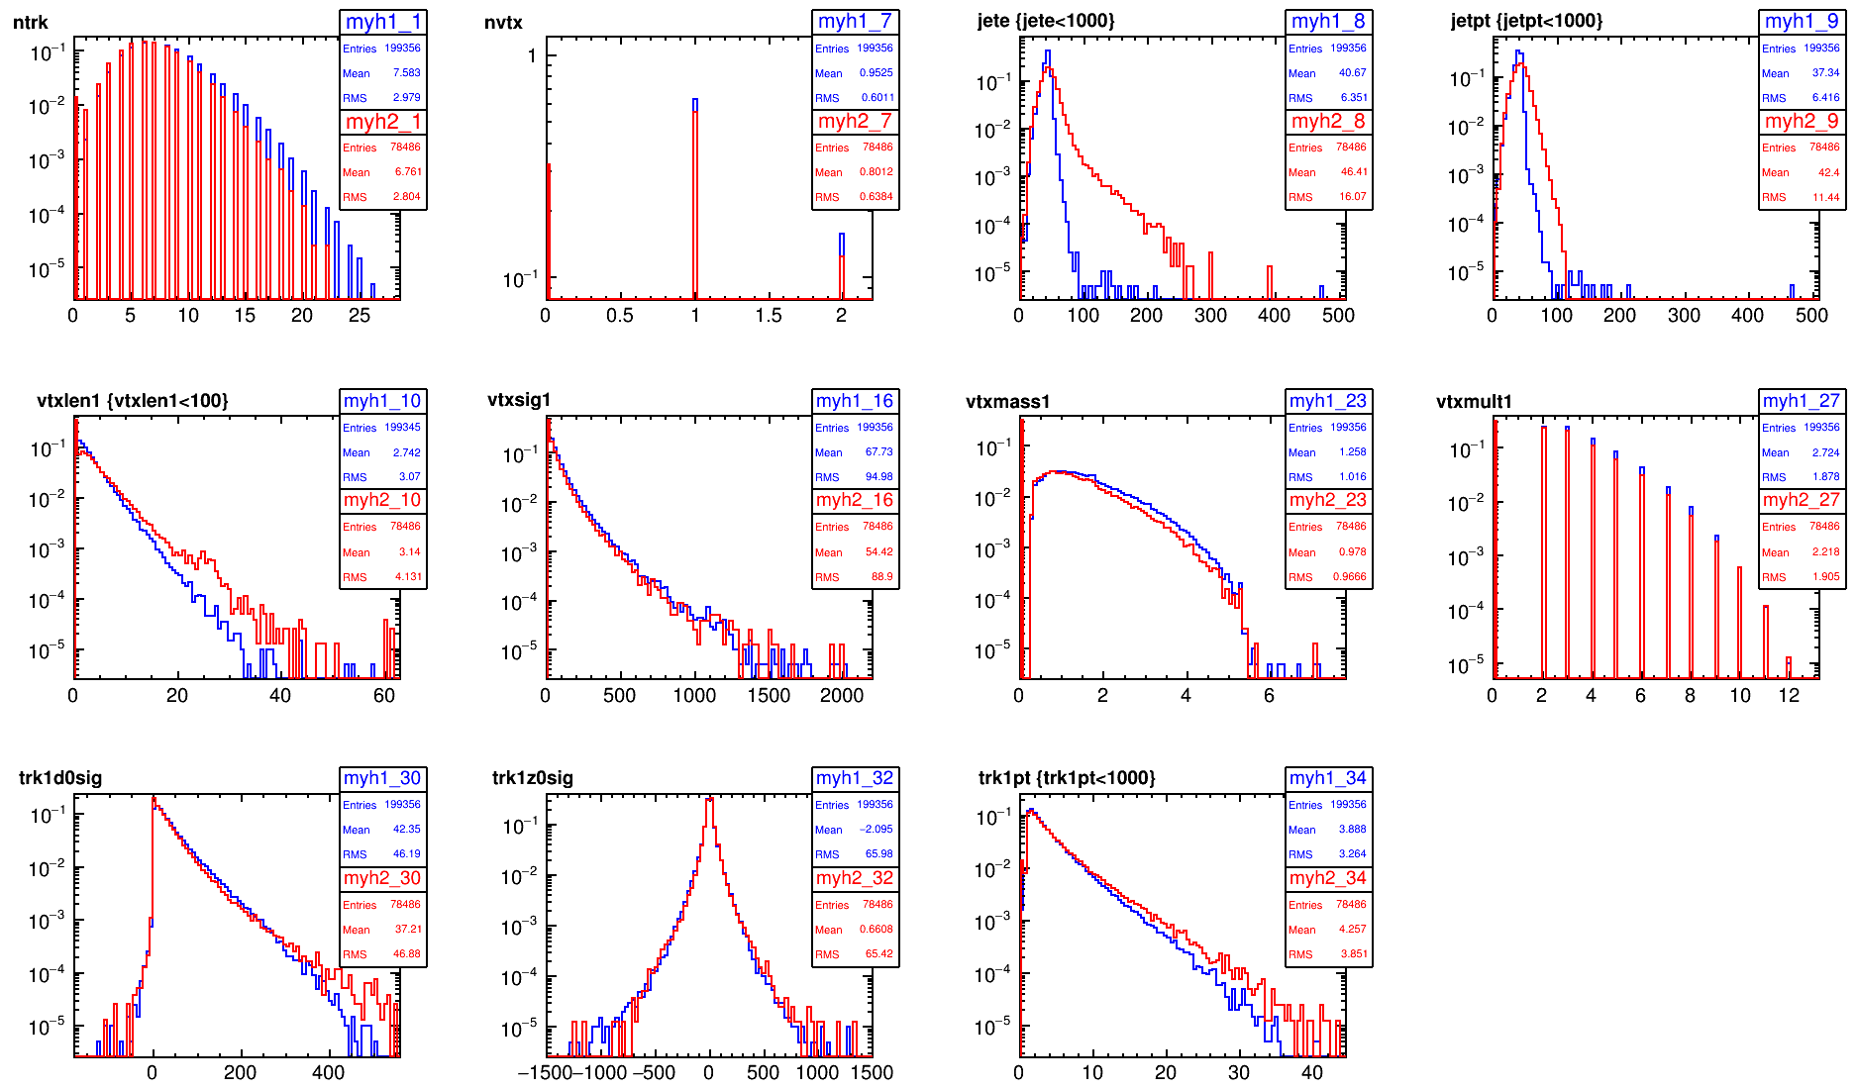
002InnerPitch->CDR
7hits
bb

Slide 65
002InnerPitch->CDR
7hits
remove HF hadrons
ll

Slide 66
002InnerPitch mat*0.5->CDR
7hits
remove HF hadrons
ll

Slide 67
Backup

Slide 68

Generation (by A. Coccaro)
MadGraph5:
pp->bb / cc / ll (uds) at √s=100TeV
fixed quark pT: Ex: 47.5 < pT(b) < 52.5 GeV
Central eta: |η(b)|<0.05
DR(bb)>0.4
Samples:
Quark pT in GeV: 50, 100, 200, 500, 1000, 2000, 5000, 10000
20k events per sample
1M events for 50 & 500 GeV samples

Slide 69

Hadronization
Pythia6:
MSTP(81)=20 Multiple Interaction: OFF
MSTP(61)=1 FSR: ON
MSTP(71)=1 ISR: ON
b quark pT spectrum
arbitrary units
to be redone

Slide 70




Detector Model
CLIC_SiD with FCC vertex and squeezed FCC tracker.
Barrel only. Vertex and tracker endcaps removed (do not fit inside CLIC_SiD).
Tracker max z = 1536 mm instead of 2250mm (FCC), to avoid clashes with the CLIC endcap calorimeter
Tracker outer layer R reduced from 1541mm (FCC) to 1206mm (CLIC)

Slide 71
Simulation
LCSim
use FCC thickness and material budget, which include services&supports
Tracker: X/X₀= 3% [200um active Si]
Outer vertex: X/X₀= 1.5% [100um active Si]
Inner vertex: X/X₀= 1% [100um active Si]

Slide 72



Digitisation
Use pixel pitch as in FCC vertex and tracker (digitized as long pixels).
Default SiD digitizer simulates charge deposit, diffusion & drift, read-out charge sharing, and performs clustering. -> did NOT use it
We used a simplified digitizer, providing direct relationship between pitch and single point resolution (as done for Fast Sim).
By now, factor out detector technology
→ Smear Simulated hit position with a Gaussian of σ=√12
SimHit-RecoHit residuals in the tracker layers
σ_{RPhi}=9.5um
σ_{Z}=14700mm

Slide 73
Efficiency of Hit reconstruction
Simple check on single muons
GEN | SIM | DET SIM | RECO |  |  | # events
# events |  |  |  |  |  | 6600
 | ==1 MCpart |  |  |  |  | 5224
 |  | ==6 SimTrackerHits |  |  |  | 5223
 |  |  | ==6 TKRTrackerHits |  |  | 5223
 |  | ==6 SimVertexHits |  |  |  | 5224
 |  |  | ==6 VXDVertexHits |  |  | 5213
100% Tracker Hit reconstruction efficiency
99.8% of events with all Vertex hits reconstructed → 0.035% hit reconstruction inefficiency
GEN | TRACK RECO |  |  |  |  | # events
# events |  |  |  |  |  | 6600
 | ==1 Track |  |  |  |  | 6600
100% track reconstruction efficiency

Slide 74
Tracking
Tracking parameters
Tracking weights need to be optimized
Parameters Used
MinPT= 0.2
MinHits= 6
MinConfirm= 1
MaxDCA= 10.0
MaxZ0= 10.0
MaxChisq= 10.0
BadHitChisq= 5.0
→ we have 6+6 layers, but we want to be able to reconstruct tracks only in the vertex or only in the tracker (for very displaced decays)
CLIC_SiD default
MinPT= 0.2
MinHits= 6 or 7
MinConfirm= 1
MaxDCA= 5.0
MaxZ0= 10.0
MaxChisq= 10.0
BadHitChisq= 5.0
Tracking strategies:
S=seed C=confirm; others=extend
v1 | v2 | v3 | v4 | v5 | v6 | t1 | t2 | t3 | t4 | t5 | t6
S | S | S | C
 | S | S |  | S | C
S |  |  | S | S | C
S |  | S | S |  | C
S |  | S |  | S | C
S | S | S |  |  | C
… and automatic production of the strategies should be reviewed
ongoing

Slide 75
Reconstruction & Identification
Use default pandora as in CLIC_SiD
No timing cuts on the PFOs

Slide 76

Event display
dijet (bb)
pT(b)=50GeV
REC file

Slide 77


can tell displaced vertices from direction of reconstructed tracks

Slide 78


DSTViewer
kt_2jets
PandoraPFOsInJets
clusters
rebuilds the vertices?
No secondary vertex object…

Slide 79


Vertexing
LCFIPlus. Default
Consider only PFOs in 2 kT jets of R=0.5.
Avoid including particles in the “beam jets” (fwd particles close to the beam)
(Vertexing will rerun its own jet algorithm)
To do: review how these cuts are actually applied
(ongoing)

Slide 80

Flavour Tagging
LCFIPlus: Default as in CLIC_SiD
Training done with all events (no cut on jet pT)
Samples processed:
50 GeV
100 GeV
200 GeV

Slide 81
50GeV
inverted values in Y axis, for comparison with LHC
for BDT cut = 0.3
rej.
tagging efficiency depends more strongly in pT for b’s than for c’s

Slide 82

100GeV
rej.
Higher pT gives better rejection in general, except for b tagging against light jets

Slide 83

200GeV
very small differences compared to 100 GeV

Slide 84

50GeV – Comparison with CLIC
ee->jj , No ISR, narrower pT spectrum, x50 more stats

Slide 85


form previous cross-checks:
CLIC_SiD detector
pp coll at 100 TeV
MI off, ISR FSR on
pT(q)=50 GeV
Default tracking strategies
use PFOs in 2 kT R=0.5 jets
pT(jet)>40GeV (for training)
x5 (x25) more stats: 100k bb evts ; 100k cc evts ; 500k uu evts
much closer to the CLIC results
Will need more stats for all points

Slide 86



50GeV – Comparison with HL-LHC
pT(jet)>20GeV
|eta(jet)|<2.5
b-tagging: Run 1 config:
pT(track)>1GeV
FCC “better” at c-rejection, “worse” at l-rejection
→ probably only due to statistics available for training
http://atlas.web.cern.ch/Atlas/GROUPS/PHYSICS/UPGRADE/PLOT-UPGRADE-2014-003/

Slide 87
Cross-checks
Compare track parameters to fast simulation

Slide 88



D0
FULL Sim
FAST Sim
100 GeV
E=100GeV muon
at 80-100 degrees(|eta|<0.175):
trkd0_fit sigma = 0.00578595 mm
(remember we have squeezed tracker)

Slide 89




Z0
FULL Sim
FAST Sim
100 GeV
E=100GeV muon
at 80-100 degrees(|eta|<0.175):
trkz0_fit sigma = 0.0119725 mm:q
(remember we have squeezed tracker)
(averaged over a larger eta range, not including)

Slide 90




PT
FULL Sim
FAST Sim
WTF
100 GeV
E=100GeV muon
at 80-100 degrees(|eta|<0.175):
trkpt_fit sigma = 1.33291 GeV
dpT/pT (125)= 1.06%
(averaged over a larger eta range, not including)
(remember we have squeezed tracker)

Slide 91
Wrong track pT already after digitisation.
When can it go wrong?
Generation/Simulation: *.mac + geom.lcdd
Digitisation: clic_*_prePandora.lcsim
Tracking: clic_*_trackingStrategies.xml
plotting

Slide 92
Checks
Generation/Simulation: *.mac + geom.lcdd
Changed compact.xml file to bField=5 → muons got back to 100 GeV
<field type="Solenoid" name="GlobalSolenoid" inner_field="5.0”
Digitisation: clic_*_prePandora.lcsim
Tracking: clic_*_trackingStrategies.xml
Plotting (calculation of track pT)
the pt of the pfo is calculated from the same track parameters, and it is also 125

Slide 93

NHits
mostly 1 missed hit

Slide 94
cross check statistics

Slide 95
(last meeting slides)

Slide 96


Current baseline geometry
http://fcc-tklayout.web.cern.ch/fcc-tklayout/FCChh_Option3.v02/index.html

Slide 97
Current baseline geometry – Vertex Detector
(version v03 will have 4 innermost layers and tilted modules)

Slide 98
Layers
FCC / CLIC CDR
1- Squeeze the tracker layers to fit inside CLIC CDR
Vertex outer layer R= 450 mm (77 mm)
Tracker outer layer R= 1206 mm (1541mm)
2- make tracker barrel layers shorter in z
Vertex max z = 820 mm
Tracker max z= 1536 mm (2250mm)
3- Remove all encaps to fit barrel detector

Slide 99
Resolution/Pitch
Fast Sim studies based on single point resolution → translate to pitch (multiply by sqrt(12) )
Only Pixel type detectors allow to define X and Y pitch → define all (incl tracker) as elongated pixels
Check what is the actual single point resolution that we get, by comparing Simulated hit and Reconstructed hit positions

Slide 100


SiD digitizer
charge deposit, difusion, drift
B neglected
read-out pixel pitch
clustering
(weighted average)
uncertainty

Slide 101


clic sid cdr default: pixel
Resolution (vertical line)
different red lines = different layers
note:
different x axis range
from documentation: 0.003 mm
cluster size=
1
2
3
4
5
6
Can’t know cluster size in each direction. It’s a convolution of both.
Position of raw hits is not stored in the container.
ResRPhi much smaller than ResZ
spikes depend on cluster size

Slide 102

Gaussian smearing
smear simulated hit position by 1/sqrt(12)
To Do: check what happens at the limit of a module

Slide 103


Back to FCC geometry: pitch

Slide 104


Back to FCC geometry: thresholds
Need to tweak the threshold to avoid going over the maximum cluster size
Use the same uncertainty for all the cluster sizes

Slide 105


FCC Opt3v02 gaussian smearing. Vertex:

Slide 106
FCC Opt3v02 gaussian smearing. Tracker:

