Slide 2
The PSB,PS & TL Optics Repository
Joint LIU-PSB/PS Meeting – February 20.2017
O. Berrig, I. Efthymiopoulos - BE/ABP

Slide 3
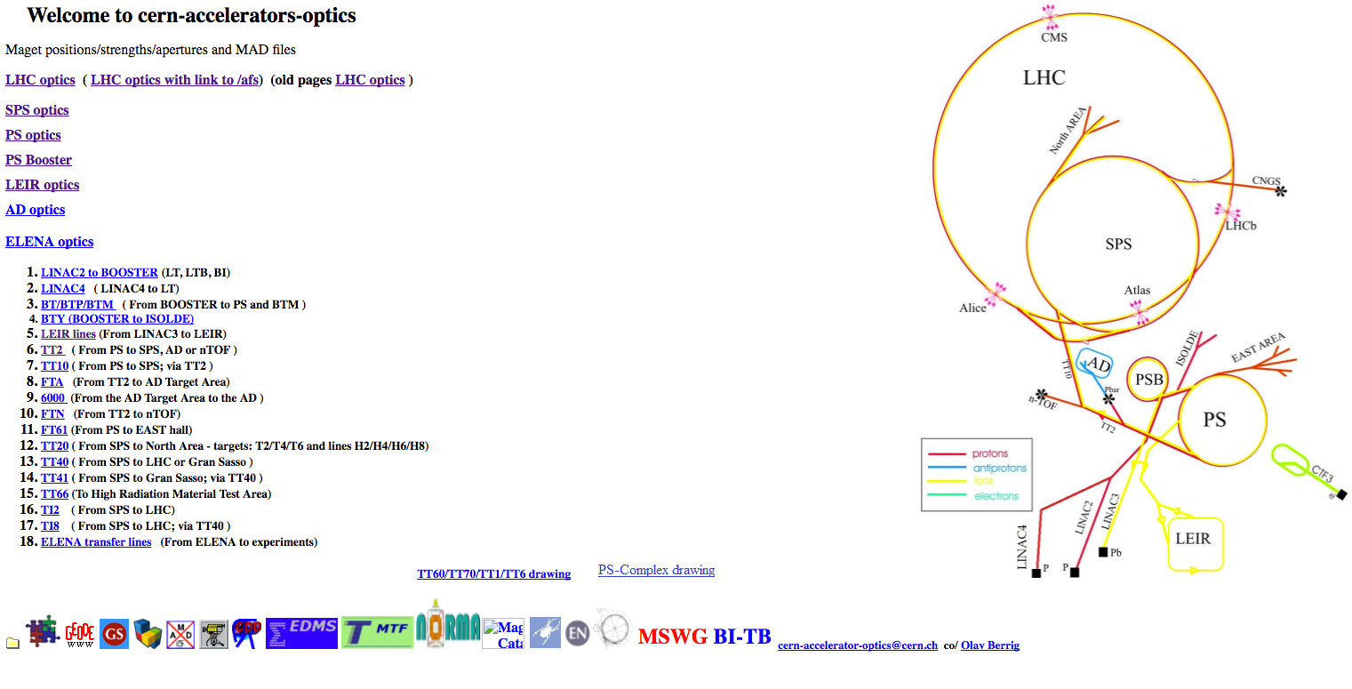
Injectors Optics Repository
BE-ABP maintains a files repository needed to run Mad-X based studies on all CERN accelerators and transfer lines – the “optics repository”
For the injectors, it is setup and managed by Olav Berrig, and from now on by Ilias Efthymiopoulos
Prime access point via the web page :
  http://cern-accelerators-optics.web.cern.ch/cern-accelerators-optics/

Slide 4
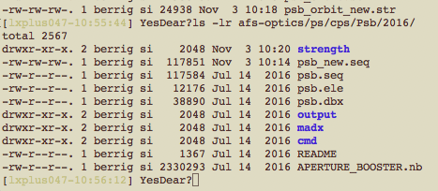
Injectors Optics Repository
Direct file access via afs/dfs/svn
Structure organized “per year”, with auxiliary files copied each time
Layout updates downloaded from the Layout database (except Psring)
  New .seq, .ele, .str files generated each time
Manual procedure !!
Checks: against previous versions, madx test runs each time
afs used as working directory – final release copied to SVN

Slide 5
LIU – PSB/PS Optics Status
PSB
LIU layout available and ~complete
  Only few minor errors still(?) to correct, eg. BT.BHZ10 length
Survey info for PSB and TL available
PS
A version of LIU layout also available, need to be verified by the project for the injection elements
  Synchronization with LayoutDB done externally “by hand”
Optics repositories for the post-LS2 configuration being made, will be populated wit the files as they become available – important for starting the beam simulation studies in all machines !!

Slide 6
Injectors Optics Repository
Still lot of manual intervention in the handling of the optics files
Key information is missing or not at the same level to all machines
  Apertures, survey, magnetic models
We need to improve to prepare for the challenges in handling the LIU post-LS2 beams in the injectors

Slide 7
So how/what can we improve?
… well we can certainly welcome some changes to improve, but then we should arrive to perfection by some stability!

Slide 8
Implementing layout changes
E-mail from Guido & PS/PSB team (16/2/2017)
Does ABP agree to be the driving force to make sure that each year there will be an updated version of the machine optics in their repository?
  ABP should contact OP before each start of the run to obtain information on the changes implemented in the machine during the winter stop => can this be started immediately for the 2017?
  Once updated, OP has to make sure that the ‘official’ optics from the repository should be used in the LSA DB. For the PS case one could start with the LHC optics at injection and at flattop, when the
Are the 3D photos in layout DB updated after each winter technical stop to always show the correct machine status?

Slide 9
Implementing layout changes
Initial request
Proposal discussed in various WG,
Modifications in LayoutDB,
ECR
evaluate feasibility and impact on beam performance
work out layout & integration issues
circulate
approve
propagate changes to ABP Optics Repository, updates of optics
propagate changes to OP
equipment owner, physics, OP, ...
update 3D photos
ABP (Olav/Ilias) is informed on the ECRs, could spot obvious errors, be aware of what is being changed
The OP files need to be updated from the optics repository – procedure to define?
T. Birtwistle: EN-ACE—CL maintains the 3d photos in the database

Slide 10
Implementing layout changes
E-mail from Guido & PS/PSB team (16/2/2017)
Does ABP agree to be the driving force to make sure that each year there will be an updated version of the machine optics in their repository?
  ABP should contact OP before each start of the run to obtain information on the changes implemented in the machine during the winter stop => can this be started immediately for the 2017?
  Once updated, OP has to make sure that the ‘official’ optics from the repository should be used in the LSA DB. For the PS case one could start with the LHC optics at injection and at flattop, when the
Are the 3D photos in layout DB updated after each winter technical stop to always show the correct machine status?
✔
✔
✔
✔
Question: how about the other photo repositories available via the OP info pages?

Slide 11
Additions to the LayoutDB
E-mail from Guido & PS/PSB team (16/2/2017)
For the PS and to guarantee consistency in the data (central source of information: layout DB), extraction of the official optics files should be done from the layout DB => collaboration between layout DB team and ABP (this already exists for the PSB rings). Which steps are still missing?
Why not yet done?
  In the madx world, the PS main dipoles are not represented as single elements, therefore not trivial to map them to the physical magnet that is stored in the database
I think we could find a solution to this problem
  Thomas (EN-ACE-CL) : the majority of the equipment is already registered in the database
…on my action to-do list

Slide 12
Additions to the LayoutDB
E-mail from Guido & PS/PSB team (16/2/2017)
We need easy access to the magnet transfer functions (relation current => strength) from the layout DB (currently partial link to NORMA DB, and from there one has to search in the documents if provided, or information missing); can be envisaged to have one field in layout DB with this information for each magnetic element and propagated for consistency with the optics repository?
Thomas (EN-ACE-CL): …. I do not see a problem with including this extra data (in a similar way to LHC).
Note:
  we need to think how to incorporate all the PFW and all correctors,…
  presently in the LayoutDB (PSB, SPS) we also maintain the strengths but only for the closed orbits, while all other strength files are calculated by running MADx. If we include in the database the current/strengh relation, I would remove the actual strengths; they will be always available in the optics repository.
…to be followed up

Slide 13
Additions to the LayoutDB
E-mail from Guido & PS/PSB team (16/2/2017)
Can we envisage a direct link between layout DB and survey DB? what is missing to have it?
  Alignments/survey measurements should be propagated to layout DB and be reflected in misalignment of elements in optics files.
Thomas Birtwistle (EN-ACE-CL) : We could strive to get to a similar situation to what we have in LHC,
  when we generate the optics sequence for ABP from the layout DB, we can include the official naming and beam position.
  In the layout DB we only store the nominal positions.
Dominique Missiaen (EN-ACE-SU): This link can only be done when the components/equipment is existing in both databases.
  Today, we have only 14 lines in the SurveyDB which have been completely validated(verified with the drawings,circuits, madx,etc) in the Layoutdb. for the PS complex and for the LIU project: L4, L4T, LT,LTB, BI and BR.
  For these 6 lines, almost all the components in LayoutDB and SurveyDB have the same slot_id and therefore the link is immediate and the misalignment can be propagated quite quickly
  For the others, it can be done when the official naming and position will be available in the LayoutDB
For PS, we should also find a solution how this can be done due to the special declaration of the magnets in madx files.
We should also understand the limitation of the layoutDB wrt nominal positions ???
…to be followed up

Slide 14
Additions to the LayoutDB
E-mail from Guido & PS/PSB team (16/2/2017)
Include the present aperture information in the layout database?
  Review present aperture model (ABP)
  Link the present vacuum chambers drawings in the layout DB
We should definitely investigate what can be done.
In particular for the PS it may be challenging because the vacuum chambers are not fixed inside the magnets.
  We need to understand that is the goal, in which accuracy in both absolute position and shape we need the information inside the magnets but also in drift regions with the instrumentation
  Also how to assure this information can remain valid in the future after interventions etc?
…to be followed up

Slide 15
Additions to the LayoutDB
E-mail from Guido & PS/PSB team (16/2/2017)
Link from the layout DB to the latest radiation survey results
Link form the layout DB to the impedance model
…to be followed up

Slide 16
LIU optics – Status
E-mail from Guido & PS/PSB team (16/2/2017)
By the end of this year (2017) ABT and ABP should provide a first version of the transfer line and ring optics of PS and PSB corresponding to the situation after LS2.
  In parallel the layout DB has to be updated to correctly describe the post-LS2 situation.
Work has started on this but not yet final
  Thomas (EN-ACE-CL) started to work on the post-LS2 configuration for the BI line (to begin with).
      ‘future’ optics file for this line are available, and are using this along with ECRs, drawings, other documents etc. to prepare the LS2 layout in the DB for the main equipment, in collaboration with TE-ABT and/or BE-ABP.
On our side a post-LS2 optics repository will(is) be made to gradually populate with the relevant files.
Note that LIU-project (through the WPs?) must approve the final layout files and configuration.
…on my action list

Slide 17
ABP Optics Repository
Triggered by the foreseen phase out of afs, we will move the ABP optics repository to use the new CERN Git service (GitLab – https://gitlab.cern.ch)
All data from the CVS repositories and the afs directories will be migrated to the new service
  maintain the same structure per ring/TL and sub-folders as today
  use tags to identify year sets or other configurations
  web interface available for download and viewing at files
We will also do a face-lift to the ABP optics web page(s)
When?
… it would take few months to set it up properly

Slide 18
Summary
ABP maintains the responsibility for the optics repository of the injectors
    Thanks to Olav for taking care of this for many years and for his support and guidance in my first steps
    We plan a major phase-lift to the repository using GitLab – like for LHC
Interesting ideas of improvement in view of LIU and post-LS2 operation of the injectors have been proposed
  Some easy – some more challenging to implement but we should make the effort
For LIU project, a good progress is made on the PSB and PS layout but need some work to finalize it and start working for the optics.
We will follow things as close as possible to meet the project timescale.

