Slide 1
Neutrinos
The little neutral ones
Notes:
Hi everybody, welcome to our outreach session.

Slide 2
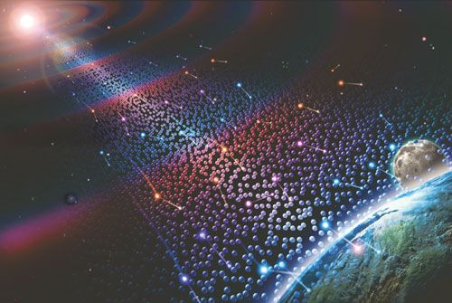
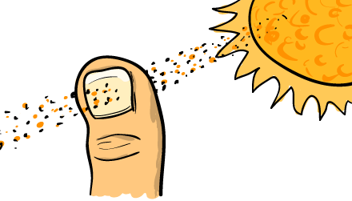
Every second:
hundreds of billions of neutrinos pass through your thumb
Only few neutrinos will interact with your body
in your lifetime
Notes:
Get everybody to hold up their thumbs
Did you know: 65 million neutrinos passed through your thumbnail each second
One of the most abundant particle (after photons), small mass, no electric charge
Most of them are coming from the sun
In your lifetime there is a 10% chance a single neutrino will interact with you
S

Slide 3
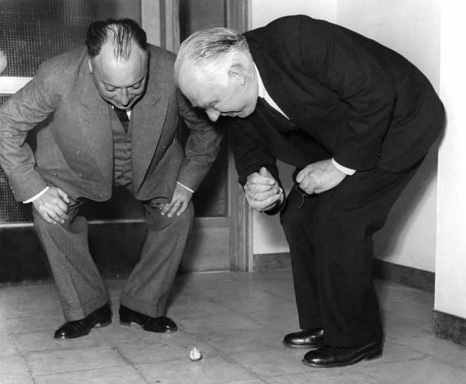
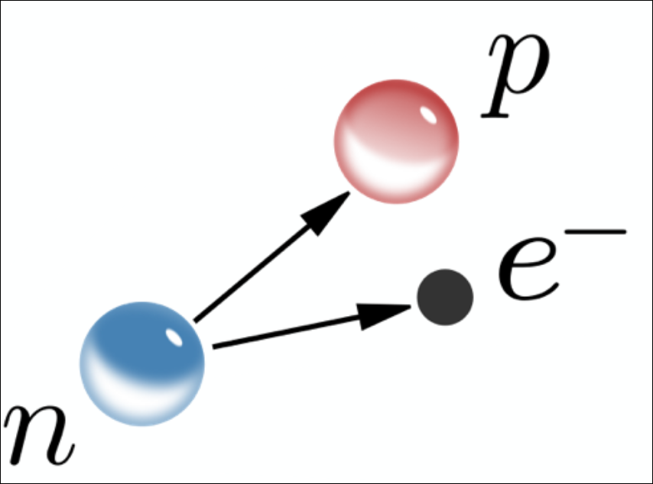
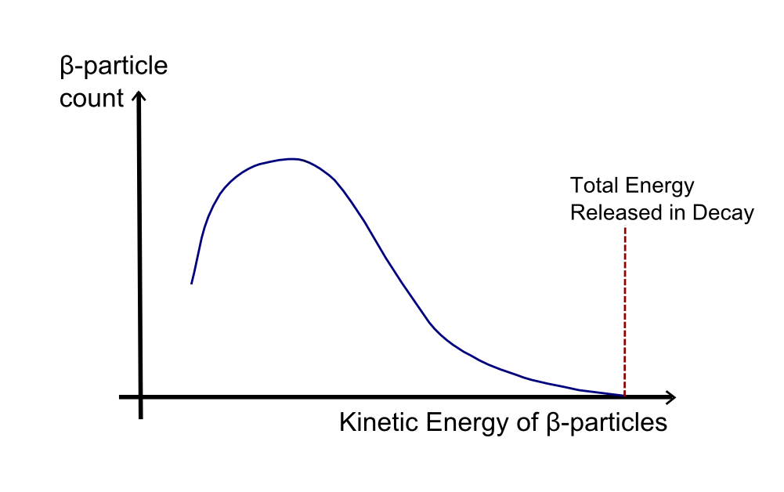
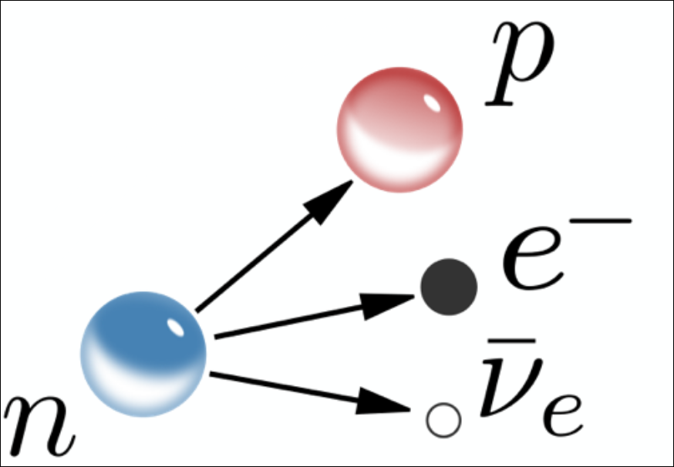
Who needs energy conservation in modern times?
I have done something very bad today by proposing a particle that cannot be detected; it is something no theorist should ever do.
Notes:
-- Expected energy conservation → Red line expected
-- What we get is this kind of shit (*click* *click*)
-- There were real geniuses like Bohr to get rid of energy conservation
-- Now this opens the question what physics is about if not conservation laws? (*click*)
-- Later our beloved Pauli came up with the idea of proposing a strange particle which might not even be possible to detect this strange thing -> neutrino was postulated

Slide 4
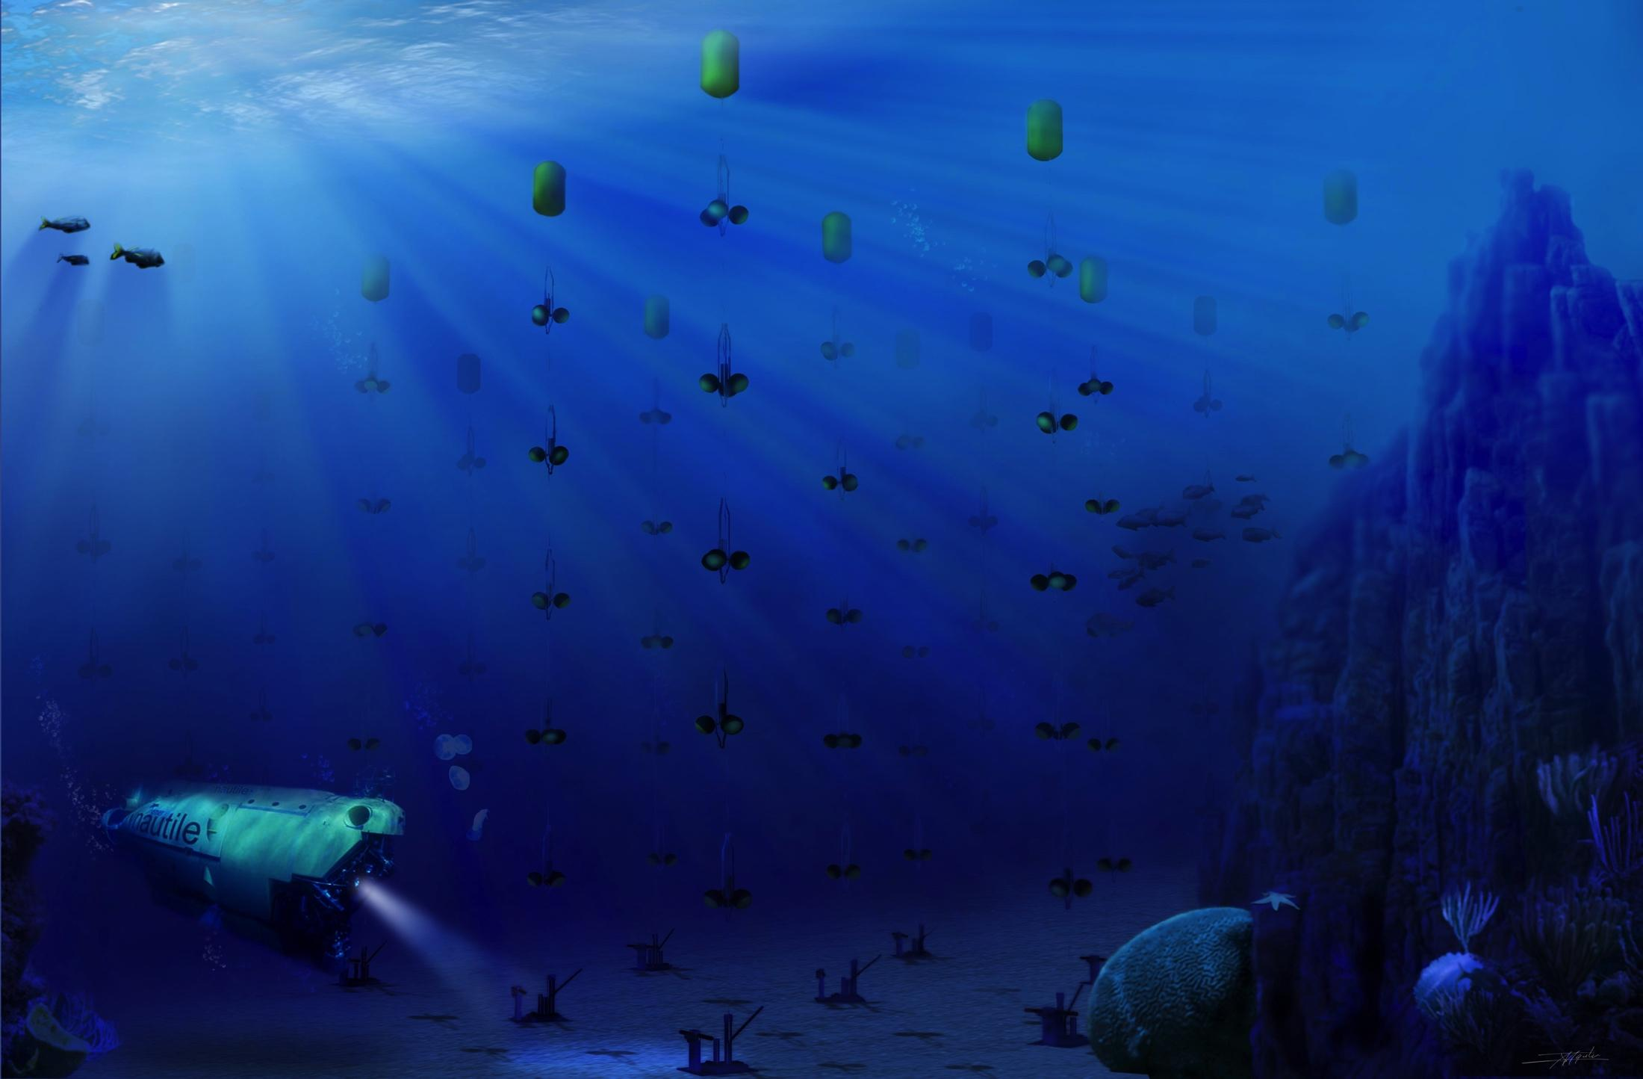
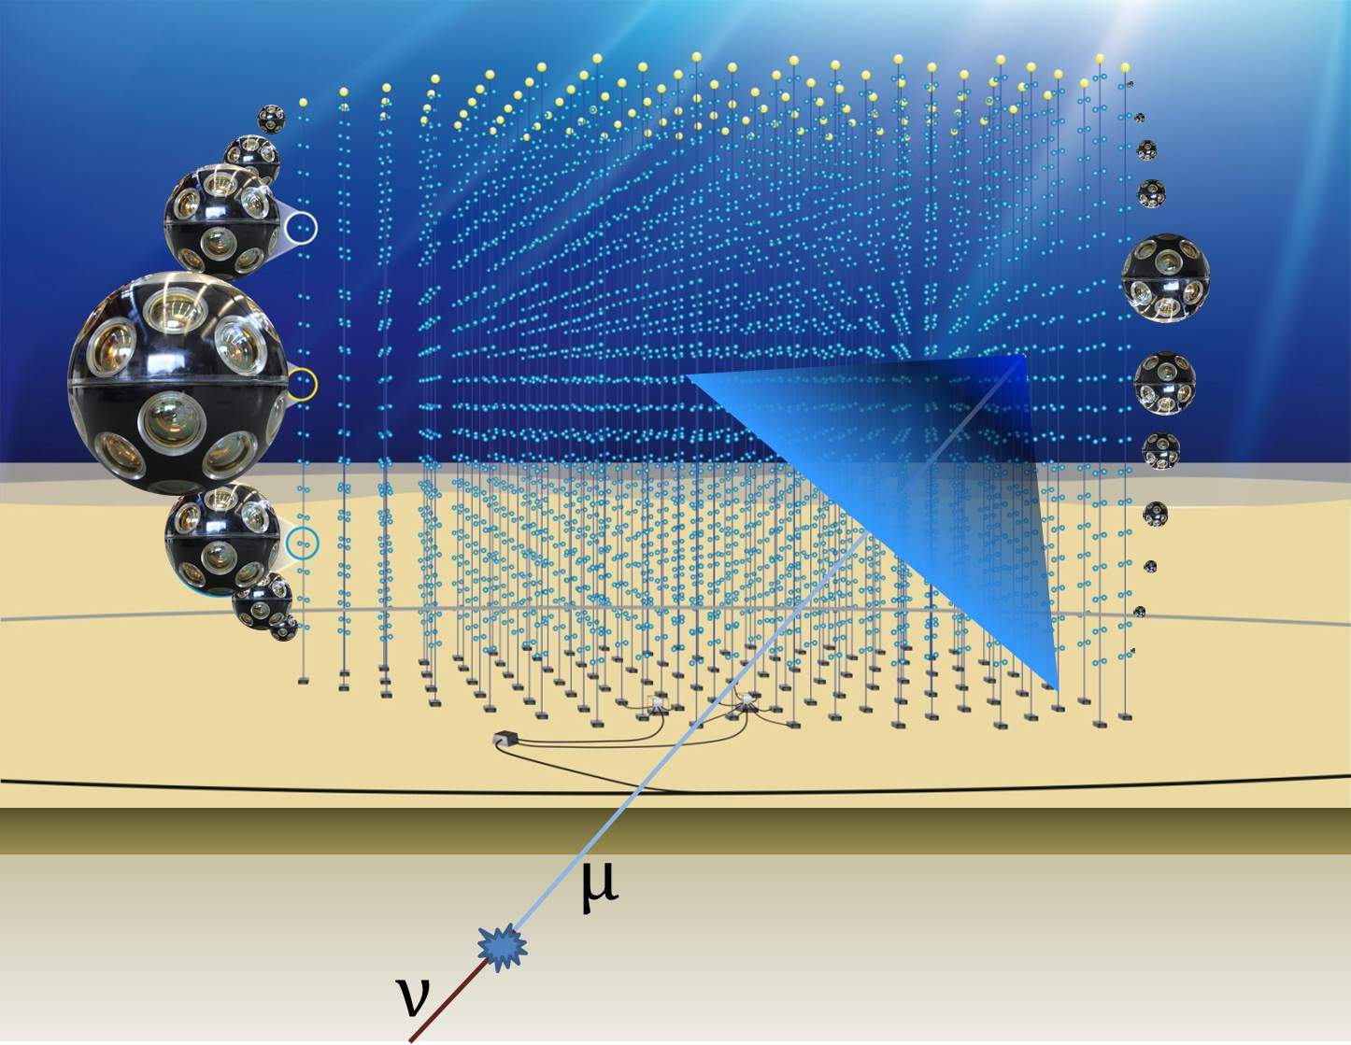
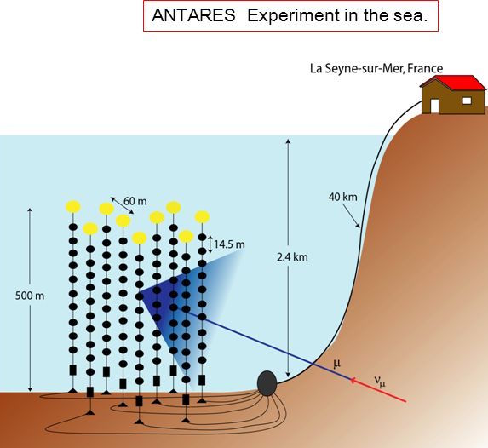
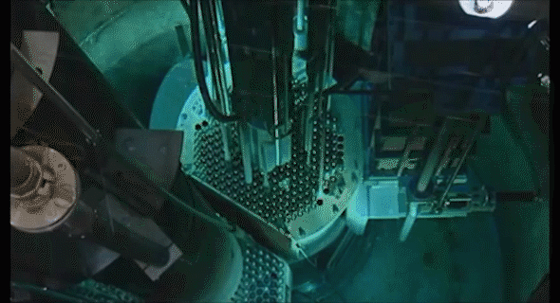
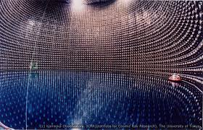
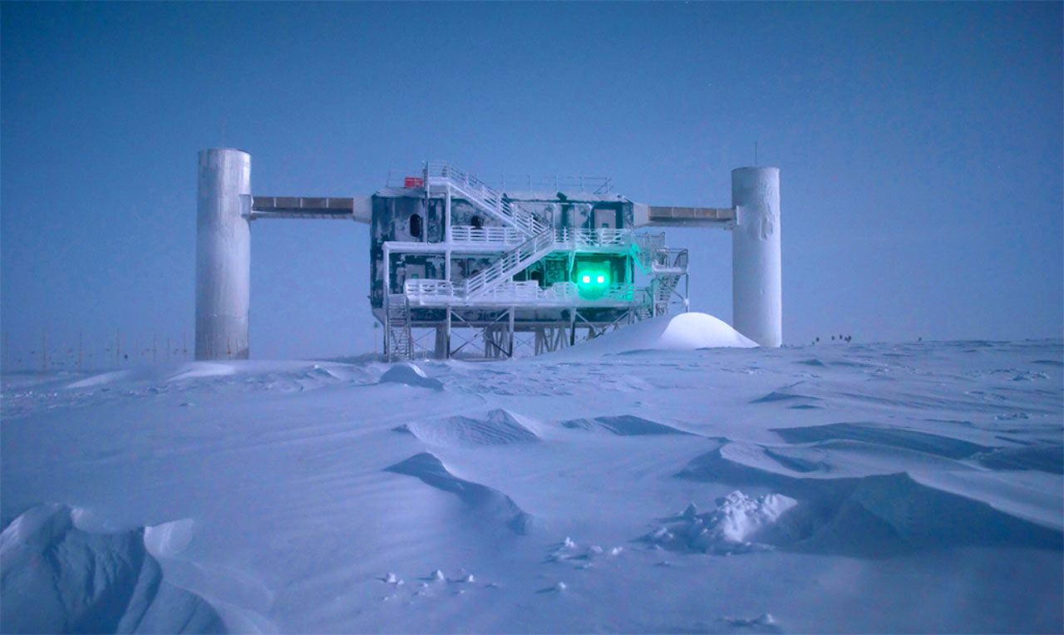
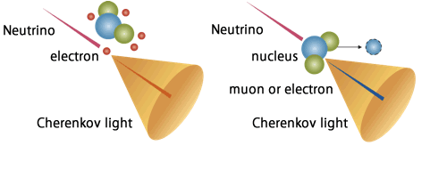
Detection
Antares
IceCube
Cherenkov radiation
Super-Kamiokande
Notes:
Pauli was wrong - we can detect them!
Detectors have to be huge to have enough chance of interaction
<click>
Ice cube uses ice at the south pole to detect neutrinos.
World’s largest neutrino detector: 1 cubic km of ice
Looks at all kinds of sources in the universe like exploding stars, gamma-ray bursts, black holes and neutron stars
<click>
Antares is 2.5km under the mediterranean sea
detects cosmic neutrinos coming through the earth from the southern hemisphere
<click>
Super-K is 1km underground under a mountain in Japan
50,000,000 L of ultra-pure water: that is 20 Olympic-sized swimming pools
<click>
All these detectors do not detect neutrinos directly: they detect the cherenkov light which is a bright blue light
Comes from charged particle traveling faster than the speed of light in the water/ice
Like a sonic boom when you hear a bang when a plane travels faster than the speed of sound, these super fast particles create a ‘bang’ of light
<click>
Just if someone asks: the gif comes from Annular Core Research Reactor (ACRR) testing facility in the US, New Mexico. Cherenkov here does not come from neutrinos, it is just for illustration purposes
Charged particles emit light under a characteristic angle when passing through a medium if their velocity exceeds the speed of light in the medium.

Slide 5
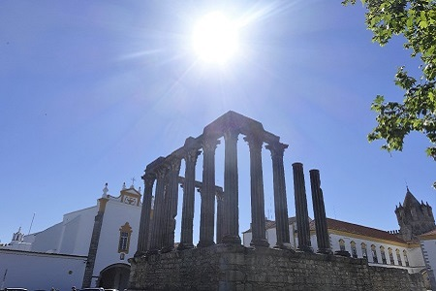
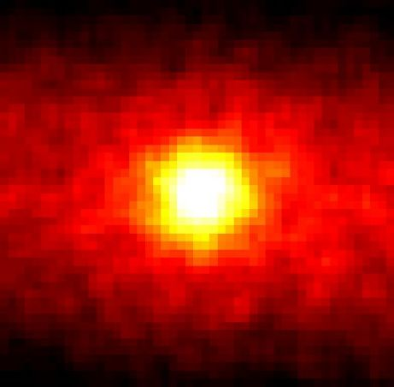
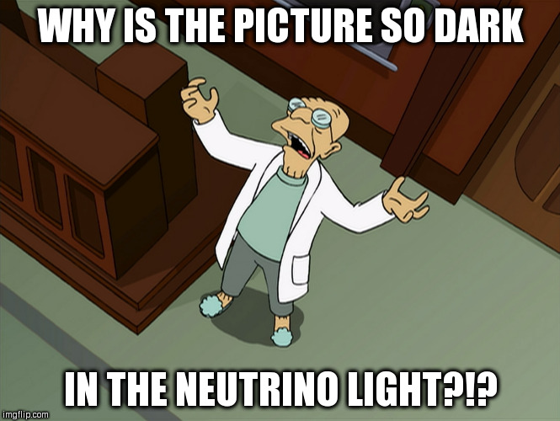
Take a picture
with neutrinos

Slide 6
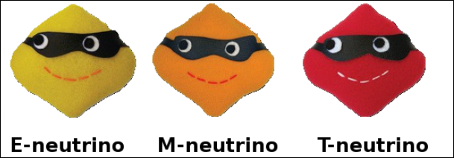


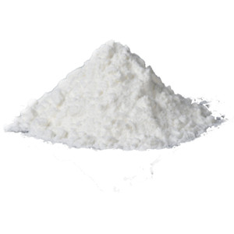

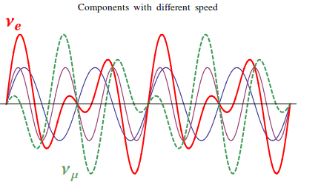



Oscillations
Three flavours of neutrino
Neutrino flavor can change via oscillation.
Mix of different quantum mass states determines the neutrino flavour.
Mystery of disappearing solar neutrinos resolved
Mystery of disappearing solar neutrinos resolved
Notes:
What about sugar and salt?

Slide 7
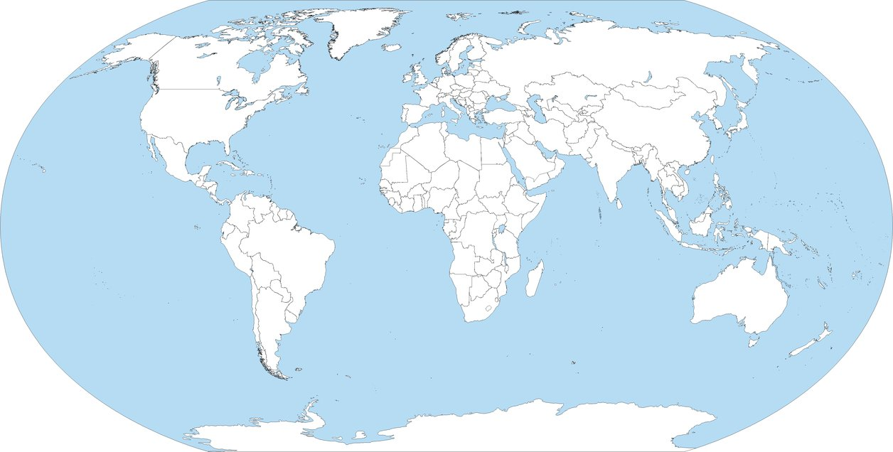
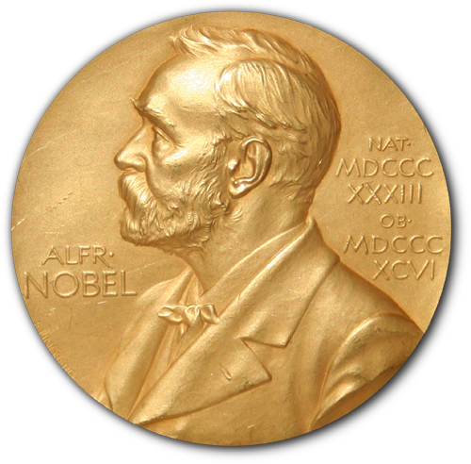
Efforts in neutrino research
~ 50 neutrino experiments hosted across 10 different countries
2002
for detection of cosmic neutrinos
1988
for neutrino beam method, and detection of the muon neutrino
4 Nobel prizes
1995
for detection of the neutrino
2015
for discovery of neutrino oscillations
Notes:
~10.. to be confirmed (clearly wrong!)
~ 50 neutrino experiments hosted in 10 different countries.

Slide 8
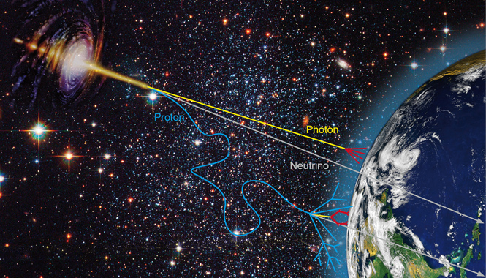
Open questions
Discover the deep nature of neutrinos
Probe our Universe:
Notes:
Should we mention some detail on understand? Majorana or Dirac, mass hierarchy; CP Violation ?, absolute mass scale

Slide 9
Thank you!

Slide 10
Thank you!

Slide 11


Backup

