Slide 1
LabVIEW projects development for critical missions and test benches
Mario Di Castro
Thanks to the precious inputs of Cédric Charrondière

Slide 2
Content
Starting with LabVIEW at CERN
Documentation and code management
Development models and workflow
Requirements analysis
Software architecture and development
Testing and deployment
Conclusions

Slide 3
Starting with LabVIEW at CERN
Use NI trainings (on site + online)
www.cern.ch/labview
We propose “LabVIEW Programming Best Practices”
Why?
  Teach LabVIEW to new comers almost every month
  Read standard code. Overlapping developers
  Maintain the code in medium and/or long term
How?
  Short exercises to verify the use of best practices
  Make sure people read/understand the wiki
  Write documentation
  Use source control
  …

Slide 4


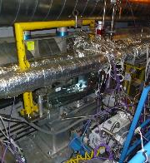
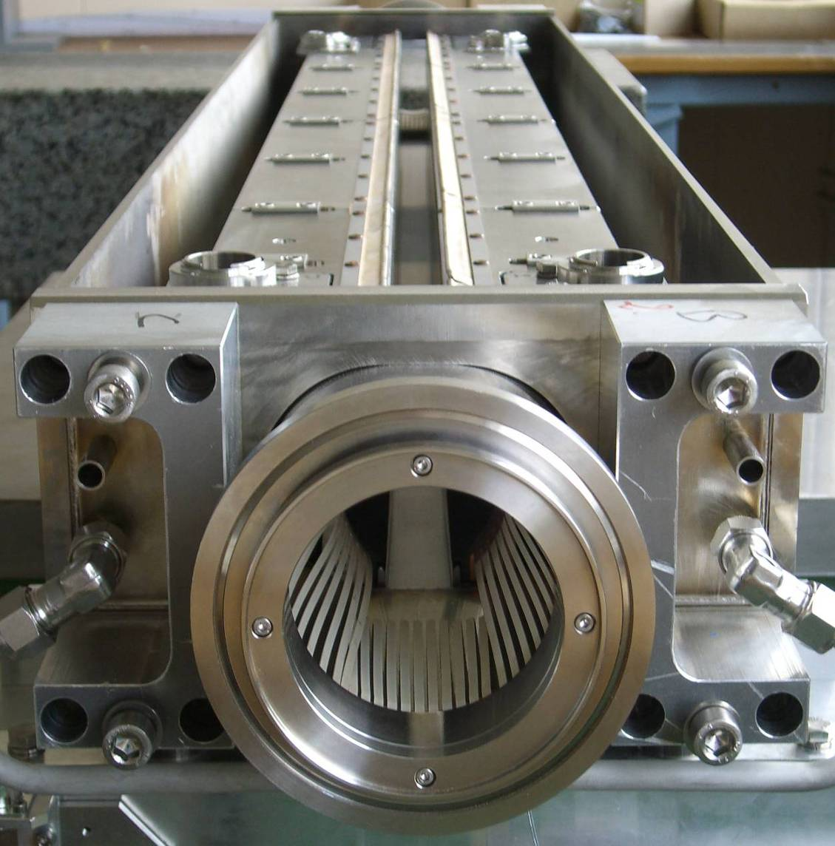
LabVIEW at CERN
At CERN we can identify 2 type of operational software written in LabVIEW
For Test benches
For Critical Missions
LHC Goniometers
LHC Collimators
Both must follow a development model, but with different needs

Slide 5
Content
Starting with LabVIEW at CERN
Documentation and code management
Development models and workflow
Requirements analysis
Software architecture and development
Testing and deployment
Conclusions

Slide 6
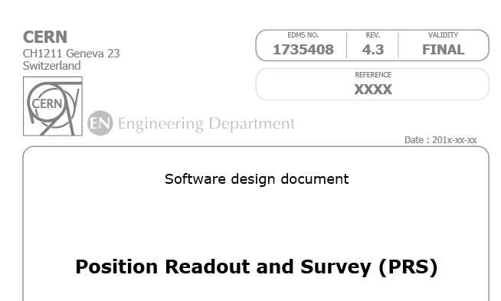
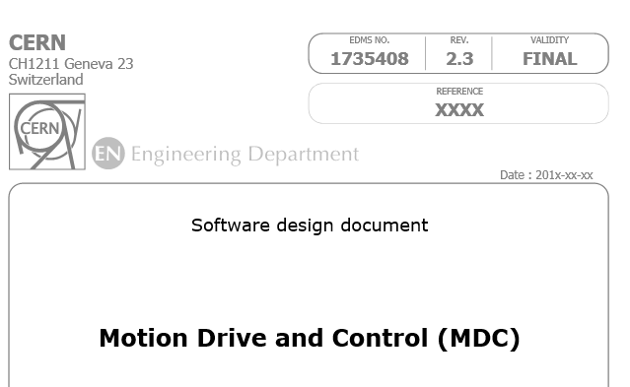



Documentation and code management
Type of document | Mandatory for test benches | Mandatory for critical mission
Functional specification
Requirements
Hardware design
Software architecture
Software documentation
Documentation volume and details have to be adapted to the criticality, the portability and the time life of the project
For critical missions, the use of documentation standards is suggested (example: IEEE standards)

Slide 7
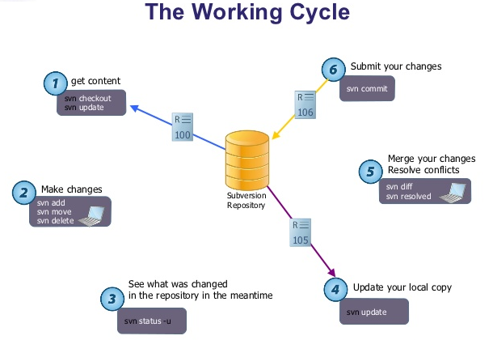
Documentation and code management
Source code control (svn, git)
  LV plugin available for svn, in the future also for git
  LV comes already with a merge graphical tool adaptable to any source code control tool
Develop drivers and write documentation
Develop communication layers and write documentation
Develop user interfaces and write documentation
Notes:
Emphasize on the tools.
Most important is the documentation! https://wikis.web.cern.ch/wikis/display/MTA/%5BRADE+BP%5D+-5-+Documentation
LabVIEW and svn: http://rade-drupal.web.cern.ch/rade-labview-and-svn

Slide 8
Content
Starting with LabVIEW at CERN
Documentation and code management
Development models and workflow
Requirements analysis
Software architecture and development
Testing and deployment
Conclusions

Slide 9

Development Models
Models/standards can be used to provide basic beginning framework for software process improvement
Encapsulation of best practice avoiding repetition of past mistakes
They provide continuity
Mandatory for operational projects

Slide 10
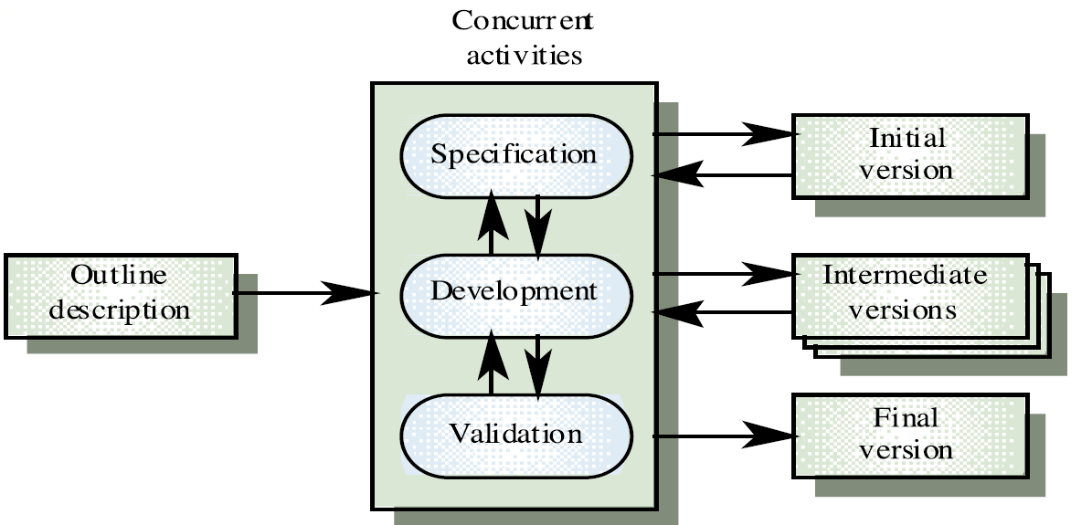
- EVOLUTIONARY
Development Models
Specification not well defined and changing during the development.
  Mostly used at CERN

Slide 11
Development Models – EVOLUTIONARY
Good solution for short term system
Low quality software
Hard to maintain and to scale

Slide 12

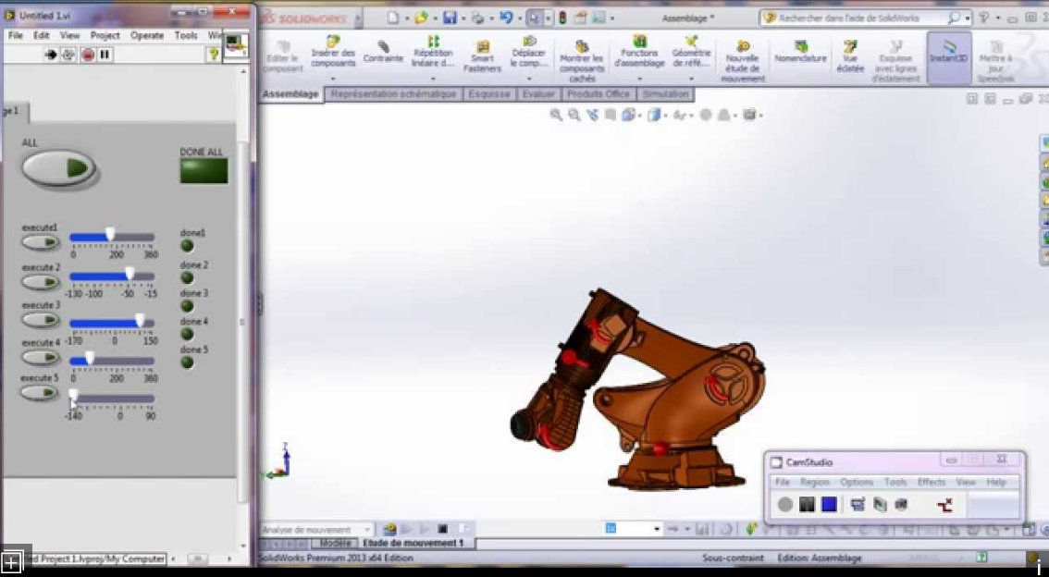
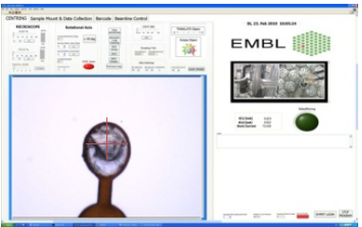
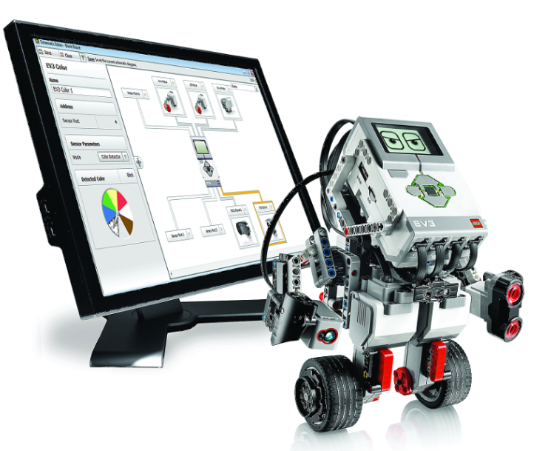
Development Models – EVOLUTIONARY
Good solution for short term system
Low quality software
Hard to maintain and to scale
Could be a good choice for research projects
Research in robotics and image processing

Slide 13
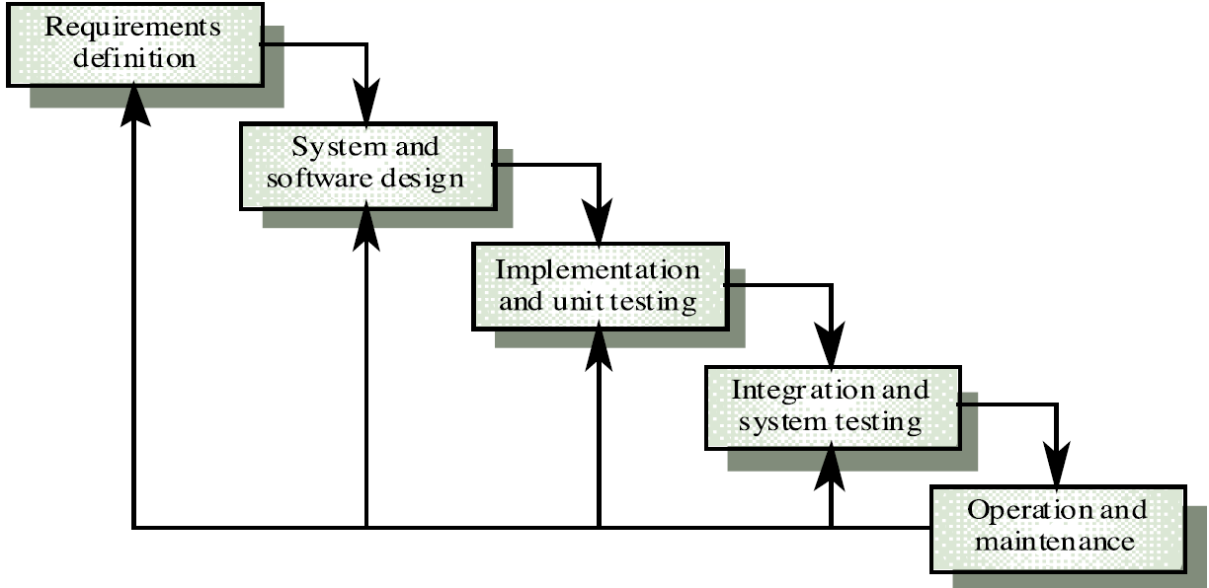
Development Models - WATERFALL
Easily understandable and applicable in all context
Rigorous model
The system can become stable only at the end of the process

Slide 14
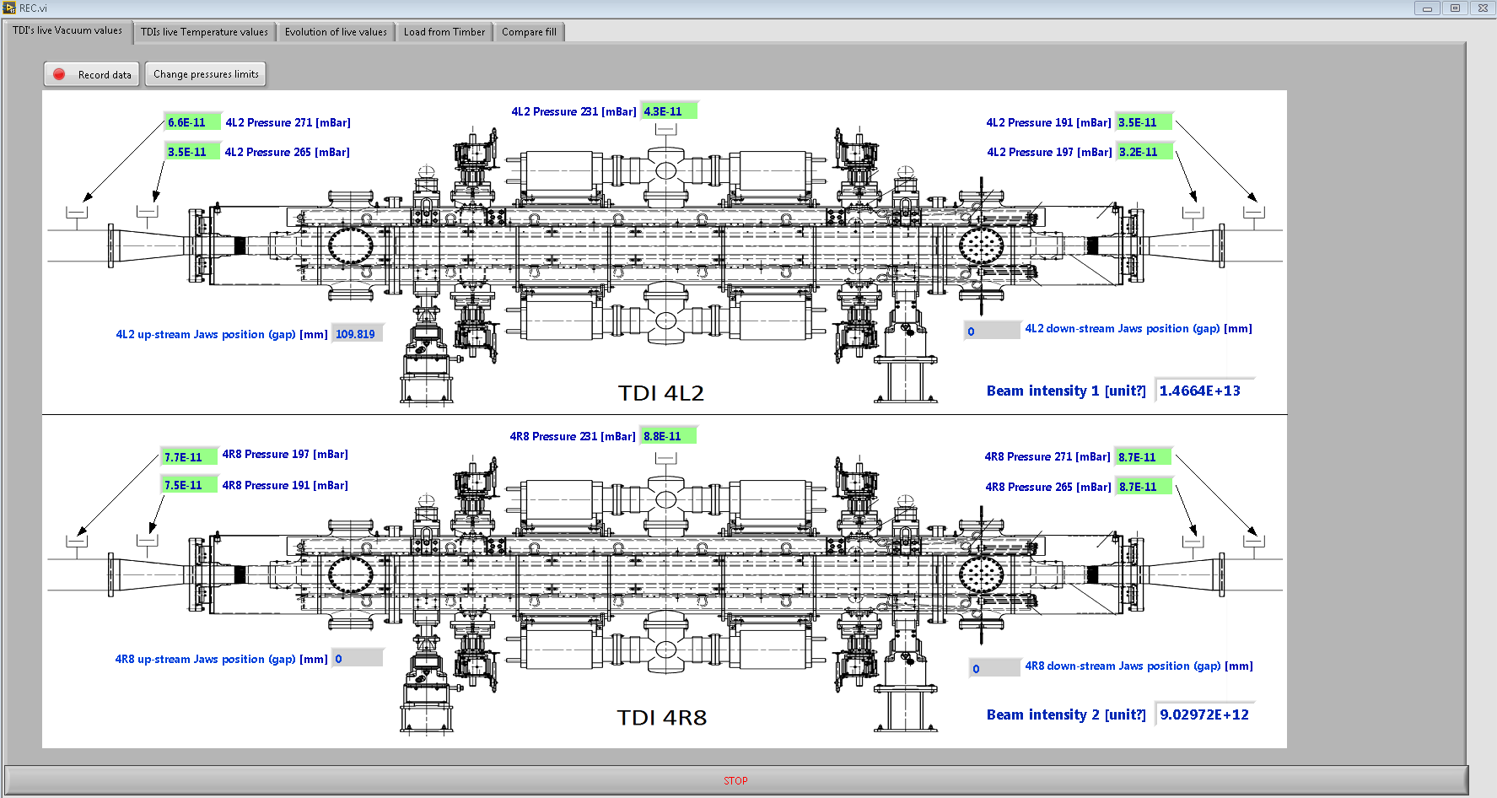
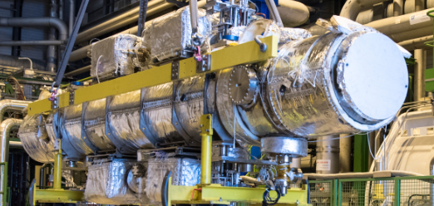
Development Models - WATERFALL
Easily understandable and applicable in all context
Rigorous model
The system can become stable only at the end of the process
Mostly recommended for test benches, monitoring and short life projects
LHC TDIs monitoring tool

Slide 15
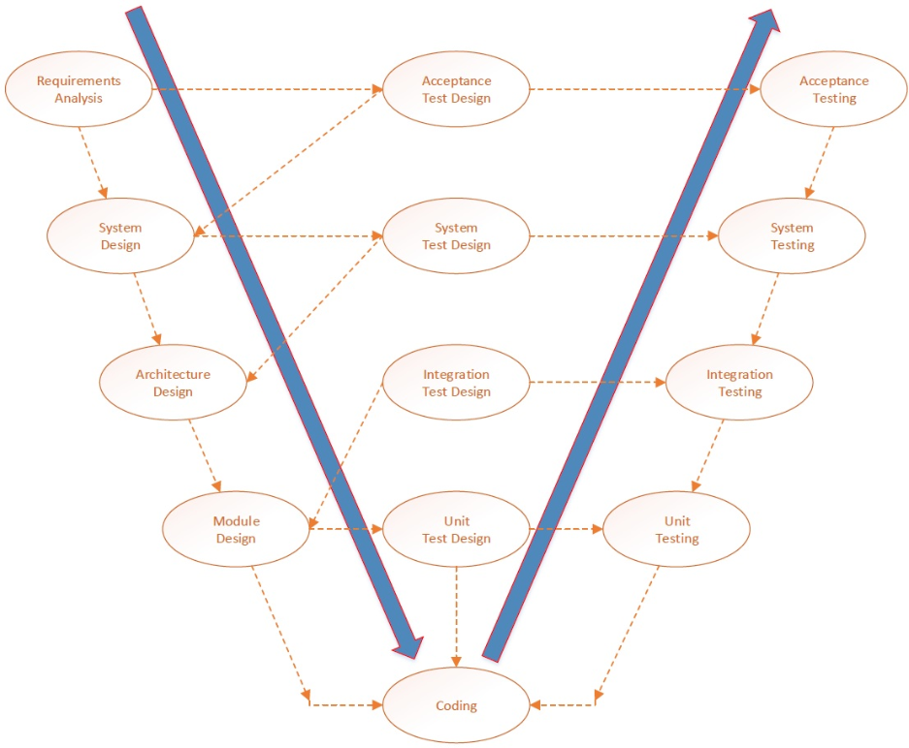
Development Models – V MODEL
Engineering design on each step
Risk analysis
Requirements instability could cause long term implementation

Slide 16
Development Models – V MODEL
Engineering design on each step
Risk analysis
Requirements instability could cause long term implementation
Mostly recommended for critical missions

Slide 17
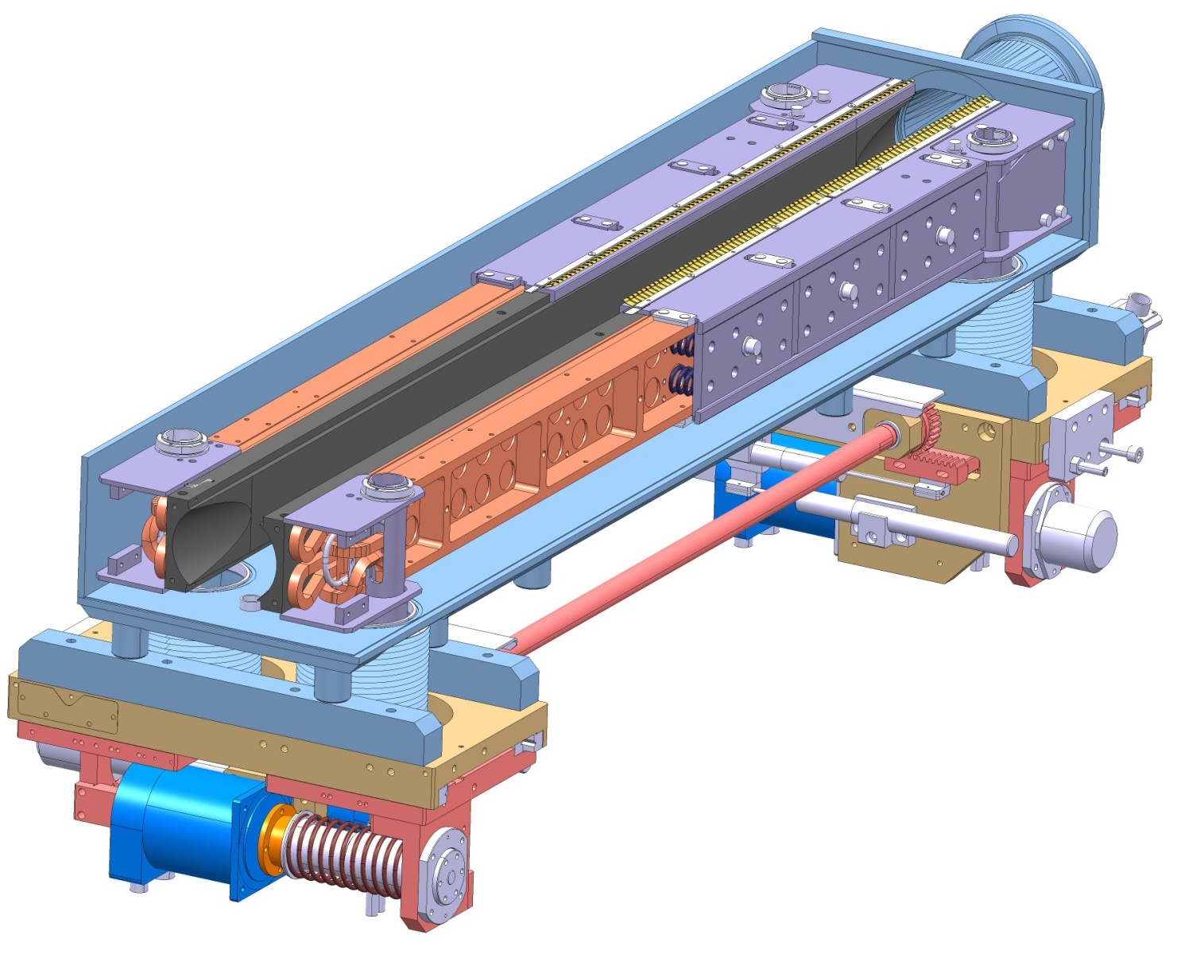
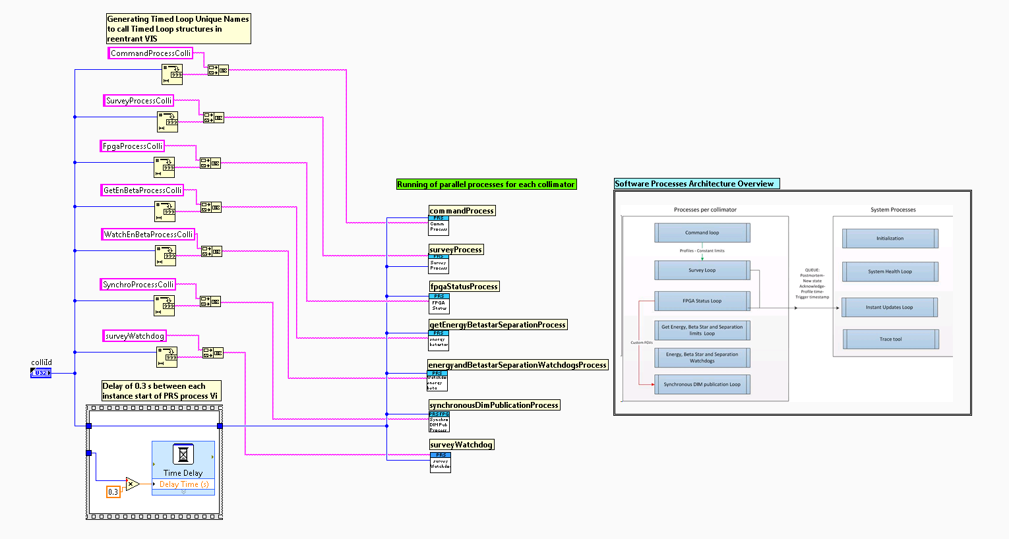
Development Models – V MODEL
Engineering design on each step
Risk analysis
Requirements instability could cause long term implementation
Mostly recommended for critical missions
LHC Collimators control

Slide 18
Development Models – V MODEL
Engineering design on each step
Risk analysis
Requirements instability could cause long term implementation
Mostly recommended for critical missions
Requirements
Testing and deployment
Architecture and Developments

Slide 19
Content
Starting with LabVIEW at CERN
Documentation and code management
Development models and workflow
Requirements analysis
Software architecture and development
Testing and deployment
Conclusions

Slide 20
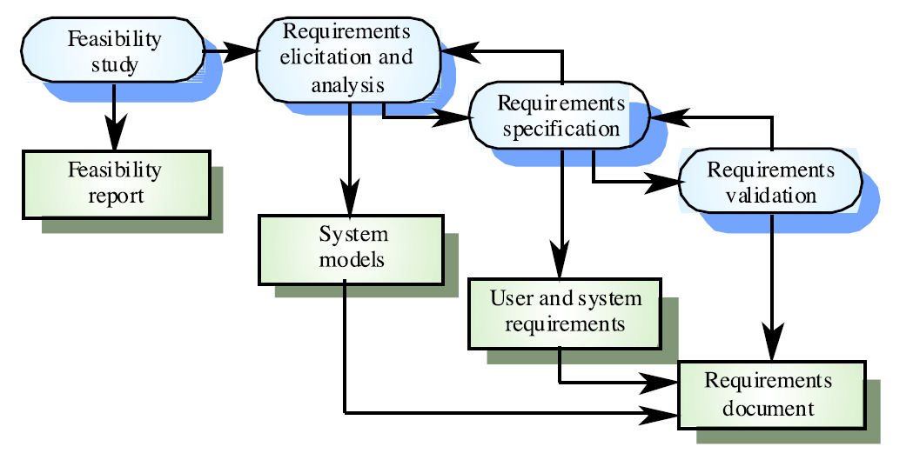
REQUIREMENTS
Fundamental step in a project workflow
  Drives the software architecture and implementation

Slide 21
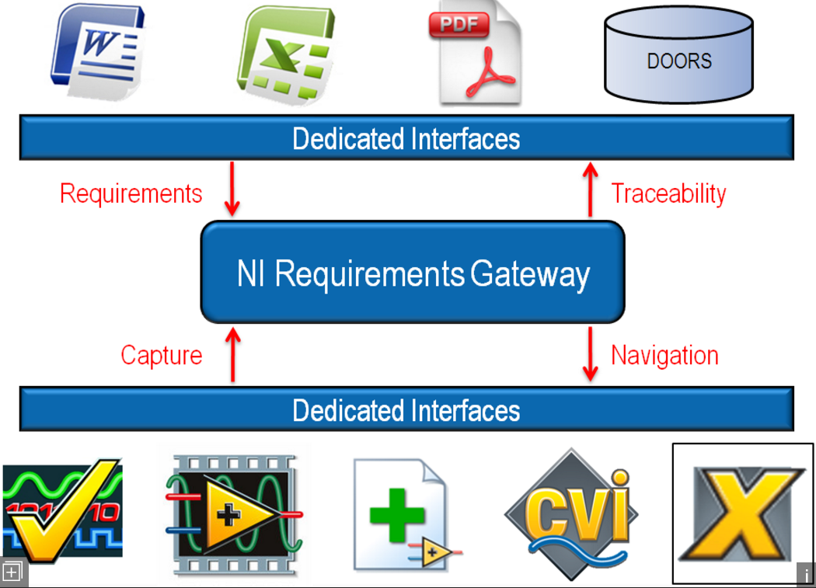
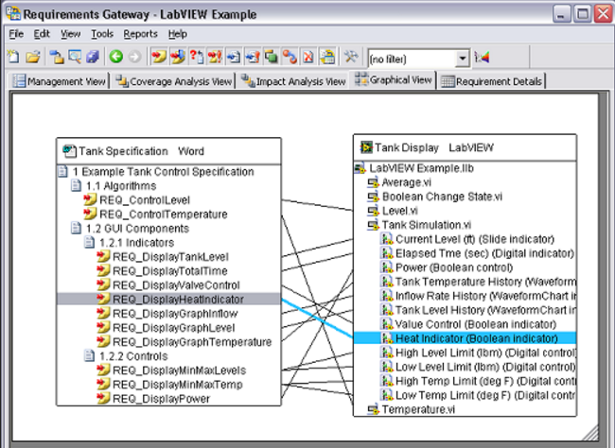
NI REQUIREMENTS GATEWAY
Requirements tracking tool
Suggested for critical mission

Slide 22

Failure mode and criticality analysis

Slide 23
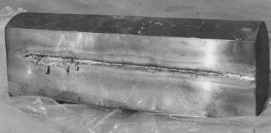

Failure mode and criticality analysis
Example of the criticality for the LHC Collimators control for their machine protection function. LHC beam parameters:
Stored energy 350 MJ per beam (factor 100 higher than others) …
Beam transverse density ~1 GJ/mm2 (factor 1000 higher than others) …
This makes the LHC beam highly destructive!!! Collimators are the closest elements to the beam ...

Slide 24
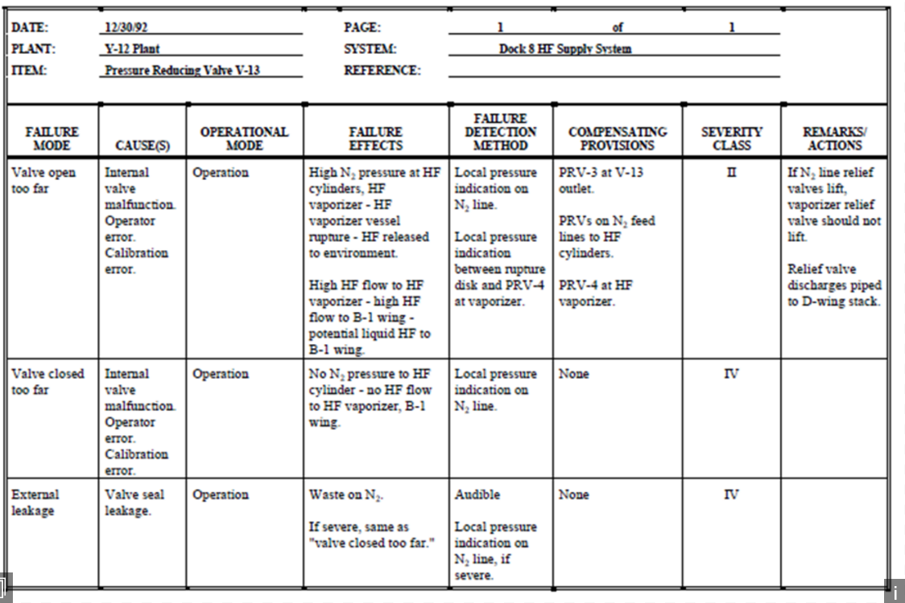
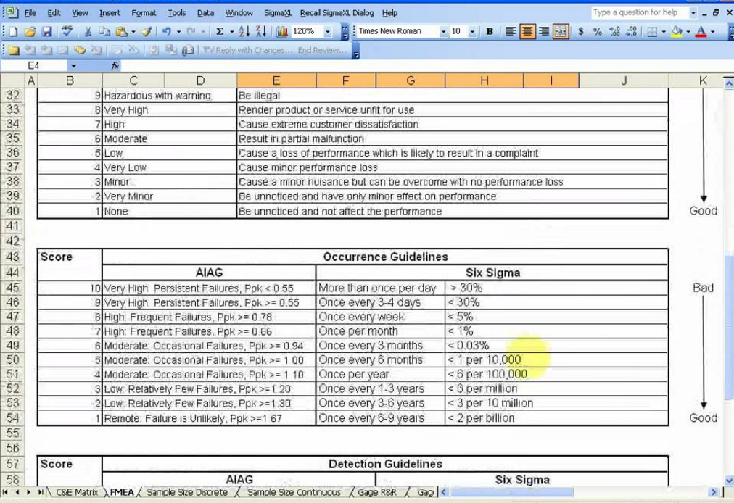
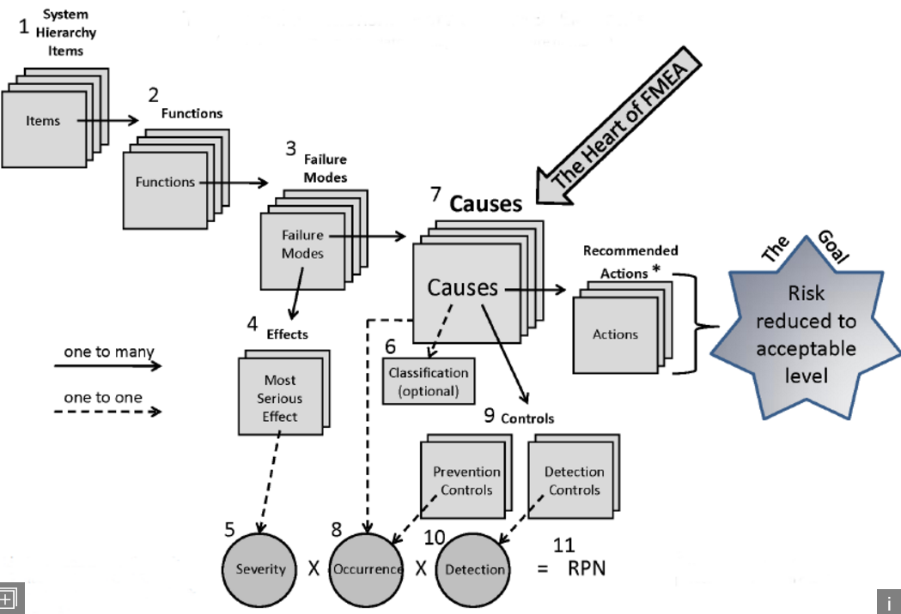
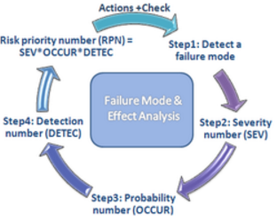
Failure mode and criticality analysis
Probably of the failure occurring
Impact to overall system health
Potential costs due to a failure
Mandatory for critical mission
Not needed for test benches

Slide 25
Content
Starting with LabVIEW at CERN
Documentation and code management
Development models and workflow
Requirements analysis
Software architecture and development
Testing and deployment
Conclusions

Slide 26
SOFTWARE ARCHITECTURE and DEVELOPMENT
Software architecture and implementation depends on the requirements
    Timing
    Criticality, reliability and availability
    Acquisition/Monitoring
    Control
    Inter process communication layer
    Portable
    Modular
    Library based
    Reusability of the code. LabVIEW Object Oriented (OOP) could be a choice
    Fail safe and redundancy

Slide 27
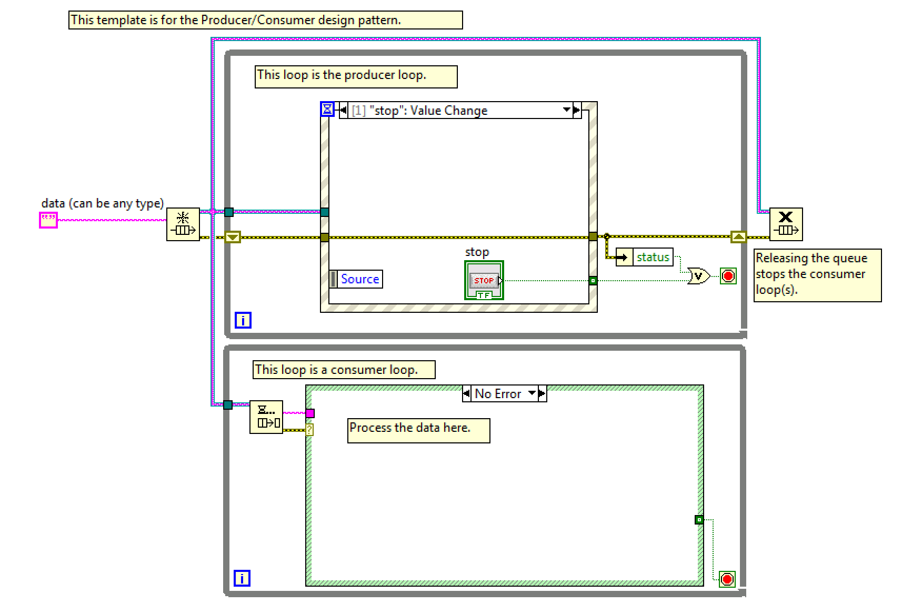
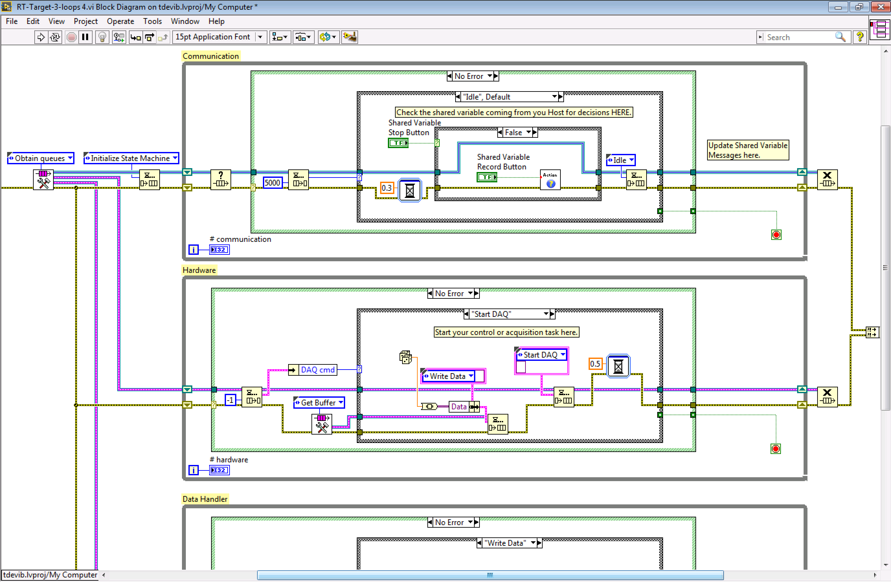
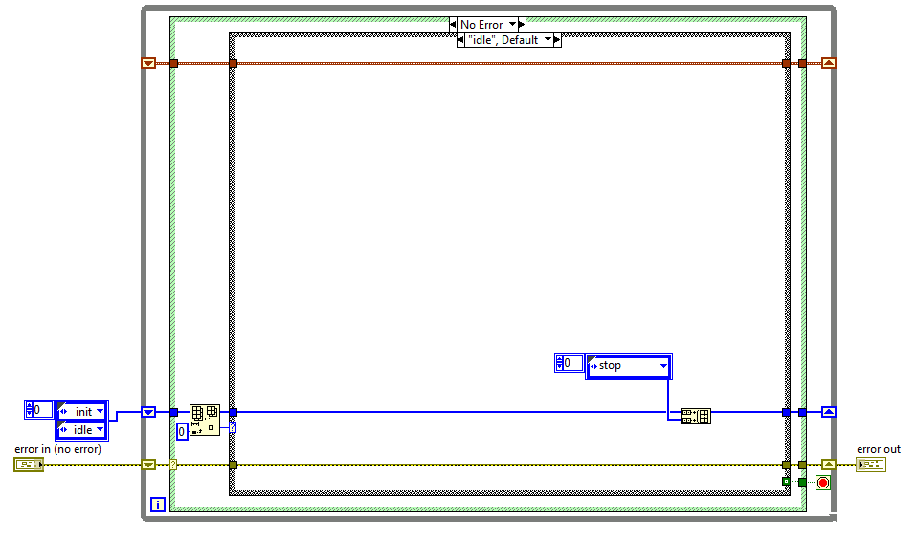
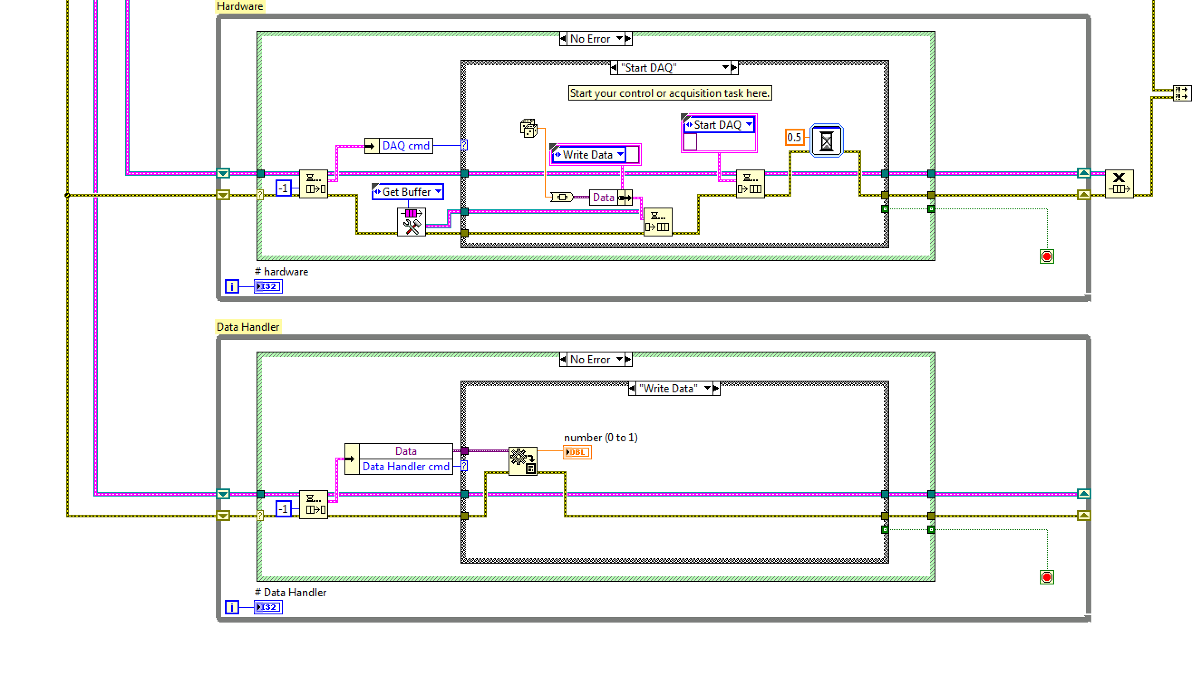
SOFTWARE ARCHITECTURE and DEVELOPMENT
Software architecture and implementation are fundamental for a successful project!
  Follow LabVIEW programming best practice
  Architecture models and template
State machine
Producer consumer
Messages handling
Software architectures are part of the CERN standard NI training

Slide 28
DEVELOPMENT MONITORING
Strongly suggested for critical missions
Audit
  Identify a group of people who are given responsibility and authority for improving organizational processes
LV architect supervising LV developers
Notifications tool for tasks assignments (Jira)
CODE review!

Slide 29
Content
Starting with LabVIEW at CERN
Documentation and code management
Development models and workflow
Requirements analysis
Software architecture and development
Testing and deployment
Conclusions

Slide 30
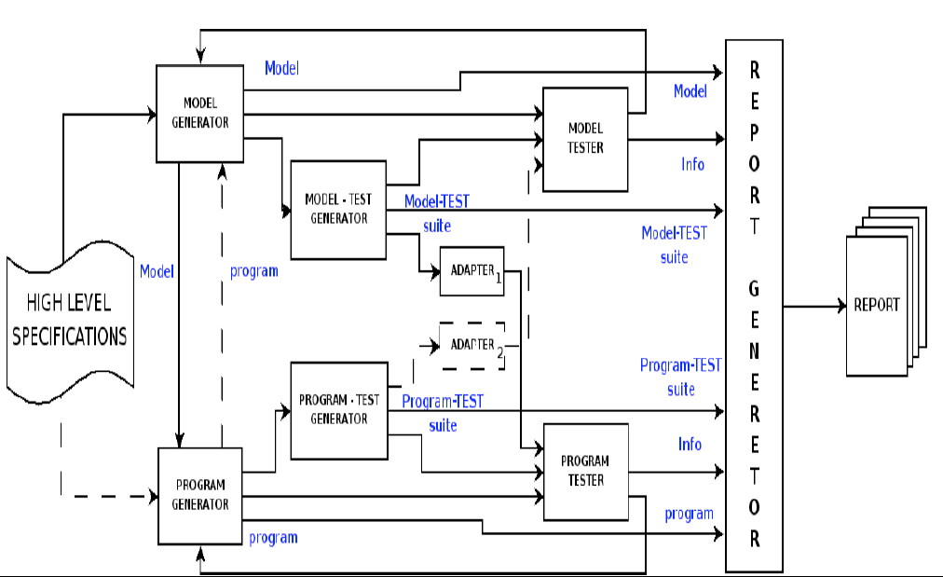
TEST and Validation
Models/standards for testing and validation of the code are fundamental for a successful project commitment
Example of test model used for the LHC Collimators control

Slide 31
TEST and Validation
Unit test
System integration
Formal review (deadlock, starvation…)
System test
  NI Tracetool for timing performance
Regression test (updates compatibility test)
Acceptance test (Alpha test)
Operational test (Beta test)
Reliability runs (long terms memory leak)
Offline System replication (mock-up)
Ad-hoc test tool
  LHC collimator test sequencer

Slide 32
DEPLOYMENT
Test-bench/mock-up first
Real conditions
    Dry runs first
Monitoring tool to track errors and operational scenarios
    RADE logger

Slide 33
CONCLUSION
LabVIEW is a great user friendly control tool used worldwide in labs, industry and accelerators domains
Projects development must follow a rigorous workflow to benefit from LabVIEW modularity and readability
Software maintainability and portability can be guaranteed using tools like SVN, Jira, Requirements Gateway etc.
Project architecture and tests have to be adapted to the requirements
Failure mode, criticality analysis and redundancy are fundamental for critical projects
Documentation is a daily task for the developers
We can provide the tools to make a GL program a powerful tool for robust test benches as well as a solution to control critical equipment

Slide 34
Thank you

