Slide 1
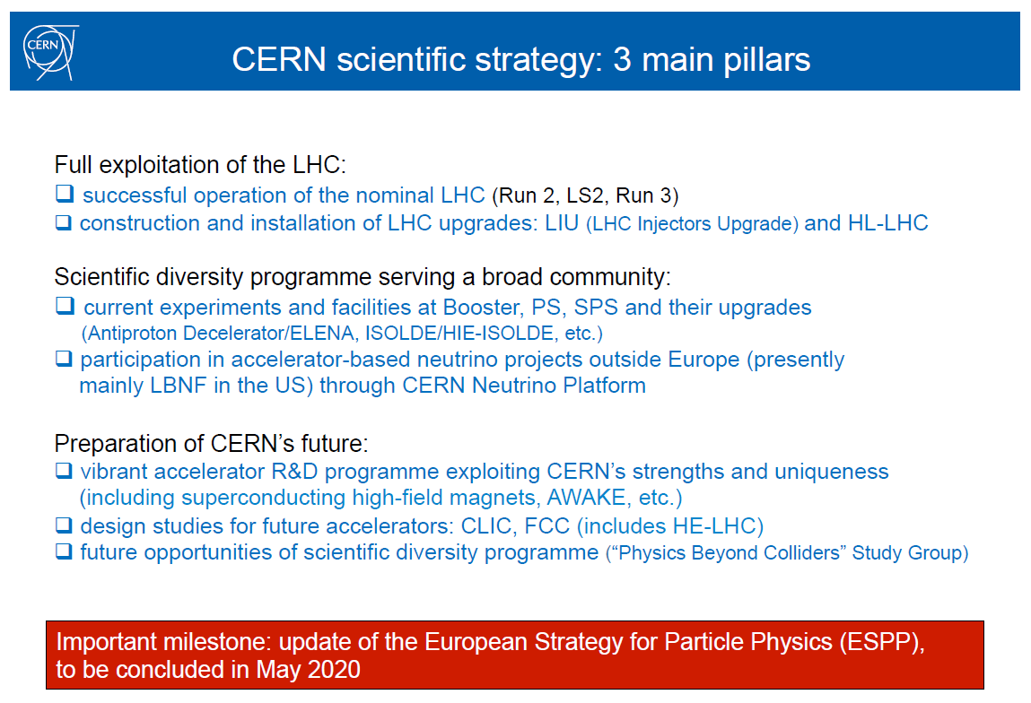
CERN scientific strategy: 3 main pillars
F. Gianotti 11/1/17

Slide 2

CLIC roadmap

Slide 3
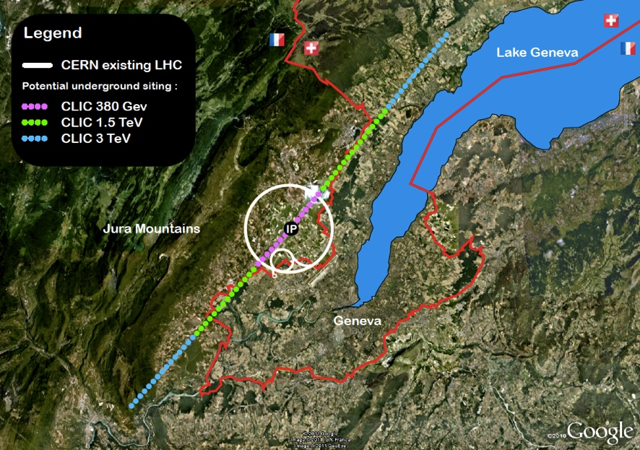
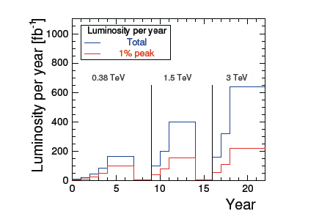
CLIC 380 GeV -> 3 TeV
Goal for next strategy update (end 2018): Present a CLIC project that is a “credible” option for CERN beyond LHC, a Project Implementation Plan. Guidelines used internally:
Adapt to physics results – LHC mostly – taking into account LHC at 13-14 TeV as results become available (be flexible)
Physics no later than 2035, solid luminosities from Higgs/top at 380 GeV (drivebeam and klystrons) to 3 TeV (staging)
Initial costs compatible with current CERN budget level (order LHC+50%) (staging)
Upgradable in 2-3 stages over a 20-30y period, without major (max 3-4 years) operational breaks, and with upgrade costs also in reasonable agreement with current budget level.
Cover accelerator, detector, physics
Three stage operation scenario from the CDR

Slide 4
Project Organisation
Over the last year the LC study organisation has changed in preparation of the European Strategy Update report. We put more emphasis on implementation studies related to the entire CLIC machine.
We still have the project organised in four main activities, each with a group of individual WPs and WP leaders:
Beamdynamic and design - D.Schulte
X-band included high off klystron studies - W.Wuensch
Linac systems: Main Linac module and Drive Beam front end - S.Doebert
Technical systems and studies - N.Catalan
General work-packages and budgets – S.Stapnes:
The studies at ATF2 and in light sources are WPs under General activities. ILC/LCC support activities likewise.
CTF3 closedown and CLEAR preparation are also under this general heading with WPs lead by R.Corsini.
Five new implementation working groups preparing for the ESU have been started (https://indico.cern.ch/category/4337/ ) – some of which also existed ahead of the CDR in 2012:
Civil Engineering & Infrastructure and Siting WG (CEIS) (lead J.Osborne) (mandate)
Cost, Power and Schedule (lead S.Stapnes) (Detailed costing of a 380 GeV machine - DB and klystrons - plus additional stages beyond)
Main Linac Hardware Baselining (lead C.Rossi) (Optimised module technical design and surrounding infrastructure in the tunnel, considering the entire lifetime of a module including commissioning, installation, conditioning, operation, rework, replacements etc.)
Baseline parameters and design (lead D.Schulte) (Designs and parameters for 380 (DB and klystrons) GeV, 1.5 TeV and 3 TeV)
Novel Accelerator methods for future stages of CLIC (lead E.Adli) (mandate)
The WGs have ~10-15 core members as needed to cover the subject, and meet every 4-6 weeks in open meetings (to all coll. members). Costing meetings are closed.
See implementation meetings every Friday 9-11 at indico link above.

