Slide 1

Impact of crossing angle reduction: Simulations and observations
F. Antoniou, S. Fartoukh, G. Iadarola, S. Papadopoulou, Y. Papaphilippou, D. Pellegrini
LRBB Wire Workshop, Divonne Les Bains, 20th March 2017

Slide 2
Outline
Observables from simulations and experience during 2016 with review of factors affecting DA and beam lifetime
Review of 2016 MD on LRBB with 2 trains
Considerations and simulations for measurements with broken IP1-IP5 H-V beam-beam compensation

Slide 3
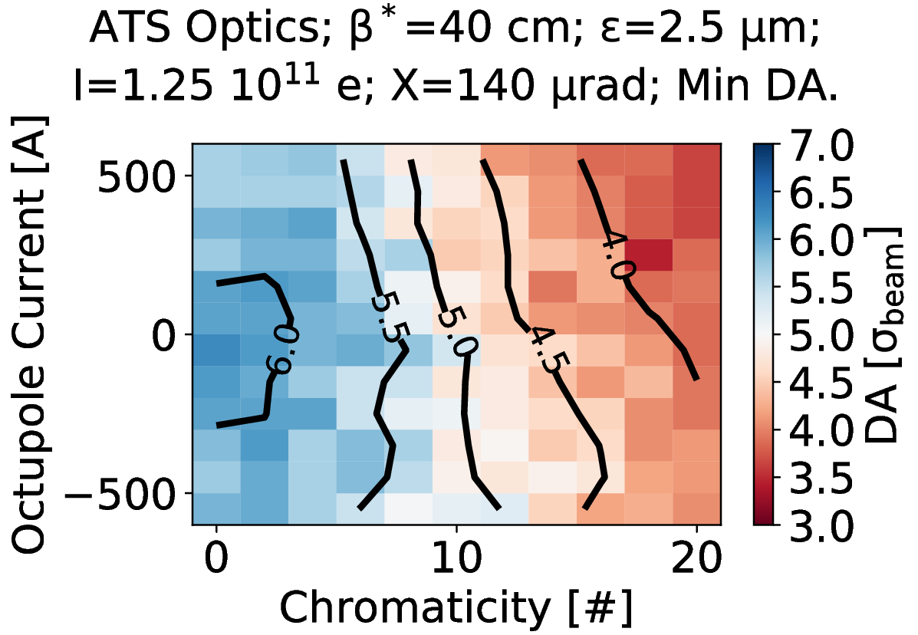
Setting the Stage: DA Scans
DA multi-parametric response used as a tool to approach limits when optimizing performances.
Not a perfect tool:
  1M turns are only 90 s of machine time
  The initial longitudinal action is fixed
  Does not take into account the actual beam phase space distribution, diffusion…
Still capable of capturing relevant aspects of the dynamics.
In 2016 this was put under great stress and confidence was gained.
Errors not included, adding some uncertainty.

Slide 4
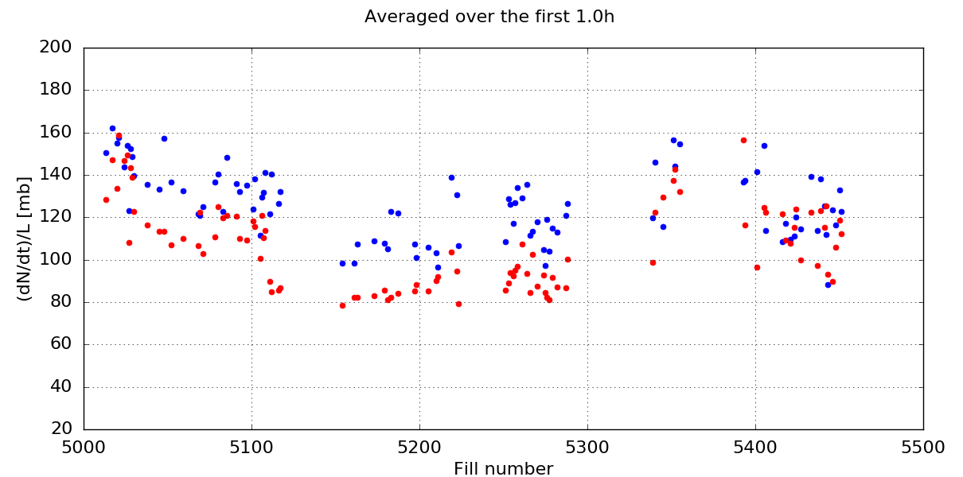
Overview of 2016 losses at beginning of SB
Beam 1
Beam 2
Burnoff Limit
F. Antoniou,
Evian 2016

Slide 5

Switch to BCMS Bunches
For the LHC this means ε: 3.75 → ~2.50 µm
Stronger head on beam-beam: $ξ=\frac{r_{e}Nβ^{∗}}{4πγσ^{2}}=\frac{r_{e}N}{4πγε}∝ε^{−1}$
Less sampling of non-linearities (including LRs): ${\left(σ=\sqrt{\frac{βε}{γ}}∝ε^{1/2}\right)}^{m}$
We are in
a regime
where 2.
prevails
Y. Papaphilippou et al.
LMC, 6 Jul 2016

Slide 6
Switch to BCMS Bunches
Beam 1
Beam 2
Transition to BCMS
Burnoff Limit

Slide 7
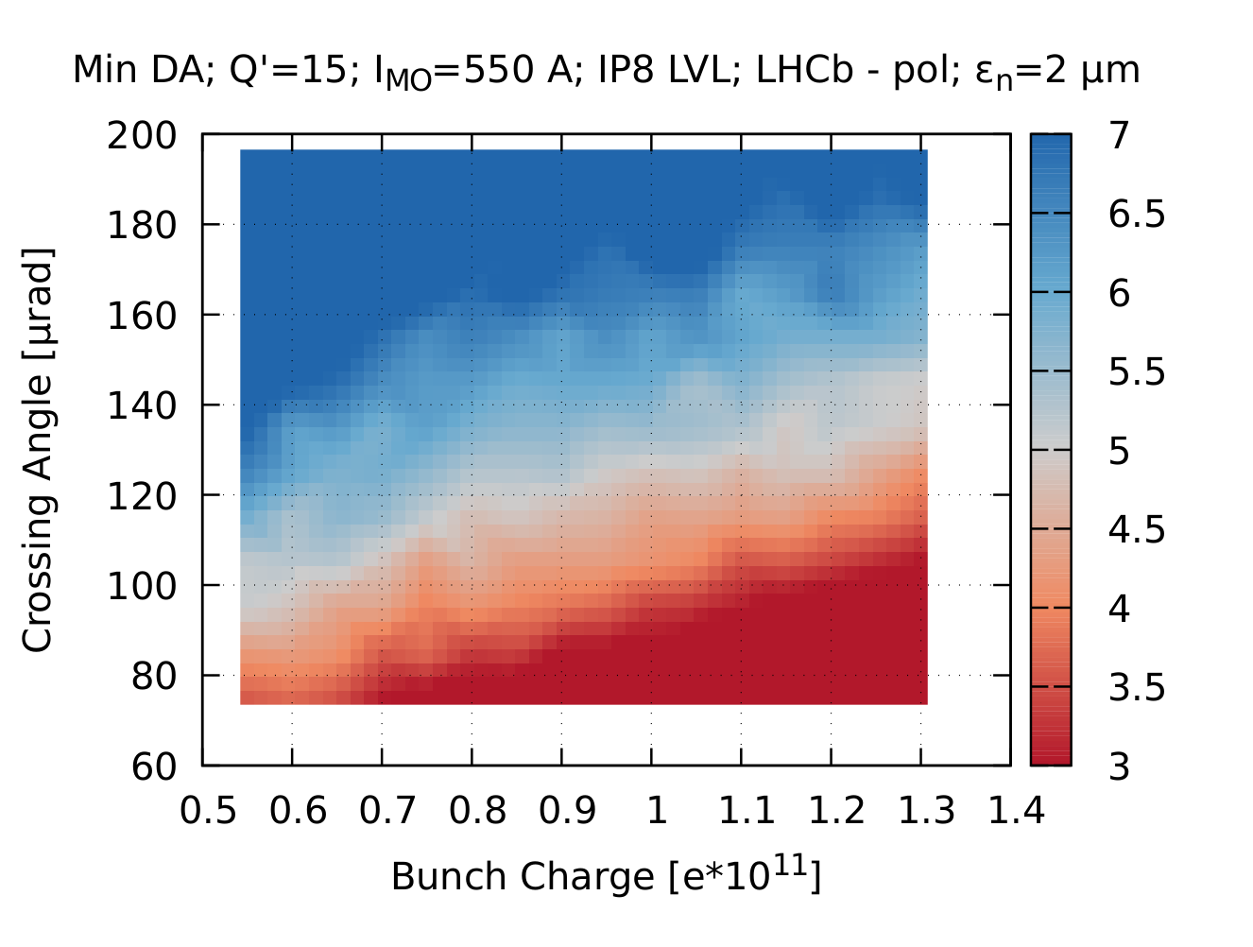
Reduction of Crossing Angle
The DA used to be on the conservative side due to limited intensity from the SPS and injection kicker
Even more margin due to the smaller emittance
Reduction of Crossing was the next natural step:
185 µrad → 140 µrad
About 5σ DA in beam units.
D. Pellegrini et al.
LBOC, 16 Aug 2016

Slide 8
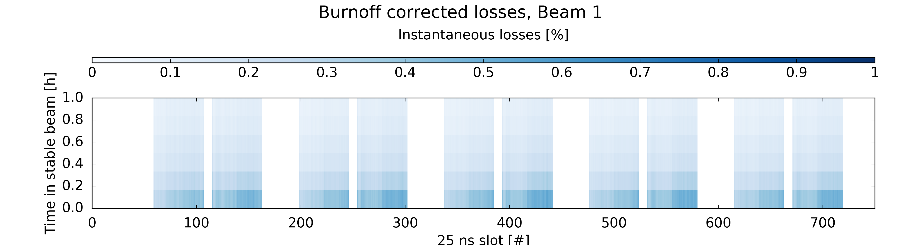
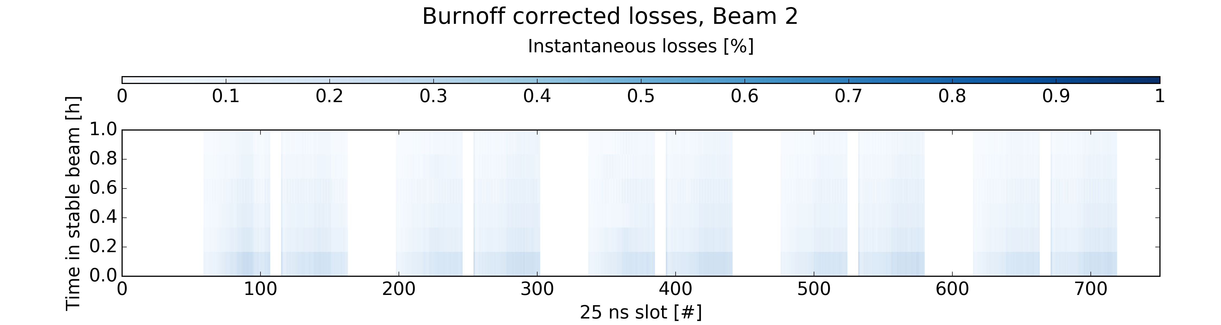
Reduction of Crossing Angle
Losses calculated as % of total intensity over 10 minute windows at beginning of Stable Beam.
Average over several fills with Xing=185urad
Minor traces of e-cloud are visible.

Slide 9
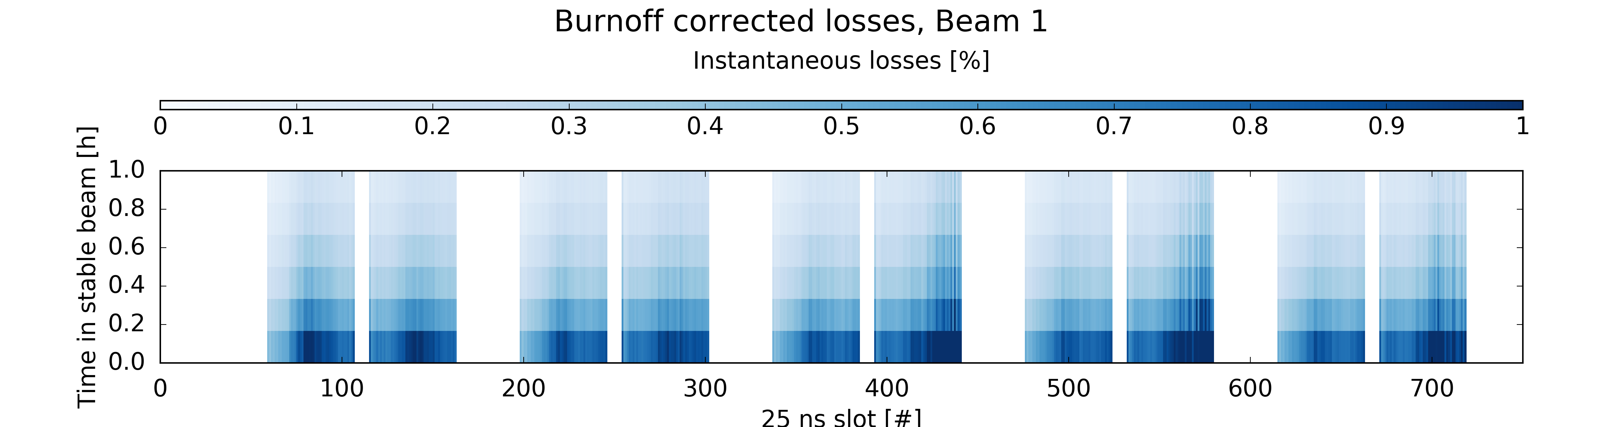

Reduction of Crossing Angle
Losses calculated as % of total intensity over 10 minute windows at beginning of Stable Beam.
Average over several fills with Xing=140urad
Traces of e-cloud and of LRs are visible.

Slide 10
Reduction of Crossing Angle
Beam 1
Beam 2
Transition to BCMS
Crossing angle reduction
Burnoff Limit

Slide 11
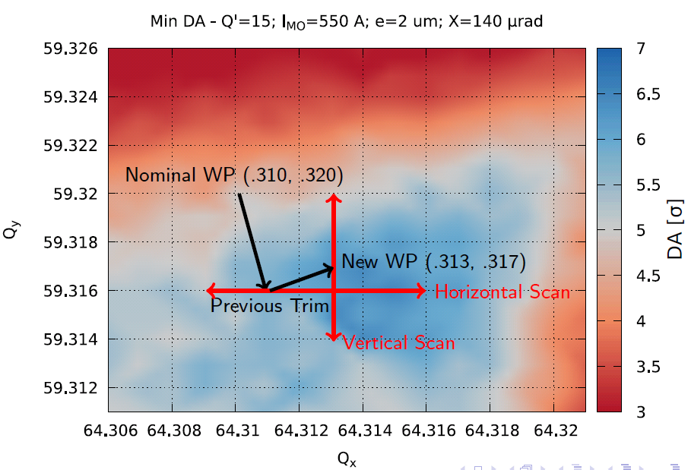
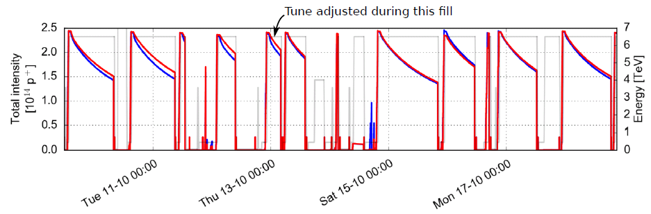
Tune Adjustment
Beam1 typically showed more losses than Beam2
DA Tune scans pointed out that the nominal WP (.31, .32) is sub-optimal
The tune of Beam1 was adjusted in operation according to predictions
Beam1 lifetime was recovered
D. Pellegrini et al.
LMC, 19 Oct 2016

Slide 12
Tune Adjustment
Beam 1
Beam 2
B1 Tune Adj
Transition to BCMS
Crossing angle reduction
Burnoff Limit

Slide 13
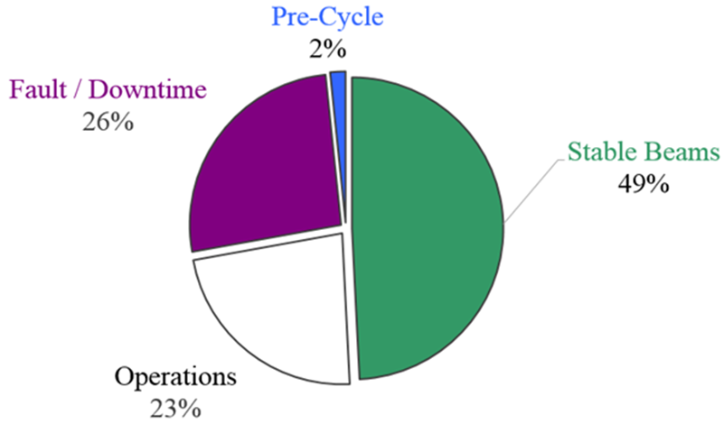
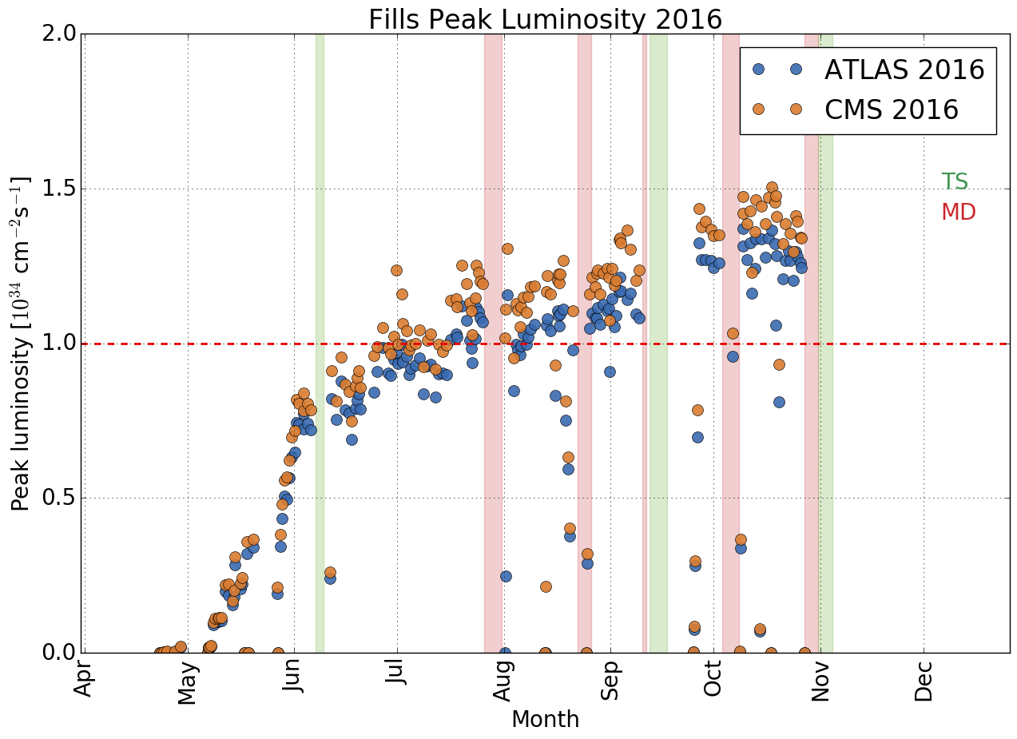
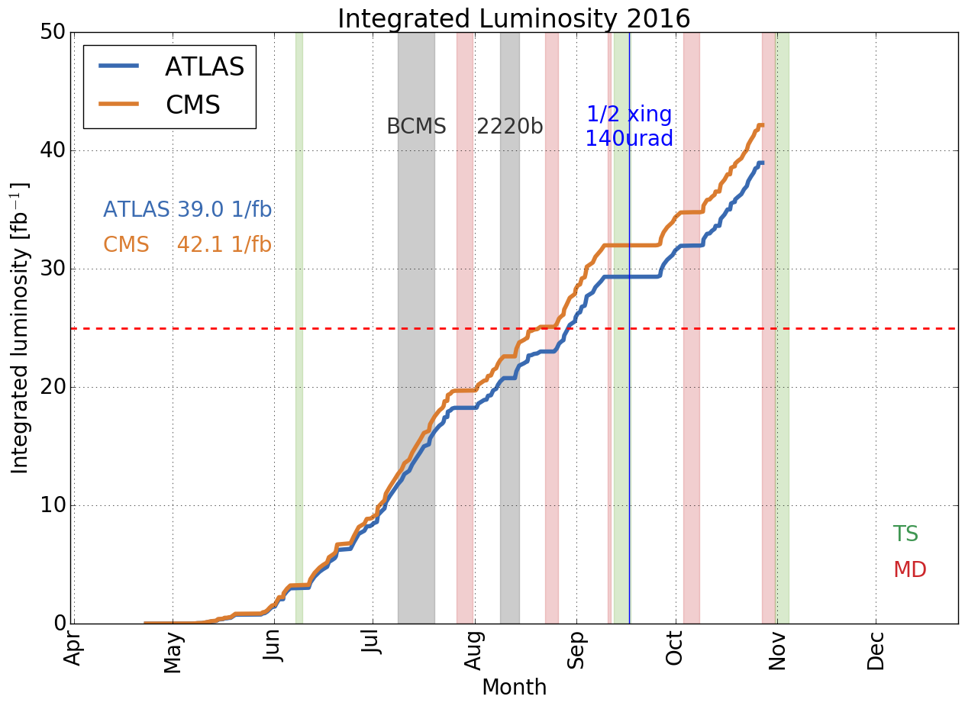
2016 Outcome
Peak luminosity at the end of the run.
The three-day period with maximum integrated luminosity also at the end of the run in spite of higher losses and less focus on production.
Control and understanding of the sensitivity to many parameters from operational experience.
E. Bravin,
Evian 2016

Slide 14
MD on LR Separation
Test performed during MD on fill 5137 by T. Pieloni et al. with symmetric trains in conditions similar to SB (strong-strong scenario).
The crossing angle was reduced in steps during collision, lifetime was closely monitored.
The impact of LR was observed especially in B1, while B2 was not so sensitive.

Slide 15
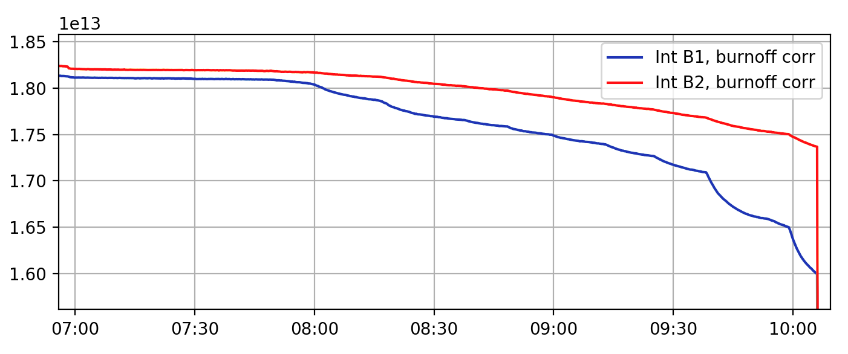
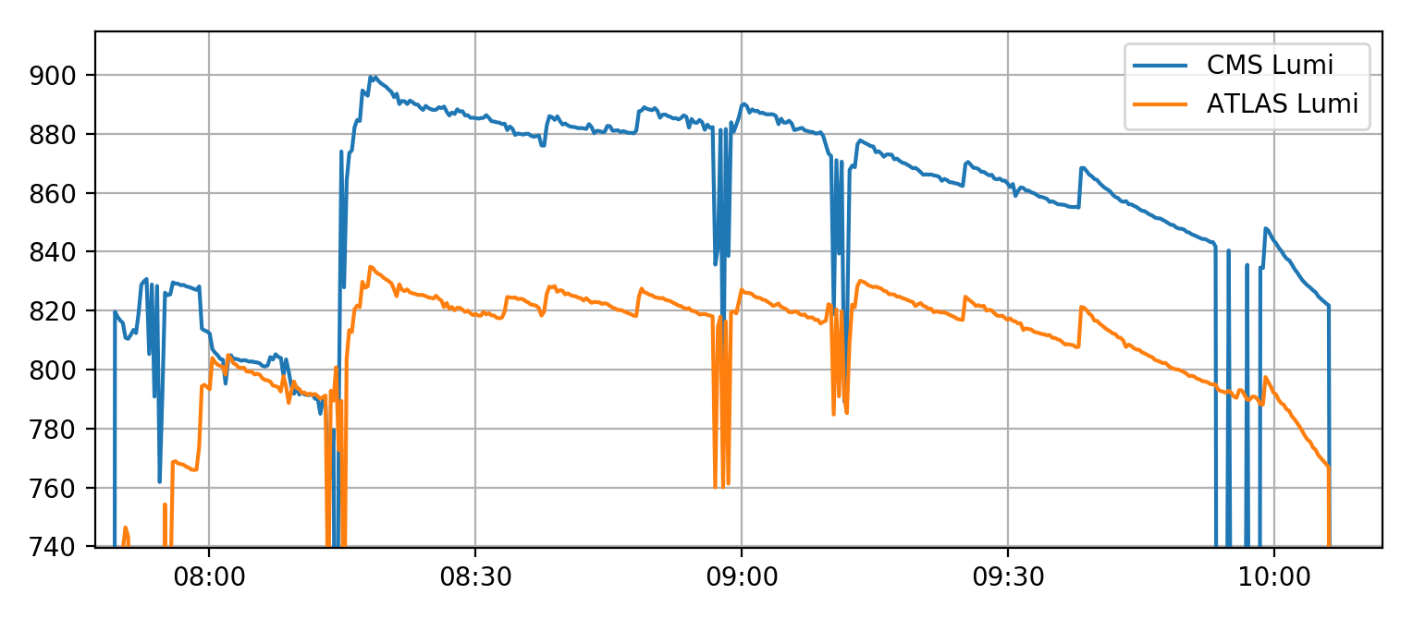
Intensity and Luminosity
Intensity decay compatible with the observed lifetimes
Luminosity imbalance commonly observed in the 2016 Run
Luminosity exchange at 9:10 – origin and implications are not clear
Intensity [p]
imbalance introduced
Reduction of crossing
Lumi [Hz/ub]
Luminosity optimisation

Slide 16
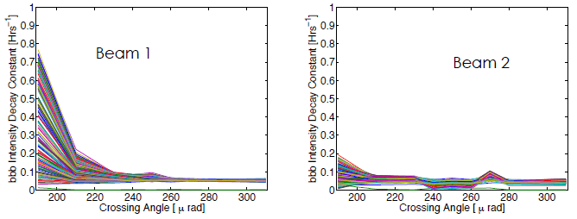
Outcome of MD on LR Separation
M. Crouch, Beam-Beam and Luminosity Meeting,
14 Oct 2016
Full
Full
Tune shift from crossing and asymmetry see talk of Belen.
The encounters at minimum separation can possible have an impact on the symmetry due to different Left and Right beta functions (S. Fartoukh)
The faster intensity decay of B1 steers towards a week-strong scenario: B2 is less and less perturbed by beam-beam.

Slide 17
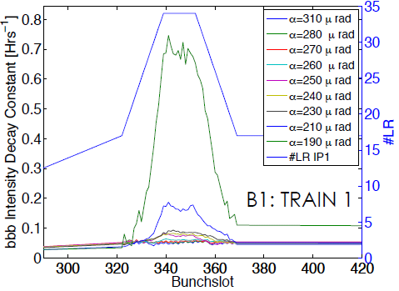
Losses VS Bunch Slot
Full Crossing Angle
Signature of LR interactions are observed in B1 as a dependency of the lifetime over the bunch slot.
B2 does not show clear dependencies until the smallest crossing angle.
M. Crouch, Beam-Beam and Luminosity Meeting,
14 Oct 2016

Slide 18
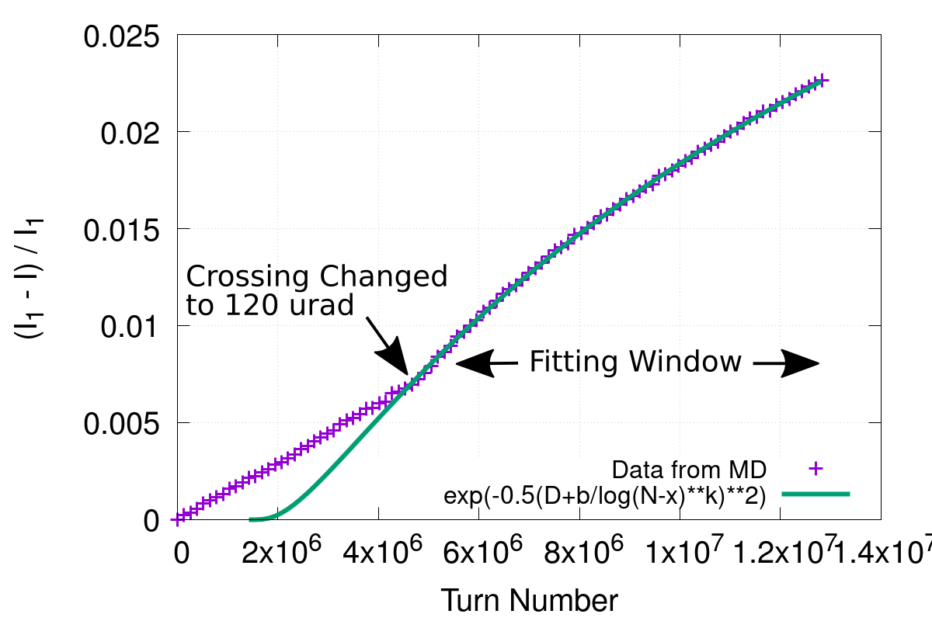
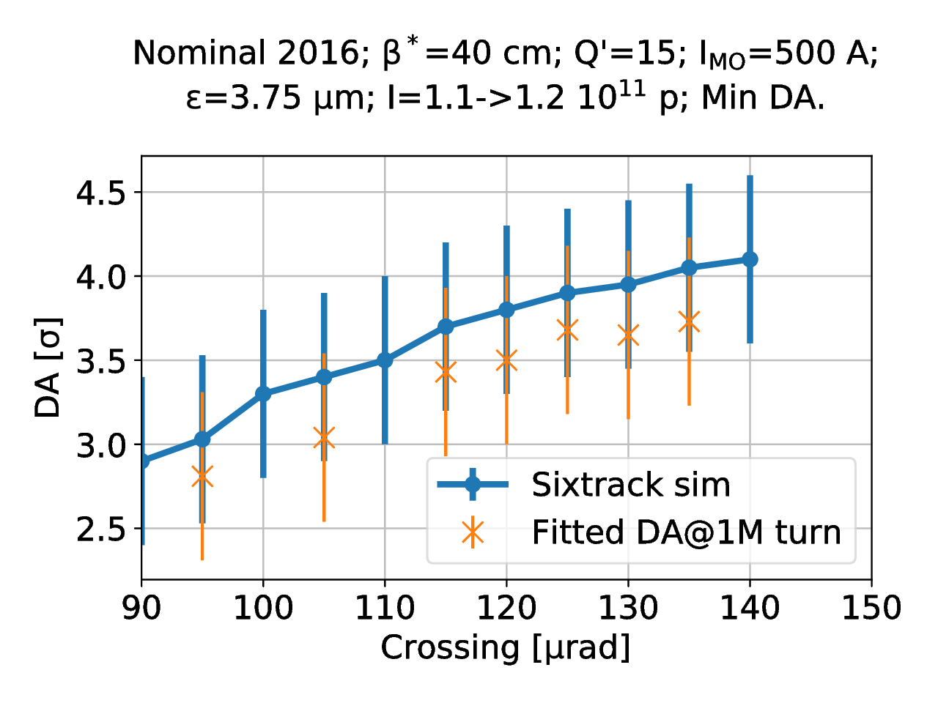
Fitting with DA and Intensity Scaling Laws
Intensity data fitted with inverse logarithm scaling law for Gaussian bunches (M. Giovannozzi, PRST-AB, 2012)
Extra fitting parameter (horizontal shift) introduced to avoid bad agreement at low number of turns
DA scaling law used to extract DA@1M turns
Delicate fit, different sets of parameters giving good agreement, DA@1M turns is more robust
Extra losses (eg burnoff) play a crucial role
Uncertainty on the beam size
Global fit for time being: pacman bunches are (erroneously) equally threated
Some agreement with simulations although the many uncertainties present
Work in progress also by M. Crouch

Slide 19
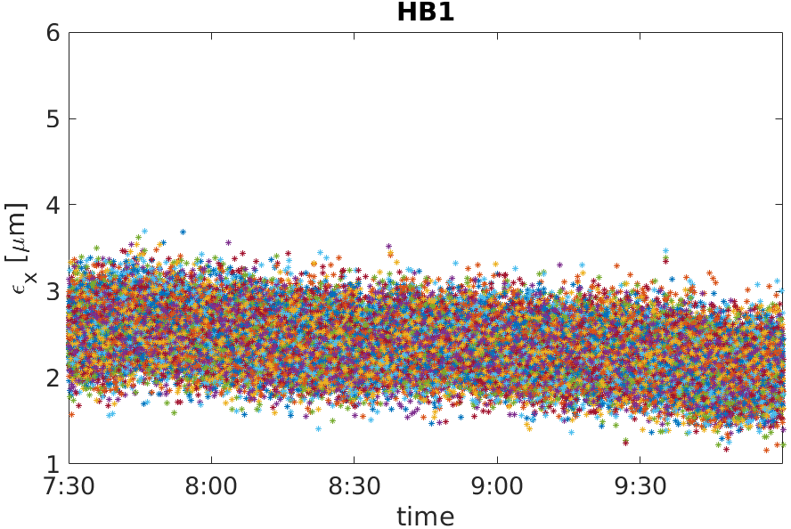
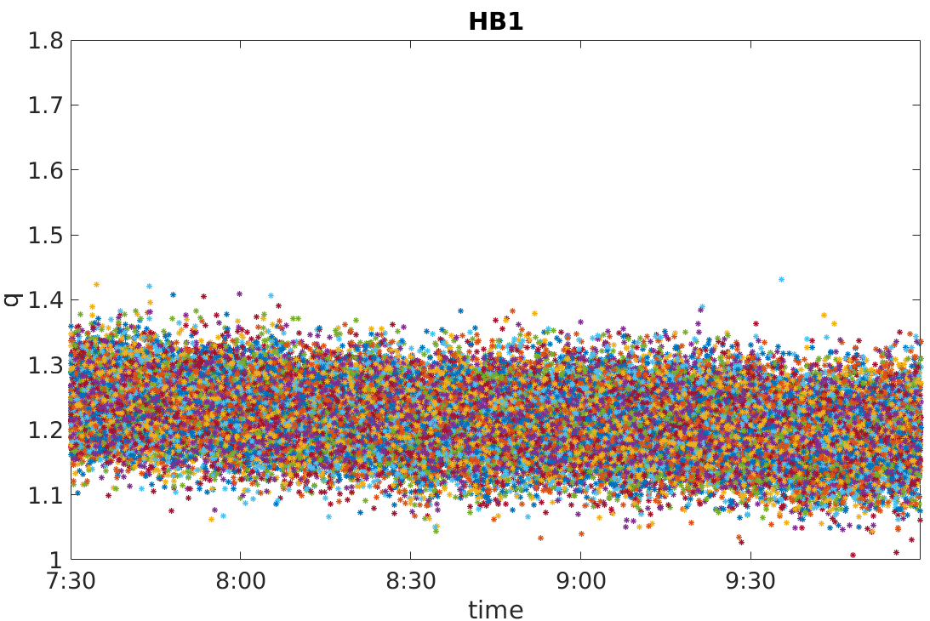
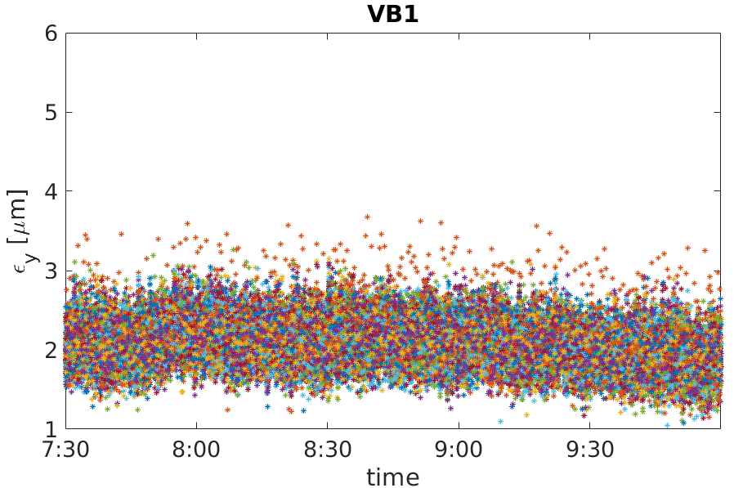
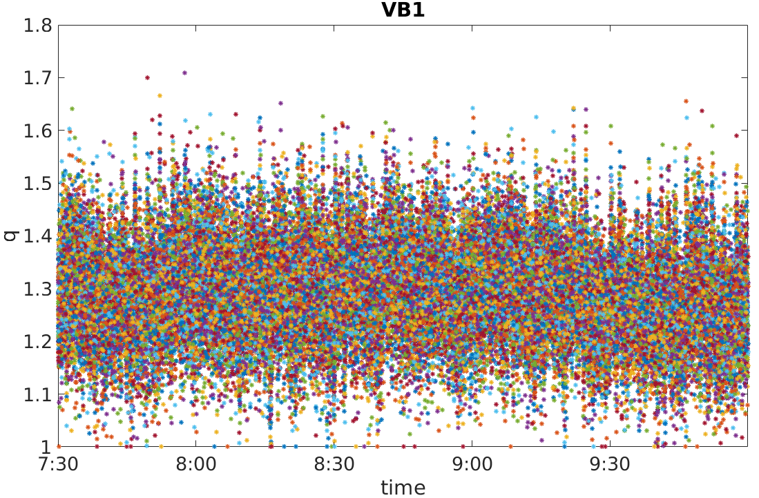
Transverse Profile analysis with q-Gaussian
Emittance evolution
Tails evolution
Need to disentangle IBS, SR and tail cleaning
Filtering and spectral cleaning, but poor sensitivity to tails from BSRT
Hard to draw conclusions
Tails appear to shrink together with the emittance but…
S. Papadopoulou

Slide 20
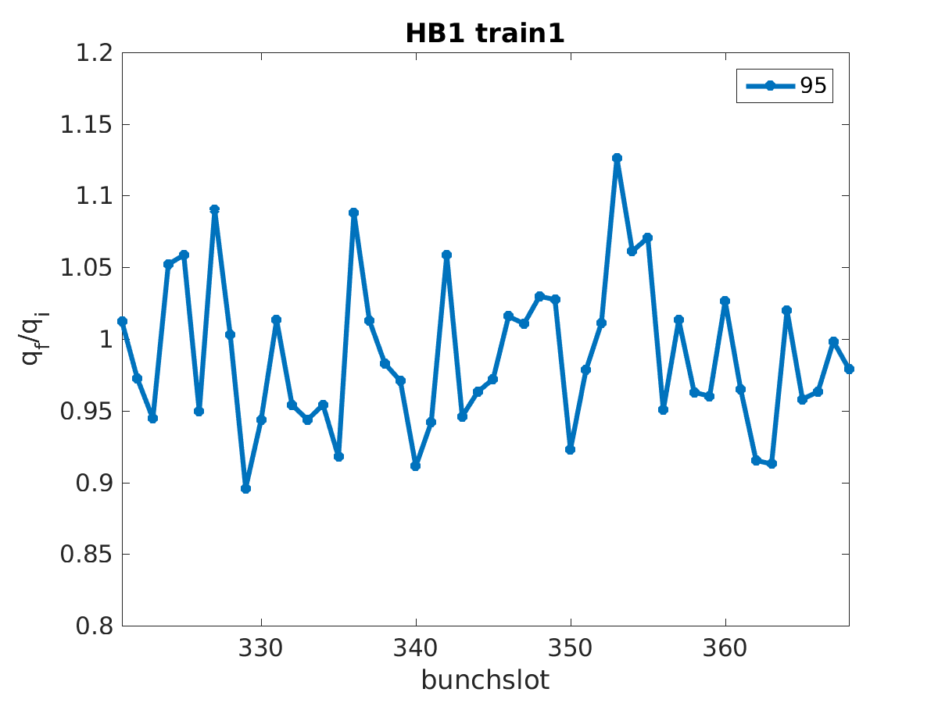
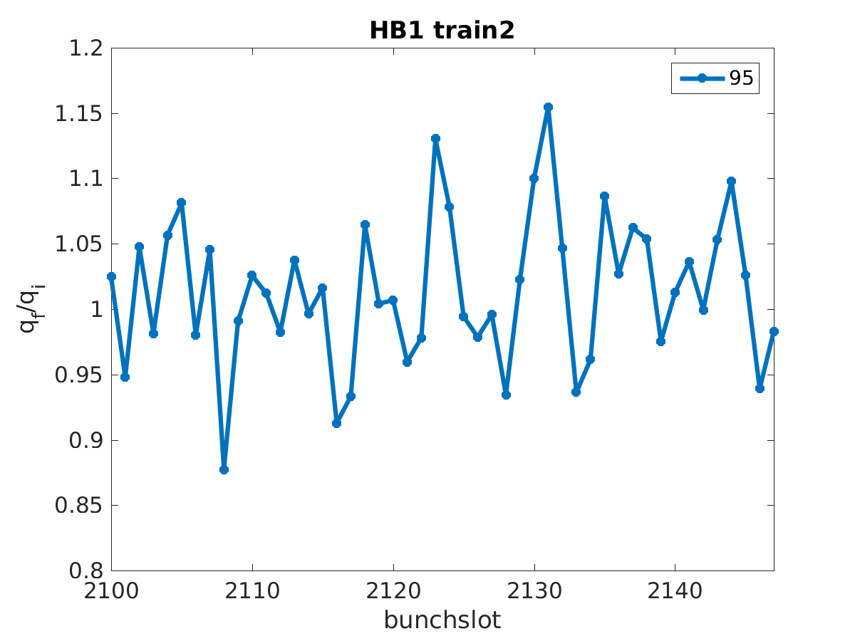
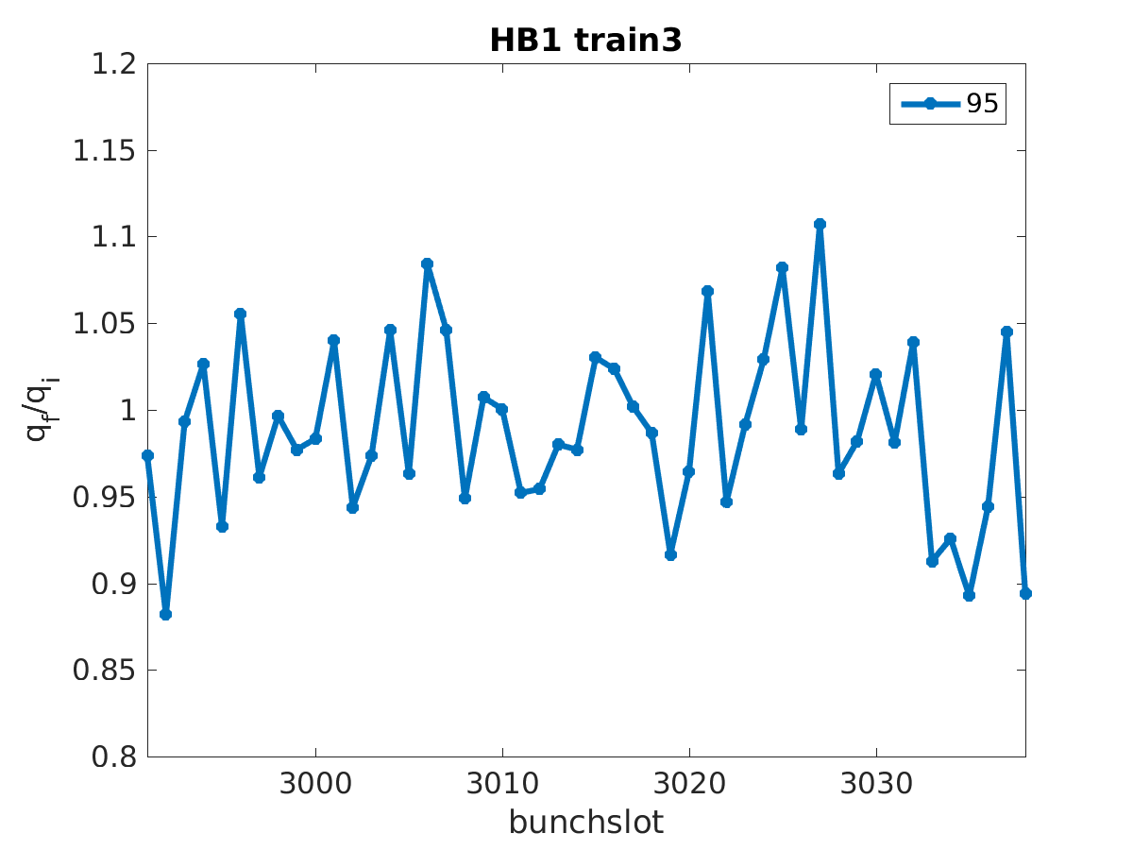
Transverse Profile analysis with q-Gaussian
S. Papadopoulou
All the bunch slots behave in comparable manners: no LR signatures.
Diffraction, noise and sensitivity to fit range.
Input for experiments of halo cleaning with wire: other monitoring techniques may be required!

Slide 21
Perturbation of Single IP: scenario
In 2017 the wire is available only in IP5.
Explore the possibility to perturb IP5 only (crossing reduction) and compensate with the wire, eventually with IP1 unsqueezed.
The HO also changes with the crossing: need to compensate with the optics.
Weak beam probing the potential of a strong train: reduce cross talks and coherent interactions.

Slide 22
Considerations for measurments with wire
Moving from small to large DA may require long time before DA losses appear again
  one could use the data immediately after the change to evaluate non-DA losses (Burnoff, Beam-Gas, …)
  the transition point may not be clear
Operate the crossing and the wire (almost) simultaneously trying to preserve the lifetime.
Switch off the wire and observe the impact on the lifetime.
The perturbations of tune, orbit, chromaticity, need to be very well compensated, both for wire and Xing.
Setup, test and feedforward of the impact of the wire – See Guido’s talk.

Slide 23
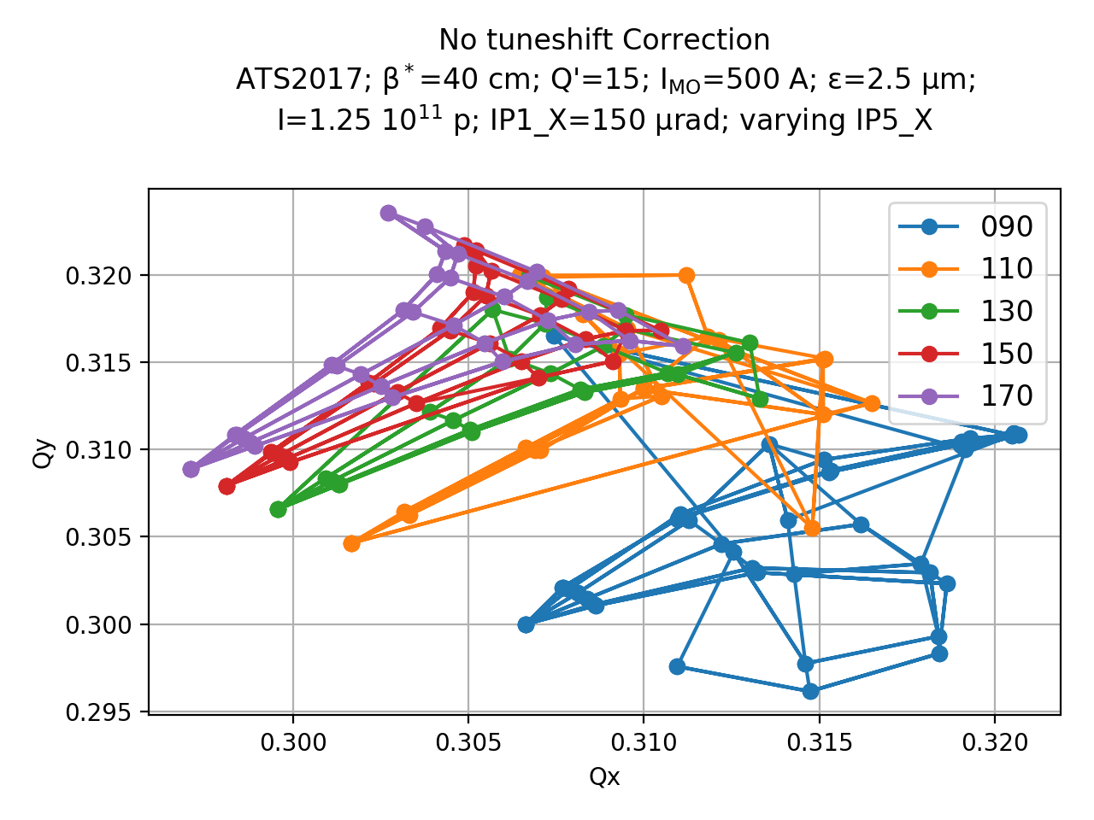
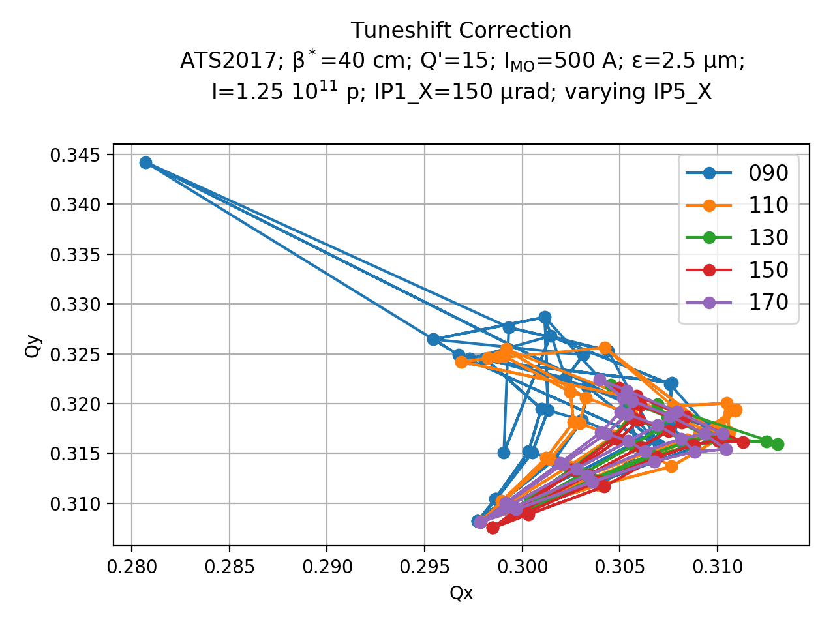
Footprints when moving Xing in IP5 only
The tuneshift of the core of the beam (also due to HO) is adjusted to less than 0.001 by trimming the optics.
The wire (not included) is expected to improve the footprint at large amplitudes (see Sasha’s Talk)

Slide 24
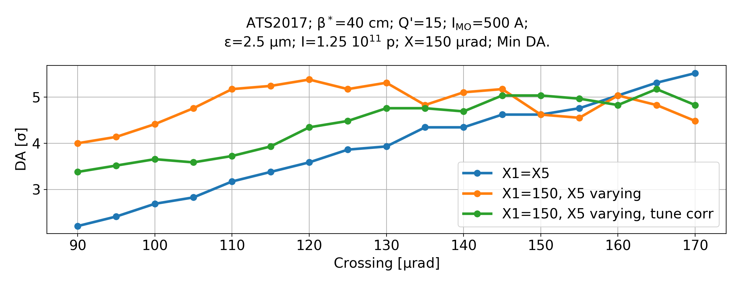
DA with asymmetric IPs, no wire
The case without tune correction shows a big improvement (the DA favours tunes close to the diagonal).
The case with tune correction is still better than the symmetric IPs.
Each of this curves is a tricky MD with many pitfalls (X1=X5 already attempted, see earlier).
Need to clarify what happens in each case when the wire is turned on/off.
One wants the best condition to test the impact of the wire, but an MD on tuneshift should be avoided!

Slide 25
Conclusions
Robust technique for DA investigation based on multi-parametric scans:
  prediction and steering of the LHC operation during 2016 Run
  Explored sensitivities to tune, crossing angle, intensity, chromaticity, octupoles, emittance
MD on LRBB gives additional insight but some aspects remain unknown
Breaking the IP1/5 symmetry appears tricky:
  Detailed knowledge of the dynamics is required
  Optics (orbit, tune, chroma) has to be adjusted to compensate for masking effects

Slide 26
Thank you!

