Slide 2
Application Launcher

Slide 3
Application Launcher
Used to classify, describe and start the applications
Based on Java web-start technology
Extends jnlp format
Standardised way of configuration
Adds a level of security
Platform independent
(maybe how it handles dependencies?)

Slide 4
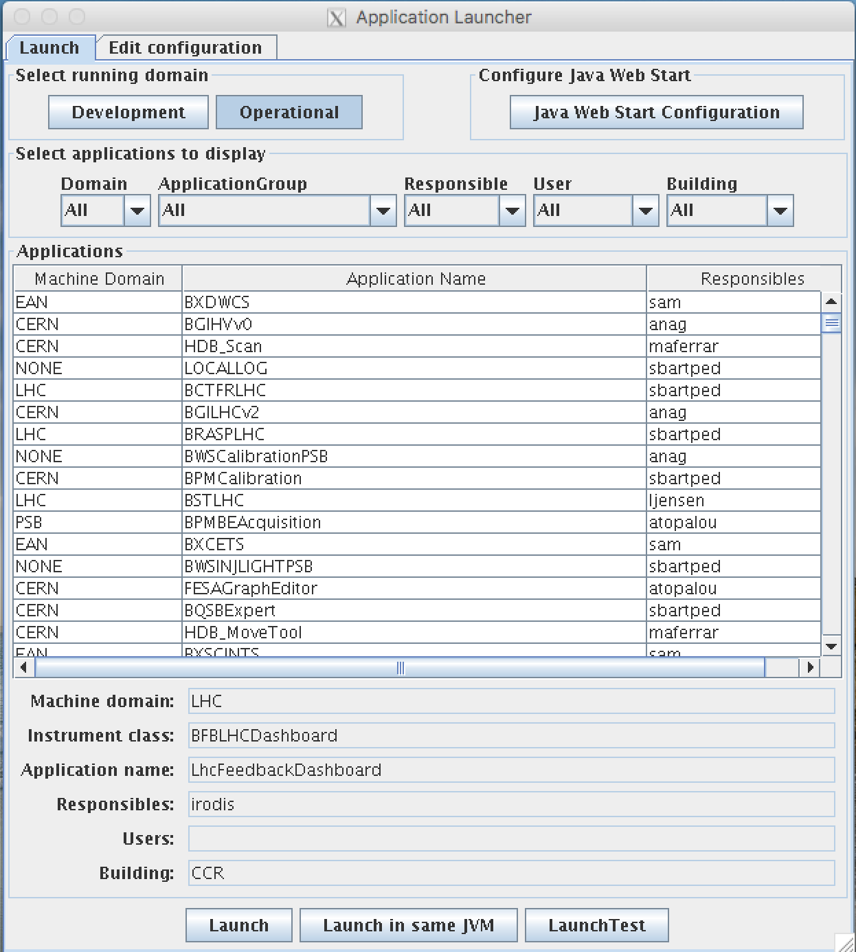
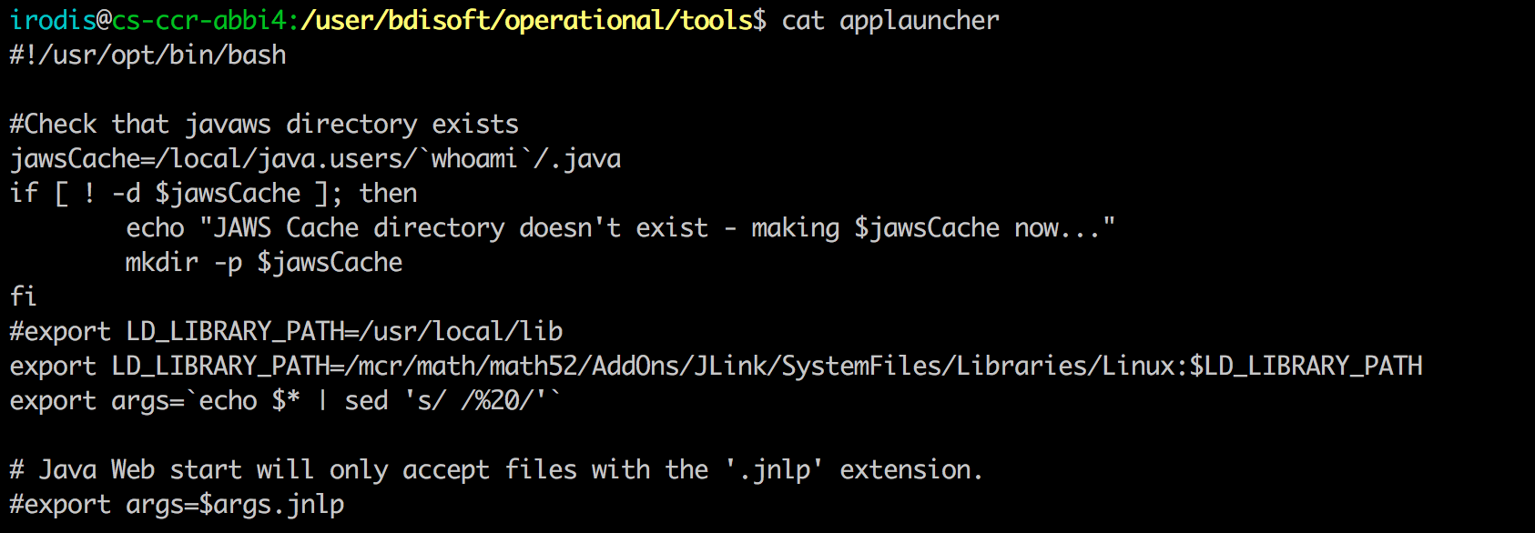
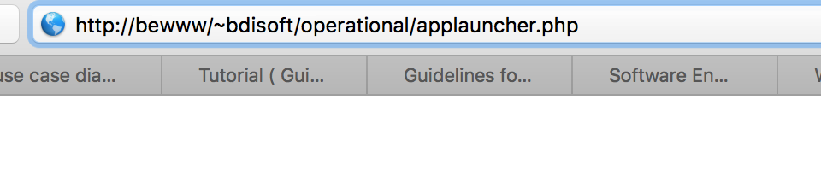
Application Launcher

Slide 5
Applauncher - use cases

Slide 6
Use case: Software Deployment
Participating actors: Developers
Flow of events:
  1. Dev clicks on the commit operational found in the ant targets
  2. System copies target/jar into artifactory
  3. System deletes previous operational jar file
  4. System copies target/jar to … /java/bdi_jars
Alternative flows:
  2a. Artifactory is unavailiable
  4a. NFS is unavailable
Entry Condition: Dev has permissions to write
Exit Condition: Dev delivers successfully, or gets an error message

Slide 7
Use case: Search
Participating actors: Developers, Users
Flow of events:
  1. Dev / User selects state (operational, development)
  2. Dev / User searches for application
Alternative flows:
  2a. System has no matches
Entry Condition: Dev / User has permissions to read / write
Exit Condition: Gets results of the search or finds no available matches

Slide 8
Use case: Software configuration
Participating actors: Developers
Flow of events:
  1. Dev searches for application
  2. Creates / edits application configuration entry
  3. Submits changes
Alternative flows:
  1a. Cannot find application due to permissions
  3a. Cannot change config due to permissions
  3b. Cannot change config due to invalid values
  3c. Cannot change config due to simultaneous changes
Entry Condition: Dev has permissions to read / write
Exit Condition: Configuration gets successfully changes

Slide 9
Use case: Launch application
Participating actors: Developers, Users
Flow of events:
  1. Search (filters) for application
  2. Select application
  3. Run application
Alternative flows:
  1a. Results not found due to permissions
  3a. Fails to run application (possible dependency problem)
Entry Condition: Dev / User has permissions to read
Exit Condition: Runs application successfully or user /dev gets error message

Slide 10
Use case: Test RC (Development)
Participating actors: Developers
Flow of events:
  1. Search for application
  2. Select application
  3. Run application
  4. Deliver operational
Alternative flows:
  1a. Results not found due to permissions
  3a. Fails to run application (possible dependency problem)
Entry Condition: Dev / User has permissions to read
Exit Condition: Runs application successfully or user /dev gets error message

Slide 12
  New requirements
BISW Portal ( LIDS , fixed displays, wiki, useful links etc)
Ability to expand functionality
Run Python
Transition to Java FX
Create modular applications(?)
Mobile support (?)

Slide 13
Web approach - Possible technologies
Technologies (Java)
Backend
JavaEE(SpringMVC, Boot)
Hibernate
JWS & JNLP
Frontend
Javascript (AngularJS, reactjs, ext.js, Ember.js)
Html + CSS

Slide 14
Web approach
Technologies (Python)
Backend
Python(Django, Flask..)
Storm, Django ORM, SQLAlchemy
JWS & JNLP
Frontend
Javascript (AngularJS, reactjs, ext.js, Ember.js)
Html + CSS

Slide 15
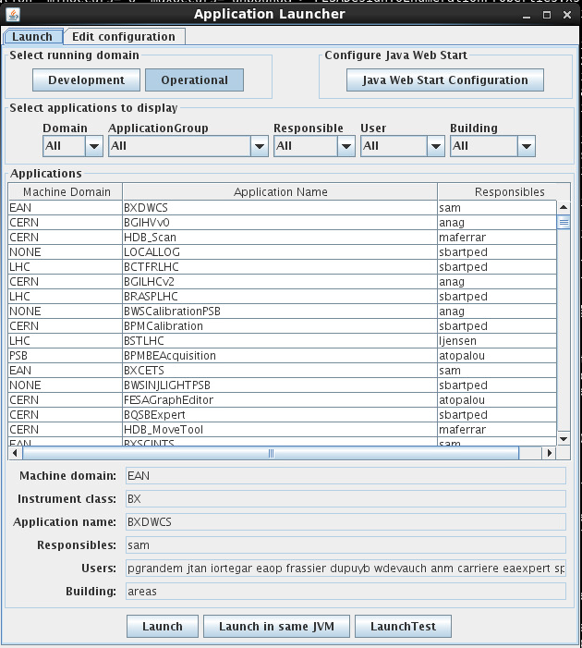
  Native Approach
JavaFX !
JavaFX, Python
JWS & JNLP
New features
New UI, easier config
Create new applications
New dependency
management
Problems:
  Integration with LIDS
  BI-SW Portal
  …

Slide 16
Evaluation of Web approach
Pros
Cross-platform
Single code base
Bypass ecosystem rules
Always updated
Can be a part of a future “web portal” and “fixed displays”
Cons
Efficiency
Higher cost of maintenance
Security
Availability can be more difficult

Slide 17
Possible approach

Slide 18
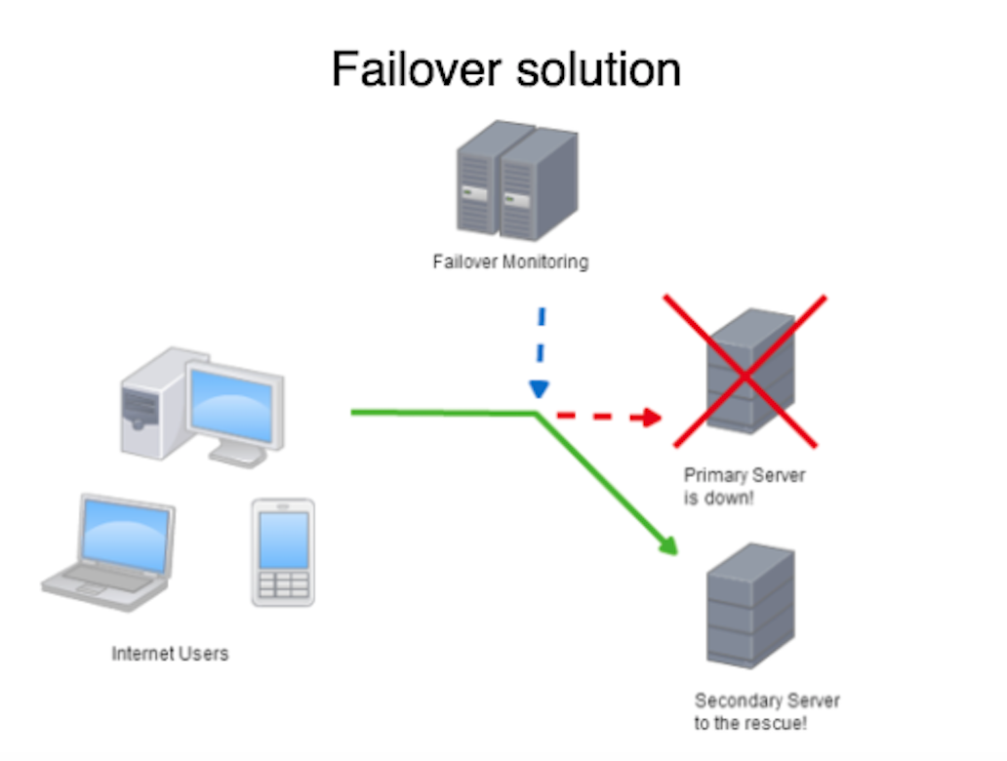


Slide 19
“Offline mode”
In case of server failure an “offline mode” will be provided.
The servers will frequently cache data

Slide 20
Failover solution-“Offline mode”

Slide 21

Recommended Technologies
Back-end
Spring boot
Front-end
AngularJS 2
JavaFX webkit
Inspired by the 3rd Developers@CERN Forum

Slide 22
Lids integration
To be continued..

