Slide 1
CME/CVE in high-energy heavy-ion collisions
Gang Wang (UCLA)

Slide 2
Chiral Magnetic effect:
spin alignment in B-field:
opposite directions for
opposite charges
handedness:
momentum and spin,
aligned or anti-aligned
courtesy of P.Sorensen
An excess of right or left handed quarks lead to a current flow along the magnetic field.

Slide 3
Nature Physics 12, 550 (2016)
Man-made chirality:
When E||B, CME conductivity is
B dependence of the negative magnetoresistance is nicely fitted with CME contribution to the electrical conductivity.

Slide 4
A whole industry of CME is semimetals
Dirac semimetal
Na₃Bi
Nature Physics 12, 550 (2016)
Weyl semimetal
TaAs

Slide 5
Why study CME in heavy-ion collisions?
Understand 1) the strong B field and many fancy effects
Y. Hirono, D. E. Kharzeev and Y. Yin PRD 92,125031 (2015)
2) vacuum transition
D. Diakonov, Prog. Part. Nucl. Phys. 51, 173 (2003)
3) chiral symmetry restoration

Slide 6
Chiral Vortical Effect
Do we have experimental evidence of B or ω?
D. Kharzeev, D. T. Son, PRL 106 (2011) 062301

Slide 7
Frozen B fields
In vacuum, the B field falls like a rock.
A conducting medium is need to save the day.
How much has B fallen off when the medium comes in play?
Gürsoy, Kharzeev & Rajagopal, Phys. Rev. C 89, 054905 (2014)

Slide 8
An indirect evidence: E
Asymmetric collisions (Cu+Au) create in-plane electric fields.
Similar to the B field, and easier to observe:
  h⁺ goes along E and h⁻ to the opposite
  charge-dependent of v₁
                ψ_{E}: electric field direction
                d_{E}: electric dipole
Y. Hirono et al., Phys.Rev. C 90 (2014) no.2, 021903
W.T. Deng and X.G. Huang, Phys.Lett. B742,296 (2015)

Slide 9
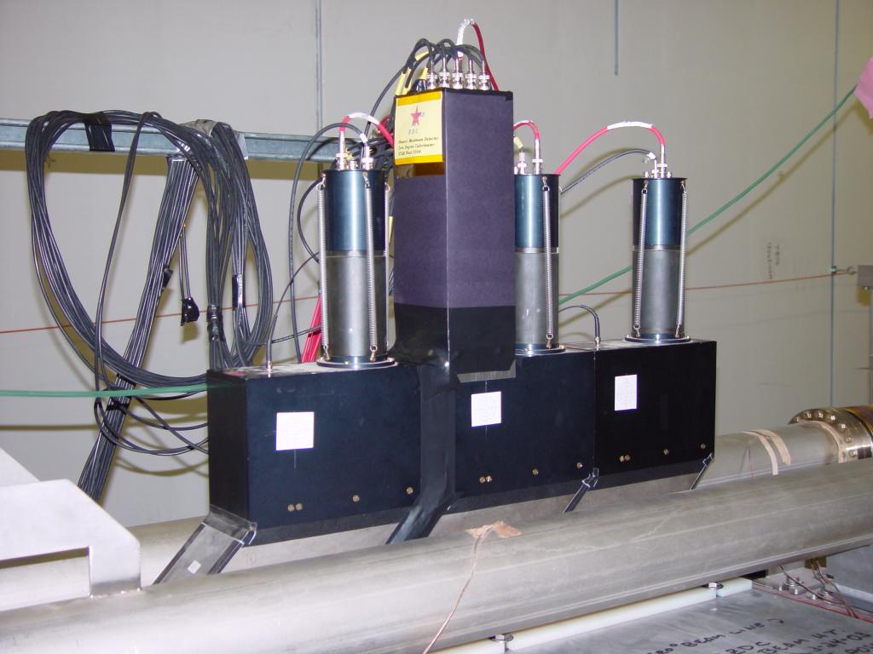
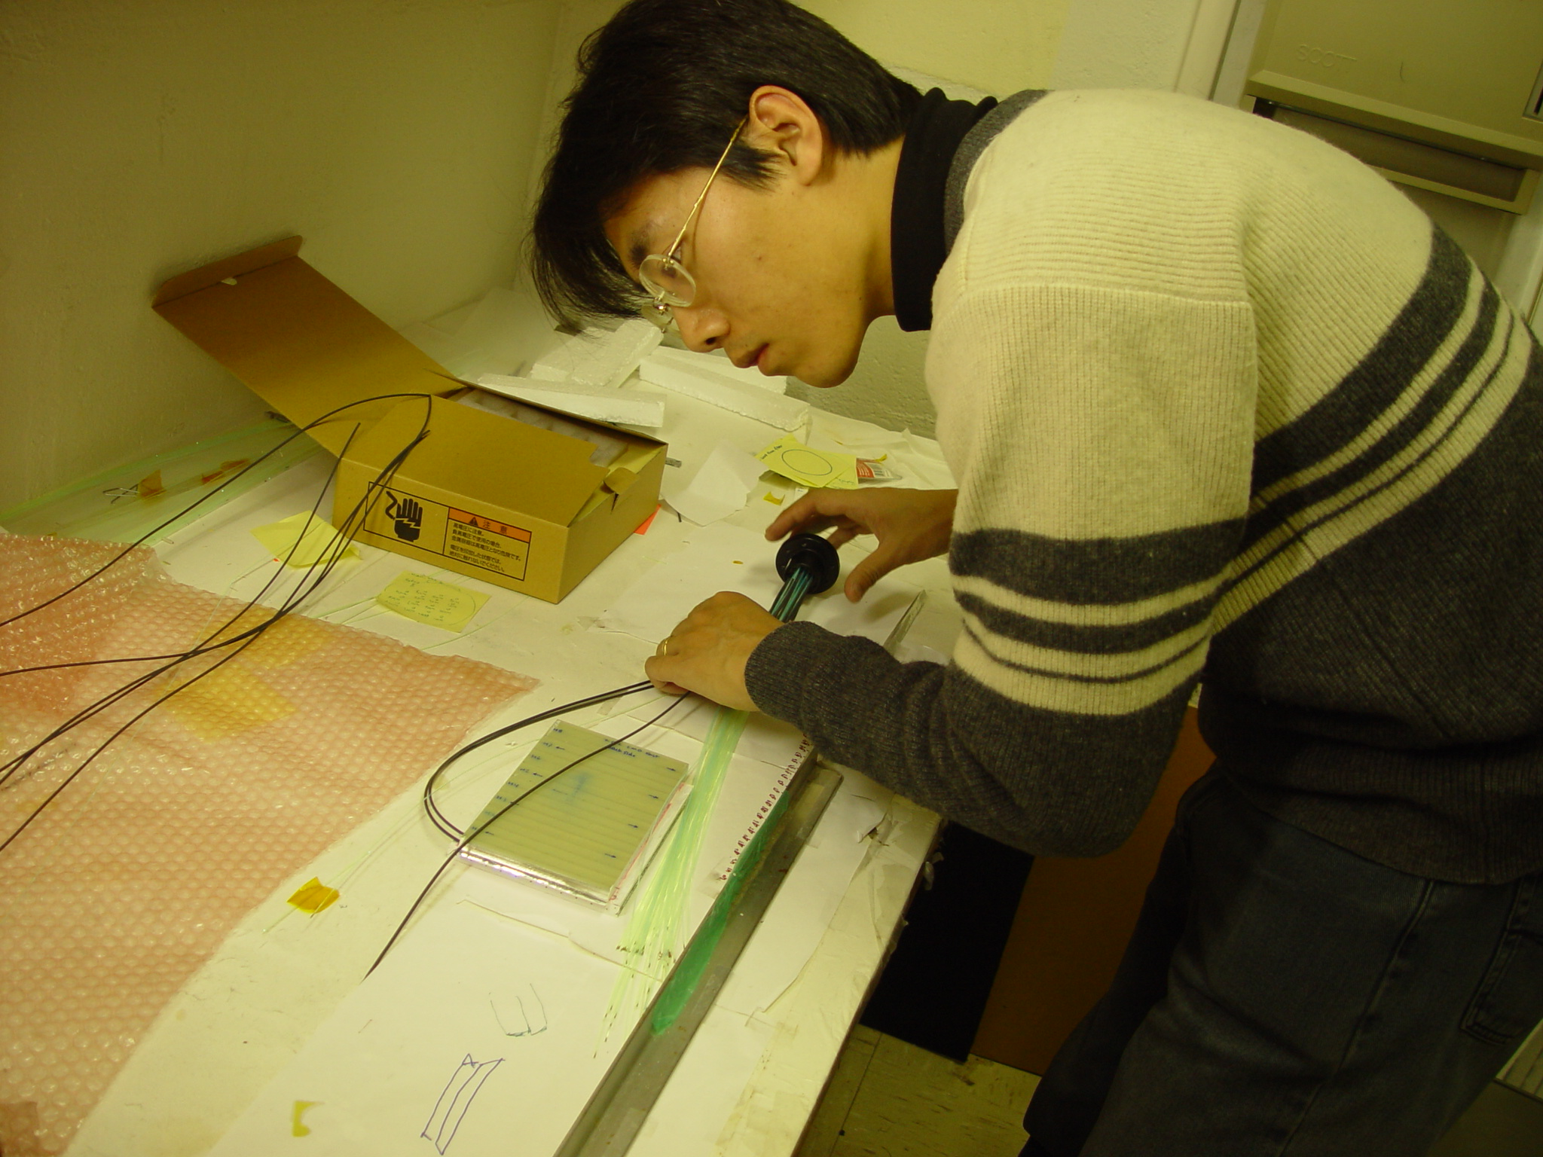
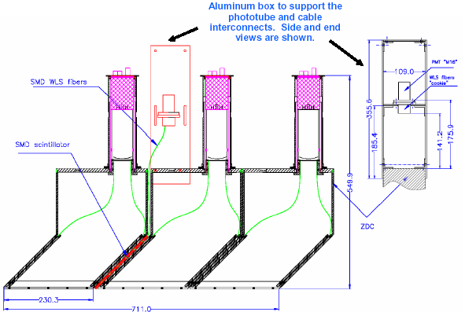
How to measure v₁
First-order event plane determined from spectator neutrons
Minimal, if any, non-flow effects
SMD is 8 horizontal slats & 7 vertical slats located at 1/3 of the depth of the ZDC
ZDC side view
Scintillator slats of Shower Max Detector
Transverse plane of ZDC
Assembling

Slide 10
v₁ in Cu+Au@200 GeV
  ψ_{E}: electric field direction
  d_{E}: electric dipole
On average, ψ_{E} is along the ψ_{RP} direction.
v₁(p_{T}) shows a difference between h⁺ and h⁻.
The sign is right.
The magnitude is 10% of what was expected.
The initial electric field does leave an imprint on final-stage particles!
Not all quarks are created in early times.
STAR, Phys. Rev. Lett. 118 (2017) 12301

Slide 11
More direct probe in B and ω
Non-zero angular momentum (~10³ ћ) transfers to Λ polarization
spin-orbit coupling
  spins of Λ and anti-Λ are both aligned with the angular momentum L
spin alignment by the B field
  Λ spin anti-aligned with B
  anti-Λ spin aligned with B

Slide 12
How to measure polarization
daughter protons prefer to go along Λ spin (opposite for anti-Λ)
ψ₁ from either ZDC-SMD or BBC
STAR, PRC 76 024915 (2007)

Slide 13
Λ global polarization
positive signals: vorticity!
initial L is larger at higher energies,
but longer lifetime and weaker stopping leave smaller signals.
STAR, arXiv: 1701.06657
I. Karpenko and F. Becattini, Eur. Phys. J. C (2017) 77: 213

Slide 14
Λ global polarization
positive signals: vorticity!
systematically,
P_{H}(Λ) < P_{H}(anti-Λ)
implying a B-field effect
for small polarization
F. Becattini et al, arXiv: 1610.02506
STAR, arXiv: 1701.06657

Slide 15
ω and B
vorticity
  ω/T ~ 2-10% (ћ=1,k_{B}=1)
  ω~ 0.02-0.09 fm⁻¹
  far surpasses other known fluids:
B field
  possible direct measure of B field, but consistent with zero
  need more statistics
STAR, arXiv: 1701.06657

Slide 16
CME observable: direct measurement?
A direct measurement of P-odd quantity “a” should yield zero.
There should be more out-of-plane charge fluctuation than in-plane.
Indeed, we see this effect,
which is on percent level!
PRC 88 (2013) 64911
Au+Au 200 GeV
RMS:
in-plane = 11.62
out-of-plane = 11.86

Slide 17
CME observable: γ correlator
S. Voloshin, PRC 70 (2004) 057901
A better way to quantify the extra charge fluctuation.
A few similar observables yield similar results
P-even quantity:
still sensitive to charge separation
background effects:
largely cancel out
Directed flow: expected to be the same for SS and OS

Slide 18
Charge separation signal
PRL 103(2009)251601;PRC 81(2010)54908;PRC 88 (2013) 64911
γ_{os} > γ_{ss}, consistent with CME expectation
Consistent between different years (2004 and 2007)
Confirmed with 1st-order EP (from spectator neutron v₁)

Slide 19
Short range correlations
200 GeV Au+Au: 40 - 60%
opposite charge in blue
opposite charge in blue
Phys. Rev. C 88 (2013) 64911
Shaded bands are systematic errors.
Prominent correlations exist at small Δp_{T} and Δη
Probably due to HBT+Coulomb

Slide 20
Modulated sign correlator (msc)
robust after removing HBT+Coulomb effects with kinematic cuts (Δη and Δp_{T})
γ weights different azimuthal regions of charge separation differently
γ is reduced to modulated sign correlator (msc) so that all azimuthal regions are equal
The charge separation signal is confirmed with msc
Phys. Rev. C 88 (2013) 64911

Slide 21
Charge-independent background
msc was splitted to study bg
N_{IN}(∆Q) stands for the number of events with ∆Q units of in-plane charge separation, and msc_{IN}(∆Q) stands for the <msc> in those events.
MEVSIM and -v₂/N tell us that the CI bg is likely due to momentum conservation + v₂
Phys. Rev. C 88 (2013) 64911

Slide 22
Charge multiplicity asymmetry correlator
count the charges of 4 regions
Phys. Rev. C 89 (2014) 44908
A similarly reduced correlator, CMA, observes a similar charge separation.
the CMA correlator (at least the opposite charge) is equivalent to MSC

Slide 23
Multi-particle charge-sensitive correlator
1 < p_{T} < 2 GeV/c
STAR preliminary
Multi-particle charge-sensitive correlator is used to measure charge separation (ΔS) relative to Ψ₂ plane
Concave for CME-driven charge separation;
flat or convex for all non-CME related backgrounds
Concave distribution observed in Au+Au

Slide 24
4 correlators
γ correlator
  easy to use and to correct for EP resolution
Modulated sign correlator (msc)
  reduced from γ
  not good for mixed PID
Charge multiplicity asymmetry correlator
  roughly equivalent to msc
  not good for mixed PID
  hard to correct for EP resolution
Multi-particle charge-sensitive correlator
  roughly equivalent to γ
  not good for mixed PID
  hard to correct for EP resolution
  have to compare with simulation to extract signal
In the following lectures, we stick to γ correlator.

Slide 25

Chiral Vortical Effect
correlate Λ–p to search for the CVE.
D. Kharzeev, D. T. Son, PRL 106 (2011) 062301

Slide 26
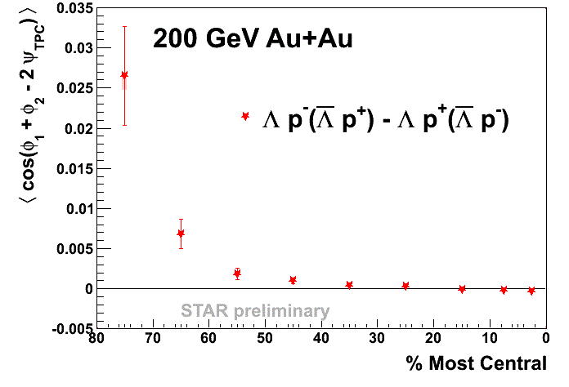
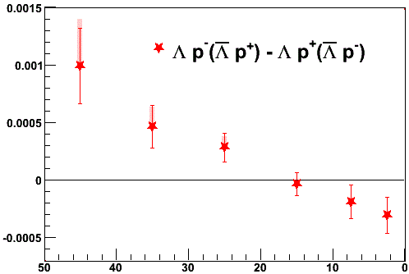
CVE observable
same baryon number:
opposite baryon number:
“same B” < “oppo B” in mid-central and peripheral collisions: consistent with the CVE expectation.

Slide 27

Summary
a long and winding road,
and still miles to go ...
but highlights here and there ...

Slide 28
Back-up slides

Slide 29
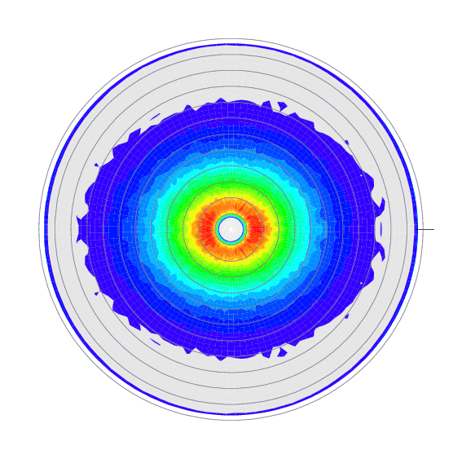
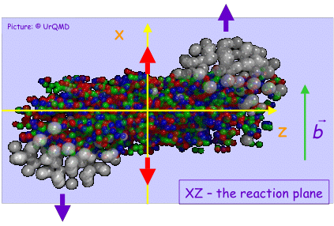
pt
Elliptic flow
Directed flow
Anisotropic flow
Higher harmonics
<px> or directed flow
rapidity

Slide 30
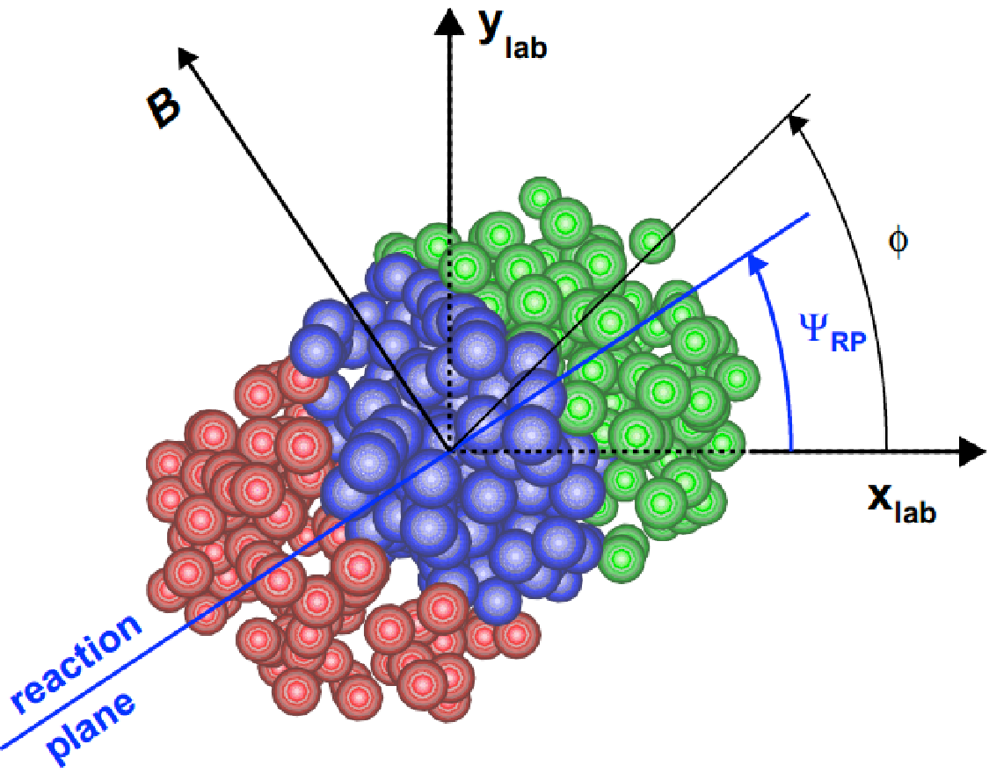
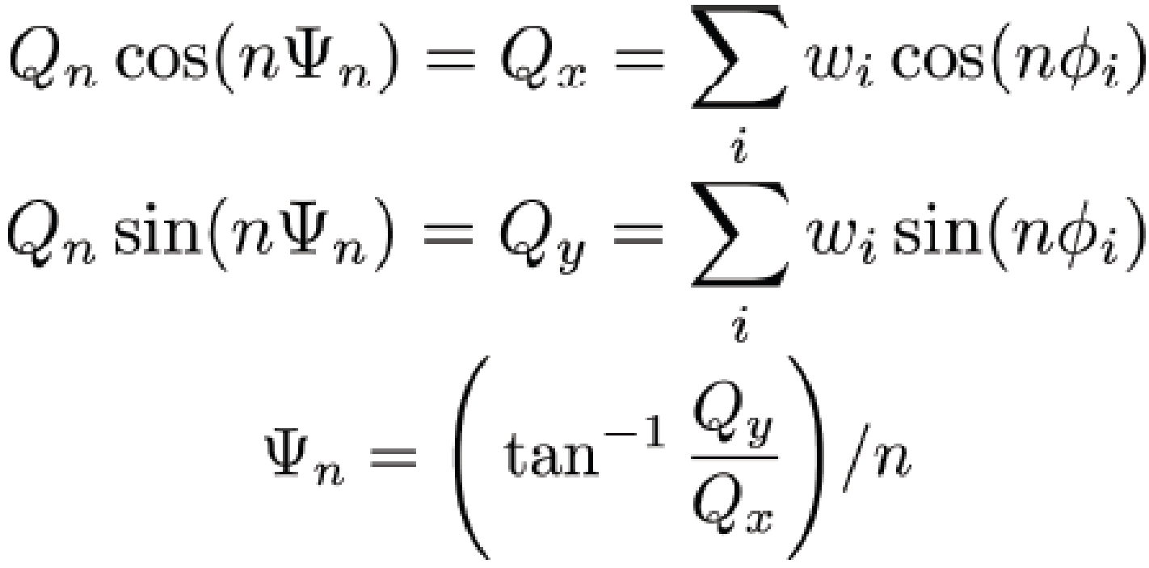
Event plane
before
The estimated reaction plane is called the event plane.
after

