Slide 1

Accelerating development of high-performance detector and imaging technologies for science and markets
Pablo Tello (CERN)
www.attract-eu.org

Slide 2
What is ATTRACT?
  ATTRACT is a new, open, pan-EU initiative to accelerate the development of high-performance detector (sensor) and imaging technologies for both scientific and industrial use.
  It involves European Research Infrastructures (ERIs), European research institutes and RTOs, small and medium enterprises (SMEs), companies, universities and business and innovation specialists.
http://www.attract-eu.org/

Slide 3
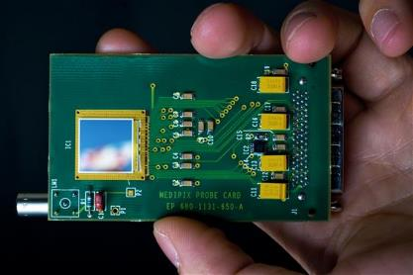
Focus on detection and imaging technologies
European Research Infrastructures (ERIs) - as well as the R&D communities associated to them - treasure an enormous and underexploited know-how on detection and imaging technologies.
Detection and Imaging technologies are at the core of future industrial developments applications and business.
Detection and imaging technologies allow for the emergence of fast innovators especially SMEs and Start-Ups.

Slide 4
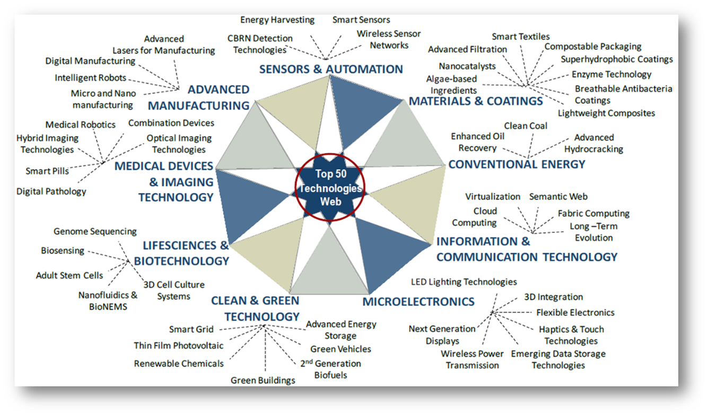
Detection and Imaging Markets
Frost & Sullivan Top 50 Technologies (TechVision 2020) estimate annual sensor & imaging market(s) at over 100 b$.

Slide 5

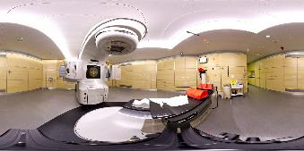

From technology to societal value for Europe
Detection and imaging technologies are and will be critical for the future of European competitiveness and jobs.
Key European industrial players will depend on them to achieve a competitive advantage.
Advances in technologies with direct social implications such as aeronautics, healthcare, automotive, urban development or energy and resource efficiency will depend strongly on them.

Slide 6
Why ATTRACT?
  There is a need from both ERIs and industry to make better use of the R&D platforms and co-develop path breaking innovations.
  The detector R&D community has many ideas of potential suitability of its technologies for other use, but often have limited contacts and mechanisms available to properly exploit this options space.
  Developing new technologies for both improved research capabilities and new applications could make good use of complementary, fertile R&D funding possibilities potentially offered by H2020 to further enhance R&D capacities.
  The European industry, in particular SMEs, find it difficult to tap into the necessary supporting (scientific) infrastructure offered by ERIs and associated labs to absorb and shorten time to money.
  SMEs, in turn, are often better equipped to interface towards MNEs than researchers.
  The European detector R&D community has the experience and expertise to help but there is no coordinated effort to assist them, while maintaining their primary research motivation.

Slide 7
How ATTRACT?
  The approach in ATTRACT is unique because:
    It is focused, technology domain-specific but touches industries and products worth over 100b$ per year.
    It is a bottom-up approach, scientific instrumentation development work being used as the engine of innovation.
    It is run as an international scientific collaboration or experiment, incorporating industry as partner.
    It engages cross-disciplinary involvement of young innovators and entrepreneurs.

Slide 8

Aligning with EU Research Infrastructures policy
H2020 aims to foster the innovation potential of research infrastructures.
This innovation potential should be realised in collaboration with industry and especially SMEs.

Slide 9
ATTRACT Is About Need to Create an Ecosystem…
New Scientific Instruments, Products, Services, Entrepreneurs, Jobs
Contributing to …
Innovation Management Platform
Connecting through …
Cross-disciplinary MSc-Student Teams
Engaging …
Industry (special attention to on SMEs)
Co-developing with …
Sensor & Imaging R&D Community With Ambitious Goals and Projects
Being driven by …

Slide 10
“Mini-ATTRACT” Phases 1 and 2
Phase 1
A wide scope of technologies with breakthrough potential (TRL 2 to 4). Plant the “Flowers”.
Selection process based on excellence (scientific merit, industrial scalability and social added value).
Phase 2
Scalability of Phase 1-selected technologies towards industrial deployment (TRL 5 to 9). Select and fund 10% of Phase 1 projects.
Construction and establishment of a self-sustained initiative (“Maxi” ATTRACT).
Preparing to repeat the “Flowers” in parallel.

Slide 11
Mini-ATTRACT Submission H2020 WP 16-17 Call
Core Consortium created to administrate the ATTRACT call(s), to be launched late 2017 or early 2018, depending if/when EC awards the INFRAINNOV-1-2017 call to ATTRACT.
18 ME will be redistributed in 100 kE grants, based on received and selected short, few-page proposals.
        Max 2 ME will be used for administrating the call(s).
Proposals selected by independent scientific advisory committee (IC; coordinated by S. Bertolucci).
Some 20 distinguished identified members, supported by reviewers selected by the members (but not made public).
Funded projects have 12 months to develop their ideas/prototypes for the next funding stage. They will present their findings in a Big event in Brussels.
An advisory comittee has been set up to prepare the way for “Maxi“ Chaired by Prof. J. Wood.

Slide 12
Funding “Mini-ATTRACT” Phases 1 and 2
Phase 1 (2017-2018): Research and Innovation Action (20 M Euros EC funding) with autonomy to launch open calls with the following objectives:
Identification of a wide spectrum of technology opportunities with breakthrough potential across the 28 EU Member States and Associated Countries.
Assessment of the feasibility and scalability of the identified opportunities.
Selection and clustering of those opportunities with potential for industrial implementation (transition towards Phase 2).
Phase 2 (2018-2019): Expected continuation call with autonomy to launch open calls with the following objectives:
Continuation with the selected opportunities from Phase 1 towards industrial applications having societal value.
Advancement towards a strategic model for a sustainable ATTRACT initiative.

Slide 13
Path Ahead for ATTRACT
2018
20 M Euros EC fund.
Seed funding of 180 breakthrough projects.
2025
Scale-up Public-Private
Capital Model
1
2019
4
Scale-up EC fund.
Private capital in place.
2
2020
Sustainable Public-Private
Capital Model
3

Slide 14
Thanks

