Slide 1

NXCALS Data Extraction and Analysis
with Apache Spark
Nikolay Tsvetkov
BE-CO-DS
Co-authors:
Jakub Wozniak
Marcin Sobieszek
Chris Roderick

Slide 2
CALS Architecture
Extraction Layer
Timber
Other Apps
> 6 000 000 extraction requests per day
1 890 000 variables (signals)
Extraction Servers
Extraction Servers
Persistence Layer
~ 100 TB
MDB
LDB
~ 650 TB
Providers Layer
Logging Process
Oracle
Logging Process
Scadar
QPSR
Logging Process
REMUS
Middleware
WinCC (PVSS)
29/05/2017
BE-CO
2

Slide 3
Storage Evolution
29/05/2017
BE-CO
3

Slide 4
NXCALS Architecture
Hbase
Last Data
Last Data
Kafka
HDFS
Log. Proc.
Data Access API
Other tools, APIs, etc.
Log. Proc.
Gobblin
Compactor
Data Ingestion
Data Extraction
Storage
Schema Partition
Provider
CCDB
29/05/2017
BE-CO
4

Slide 5


NXCALS Data Partitioning
HDFS
Compactor
Data Ingestion
Storage
Data Extraction
system/classifier/schema/date
Data stored in Parquet file format of records {f1,f2,…,fn}
  Accepts dynamic records of ANY content
  Represents a change of “state” in time for some “entities”
  Schema per entity CAN change over time
29/05/2017
BE-CO
5

Slide 6
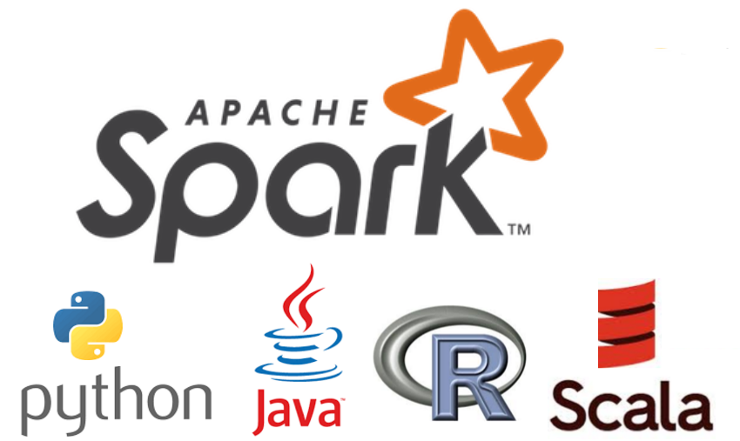
NXCALS Data Access API
Hbase
Last Data
Data Access API
HDFS
Other tools, APIs, etc.
Compactor
Data Extraction
Storage
Schema Partition
Provider
29/05/2017
BE-CO
6

Slide 7

DATA PROCESSING FRAMEWORK
Batch processing
GENERAL PURPOSE
Stream processing
Machine learning
EASY TO USE /comparing to MapReduce/
IN-MEMORY and fast /10-100x faster than MapReduce/
SCALABLE - increase the processing capacity by extending the cluster
FAULT TOLERANT – automatically handles failure of node in the cluster
29/05/2017
BE-CO
7

Slide 8







Spark High-level Architecture
Worker Node
Executor
Task
Task
Task
Worker Node
Driver
Cluster Manager
Executor
Spark Context
Task
Task
Task
Worker Node
Executor
Task
Task
Task
29/05/2017
BE-CO
8

Slide 9

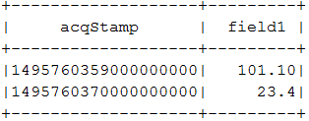
NXCALS PySpark example
>> query = DevicePropertyQueryBuilder().system("CMW") \
.device("BLM1").property("Acquisition") \
.start_time("2017-05-22 00:00:00.000") \
.end_time("2017-05-23 13:30:00.000").build_query()
>> df = spark.read.options(**query.get_map()) \
.format("cern.accsoft.nxcals.data.access.api").load()
>> df2 = df.select("acqStamp", "field1").where("field2 = 123")
>> df2.show()
29/05/2017
BE-CO
9

Slide 10
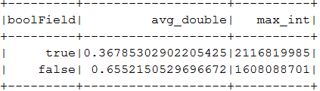
Spark DataFrame & SQL APIs
# Spark SQL example
>> df.createOrReplaceTempView("temp_table")
>> df2 = spark.sql(
"SELECT t.boolField, avg(t.doubleField) avg_double, max(t.intField) max_int " \
    "FROM temp_table t " \
    "WHERE t.acqStamp between 1495760359000000000 and 1495760370000000000“ \
    "GROUP BY t.boolField").collect()
# Spark DataFrame API
>> df2 = df.filter(df.acqStamp.between(1495760359000000000L,1495760370000000000L))\
.groupBy("boolField").agg(func.avg("doubleField").alias(‘avg_double’),\
func.max("intField").alias(‘max_int’))
>> df2.show()
29/05/2017
BE-CO
10

Slide 11
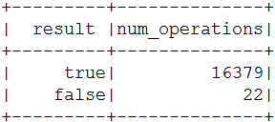
PySpark SQL JOIN example
>> query_bpm = DevicePropertyQueryBuilder().system("CMW") \
.device(“BPM1").property("Acquisition").start_time("2017-05-22 00:00:00.000") \
.end_time("2017-05-23 13:30:00.000")
.fields("cycleStamp", "floatField", "acqStamp", "doubleField").build_query()
>> df_bpm = spark.read.options(**query_bpm.get_map()) \
.format("cern.accsoft.nxcals.data.access.api").load()
>> df_bpm.createOrReplaceTempView("bpm_temp_table")
>> df2 = spark.sql(
"SELECT t1.boolField result, count(t1.boolField) cnt " \
    "FROM temp_table t1 JOIN bpm_temp_table t2 ON t2.cycleStamp = t1.cycleStamp " \
    "WHERE t2.floatField < 0.1 " \
    "GROUP BY t1.boolField")
>> df2.show()
29/05/2017
BE-CO
11

Slide 12
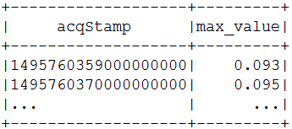
From Spark to Pandas data analysis
>> df2 = spark.sql(
"SELECT t.acqStamp, max(t.doubleField) max_value" \
    "FROM bpm_temp_table t " \
    "GROUP BY t.acqStamp")
>> df2.show()
# Collect to Pandas:
>>> pandas = df2.toPandas()
>>> pandas["max_value"].plot()
NXCALS User Guide: https://wikis.cern.ch/display/CALS/NXCALS+-+Data+Access+User+Guide
29/05/2017
BE-CO
12

Slide 13
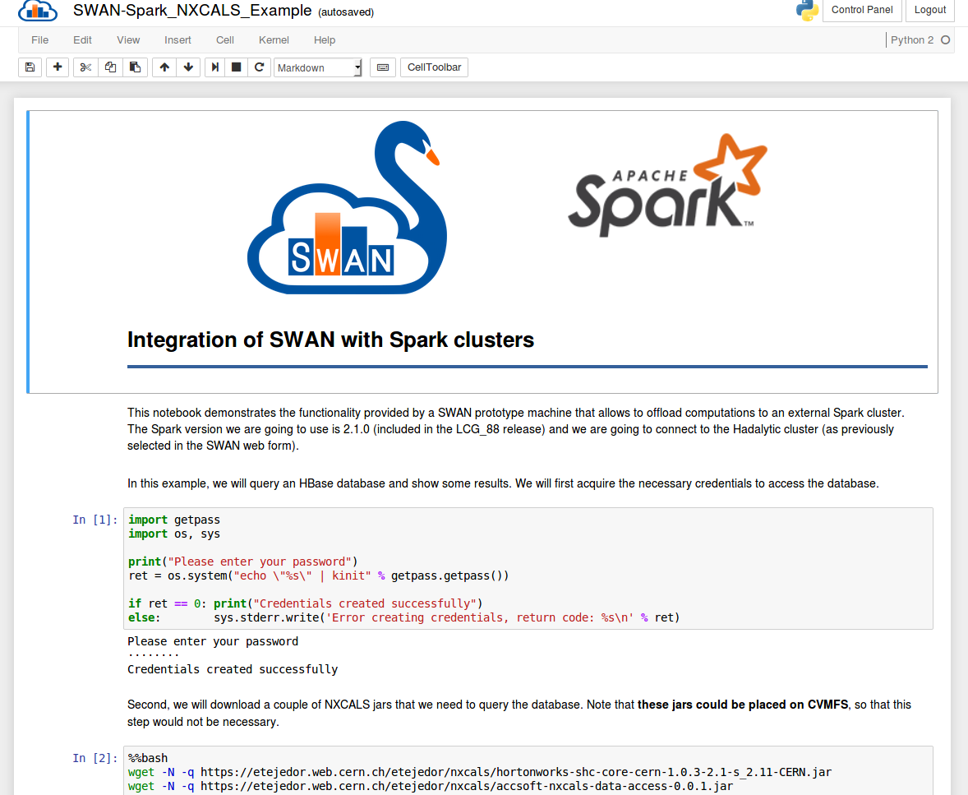
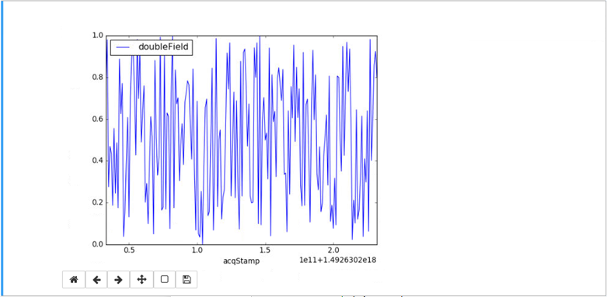
29/05/2017
BE-CO
13

Slide 14
NXCALS State?
Official dates : Ready by LS2 (Q1 2019)
  System development solid beta for Q1 2018
Data Ingestion Java API ready
  We store data from CMW devices
Data Access API with Spark first version ready
    Any Spark analysis on top of Spark DataSets
Python binding & SWAN integration
What comes next (for data extraction and analysis):
  Clients integration (business use-cases)
29/05/2017
BE-CO
14

Slide 15

Questions ?
E-mail: n.tsvetkov@cern.ch
29/05/2017
BE-CO
15

