Slide 1
Next Generation of
Post Mortem
Event Storage and Analysis
Serhiy Boychenko, on behalf of TE-MPE-MS
Databases Future Workshop, CERN
29/05/2017

Slide 2
Outlines
What is Post Mortem?
Why does it need improvements?
How the storage can be improved?

Slide 3
Outlines
What is Post Mortem?
Why does it need improvements?
How the storage can be improved?

Slide 4
Post Mortem for the Accelerators
The Post Mortem system allows the storage and analysis of transient data recordings from accelerator equipment systems
Post Mortem data is complementary to Logging data
Data buffers of shorter length (few seconds to minutes) are acquired with high frequency (KHz to GHz) around relevant events such as beam dumps, injection/extraction or powering events
Post Mortem data is vital for the analysis and understanding of the performance and protection systems of the machines
Correct transmission and storage of Post Mortem data has to be guaranteed with high reliability

Slide 5
Post Mortem Architecture
Courtesy:
Matthias Poeschl, Jean-Christophe Garnier

Slide 6
Post Mortem Use Cases
Event Name | Amount of Files | Dump Size | Frequency
Global | thousands of PMD files | hundreds of MB | several times per day
Powering | hundreds of PMD files | dozens of MB | several times per day
XPOC | hundreds of PMD files | couple of MB | several times per hour
IQC | ~30 PMD files | couple of MB | several times per hour
SPSQC | ~20 PMD files | ~250KB | few seconds intervals (every SPS cycle)
Variable file size: 1KB-12.7MB (compressed data)
Variable load: depends on the operation mode of the accelerators

Slide 7
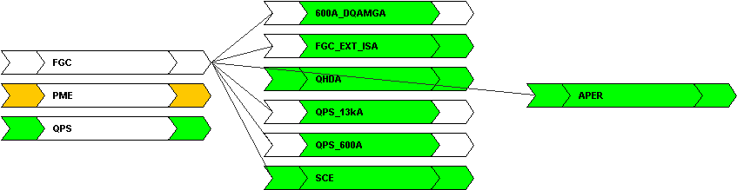
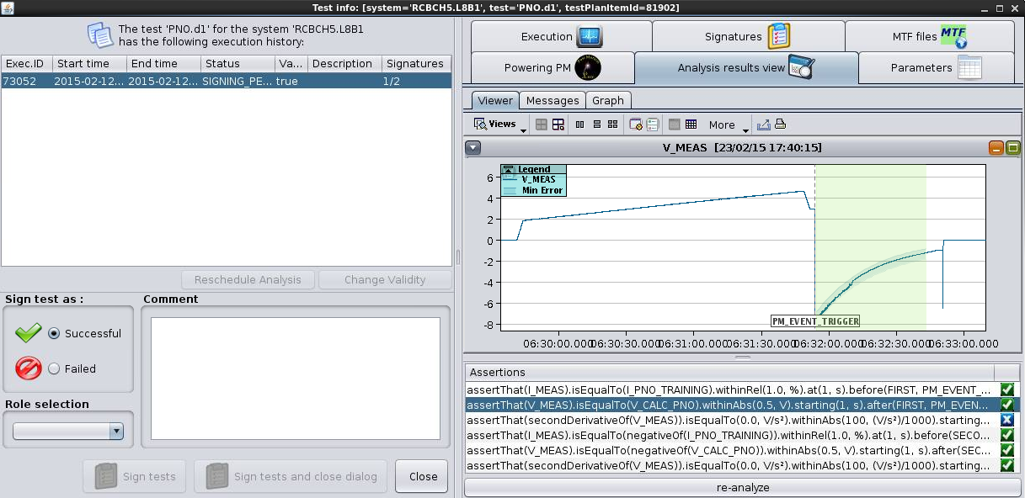
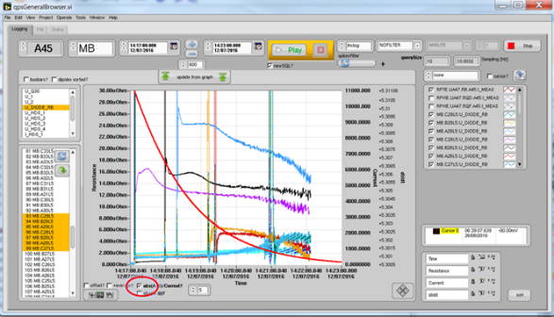
Post Mortem Users
Continuously used during
operation cycles for validation
of accelerator safety
Essential source of the data for
analysis orchestrated through the
AccTesting framework (mostly
during hardware and beam
commissioning phases)
Many users access PM data for
ad-hoc queries through LabView
or other data analysis tools

Slide 8
Post Mortem in Numbers
Operating since 2008 (originally proposed in 2002)
Deployed on 3 nodes (2 storage nodes with RAID1+0, 1 analysis node with 24 GB of RAM for in-memory processing)
Storage already contains 20+ millions files (raw data, event data and analysis results)
Total storage size to data is in the order of ~10TB
Frequent traffic bursts ~1.0MB/second (incoming) and ~12MB/second (outgoing)

Slide 9
Outlines
What is Post Mortem?
Why does it need improvements?
How the storage can be improved?

Slide 10
Shortcomings
Static load distribution
Data consistency and integrity
Limited Write performance in case of simultaneous events
Direct data access to raw data storage via NFS
Decentralization (CALS + PM integration)

Slide 11
Requirements
Backward compatibility for all users
Horizontal scalability
High level of reliability for data ingestion
Flexibility for integration of the new the new use cases/extensions to additional accelerators

Slide 12
Outlines
What is Post Mortem?
Why does it need improvements?
How the storage can be improved?

Slide 13
The New Architecture
Courtesy:
Matthias Poeschl, Jean-Christophe Garnier

Slide 14
Data Retrieval Layer - PM REST API
Abstract storage implementation details from users (potential for common API with CALS)
  Intend usage of cache for increased performance for low latency use-cases (IQC, XPOC) and to unload data storage layer
Enable access to the data using standard serialization formats
Provide advanced data filtering capabilities
Enhance the data retrieval layer with scaling and load-balancing features
Detailed monitoring of the Post Mortem system usage
Already up and running! (http://pm-api-pro.cern.ch/)

Slide 15
Data Collection Layer
Support dynamic load distribution
Enable horizontal scalability
Increase service maintainability and availability
Provide multiple and pluggable protocols for data collection
Kafka architecture studied by CALS team is an option (research is ongoing)

Slide 16
Data Storage Layer
Distributed storage solution
High availability with advanced fault tolerance
Consistency ensured by underlying implementation
Flexibility to support different file formats
High throughput and low latency
Research is mostly finished. Developments are being planned.

Slide 17
Data Storage Layer
Serialization format study
  Multiple serialization formats have been studied: JSON, BSON, Avro, …
  Multiple compression techniques evaluated: Deflate, Gzip2, Snappy, xz, …
  Avro was presenting the best results with Deflate
Storage solution evaluation
  Multiple storage systems were compared using representative sets of PM data: CEPH, MongoDB, HDFS, GlusterFS
  GlusterFS was performing best for separated write/read workloads
  CEPH was performing best for mixed workloads, especially with small files

Slide 18
NEXTGEN CALS Integration
Low latency use cases (IQC, XPOC, SPSQC) still prevent the full integration with NEXTGEN CALS infrastructure
Very small file size (in large quantities) might impact the query execution time significantly
Remaining use cases, data collection, storage and retrieval API might be shared to provide the user the best possible data

Slide 19
Thank you for attention!
Questions are welcome!
Besides the authors stated in INDICO, additional credit goes to former members of the team:
Mateusz Koza, Roberto Orlandi, Matthias Poeschl.

