Slide 1
Kafka
Lionel Cons – IT/CM/MM
Database Futures Workshop (29-30 May 2017)
Notes:
https://indico.cern.ch/event/615499/

Slide 2

What is Kafka?
tagline: “a distributed streaming platform”
originally developed by LinkedIn
written in Java and Scala
open sourced in 2011
Apache but with a company behind: Confluent
used by: LinkedIn, Netflix, PayPal, Spotify, Twitter…
Database Futures Workshop (May 2017)

Slide 3
What is a Streaming Platform?
key capabilities:
      publish and subscribe to streams of records
      store streams of records in a fault-tolerant way
      process streams of records as they occur
main uses:
      data pipelines that reliably get data between systems
      applications that transform or react to the streams of data
Database Futures Workshop (May 2017)

Slide 4
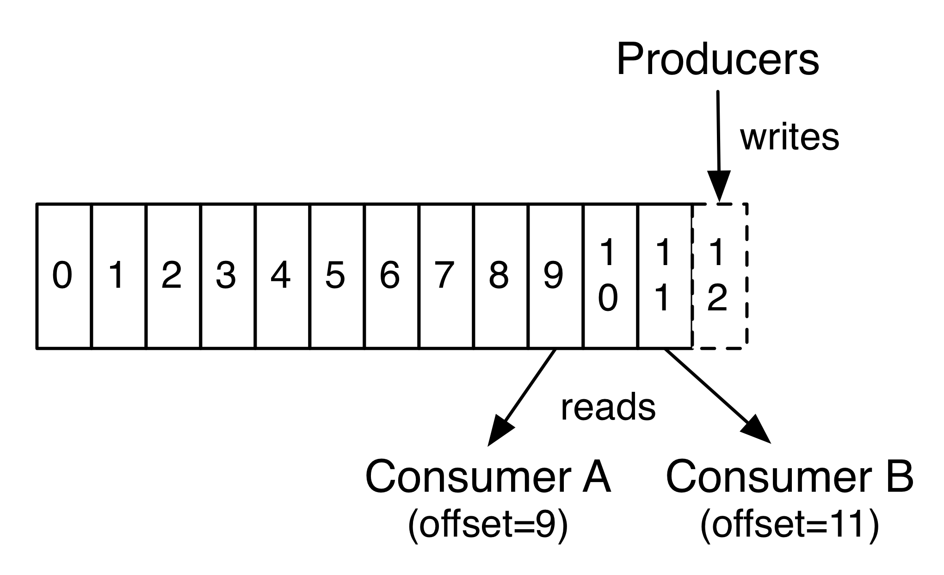
How does it work?
producers add data to append-only topics
consumers access data using indexes
data retention is based on time or size
Database Futures Workshop (May 2017)

Slide 5
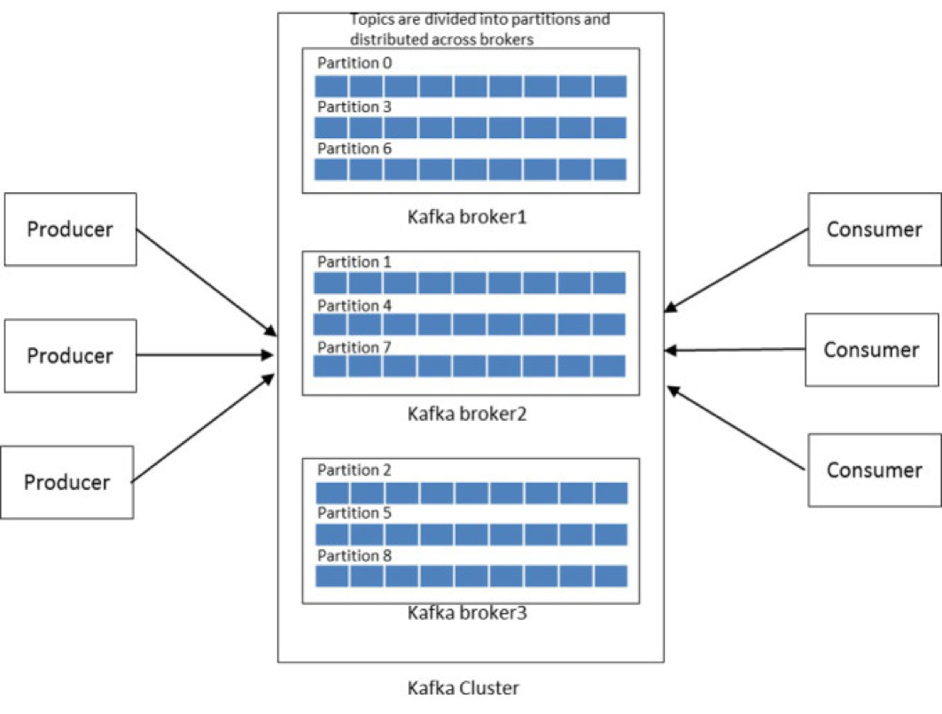
How does it work?
topics can be replicated (fault tolerance)
topics can be partitioned (scalability)
partitions are distributed amongst brokers in a cluster
Database Futures Workshop (May 2017)

Slide 6
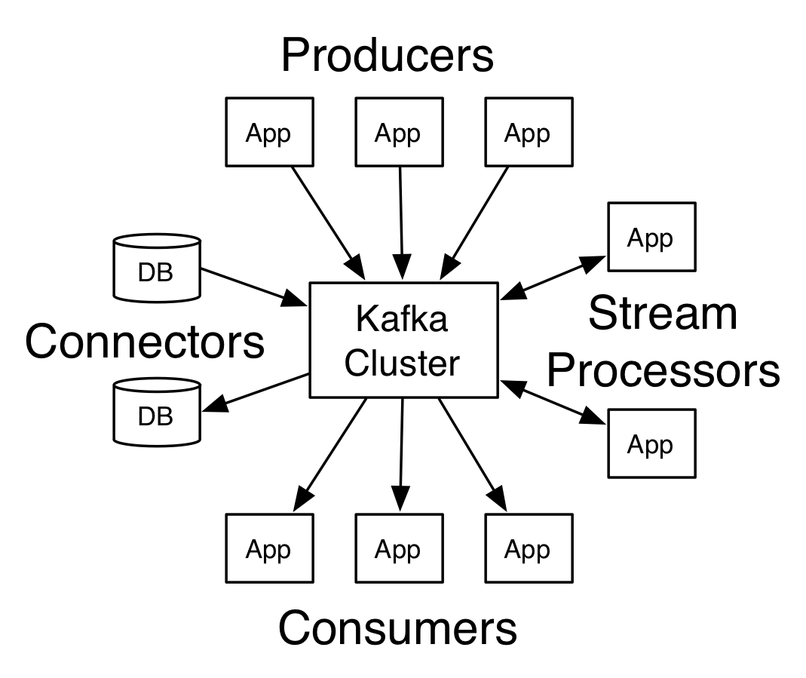
How to use Kafka?
client APIs: C/C++, Go, Java, Python…
agents: Camel, Flume, Logstash…
processing frameworks: Gobblin, Spark, Storm…
connectors: ElasticSearch, HDFS, JDBC…
Database Futures Workshop (May 2017)
Notes:
https://kafka.apache.org/documentation/#api: Producer, Consumer, Streams and Connect

Slide 7
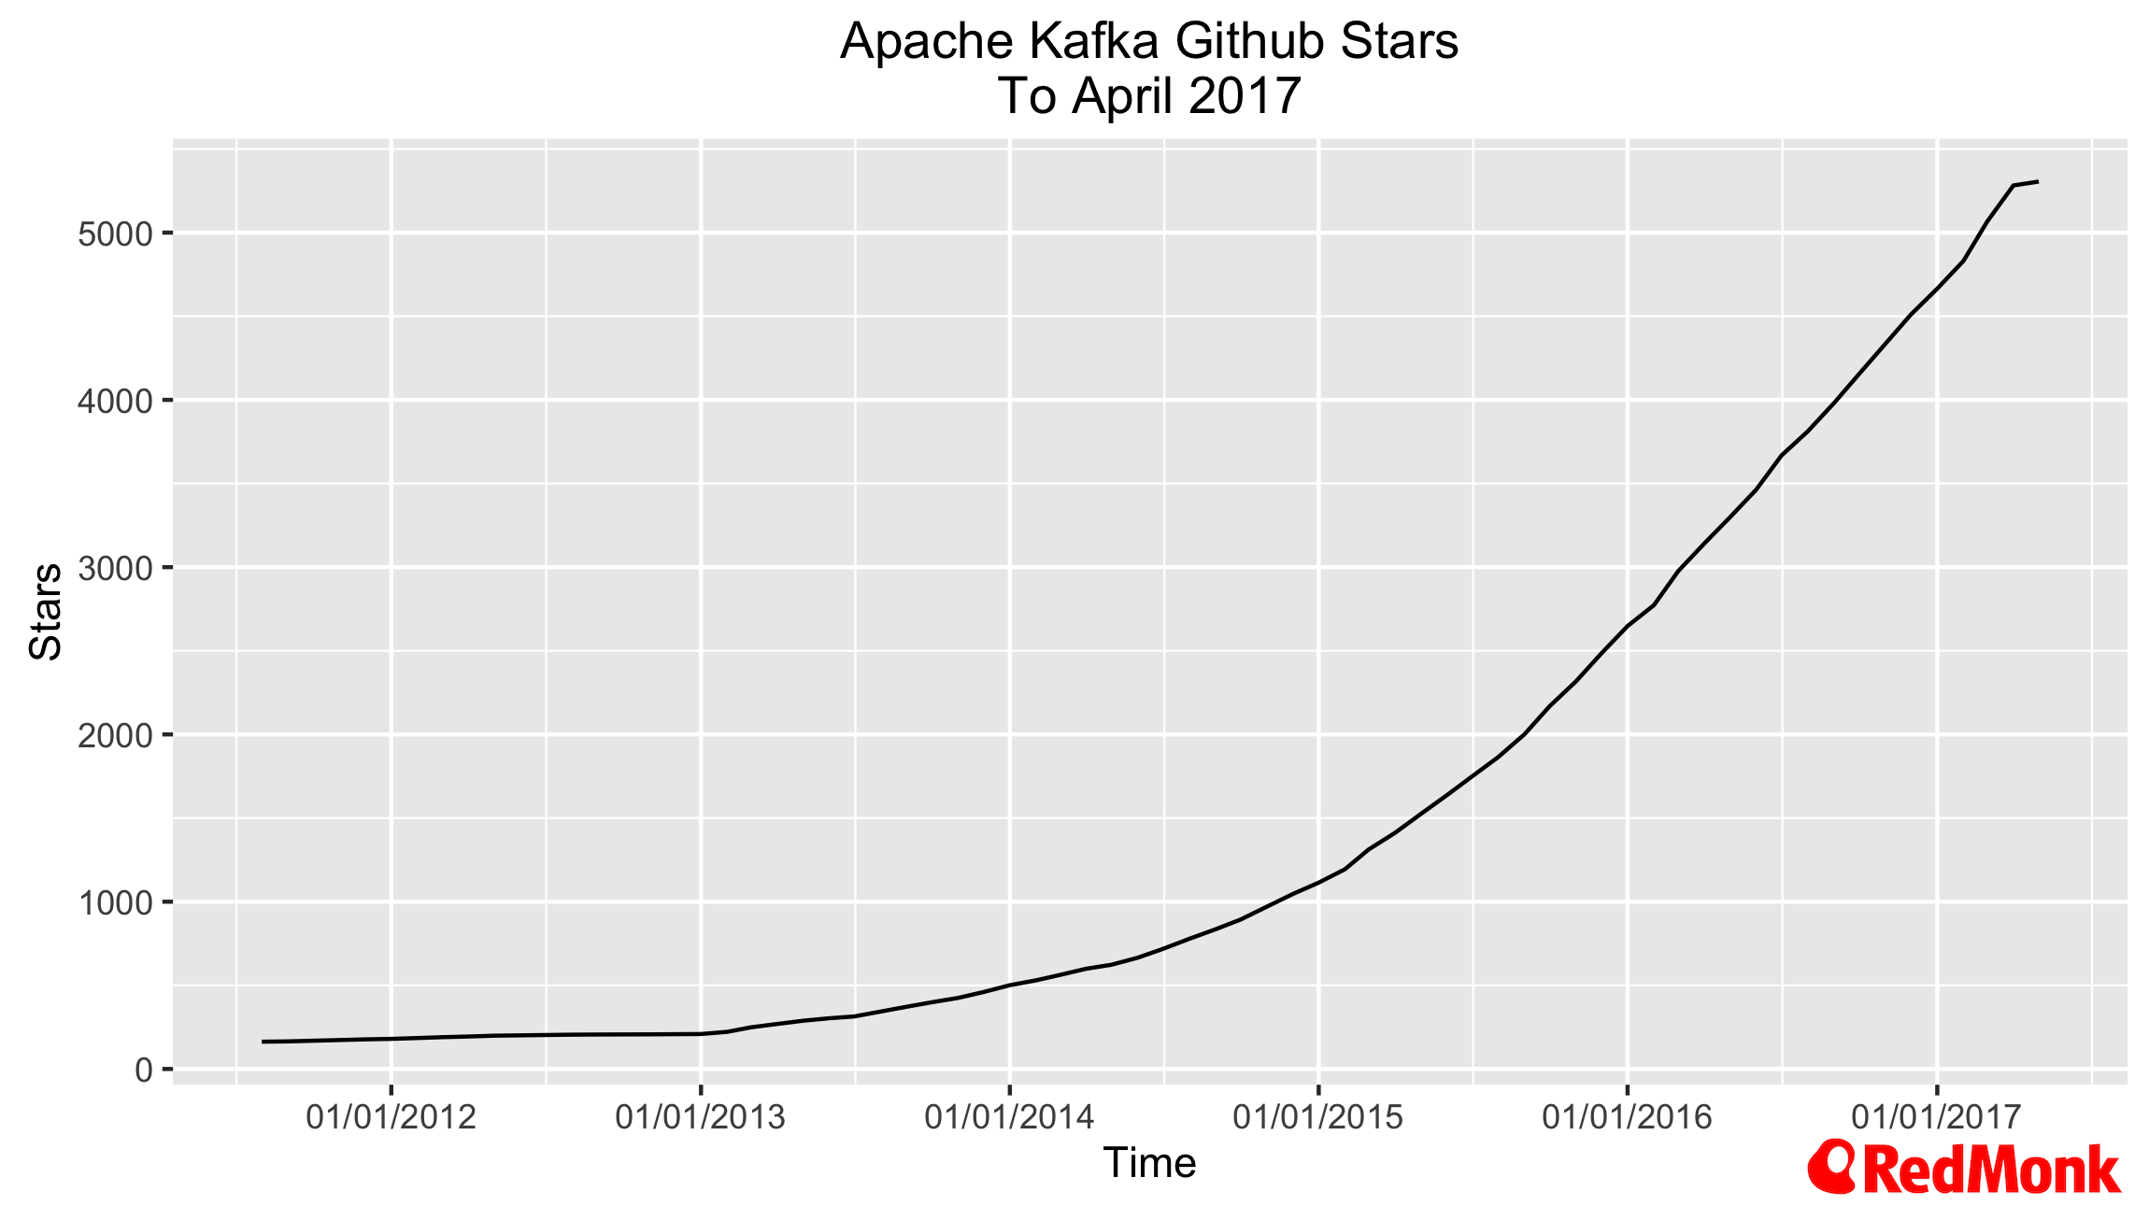
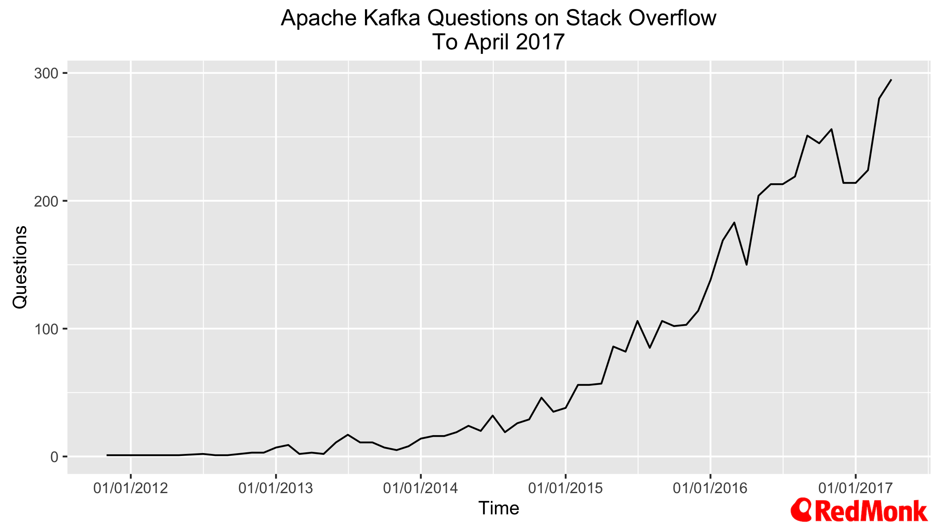
Kafka Popularity
Credit: Redmonk
Database Futures Workshop (May 2017)

Slide 8
Kafka Pilot Service
joint collaboration between IT-CM and IT-DB
on-demand service approach
dedicated or shared clusters depending on use case
best effort support
service documentation and user guide:
http://cern.ch/nile-user-guide/
Database Futures Workshop (May 2017)

Slide 9
Kafka Pilot Service Features
different hardware configurations:
  physical or virtual machines
  local (SSD), NetApp or Ceph storage
security: Kerberos and SSL
monitoring
cluster management: REST API and web interface
evaluation of Kafka mirroring for higher availability
Database Futures Workshop (May 2017)

Slide 10
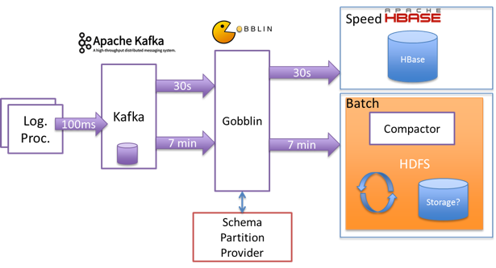
Kafka Pilot Service Use Case: CALS
Credit: BE-CO-DS
Database Futures Workshop (May 2017)

Slide 11
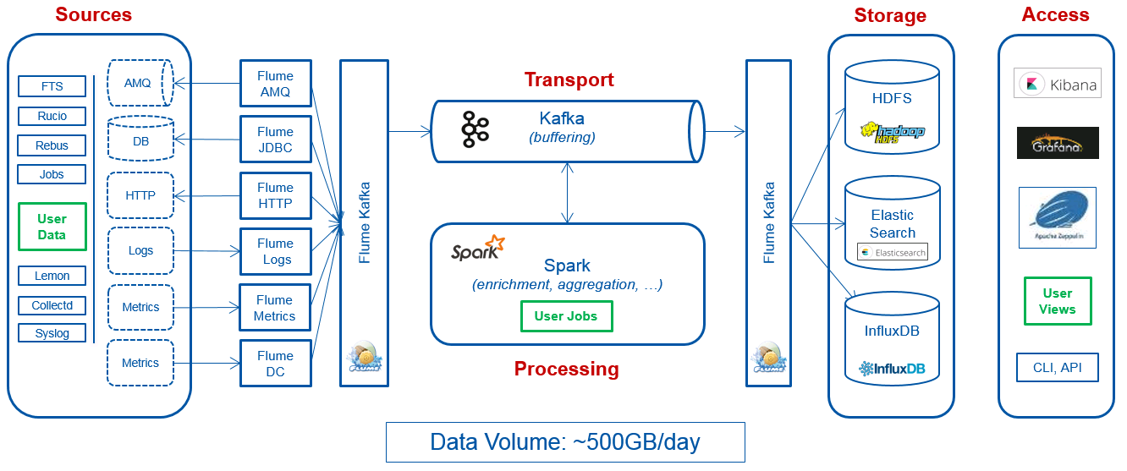
Kafka Pilot Service Use Case: MONIT
Credit: IT-CM-MM
Database Futures Workshop (May 2017)

Slide 12
Kafka Pilot Service Status
currently in testing phase
3 users so far: CALS, MONIT and security team
open for new use cases: contact us!
hope to finish testing by Q2 and have a production service by Q3
Database Futures Workshop (May 2017)

Slide 13
For more information
Apache Kafka:
https://kafka.apache.org/
pilot service documentation:
http://cern.ch/nile-user-guide/
pilot service team:
it-db-nile-admins@cern.ch
Database Futures Workshop (May 2017)

