Slide 1
Simulation of X-Z Coherent Instability in FCC-ee @ 45.5 GeV Using Quasi-Strong-Strong Model
Dmitry Shatilov
BINP, Novosibirsk
47th FCC-ee Optics Design Meeting
CERN, 24 February 2017

Slide 2
Preamble
X-Z coherent instability was discovered by K. Ohmi in strong-strong simulations and first reported at FCC Week in Rome, April 2016.
In September 2016 I also tried to reproduce this instability in quasy-strong-strong simulations. The first results were “positive”: the instability was observed. Then I found a logical bug in the model, and after fixing it the instability “disappeared”.
The instability “appeared” again after updating the model, which now accounts not only “crabbing” of the opposite bunch, but also its complicated shape in X-Z plane. This was done in December 2016. In the next two months the code efficiency for such specific simulations was increased by about one order of magnitude.
The main issues to be discussed
The model. How it is possible that weak-strong simulations are capable of observing coherent instability?
Examples of simulation results, some observations.
The model for optimization. First attempts to overcome the instability.
The “what to do” list for the next week (and further).

Slide 3
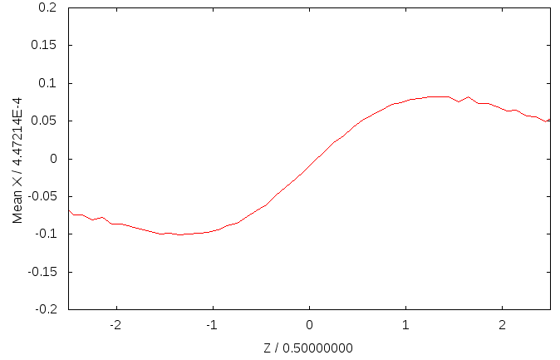
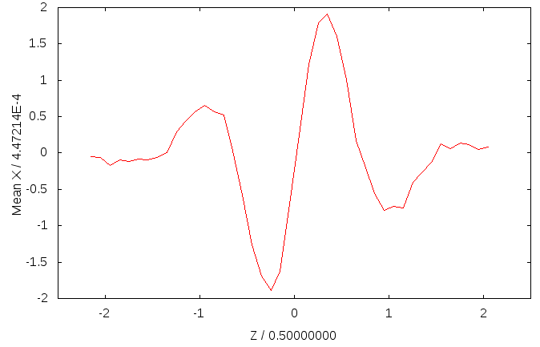
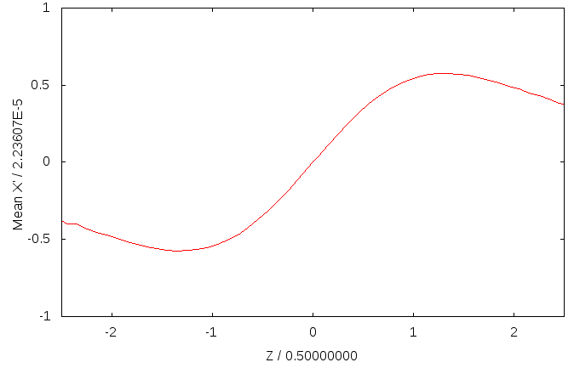
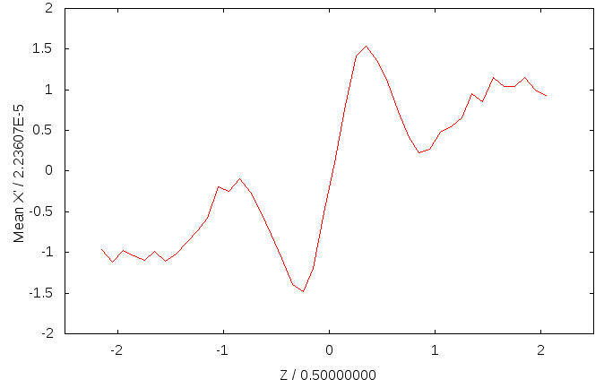
Bunch Shape in X-Z Plane
ν_{x} = 0.55, β_{x} = 20 cm, σ_{z} = 0.5 cm, N_{p} = 4⋅10¹⁰
Weak-strong (steady state) Strong-strong (one turn, evolved instability)
Crabbing angle (mrad):
0.05 (from <XZ>)
0.10 (from slope)
Crabbing angle (mrad):
0.04 (from <XZ>)
9.0 (from slope)
Px /σ_{px} vs. Z/σ_{z} X/σ_{x} vs. Z/σ_{z}

Slide 4
Discussion (1)
The transverse shift of slices during the interaction is small as compared to the “initial” slice offset (disruption parameter is small). So, we may consider the bunch shape “frozen” during collision time. This allows to use weak-strong simulation technique, but the opposite bunch shape should be updated every turn => quasi-strong-strong model.
In this model there are no “wakes”. The head and tail oscillates somehow “synchronously”, but they are equal. There is no preferred direction. That is why the name “head-tail” does not seem quite appropriate for this instability.
Observation of bunch crabbing from <XZ> values can be useful to detect the instability, but the actual crabbing of the center of bunch can be mu-u-u-uch larger. That is why a simplified model (straight bunch shape with altering crab angle) failed to see this instability.

Slide 5
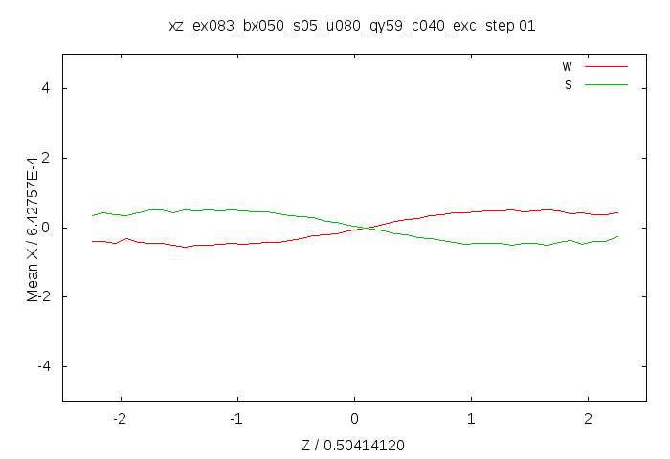
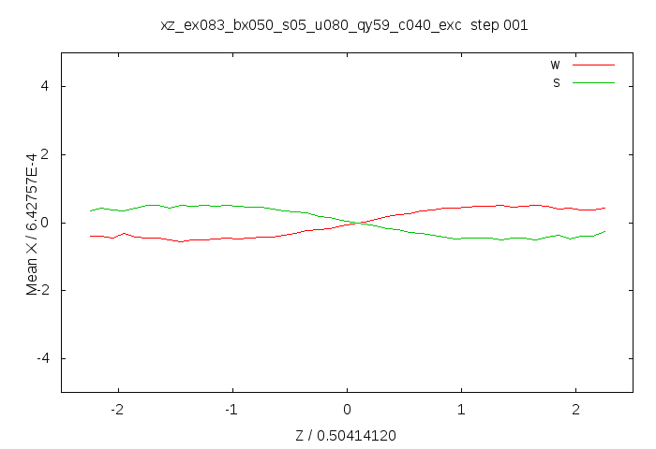
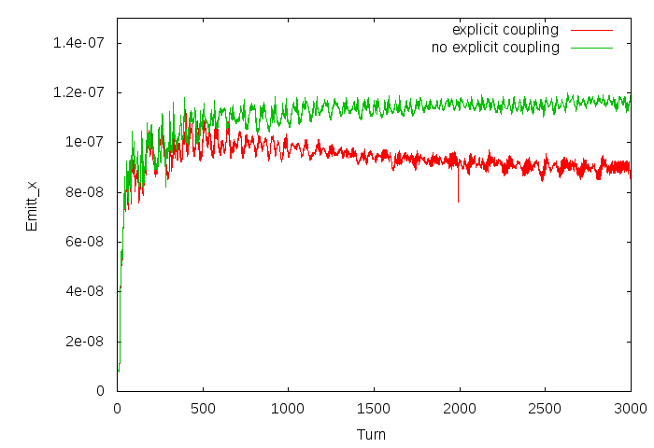
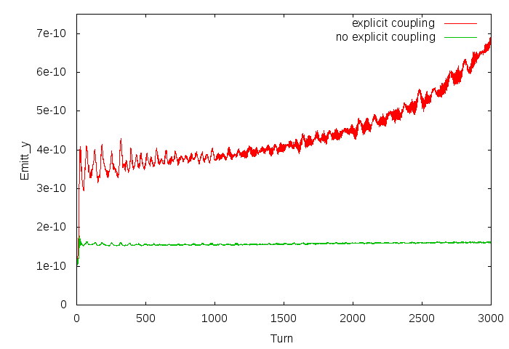

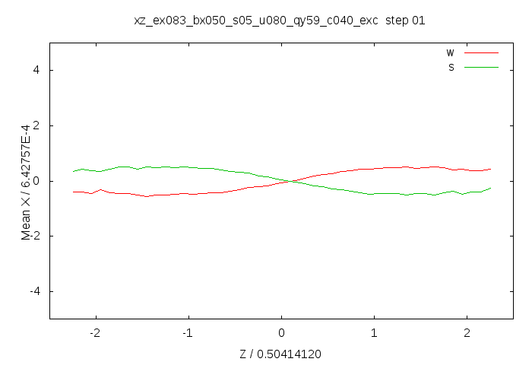
Another Example
ν_{x} = 0.54, β_{x} = 50 cm, σ_{z} = 0.5 cm, N_{p} = 4⋅10¹⁰
Emitt_x (cm) Emitt_y (cm)

Slide 6
Discussion (2)
The luminosity is affected mainly by the vertical emittance growth due to explicit betatron coupling and the horizontal emittance blowup. Therefore, we must stay below the threshold of this instability.
The instability itself is 2D, it does not depend on the vertical dimension. Thus, to perform optimization, we may use a simplified model without explicit coupling.
Furthermore, to simplify the task, we temporarily turned beamstrahlung OFF to get rid of σ_{z} dependence on the other parameters.
The parameters to be optimized: β_{x}, ν_{x}, ε_{x}, σ_{z}, ν_{z}, N_{p}. The main goal is to understand how the threshold of this instability can be raised. After that we should turn beamstrahlung ON to find a self-consistent solution.
It was clear from the very beginning that decrease of β_{x} helps. Our goal should be to keep β_{x} not too small (e.g. ≥ 20 cm) and adjust the other parameters in order to obtain maximum luminosity, while it is below the instability threshold.

Slide 7
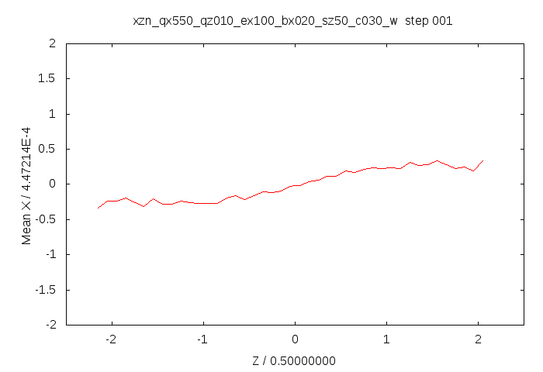
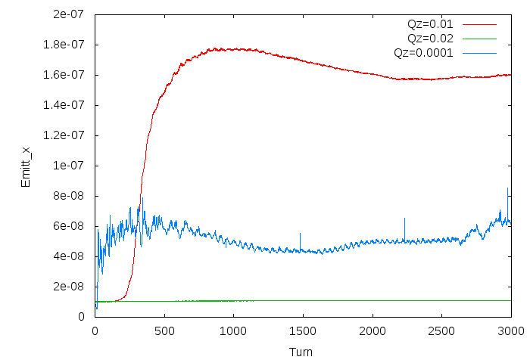

Dependence on ν_{z}
ν_{x} = 0.55, β_{x} = 20 cm, σ_{z} = 0.5 cm, N_{p} = 3⋅10¹⁰
When changing ν_{z}, ν_{x} should be adjusted to avoid synchro-betatron resonances, which are very strong for collision with large Piwinski angle. The instability still exists when ν_{z} = 0.0001.
We need to increase ν_{z} without decreasing σ_{z} => increase the momentum compaction!
Another reason for α increase: microwave instability due to resistive wall, as reported by M. Migliorati and M. Zobov.
One more reason: polarization issues, as required by I. Koop.
How? For example, combining the arc cells. This also affects ε_{x}, but if it is increased from 83 pm to ~300 pm, we still should be able to keep ε_{y} within 1÷1.5 pm.

Slide 8
What to do next week (and further)
Cross check the results of Lifetrac and BBSS (by K. Ohmi). Make sure that we see the same phenomenon.
Understand how much α can be increased, what will be ε_{x}, then try to optimize (or relax?) the other parameters.
Turn beamstrahlung ON and find self-consistent solution.
Lattice and DA optimization for the new set of parameters (K. Oide ?).
Explicit coupling, test for 3D flip-flop (decrease of β_{x} helps!).
Cross check the final results with BBSS.

