Slide 1
LEP Polarimeter Recap
J. Wenninger

Slide 2
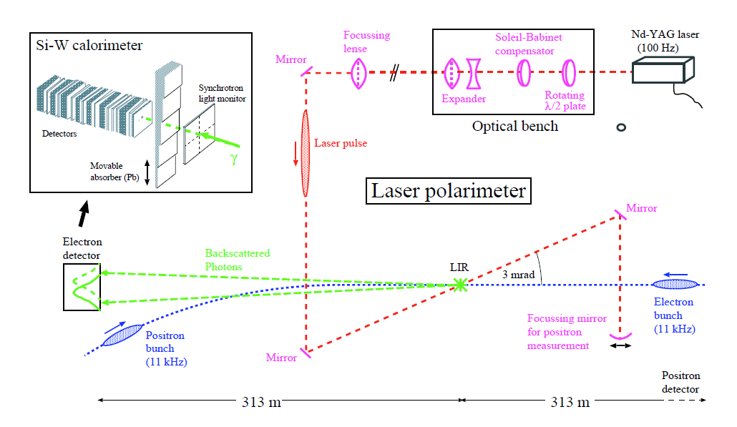
LEP polarimeter layout
240 m
390 m
The LEP polarimeter was upgraded to higher power and for e+ measurements in 1993.
  Operation with e+ difficult due to issues with the in-vacuum mirrors and vibrations.

Slide 3
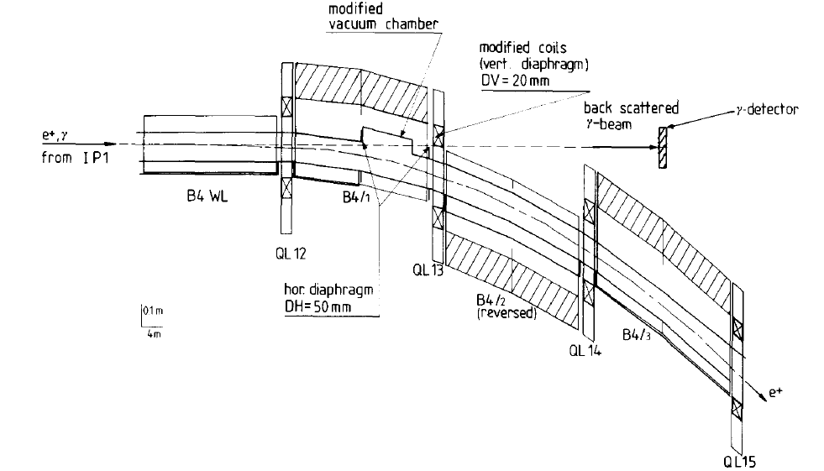
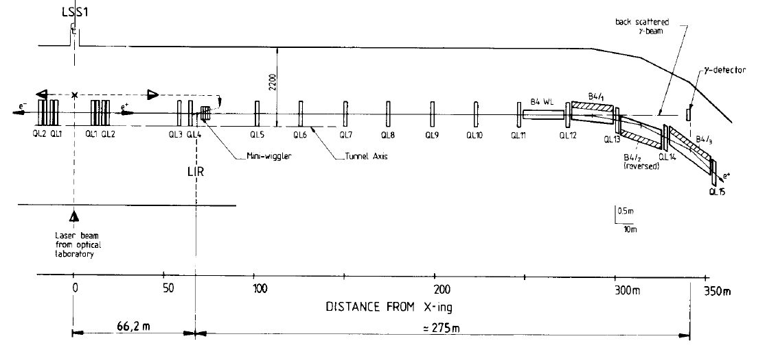
LEP polarimeter layout
The backscattered Compton photons were extracted at the entrance of the arc (Al window in the vacuum chamber ~ 50 x 25 mm²).
  Note that the layout was actually reversed (design drawing !).
  β functions at LIR (Laser-beam IR) ~40-120 m, beam sizes ~0.4 -1 mm.

Slide 4
Laser
For the 1993 LEP run a more powerful laser was installed:
NdYag laser operated at 100 Hz.
  In reality two 50 Hz lasers with a single cavity. A pair of lamps+rods were pulsed alternatively (each at 50 Hz).
Pulse energy 125 mJ → ~4000 Compton photons per pulse (45 GeV).
Pulse length ~5 ns for a bunch length of ~1-2 cm (~30-60 ps).
  Angle of 3 mrad between laser and beam – luminosity loss of ~10 due to the crossing and laser+beam parameters.
Circular polarization flipped every other pulse.
With best overlap of laser & beam spots, the beam lifetime of target bunch could go down to ~4-6 hours.
  The laser could aim at one bunch at a time, flip from one bunch to the next in a fraction of a second.

Slide 5
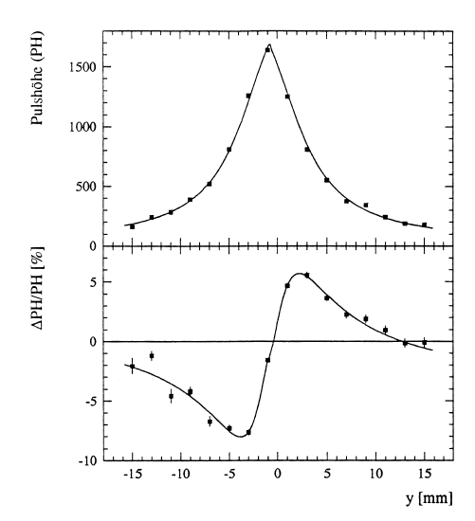
Detector
Si-strip detectors with 2 mm wide strips, 32 mm total detector width.
Typically ~2 RL of Tungsten in front of detectors.
Horizontal & vertical profiles available, ~ 5 mm rms wide.
Position of photon beam in the detector stabilized with a FB on the beam angle at the laser IR.
  Manual re-steering of beam position if pulse height dropped (too much)
Sensitivity @ detector: Δy = S x P
  Simulation : S = 5.4 ± 1μm / %
  Measured : S = 4.4 ± 0.2 μm / %
  Δy = 440 μm for 100% polarization
  Difference due to laser polarization ~85%.
Profile asymmetry for the 2 helicities of the laser
P = 57%

Slide 6
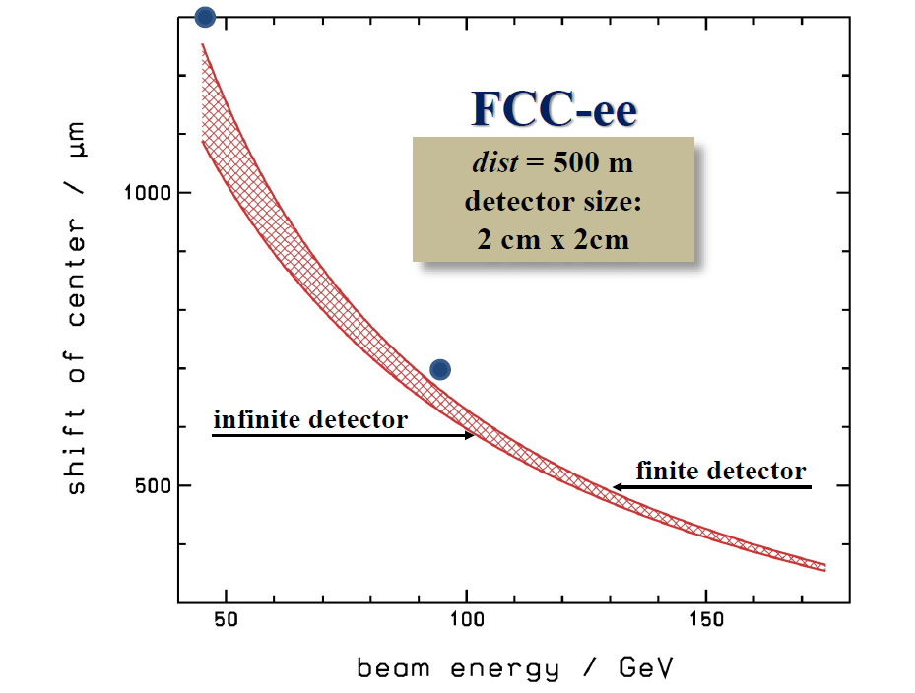
Comparison with simulation
The LEP polarimeter sensitivity scaled to a distance of 500 m (linearly) is in line with the simulations presented by Wolfgang at the last meeting (9.2.2017) → dominated by the geometry (beam optics plays a minor role).
LEP (simulated)
LEP (achieved
Including laser pol.)

Slide 7
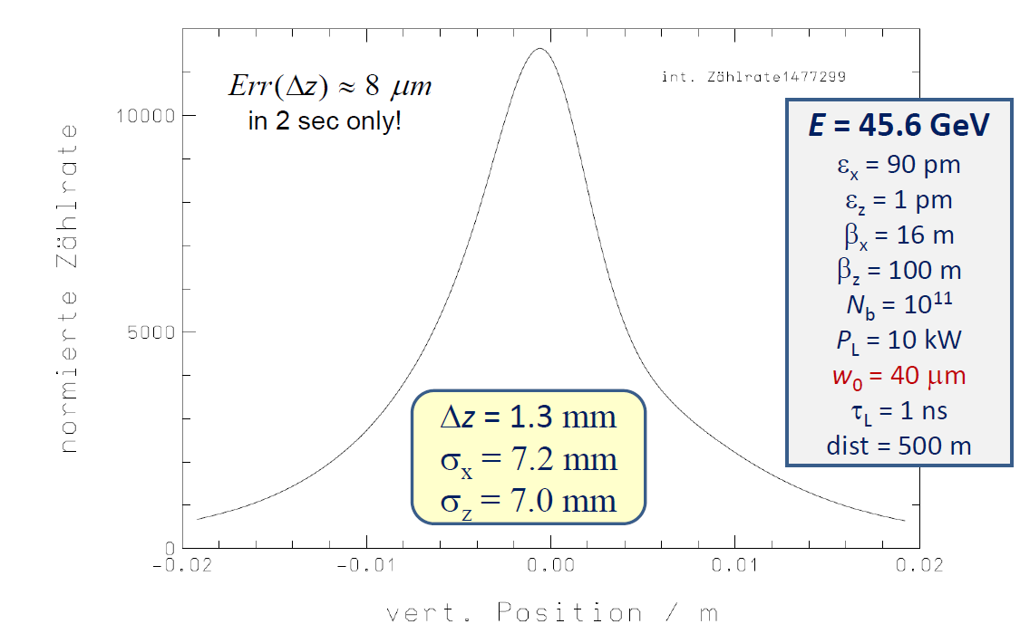
Comparison with simulation
The profile FWHM for the simulation (Wolfgang, 9.2.2017) and the LEP actual data also agree well !
~8 mm
~8.5 mm
= 10 μJ / pulse?

Slide 8
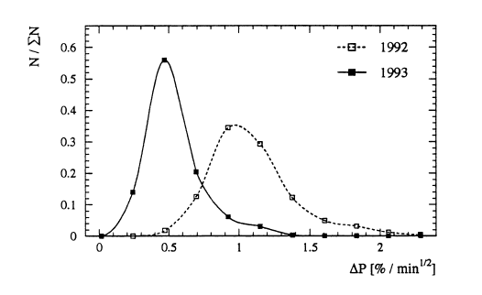
Polarization accuracy
Data acquisition provided ~ one measurement / 8 seconds.
Typical LEP polarization accuracy was ~0.5% / min. This corresponds to Δy accuracy of ~ 2 μm.
  This is much worse (~3 orders magnitude) than the simulation by Wolfgang (unless I have made a mis-interpretation). The beam-laser overlap and the crossing angle can only explain 1-2 orders of magnitude.
Accuracy on P for a 1 minute measurement time

