Slide 1
Weekly Update
Carlos Vergel Infante
Match 8,2017

Slide 2
New Stave #4
Blind analysis (except for Soeren)
Every side was scanned three times: 0, Pressurized, and 0’ PSI.
Residual are calculated 0’ – 0 Scans
Flaws are search in pressurize -0 Scans
Plots before and after sealing process, and with 3 and 5 PSI

Slide 3
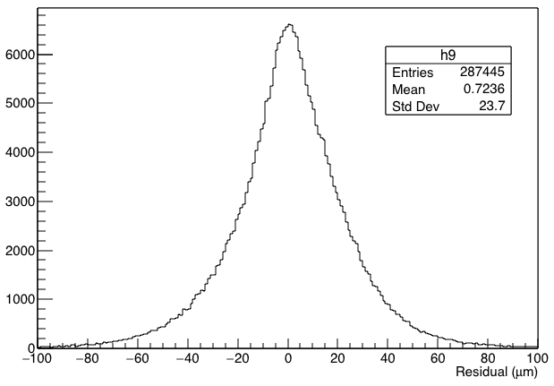
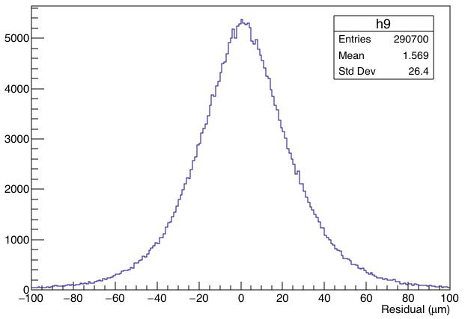
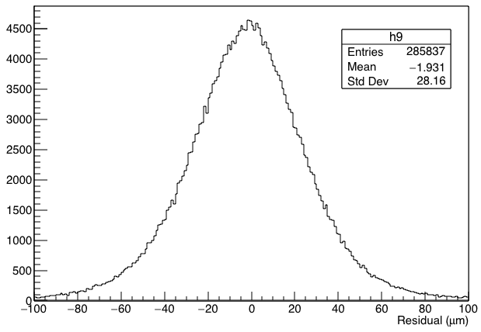
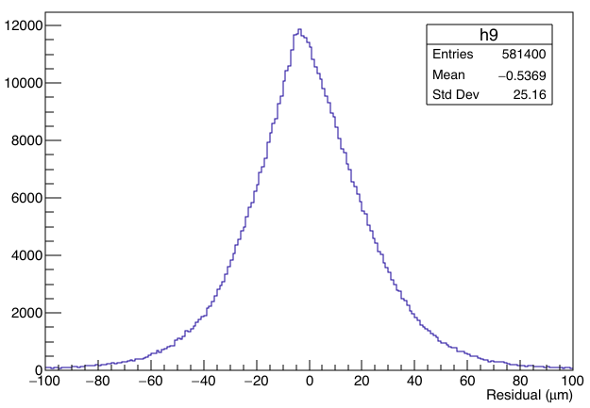
Comparison 3 and 5 PSI BEFORE
Side L
Side R

Slide 4
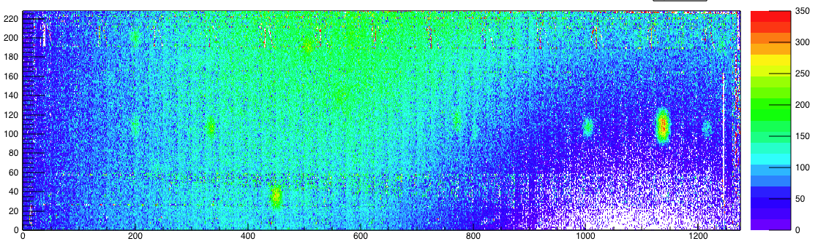
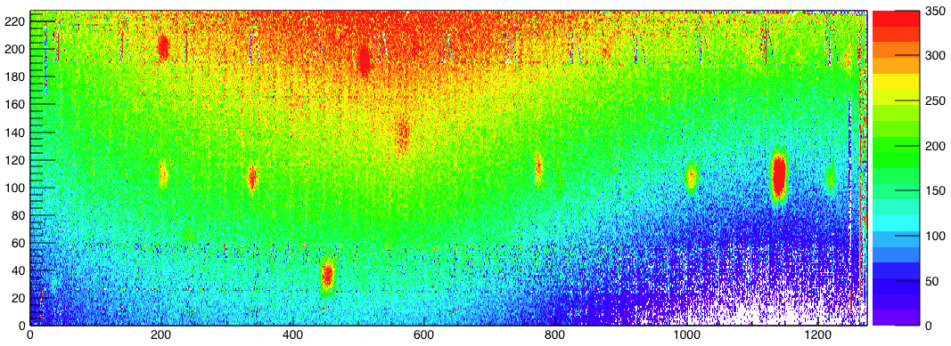
Comparison 3 and 5 PSI BEFORE (Side L)
3 PSI
5 PSI

Slide 5
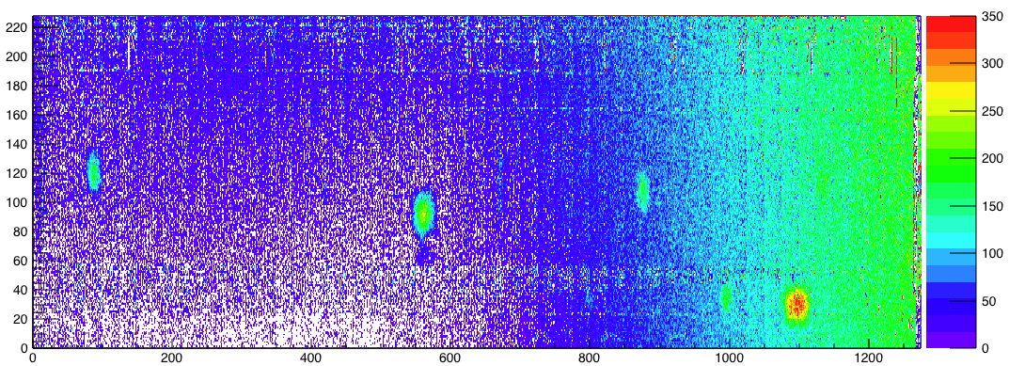
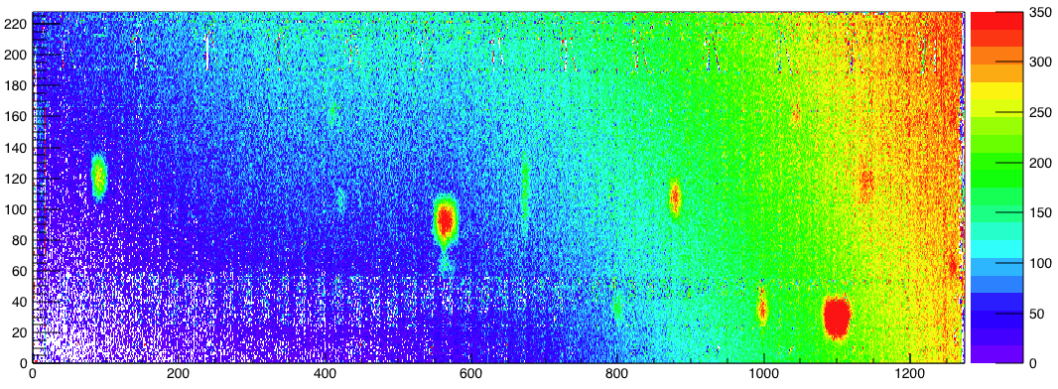
Comparison 3 and 5 PSI BEFORE (Side R)
3 PSI
5 PSI

Slide 6
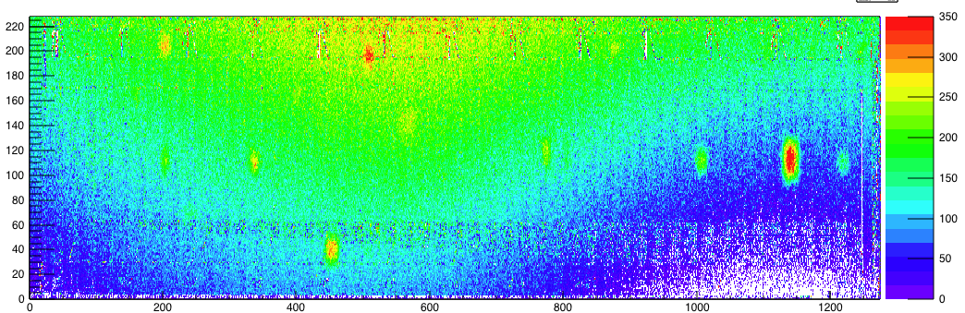
Comparison 3 PSI BEFORE and AFTER(Side L)
Before
After

Slide 7
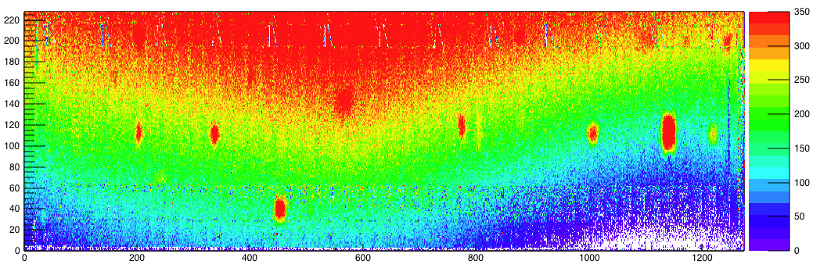
Comparison 5 PSI BEFORE and AFTER(Side L)
Before
After

Slide 8
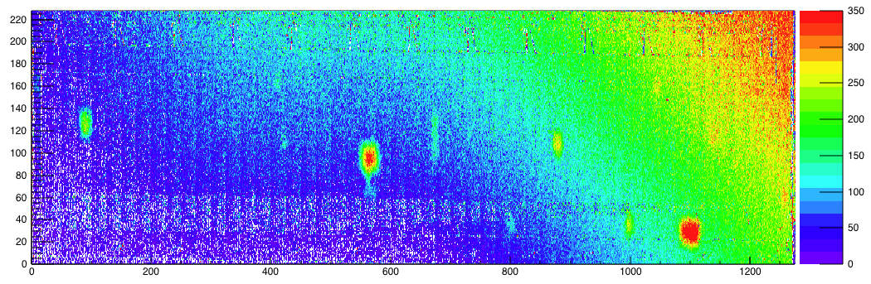
Comparison 3 PSI BEFORE and AFTER(Side R)
Before
After

Slide 9
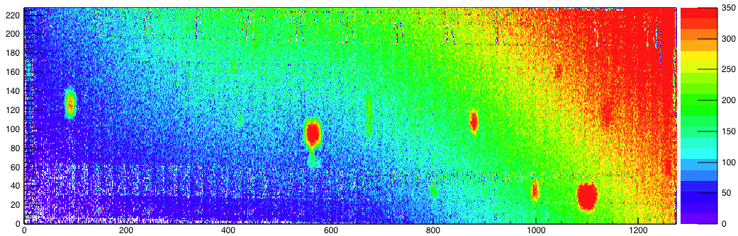
Comparison 5 PSI BEFORE and AFTER(Side R)
Before
After

