Slide 1
Laser scanning update

Slide 2
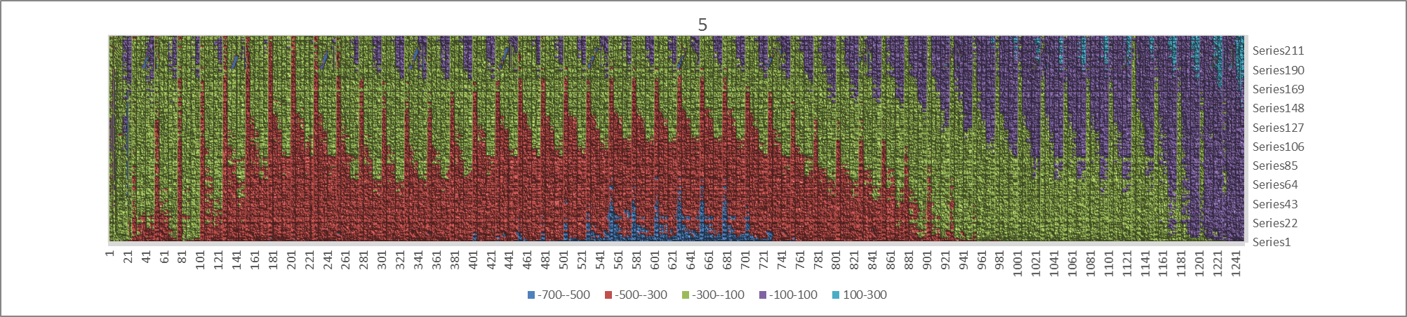
Reminder: 5 laser lines

Slide 3
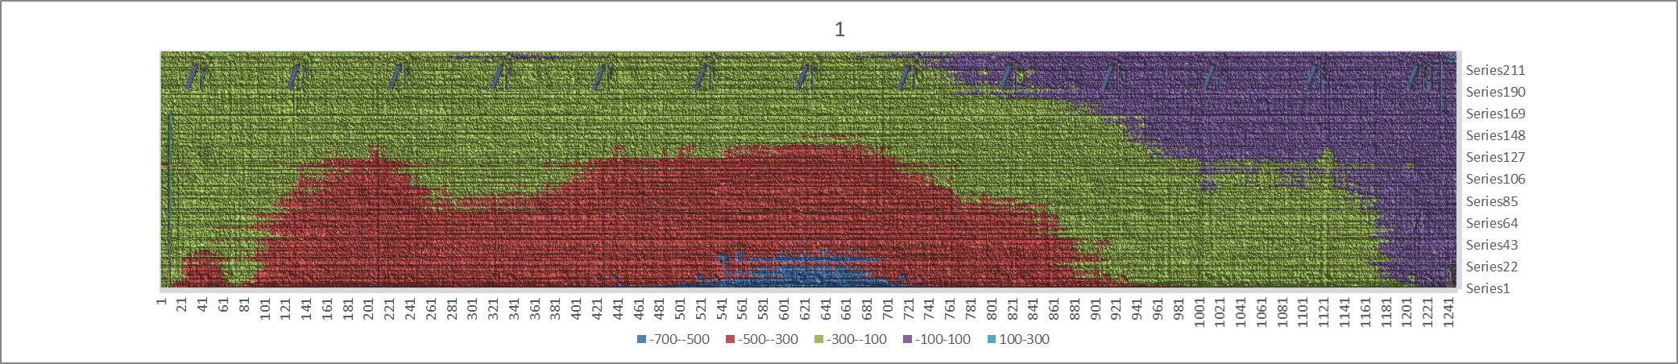
1 laser line(only center line)
Scan: 45 minutes
Return: 20 minutes
Total: 1 h 5 minutes

Slide 4
rms

Slide 5
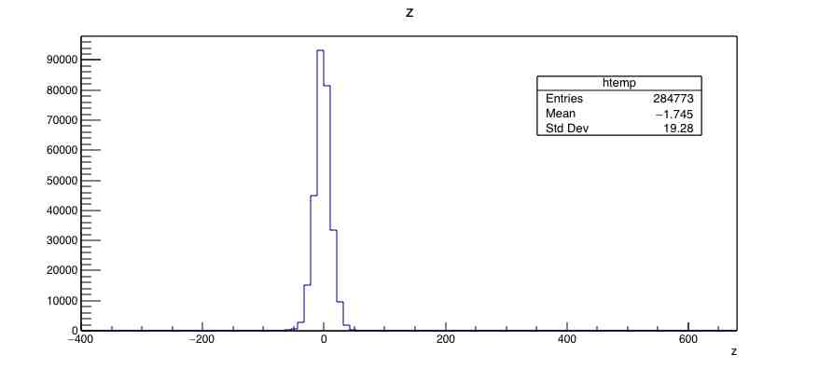
Histogram

