Slide 1
Laser experiment update
4/26/2017

Slide 2
Three measurement for #4 stave
1: On the optical table, with 5 laser lines(old);
2: On the supporting, last week, with 1 line(new 1);
3: On the supporting, on Monday and Tuesday, with 1 line(new 2);
1: pressure test: 5psi – 0 psi;
2: histogram of the difference (for rms);

Slide 3
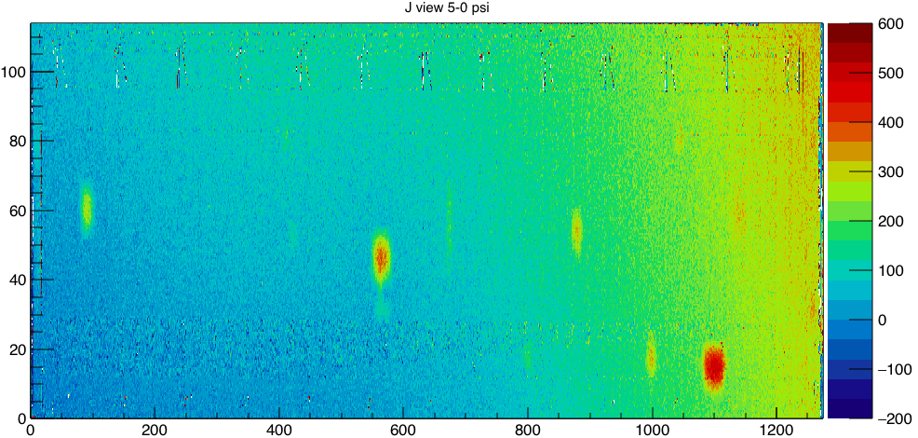
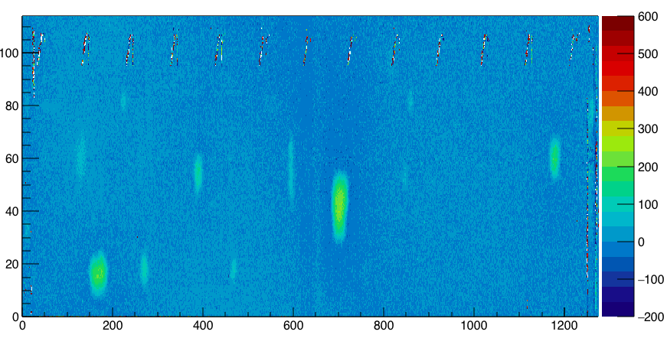
J view 5-0 psi for Old and New1

Slide 4
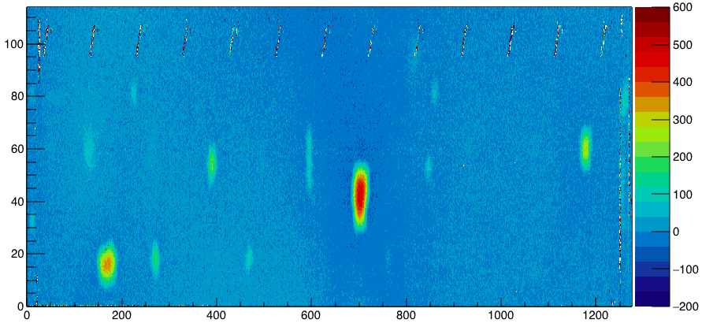
J view cont. (new2)

Slide 5
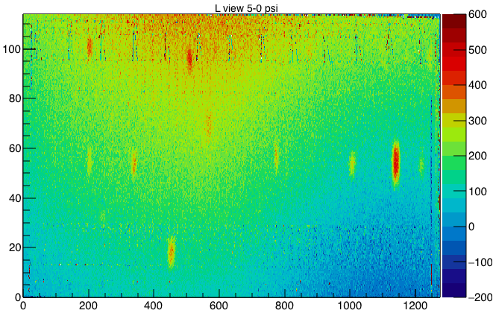
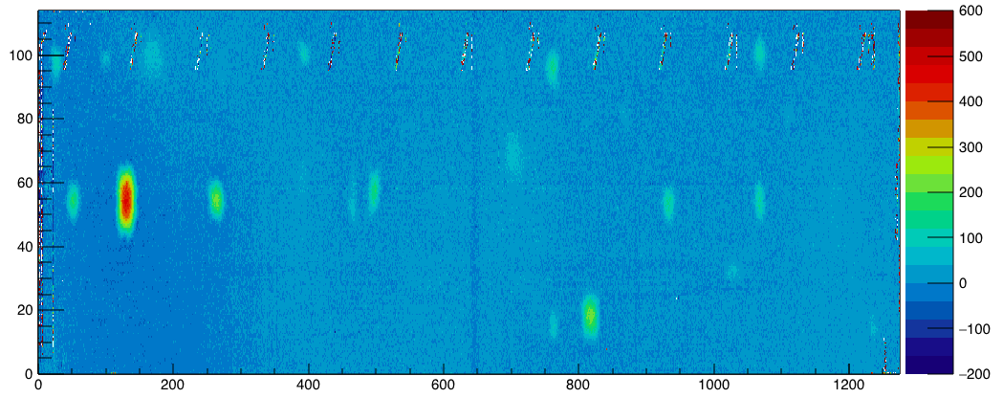
L view 5-0 psi for Old and New1

Slide 6
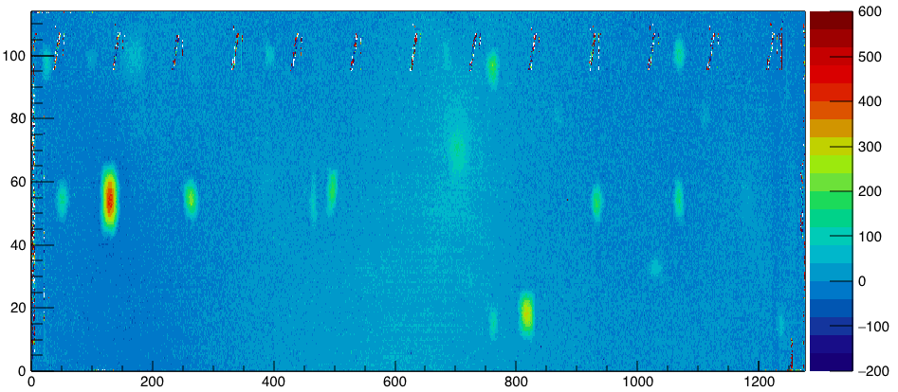
L view cont. (new2)

Slide 7
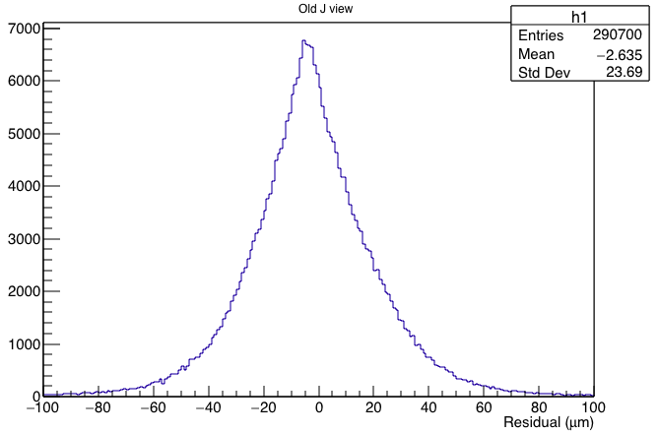
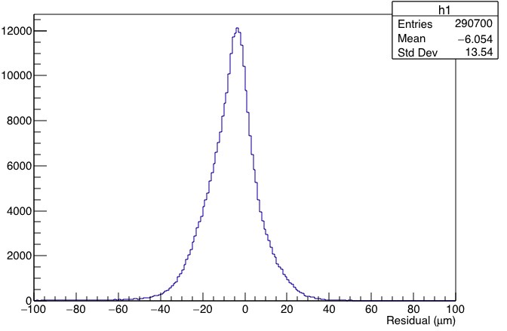
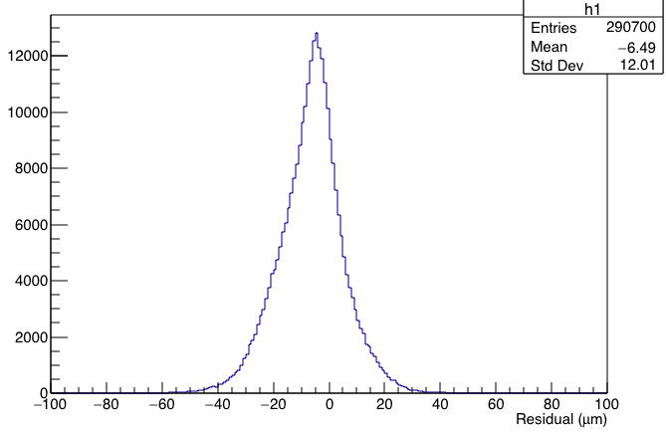
Histogram for the difference between two 0 psi scanning for J view.
old
new1
new2

Slide 8
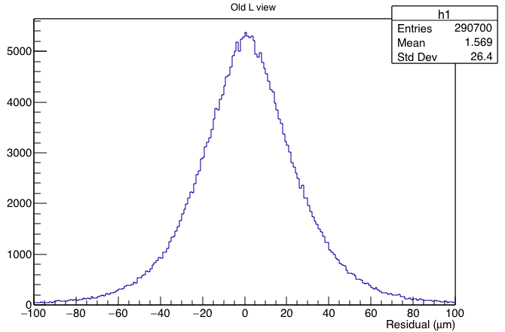
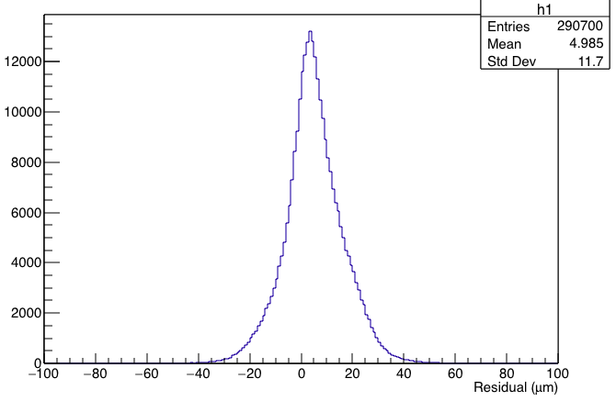
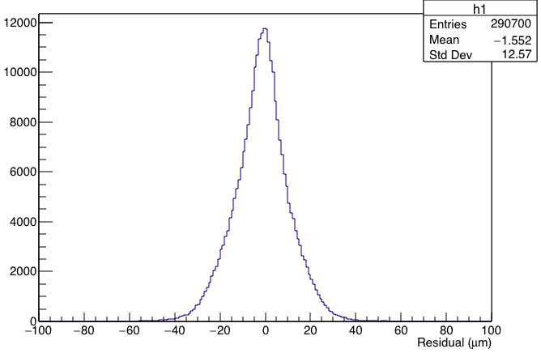
Histogram for the difference between two 0 psi scanning for L view.
old
new1
new2

Slide 9
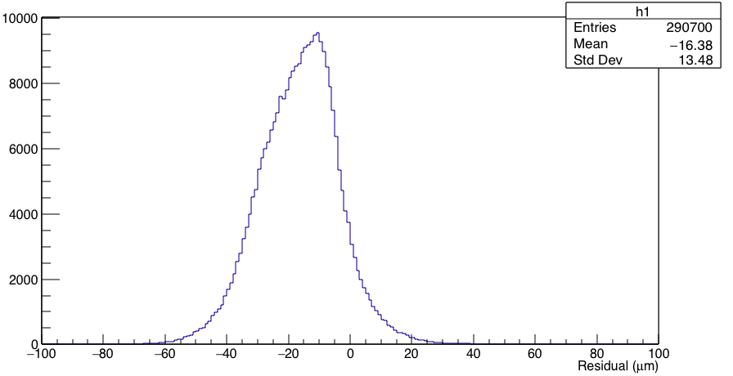
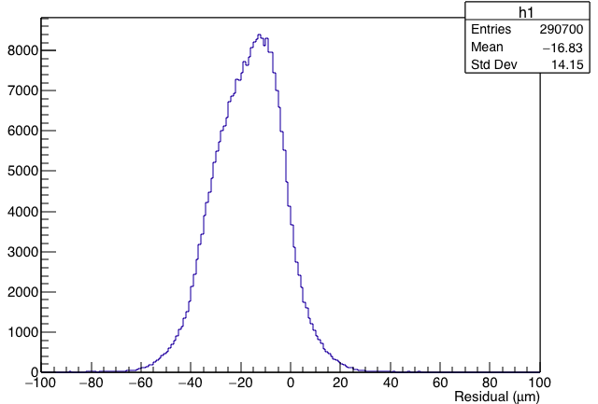
Difference for first two 0 psi measurement(for saturated)
new1
J view
2-1
new2

Slide 10
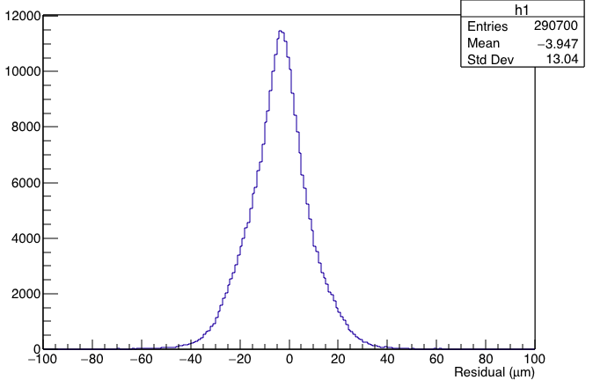
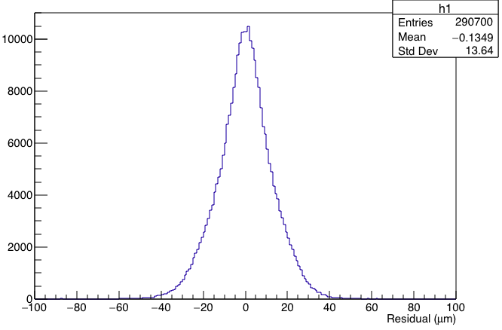
Difference for first two 0 psi measurement(for saturated)
new1
L view
2-1
new2

Slide 11
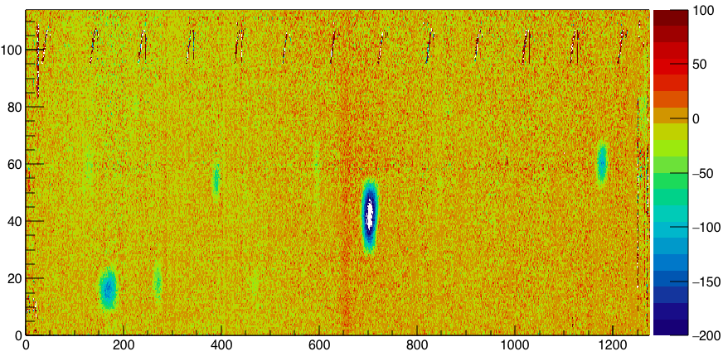
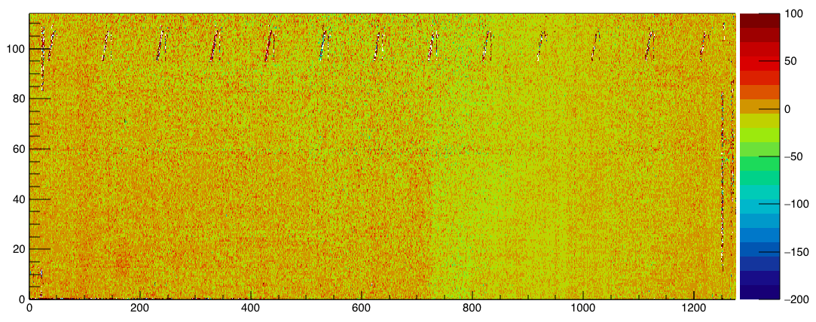
J view 4-2 new 1 and new 2

Slide 12
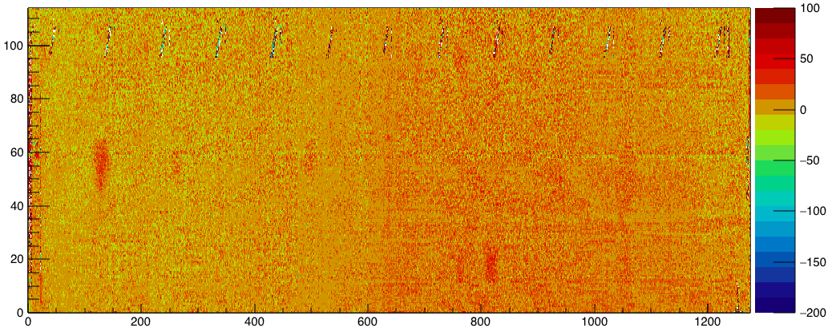
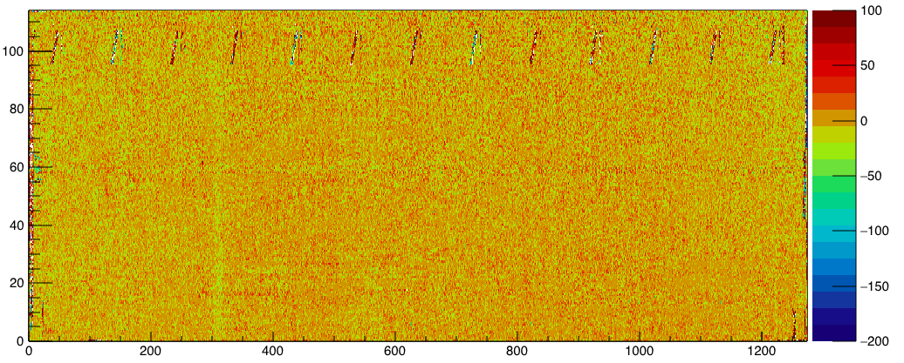
L view 4-2 new 1 and new 2

