Slide 1
Local Flatness Test
(Study)
Carlos Vergel Infante

Slide 2
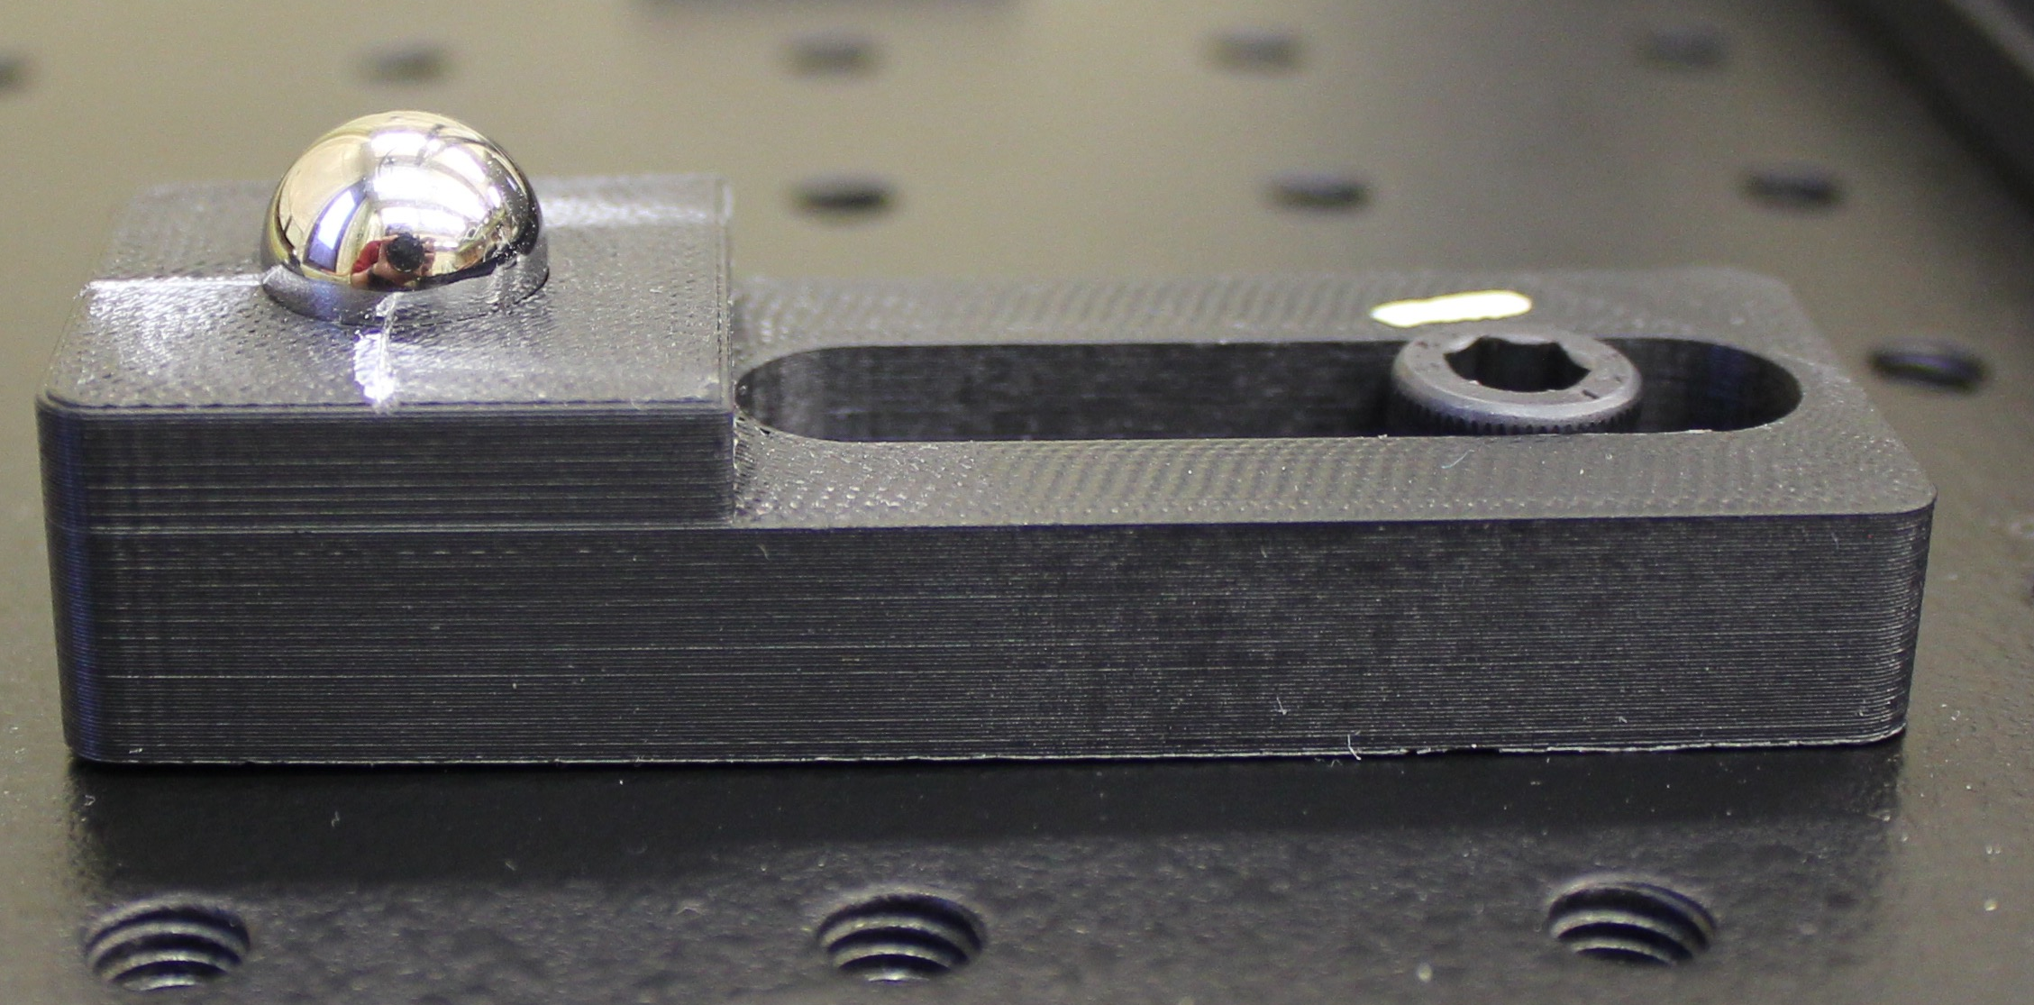
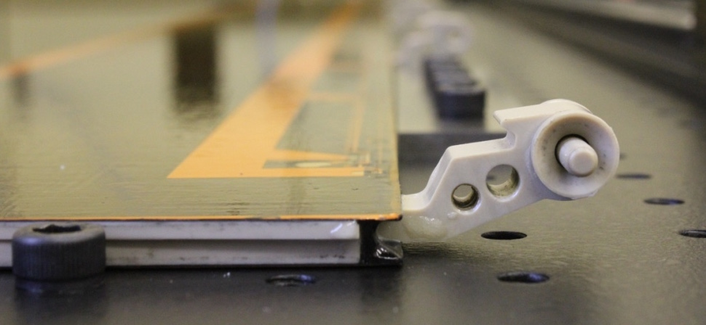
Local Flatness Test
13 modules of about 10 x 13 cm will be placed at each side of the stave core.
The stave core will be bent when placed in the experiment (Edge support).
The modules should be flat and will be placed in a bent surface. We want to know the maximum distance between a module and the surface of the stave core. This is to know how much glue to put on it.
Pipes
Holders
9
13
1
4
White connectors
For the other side of the edge support, we kept the holders at the position of the white connectors.

Slide 3
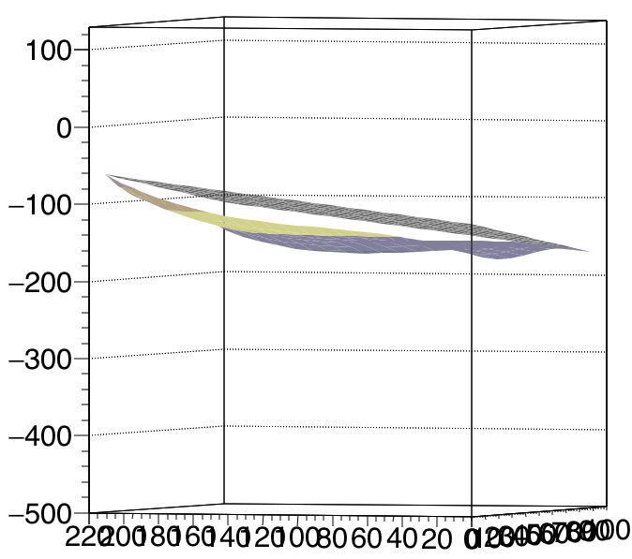
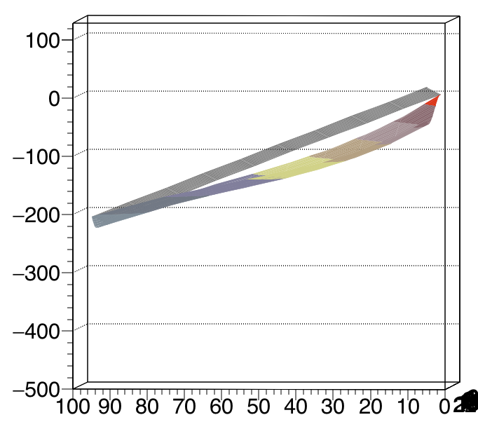
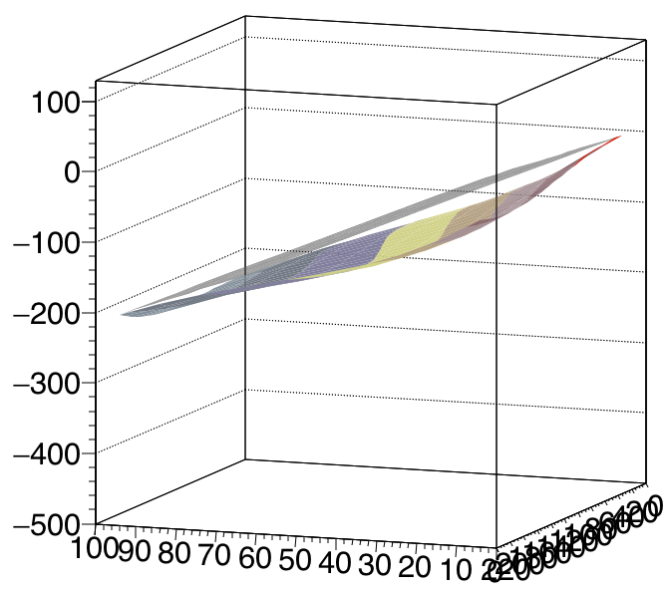
Placing a plane on top of a surface
The data from the scan (bending test) was fitted into a 3-order polynomial. The original scan has 220 x 97 pixels.
The surface was reduced to 22 x 10 pixels. One point (every half cm) x (every cm).
Three points create a plane. An iteration of three points in the fitted surface creating a plane each time.
Two conditions were required to find the desired plane:
  All values of the fitted surface had to be below the tested plane.
  Minimum of the sum of all distances between plane and surface.
When the plane is found. The maximum distance between the plane and the plane is searched.
This is done for all 26 modules (13 at each side).
Only tested from SIMPLE SUPPORT.

Slide 4
Toy Model

Slide 5
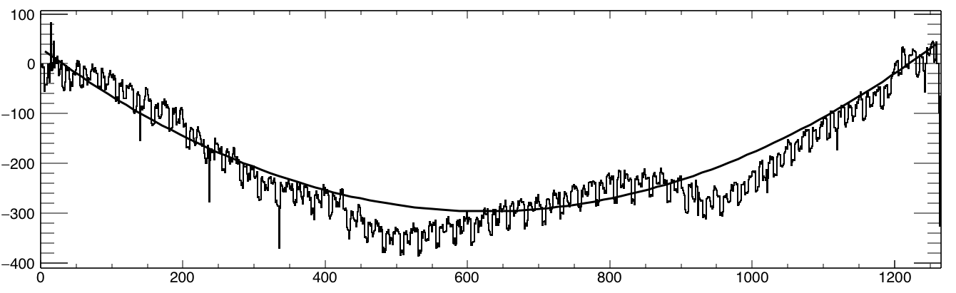
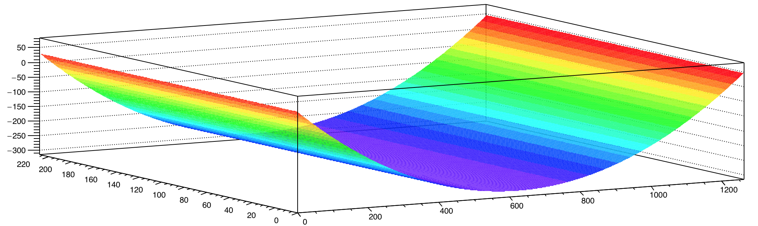
Fit: Second order polynomial

Slide 6
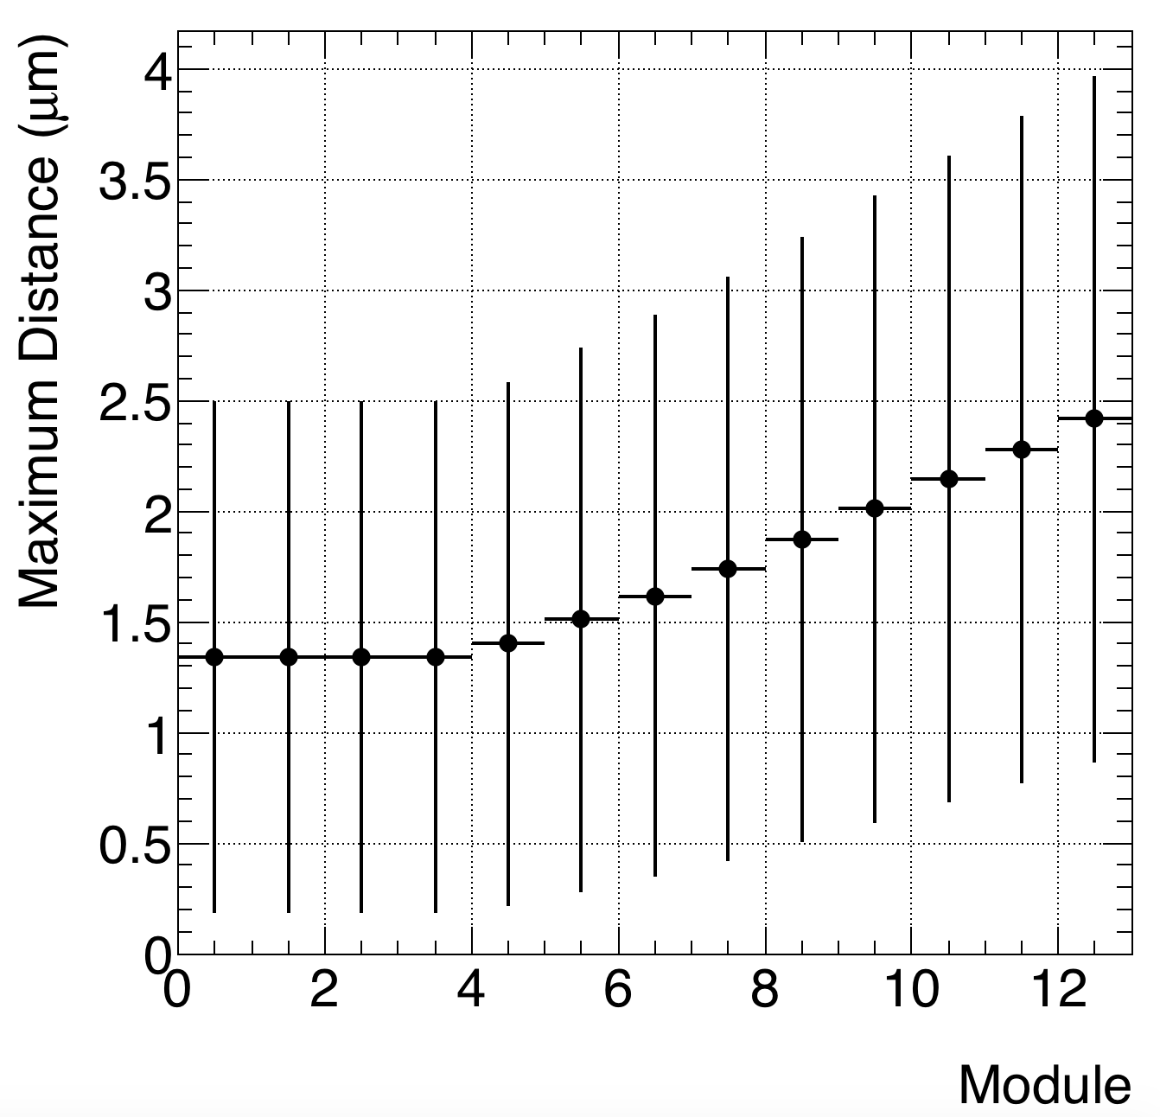
J side based

Slide 7
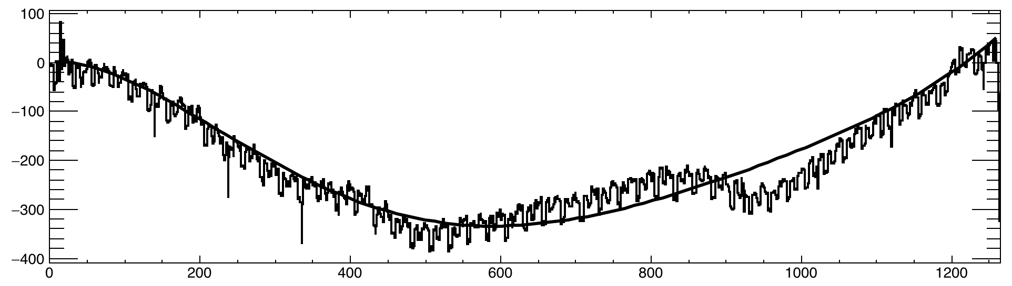
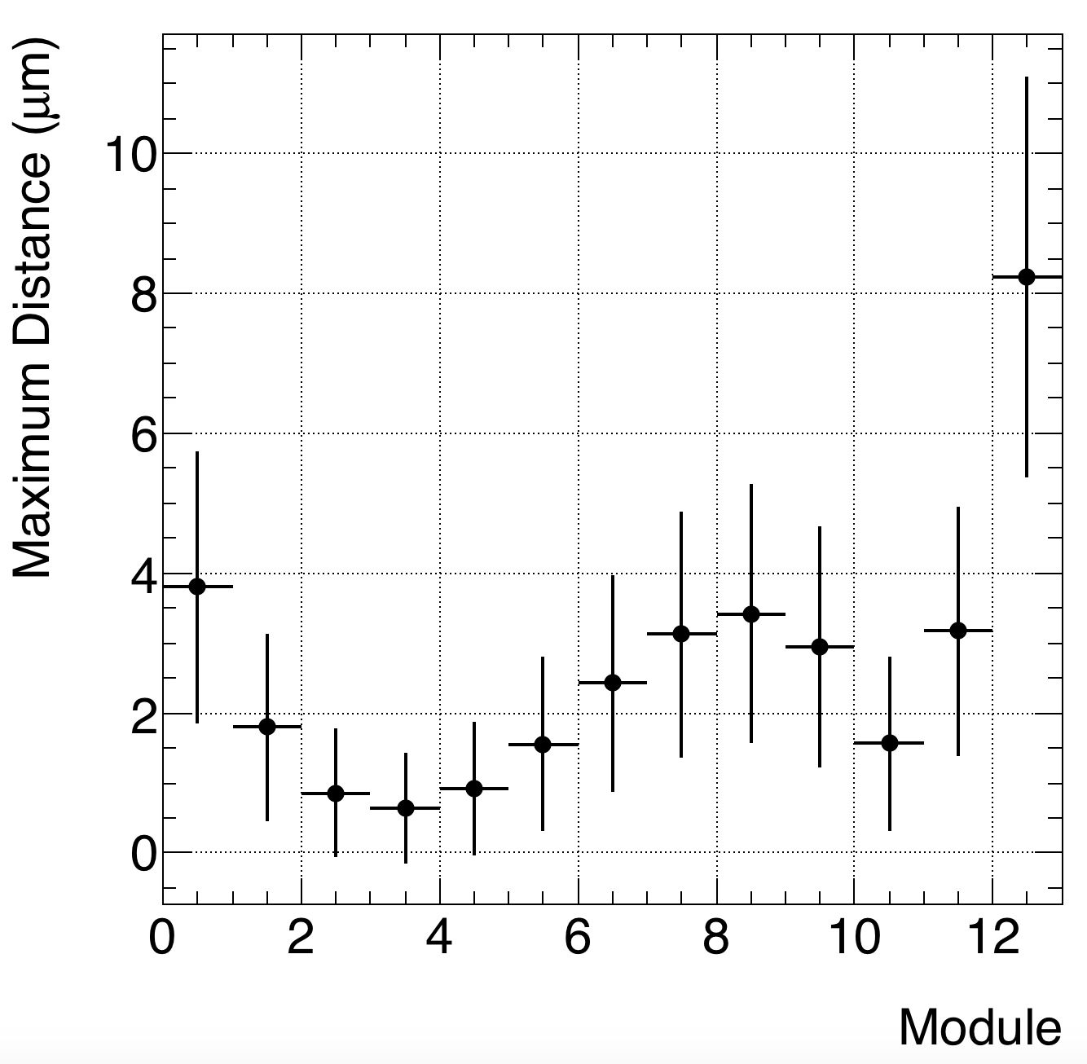
Fit – five order polynomial

Slide 8
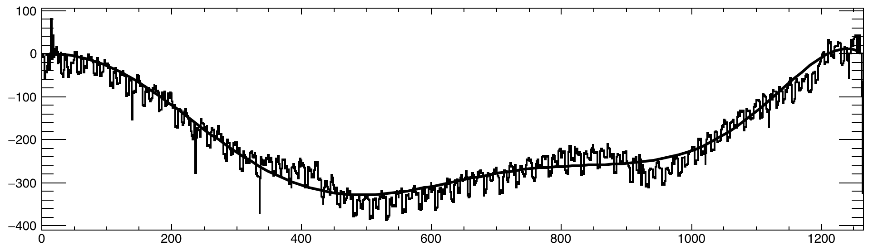
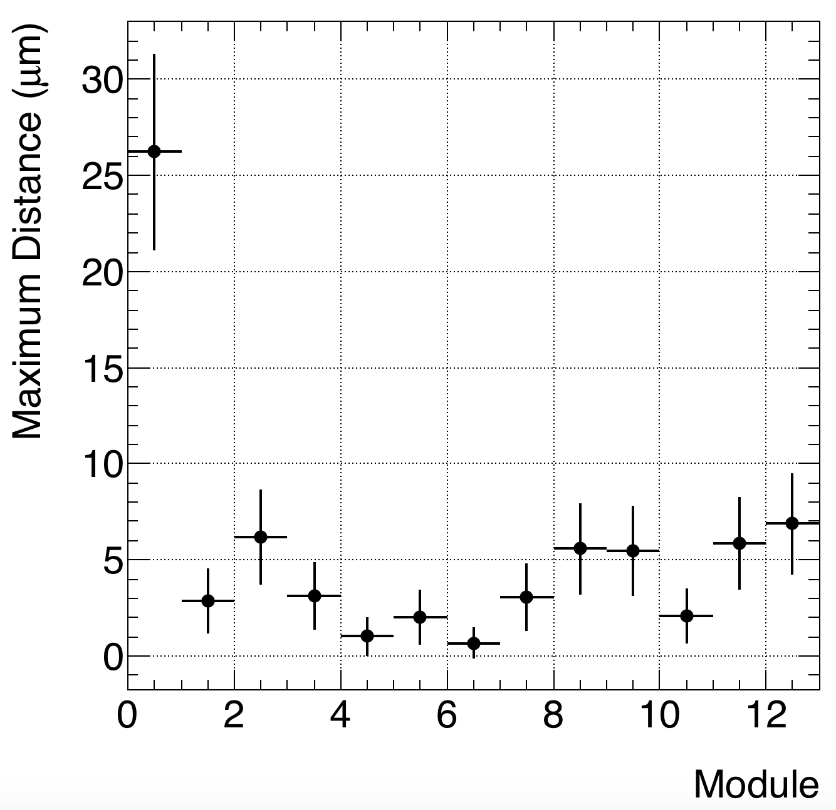
Fit-seven order polynomial

Slide 9
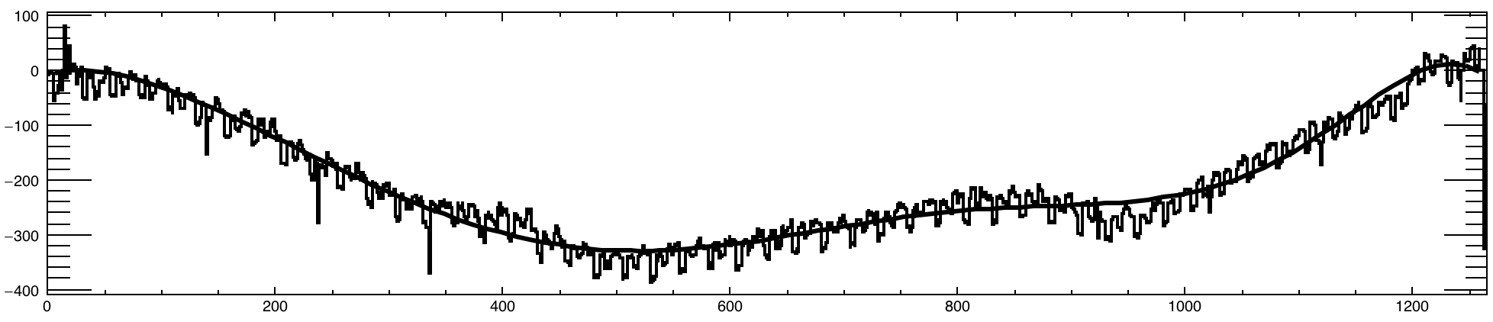
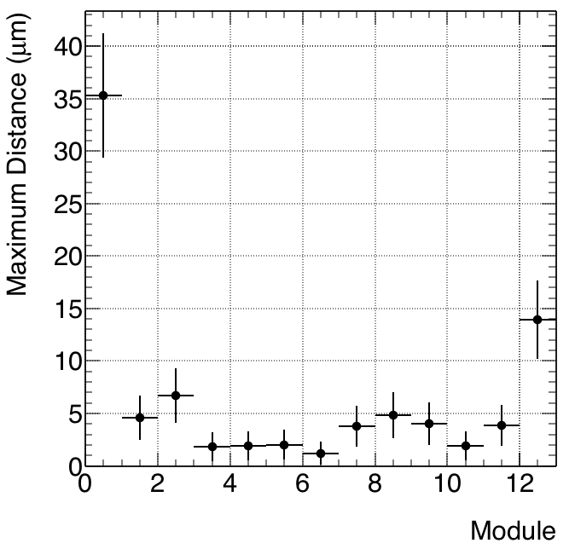
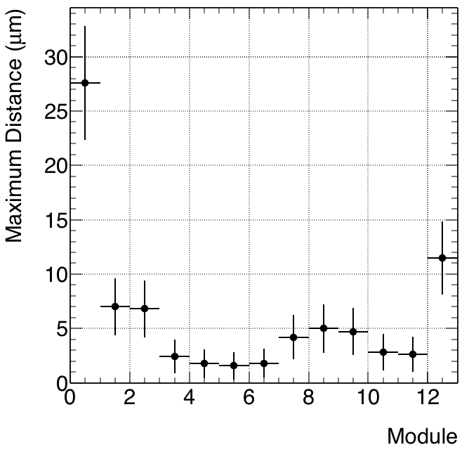
Fit-eight order polynomial
Concave (plane above)
Convex (plane below)

Slide 10
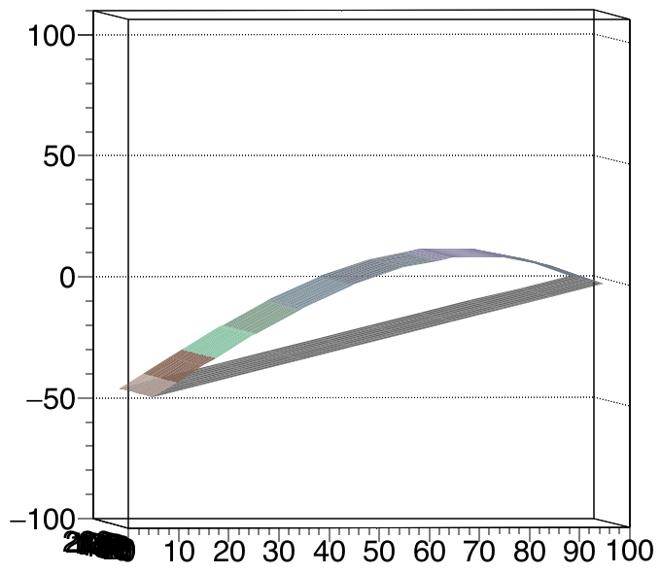
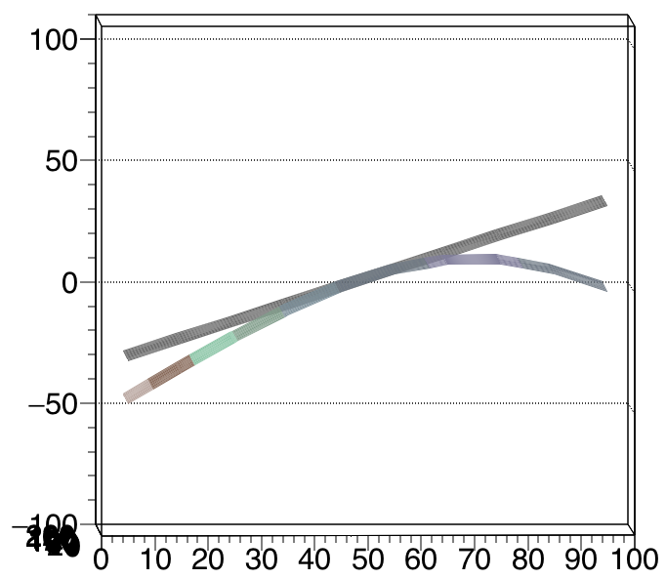
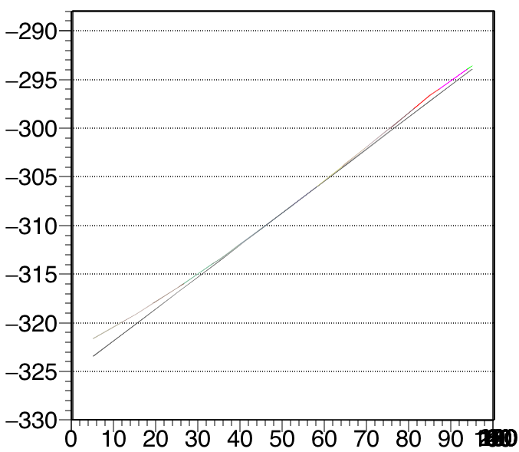
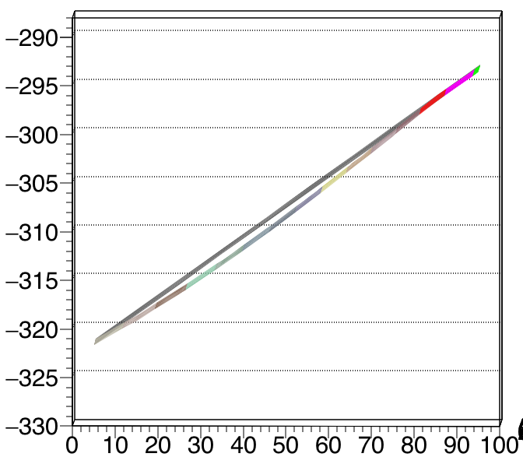
Module 1
Module 7

Slide 12
Simple Support

Slide 13
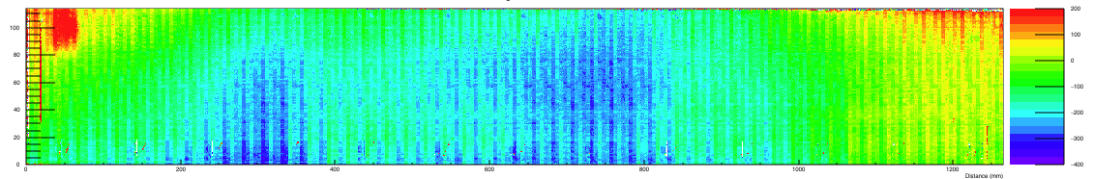
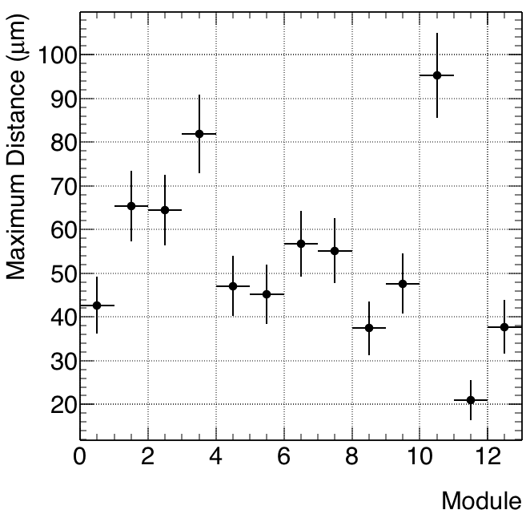
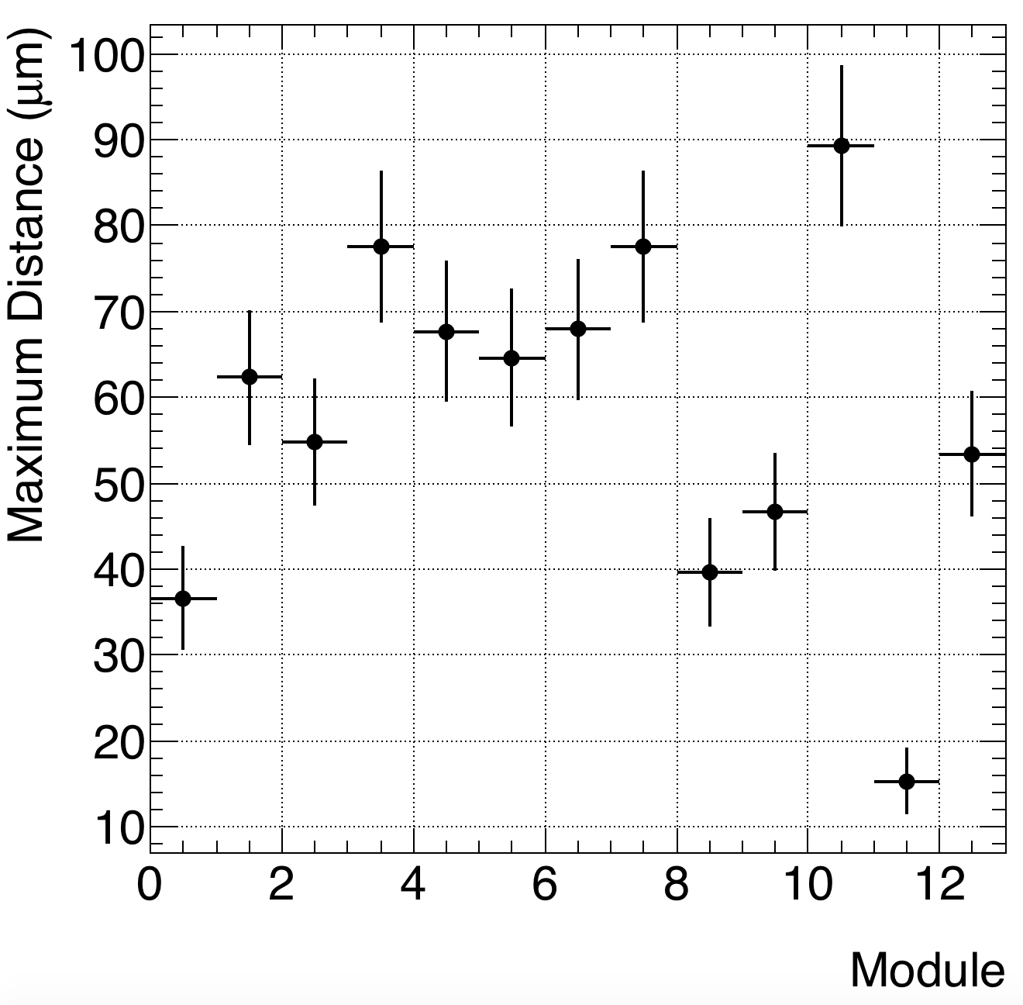
J side
Concave
Convex (inverted)

Slide 14
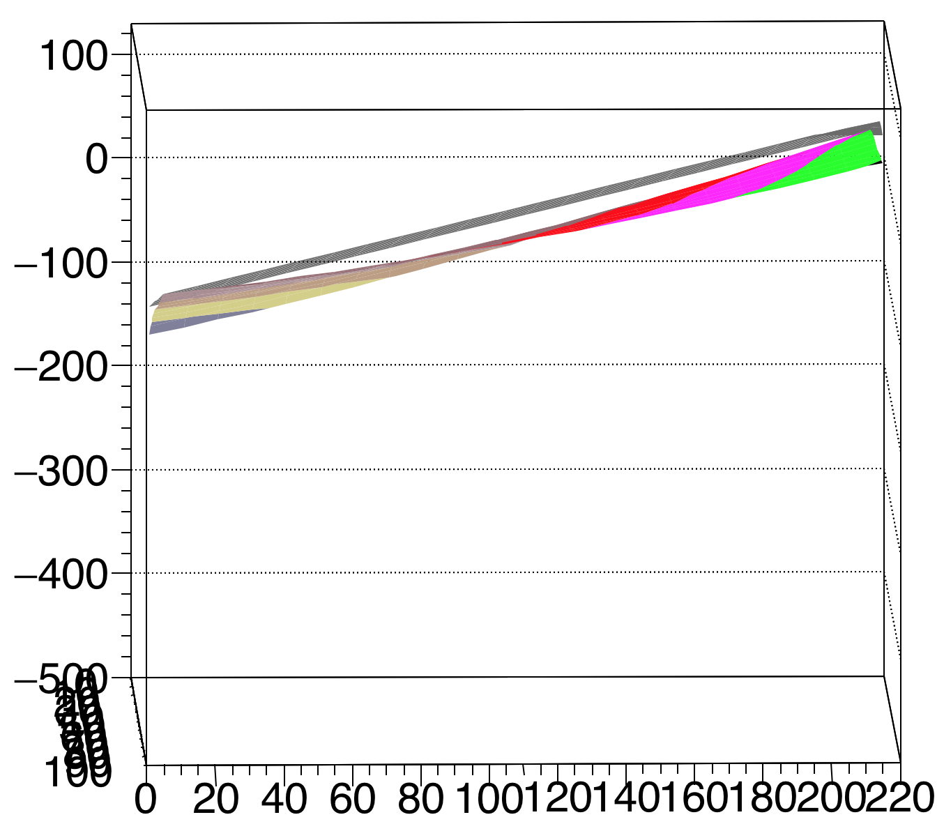
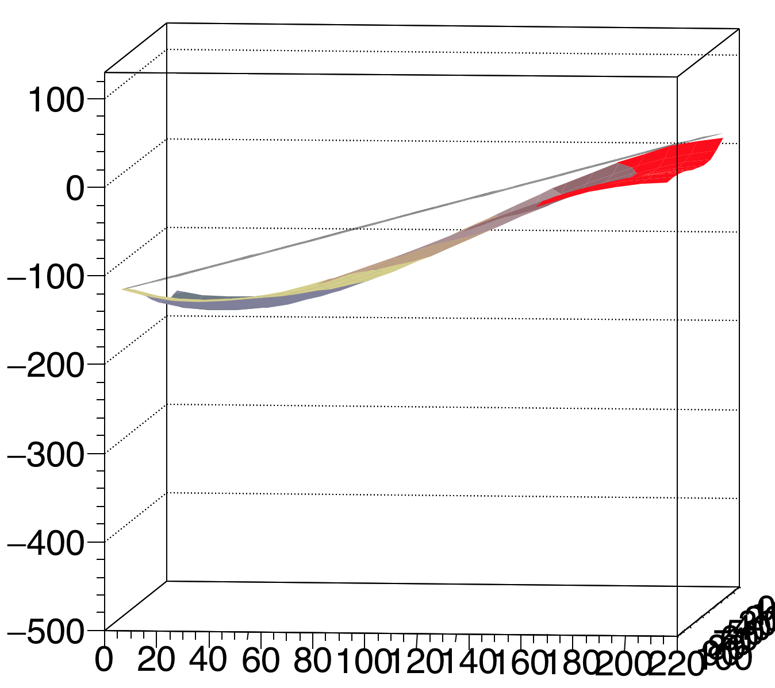
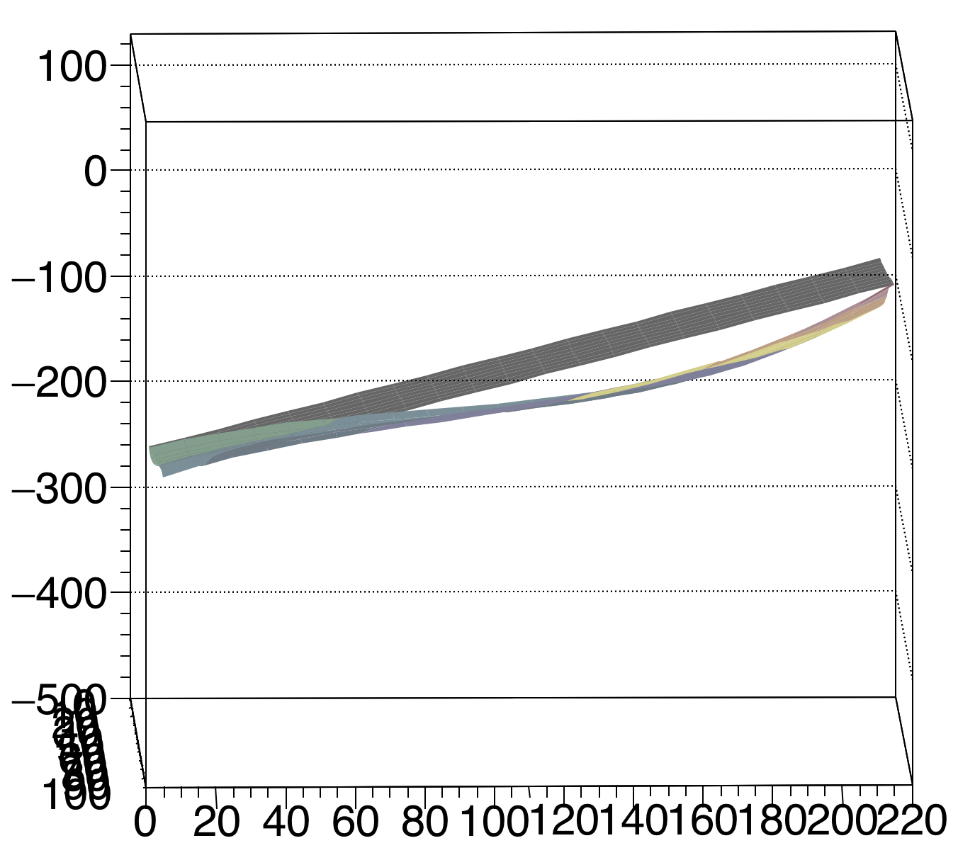
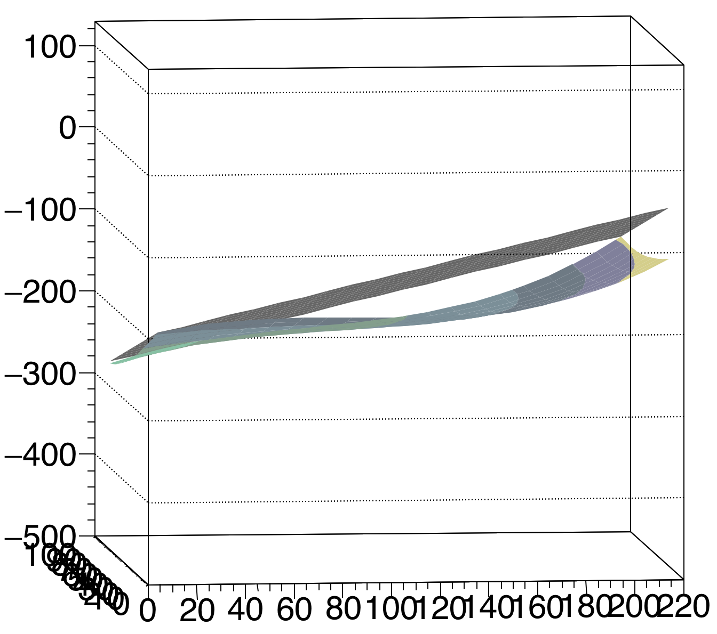
Concave - Modules 1 2 / 3 4
J Side
42.69
65.44
64.48
81.85

Slide 15
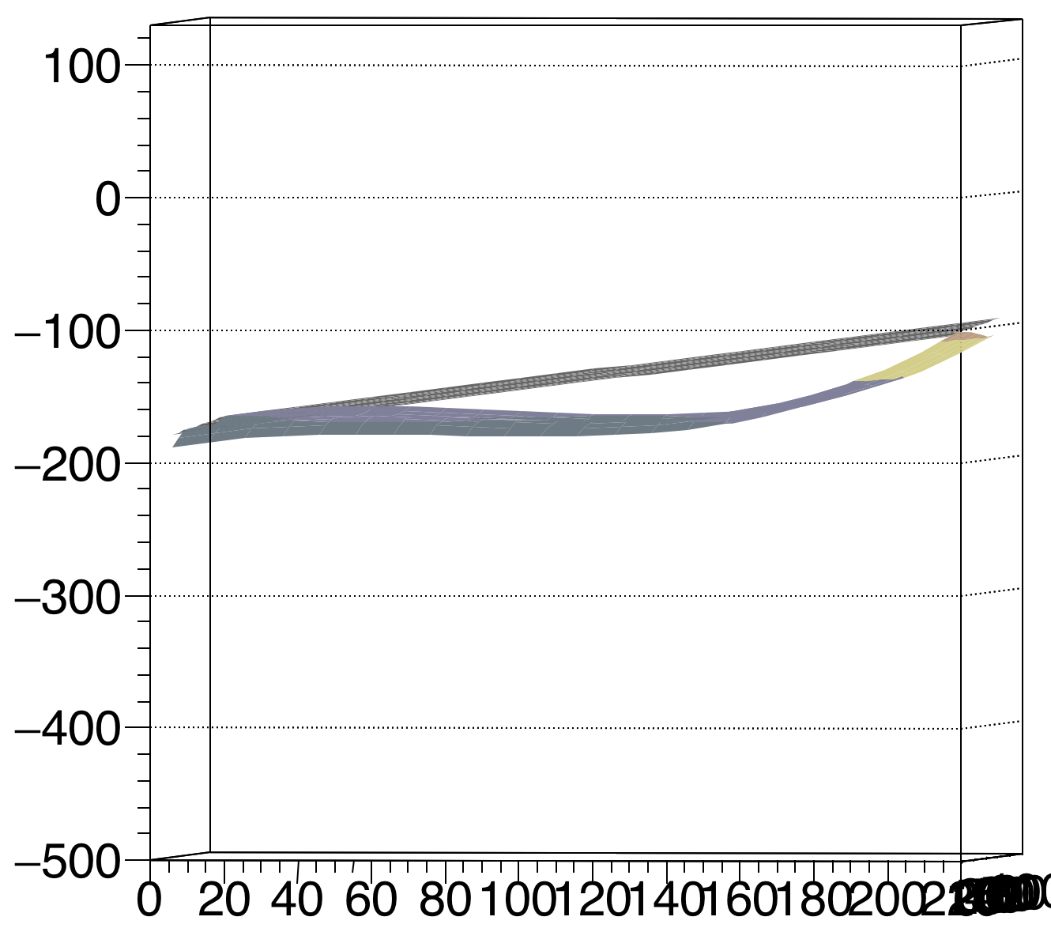
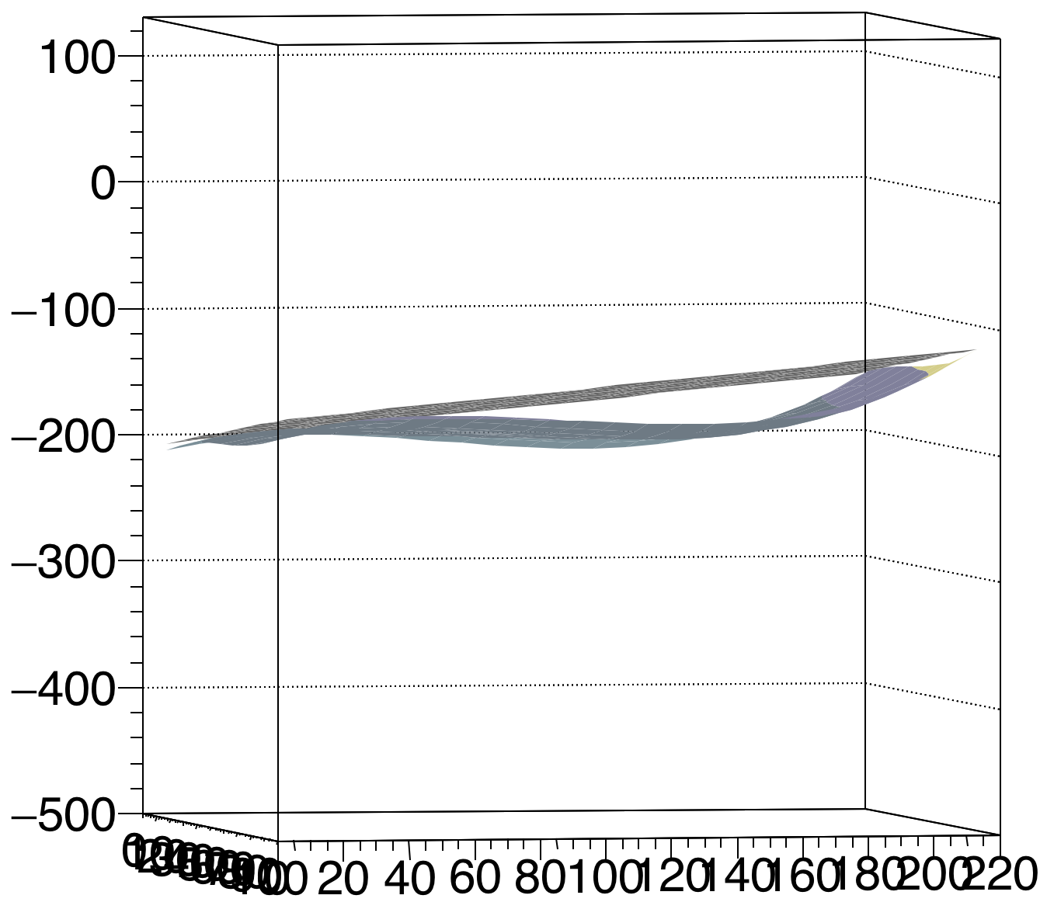
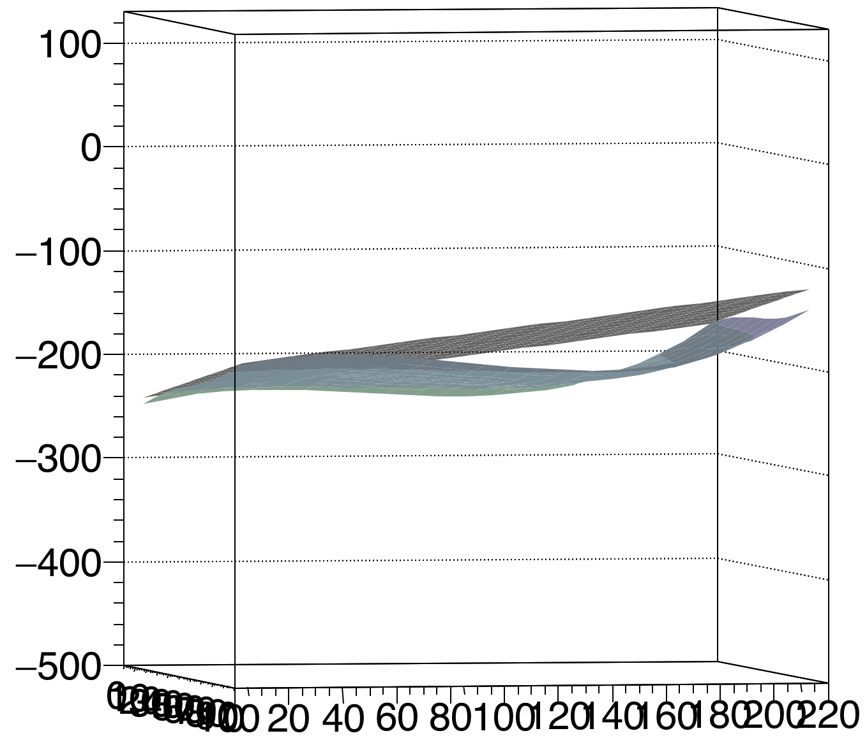
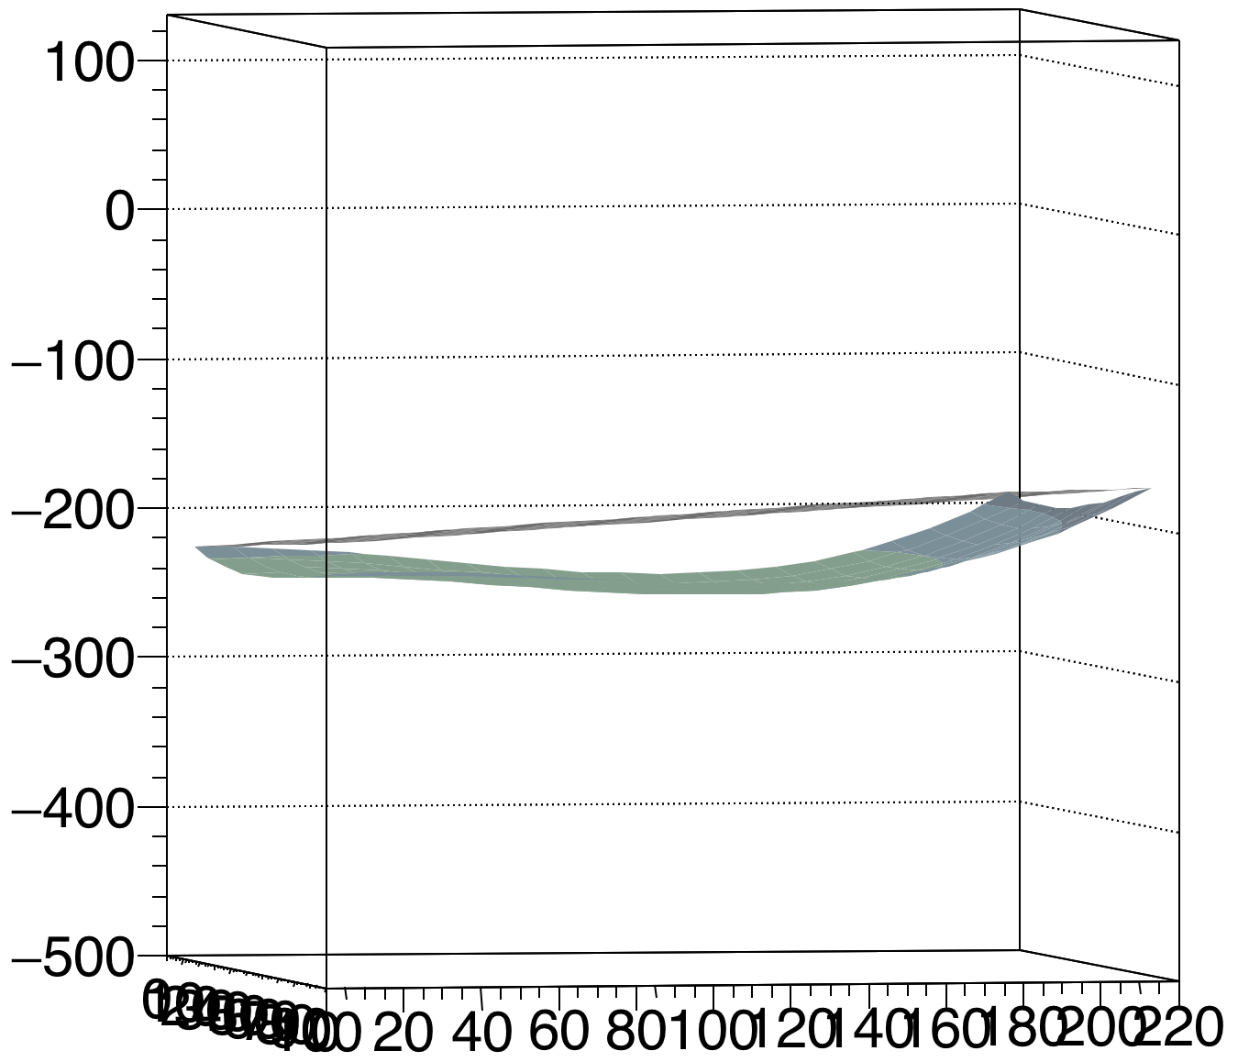
Concave - Modules 5 6 / 7 8
J Side
47.10
45.17
56.71
55.12

Slide 16
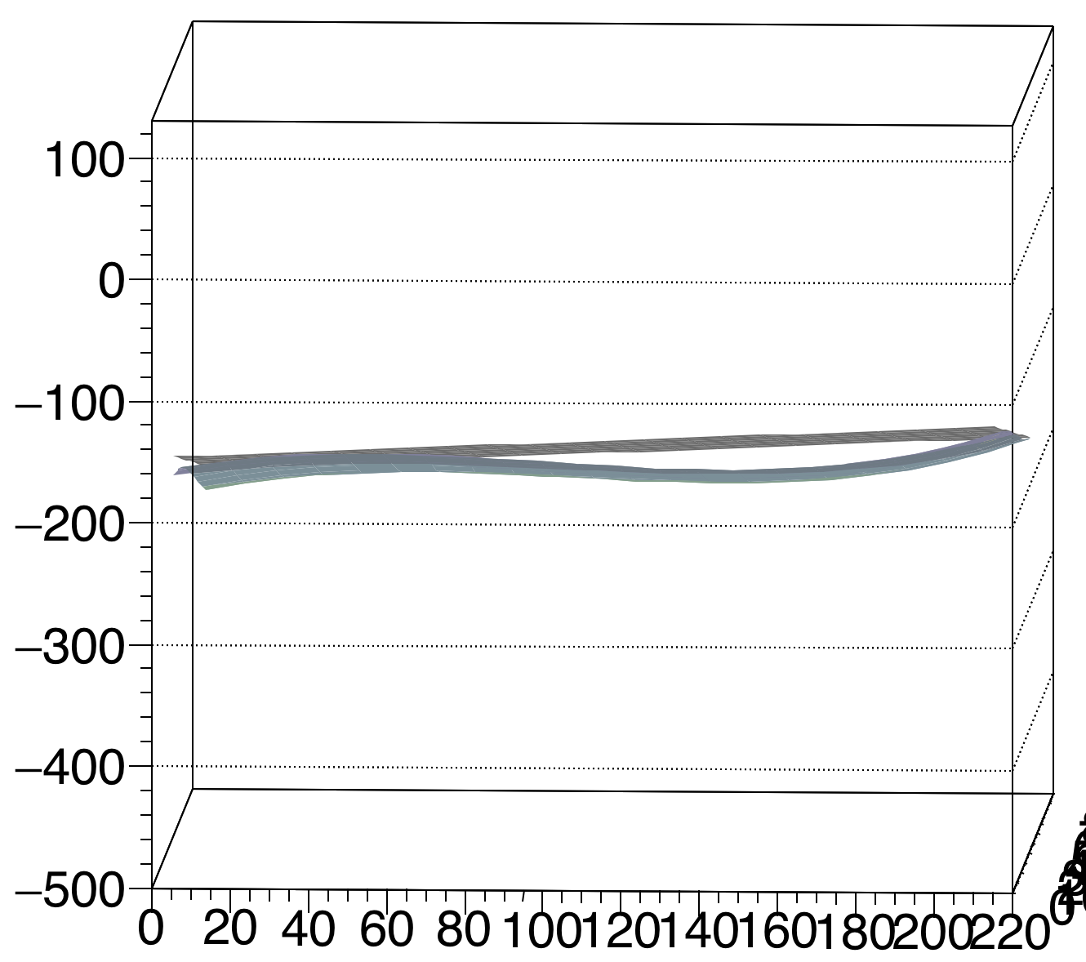
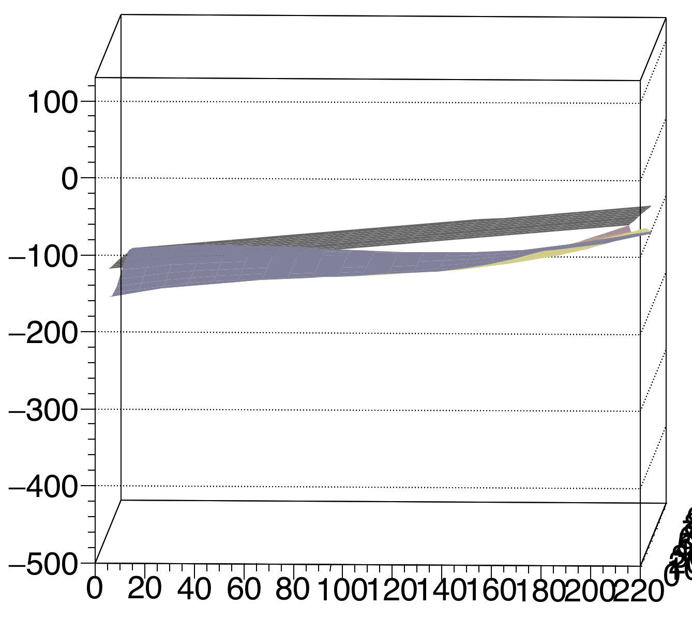
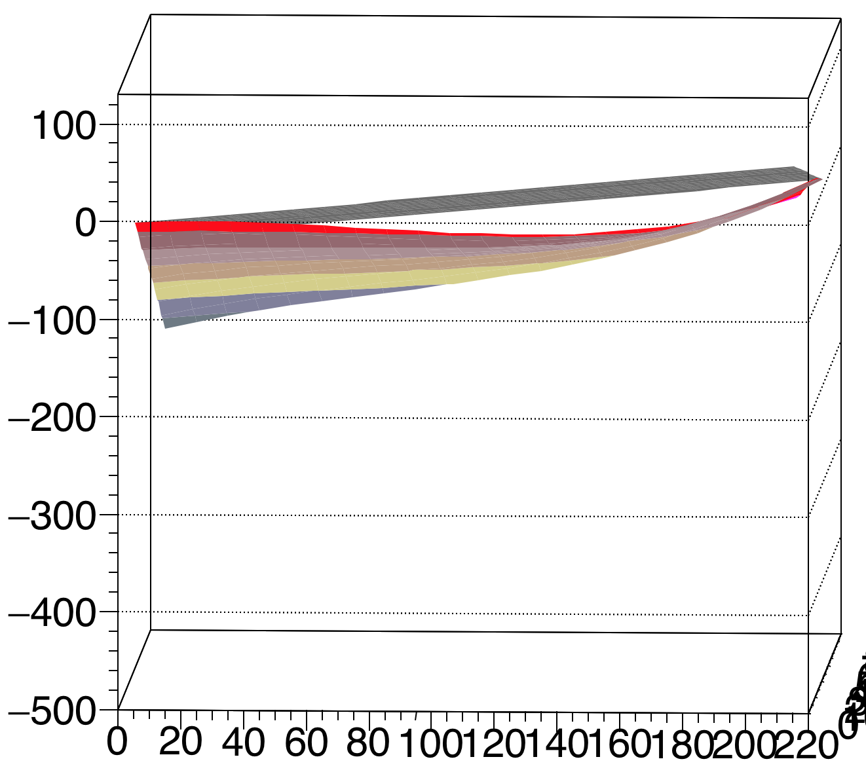
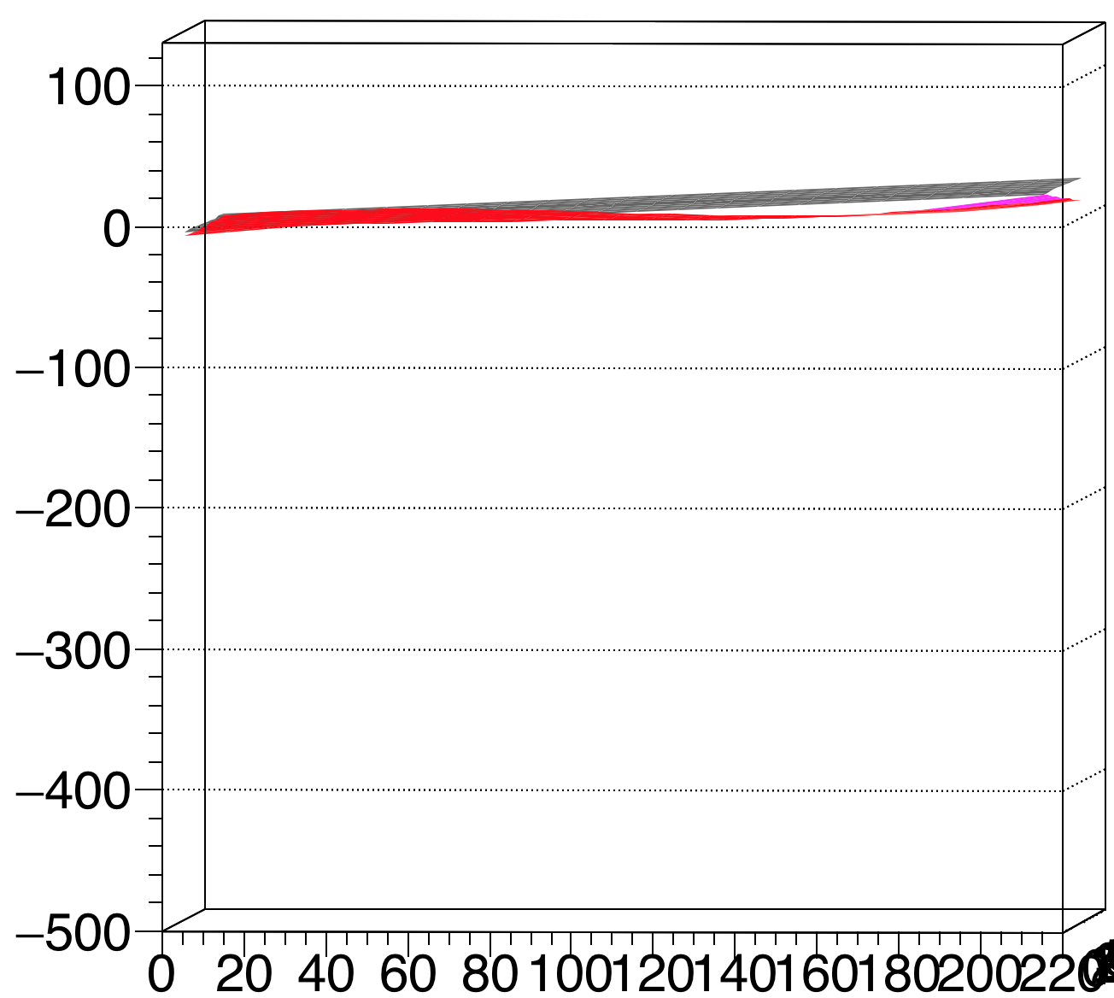
Concave - Modules 9 10 / 11 12
J Side
37.46
47.60
95.30
20.91

Slide 17
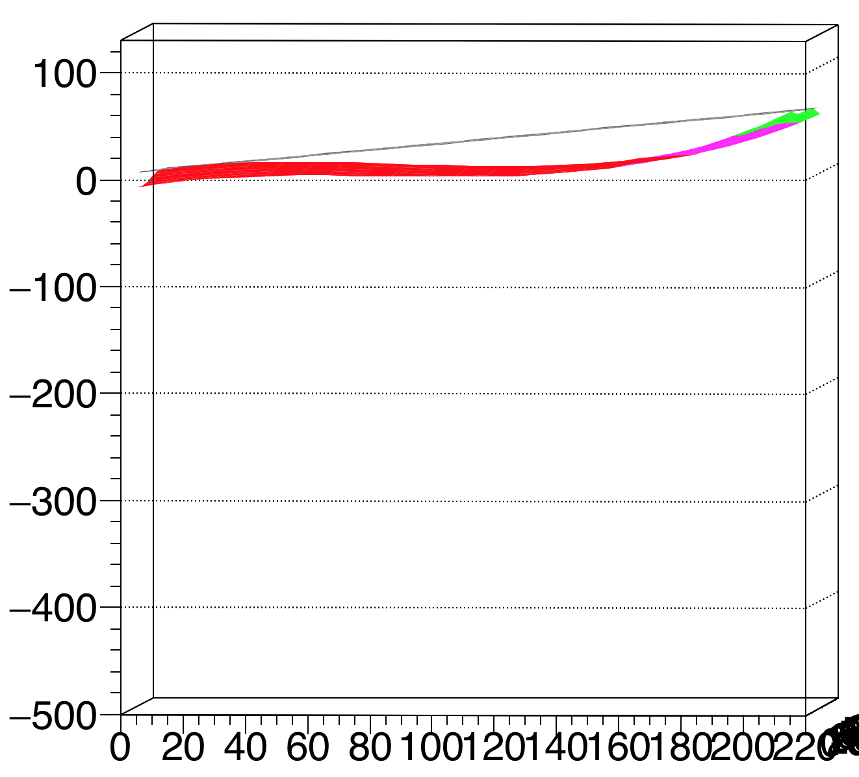
Concave - Module 13
J Side
37.75

Slide 18
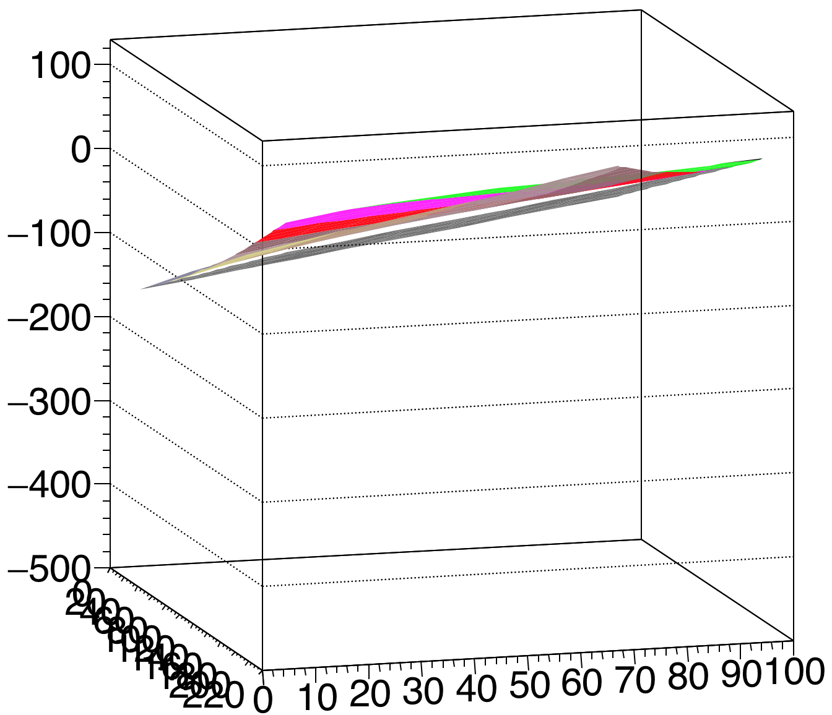
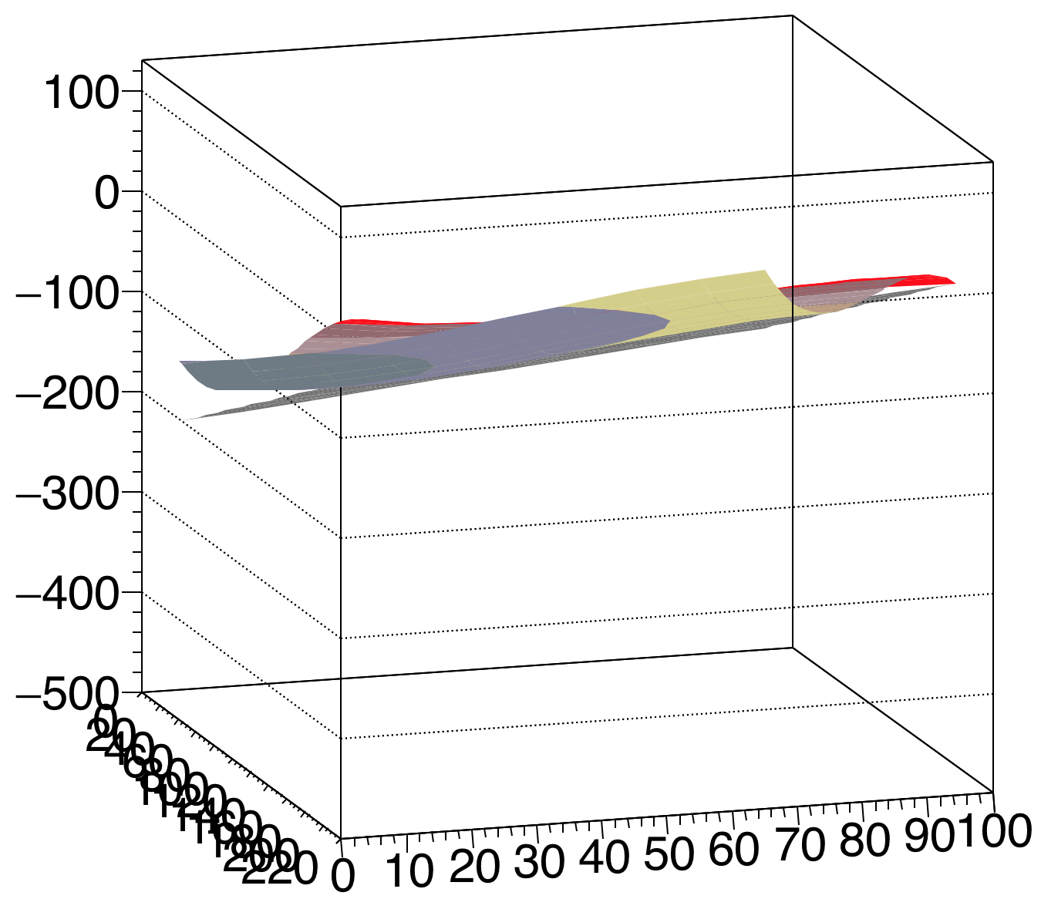
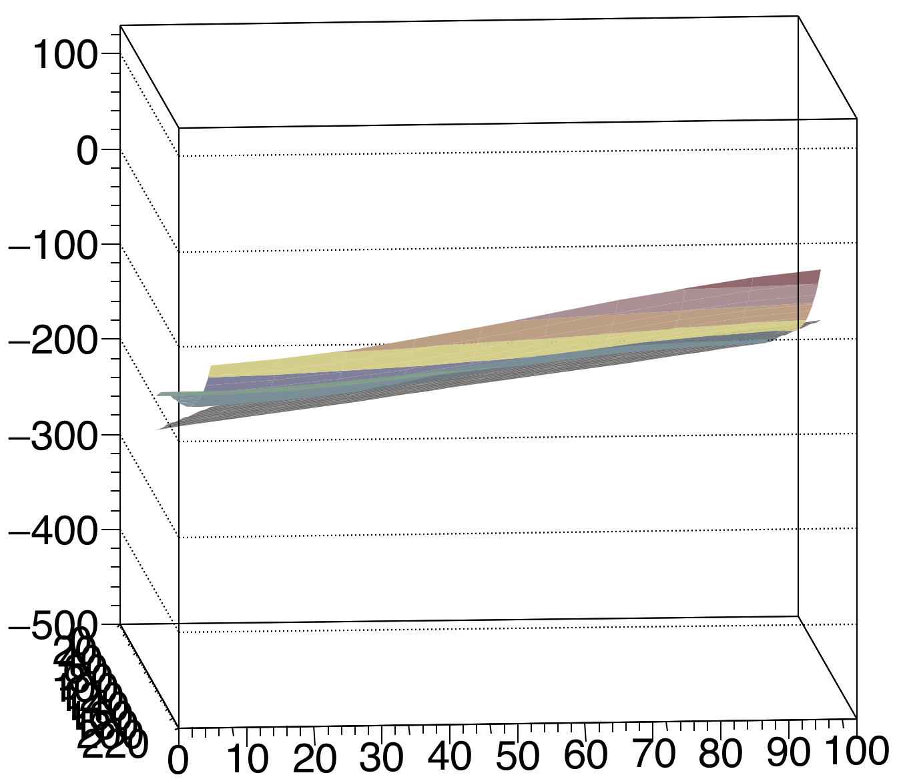
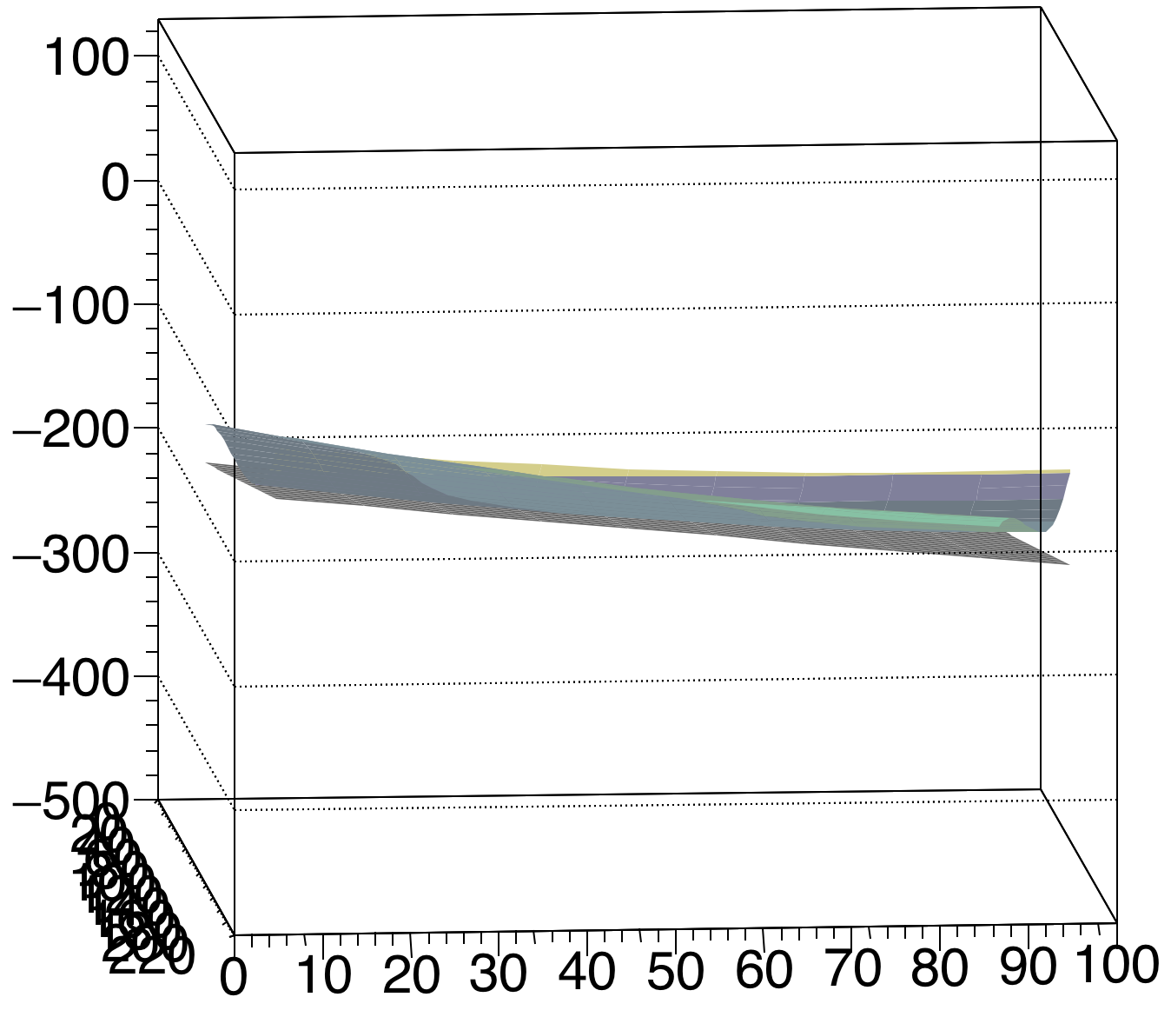
Convex - Modules 1 2 / 3 4
J Side
36.57
62.31
54.74
77.57

Slide 19
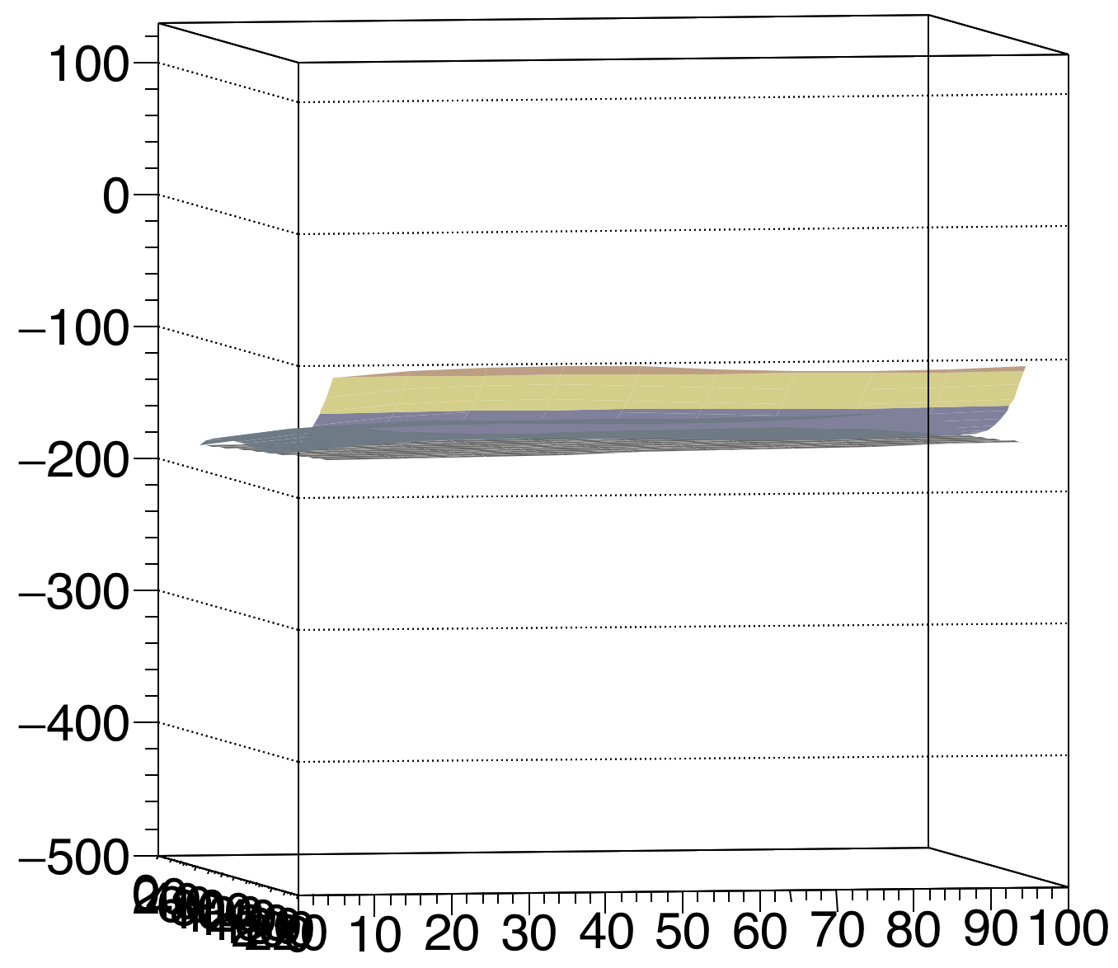
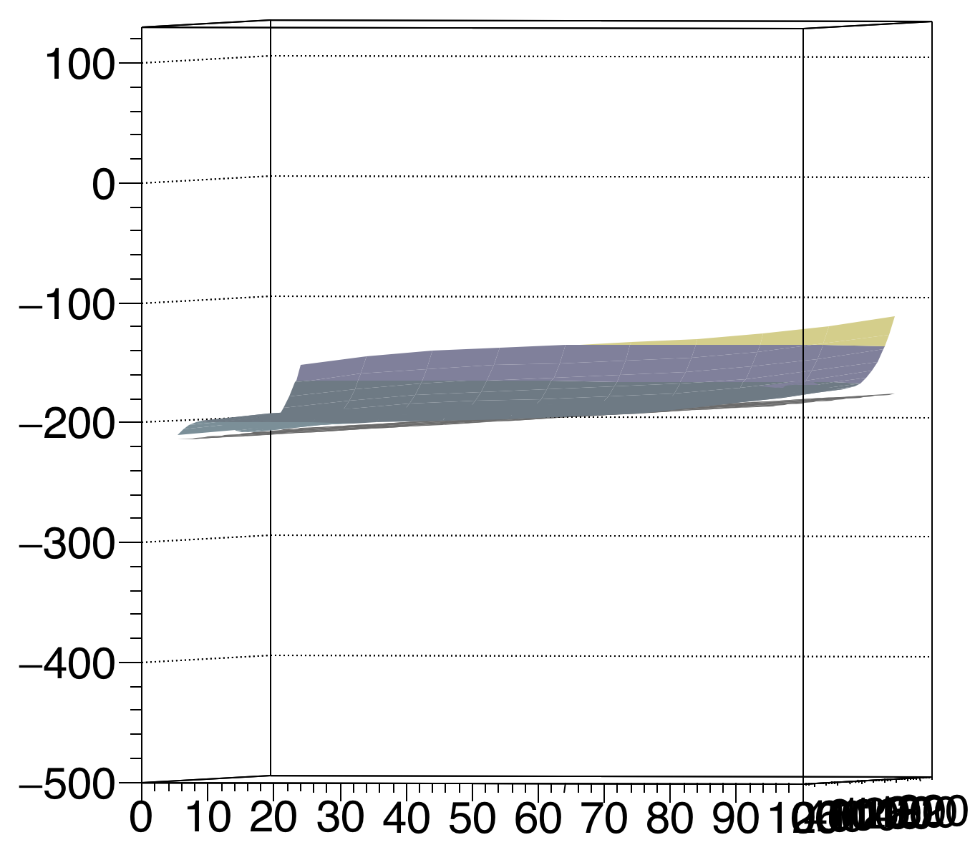
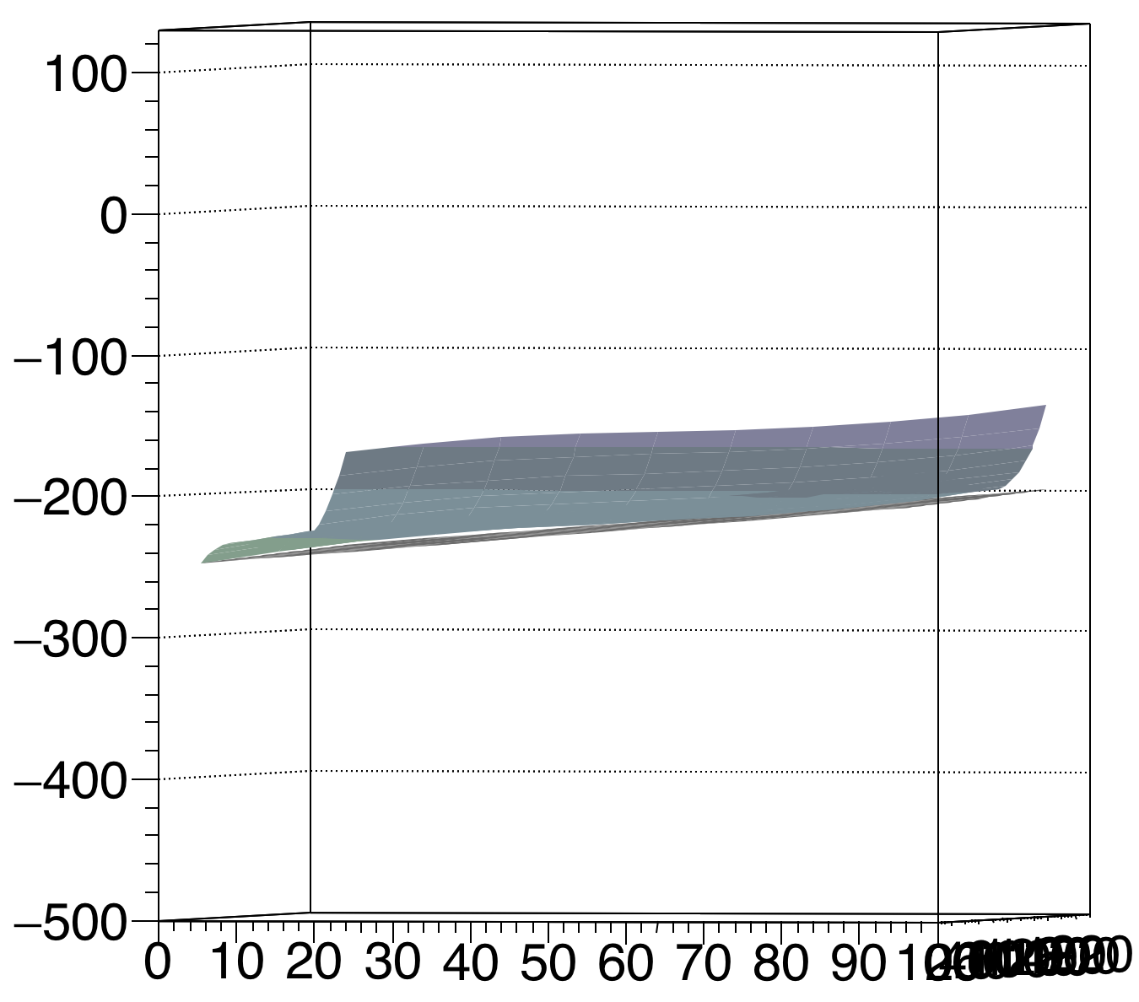
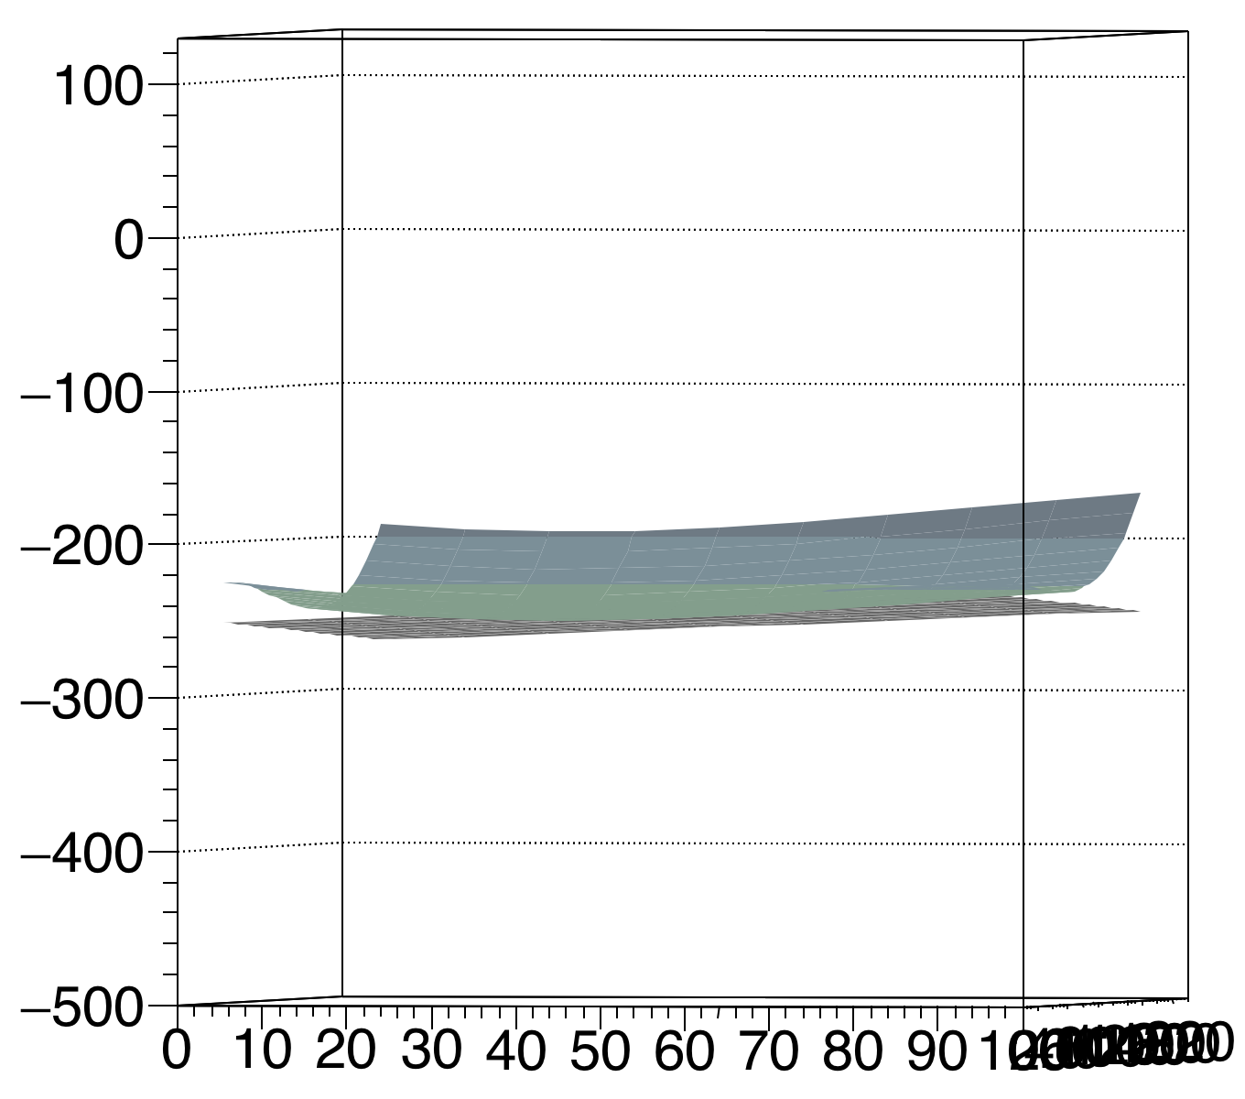
Convex - Modules 5 6 / 7 8
J Side
67.67
64.61
67.94
77.53

Slide 20
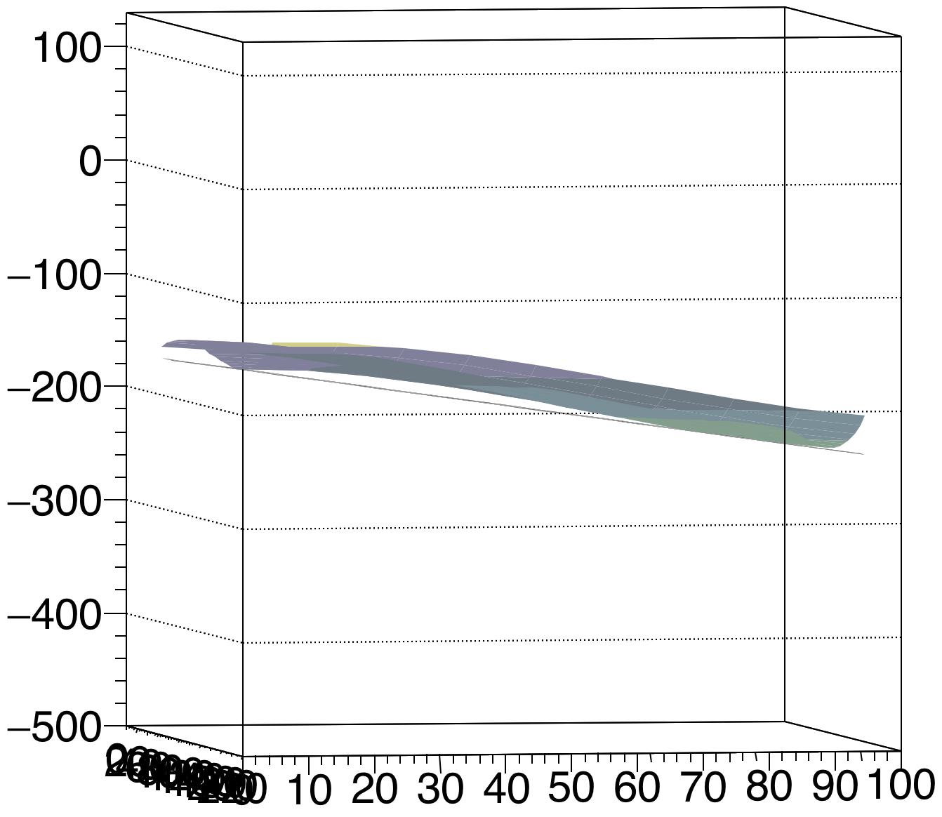
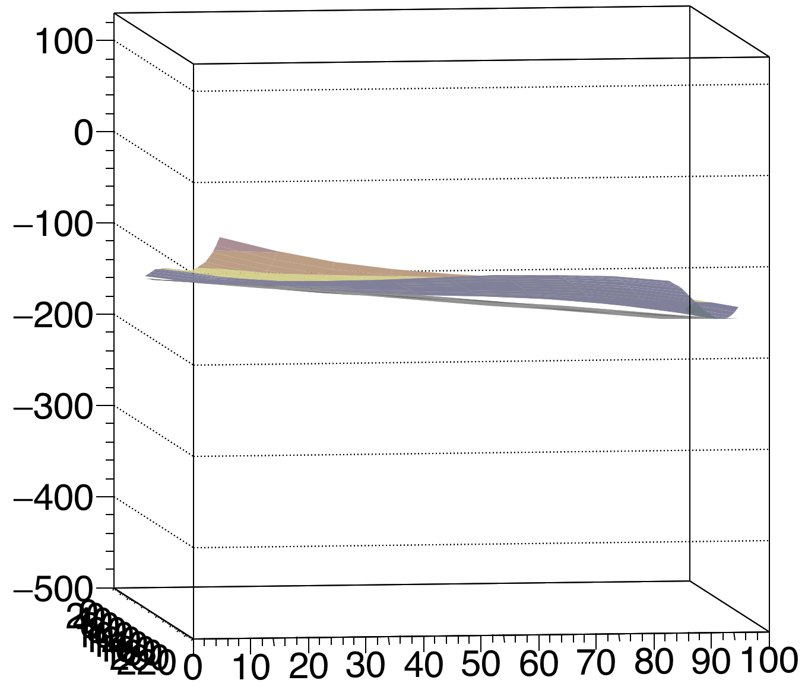
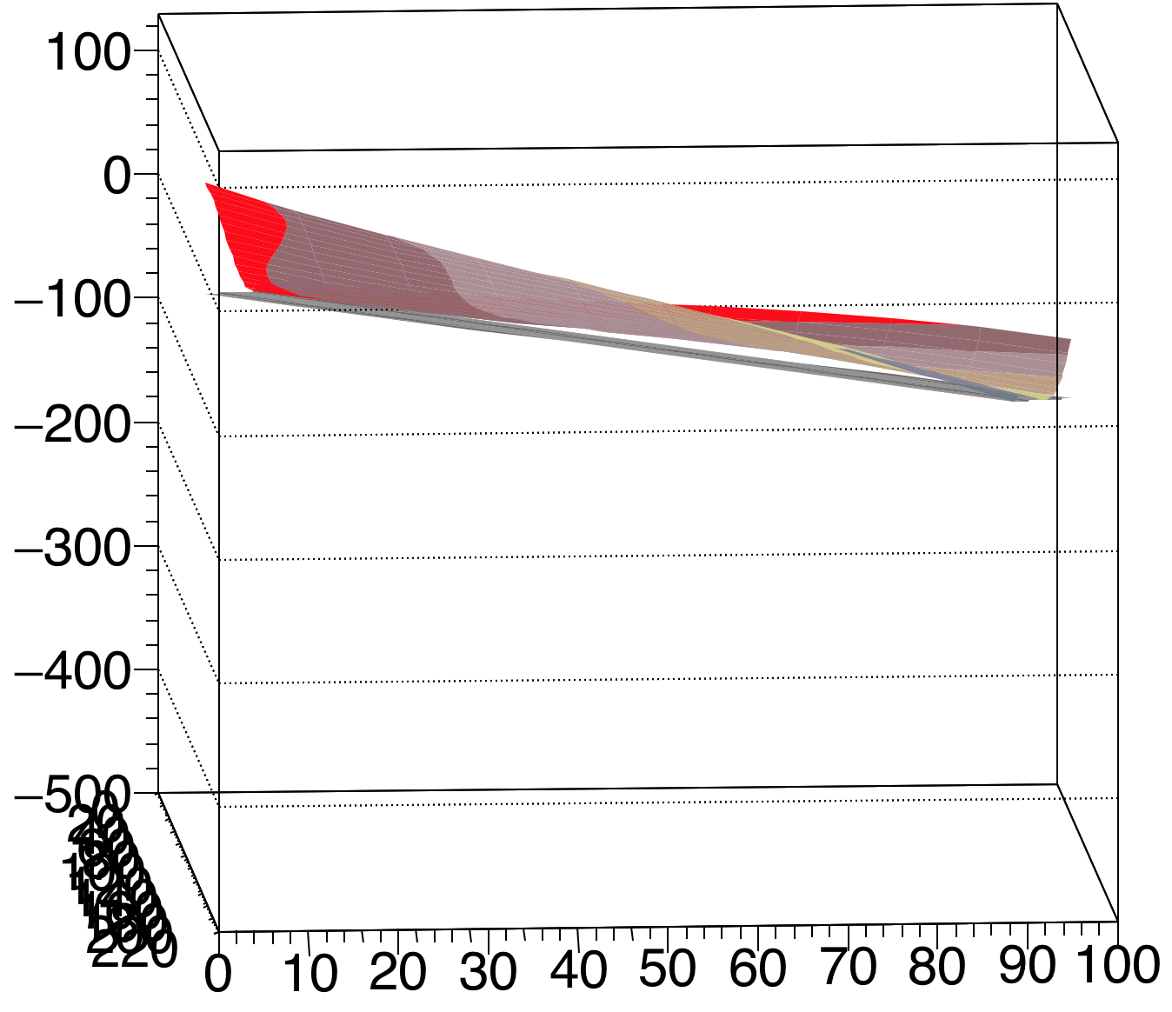
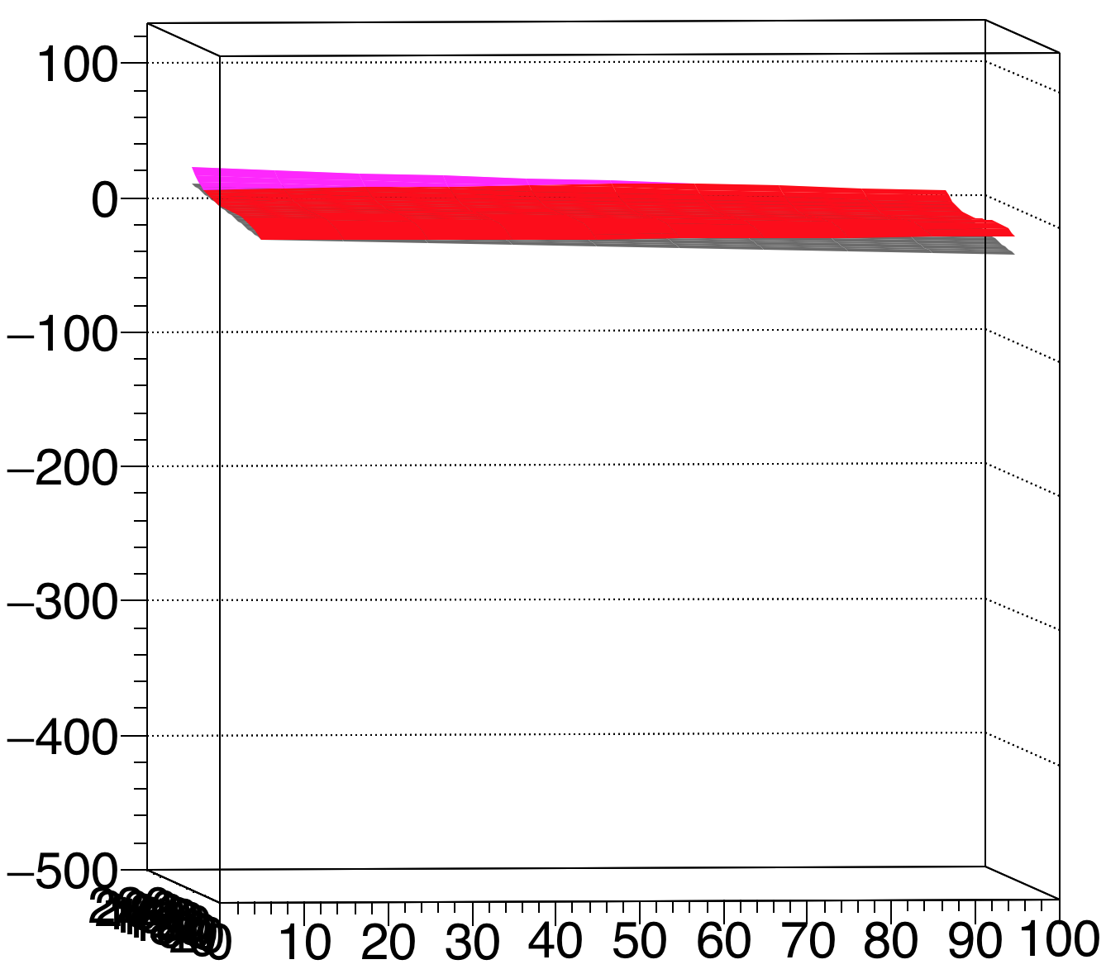
Convex - Modules 9 10 / 11 12
J Side
39.69
13.30
89.30
15.32

Slide 21
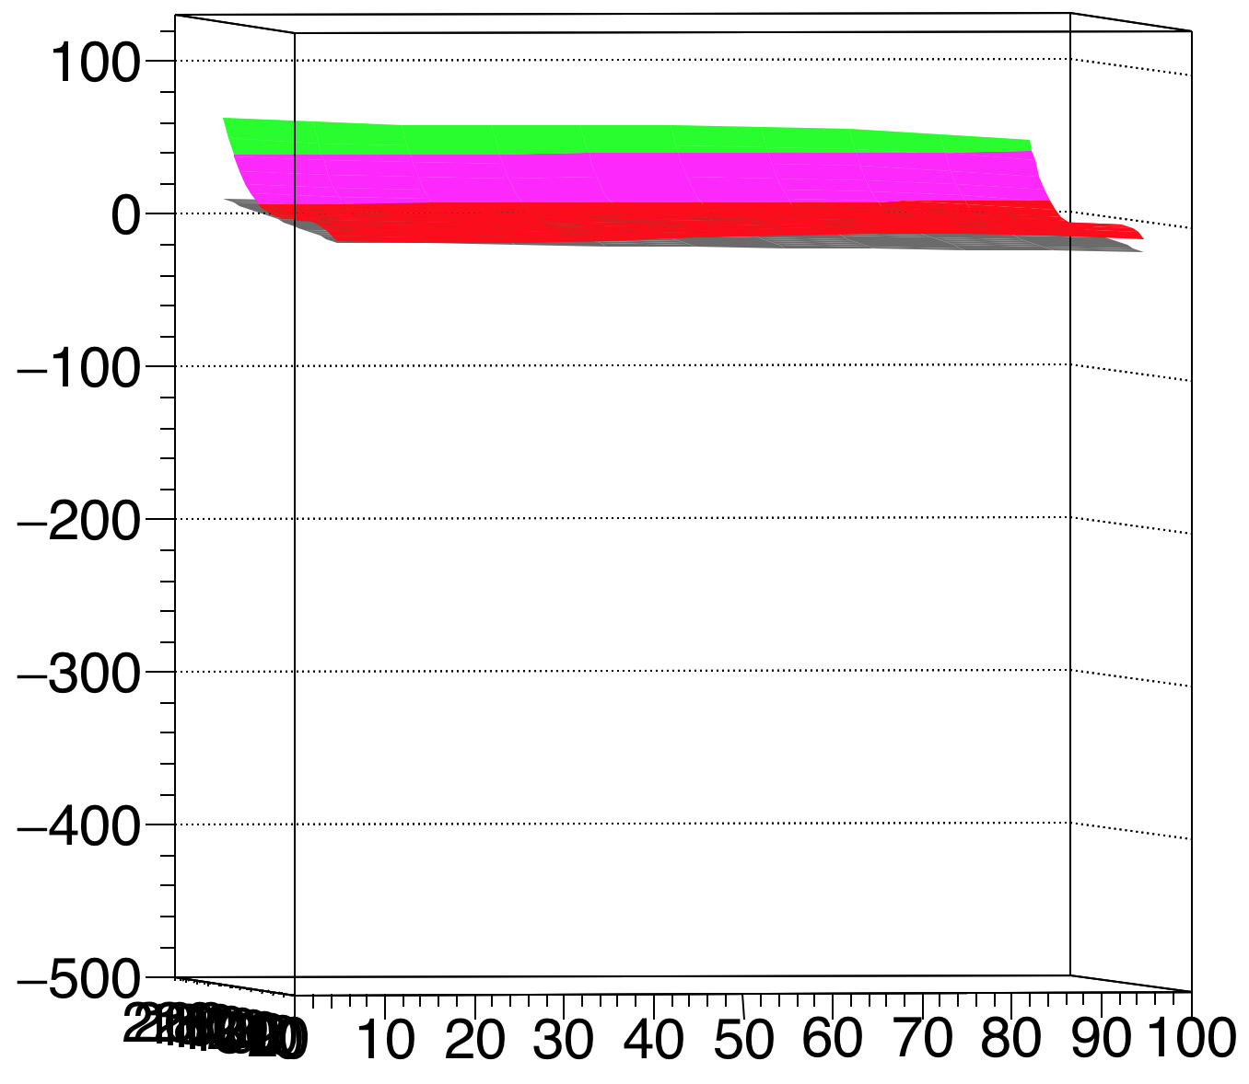
Convex - Module 13
J Side
53.37

Slide 22
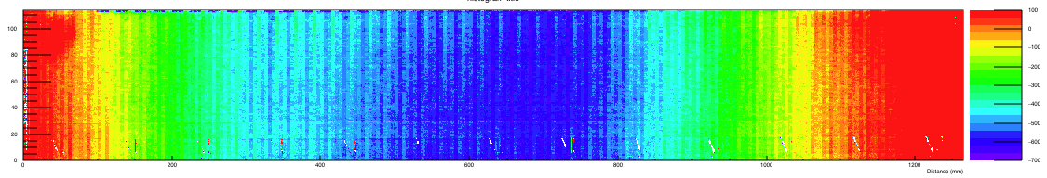
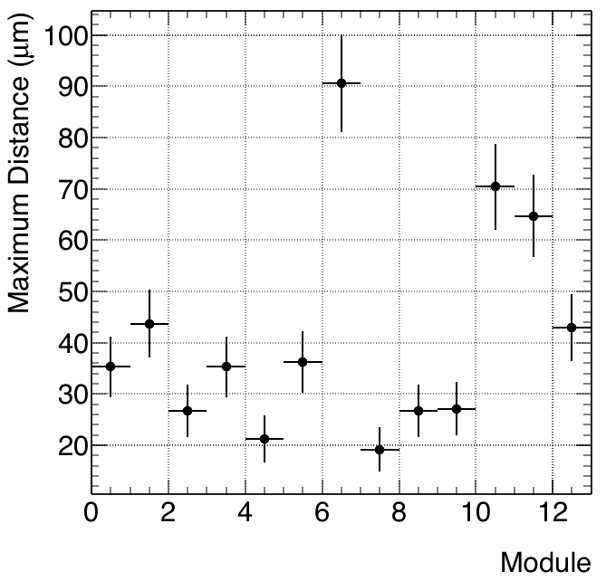

L side
Concave
Convex (inverted)

Slide 23




Concave - Modules 1 2 / 3 4
L Side
35.29
43.71
26.72
35.27

Slide 24




Concave - Modules 5 6 / 7 8
L Side
21.21
36.27
90.67
19.18

Slide 25




Concave - Modules 9 10 / 11 12
L Side
26.67
27.06
70.41
64.70

Slide 26

Concave - Module 13
L Side
42.87

Slide 27




Convex - Modules 1 2 / 3 4
L Side
42.76
28.95
24.61
50.43

Slide 28




Convex - Modules 5 6 / 7 8
L Side
24.19
48.96
98.57
26.58

Slide 29




Convex - Modules 9 10 / 11 12
L Side
28.08
35.80
48.37
82.46

Slide 30

Convex - Module 13
L Side
48.66

Slide 31
Edge Support

Slide 32



J side
Concave
Convex (inverted)

Slide 33




Concave - Modules 1 2 / 3 4
J Side
63.27
84.30
52.32
69.18

Slide 34




Concave - Modules 5 6 / 7 8
J Side
51.81
47.69
62.33
53.60

Slide 35




Concave - Modules 9 10 / 11 12
J Side
37.42
51.04
73.72
66.72

Slide 36

Concave - Module 13
J Side
13.49

Slide 37




Convex - Modules 1 2 / 3 4
J Side
62.50
79.82
55.81
80.35

Slide 38




Convex - Modules 5 6 / 7 8
J Side
74.28
66.85
69.34
82.52

Slide 39




Convex - Modules 9 10 / 11 12
J Side
40.30
44.09
77.20
46.51

Slide 40

Convex - Module 13
J Side
16.05

Slide 41


L side
Concave
Convex (inverted)

Slide 42




Concave - Modules 1 2 / 3 4
L Side
52.43
41.71
115.49
30.62

Slide 43




Concave - Modules 5 6 / 7 8
L Side
22.20
28.60
49.09
142.08

Slide 44




Concave - Modules 9 10 / 11 12
L Side
147.565
43.56
68.15
14.85

Slide 45

Concave - Module 13
L Side
143.45

Slide 46




Convex - Modules 1 2 / 3 4
L Side
46.35
69.91
96.59
40.51

Slide 47




Convex - Modules 5 6 / 7 8
L Side
24.07
42.39
32.87
138.33

Slide 48




Convex - Modules 9 10 / 11 12
L Side
162.76
58.31
78.83
17.14

Slide 49

Convex - Module 13
L Side
109.55

