Slide 1


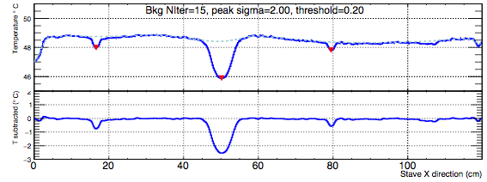
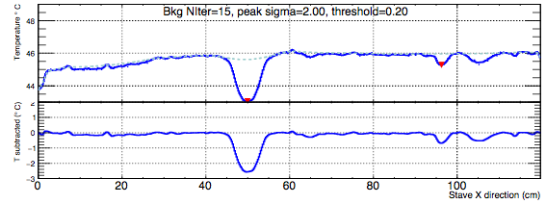
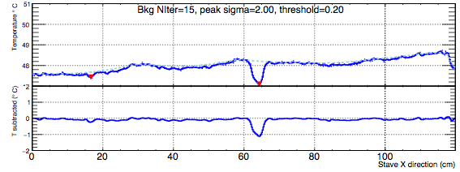
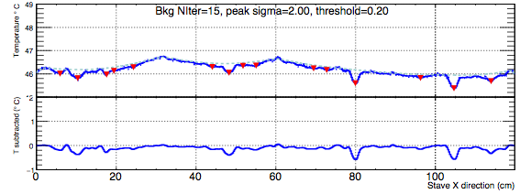
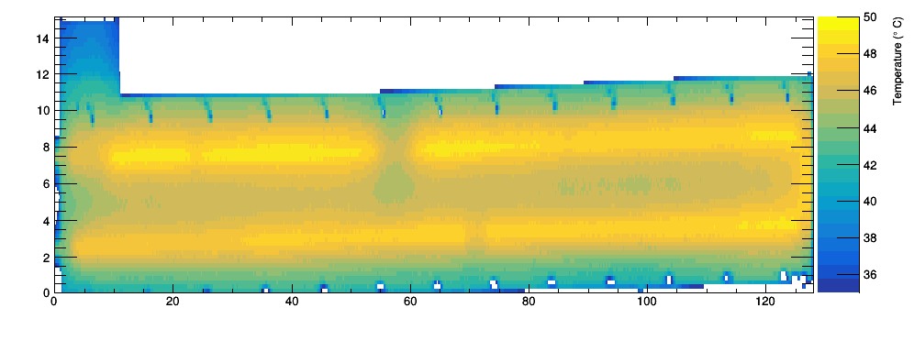
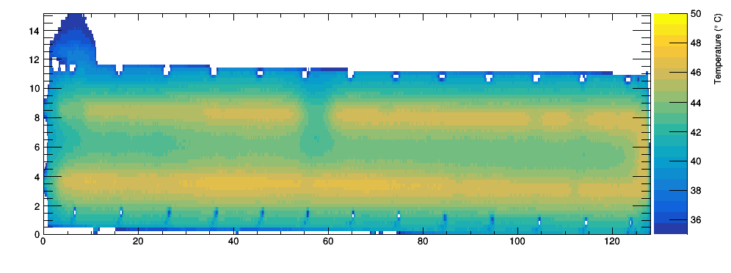


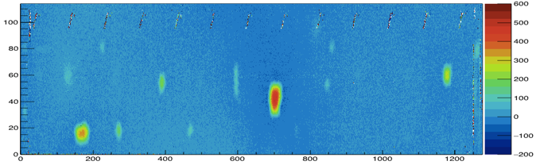

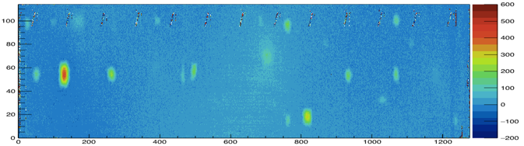
Stave #4 comparison, matching
(B): 2-3 cm
(A): 5–8 cm
(B): <=2cm
(A): 5–8 cm
(B): 2–3 cm
Thermal imaging
J side
L side
L side
??
From Boping & Carlos
laser scanning

Slide 2
backup

Slide 3


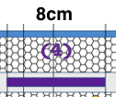






















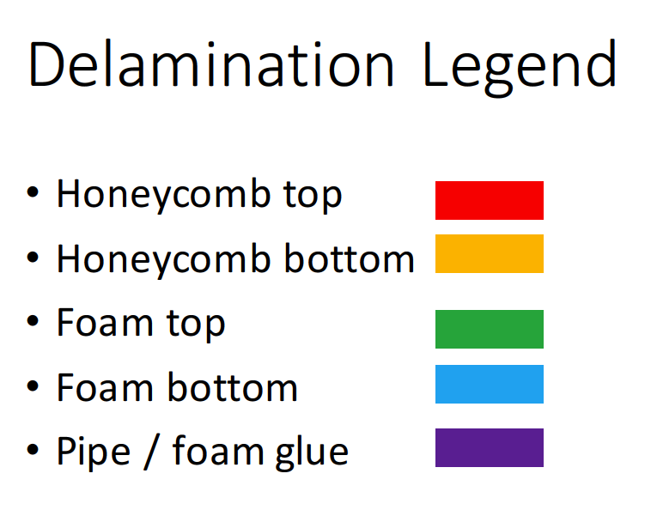
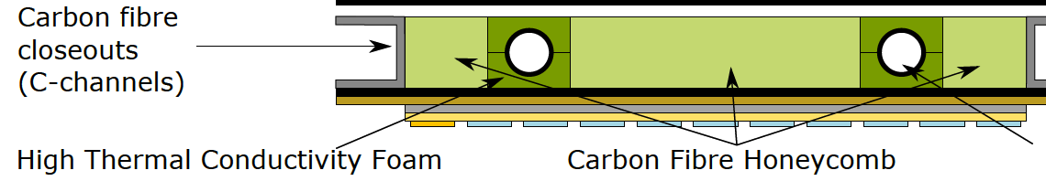
Delamination type from stave #2
3.5cm
4cm
(C)
can be fluctuation.
(A)
might be one of the two peaks.
(B)
Conclusions below depend on how accurately the delaminations are implemented.
(A): Pipe-foam glue missing (full pipe ring or partially??).
  1 (nice peak) out of the 3 seen on both sides, the other two seen on one side.
  2.5 cm one is hardly seen. 8cm one doesn’t form nice peak. Might due to some other kind of delamitation on a larger scale.
(B): Foam-facing glue missing (full).
  Mostly form a nice peak ~1 C height.
  3cm is clear, 2cm can also be found.
  Effect seen also on the other side’s T distribution.
(C): Foam-facing glue missing (partial).
  Cannot form nice peaks. A wider T deficit seen.
  2cm is hardly seen. 2.5cm is found.

