Slide 1
Weekly Update
Carlos Vergel-Infante
May 3rd, 2017

Slide 2
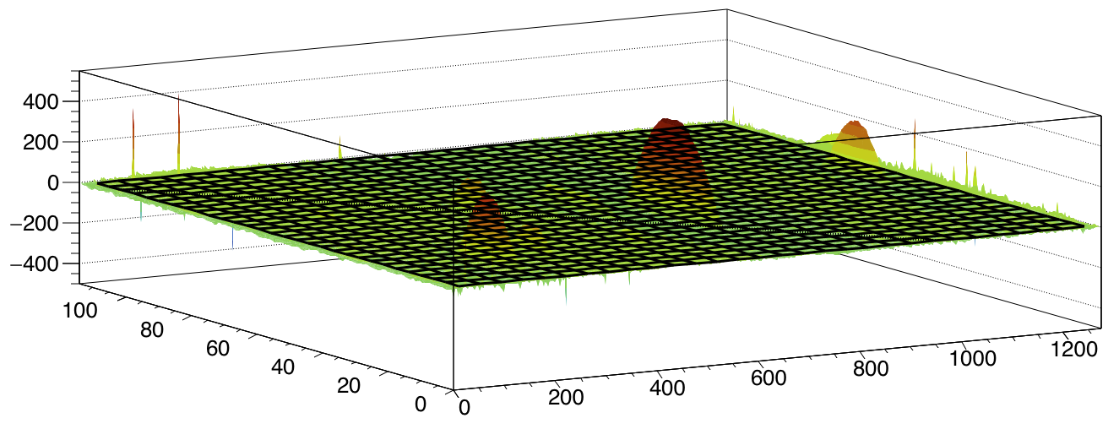
After removing peaks
Each pixel calculates the average of the neighbors.
Then, the stave is fit to a 2D plane
If the absolute difference between average and pixel value is larger than 20, replace for fitted value of the pixels
Plot pixel - fitted plane

Slide 3
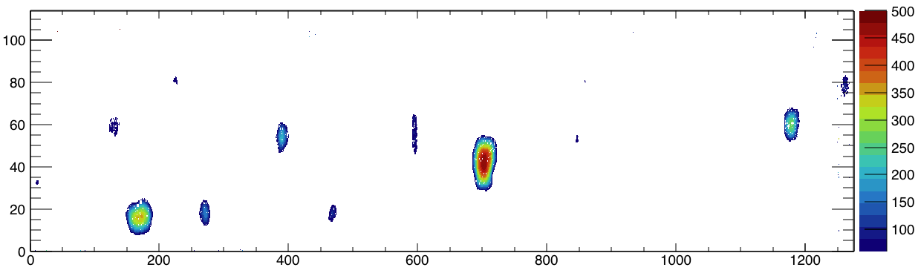
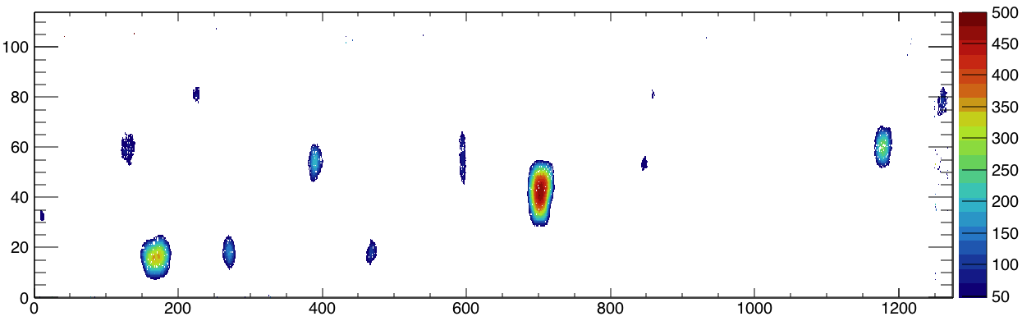
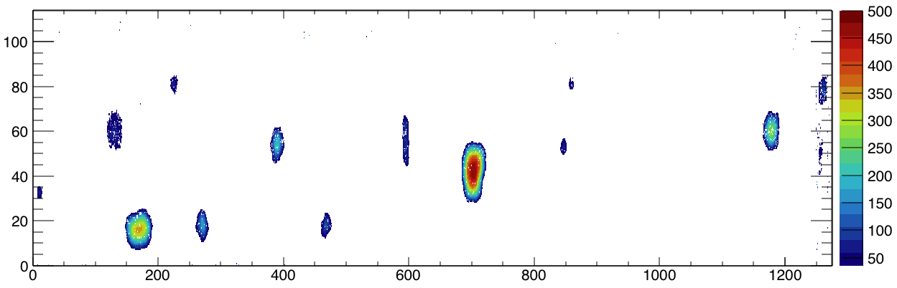
Taking sigma as 12 um
J side
5 sigma (60 um)
4 sigma (48 um)
3 sigma (36 um)

Slide 4
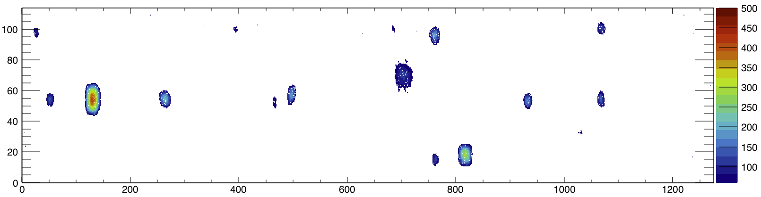
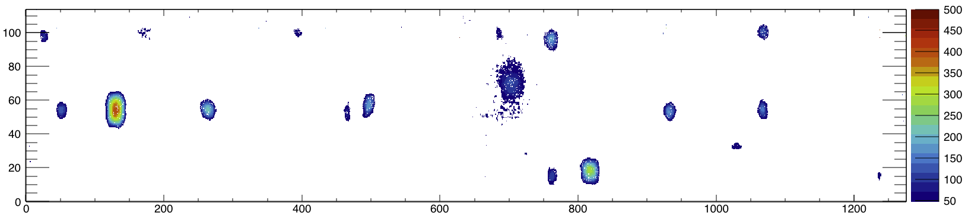
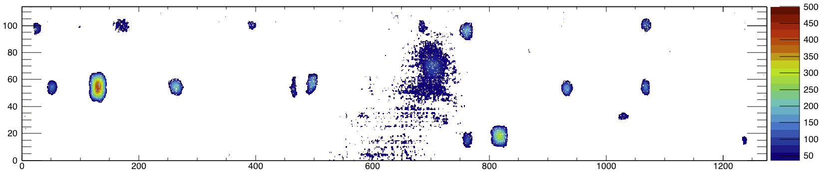
Taking sigma as 12 um
L side
5 sigma (60 um)
4 sigma (48 um)
3 sigma (36 um)

Slide 5
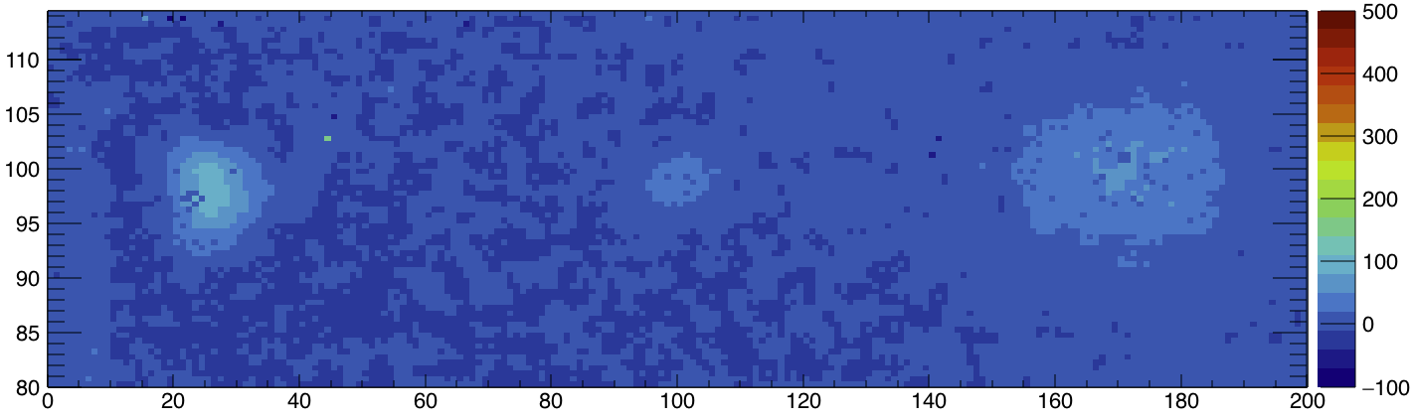
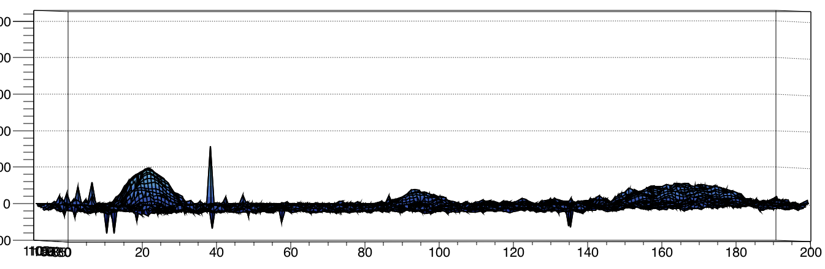

Slide 6
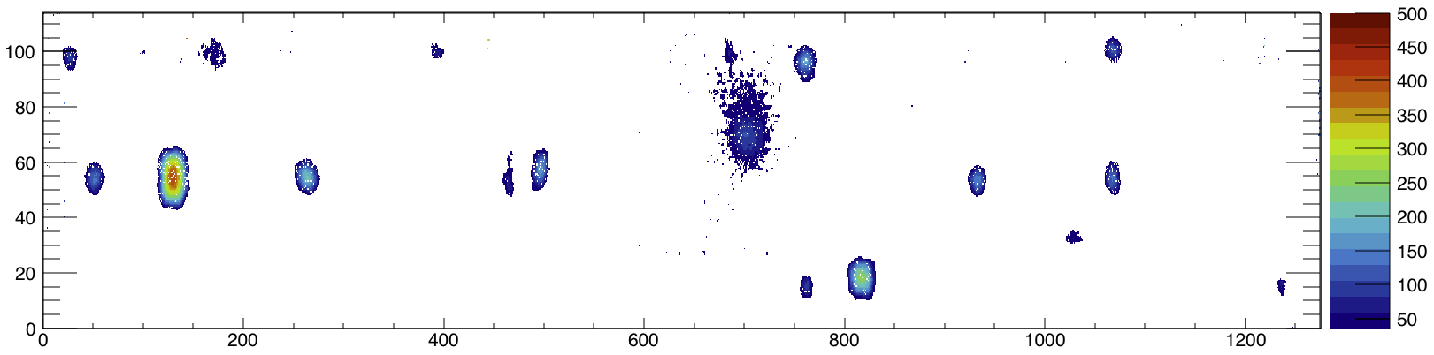
Edge support (3 sigma)
Full support

Slide 7
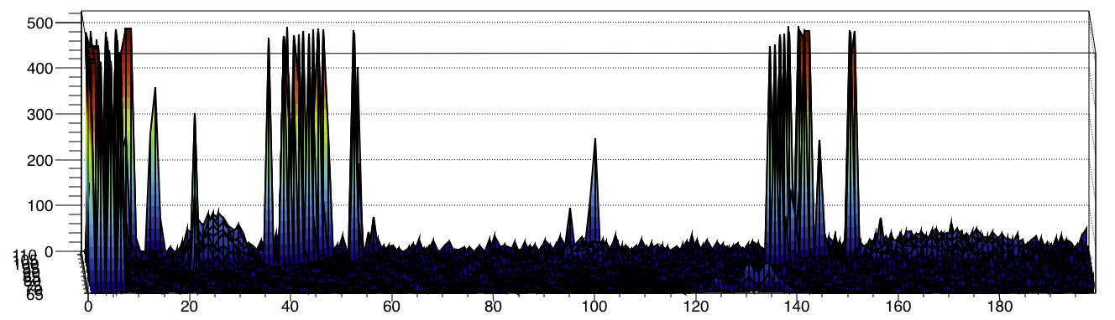
Only one of the three peaks over 3 sigma is noticeable.

Slide 8
Back Up

Slide 9
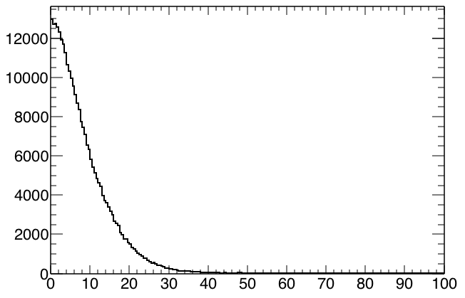
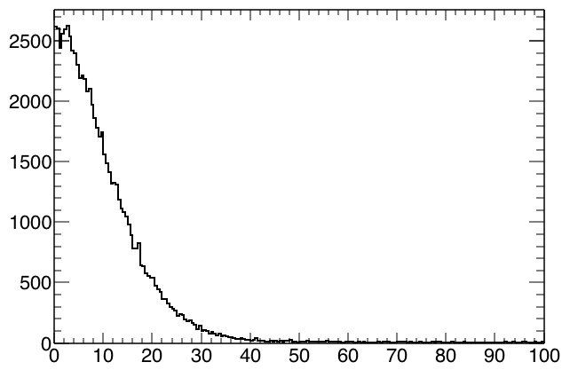
3x3 average minus pixel value in absolute value for the whole stave
For only the part with the 13 objects

