Slide 1
Laser update
May 10, 2017

Slide 2
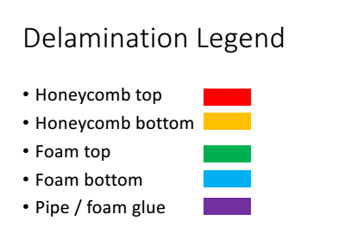
Comparison(map and measurement)
I guess what we can see:
J view: honeycomb bottom(yellow) and (?)foam bottom(blue)
L view: honeycomb top(red) and (?)foam top(green)

Slide 3


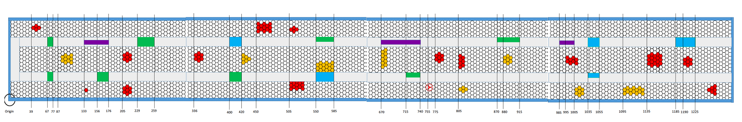
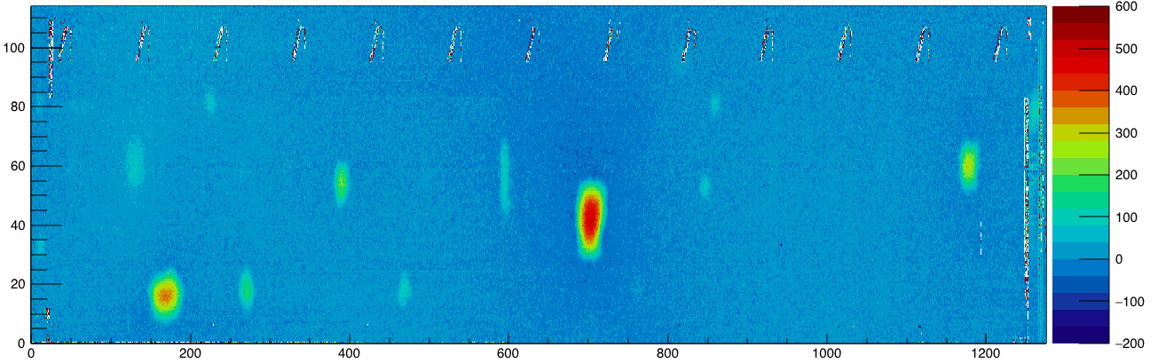
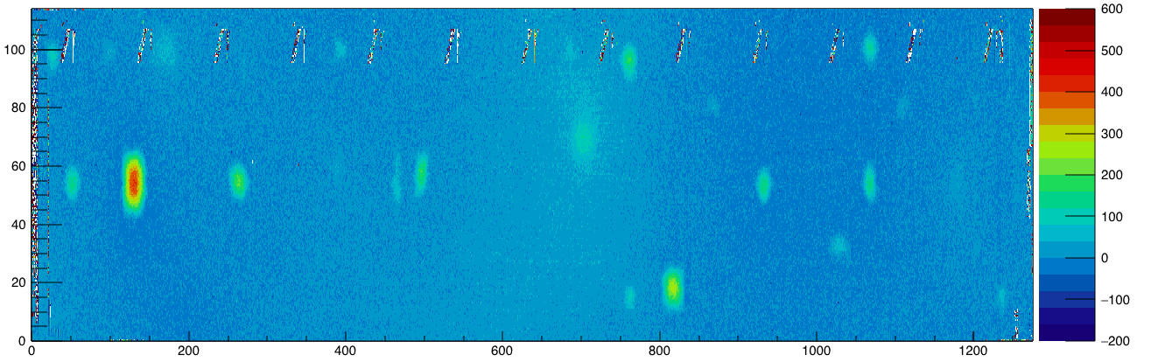
J view
L view

Slide 4
Weird points and lines
J view
L view

Slide 5
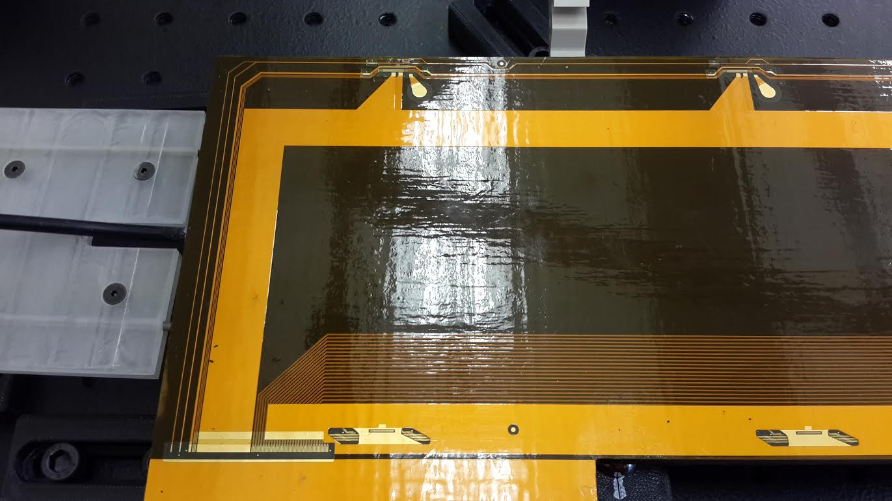
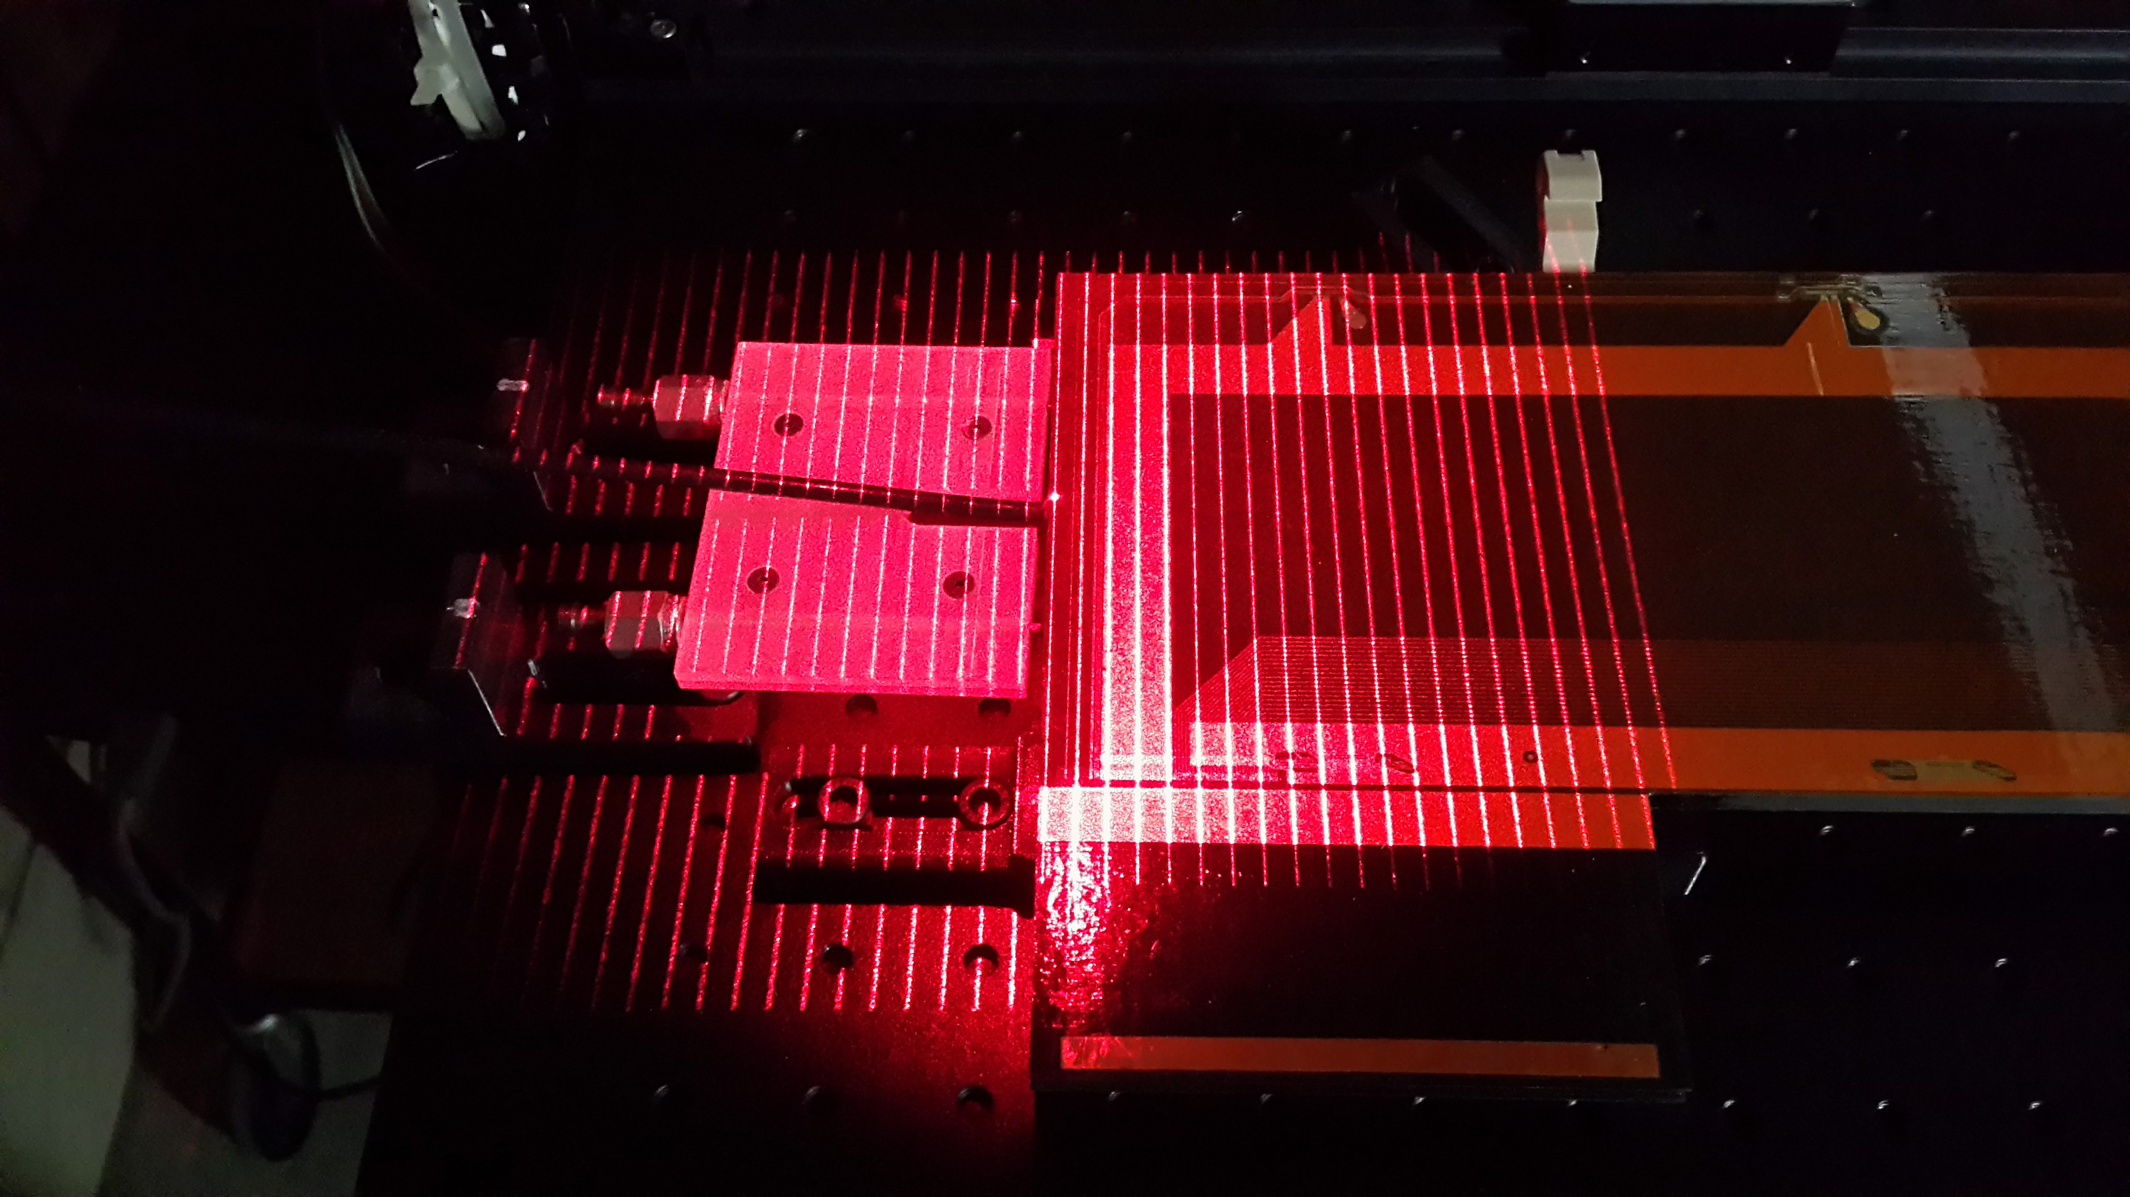
In Real world(L view Beginning)
Two material; different brightness

Slide 6
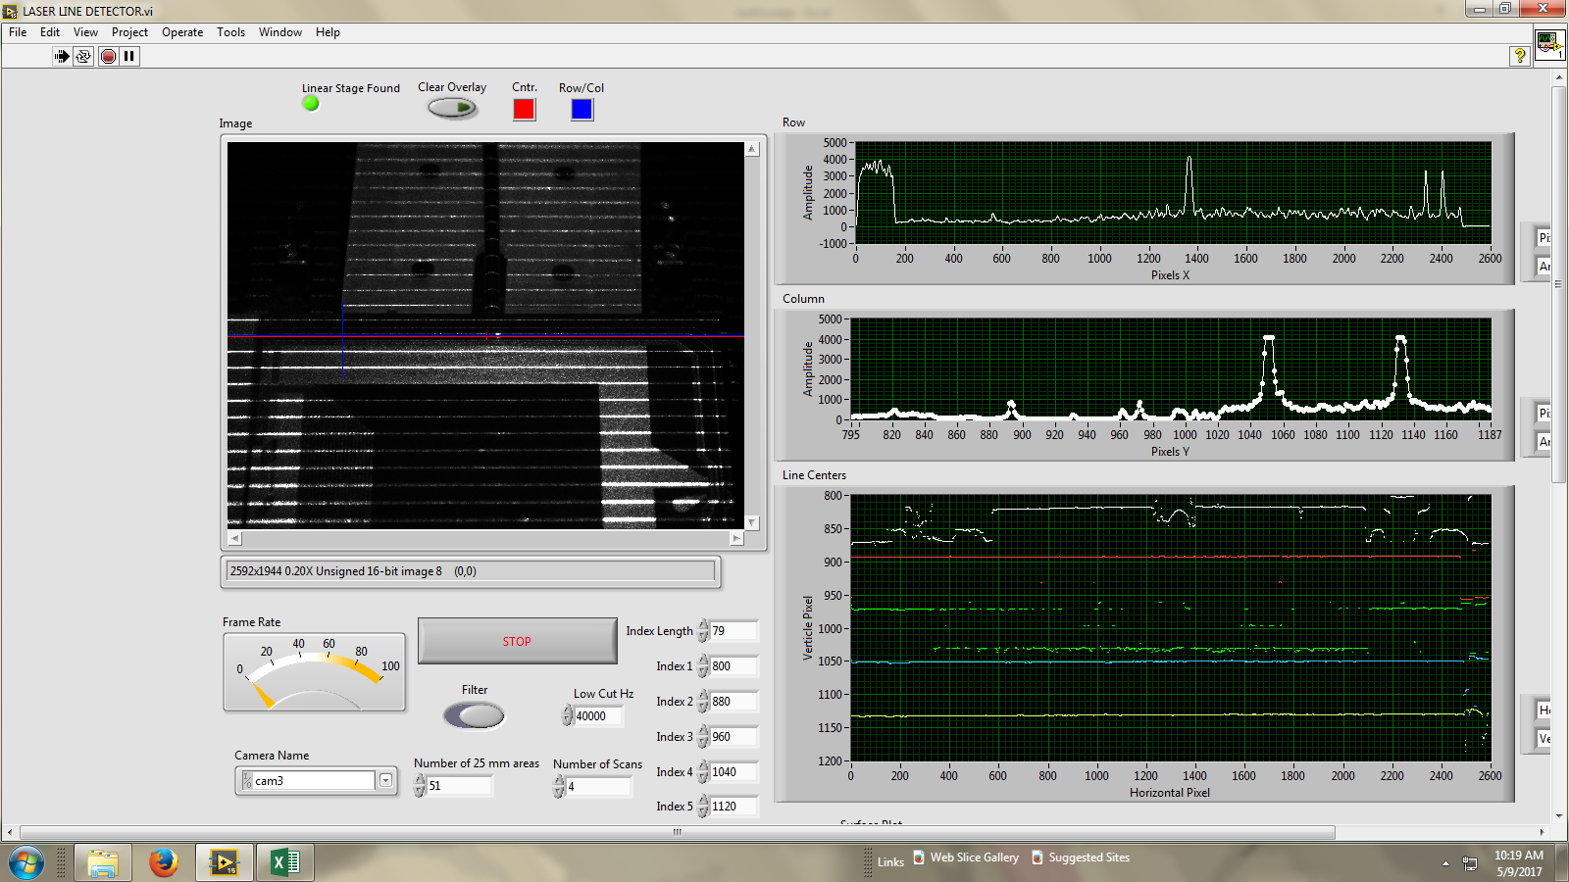
In Labview

Slide 7
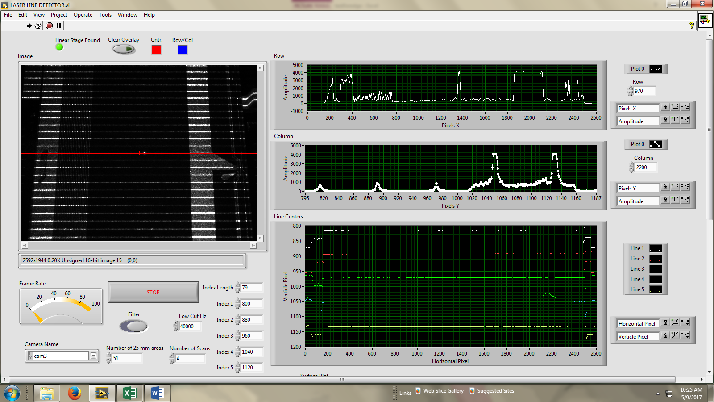
(weird lines)

Slide 8
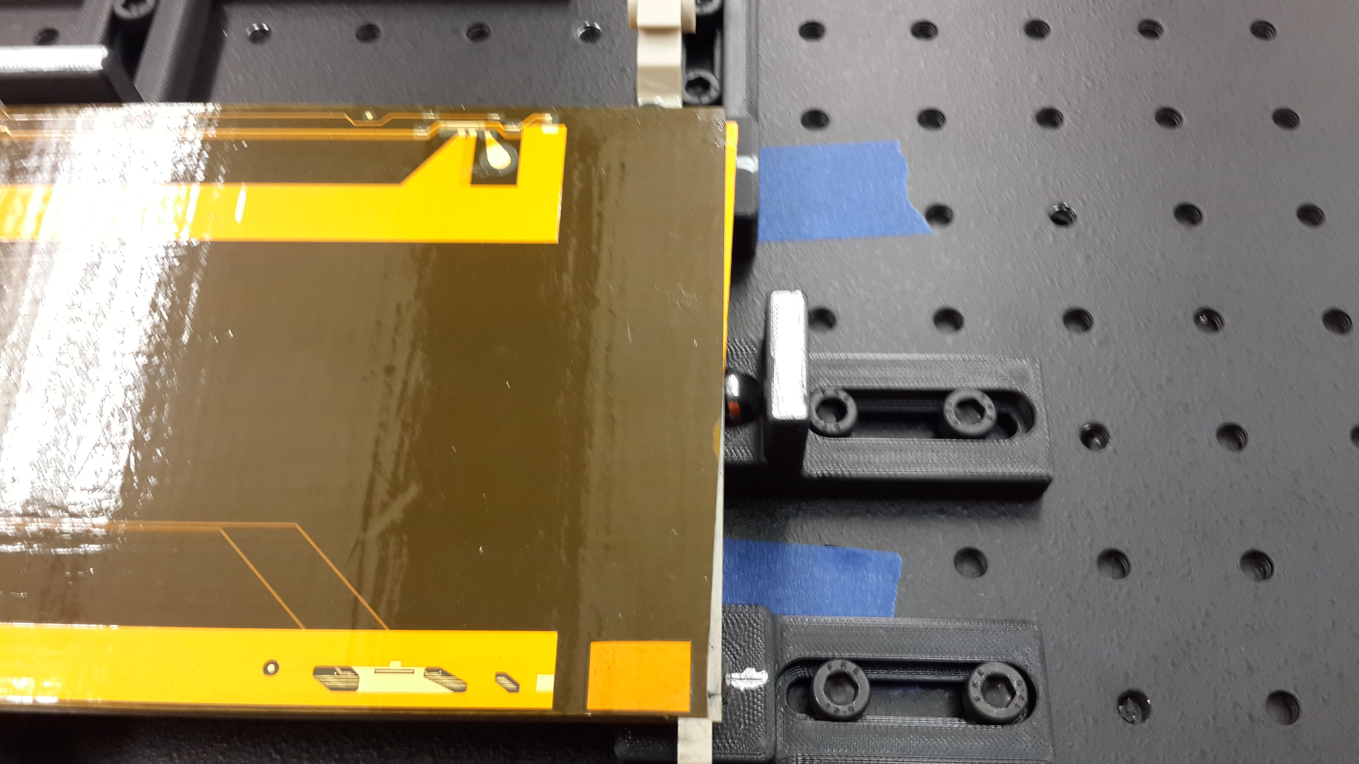
L view End

Slide 9
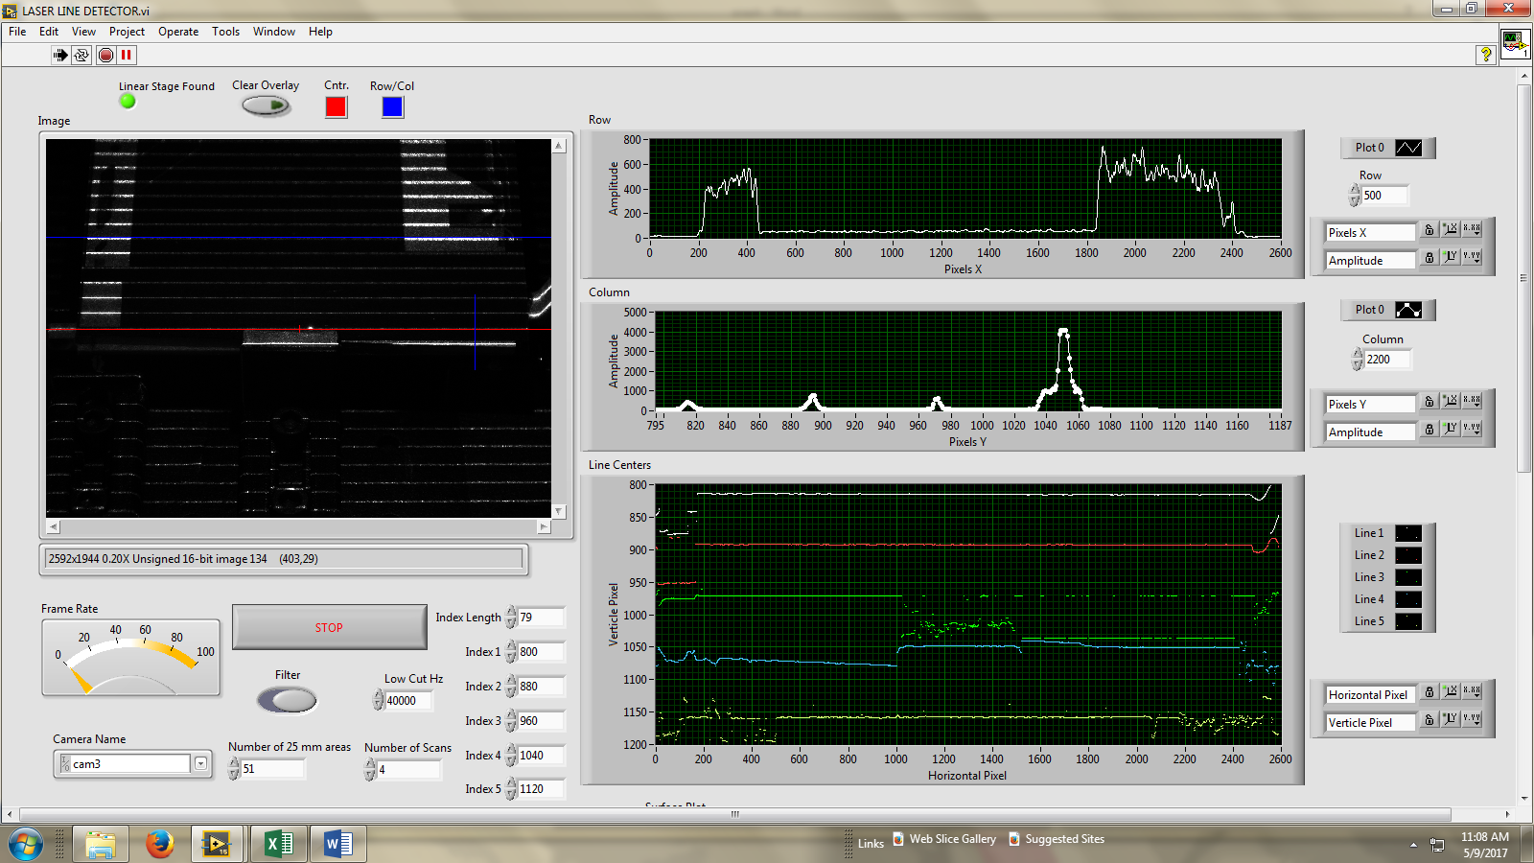
L view end

Slide 10
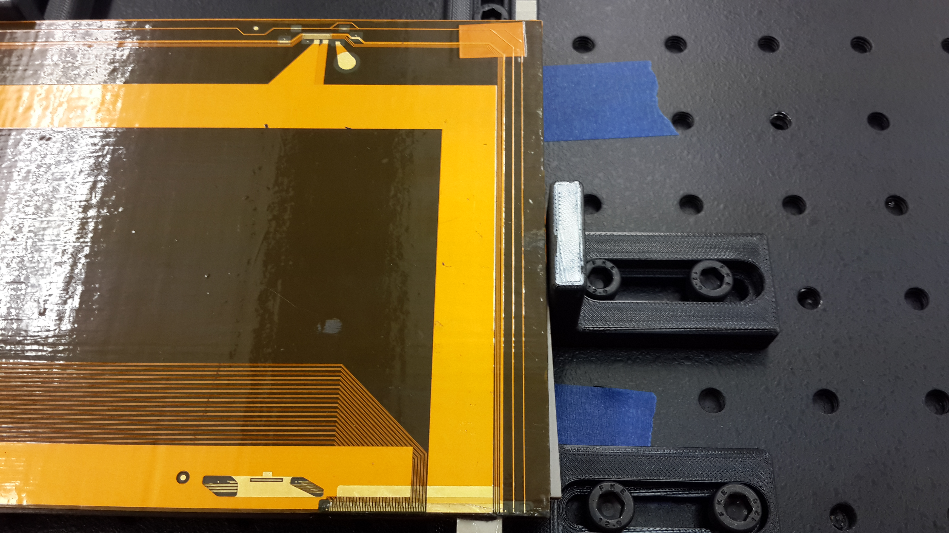
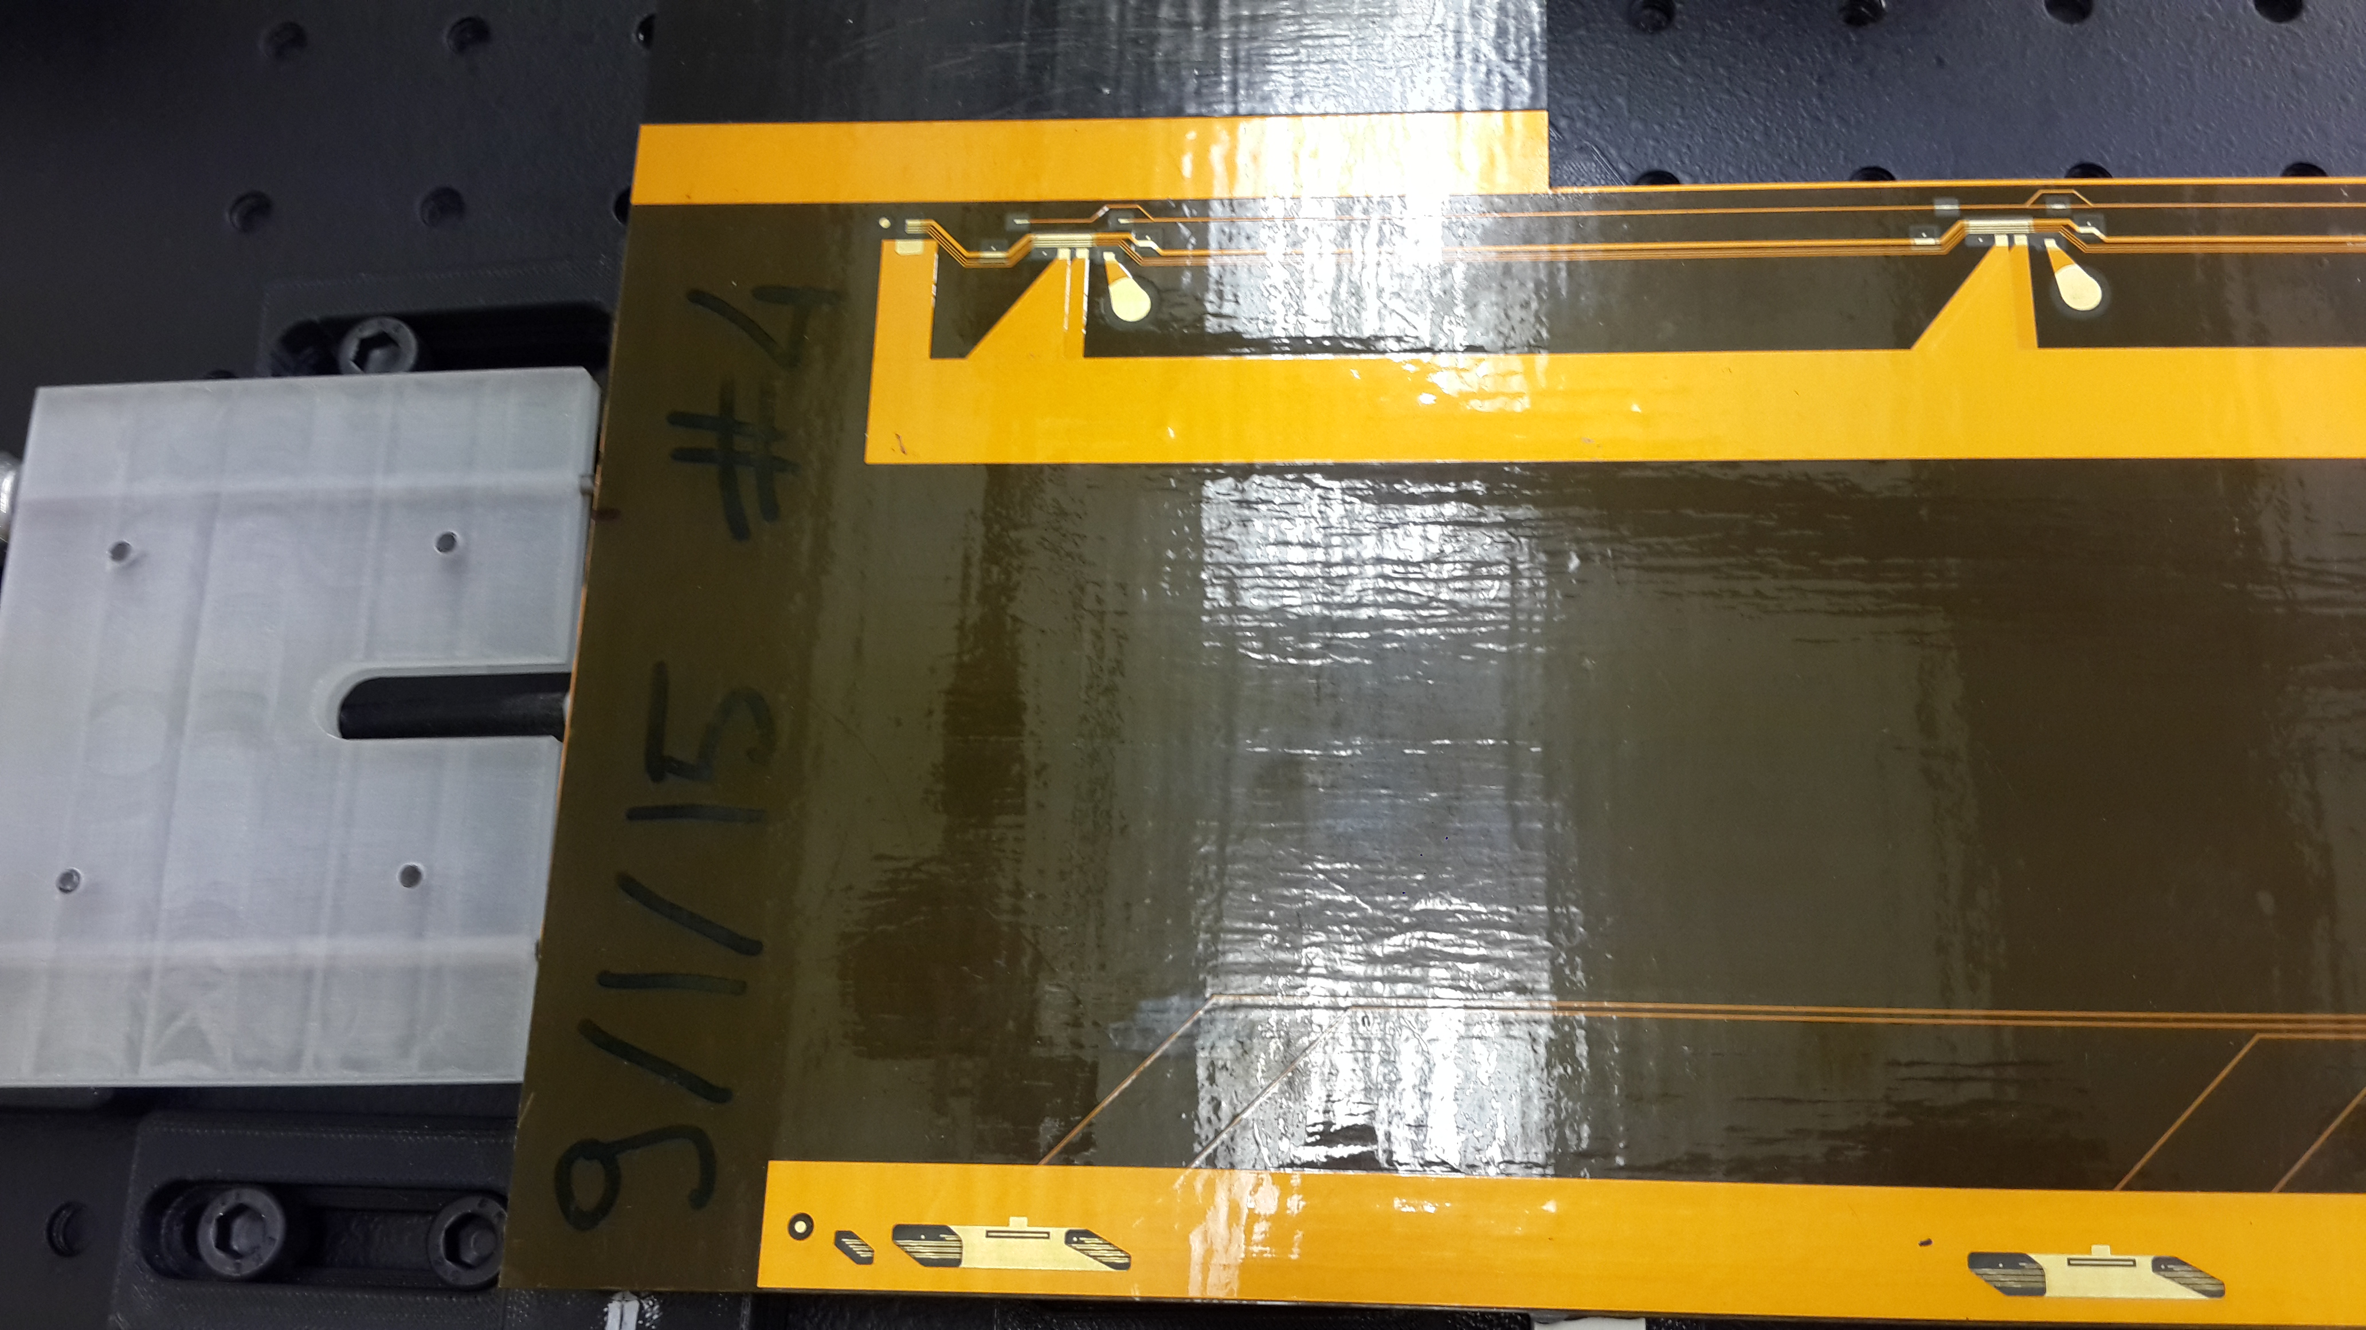
J view

