Slide 1
Laser update
May 31, 2017

Slide 2
Outline
1: Bending with simple support(#2)
2: Resistance(#4);
3: Scanning for 1 module(#4).

Slide 3
Simple support #2
0(g) | 0(mm)
50 | 0.205
100 | 0.547
150 | 0.735
200 | 1.05
250 | 1.3
300 | 1.53
350 | 1.77
500 | 2.59
L
0(g) | 0(mm)
50 | 0.25
100 | 0.45
150 | 0.75
200 | 1.02
250 | 1.28
300 | 1.52
350 | 1.75
500 | 2.54
J

Slide 4
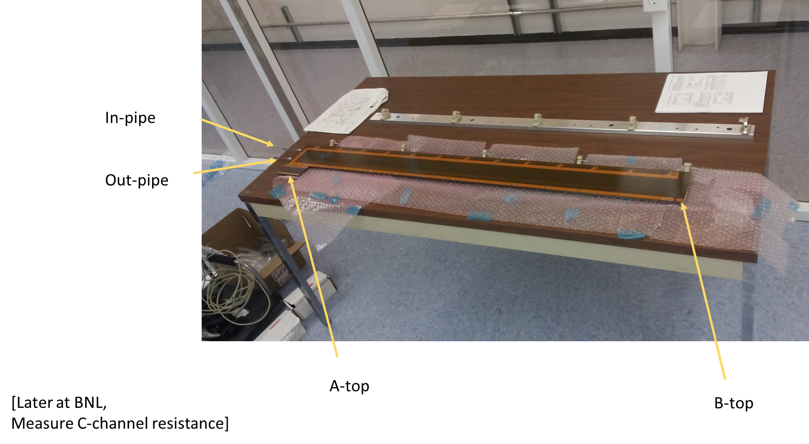
Resistance #4
resistance | A-top | (ohm)
 | B-top | No reading??
 | A-bottom | 3.2-4.4
 | B-bottom | No reading??
 | Inlet Pipe | 3
 | Outlet Pipe | 3.01
 | C-channel short
 | C-channel long
DC Resistance
 | A-top
 | B-top | 1.18
 | A-bottom | 0.86
 | B-bottom | 1.35
 | Inlet Pipe | 1.35
 | Outlet Pipe | 0.85
 | C-channel short
 | C-channel long

Slide 5
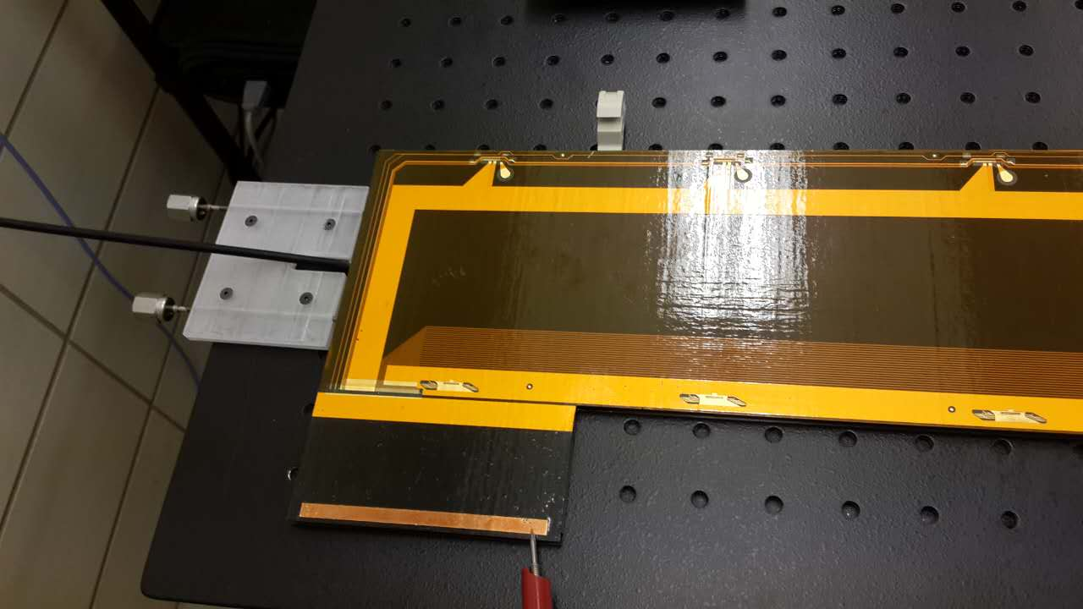
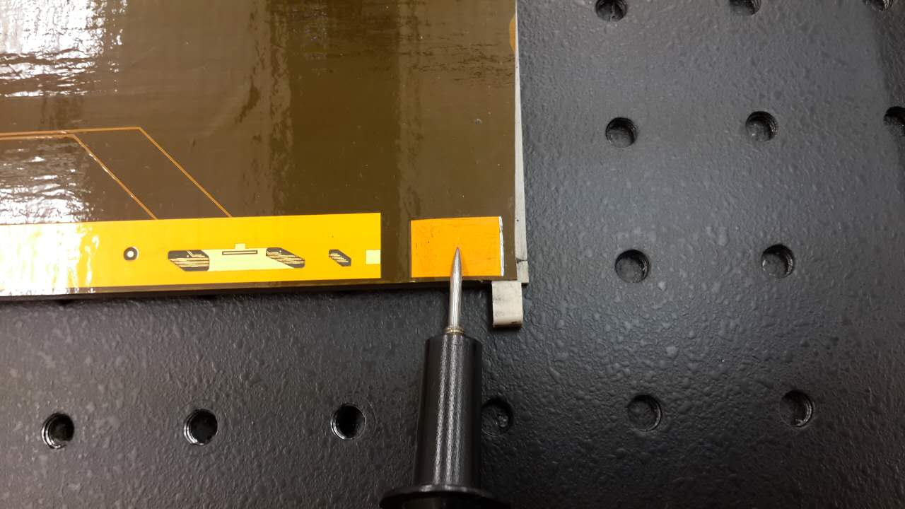
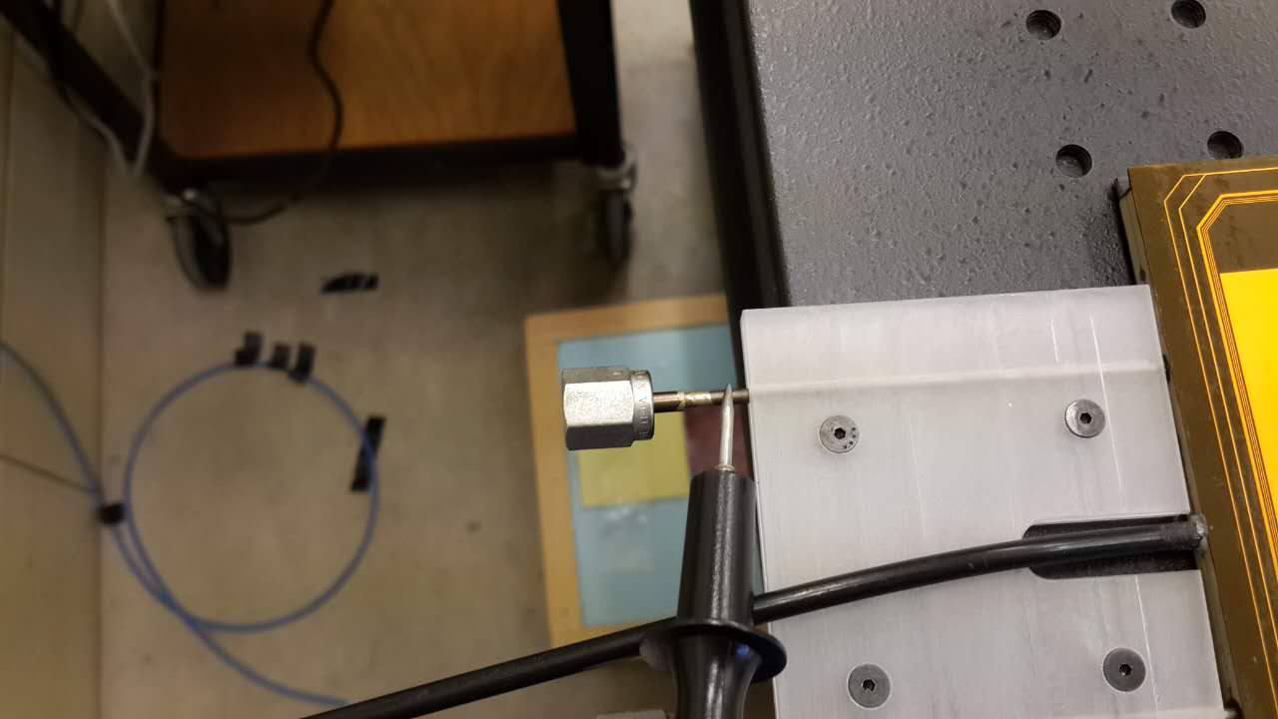
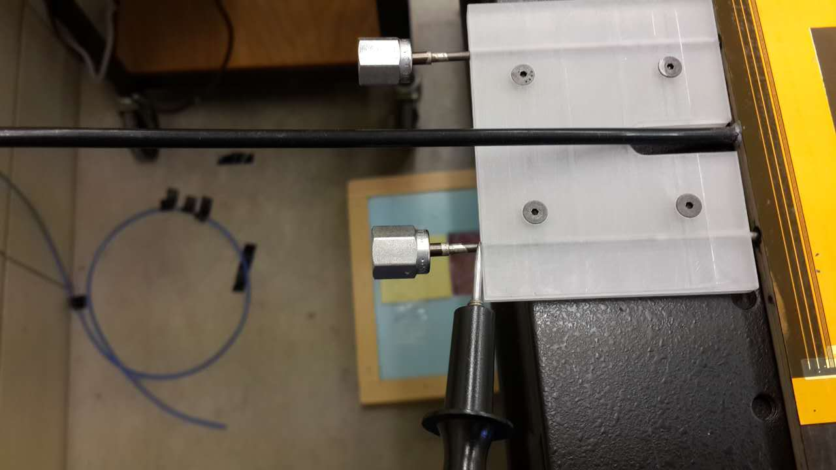

Slide 6
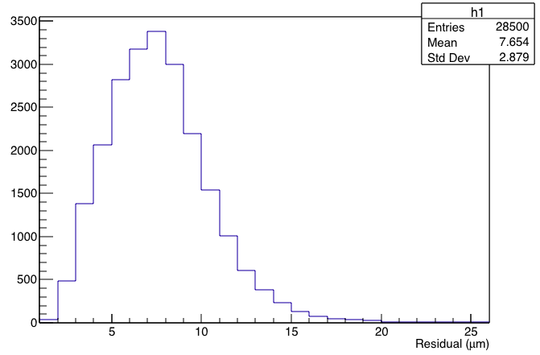
Rms for 1 module
1:Scan 50 times for 1 module;
2:Calculate the rms for the whole area;
3:Draw the histogram for rms;

