Slide 1
Laser update
June 7, 2017

Slide 2
Outline
1: Bending with simple support(#2)
2: Resistance(#4);
3: Scanning for 1 module(#4).

Slide 3

Simple Support

Slide 4
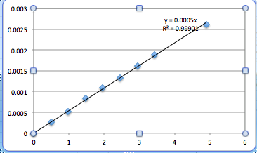

Simple support #2
L view 1.25m | Weight(N) | Deflection(m)
 | 0.49 | 0.00026
 | 0.98 | 0.00052
 | 1.47 | 0.00084
 | 1.96 | 0.0011
 | 2.45 | 0.00132
 | 2.94 | 0.00161
 | 3.43 | 0.00188
 | 4.9 | 0.00262
= slope

Slide 5
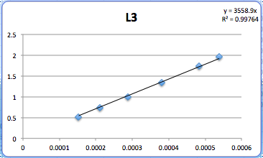
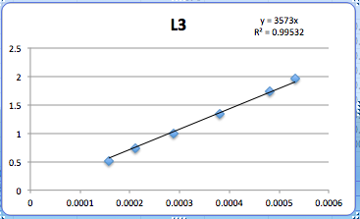
Data(stave #2)
D=57
L³(m³) | 1.953125 | 1.728 | 1.331 | 1 | 0.729 | 0.512
delta/weight (L view) | 0.000538308 | 0.00048381 | 0.000379461 | 0.000287054 | 0.000211036 | 0.000152748
J view | 0.000532009 | 0.000481559 | 0.00037986 | 0.000287424 | 0.000211521 | 0.000157479
Lview: D=3558.9/48=74.14
Before: D=74.63
Jview: D=3573/48=74.44
Before: 74.28

Slide 6
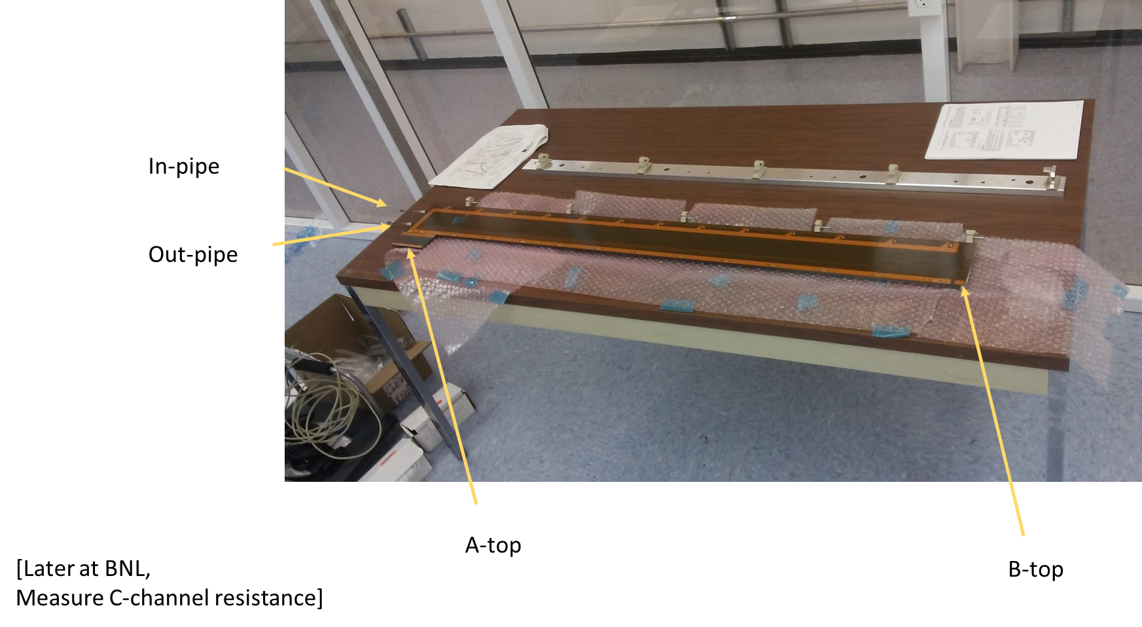
Resistance #4
resistance | A-top | (ohm)
 | B-top | 2.4
 | A-bottom | 3.2
 | B-bottom | 4.1
 | Inlet Pipe | 3.4
 | Outlet Pipe | 3.55
 | C-channel short
 | C-channel long
DC Resistance
 | A-top
 | B-top | 1.18
 | A-bottom | 0.86
 | B-bottom | 1.35
 | Inlet Pipe | 1.35
 | Outlet Pipe | 0.85
 | C-channel short
 | C-channel long

Slide 7
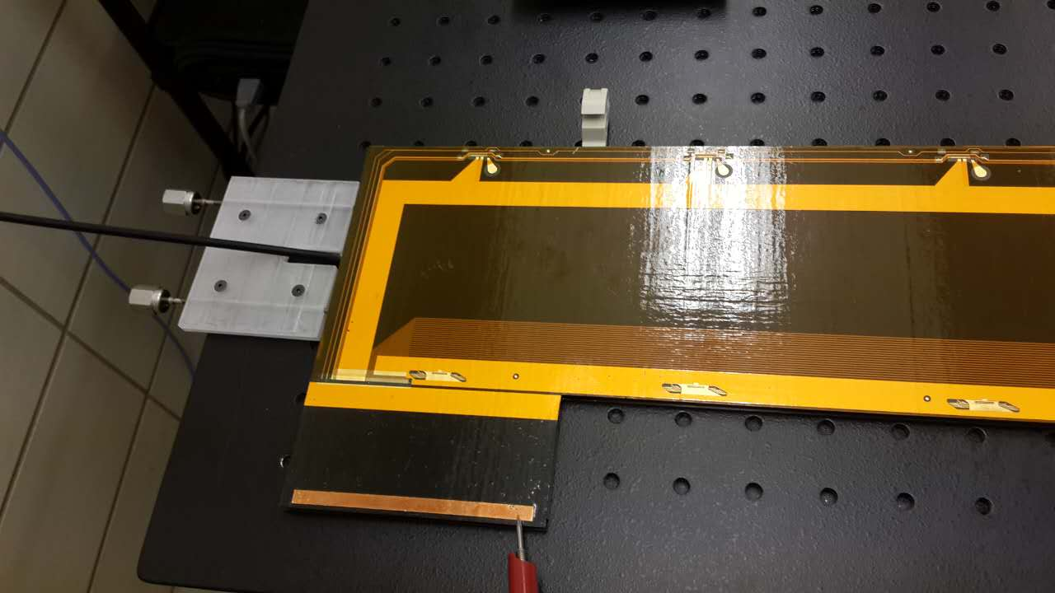
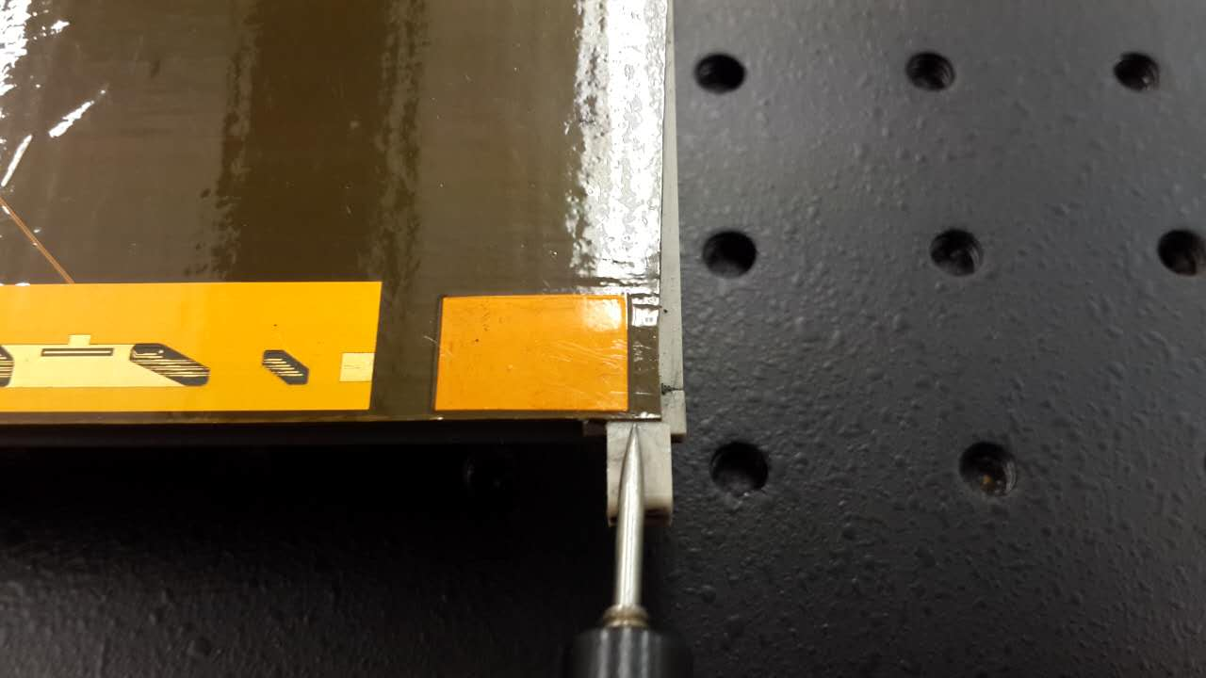
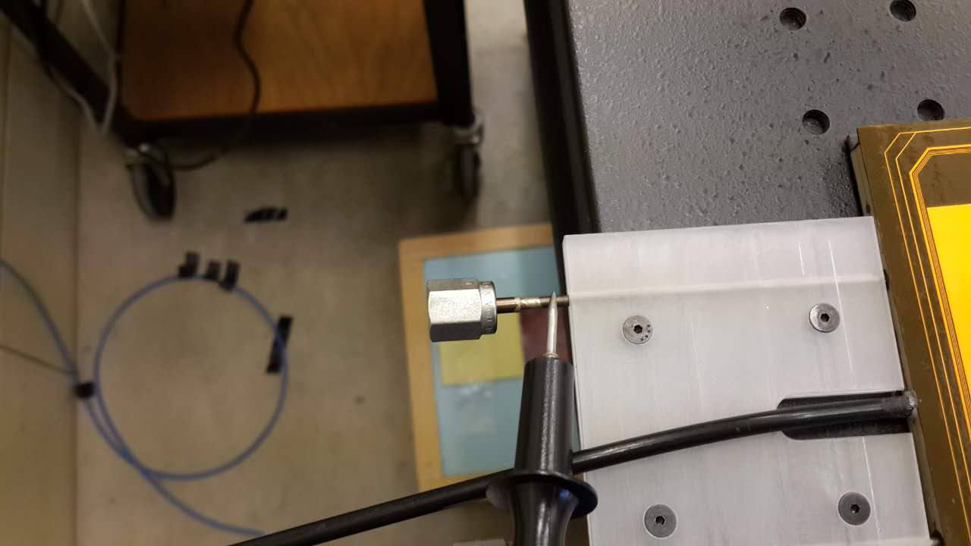
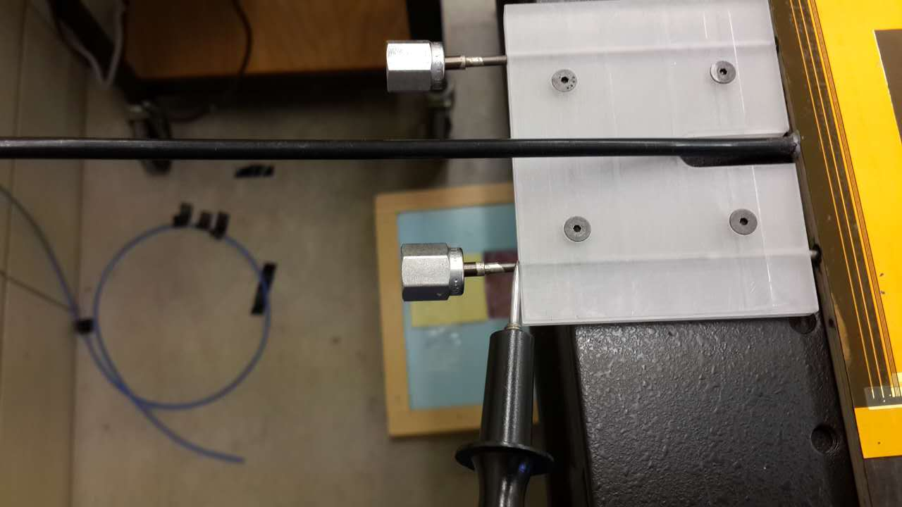

Slide 8
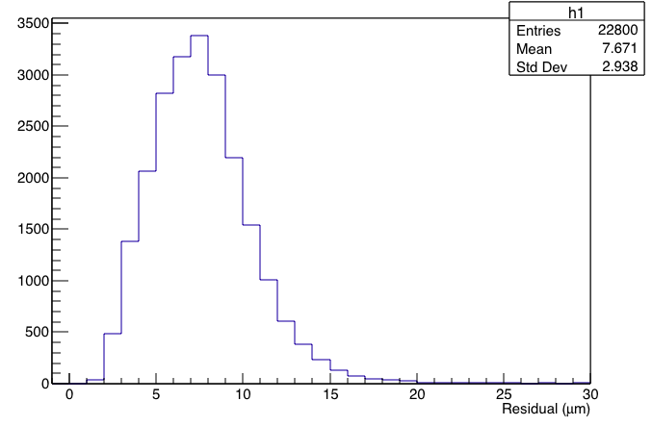
Rms for 1 module
1:Scan 50 times for 1 module;
2:Calculate the rms for the whole area;
3:Draw the histogram for rms;

Slide 9
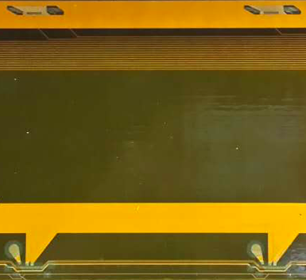
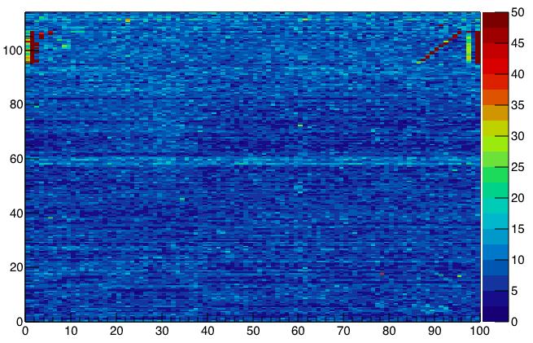
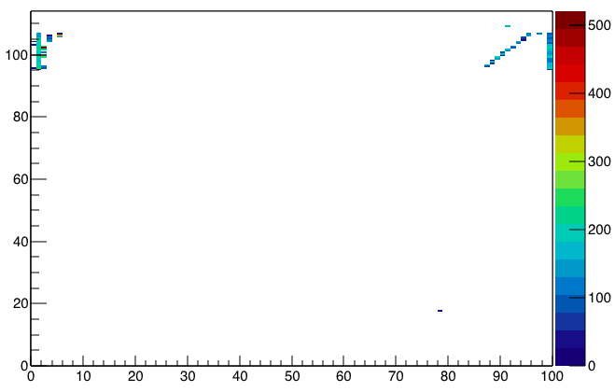
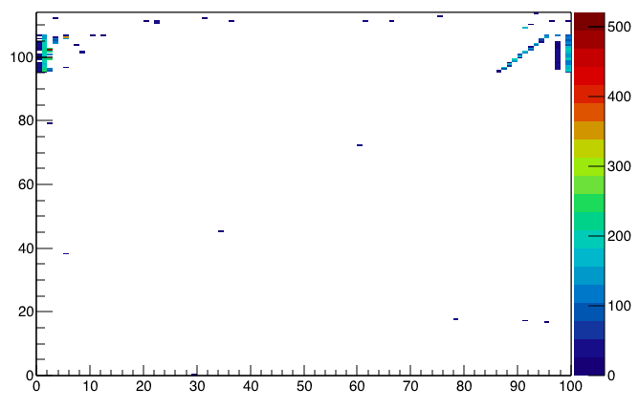
rms
Rms>35; 90 pixels
Rms>21; 152 pixels

