Slide 1
Local Flatness Test: average 25 scans
Carlos Vergel Infante & Boping Chen
June 14th, 2017

Slide 2
Working to improve the local flatness test for stave core #4.
One line scan
Full support
We are taking data now with a smaller window (new)
Took 25 scans of each side of the stave (plus one for saturation) to reduce fluctuation (new)
(From last week) We should be able to remove tape problems by removing pixels with large rms. (new)

Slide 3
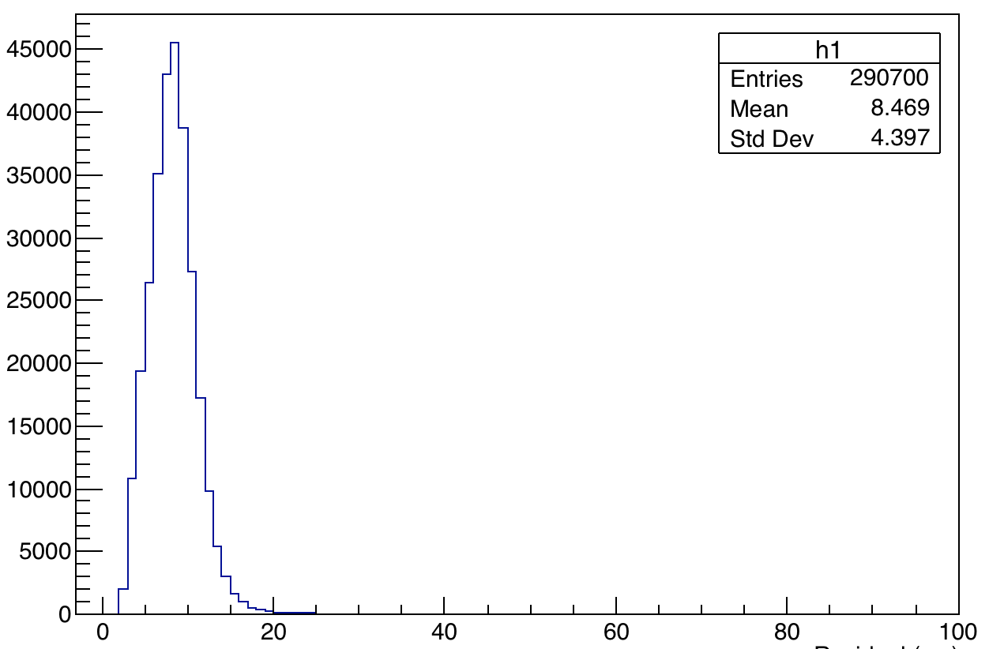
RMS histogram
Tape problems are over here!

Slide 4
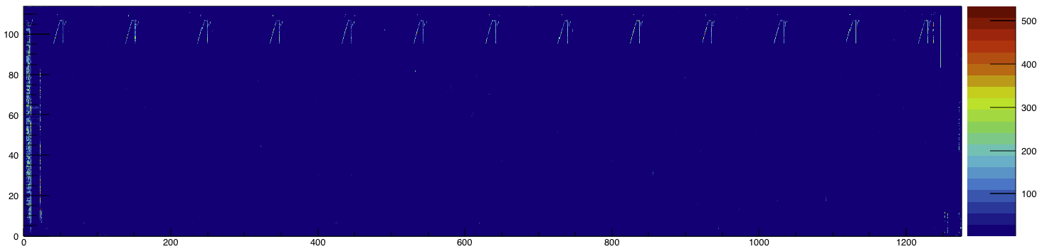
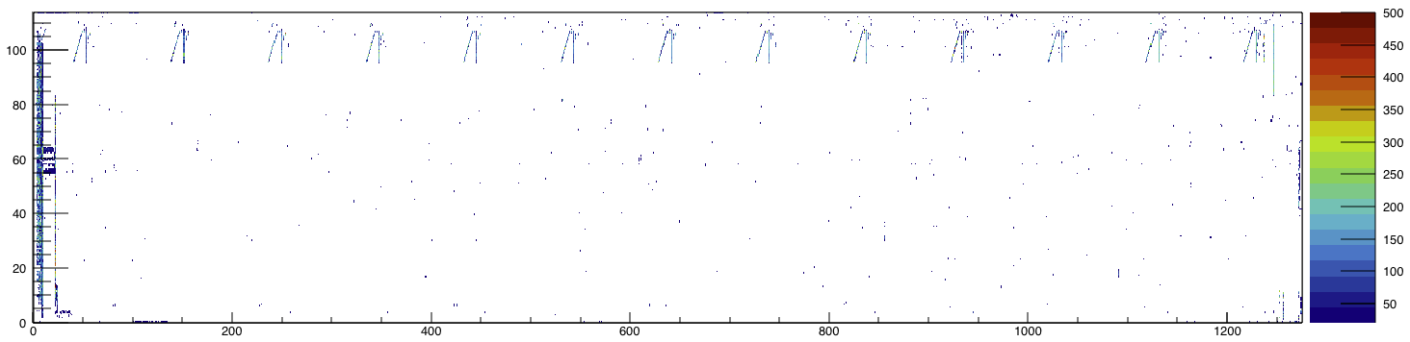
RMS plot of the L side of the stave
Only showing rms>20 um.

Slide 5
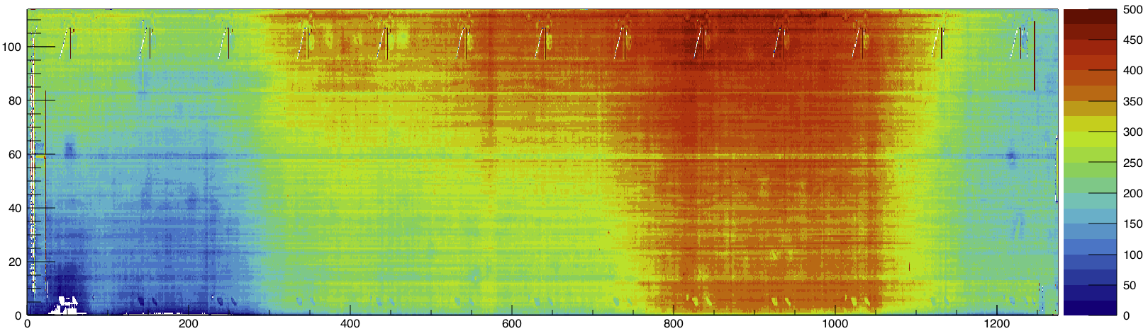
Average over 25 scans plot (side L)
Small effect in the surface are now visible in the plot (better to see in the lab)
I think this line is caused to the dot in the center line. For the resolution that we are getting we might think in changing the laser line we are using. Maybe using another laser line.

Slide 6
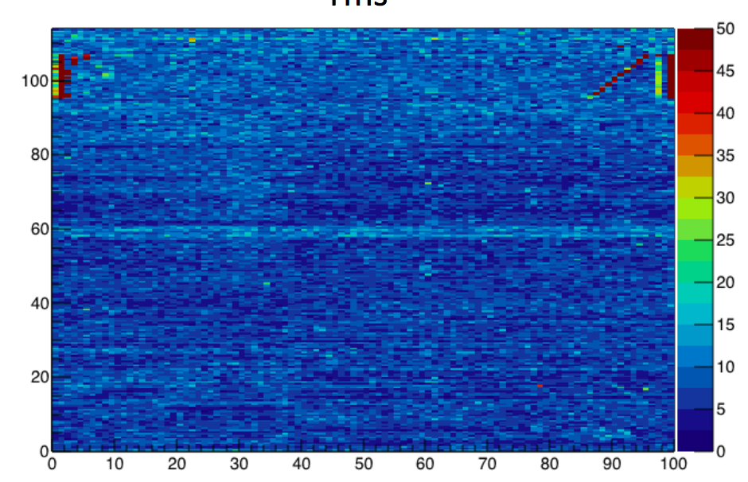

Slide 7
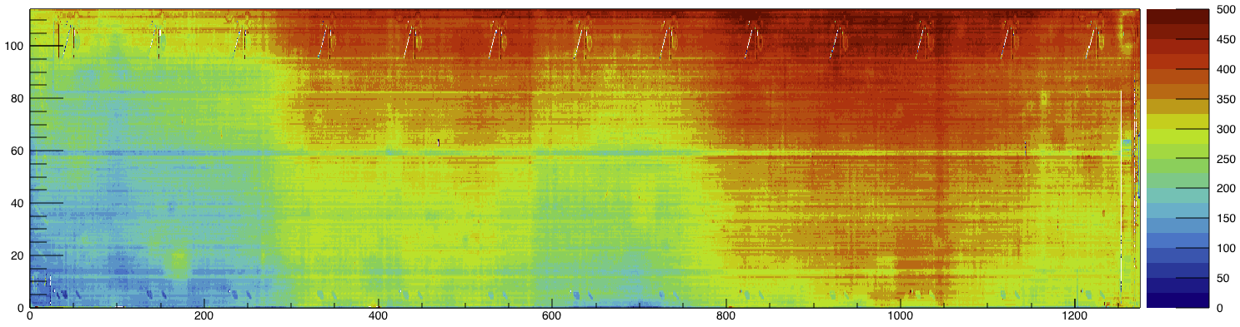
L side
J side
The y-coordinate in the J side is flipped from our convention to facilitate the comparison between scans in case the effect is due to the support.

