Slide 1
Pressurized test (25 times) side J and Local Flatness update
Carlos Vergel Infante
Boping Chen

Slide 2
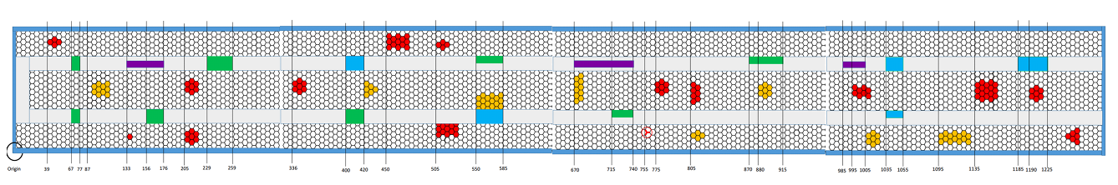
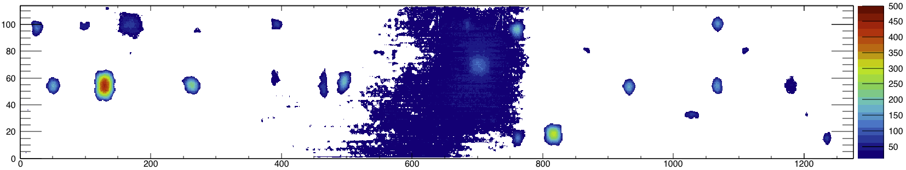
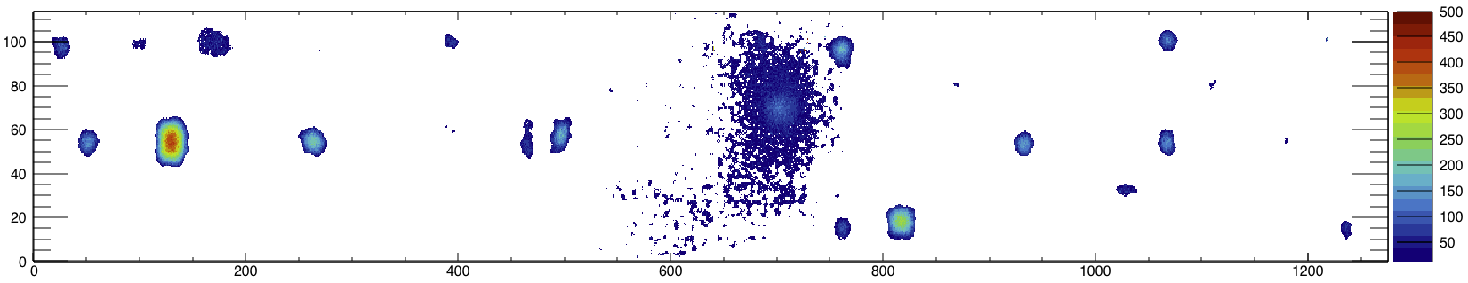
Side J of the Stave #4

Slide 3
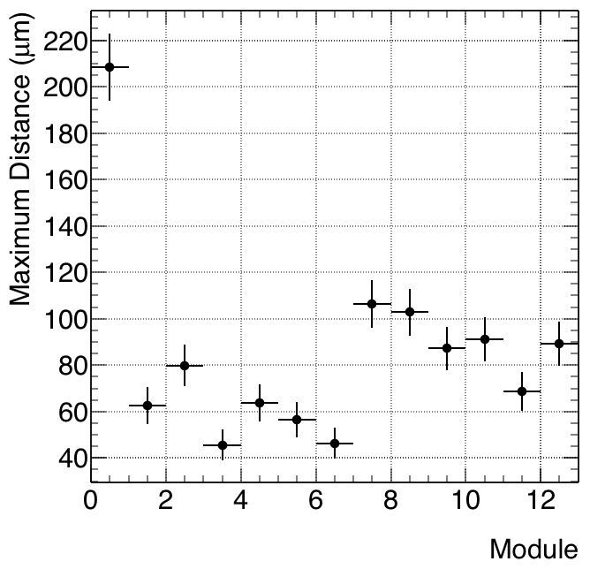
Couple of mistakes were found on the old code.
Peaks are removed now by ignoring all pixels with rms larger than 15 um.
Instead of selecting the average of each new area (10 pixels in x and 10 pixels in y), the maximum value was selected.
The max height is selected with respect to these maximums of area. Work need to be done here.

Slide 4
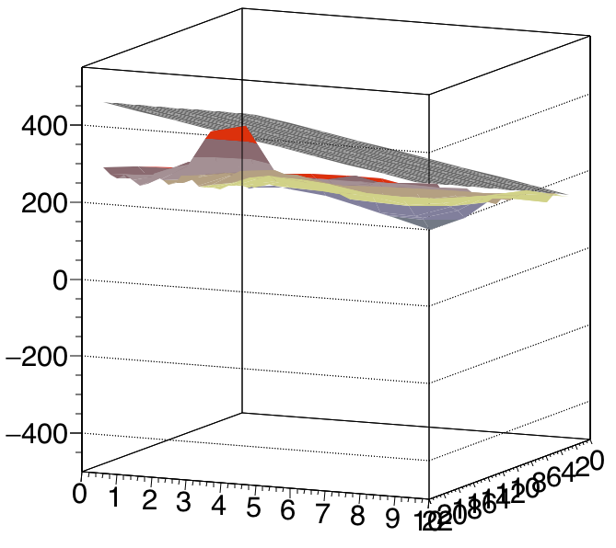
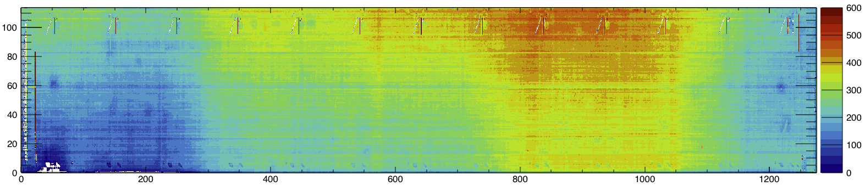

Slide 5
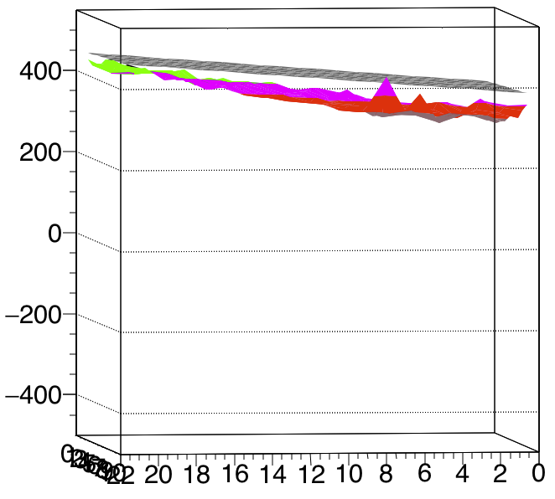
Module Num. 8

