Slide 1
Laser Update
July 5,2017
Boping Chen
Shuaiyan Kang

Slide 2
First Module of Stave #4 (L side)
Three laser lines were used in total
It was scanned 50 times with each laser line
Standard deviation distribution was plotted (p.3-5)

Slide 3
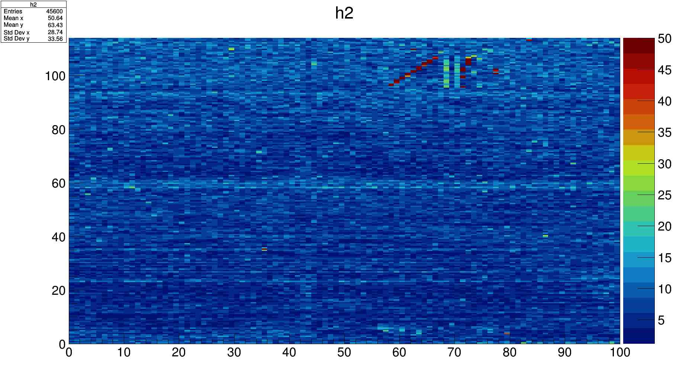
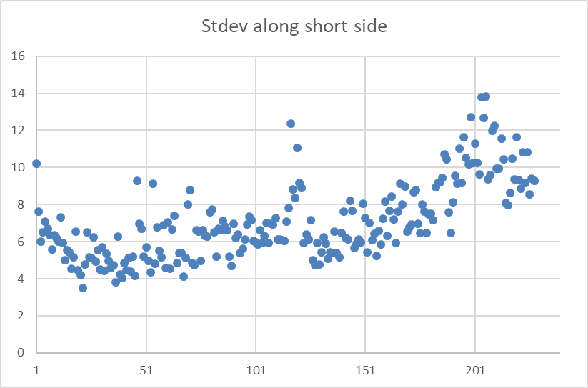
Laser line with red dot
μm
mm

Slide 4
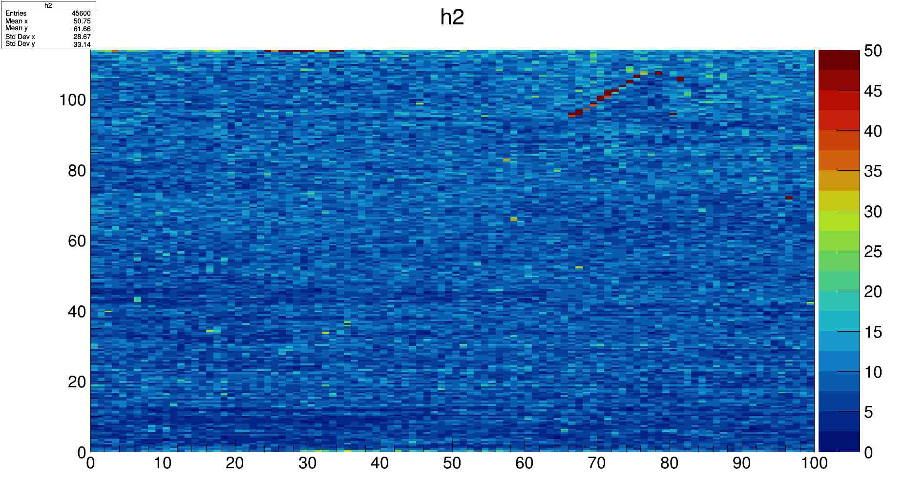

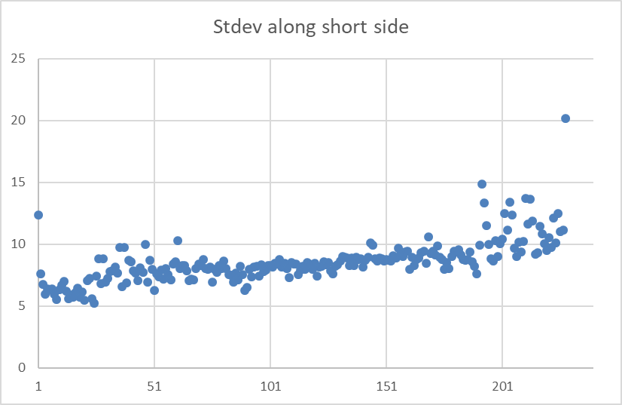

Ahead

Slide 5
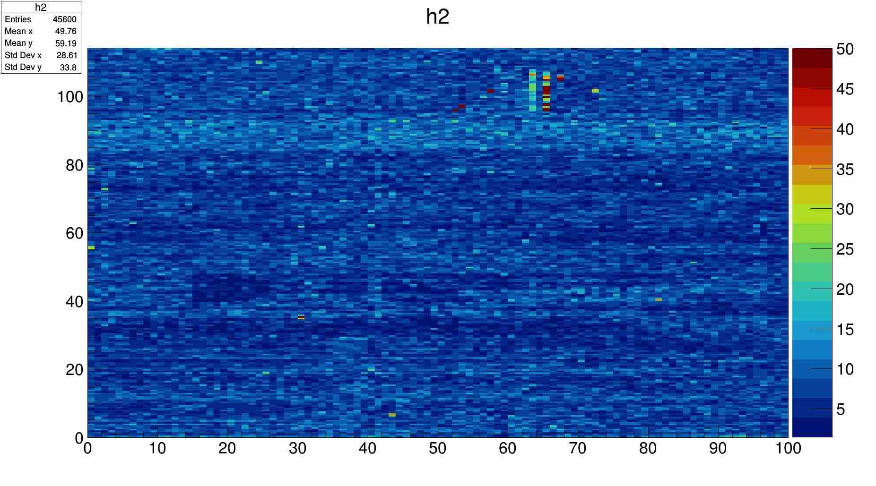
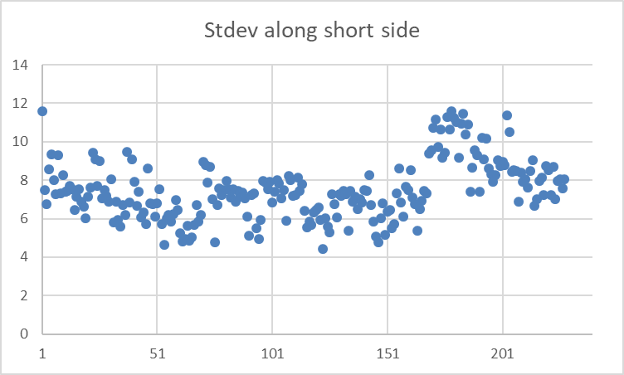
Below

