Slide 1




New stave no5
William Heidorn, Jie Yu
Iowa State University
ISU group meeting, August.09.2017

Slide 2
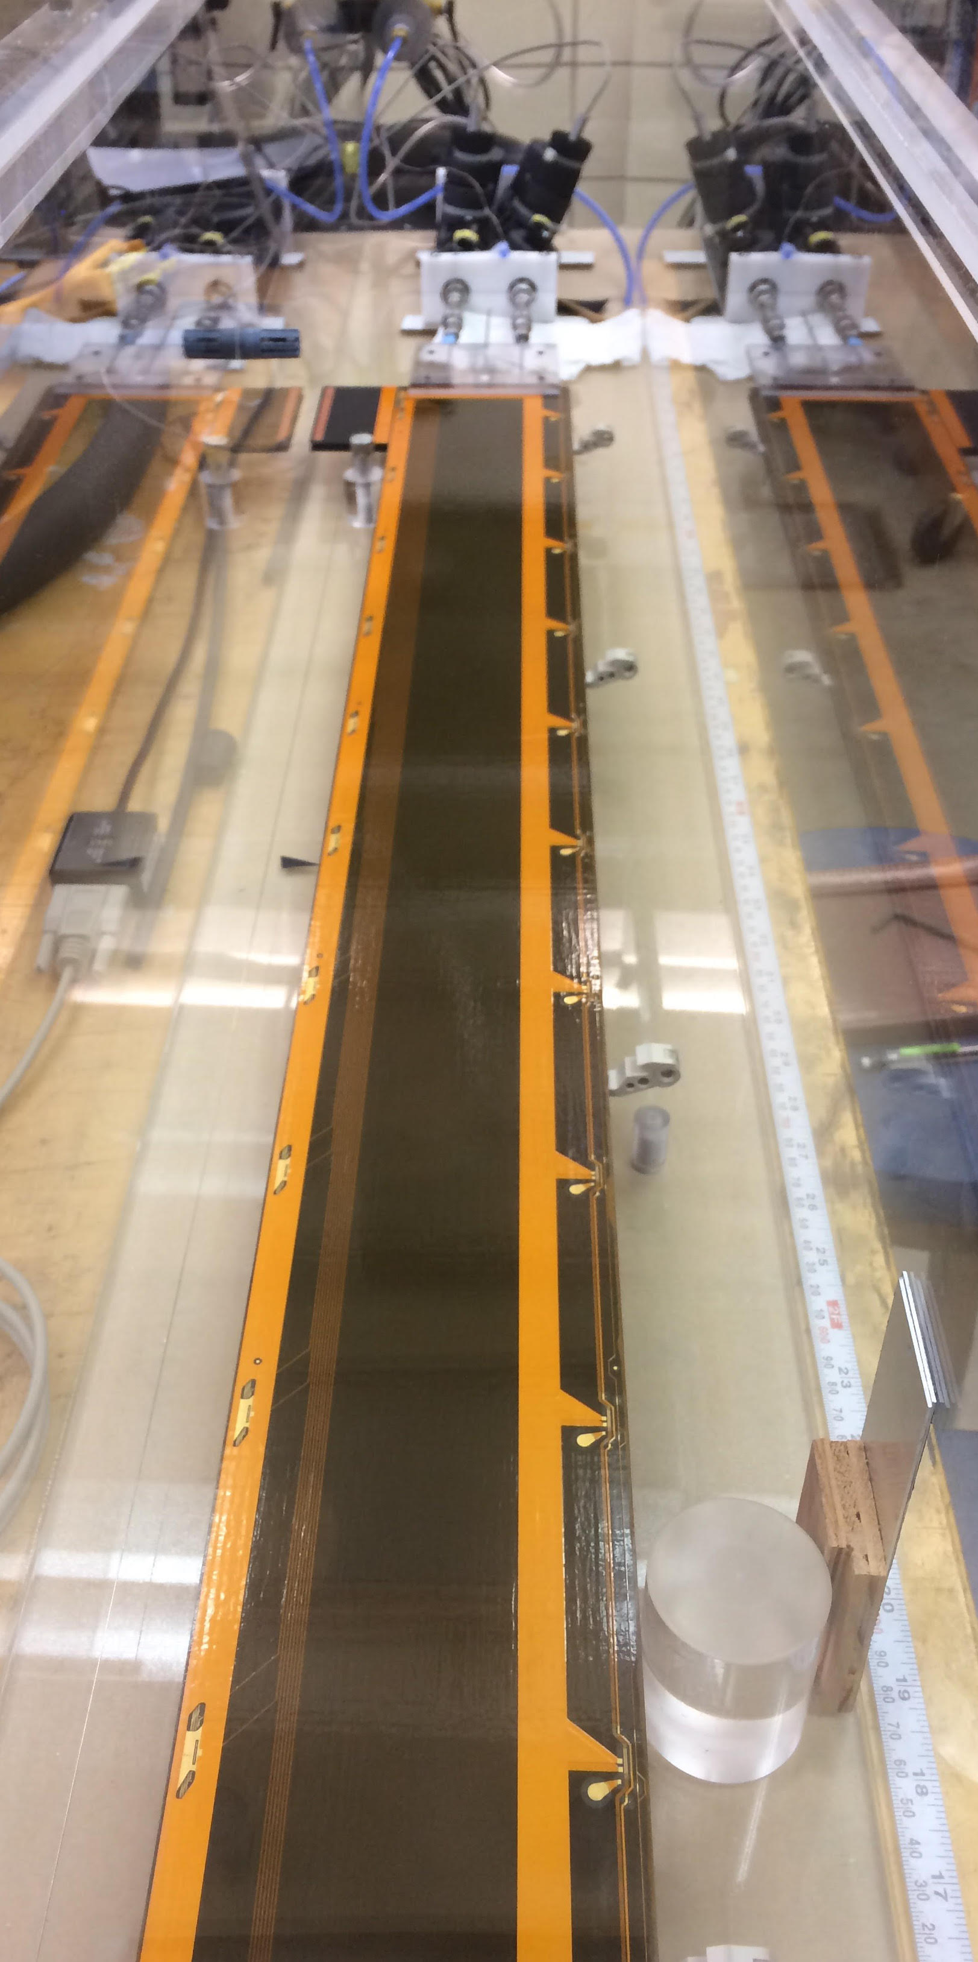


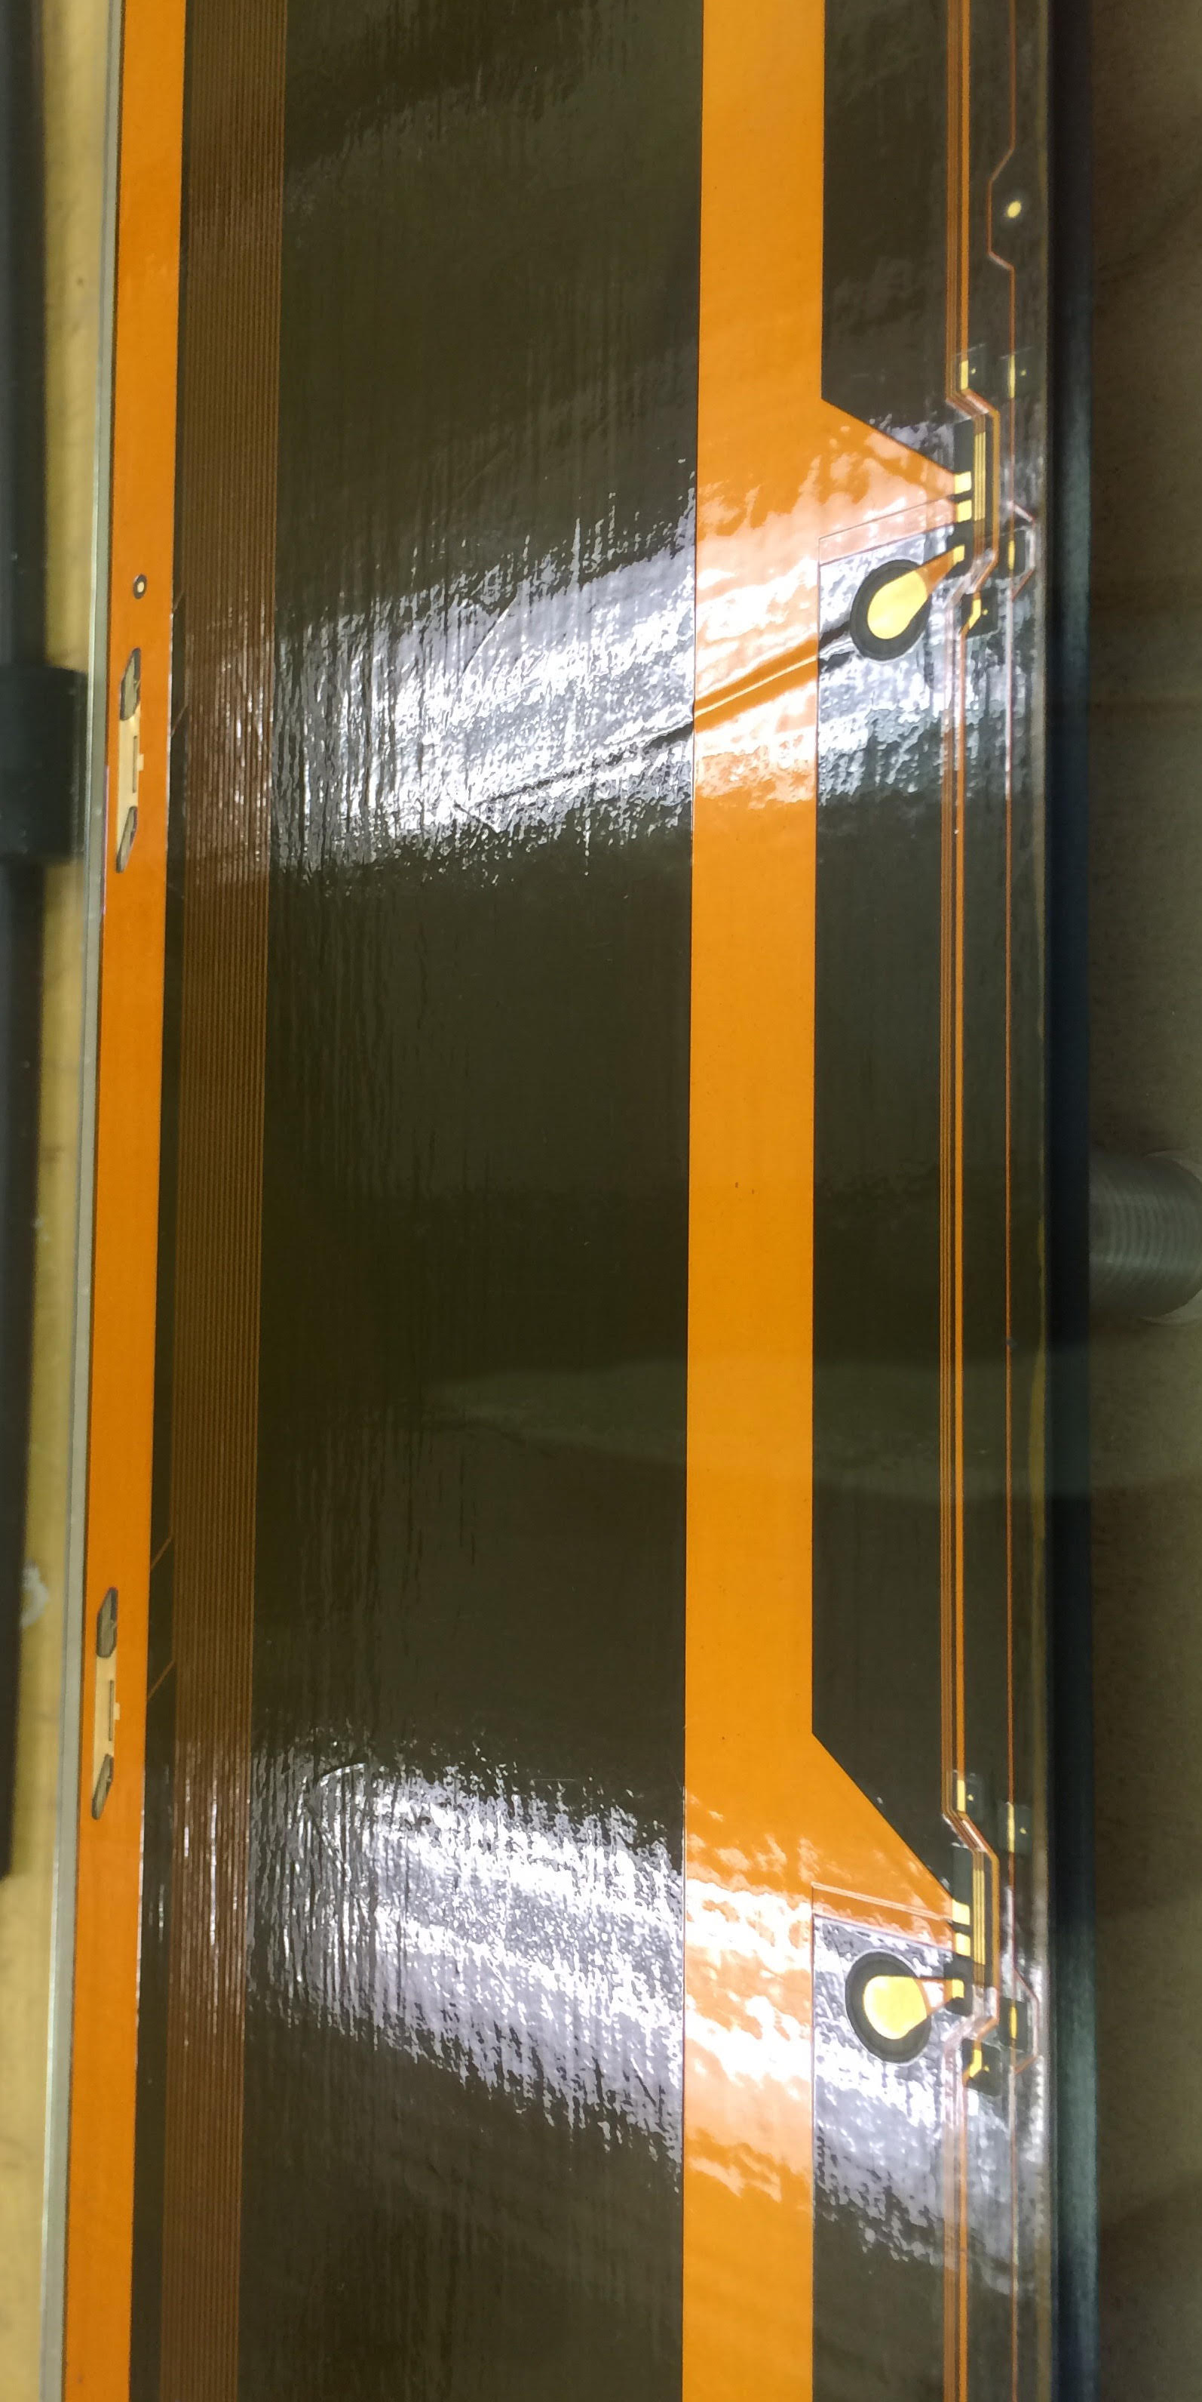
set up and data taking
Stave (no 5 ?) no intended flaws.
  Stave connectors affect our L side setup. Temporary solution managed.
  A small pop up area on the stave (J side).
  measurements of L and J side @-55 and +50 C.

Slide 3
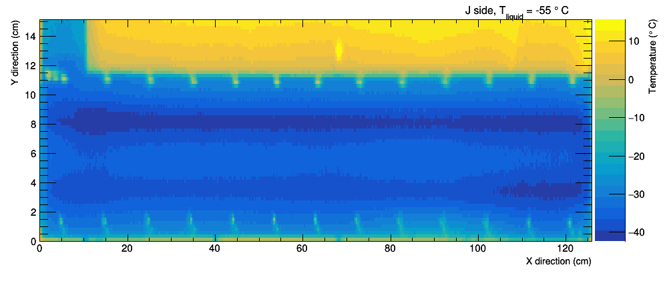
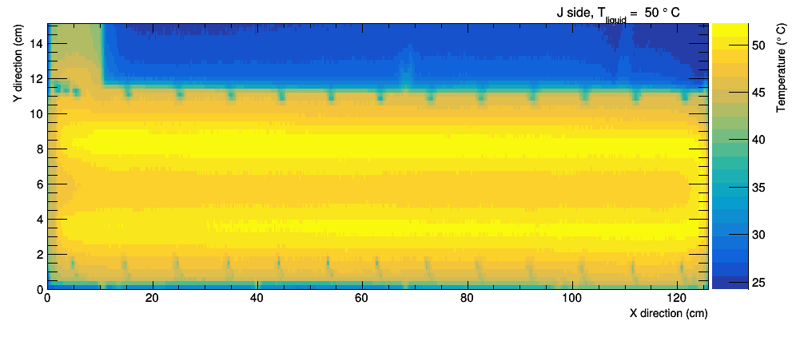
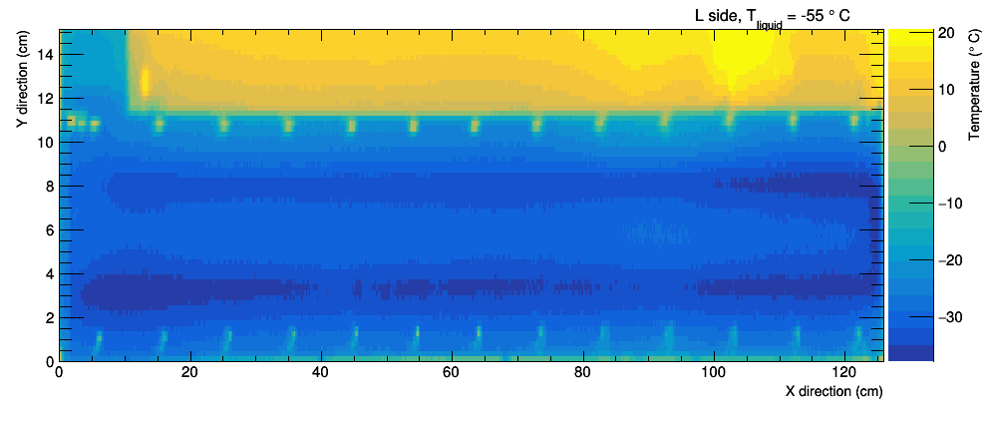
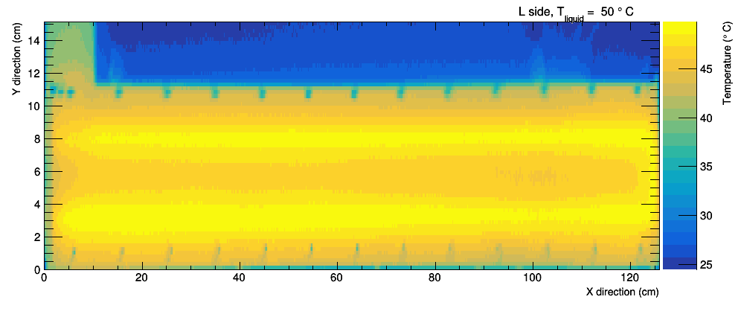
J side
@ —55 C
@ +50 C
J side
glass edge cover.
L side

Slide 4
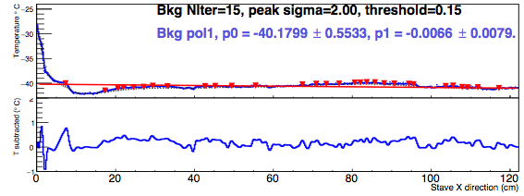
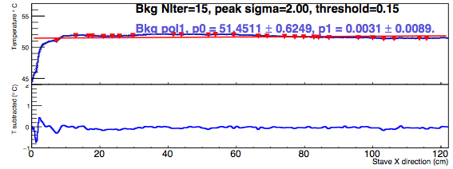

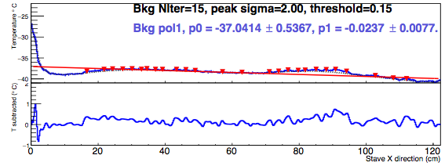
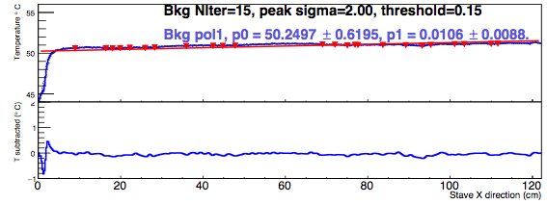
T profile J side
edge effect due to end of stave card.
@ —55 C
@ +50 C
Liquid inlet
Liquid outlet
Rather smooth after background subtraction.
Edge glass effect.

Slide 5
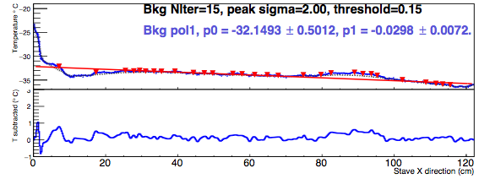
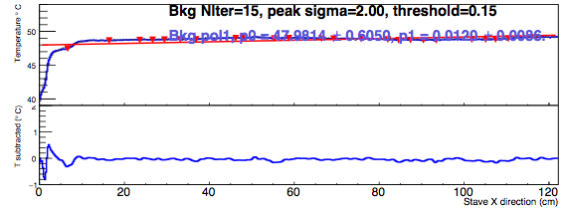
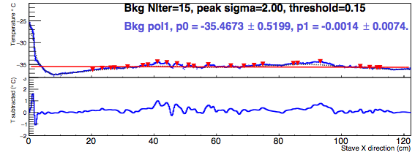
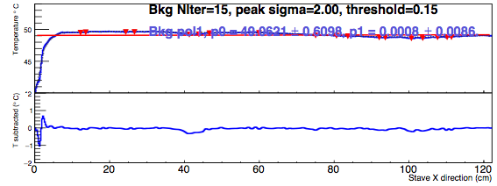
T profile L side
edge effect due to end of stave card.
@ —55 C
@ +50 C
Liquid outlet
Liquid inlet
Maybe larger fluctuations @-55C, but don't look like flaws.

Slide 6
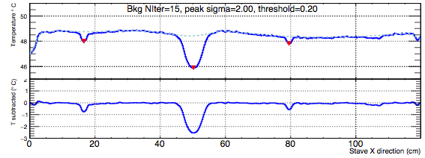
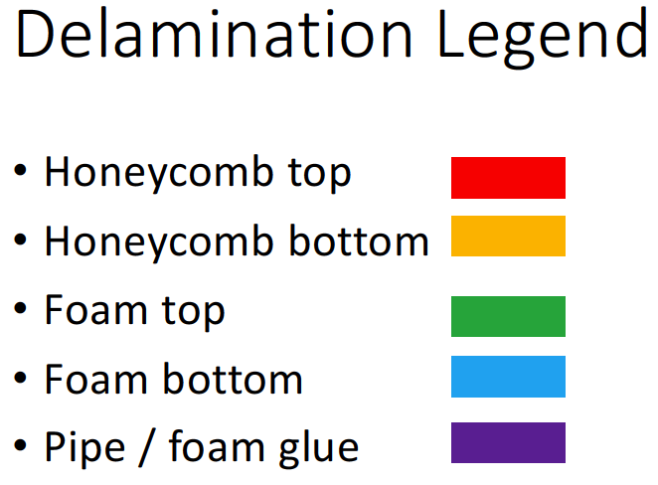

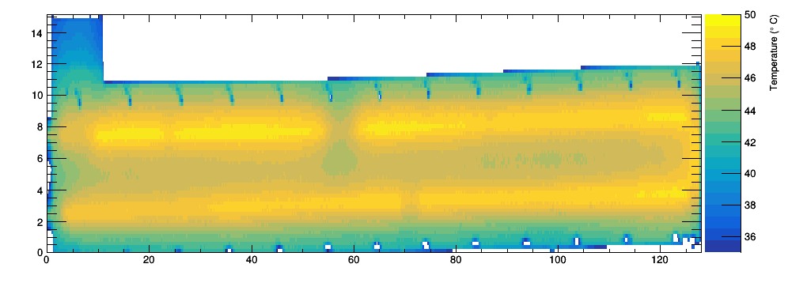
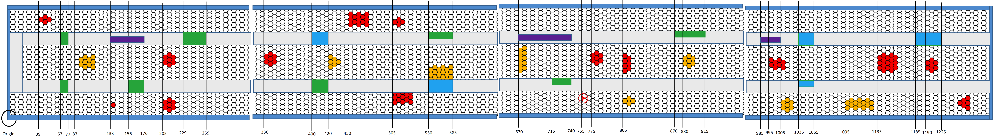
Stave #4 flaws for comparison
(B): 2-3 cm
(A): 5–8 cm
(B): <=2cm
?
J side
J side
(A): Pipe-foam glue missing (partial).
(B): Foam-facing glue missing (full)
  detected: 2cm. undetected: 1 cm.
(C): Foam-facing glue missing (partial).
  seen, but not clearly.
4cm
one sided?
X
2cm
X
8cm
2cm
X
(X)
3.5cm
10
20
30
40
50
60
70
80
90
100
110
120
130

Slide 7
Summary
Very first look at the stave #5, no intended flaws.
  No obvious flaws are detected using either high or low temperature data.
  Some edge effect due to end of stave card and supporting glass as expected.
  T profile is smoother @+50 C as seen before.

Slide 8
backup

Slide 9
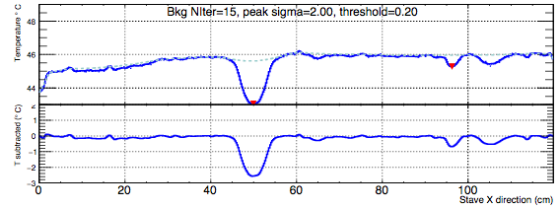
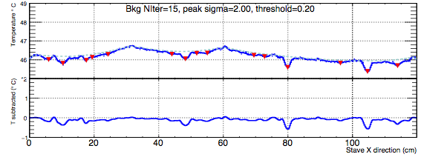
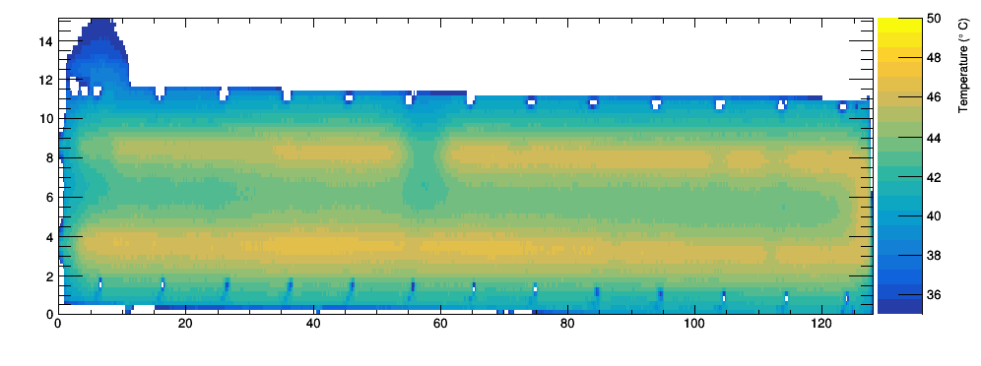
Stave #4 comparison, matching
(A): 5–8 cm
(B): 2–3 cm
Undetected
Total
?
?
2
8
1
3
L side
(A): Pipe-foam glue missing (partial) undetected 1.
(B): Foam-facing glue missing (full) all found (?!).
  1 cm can also be seen. Not so clearly.
(C): Foam-facing glue missing (partial) undetected 2.
  3 and 4.5 cm, closer to liquid in/out.
L side
L side
??
2 cm
X
X
8cm
X
3cm
4.5 cm
3.5cm
2cm
1cm
10
20
30
40
50
60
70
80
90
100
110
120
130

Slide 10
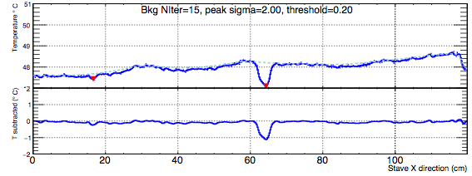
Stave #4 comparison, matching
(B): 2-3 cm
(A): 5–8 cm
(B): <=2cm
Undetected
Total
?
1.5
5
?
2
3 ?
J side
J side
(A): Pipe-foam glue missing (partial) undetected 2.
(B): Foam-facing glue missing (full) undetected 1.
  very close to liquid in/out edge!
(C): Foam-facing glue missing (partial) undetected 0.5
  seen, but not clearly.
4cm
one sided?
X
2cm
X
8cm
2cm
X
(X)
3.5cm
10
20
30
40
50
60
70
80
90
100
110
120
130

Slide 11


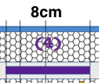






















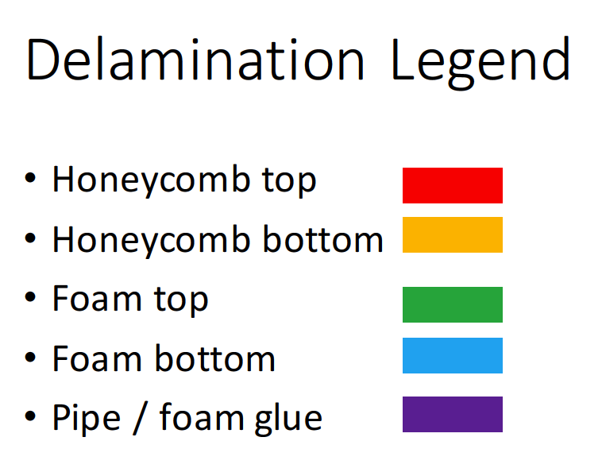
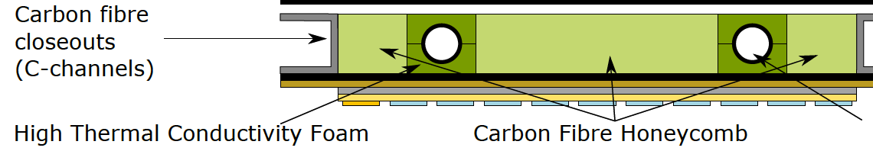
Delamination type from stave #2
3.5cm
4cm
(C)
can be fluctuation.
(A)
might be one of the two peaks.
(B)
Conclusions below depend on how accurately the delaminations are implemented.
(A): Pipe-foam glue missing (full pipe ring or partially??).
  1 (nice peak) out of the 3 seen on both sides, the other two seen on one side.
  2.5 cm one is hardly seen. 8cm one doesn’t form nice peak. Might due to some other kind of delamitation on a larger scale.
(B): Foam-facing glue missing (full).
  Mostly form a nice peak ~1 C height.
  3cm is clear, 2cm can also be found.
  Effect seen also on the other side’s T distribution.
(C): Foam-facing glue missing (partial).
  Cannot form nice peaks. A wider T deficit seen.
  2cm is hardly seen. 2.5cm is found.

