Slide 1


Stave QA: Weekly Update
William Heidorn, Jie Yu
Iowa State University
ISU Weekly Meeting
August 16, 2017

Slide 2
A mysterious ”hot spot” appears
Over the last few measurements there has been some sort of hot spot inside of the box. It has often been ignored because it was only a small scale effect of around a degree at most over the whole camera.
Believing that we had removed all of the vignetting effects we have tried multiple experiments to find the source of the problem.
Possible sources could be…
  Actual hot spots
  Dust or small debris
  Camera issues

Slide 3
80 Degree Lens Rotation

Slide 4
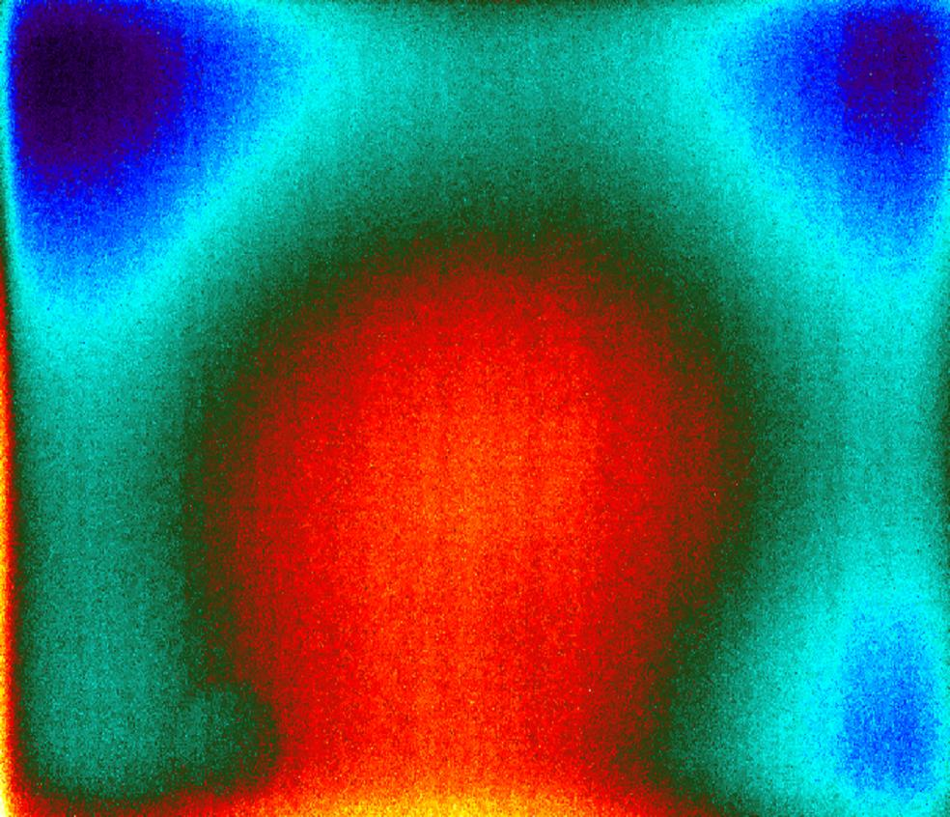
80 Degree Lens With a Cap on
You can see two different kinds of effects that did not change with camera rotation and then still persisted with the lens cap on
  A perfect spot on the lens (maybe debris between the lens and the camera?)
  A vignetting like background gradient

Slide 5

Changing Lenses
Thinking that it could be debris between the lens and camera the lens was changed to the 25 degree lens and left on the cap
No shape or gradient is found in this image… so we thought it must be a lens specific effect
We changed back to the original 80 degree lens and we found a similar image… Problem solved?

Slide 6
Re-Mounting the Camera
After finding that the spot was gone we mounted the camera and found that there was a hot spot directly where the power supply was plugged into the hanging outlet.
To show that it was a physically hot spot a hand was put onto the other side and held in place for about a minute

Slide 7
Re-Mounting the Camera (cont.)
You can see that the heat flows through and can easily detect anything warm touching the box
The power supply was then pulled out of the way and we waited about 30-45 minutes for the two spots to go away

Slide 8
Long Term Evolution of the Hot Spots
After the two spots faded we wanted to watch and see what happened to the background temperature pattern over time
Start
100 minutes
200 minutes

Slide 9
Long Term Evolution (cont.)
Changing temperature in the room effects the mean temperature of the box but does not appreciably change the RMS of the box

Slide 10
Long Term Evolution Trial 2
T=0
T=100 min
T=200 min
Time when Roy closed office door

Slide 11
Conclusions
Many small things can contribute to temperature variations seen by the camera
  Hot spots caused by small sources of heat
  Temperature changes in the room
  Other effects?

Slide 12
Backup Slides

