Slide 1
Laser pressure test
Carlos/Shuaiyan/Boping
Aug.16.2017

Slide 2
Stave #5
Monday: J side. 11 scans:
1 saturation; 5 “0psi”; 5 “5psi”;
Tuesday: L side. 11 scans:
1 saturation; 5 “0psi”; 5 “5psi”;

Slide 3
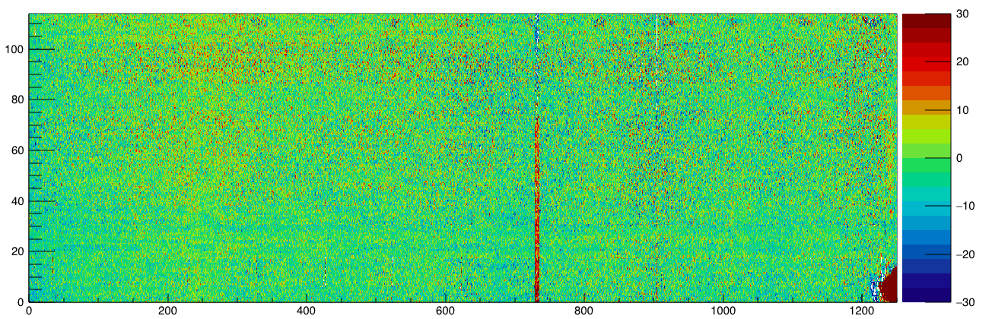
J side, 5psi-0psi(average)
Two vertical lines, and a mistake(not a defect).

Slide 4
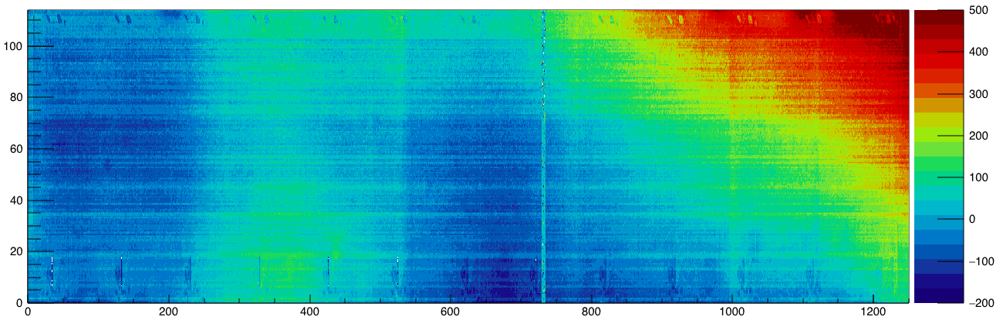
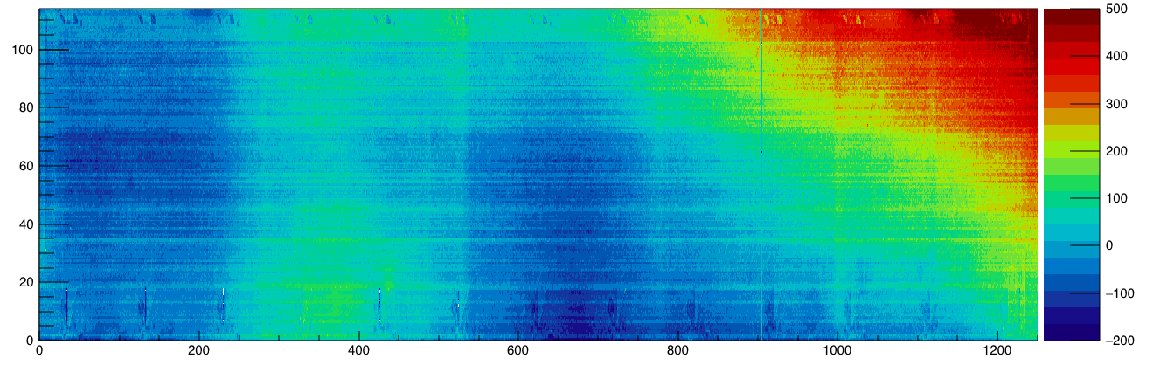
11
8

Slide 5
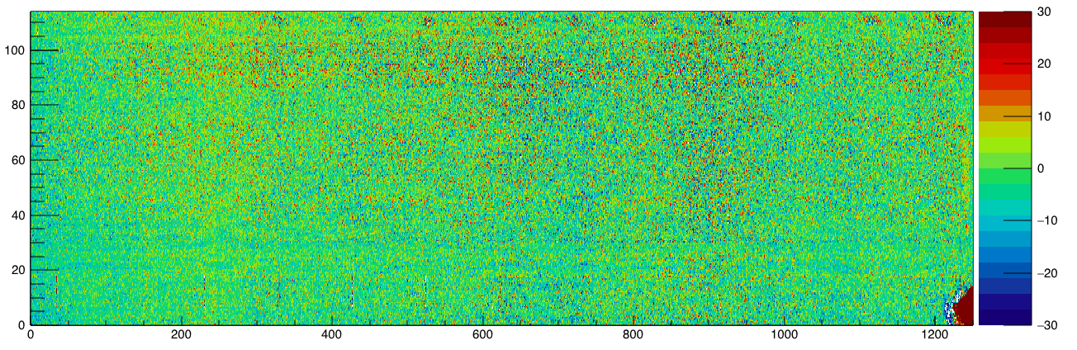
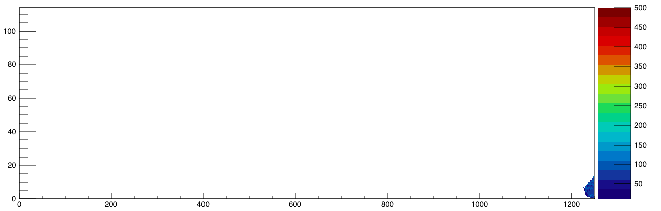
5psi(Without 11&8)-0psi
Laser defect finding algorithm

Slide 6
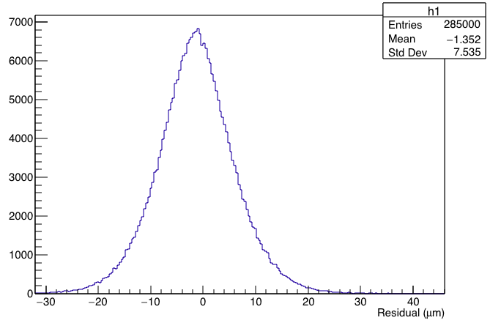
Histogram for difference

Slide 7
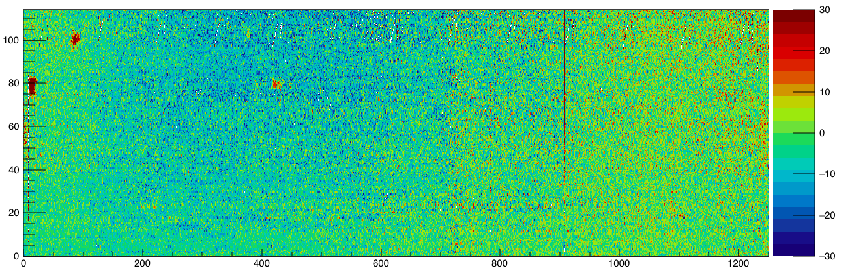
L side, 5psi-0psi
Two vertical lines, two defects? And a small defect?

Slide 8
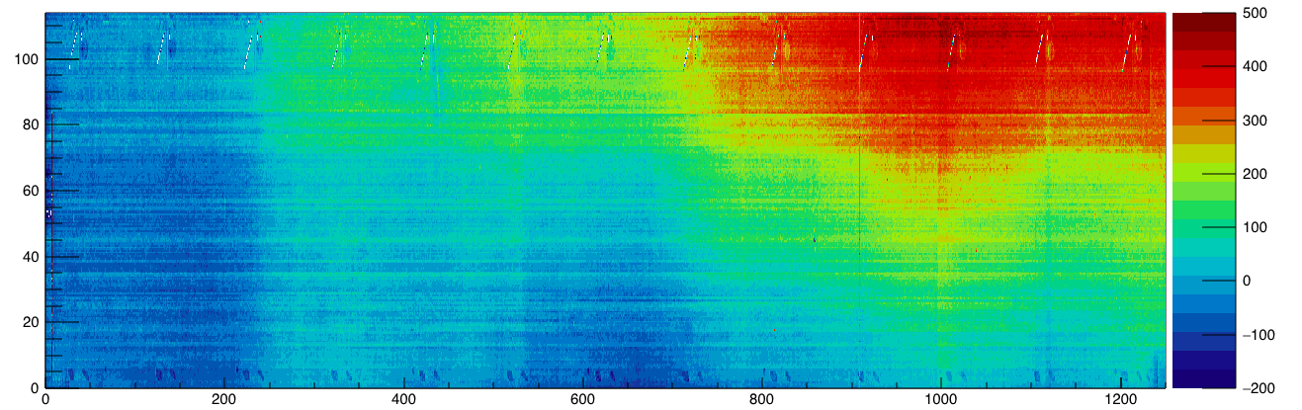
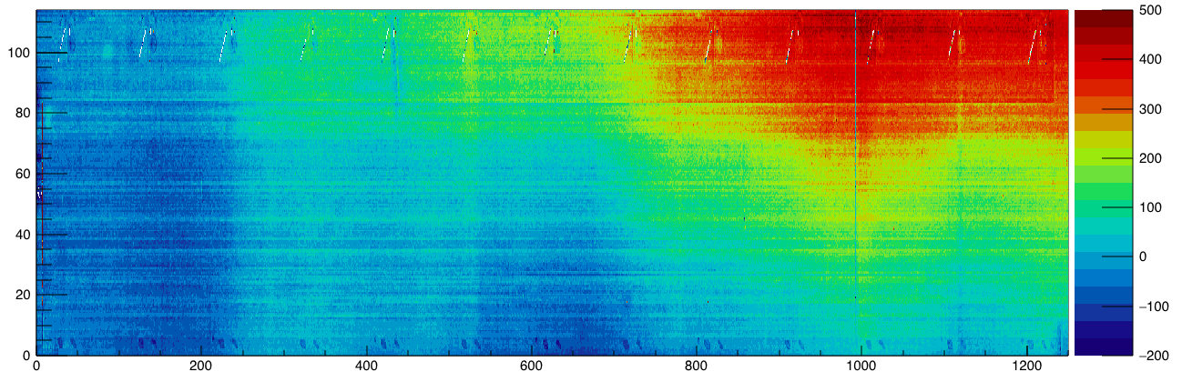
5
11

Slide 9
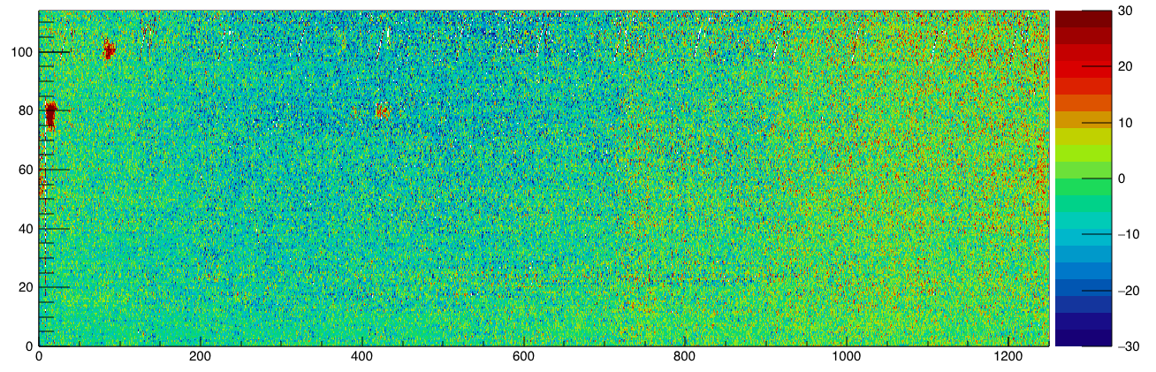
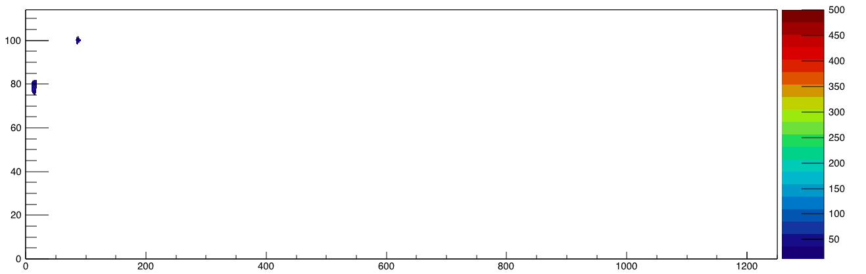
Without 5&11
Laser defect finding algorithm

Slide 10
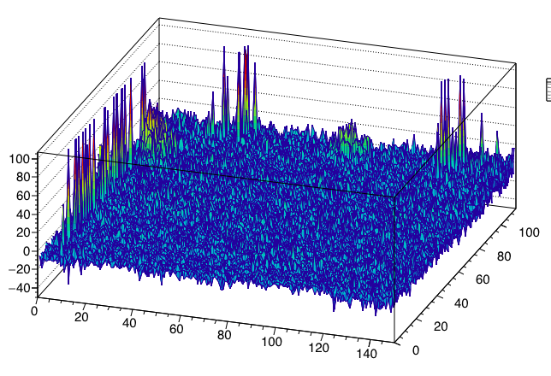
3d plot, two defects

Slide 11
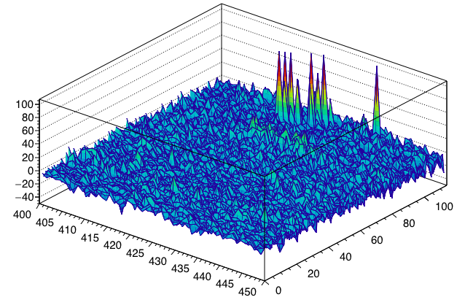
A possible defect?

Slide 12
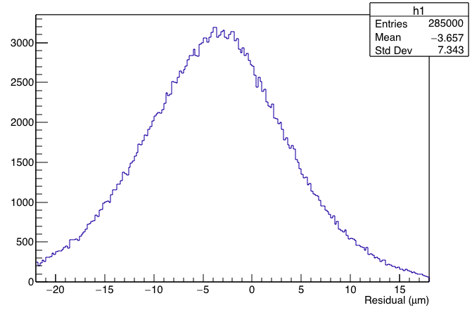
Histogram

Slide 13
backup

Slide 14
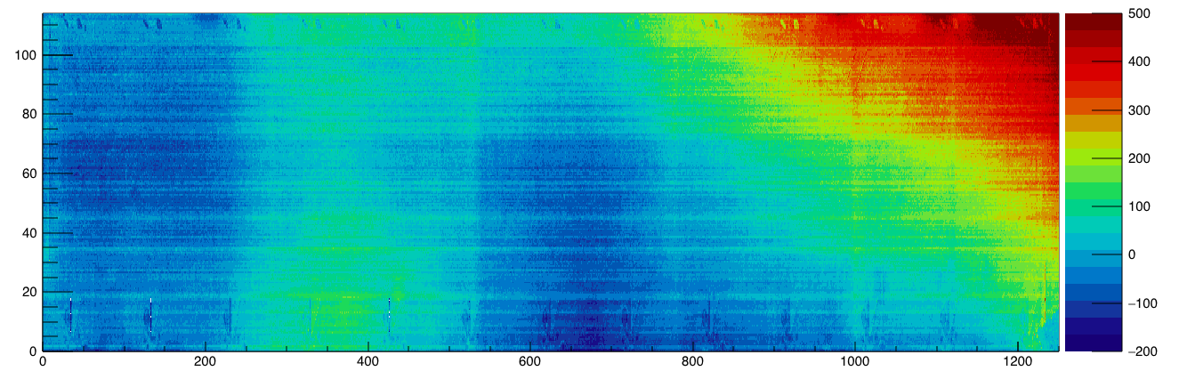
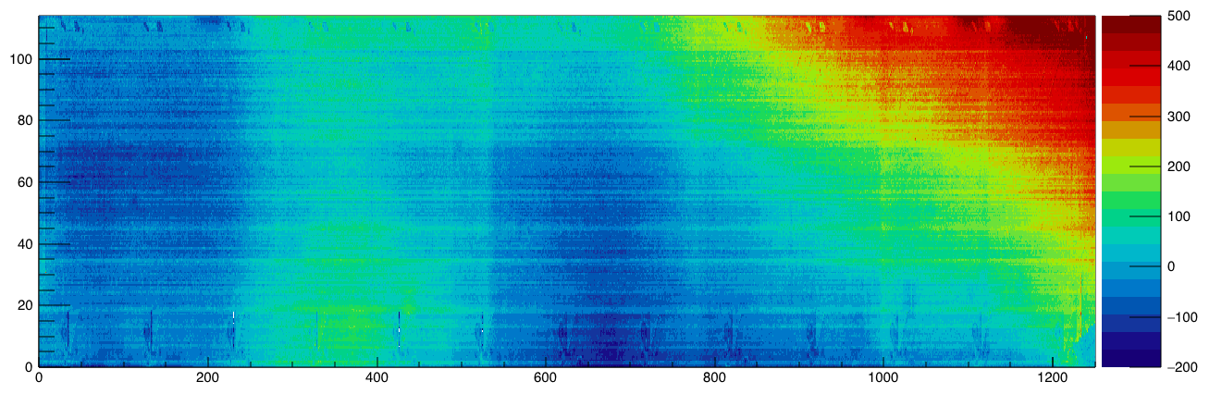
J side backup 0 psi

Slide 15
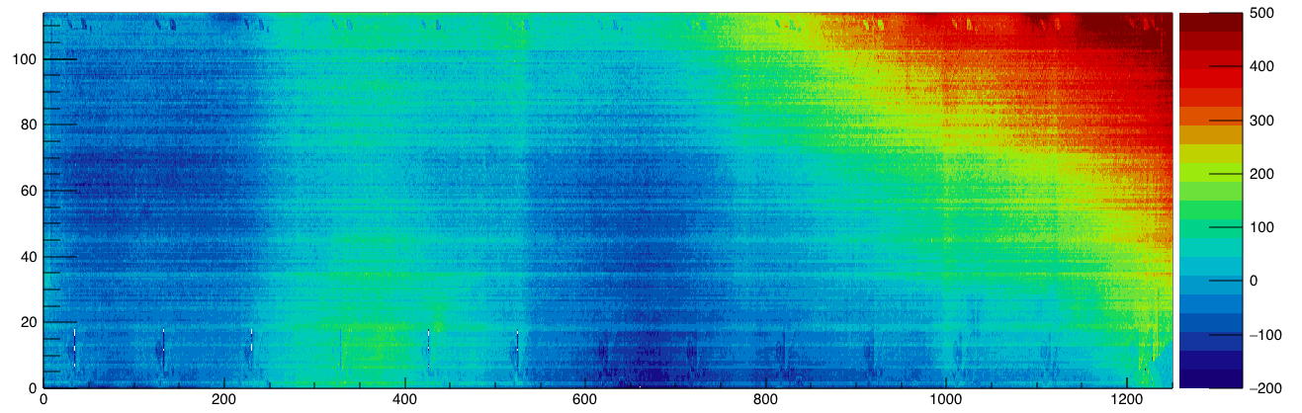
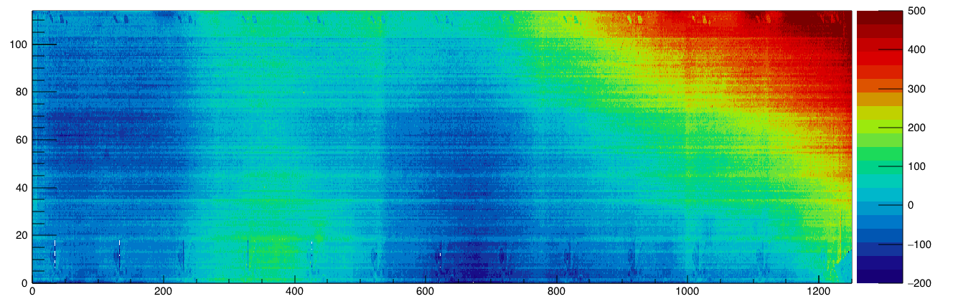

Slide 16
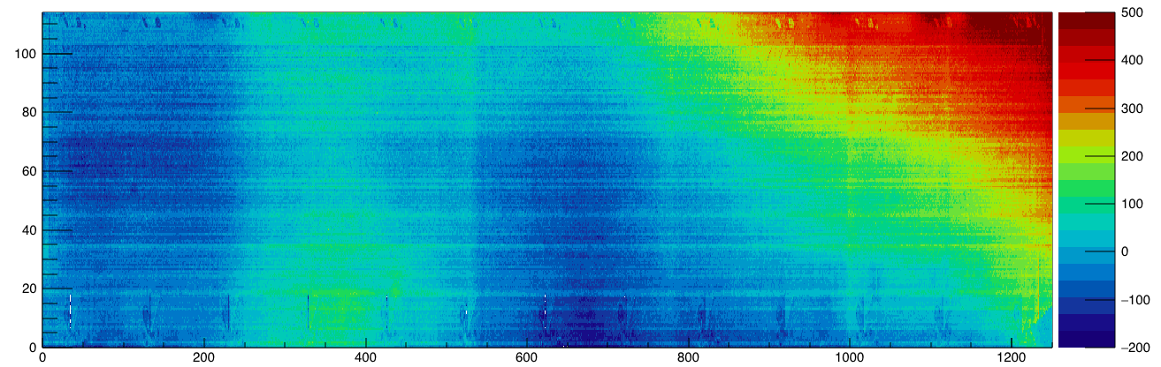

Slide 17
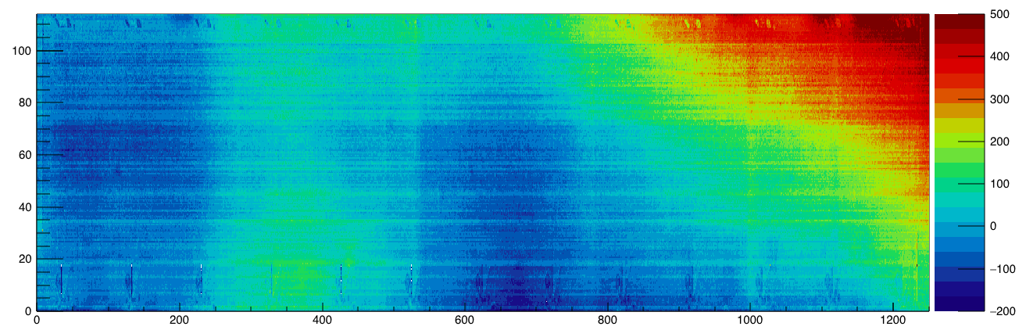
J side backup 5 psi

Slide 18
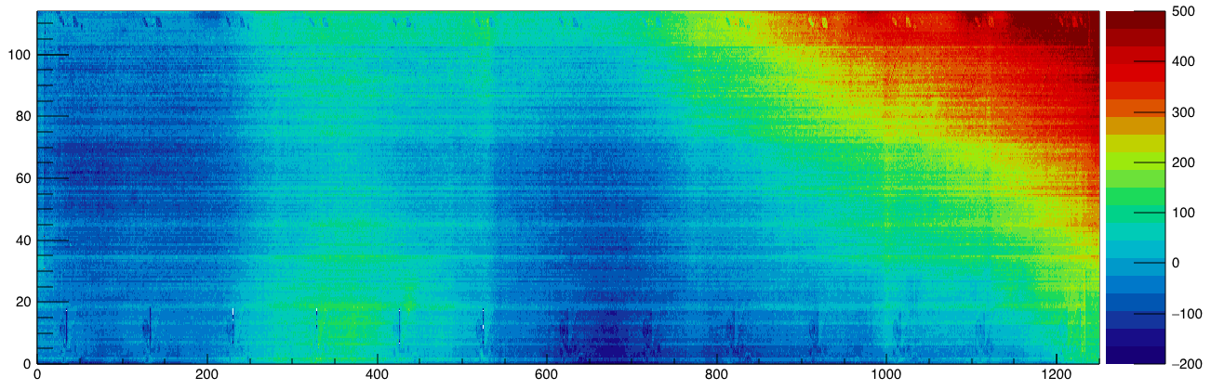
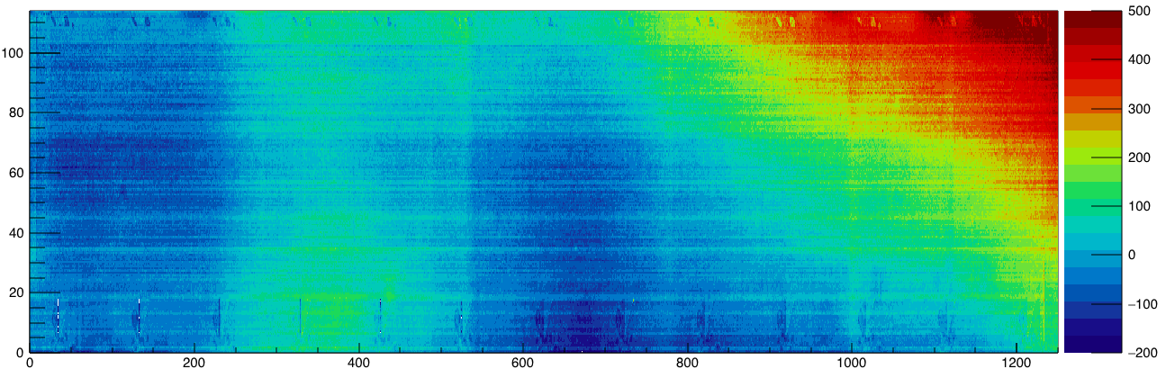

Slide 20
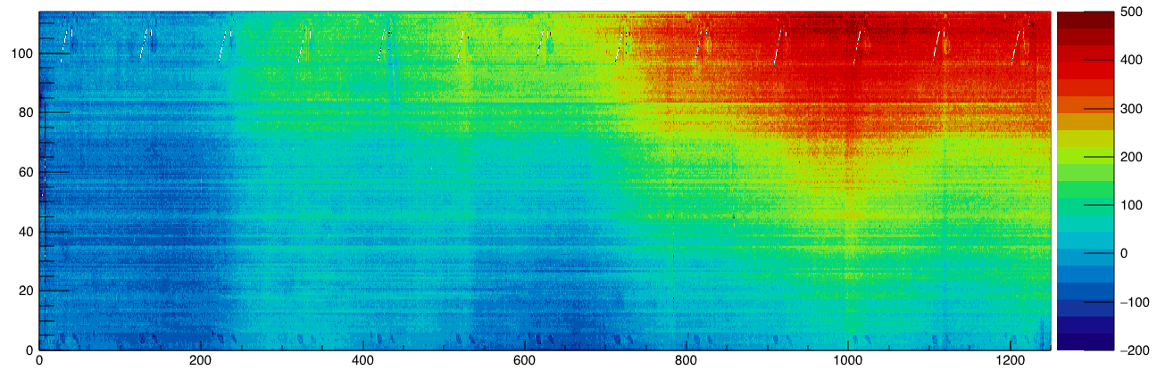
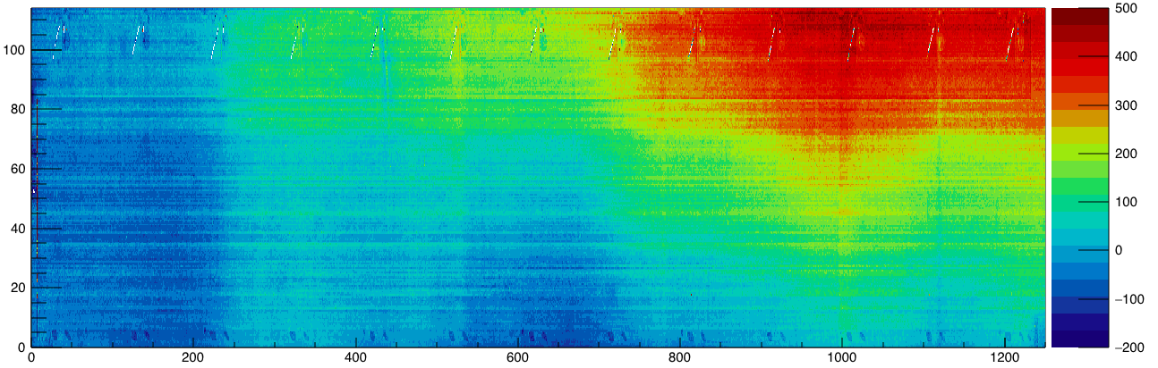
L side backup 0 psi

Slide 21
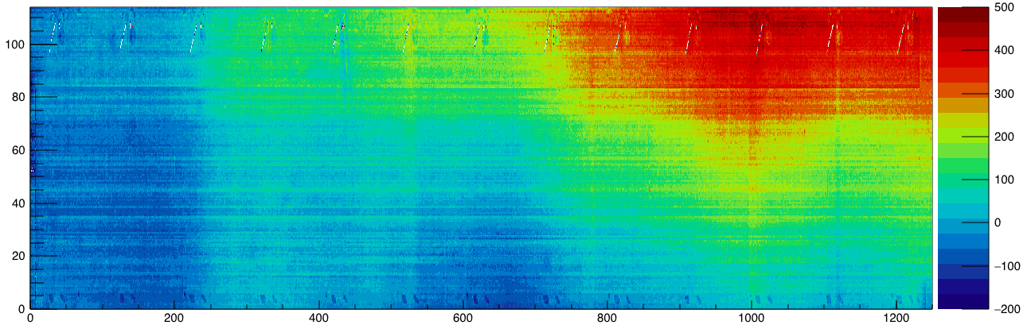

Slide 22


Slide 23

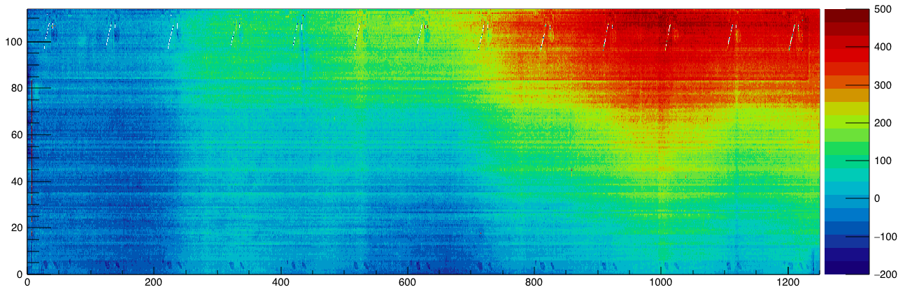
L side backup 5 psi

Slide 24



