Slide 1
Stave#5 bending&resistence
Shuaiyan/Carlos/Boping

Slide 2
Stave#5
1: Bending with simple support;
2: Resistance;
3: Edge support.

Slide 3

Simple Support

Slide 4

Simple support #5
L view 1.2m | Weight(N) | Deflection(m)
 | 0.49 | 0.00017
 | 0.98 | 0.00041
 | 1.47 | 0.00062
 | 1.96 | 0.00085
 | 2.45 | 0.00111
 | 2.94 | 0.00136
 | 3.43 | 0.00161
 | 4.9 | 0.0023
= slope

Slide 5
Data(stave #5)
D=57
L³(m³) | 1.728 | 1.13 | 1 | 0.729 | 0.512
delta/weight (L view) | 0.000486623 | 0.000351312 | 0.000281427 | 0.000209655 | 0.000154433
J view | 0.000485851 | 0.000375407 | 0.000293432 | 0.00021823 | 0.00015066
Lview: D=3552.4/48=74.01
Stave#2: D=74.63
Jview: D=3466.1/48=72.21
Stave#2: 74.28

Slide 6
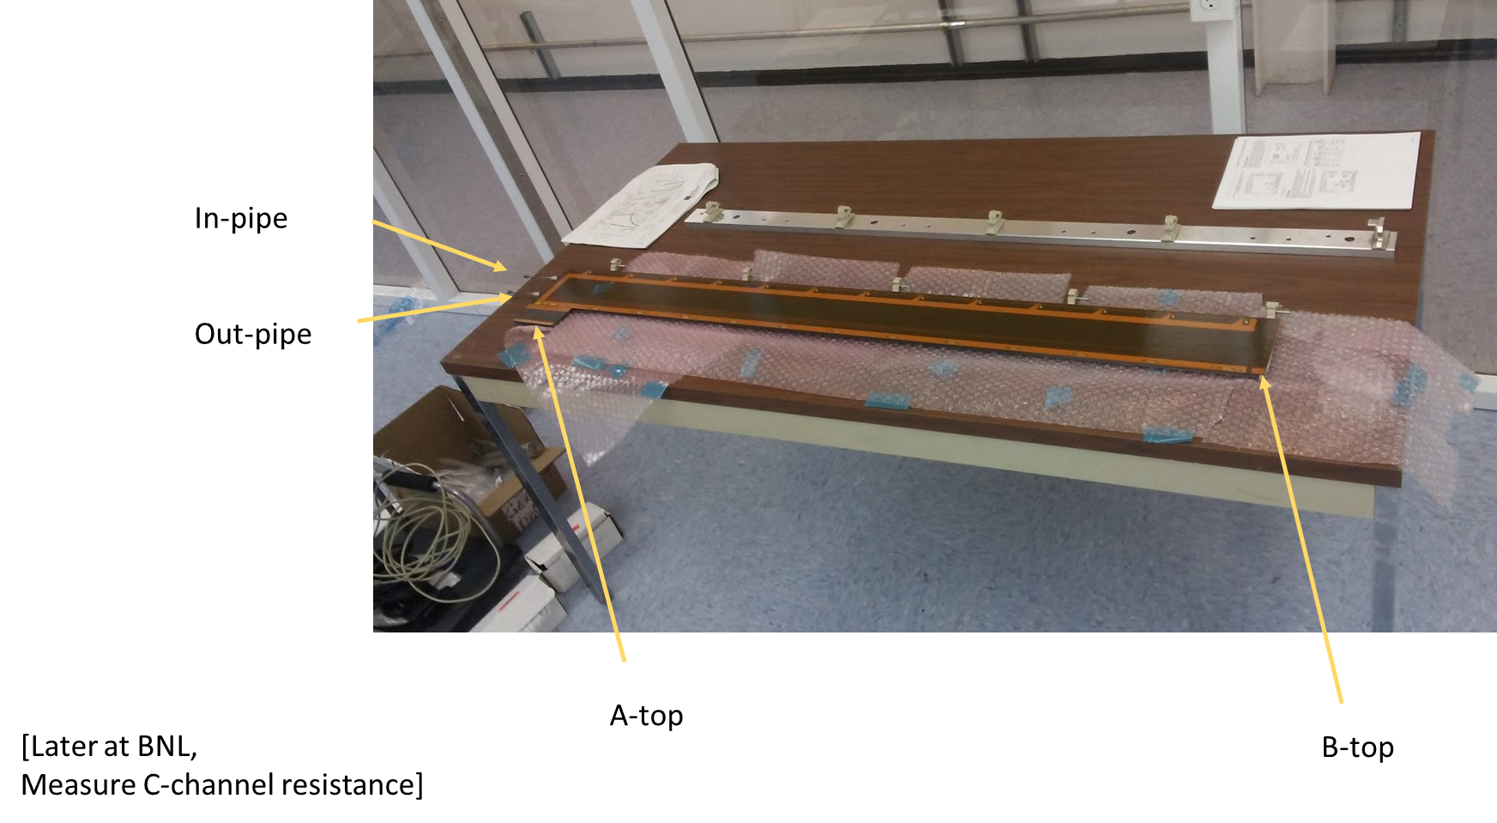
Resistance #5
resistance | A-top | (ohm)
Stave#2 | B-top | 2.4
 | A-bottom | 3.2
 | B-bottom | 4.1
 | Inlet Pipe | 3.4
 | Outlet Pipe | 3.55
resistance | A-top | (ohm)
stave#5 | B-top | 9.0-13
 | A-bottom | 1.3-1.7&0.8
 | B-bottom | 9.0-11
 | Inlet Pipe | 2.9-3
 | Outlet Pipe | 4.3-4.4

Slide 7
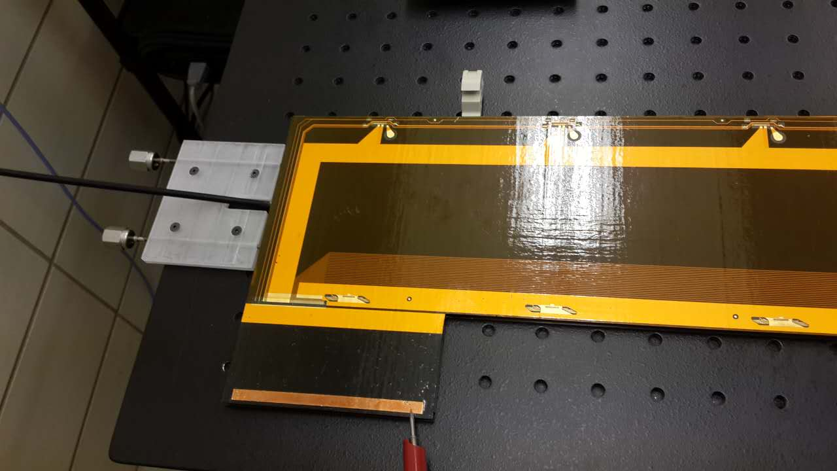
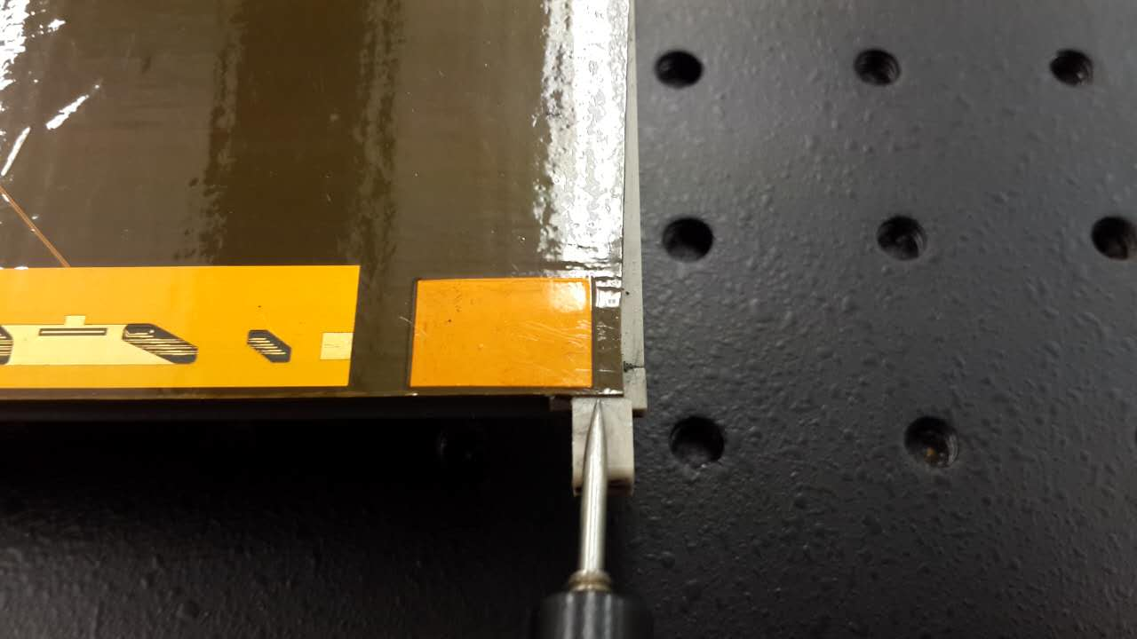
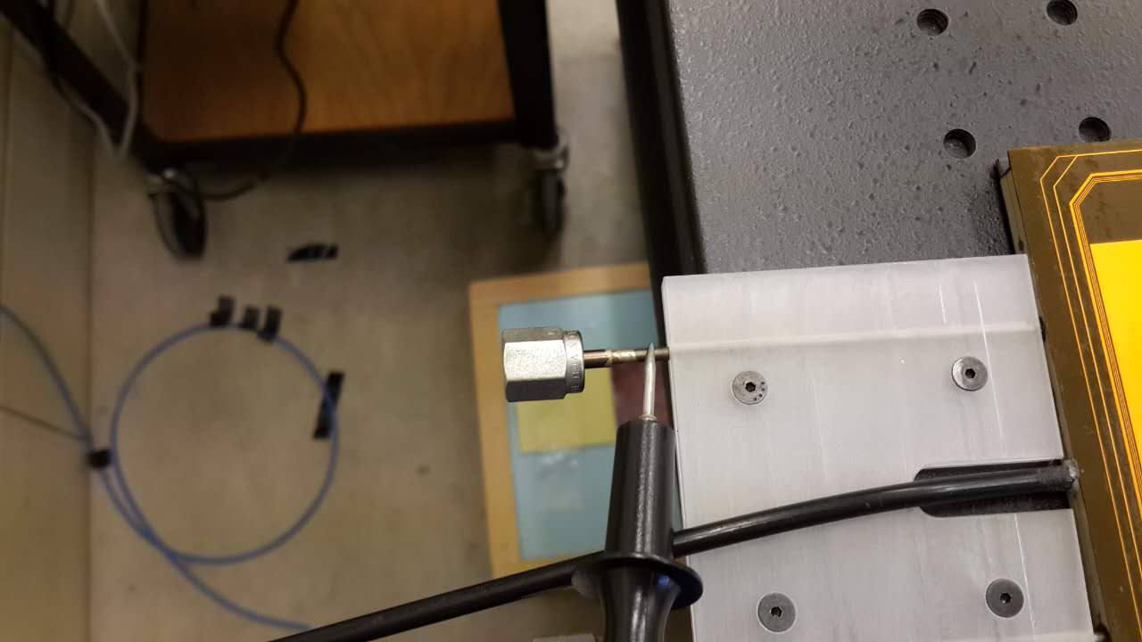
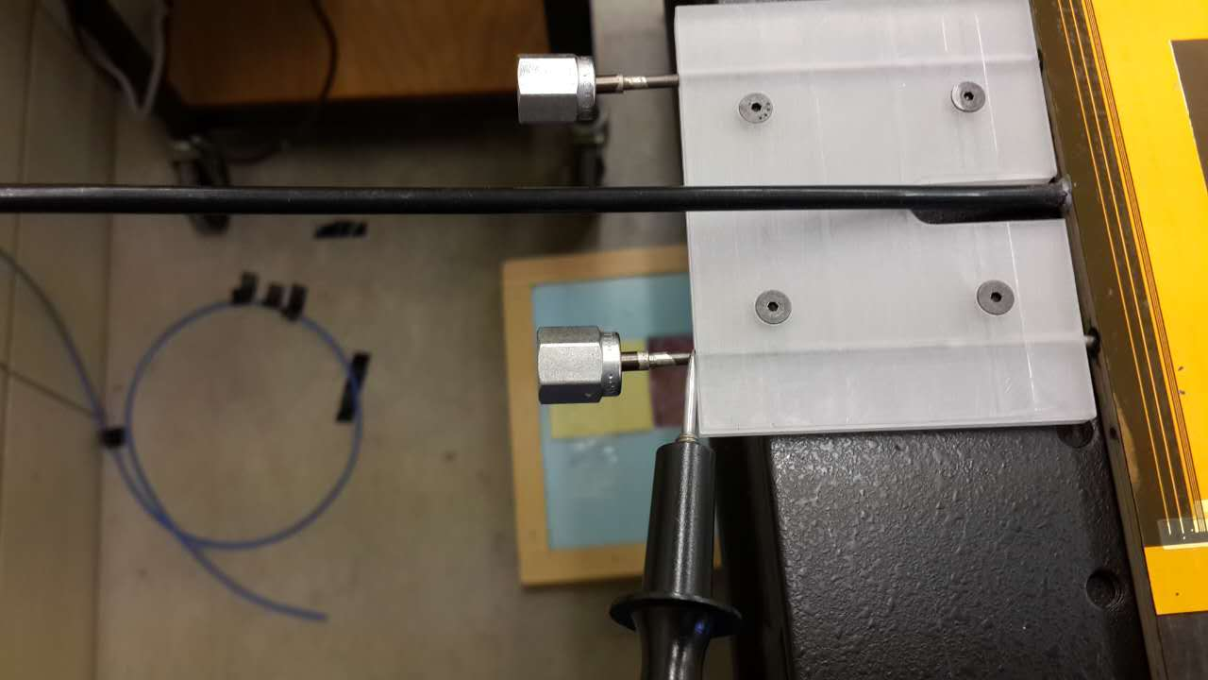

Slide 8
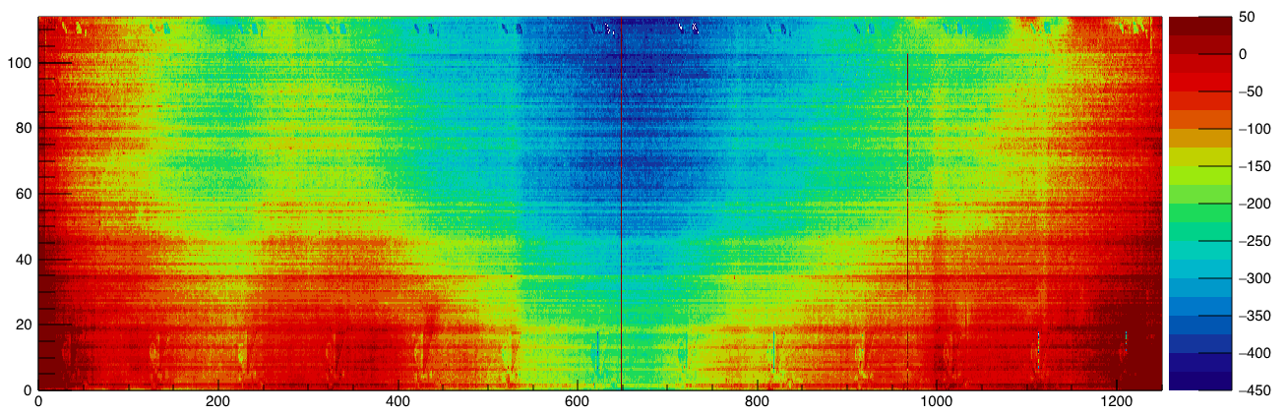
Edge support J view

Slide 9
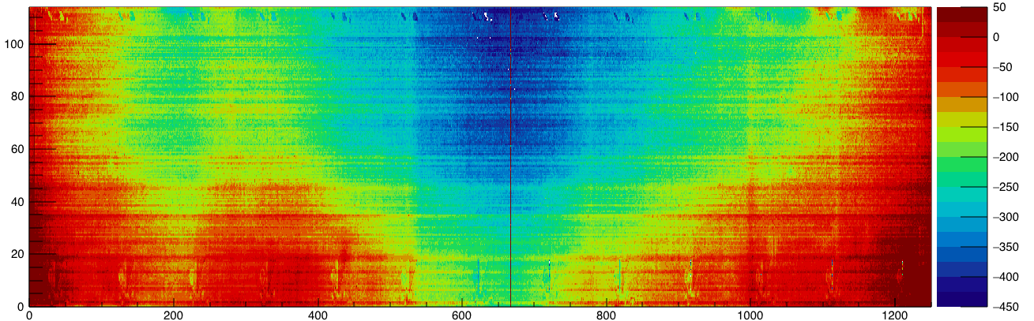
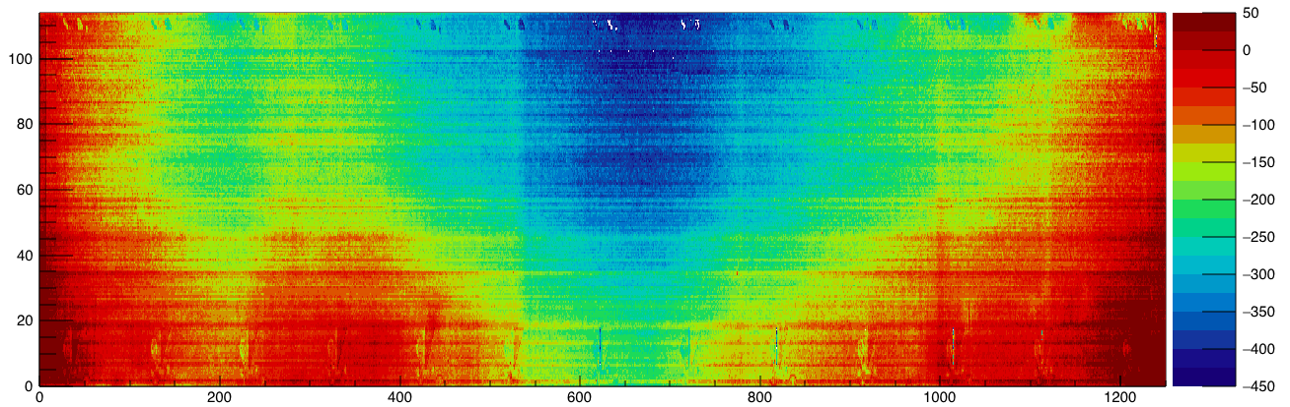

Slide 10
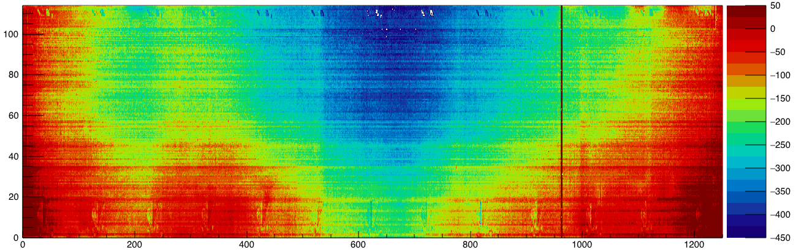


Slide 11
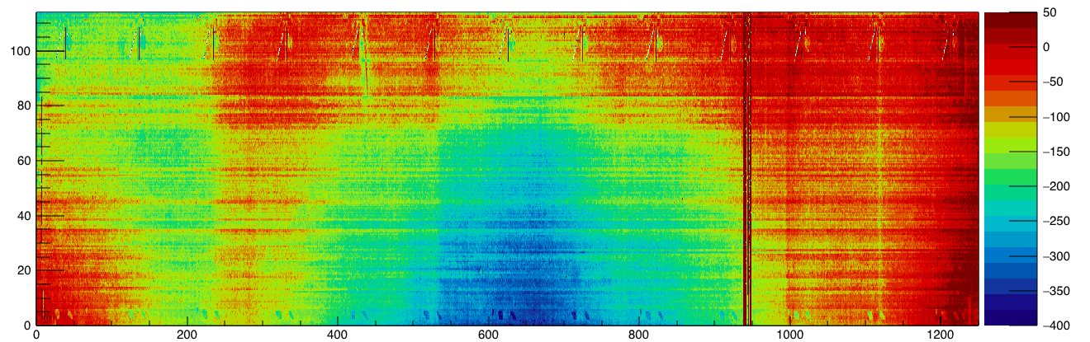
Edge support L view

Slide 12
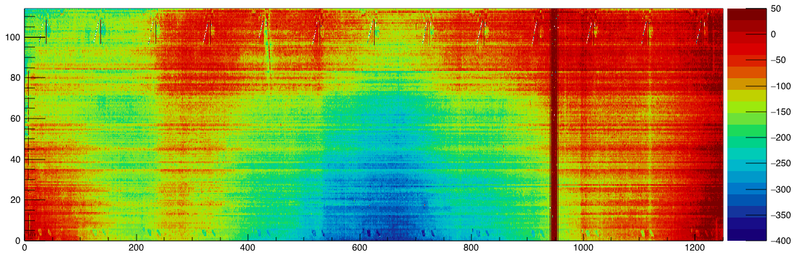
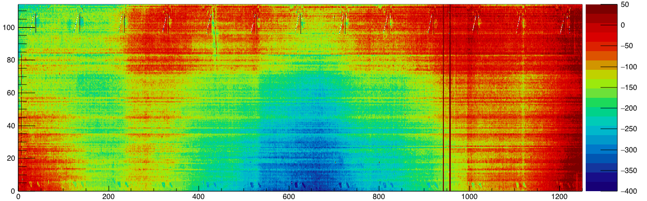

Slide 13
