Slide 1


Stave QA: Box Temperature Experiments
William Heidorn, Jie Yu
Iowa State University
ISU Weekly Meeting
August 30, 2017

Slide 2
Stave Installation
When installing a stave into the box, we wanted to get an estimate on how long to wait for the stave to come to equilibrium with the box
The new stave(stave 5) was installed on Friday in the afternoon. It was then monitored and a picture was taken every 10 minutes. The Stave and box were left alone in the box. The door to Roy’s office was kept closed. We stayed out of the room except to check to see if the programs were running…
  The software crashed after the first 45 minutes or so… so we had a gap in data…
  We are uncertain as to what caused the crash

Slide 3
Install: Stave Pics (T = 0)

Slide 4
Install: Stave Pics (T = 40 min)

Slide 5
Install: Equalizing Plot
As you can see the Average Box Temperature does not change much… but the distribution becomes a single peak once it has stabilized. This can then be used to find the standard deviation of the ambient temperature…
The Std Dev of the peak decreases during the 40 minutes

Slide 6
Install: Long Term Plots (T = 0, 110, 200 min)
T = 0 min
T= 110 min
T = 200 min
The profile stays relatively Gaussian once it reaches an equillibrium state.
From the last 10 data points the Average Std Dev can be calculated
0.113 +/- 0.008 C°

Slide 7
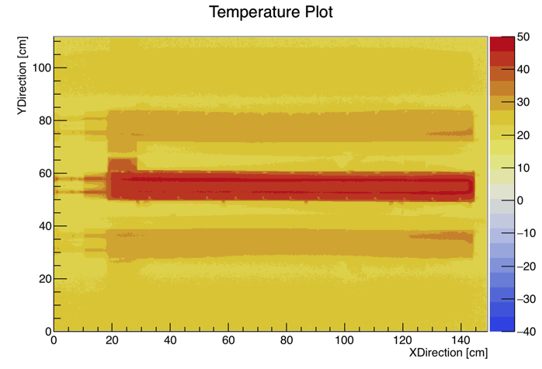
Heating: Looking only at the upper sides
A short study was done to see how the box temperature was effected during the heating and cooling process
An image of the stave was taken every minute during a 35 minute period
The stave and its 1st order reflection are removed to get a better look at the box temperature

Slide 8
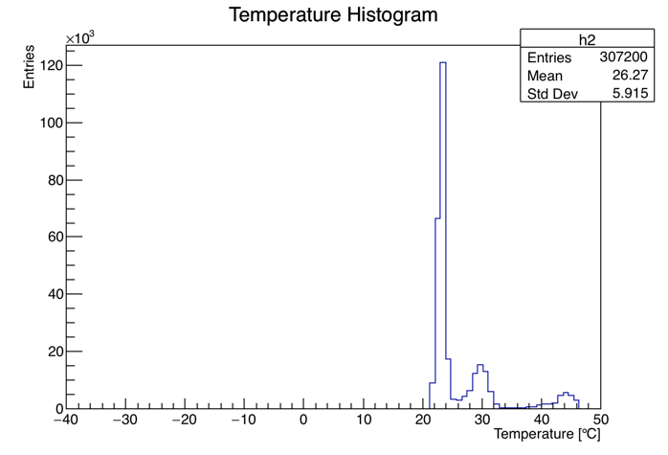
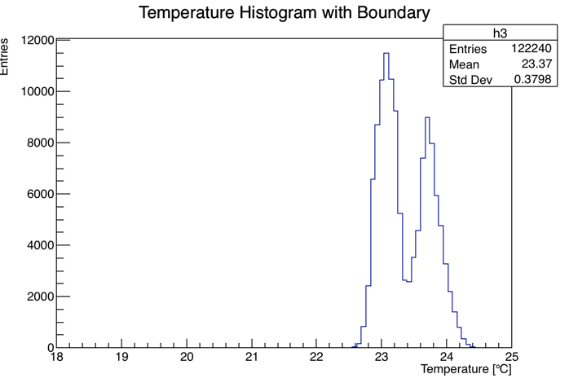
Cooling: Looking only at the upper sides
Again we see the two main reflections and stave in the overall histogram
The 2nd order reflections can again be seen in the cut data
This is just another method of looking at the average box temperature as a function of time…
  Not very accurate

Slide 9
Heating and Cooling Comparisons
Box Temperature Measurements
  Floating Thermocouple This method uses a thermocouple that is located a few centimeters above the inlet and outlet points of the stave. It is often too close to the pipes and gets effected by them because it generally does not stay where we want it too…
  Aluminum Plates This method was discussed in June 2017. It involved using 3 aluminum plates balanced inside the box at the same level as the stave. The temperature was extrapolated from the plates and averaged among them to get a box temperature
    https://indico.cern.ch/event/616071/contributions/2629008/attachments/1476952/2288381/20170612Update.pdf
  Side Measurements Most recent attempt at find the box temperature
Box Temperature | “Floating Thermocouple” | Aluminum Plates | Box side measurements
T minimum = | 19.6 +/- 1 | 20.3 +/- 2.2 | 17.9 +/- 0.5
T maximum = | 26.6 +/- 1 | 26.3 +/- 1.1 | 23.4 +/- 0.4

Slide 10
Comparison: L-Side Ambient and Cold

Slide 11
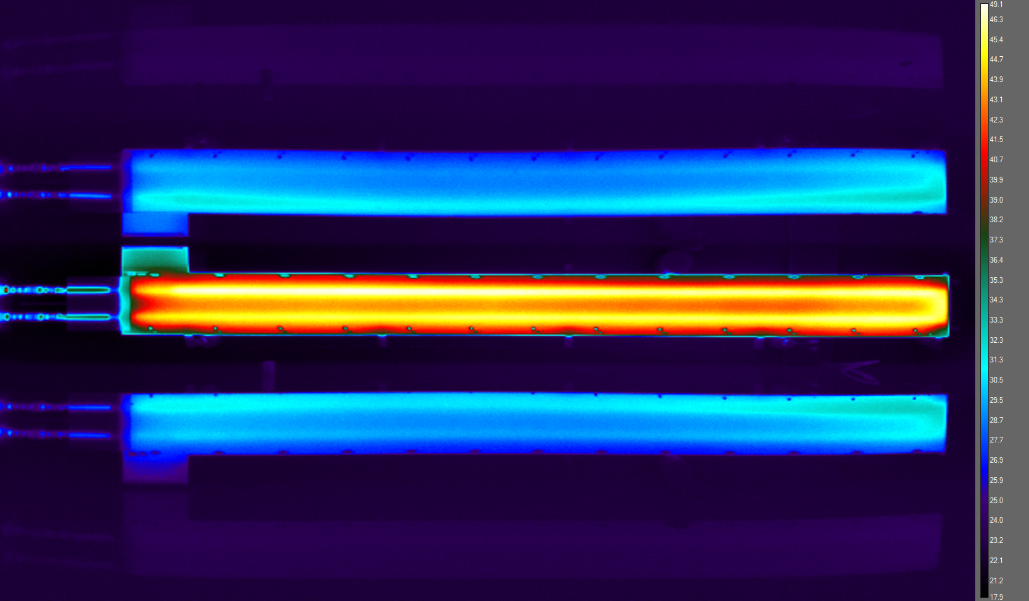
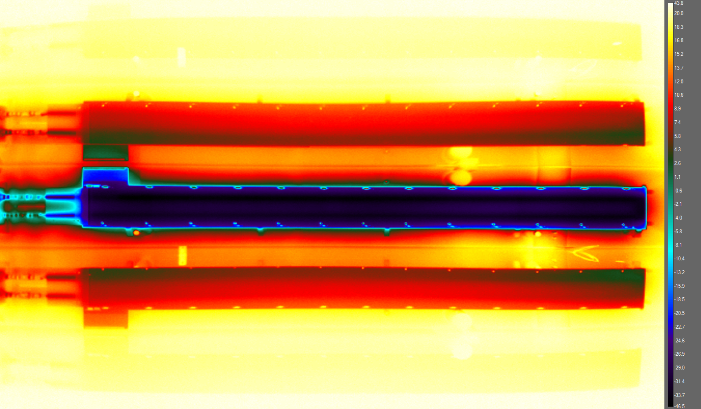
Comparison: J-Side Hot and Cold

Slide 12
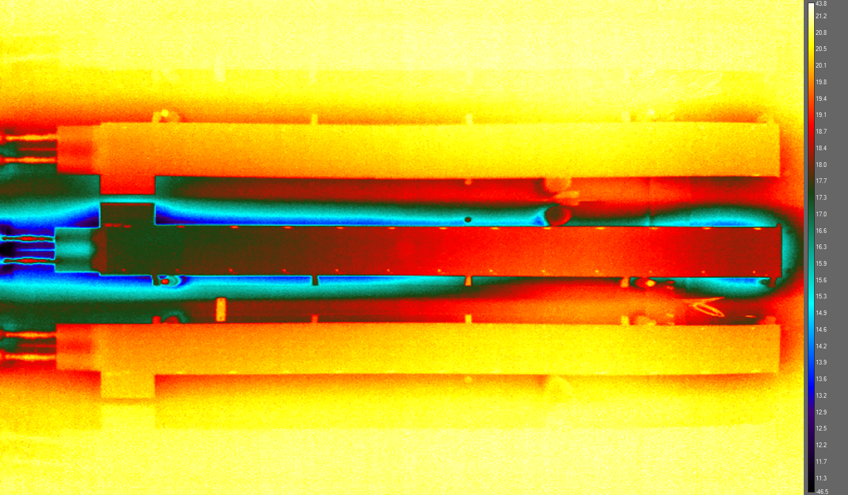
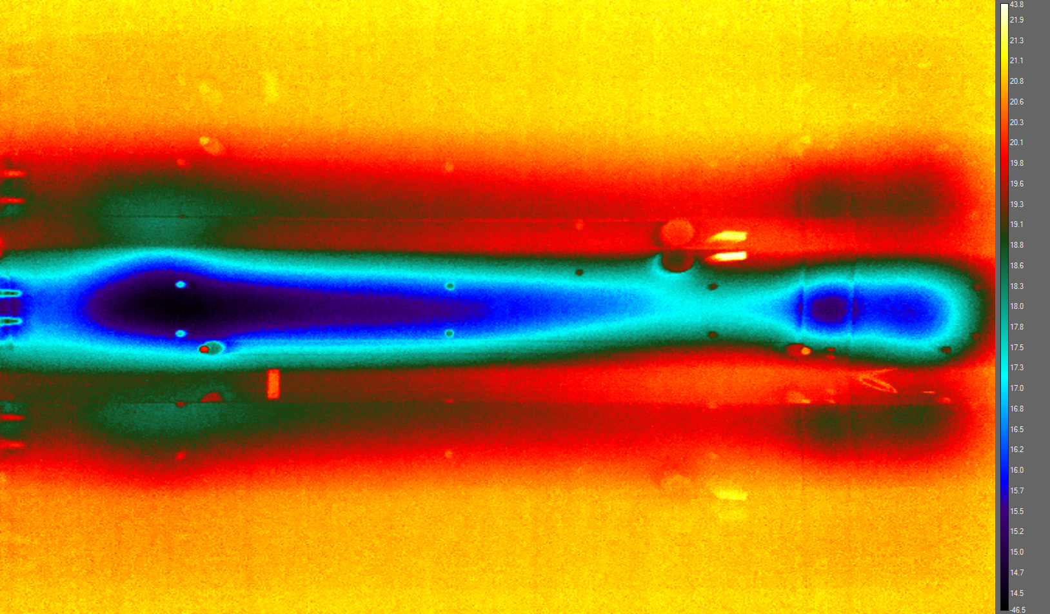
Comparison: J-Side Reset to Ambient/ Stave Removal
Background nonuniform heating of the box… ????

Slide 13
Conclusions
It takes approximately 40 minutes to get the stave and the box to come to equilibrium after install
The background fluctuations of the room temperature appear as around a 0.113 +/- 0.008 C° standard deviation of the box temperature
There may be another viable way to measure the ambient box temperature by measuring the temperature of the sides of the box
We have a new background nonuniformity… it may just be due to non uniform heating and cooling of the box

Slide 14
Backup Slides

Slide 15
Backup Slides: Stave at Ambient (T=150 min)
This image shows a stave at ambient temperature in the box
  You can see reflections of the camera… and the reflections of the camera reflection!
  You can see the Plexiglas lip from the box

