Slide 1


STAVE QA: LASER UPDATE
William Heidorn, Jie Yu
Iowa State University
ISU Weekly Meeting
August 9, 2017

Slide 2
Laser Scanning
Last week I spent some time learning about how to use the laser scanning apparatus and software. Here are some links to resources that are very informative
  https://twiki.cern.ch/twiki/bin/view/Sandbox/LaserScanningMethod
    How scanning works with links to most of what is needed to understand stave apparatus setup
  Currently there is a page for calibration so in the next week I will be compiling Boping’s notes and uploading them.
  https://twiki.cern.ch/twiki/bin/view/Sandbox/PlottingInRoot
    A set of instructions to plot and work with the raw data from excel

Slide 3
Practice Scanning
I scanned the stave twice with various coins on the surface. Between the scans I removed some of the coins and added them in different places.
I used some of Carlos’ root codes to draw the stave and look at the different scans and their subtraction

Slide 4
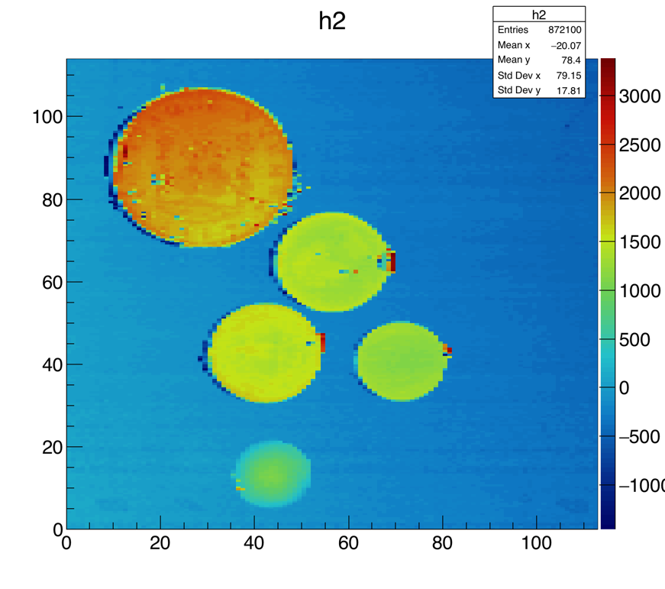
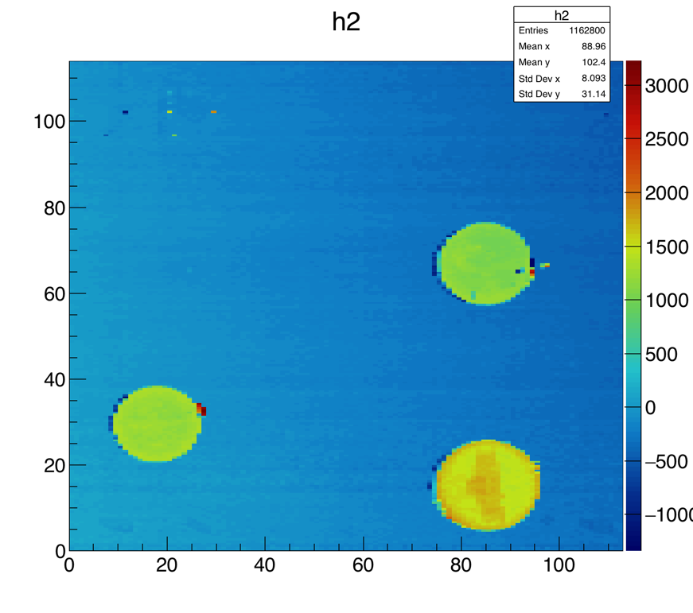
Stave Scans with Coins- (5 different coins can you identify them all?)

Slide 5
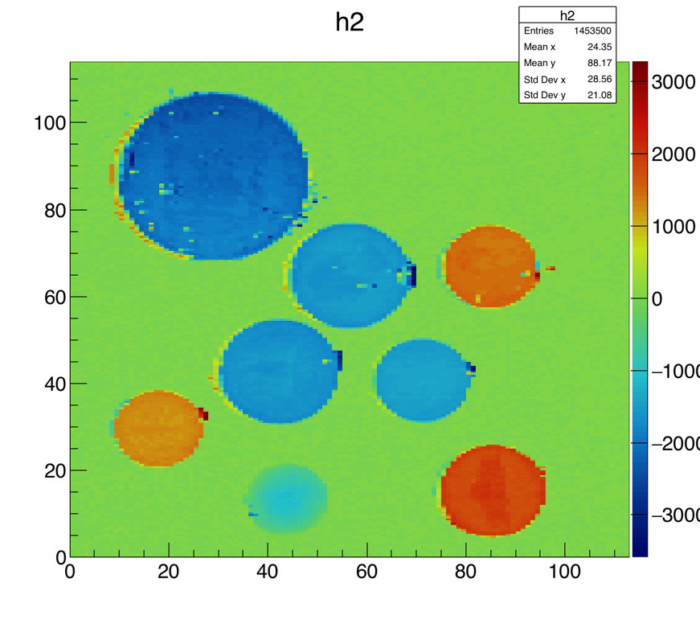
Subtracted Scan (with coin labels)
Spanish Dollar
Quarters
Pennies
Dime
Nickel
Plastic Bump

Slide 6
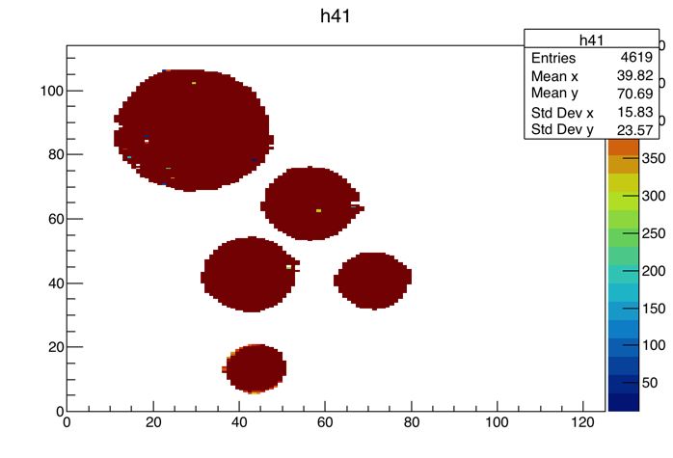
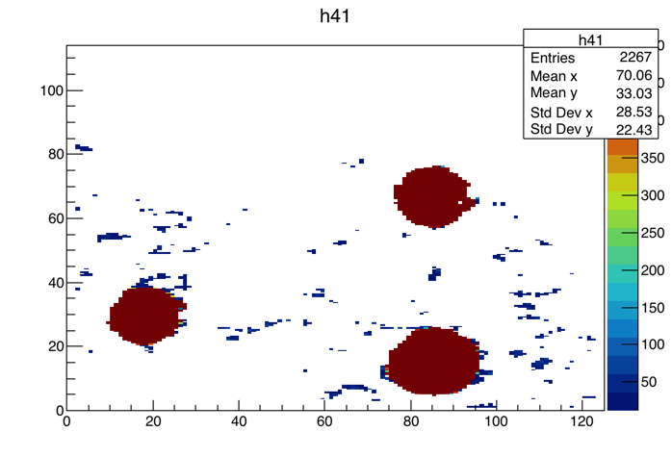
Finding the peaks
Using the scpeaks.C program on both subtracted scans

Slide 7
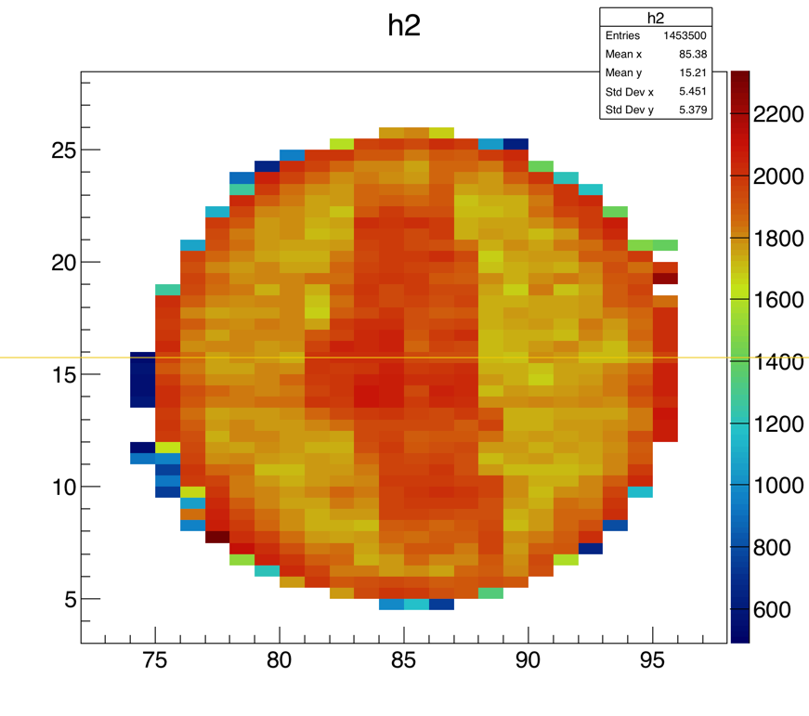
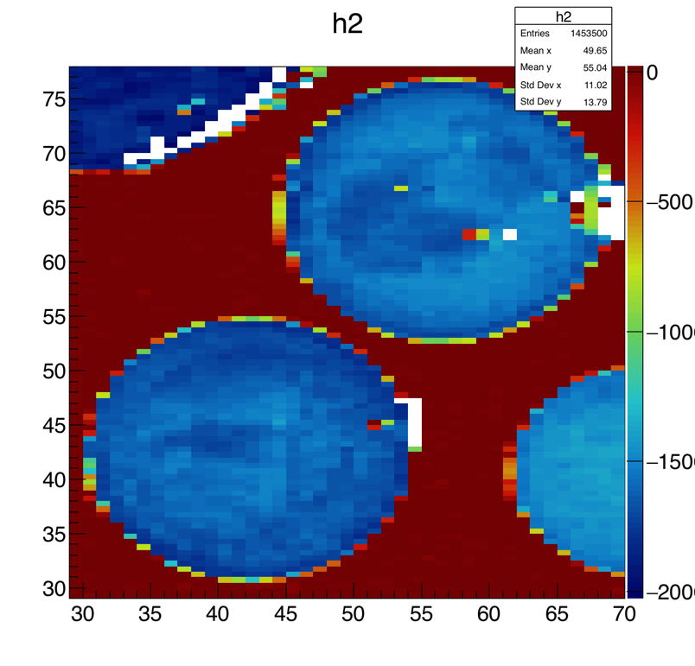
Coin Comparisons
Nickel Back:
Thickness = 1.95 mm;
Diameter = 21.21 mm;
Quarter:
Thickness = 1.75 mm; Diameter = 24.26 mm;

Slide 8
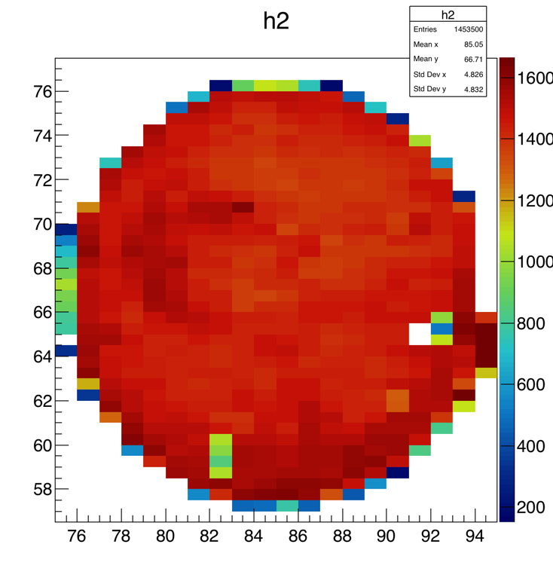
Coin Comparisons cont.
Penny Face:
Thickness = 1.52 mm;
Diameter = 19 mm;

Slide 9
Future Stave QA work
Current Goal: Continue filling in the laser scanning twiki and then work on compiling data for the thermal imaging portion.
At some point
  When more novec fluid arrives calibrate the flow rate
  Do a full practice run laser scan
  Look at cleaning up laser scanning LabVIEW code
  Long term stave core analysis?

Slide 10
Backup Slides

