Slide 1
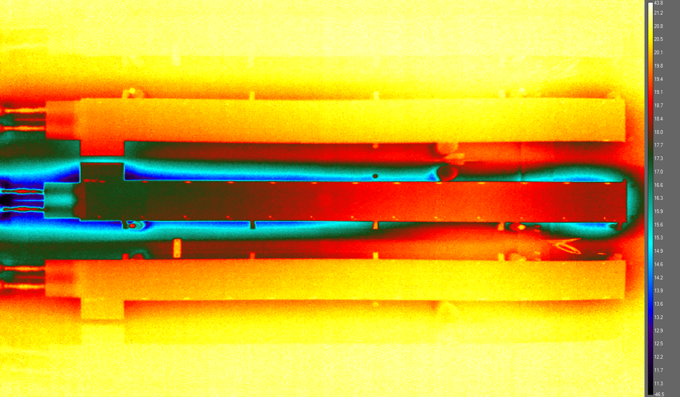
Stave enclosure thermo background study
Issue:
There exists themo irregularities within the stave enclosure that should be eliminated.

Slide 2
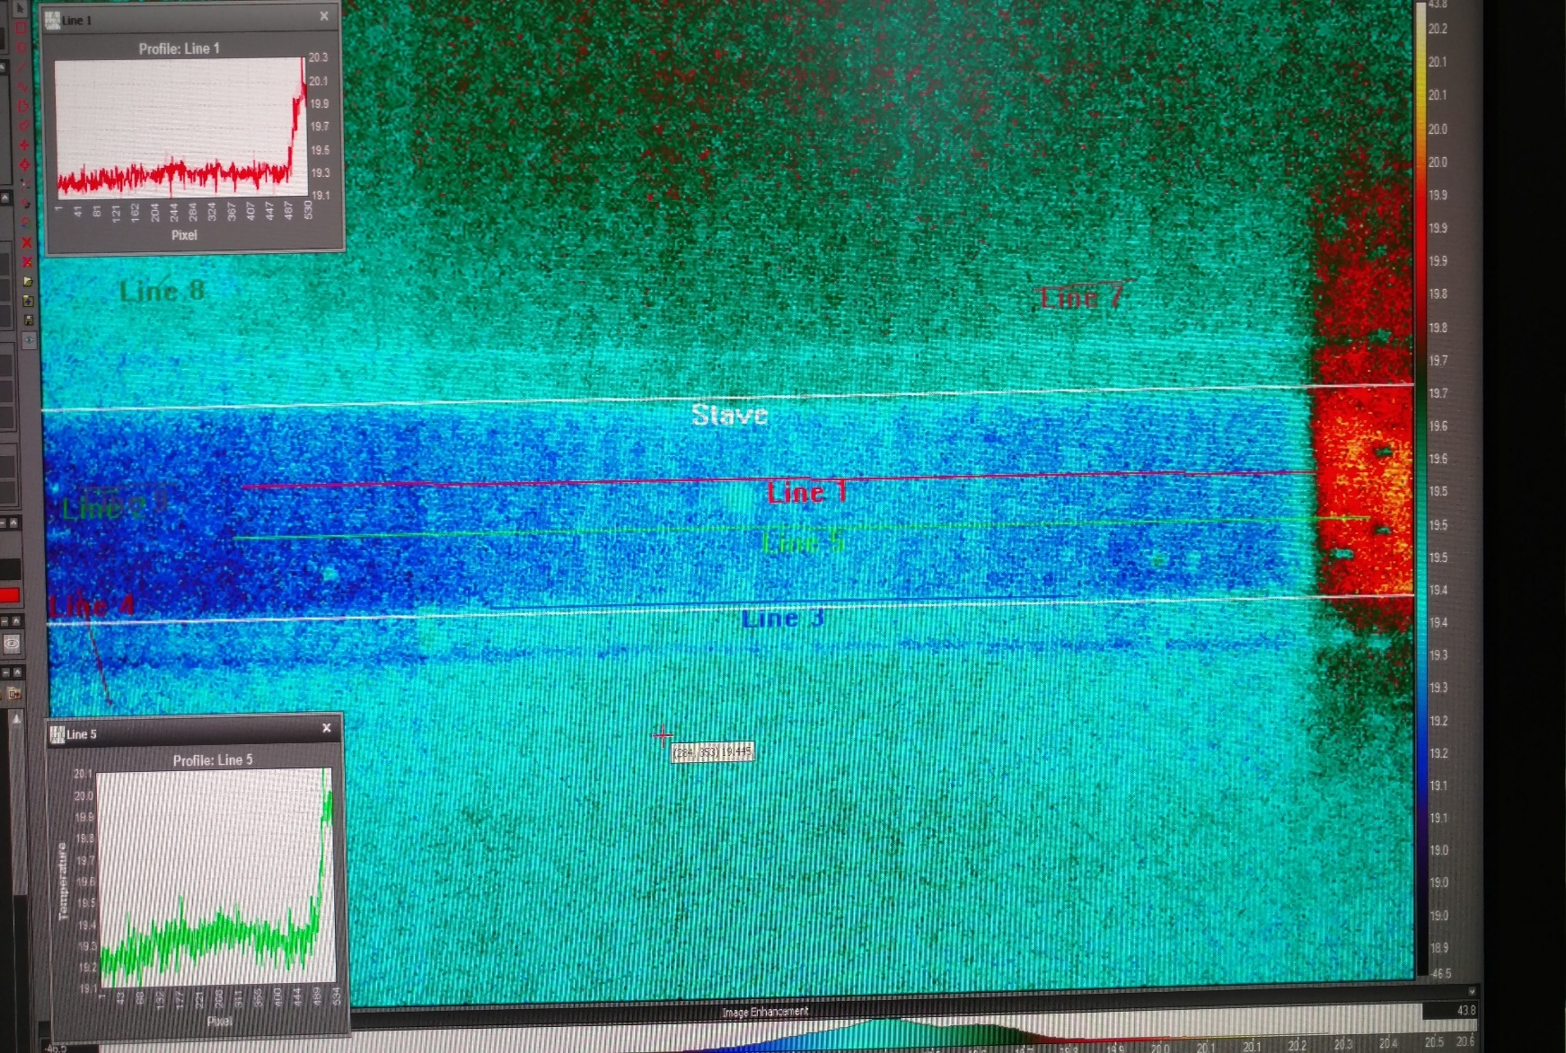
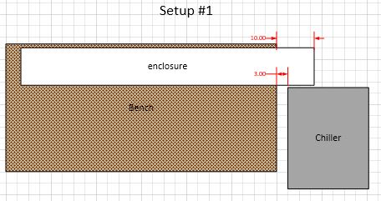
Stave enclosure thermo background study
Only chiller running for 6 min. No fluid flow & no stave in enclosure. Chiller set @ 20C
Chiller exhaust heats right end of enclosure.

Slide 3
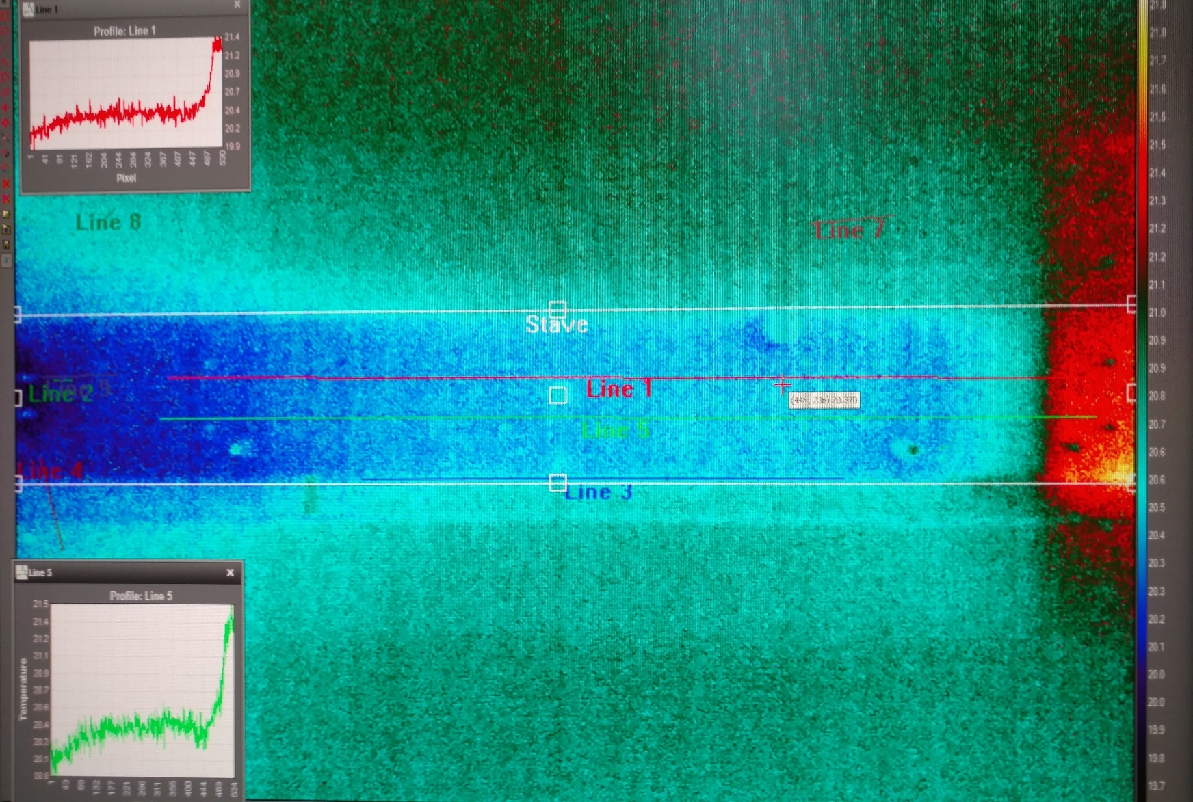
Stave enclosure thermo background study
Both chiller & booster pump running for 12 minutes. No stave in enclosure. Chiller set @ 20C
The chiller exhaust heat progress to left end of enclosure.

Slide 4
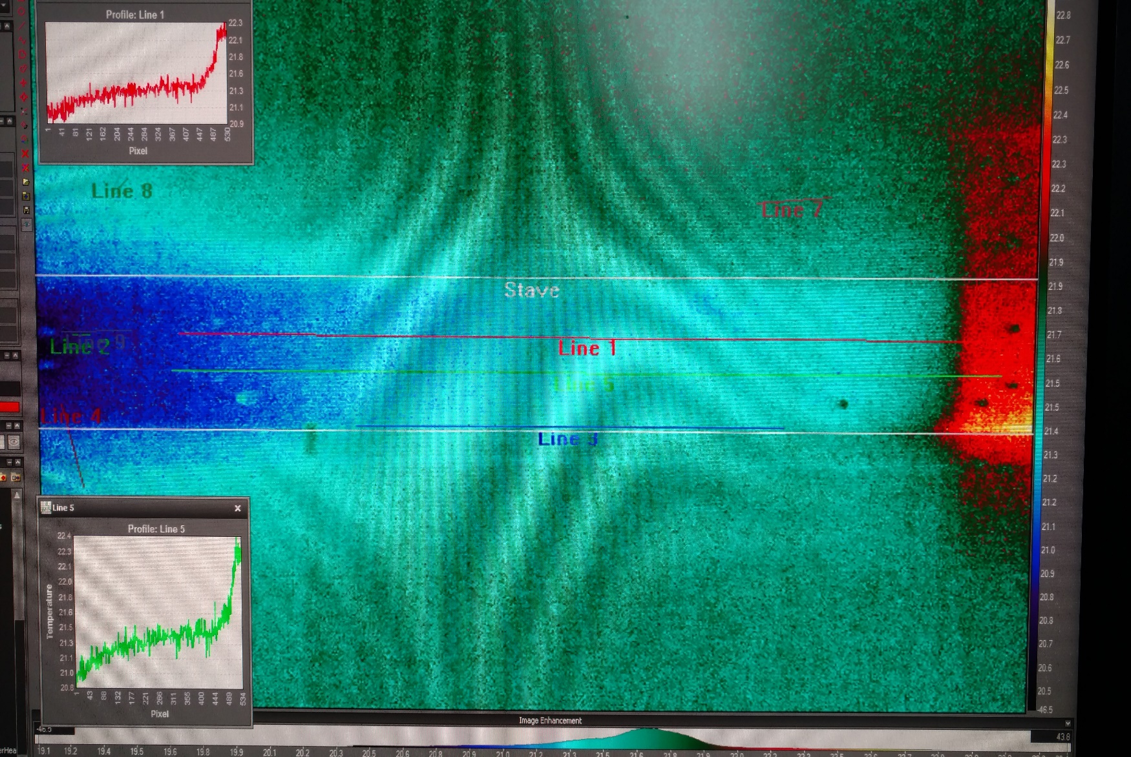
Stave enclosure thermo background study
Both chiller & booster running for 2.5 hours. No stave in enclosure. Chiller set @ 20C
Thermo equilibrium from chiller exhaust.

Slide 5
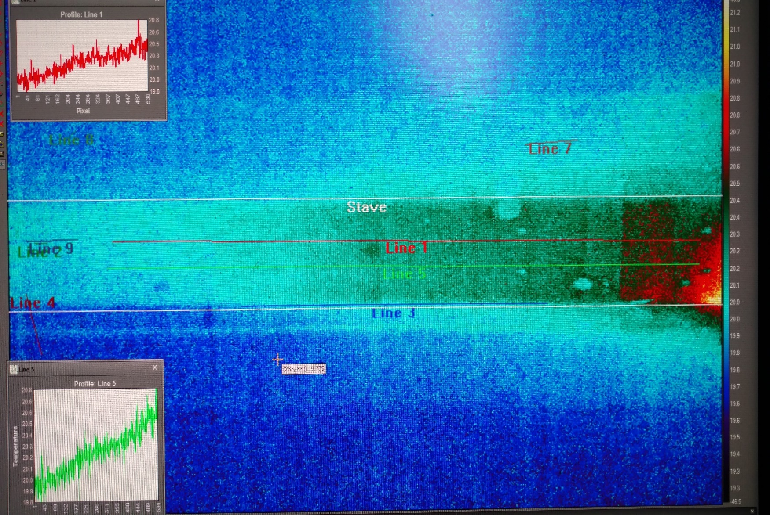
Stave enclosure thermo background study
2 hours after shut down of chiller & booster pump. No stave in enclosure. Chiller set @ 20C
Takes some time to recover from chiller exhaust.

Slide 6
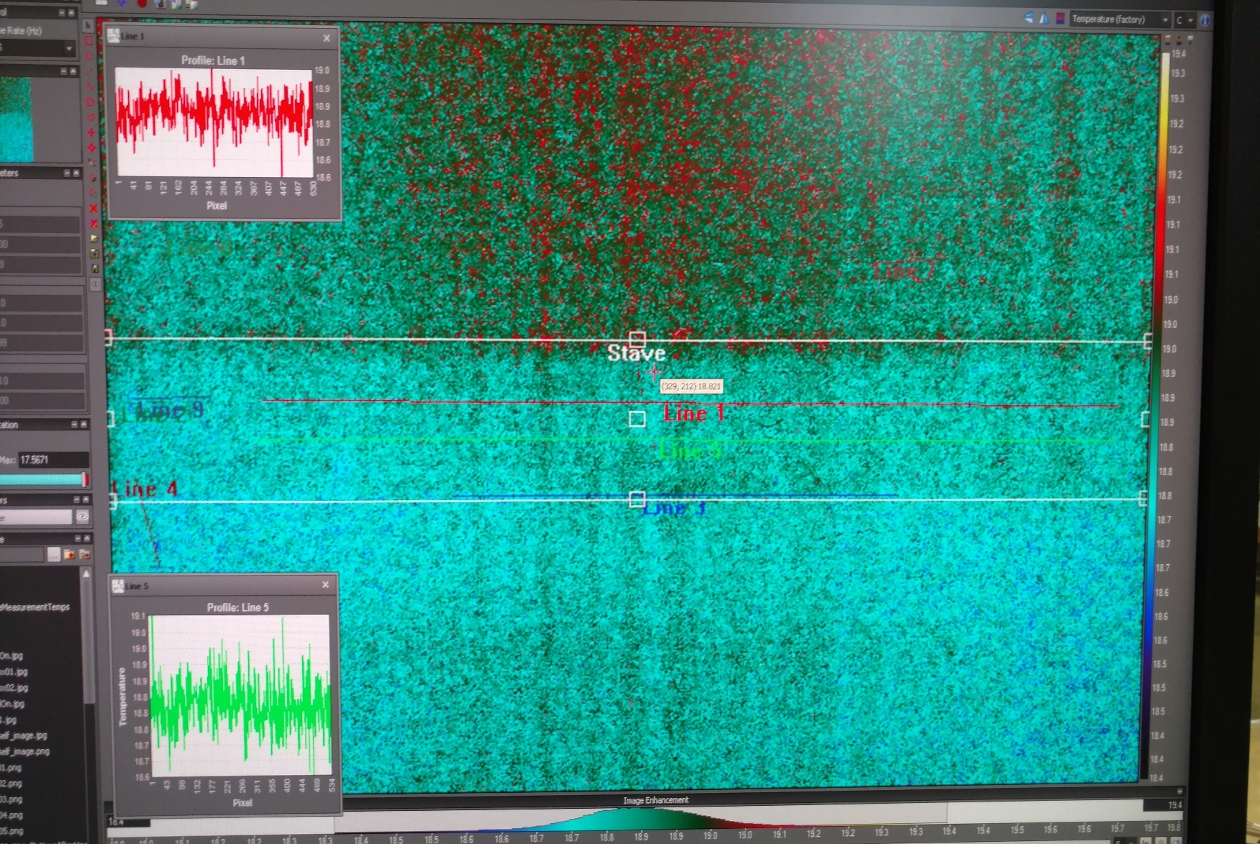
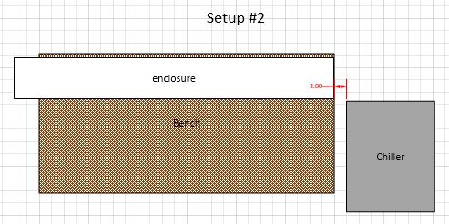
Stave enclosure thermo background study
Background at start. No stave in enclosure. Chiller set @ 20C
Enclosure moved to avoid chiller exhaust.

Slide 7
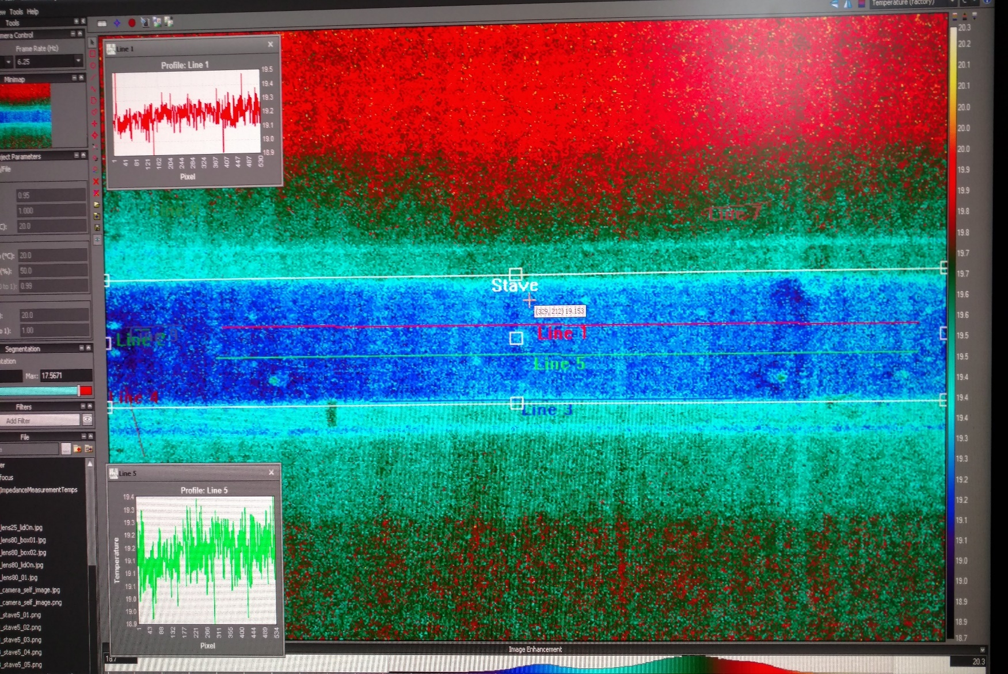
Stave enclosure thermo background study
Chiller running for 35 minutes. No fluid flow. Chiller set @ 20C
Chiller exhaust has much smaller effect on right end.

Slide 8
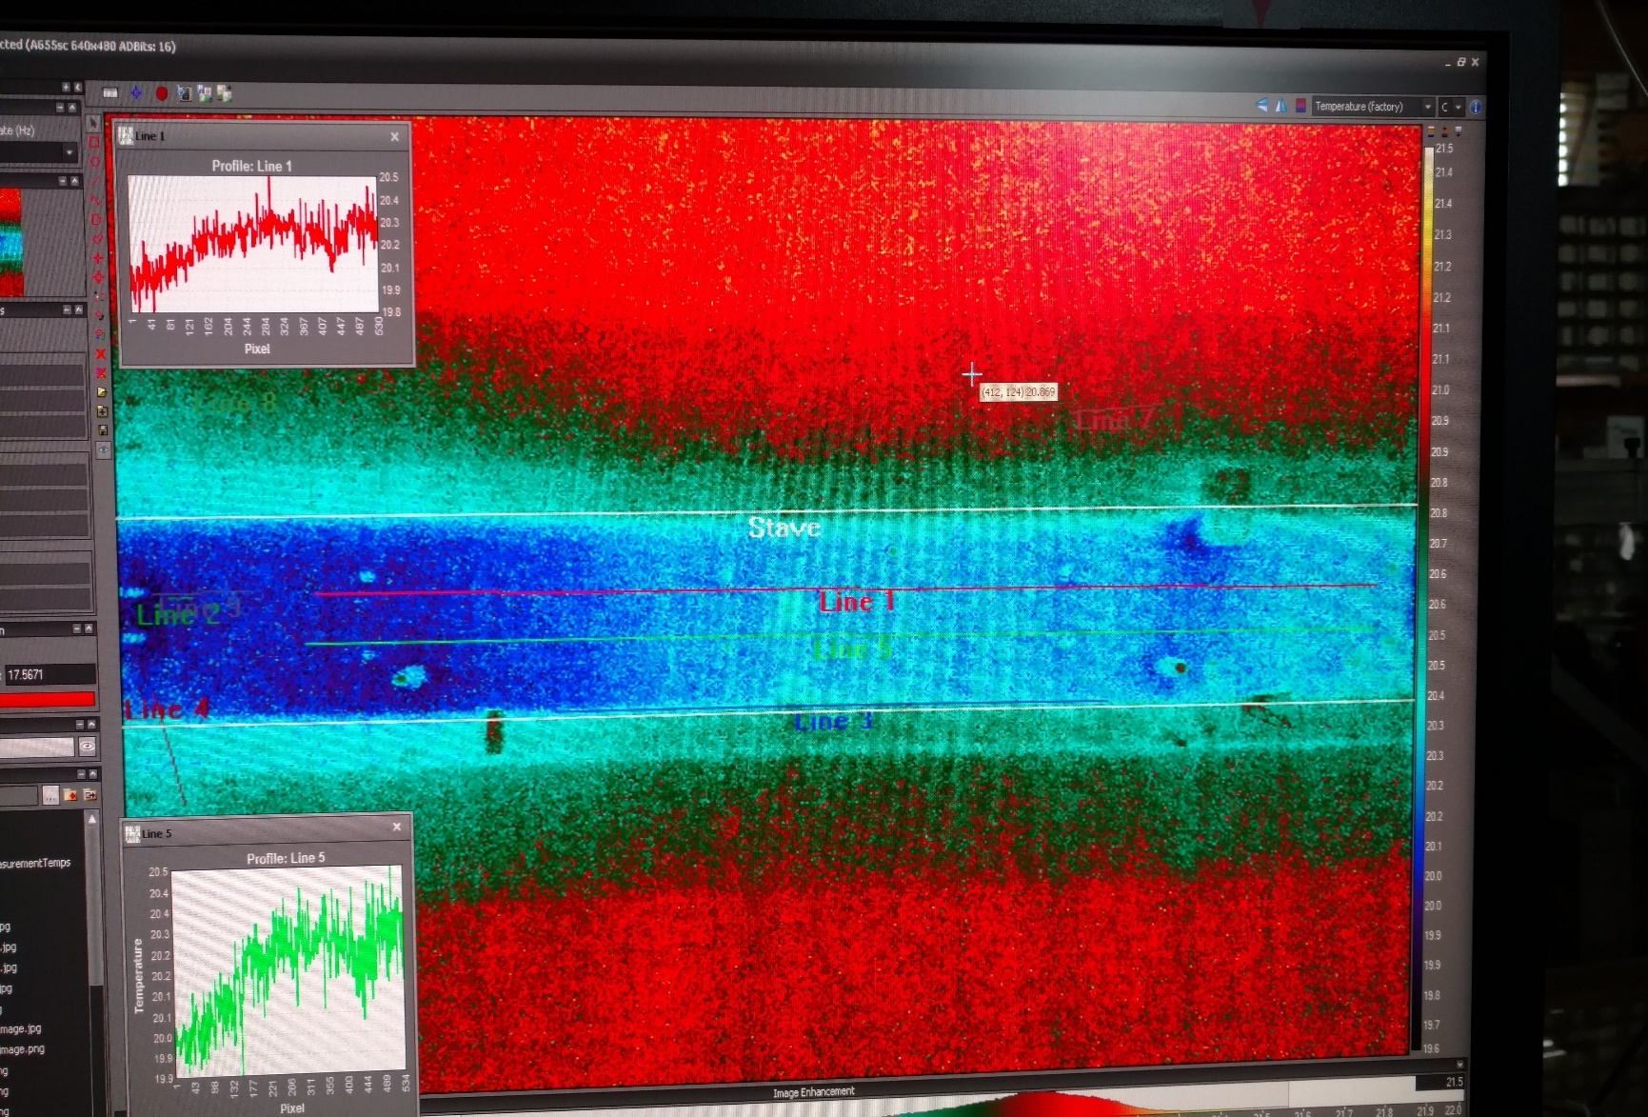

Stave enclosure thermo background study
Chiller & booster pump running for 56 minutes. No stave in enclosure. Chiller set @ 20C
Eventually chiller exhaust is affecting enclosure.

Slide 9
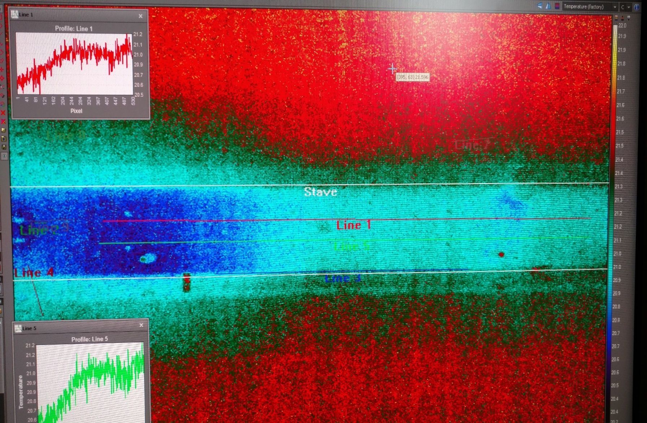
Stave enclosure thermo background study
Chiller & booster pump running for 120 minutes. No stave in enclosure. Chiller set @ 20C
Chiller exhaust continues to heat enclosure.

Slide 10
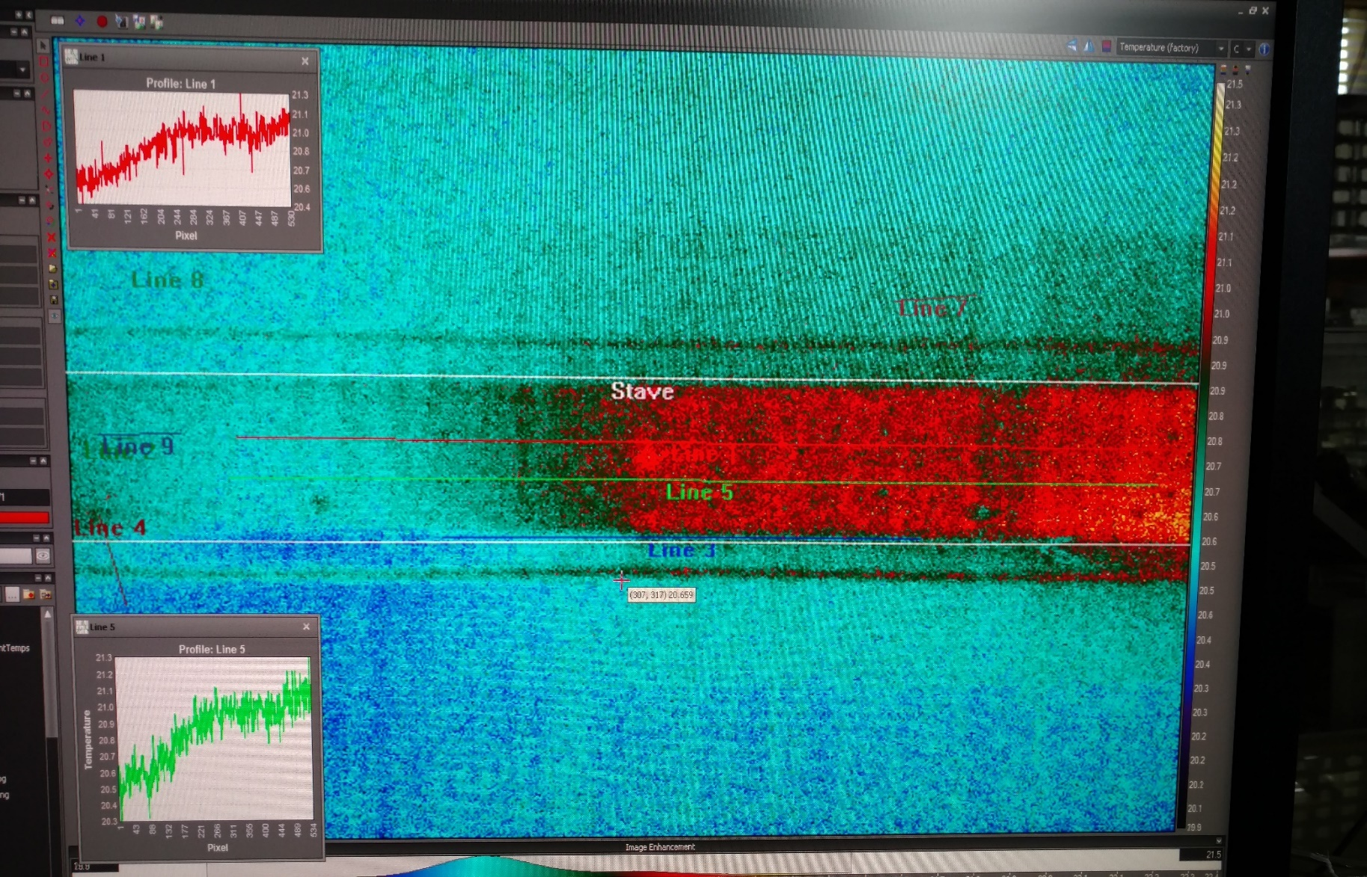

Stave enclosure thermo background study
45 minutes after shut down.
Again the time to recover from chiller exhaust is long.

Slide 11
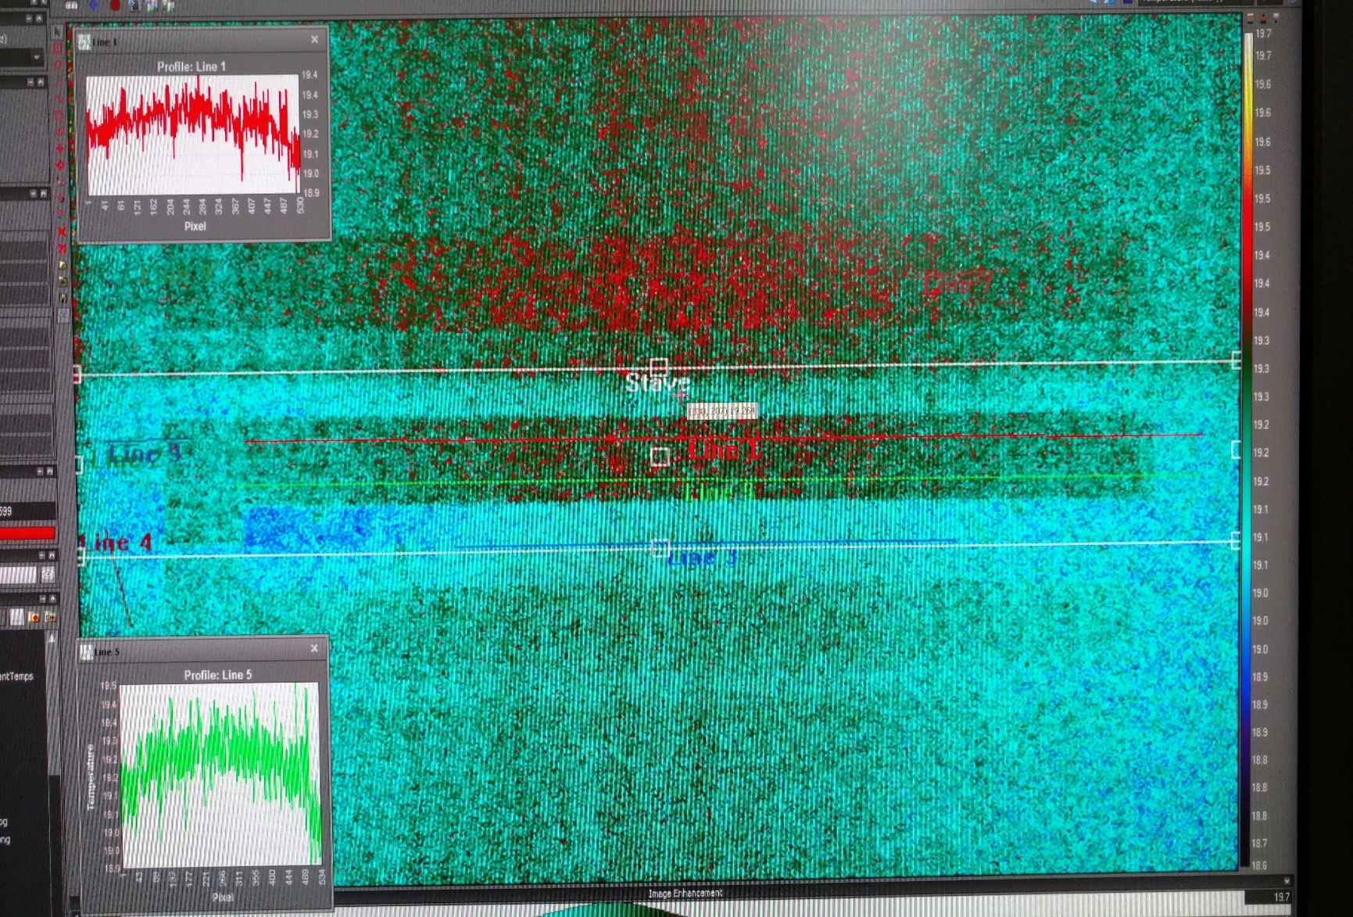
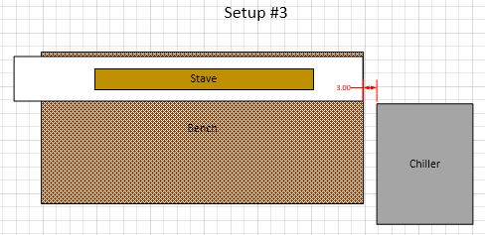
Stave enclosure thermo background study
Background at start. Stave in enclosure. Chiller set @ 20C
Stave now included in study.

Slide 12
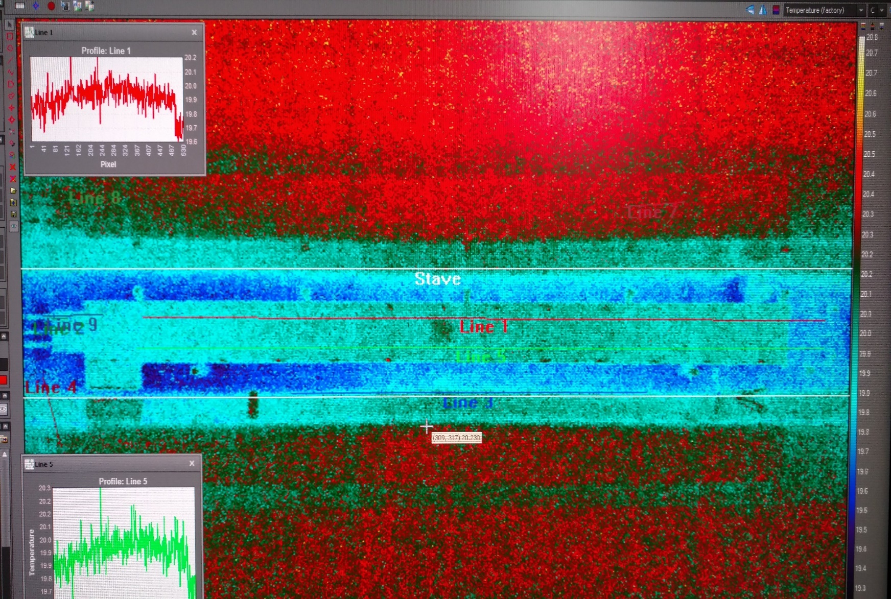
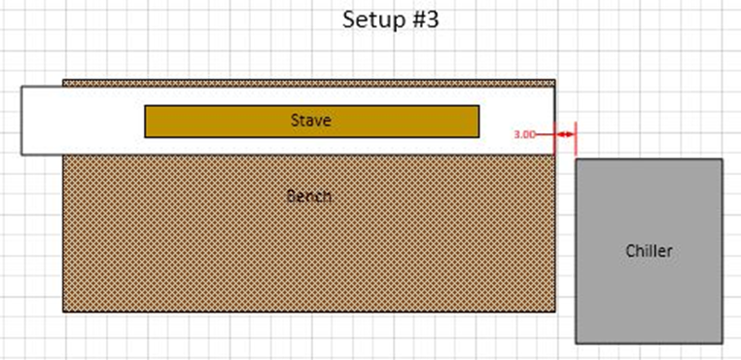
Stave enclosure thermo background study
Chiller & booster pump running for 50 minutes. No fluid flow. Chiller set @ 20C
Start to see warm area under stave. Right end a bit cooler.

Slide 13
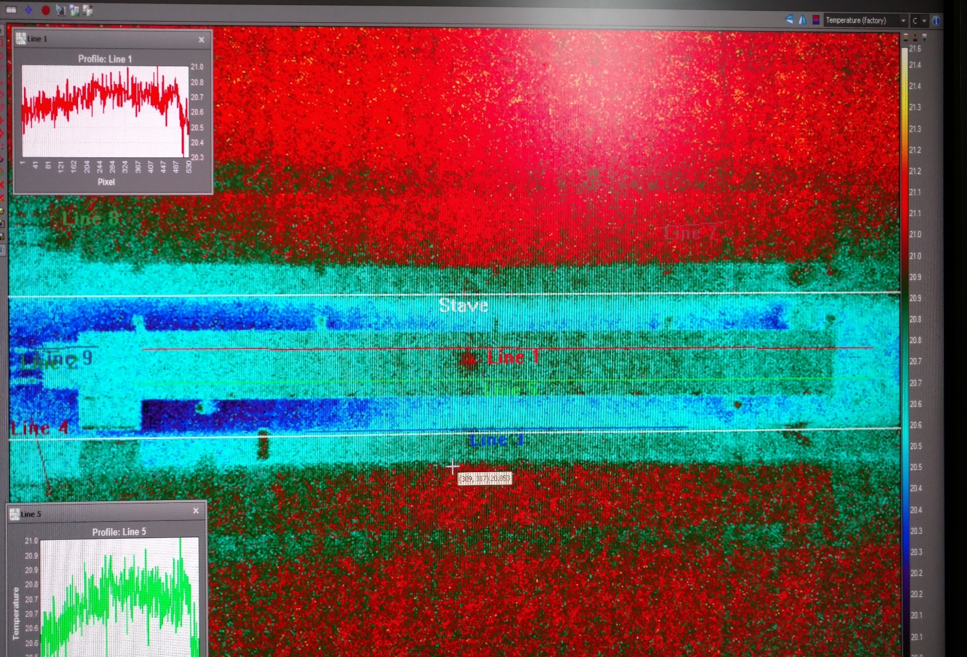
Stave enclosure thermo background study
Chiller & booster pump running for 1.5 hours. No fluid flow. Chiller set @ 20C
Chiller exhaust taking over.

Slide 14
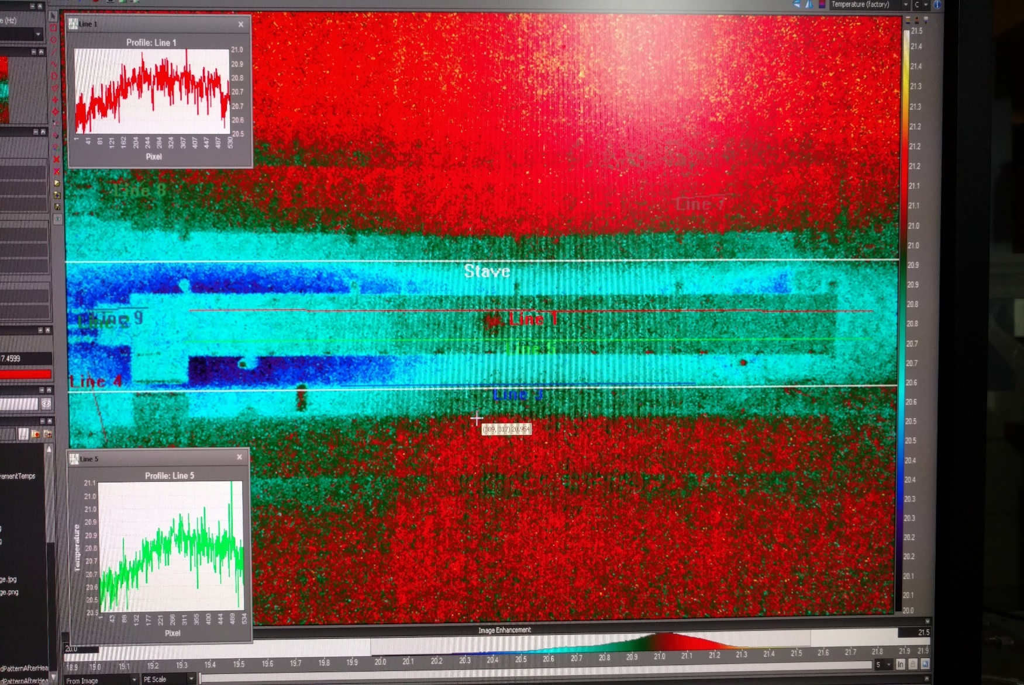
Stave enclosure thermo background study
Chiller & booster pump running for 2 hours. No fluid flow. Chiller set @ 20C
Chiller exhaust continues to affect.

Slide 15
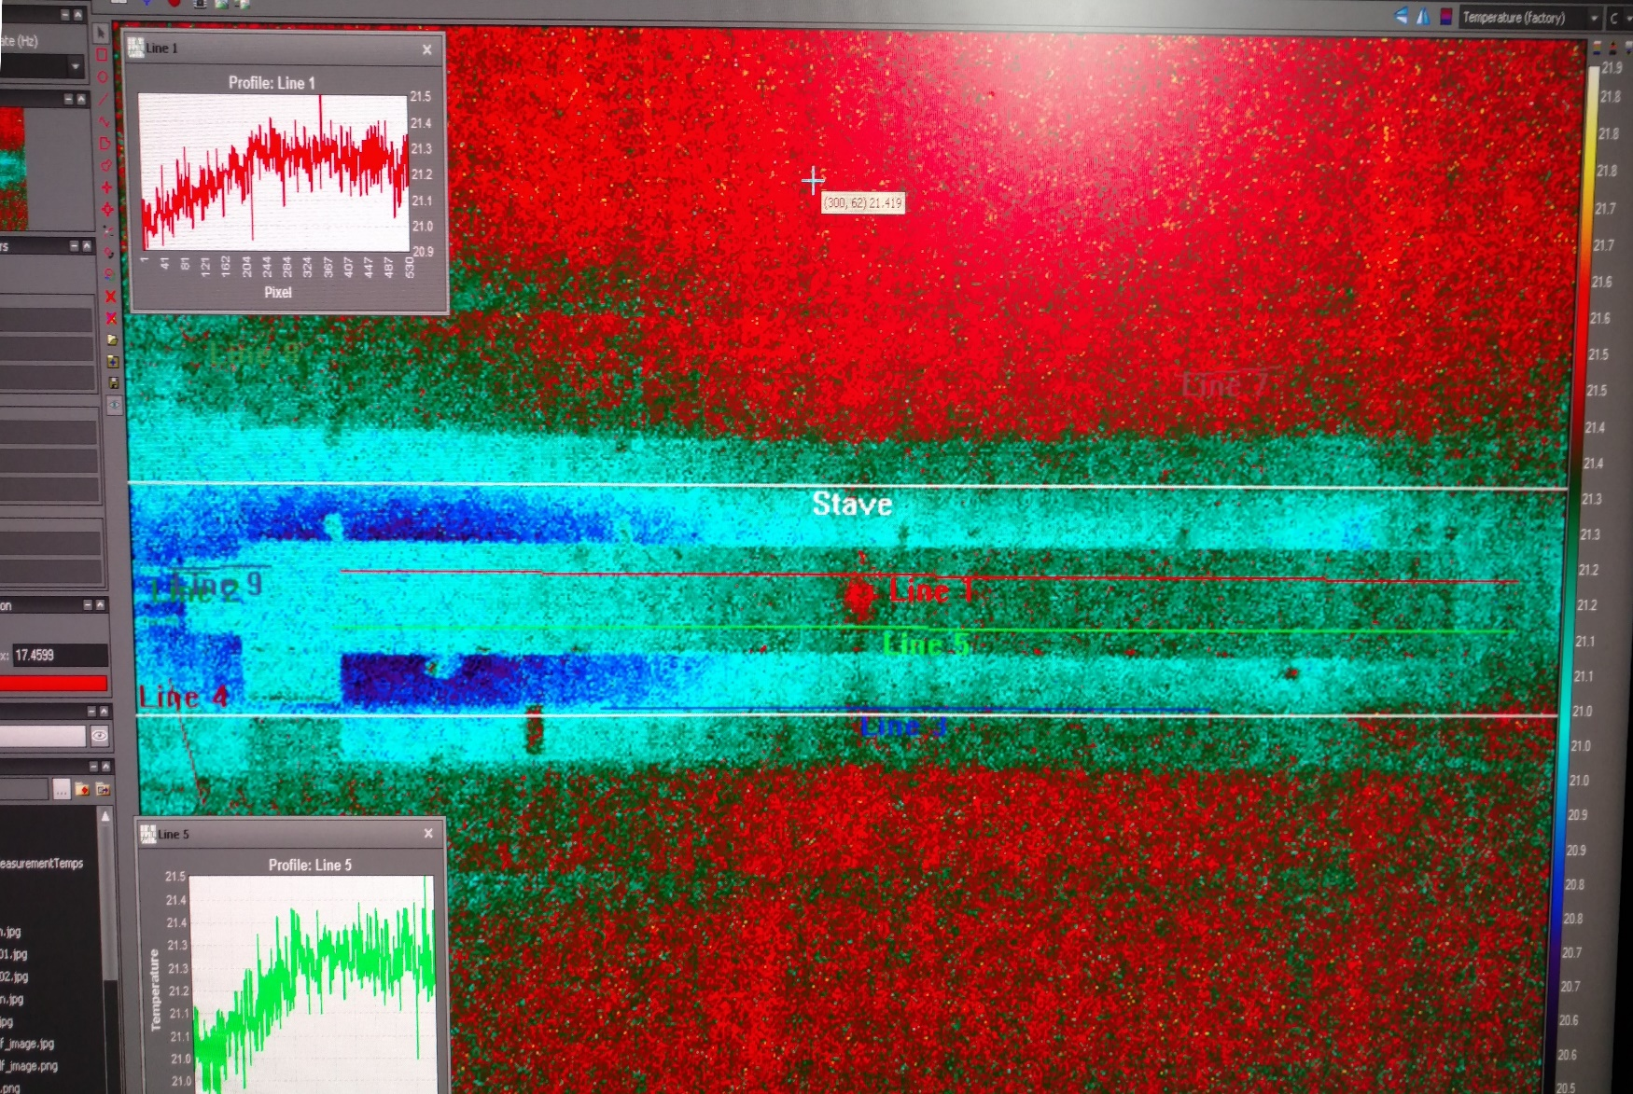
Stave enclosure thermo background study
Chiller & booster pump running for 2.83 hours. No fluid flow. Chiller set @ 20C
Equilibrium with chiller exhaust.

Slide 16
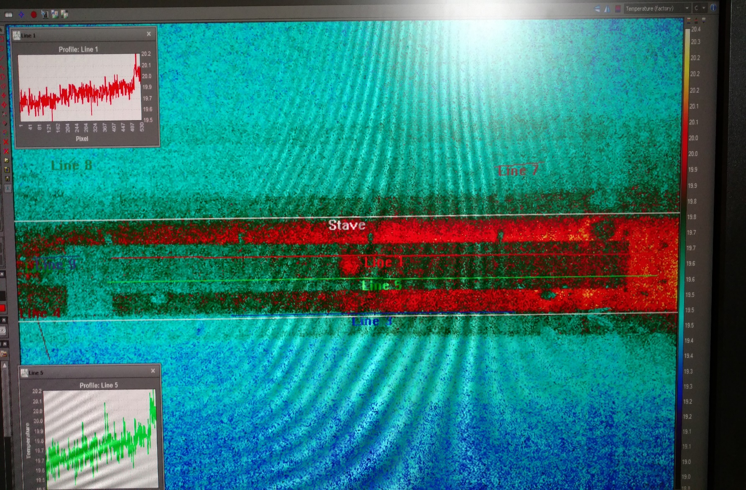
Stave enclosure thermo background study
2.5 hours after shut down.
Again, long time to recover.

Slide 17
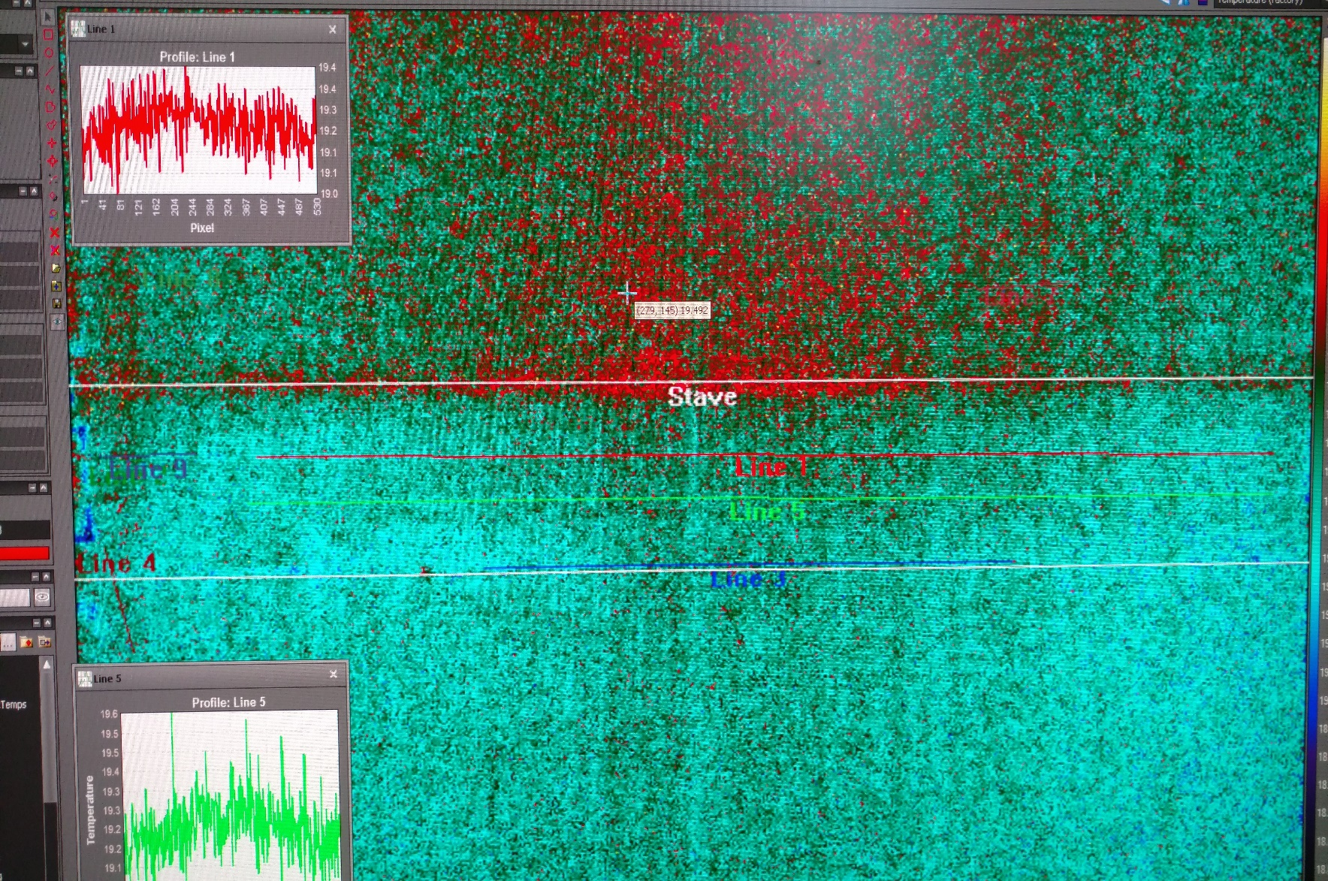
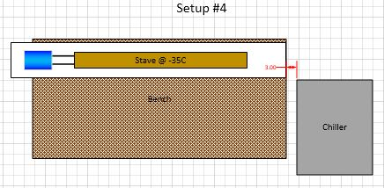
Stave enclosure thermo background study
Background before start.
This run will now have cool fluid flowing through stave.

Slide 18
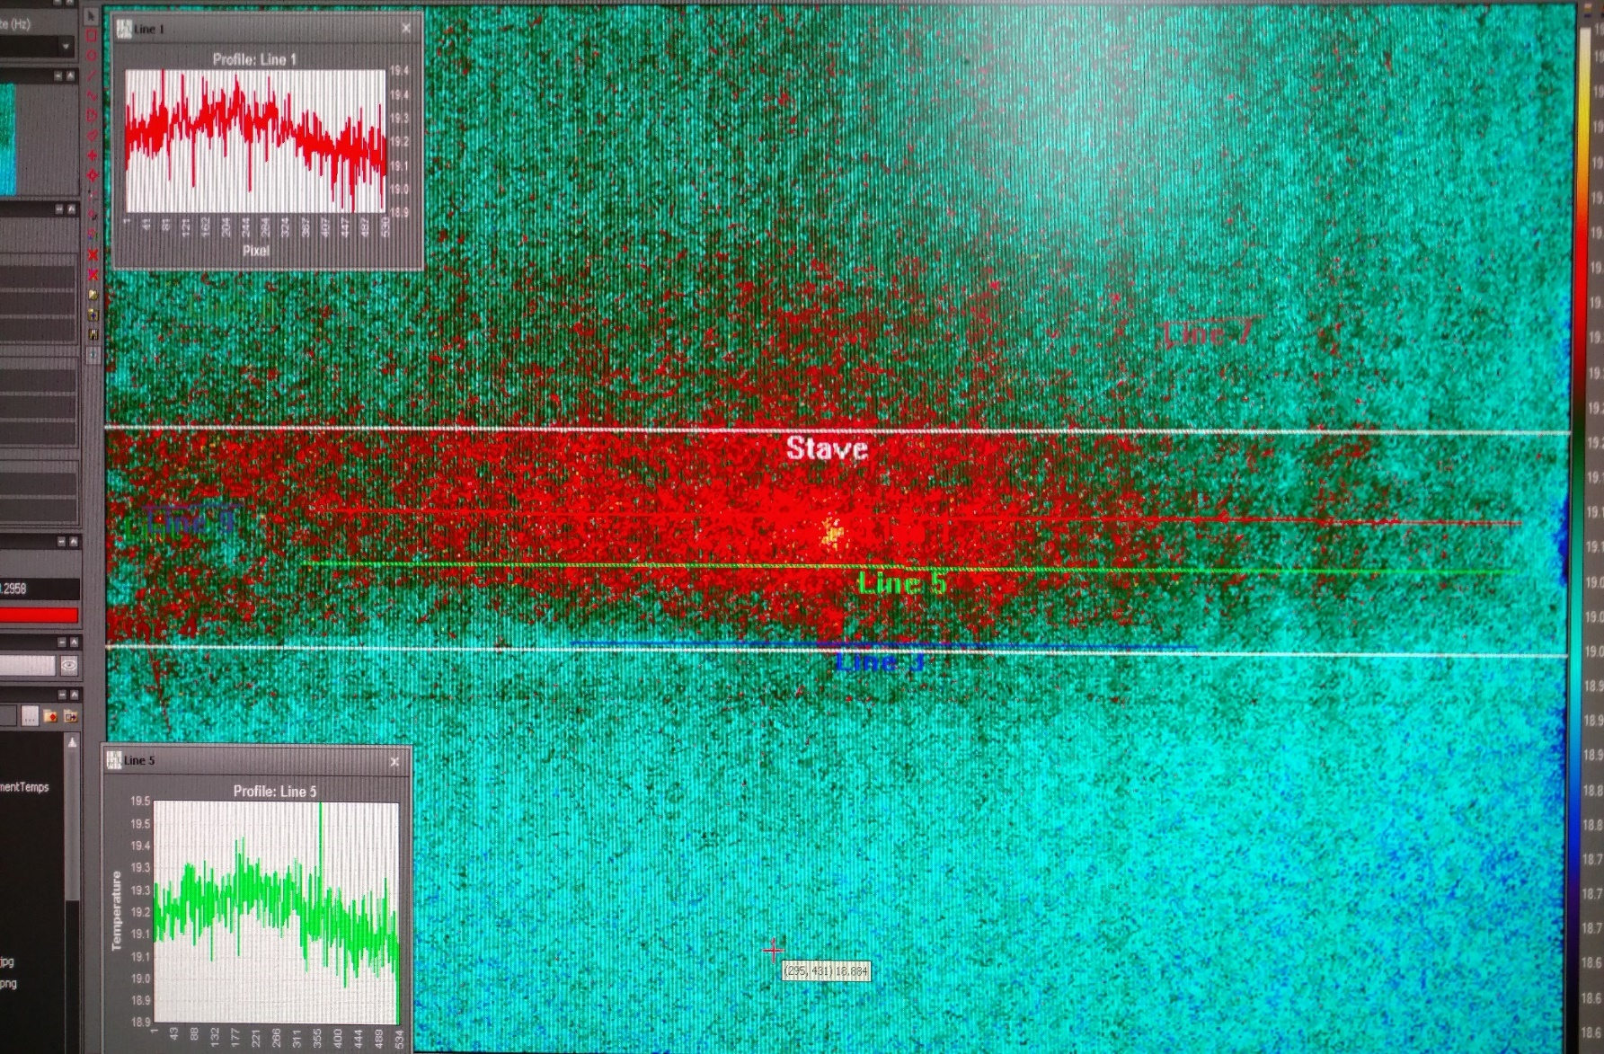
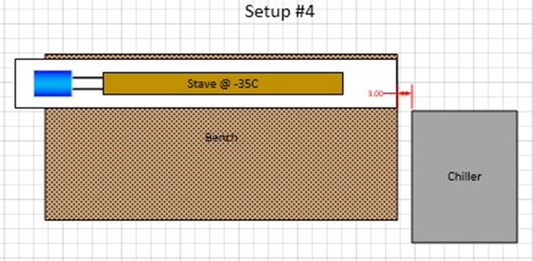
Stave enclosure thermo background study
Chiller & booster started, fluid set to 10C. Fluid flow through stave. N2 gas flowing @ 12psi.

Slide 19
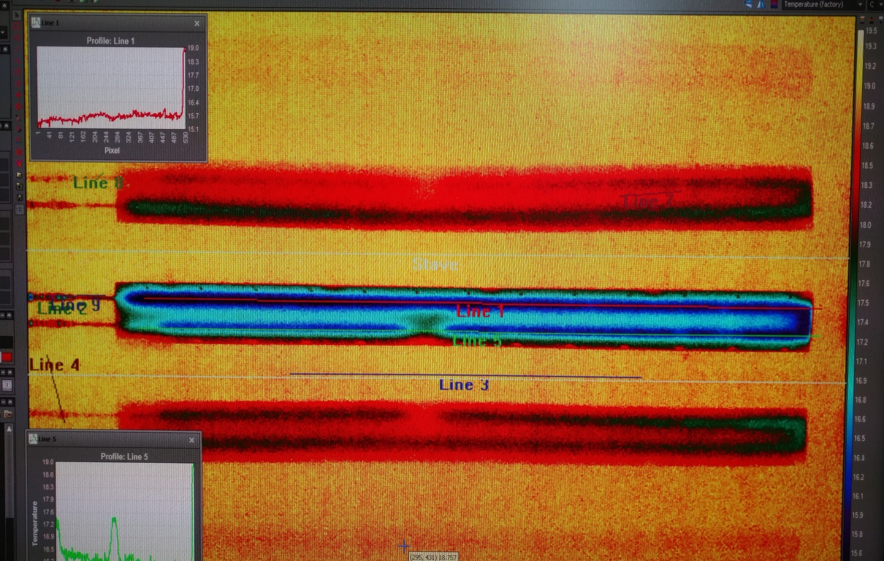
Stave enclosure thermo background study
Chiller & booster pump running for 1 minute. 10C fluid flowing through stave. N2 gas flowing @ 10psi. (N2 flow decreases naturally.)
Chiller exhaust effect is too small to see.

Slide 20
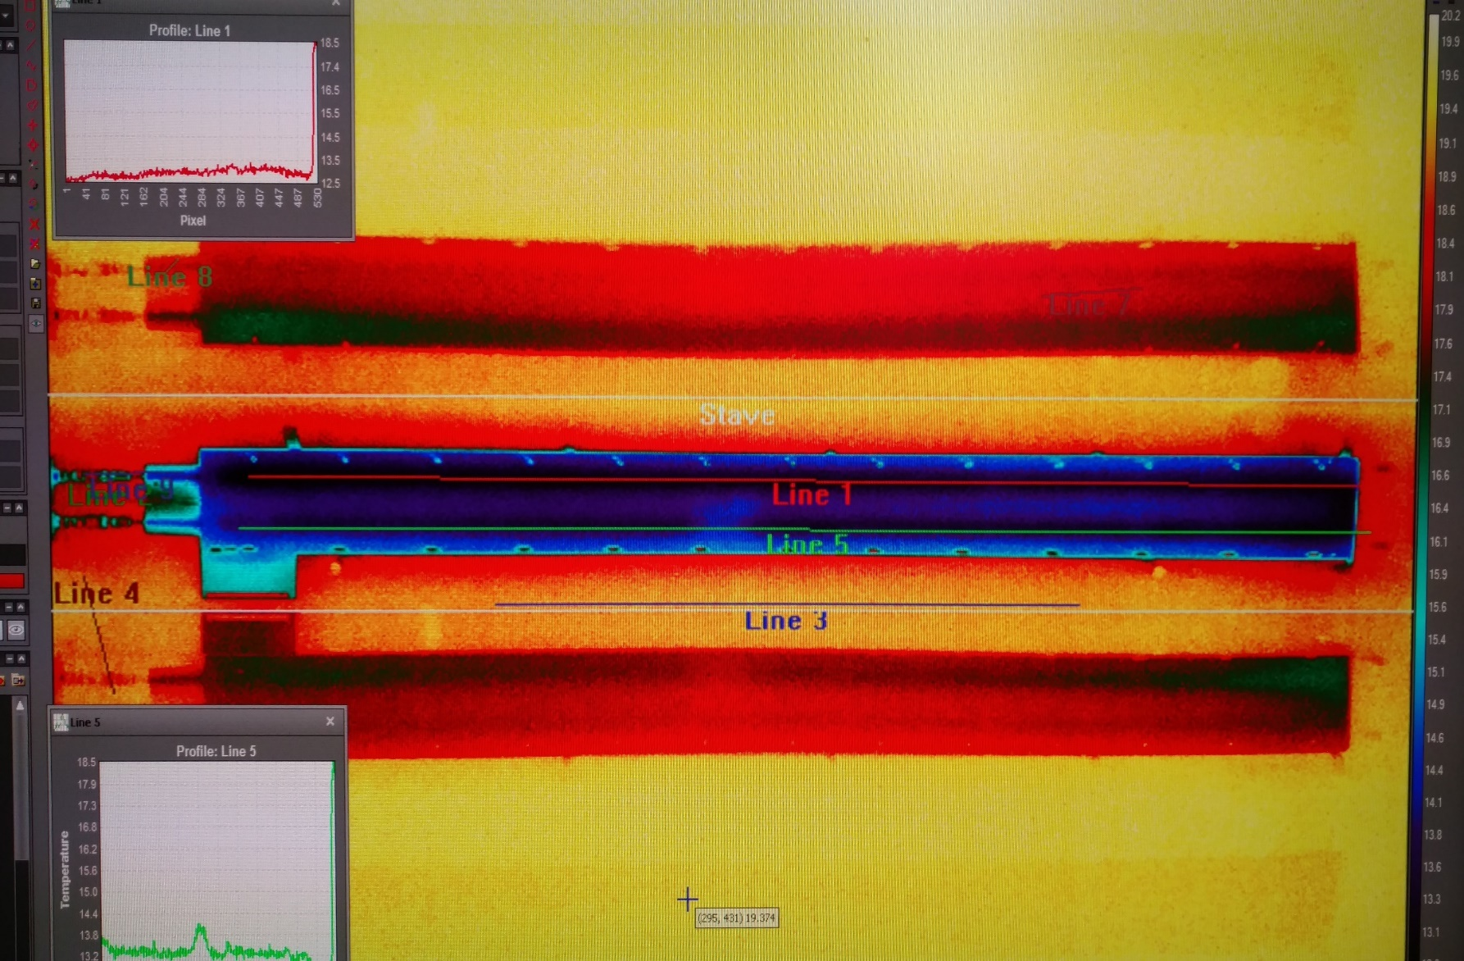
Stave enclosure thermo background study
Chiller & booster pump running for 35minutes. 10C fluid flowing through stave. N2 gas flowing @ 9psi.
Warm area appears under stave. Chiller exhaust not apparent at right end.

Slide 21
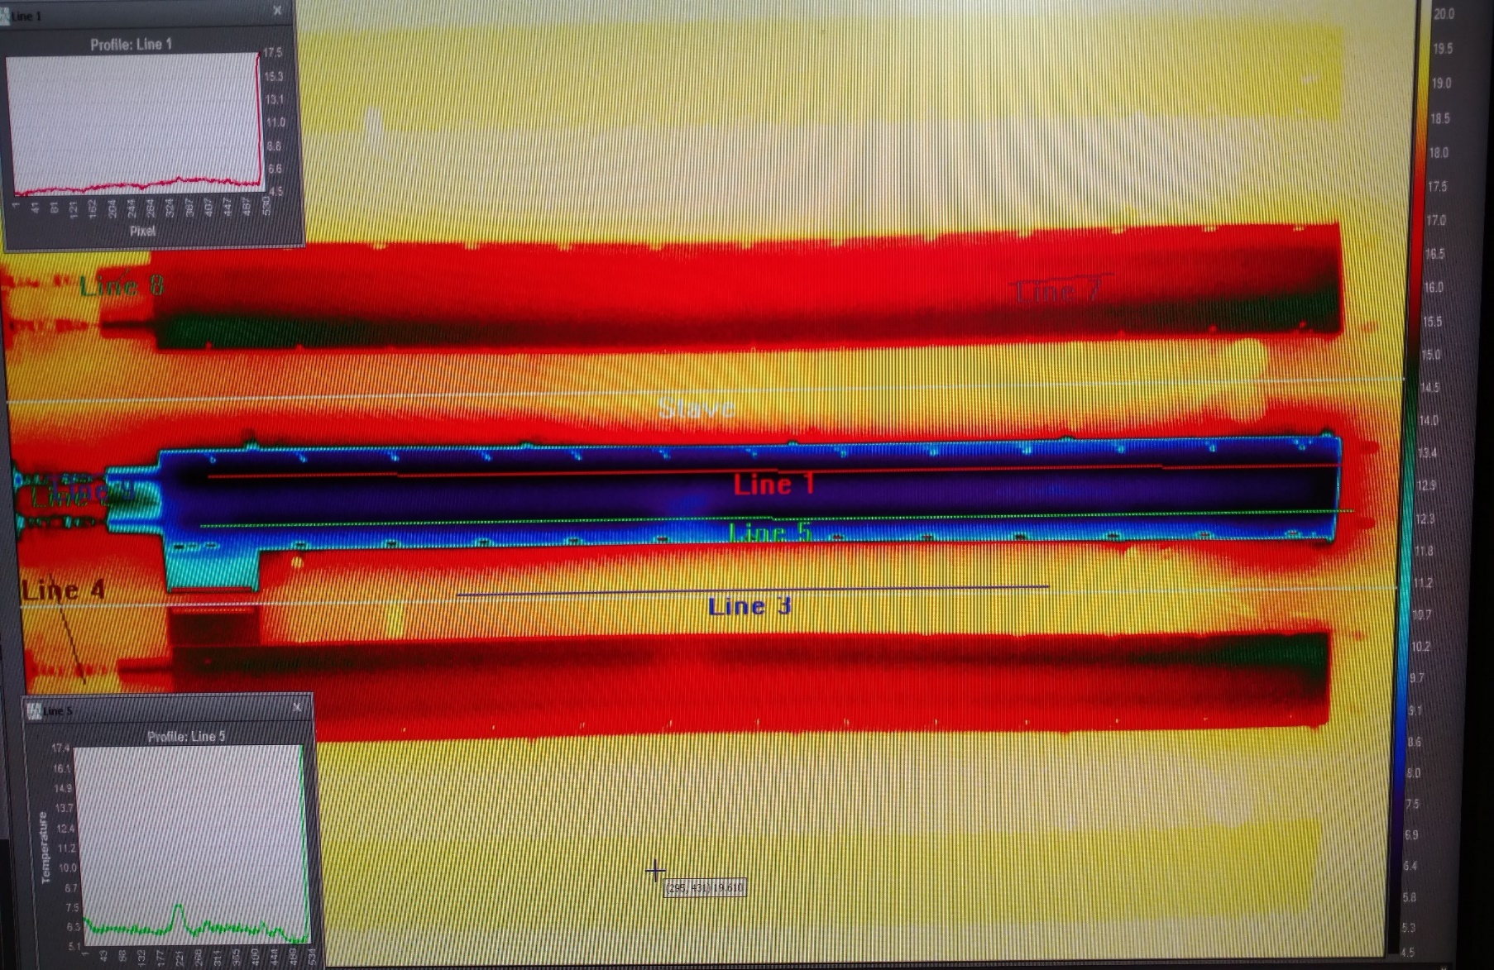
Stave enclosure thermo background study
Chiller & booster pump running for 1.2hr with 0C fluid flowing through stave. N2 gas flowing @ 8psi.
Warm area still present under stave. Right end cool despite chiller effect. Note humidity sensor now seen.

Slide 22
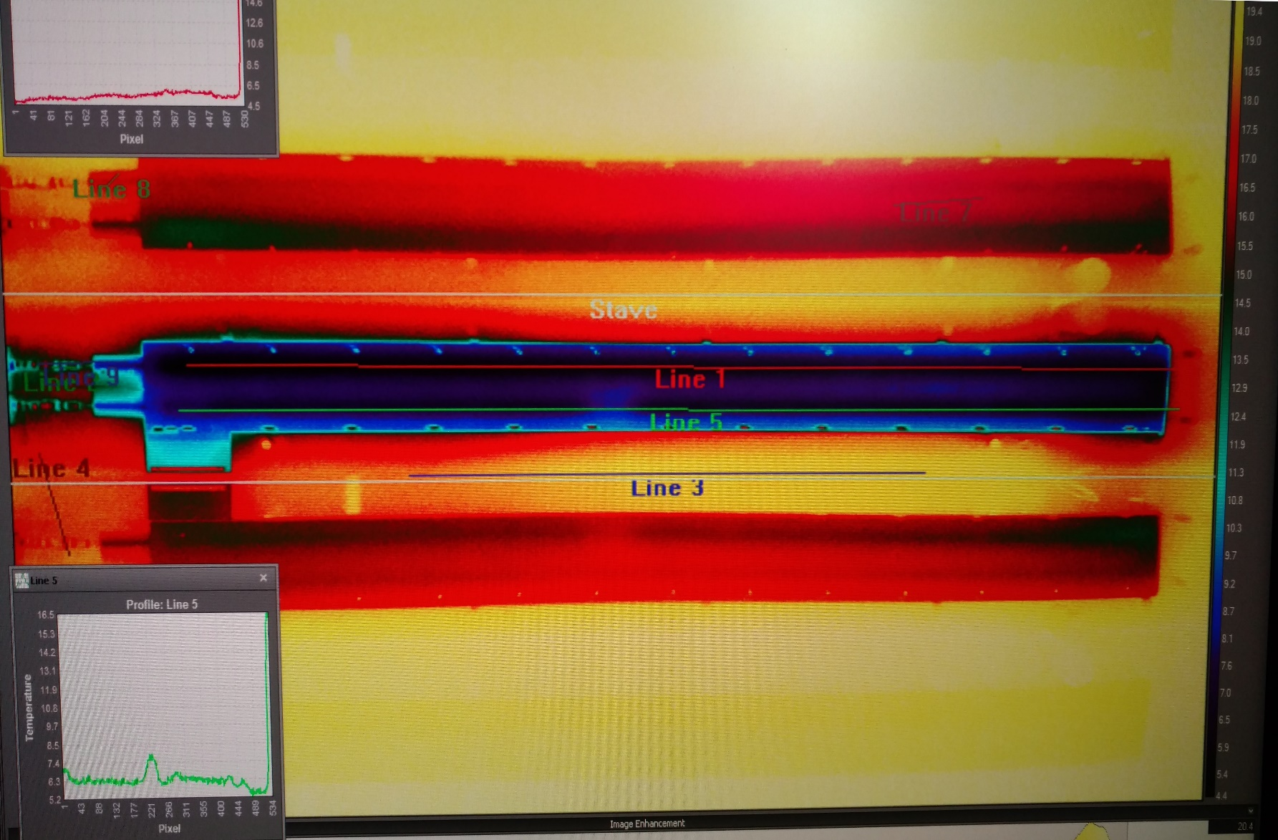
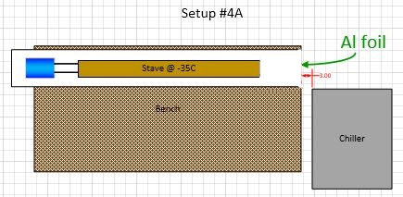
Stave enclosure thermo background study
After 1.6 hours running with 0C fluid, added Aluminum foil on end plate of enclosure near chiller. N2 gas flowing @ 7 psi.

Slide 23
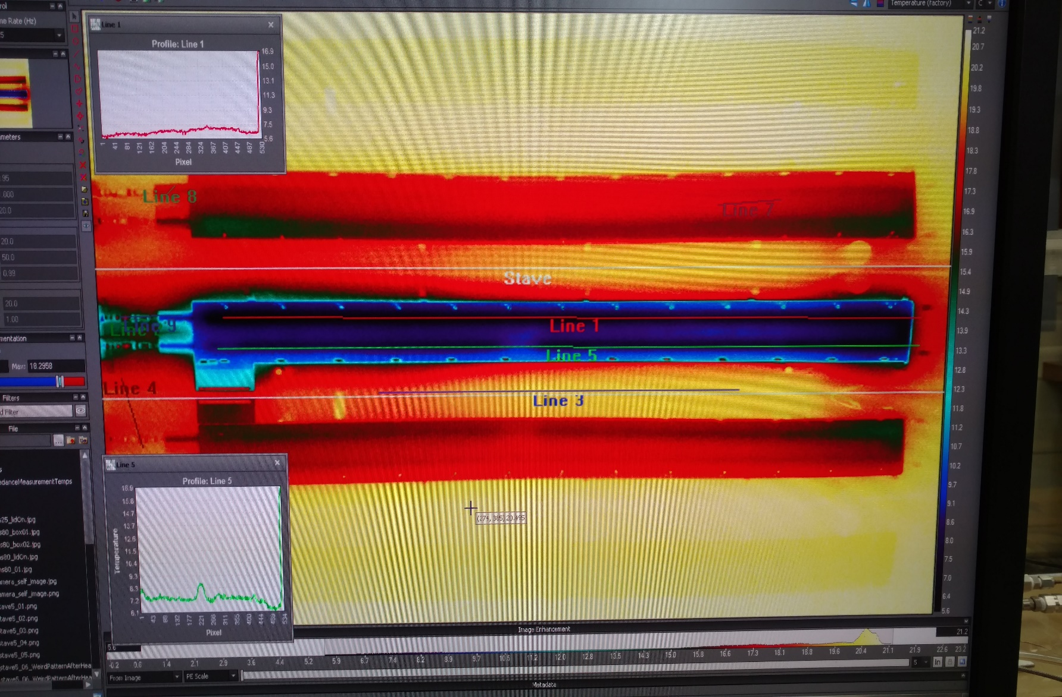
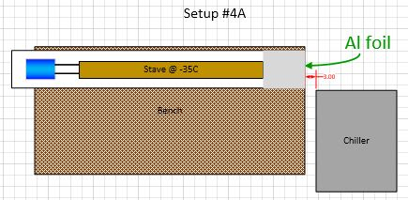
Stave enclosure thermo background study
After 1.6 hours more foil added on end of enclosure. 11” foil covered left,right,top of enclosure end. 0C fluid flowing through stave. N2 gas flowing @ 7 psi. Warm area under stave still present.

Slide 24
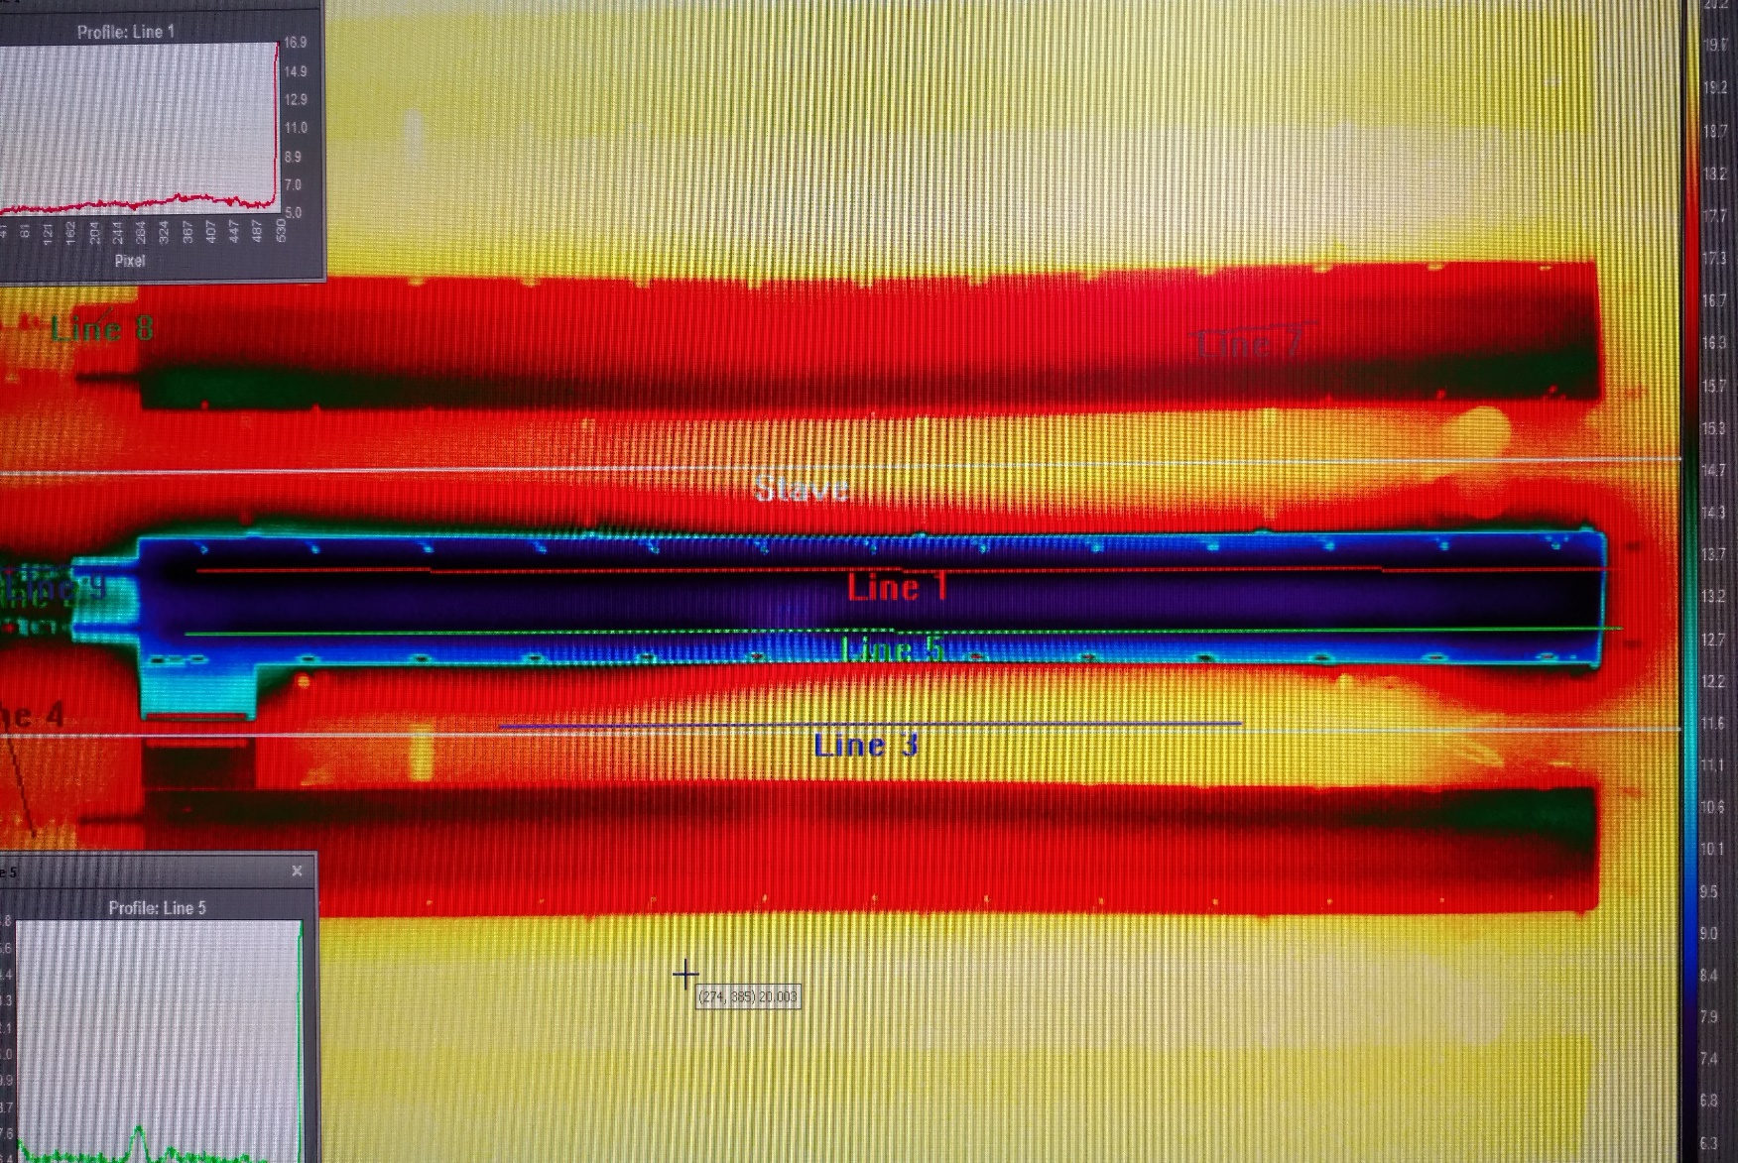
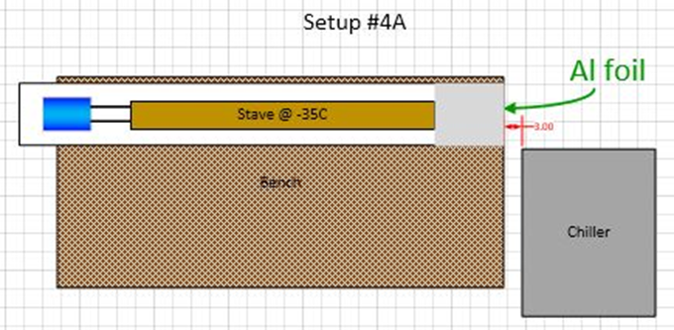
Stave enclosure thermo background study
1.25 hours @ 0C fluid with 11” aluminum foil covering 3 of 4 surfaces at enclosure end. N2 gas flowing @ 7psi. Foil not improving situation.

Slide 25

Stave enclosure thermo background study
Further work:
Start a run with foil in place at beginning.
Cover more of enclosure in foil.
Raise the enclosure off bench.
Move chiller so exhaust directed away from end of enclosure.

