Slide 1




Flaw finding of Stave 2 R(intended flaws) vs Stave 5 (flawless)
William Heidorn, Jie Yu
Iowa State University
Stave QC discussion, Sep.13.2017

Slide 2


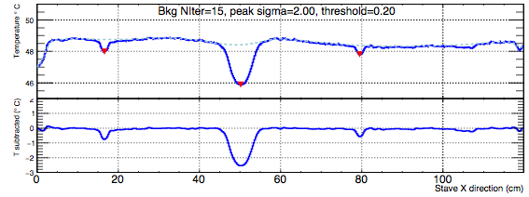

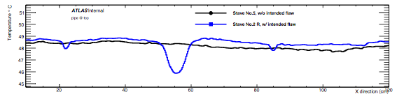

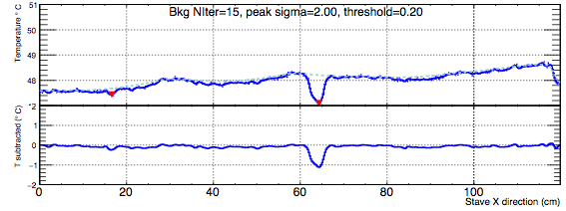
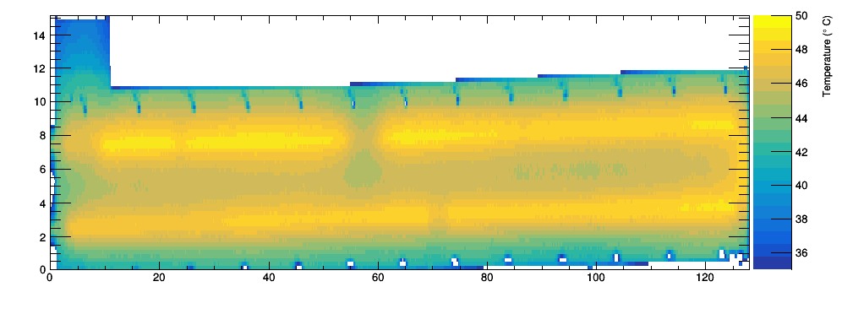
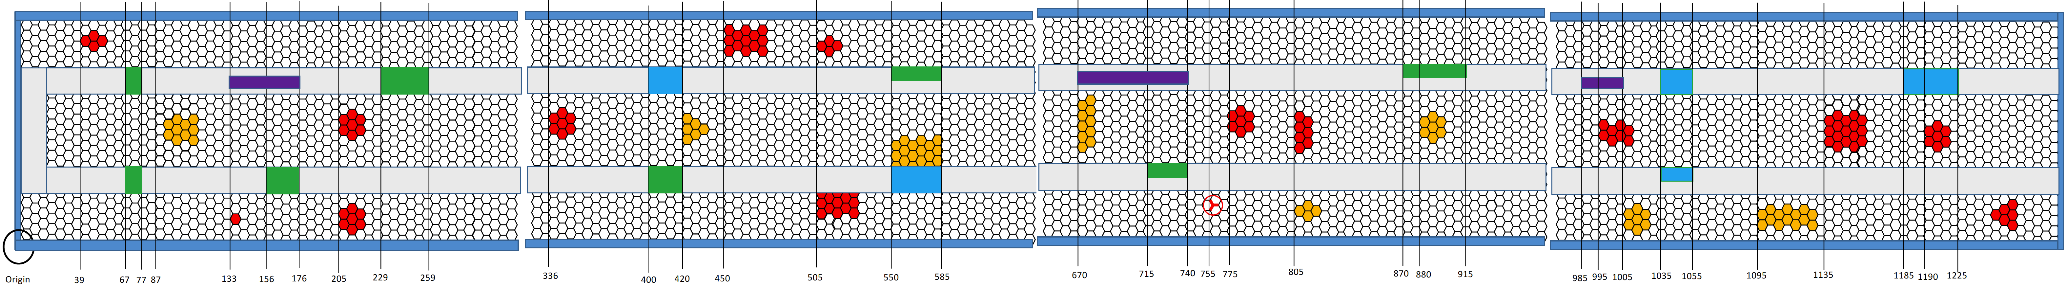
Stave #4(2R) vs. #5 comparison
Stave #2R with flaws
(B): 2 cm
(A): 8 cm
(B): 2cm
?
2 cm
8 cm
2 cm
Stave #2R vs. #5
?
Plot above: J side inlet temperature.
  smallest detected flaw from Stave 2R: 2cm foam-facing.
  no obvious low peak can be found from stave No.5
J side
4cm
one sided?
X
2cm
X
8cm
2cm
X
(X)
3.5cm
10
20
30
40
50
60
70
80
90
100
110
120
130

Slide 3
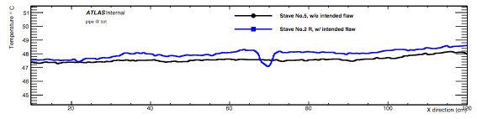
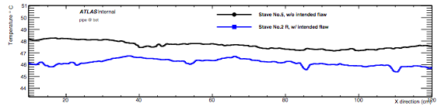
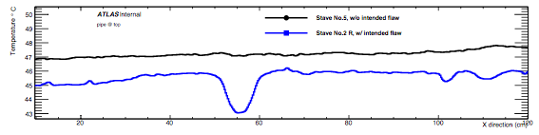
Stave #4(2R) vs. #5 comparison: more
Corresponding flaws for
Stave #2R found in backup
J side outlet temperature
No obvious flaws found
from Stave #5
L side inlet temperature
L side outlet temperature

Slide 4
backup

Slide 5
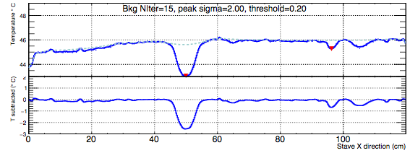
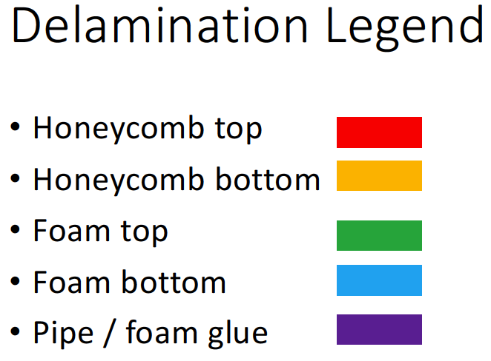
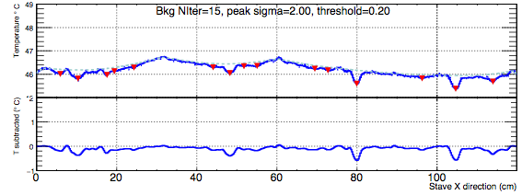
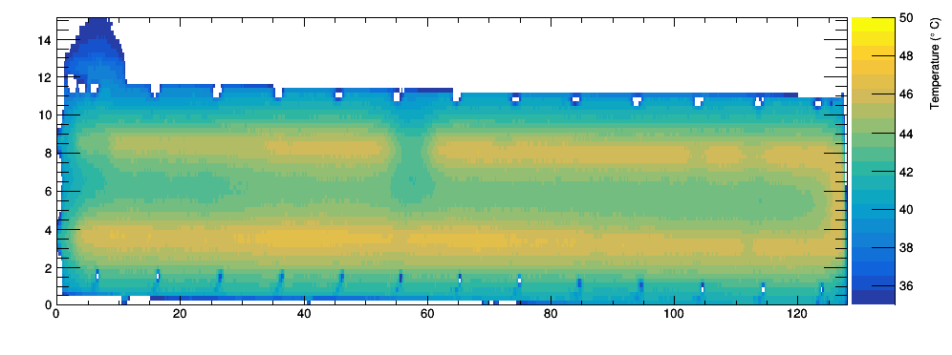
Stave #4(2R) comparison, matching
(A): 5–8 cm
(B): 2–3 cm
Undetected
Total
?
?
2
8
1
3
L side
(A): Pipe-foam glue missing (partial) undetected 1.
(B): Foam-facing glue missing (full) all found (?!).
  1 cm can also be seen. Not so clearly.
(C): Foam-facing glue missing (partial) undetected 2.
  3 and 4.5 cm, closer to liquid in/out.
L side
L side
??
2 cm
X
X
8cm
X
3cm
4.5 cm
3.5cm
2cm
1cm
10
20
30
40
50
60
70
80
90
100
110
120
130

Slide 6


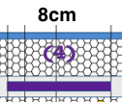






















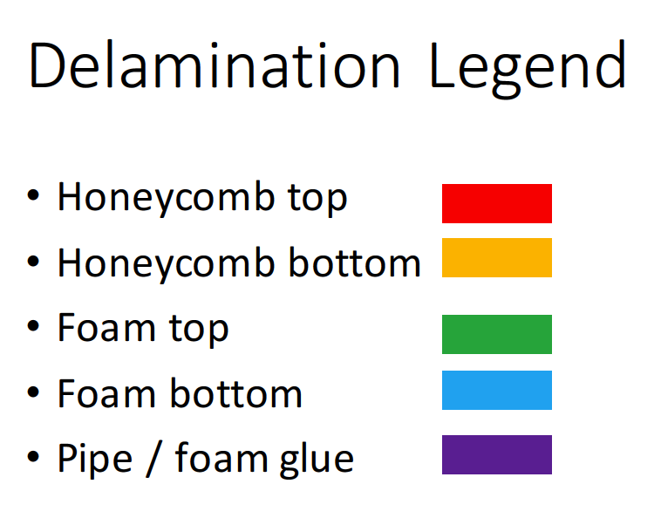
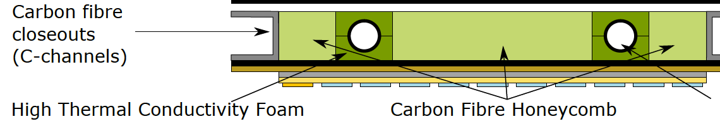
Delamination type from stave #2
3.5cm
4cm
(C)
can be fluctuation.
(A)
might be one of the two peaks.
(B)
Conclusions below depend on how accurately the delaminations are implemented.
(A): Pipe-foam glue missing (full pipe ring or partially??).
  1 (nice peak) out of the 3 seen on both sides, the other two seen on one side.
  2.5 cm one is hardly seen. 8cm one doesn’t form nice peak. Might due to some other kind of delamitation on a larger scale.
(B): Foam-facing glue missing (full).
  Mostly form a nice peak ~1 C height.
  3cm is clear, 2cm can also be found.
  Effect seen also on the other side’s T distribution.
(C): Foam-facing glue missing (partial).
  Cannot form nice peaks. A wider T deficit seen.
  2cm is hardly seen. 2.5cm is found.

