Slide 1
Laser Multiple times scan

Slide 2
Old: take one image, find the line, move 1 mm;
New: take 10 images, find the line, save all of them, then move 1 mm.

Slide 3
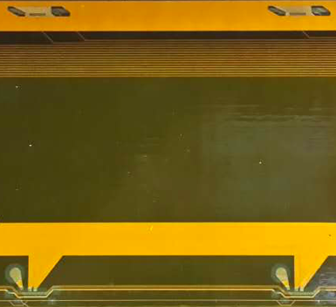
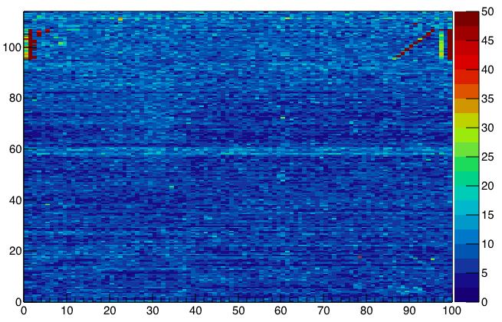
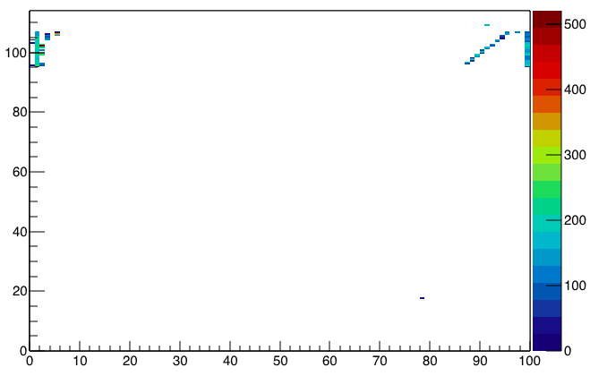
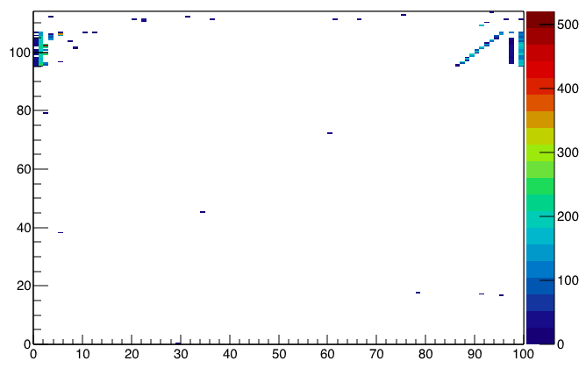
rms
Rms>35; 90 pixels
Rms>21; 152 pixels

Slide 4
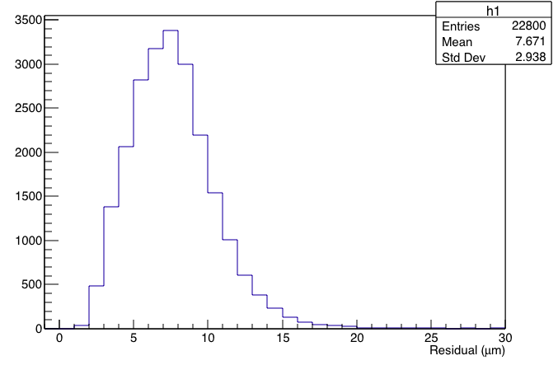
Rms for 1 module(old)
1:Scan 25 times for 1 module;
2:Calculate the rms for the whole area;
3:Draw the histogram for rms;
It is the uncertainty for height,
u(height)=f(u(camera),u(laser),
u(linear cart),……)

Slide 5
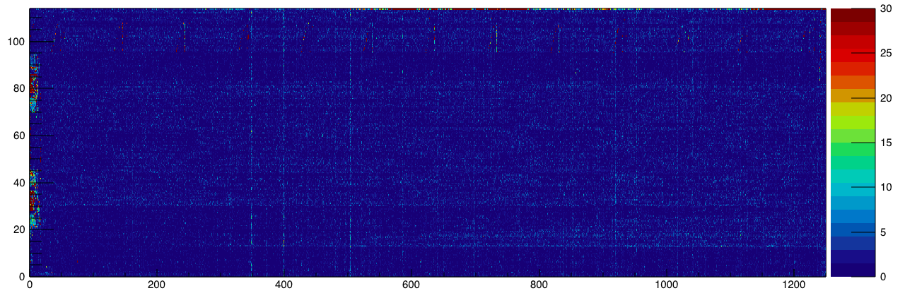
Rms for the whole stave(new)

Slide 6
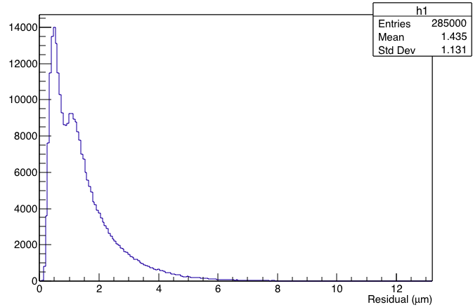
Rms distribution
1:Scan 10 times for the whole stave;
2:Calculate the;
3:Draw the histogram for rms;
It is the uncertainty for height,
u’(height)=f(u(camera),u(laser),……)
u’<<u

