Slide 1
Continually scanning

Slide 2
Before: scan 1mm, move 1mm;
Now: Continually moving, take image per ~1.04mm
The speed of linear cart is 1mm/s;
The camera takes photos continually, but each time it takes a little longer than 1s to run the algorithm to find the line and save the data. (If we change to another computer, it may be faster or slower?)

Slide 3
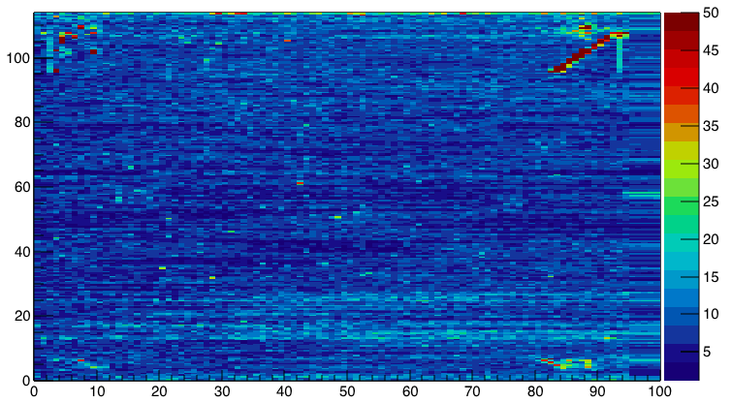
Rms for 1 module(25 times)
The linear cart stop here.

Slide 4
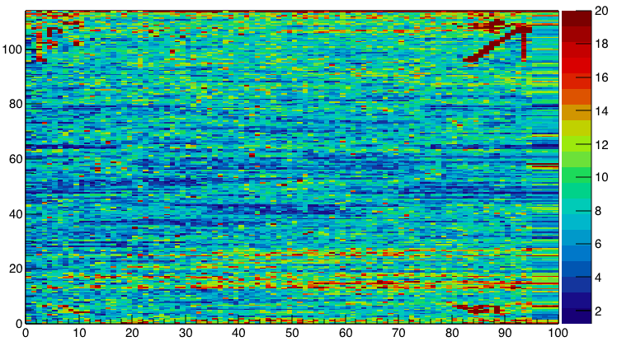

Slide 5
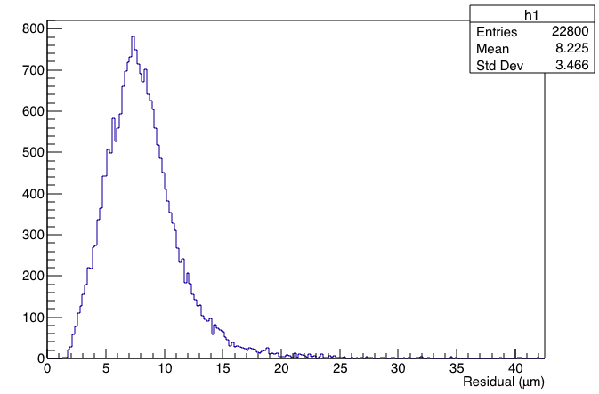
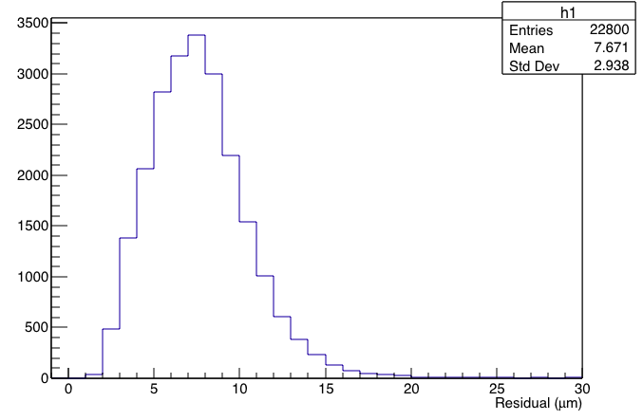
Rms distribution
New rms
before

Slide 6
For whole stave: ~40 minutes.
One tiny problem, linear cart and camera works separately. One will not stop, even if another stops.
Take image when the linear cart goes back?

