Slide 1
BLM DIAMOND system
Future Acquisition and Processing Electronics
With the contribution of:
Ewald Effinger, Jiri Kral, Stephane Bart Pedersen, and Chen Xu

Slide 2
Current Installations

Slide 3
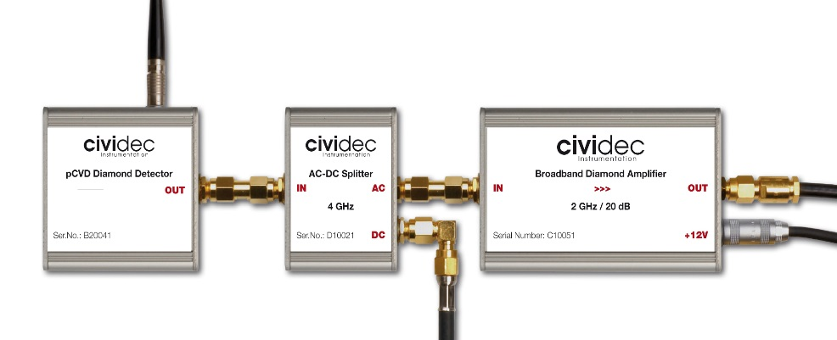

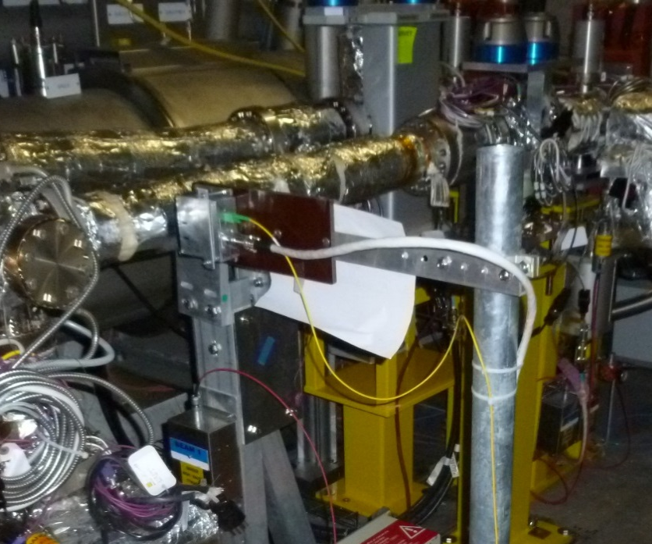
Diamond types
CIVIDEC
  Pt. 2,8 | Pt. 6 | Pt. 7 – total 8 detectors
  Copper cables
BCM1F
  Pt. 4
  – total 4 detectors
  Fiber (analogue)

Slide 4

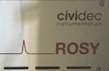

Electronic types
LeCroy scopes
  Custom BI FESA server
ROSY System
  2 sets of 4-channel picosecond-resolution oscilloscopes, first for waveform digitization, second with FPGA for online time-loss histograms.
  Embedded PC with Linux server for device configuration and data output.

Slide 5
Some User Cases
Direct waveform output to IQC triggered by beam-injection pre-pulse (Pt2,Pt8)
Sub-minute continuous beam loss waveforms with bunch-resolving compatible sampling rate
Level triggered waveform acquisition as fast UFO-buster in Pt7

Slide 6
VFC/ADC electronics
Standardisation and long term maintenance

Slide 7
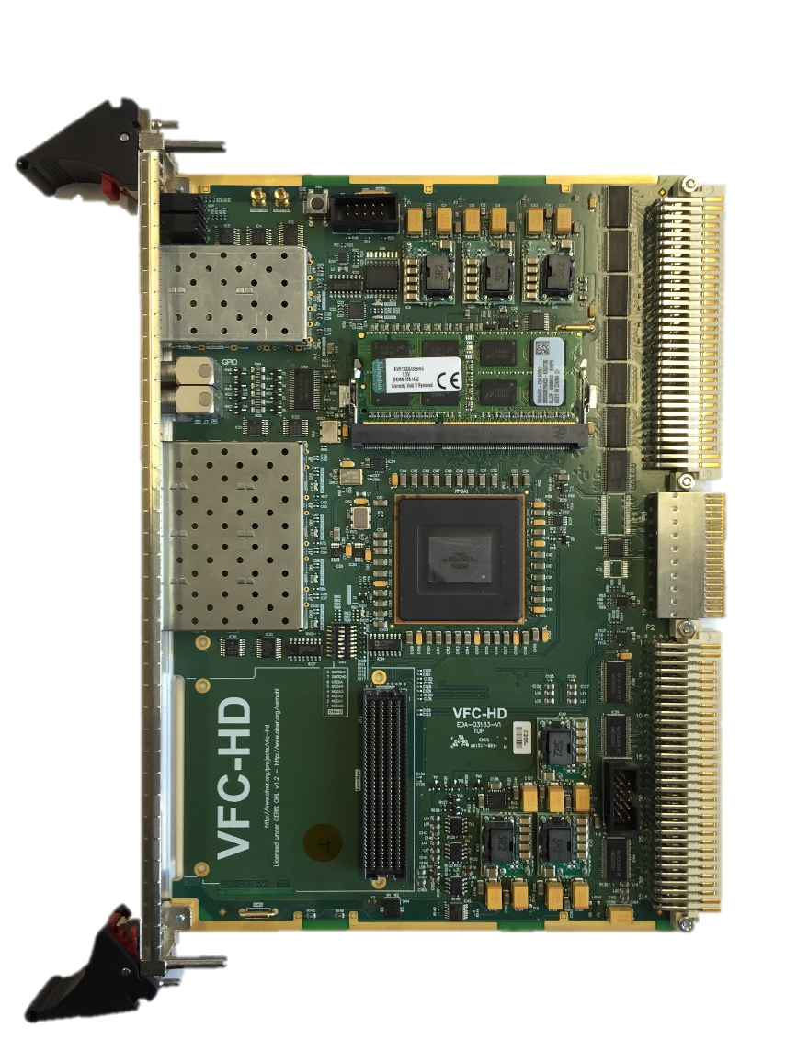
VFC-HD Carrier module
BE-BI development as the future carrier board for most of its systems
Beam Synchronous Timing
DDR3
VME64x interface
Ethernet (White Rabbit)
P0 User defined connection
4 SFP for fast connections to the Front-ends
ARRIA V FPGA
Rear Transition Module connection
HPC-FMC slot

Slide 8
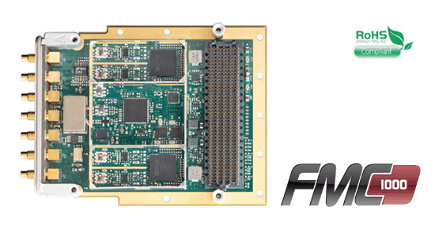
FMC-1000 Mezzanine
FMC-HPC module with
  2x1000 MSPS 14-bit ADCs,
  2x1000 MSPS DACs,
  DC coupled A/D & DACs

Slide 9
Settings/Variables
Acquisition/Binning frequency:
  Fixed acquisition at 650 MHz (limited by carrier)
  Selectable binning 1.54 ns – 50 ns , i.e. multiples of base frequency
  Binning by averaging on the FPGA input stage
  Separate setting for histogram and waveform binning
Histogram refresh and reset:
  Refresh at 10 ms – 1.2 s
  With reset at each refresh or at basic period
  Limitation is only the maximum number of hits/bin (now at 5.8 s)
Histogram threshold level:
  Complete ADC range
  Counting at rising edge of the bin or each bin over threshold
Waveform Capture trigger event:
  External (timing events)
  Internal (edge, continuous)
Capture bunch selection:
  all bunches or a single bunch

Slide 10
Some examples
Single on-board FPGA:
  Scope and histogram in parallel for all channels
  (without splitting the analogue signal)
  Continuous histograms
Dual DDR3 memories:
  4000 LHC turns waveform of all bunches
  14 m LHC turns waveform in single bunch
  Note: it will take a few minutes (~ 5 m) to readout the complete waveform
Long term possibilities:
Connect to BIS
… completely BI owned system

Slide 11
Deployment/Future
Already a prototype installation in the lab
  Major features available in firmware and server
  Expert GUI available for the histogram and waveform
First deployment at LSS1 of SPS
Four more mid-2017
  locations to be decided
Gradually add features in firmware and server
  Add settings and more features
  Add monitoring of the system
  Connect to the Logging and PM servers

Slide 12
Thank you

