Slide 1

First thoughts about the FCC-ee polarization wigglers
Attilio Milanese, Marek Bohdanowicz
23 Mar. 2017

Slide 2
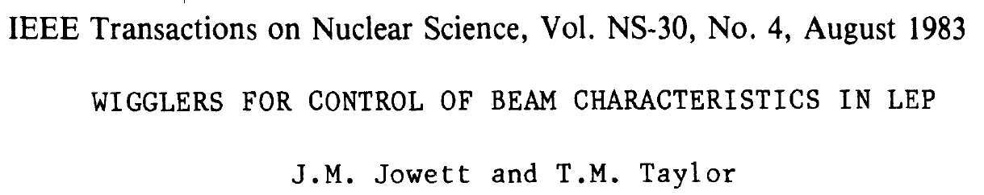
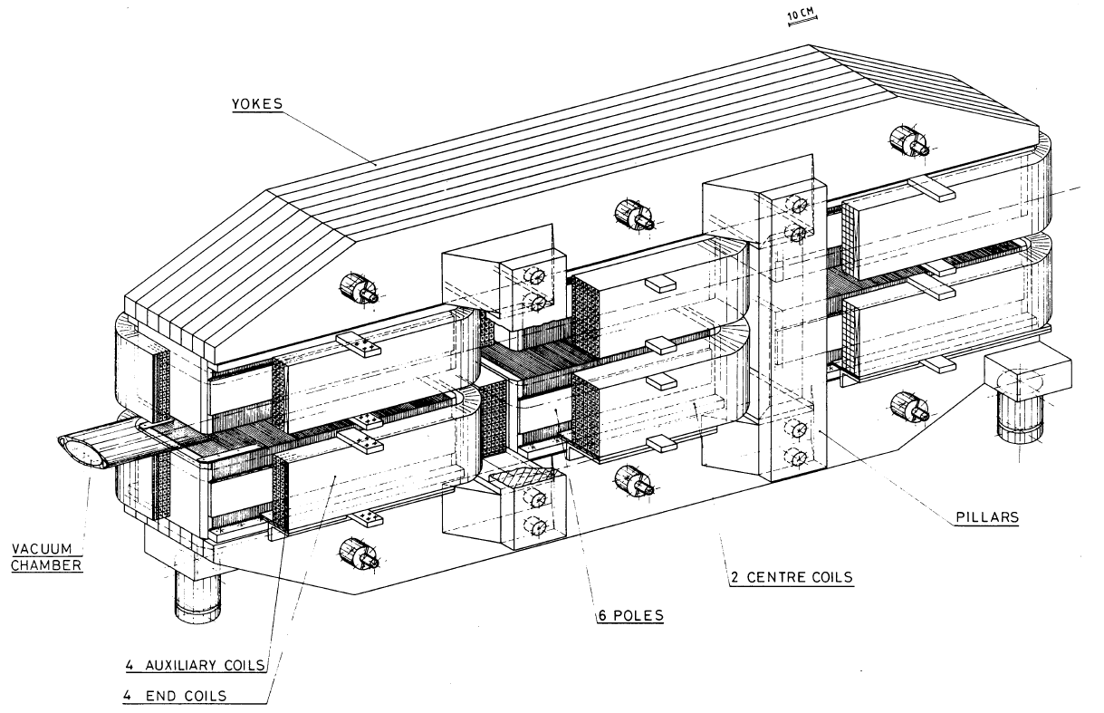
The reference example – also for the nomenclature –
is the LEP polarization wiggler

Slide 3
Tentative (realistic) parameters are used so far
 |  |  | FCC-ee | LEP
full gap height | h | [mm] | 90 | 100
central field | B₊ | [T] | 0.7 | 1.0
central pole length | L₊ | [mm] | 700 | 760
asymmetry ratio (L₋/L₊) | r | [/] | 4 | 2.5
gap
could be changed to 80 mm, as last version of dipoles
distance between B₊ and B₋ poles
so far dictated by coil design
excitation range
if B is fixed (or within a small range), trims could be avoided
field quality
∫B overall (central and within ± lateral distance)
B₊ and B₋ uniformity over ± lateral distance, possibly also longitudinally
to be discussed

Slide 4
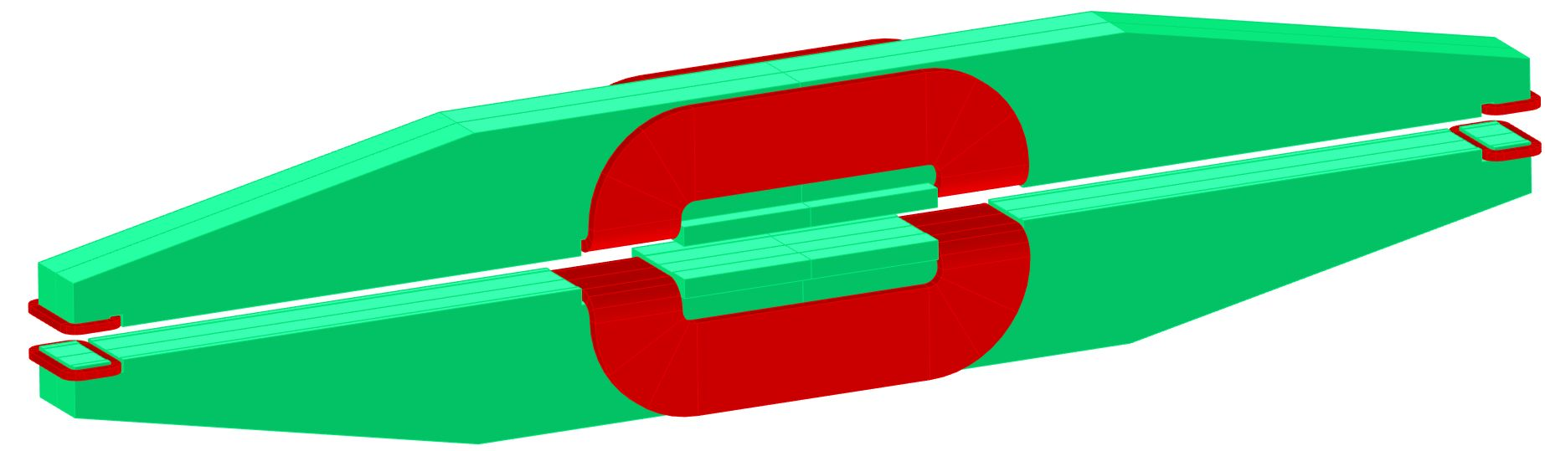
This is a first magnetic concept, which keeps some of the ideas of the LEP design, in particular the “floating” poles
narrower (200 mm) lateral poles
central main coils
beam
side trim coils
wider (300 mm) central pole
mass ≈ 4 tons

Slide 5
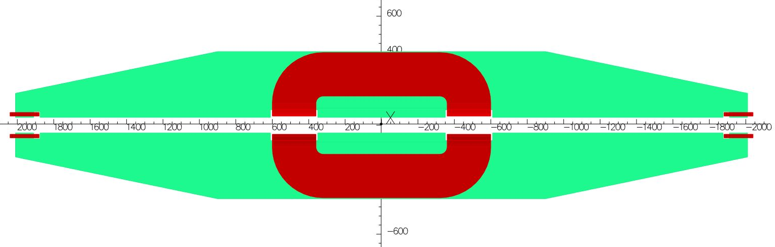
With these poles and distances, the overall length is ≈ 4 m (it was 3 m for LEP) – a “self cancelling” single unit looks feasible
beam

Slide 6

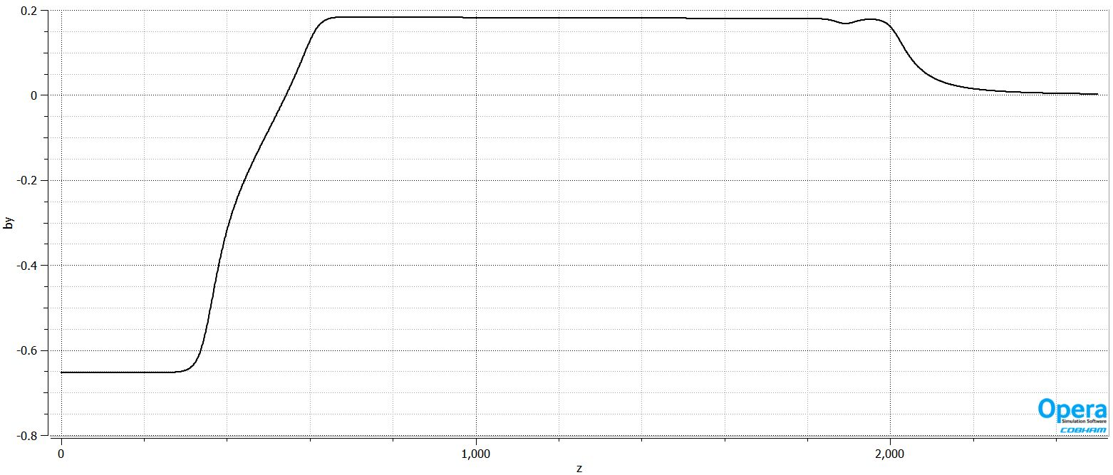
The plot of central B vs. a longitudinal axis looks as expected
B_{y} [T]
350
260
1400
z [mm]
center
end of L₊
start of L₋
cutout for trim coil
end of L₋

Slide 7
The self cancellation of the field is promising – the simulation is with trim coils off, realistic nonlinear iron and (very) limited overall optimization
x [mm] | central B₊ [mT] | ∫B [mTm]
0 | 652.54 | 3.22
10 | 652.59 | 3.19
20 | 652.80 | 3.05
30 | 653.22 | 2.73
NI = 2×31700 A
P ≈ 50 kW
ΔB/B for central B₊
at 1∙10⁻⁴ at 10 mm radial
at 10∙10⁻⁴ at 30 mm radial
3.2 mTm means
0.02 mrad at 45 GeV

Slide 8
Conclusions
at the level of a feasibility investigation such a wiggler looks indeed feasible
requirements
iterate on field, pole (effective?) lengths, lateral / longitudinal field homogeneity, etc. – maybe tracking would be helpful?
magnetic design
among other things, explore in particular other coil geometries, as the saddle shape introduces saturation
shall we propose a prototype
(ex. scale 1:4, overall length ≈ 1 m)
to be ready for the CDR?

Slide 9
thank you

